Slide 1
Crash course on computer architecture — Memory Hierarchy and Cache performance
Areg Melik-Adamyan, PhD

Slide 2

References
CAQA 6th ed.
  Chapter 2
  Appendix B
  Appendix D
  Appendix L
Other
Patt, “Requirements, Bottlenecks, and Good Fortune: Agents for Microprocessor Evolution,” Proceedings of the IEEE 2001.

Slide 3
Abstraction: Virtual vs. Physical Memory
Programmer sees virtual memory
  Can assume the memory is “infinite”
Reality: Physical memory size is much smaller than what the programmer assumes
The system (system software + hardware, cooperatively) maps virtual memory addresses to physical memory
  The system automatically manages the physical memory space transparently to the programmer
+ Programmer does not need to know the physical size of memory nor manage it → A small physical memory can appear as a huge one to the programmer → Life is easier for the programmer
-- More complex system software and architecture
A classic example of the programmer/(micro)architect tradeoff

Slide 4
(Physical) Memory System
You need a larger level of storage to manage a small amount of physical memory automatically
  → Physical memory has a backing store: disk
We will first start with the physical memory system
For now, ignore the virtual→physical indirection
We will get back to it when the needs of virtual memory start complicating the design of physical memory…

Slide 5
Ideal World
Pipeline
(Instruction
execution)
Instruction
Supply
Data
Supply
- Zero latency access
- Infinite capacity
- Zero cost
- Perfect control flow
No pipeline stalls
Perfect data flow
(reg/memory dependencies)
Zero-cycle interconnect
(operand communication)
Enough functional units
Zero latency compute
Zero latency access
Infinite capacity
- Infinite bandwidth
Zero cost

Slide 6
Memory Technology
Amdahl:
  Memory capacity should grow linearly with processor speed
  Unfortunately, memory capacity and speed has not kept pace with processors
Some optimizations:
  Multiple accesses to same row
  Synchronous DRAM
    Added clock to DRAM interface
    Burst mode with critical word first
  Wider interfaces
  Double data rate (DDR), Multiple banks on each DRAM device

Slide 7
The Problem
Ideal memory’s requirements oppose each other
Bigger is slower
  Bigger → Takes longer to determine the location
Faster is more expensive
  Memory technology: SRAM vs. DRAM vs. Disk vs. Tape
Higher bandwidth is more expensive
  Need more banks, more ports, higher frequency, or faster technology

Slide 8
The Problem
Bigger is slower
  SRAM, 512 Bytes, sub-nanosec
  SRAM, KByte~MByte, ~nanosec
  DRAM, Gigabyte, ~50 nanosec
  Hard Disk, Terabyte, ~10 millisec
Faster is more expensive (dollars and chip area)
  SRAM, < 10$ per Megabyte
  DRAM, < 1$ per Megabyte
  Hard Disk < 1$ per Gigabyte
  These sample values (circa ~2011) scale with time
Other technologies have their place as well
  Flash memory, PC-RAM, MRAM, RRAM (not mature yet)

Slide 9
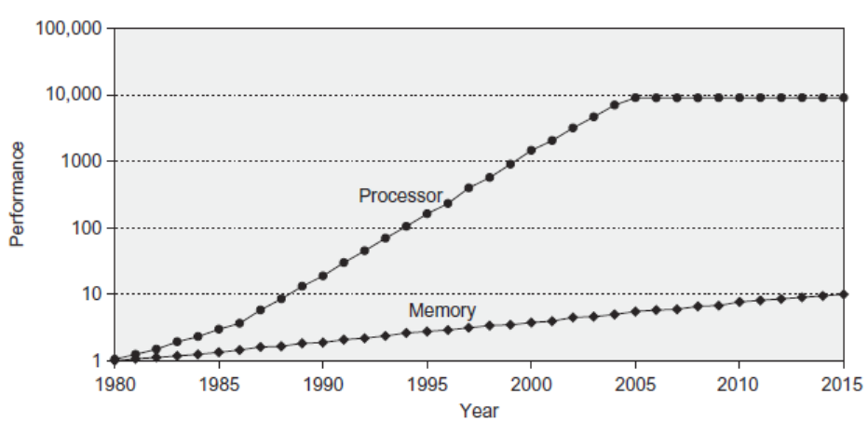
Motivation for Memory Hierarchy

Slide 10
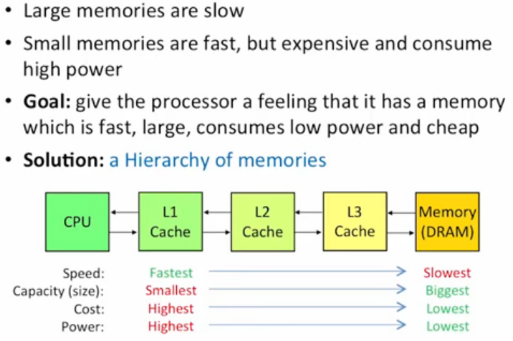
Memory Tradeoffs

Slide 11
Memory Hierarchy Design
Memory hierarchy design becomes more crucial with recent multi-core processors:
  Aggregate peak bandwidth grows with # cores:
    Intel Core i7 can generate two references per core per clock
    Four cores and 3.2 GHz clock
      25.6 billion 64-bit data references/second +
      12.8 billion 128-bit instruction references/second
      = 409.6 GB/s!
    DRAM bandwidth is only 8% of this (34.1 GB/s)
    Requires:
      Multi-port, pipelined caches
      Two levels of cache per core
      Shared third-level cache on chip

Slide 12
Locality
One’s recent past is a very good predictor of his/her near future.
Temporal Locality: If you just did something, it is very likely that you will do the same thing again soon
  since you are here today, there is a good chance you will be here again and again regularly
Spatial Locality: If you did something, it is very likely you will do something similar/related (in space)
  every time I find you in this room, you are probably sitting close to the same people

Slide 13
Memory Locality
A “typical” program has a lot of locality in memory references
  typical programs are composed of “loops”
Temporal: A program tends to reference the same memory location many times and all within a small window of time
Spatial: A program tends to reference a cluster of memory locations at a time
  most notable examples:
    1. instruction memory references
    2. array/data structure references

Slide 14
Caching Basics: Exploit Temporal Locality
Idea: Store recently accessed data in automatically managed fast memory (called cache)
Anticipation: the data will be accessed again soon
Temporal locality principle
  Recently accessed data will be again accessed in the near future
  This is what Maurice Wilkes had in mind:
    Wilkes, “Slave Memories and Dynamic Storage Allocation,” IEEE Trans. On Electronic Computers, 1965.
    “The use is discussed of a fast core memory of, say 32000 words as a slave to a slower core memory of, say, one million words in such a way that in practical cases the effective access time is nearer that of the fast memory than that of the slow memory.”

Slide 15
Caching Basics: Exploit Spatial Locality
Idea: Store addresses adjacent to the recently accessed one in automatically managed fast memory
  Logically divide memory into equal size blocks
  Fetch to cache the accessed block in its entirety
Anticipation: nearby data will be accessed soon
Spatial locality principle
  Nearby data in memory will be accessed in the near future
    E.g., sequential instruction access, array traversal
  This is what IBM 360/85 implemented
    16 Kbyte cache with 64 byte blocks
    Liptay, “Structural aspects of the System/360 Model 85 II: the cache,” IBM Systems Journal, 1968.

Slide 16
Memory Hierarchy Basics
When a word is not found in the cache, a miss occurs:
  Fetch word from lower level in hierarchy, requiring a higher latency reference
  Lower level may be another cache or the main memory
  Also fetch the other words contained within the block
    Takes advantage of spatial locality
  Place block into cache in any location within its set, determined by address
    block address MOD number of sets in cache

Slide 17
Memory Hierarchy Basics
n sets => n-way set associative
  Direct-mapped cache => one block per set
  Fully associative => one set
Writing to cache: two strategies
  Write-through
    Immediately update lower levels of hierarchy
  Write-back
    Only update lower levels of hierarchy when an updated block is replaced
  Both strategies use write buffer to make writes asynchronous

Slide 18
Memory Hierarchy Basics
Miss rate
  Fraction of cache access that result in a miss
Causes of misses
  Compulsory
    First reference to a block
  Capacity
    Blocks discarded and later retrieved
  Conflict
    Program makes repeated references to multiple addresses from different blocks that map to the same location in the cache

Slide 19
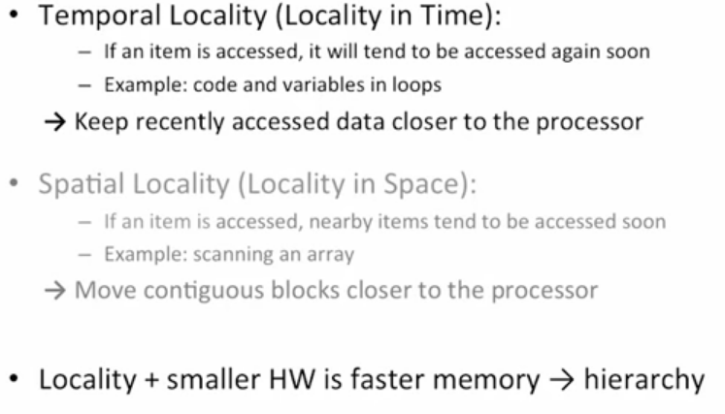
Why This All Works?

Slide 20
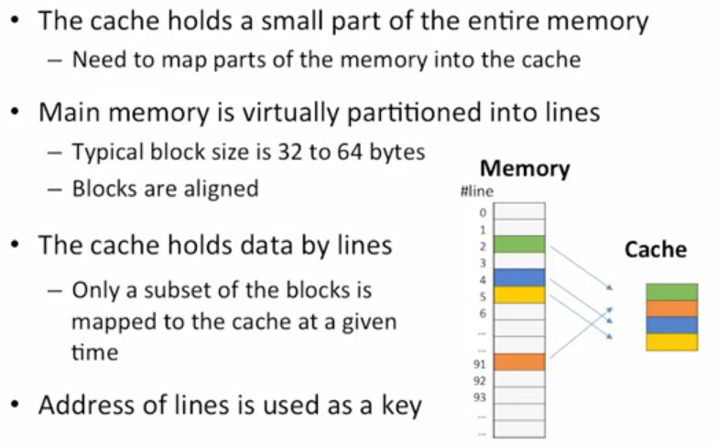
Cache – Main Idea

Slide 21
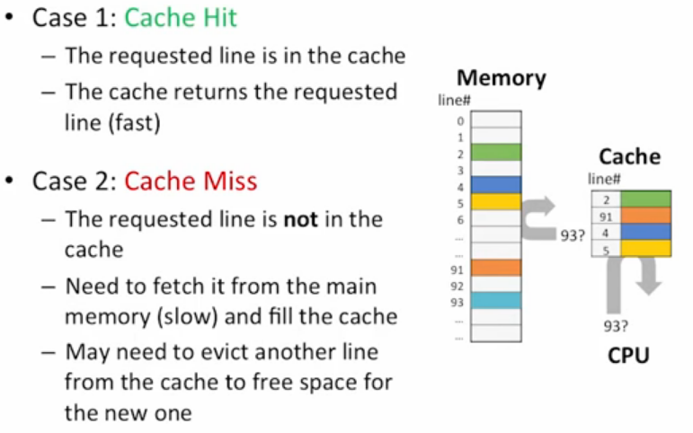
Cache Lookup

Slide 22
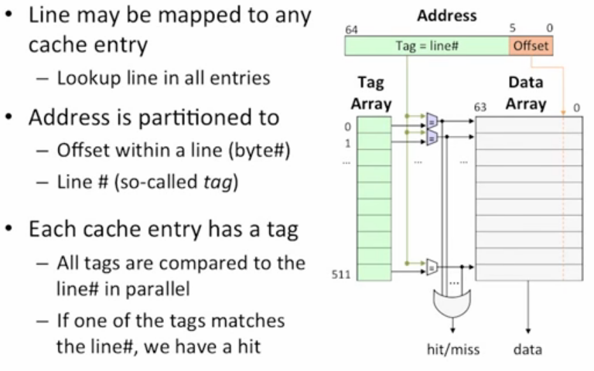
Fully Associative Cache

Slide 23
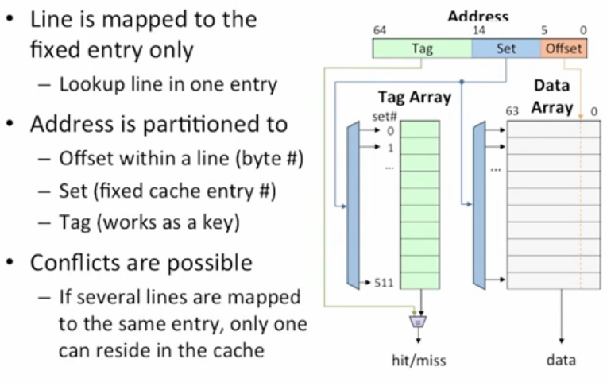
Direct Map Cache

Slide 24
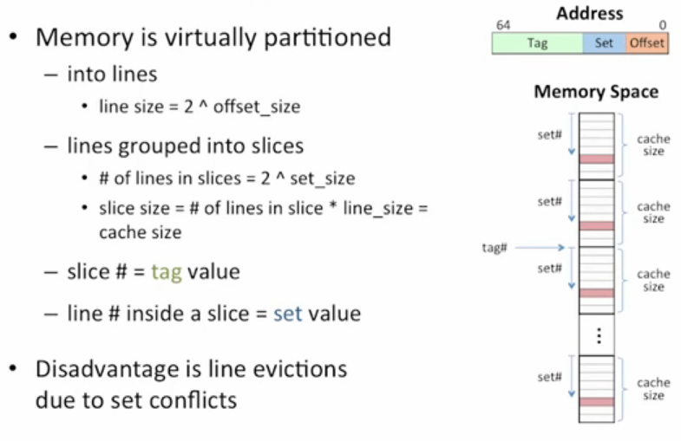
Direct Map Memory Layout

Slide 25
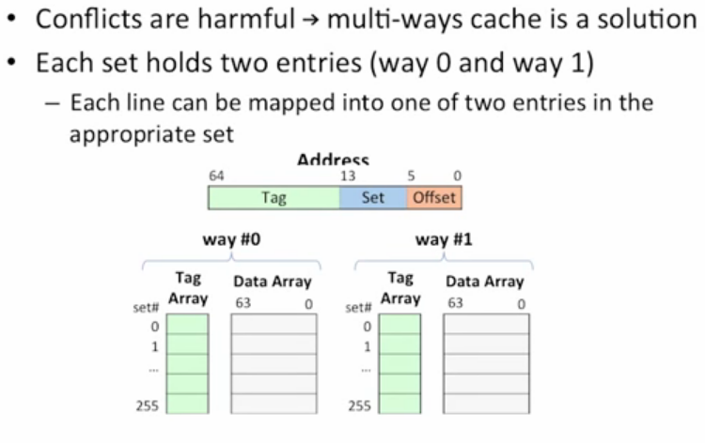
2-Way Associative Cache

Slide 26
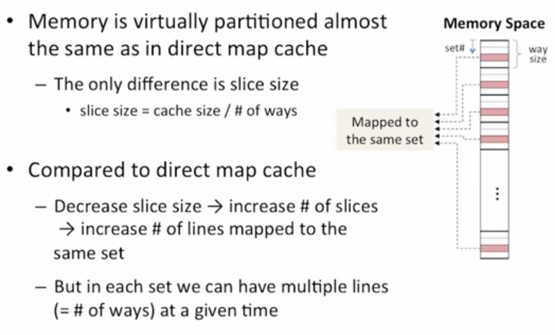
Multi-way Memory Layout

Slide 27
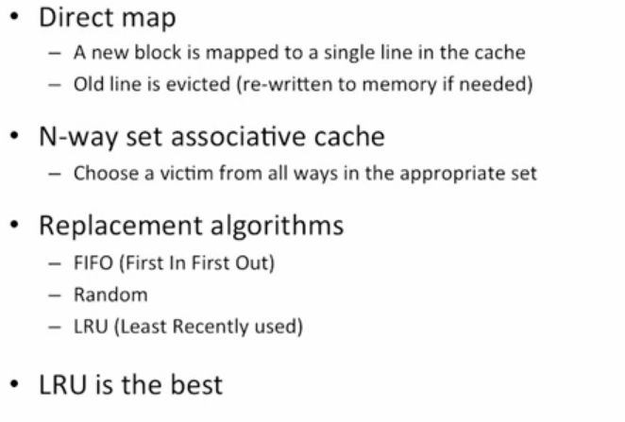
Line Replacement Policy

Slide 28
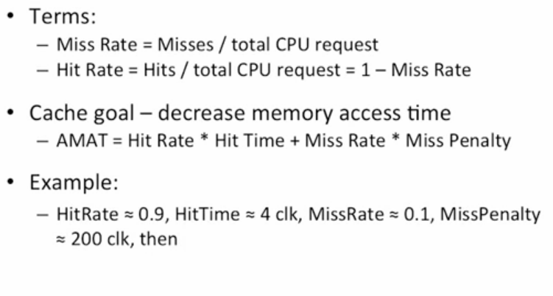
Cache Performance

Slide 29
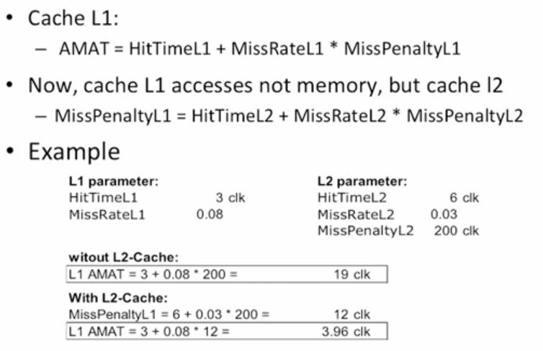
2-level Cache Performance

Slide 30
AMAT Formula
Speculative and multithreaded processors may execute other instructions during a miss
  Reduces performance impact of misses

Slide 31
Optimization Basics
Six basic cache optimizations:
  Larger block size
    Reduces compulsory misses
    Increases capacity and conflict misses, increases miss penalty
  Larger total cache capacity to reduce miss rate
    Increases hit time, increases power consumption
  Higher associativity
    Reduces conflict misses
    Increases hit time, increases power consumption
  Higher number of cache levels
    Reduces overall memory access time
  Giving priority to read misses over writes
    Reduces miss penalty
  Avoiding address translation in cache indexing
    Reduces hit time

Slide 32
Memory Technology and Basic Optimizations
Performance metrics
  Latency is concern of cache
  Bandwidth is concern of multiprocessors and I/O
  Access time
    Time between read request and when desired word arrives
  Cycle time
    Minimum time between unrelated requests to memory
SRAM memory has low latency, use for cache
Organize DRAM chips into many banks for high bandwidth, use for main memory

Slide 33
Advanced Optimizations
Reduce hit time
  Small and simple first-level caches
  Way prediction
Increase bandwidth
  Pipelined caches, multibanked caches, non-blocking caches
Reduce miss penalty
  Critical word first, merging write buffers
Reduce miss rate
  Compiler optimizations
Reduce miss penalty or miss rate via parallelization
  Hardware or compiler prefetching

Slide 34
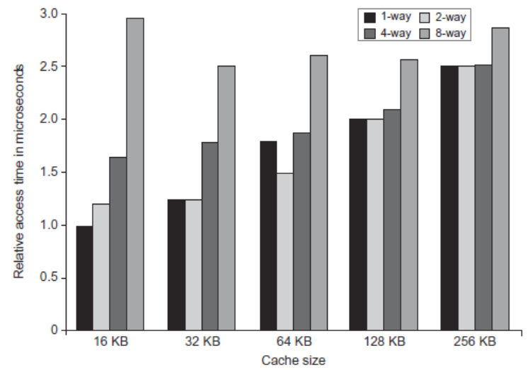
L1 Size and Associativity
Access time vs. size and associativity

Slide 35
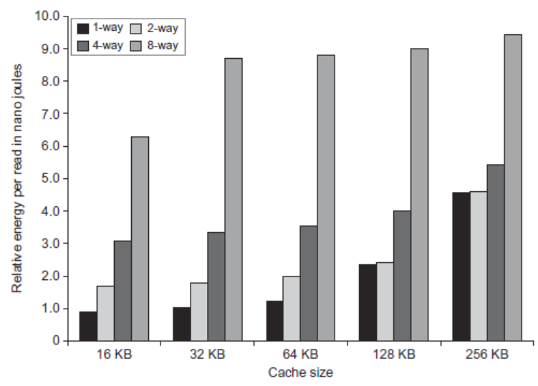
L1 Size and Associativity
Energy per read vs. size and associativity

Slide 36
Way Prediction
To improve hit time, predict the way to pre-set mux
  Mis-prediction gives longer hit time
  Prediction accuracy
    > 90% for two-way
    > 80% for four-way
    I-cache has better accuracy than D-cache
  First used on MIPS R10000 in mid-90s
  Extend to predict block as well
  “Way selection”
  Increases mis-prediction penalty

Slide 37
Pipelined Caches
Pipeline cache access to improve bandwidth
  Examples:
    Pentium: 1 cycle
    Pentium Pro – Pentium III: 2 cycles
    Pentium 4 – Core i7: 4 cycles
Increases branch mis-prediction penalty
Makes it easier to increase associativity

Slide 38
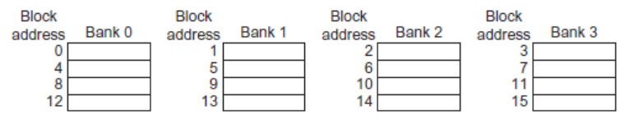
Multibanked Caches
Organize cache as independent banks to support simultaneous access
  Intel i7 supports 4 banks for L1 and 8 banks for L2
Interleave banks according to block address

Slide 39
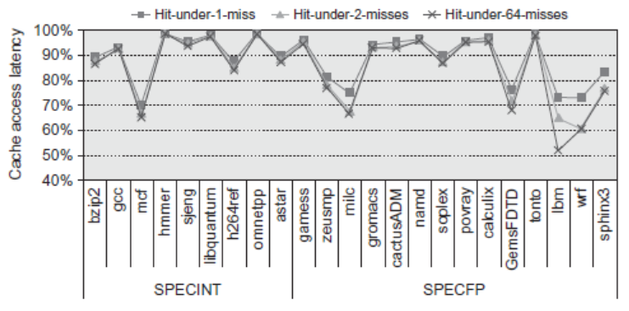
Nonblocking Caches
Allow hits before previous misses complete
  “Hit under miss”
  “Hit under multiple miss”
L2 must support this
In general, processors can hide L1 miss penalty but not L2 miss penalty

Slide 40
Critical Word First, Early Restart
Critical word first
  Request missed word from memory first
  Send it to the processor as soon as it arrives
Early restart
  Request words in normal order
  Send missed work to the processor as soon as it arrives
Effectiveness of these strategies depends on block size and likelihood of another access to the portion of the block that has not yet been fetched

Slide 41
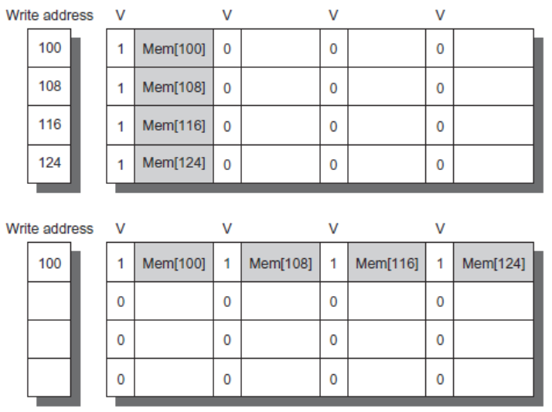
Merging Write Buffer
When storing to a block that is already pending in the write buffer, update write buffer
Reduces stalls due to full write buffer
Do not apply to I/O addresses
No write buffering
Write buffering

Slide 42
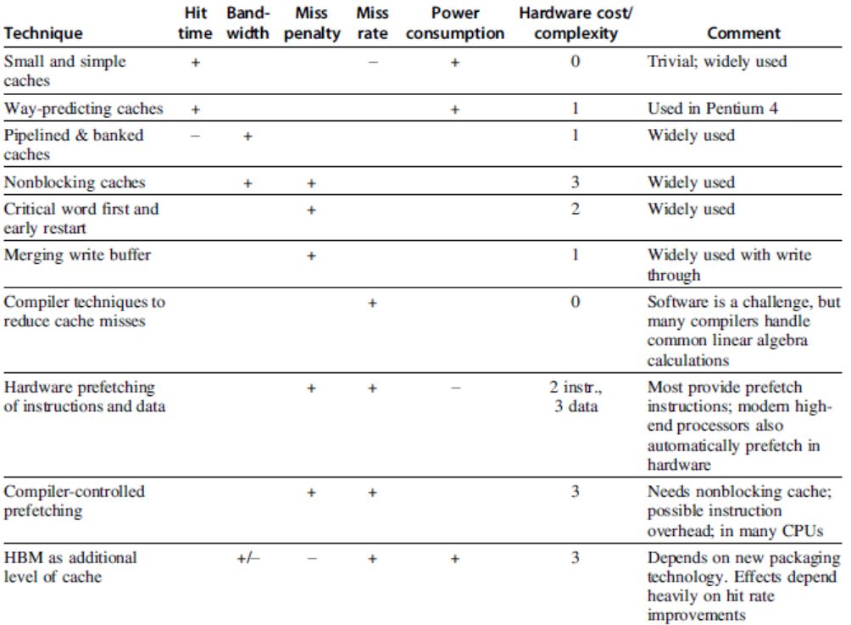
Summary

Slide 43
Compiler Optimizations
Loop Interchange
  Swap nested loops to access memory in sequential order
Blocking
  Instead of accessing entire rows or columns, subdivide matrices into blocks
Loop Fusion
  Instead of accessing entire rows or columns, subdivide matrices into blocks
Prefetching

Slide 44
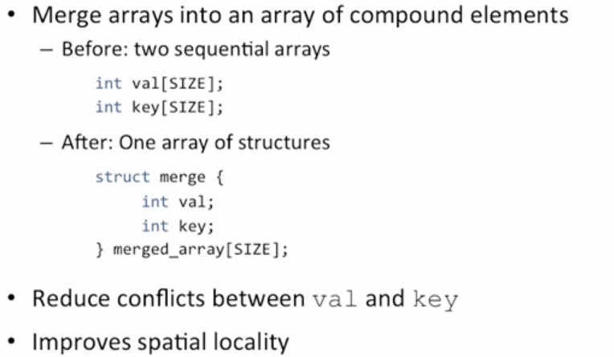
Code Optimization: Merging Arrays

Slide 45
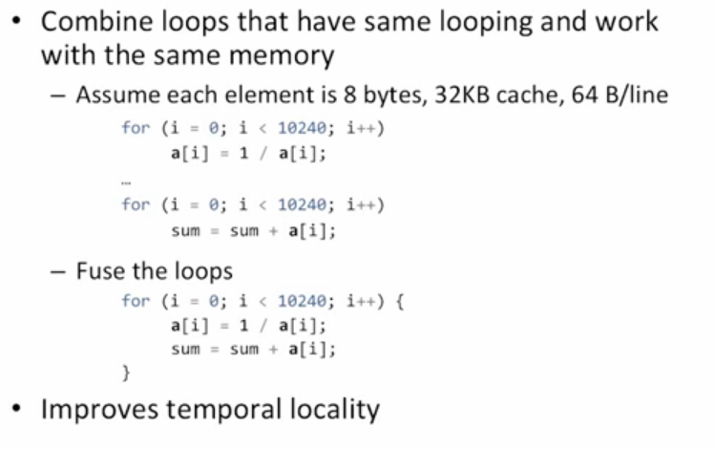
Code Optimization: Loop Fusion

Slide 46
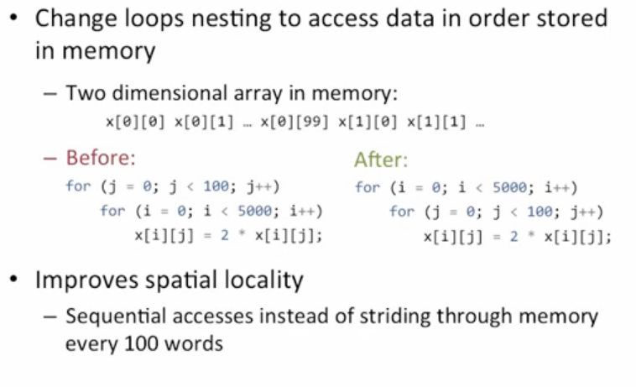
Code Optimization: Loop Interchange

Slide 47
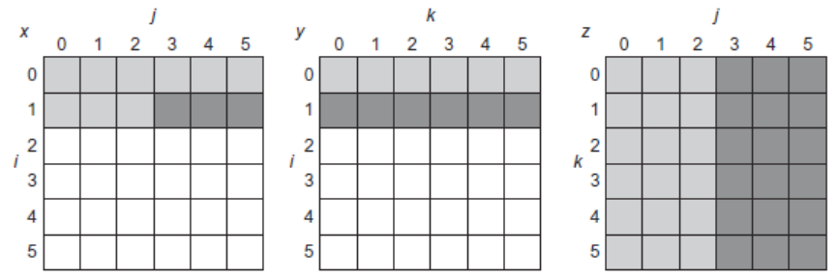
Blocking
for (i = 0; i < N; i = i + 1)
for (j = 0; j < N; j = j + 1)
{
r = 0;
for (k = 0; k < N; k = k + 1)
r = r + y[i][k]*z[k][j];
x[i][j] = r;
};

Slide 48
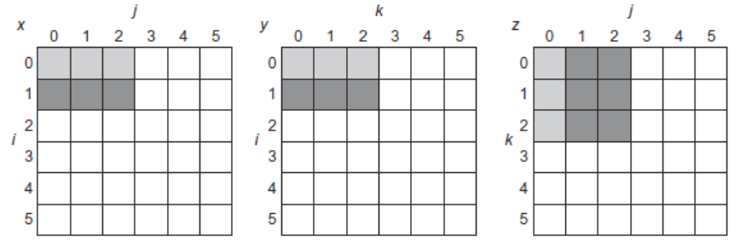
Blocking
for (jj = 0; jj < N; jj = jj + B)
for (kk = 0; kk < N; kk = kk + B)
for (i = 0; i < N; i = i + 1)
for (j = jj; j < min(jj + B,N); j = j + 1)
{
r = 0;
for (k = kk; k < min(kk + B,N); k = k + 1)
r = r + y[i][k]*z[k][j];
x[i][j] = x[i][j] + r;
};

Slide 49
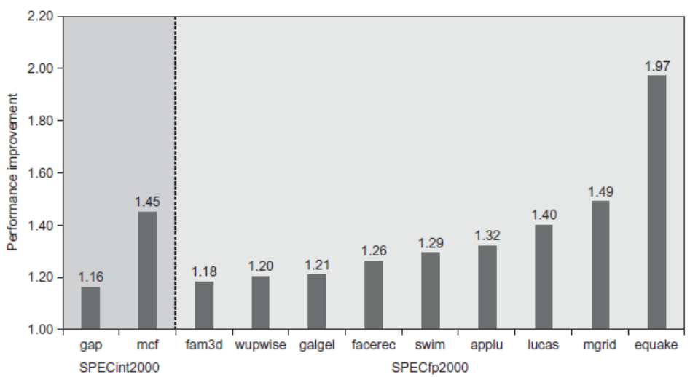
Hardware Prefetching
Fetch two blocks on miss (include next sequential block)
Pre-fetching

Slide 50
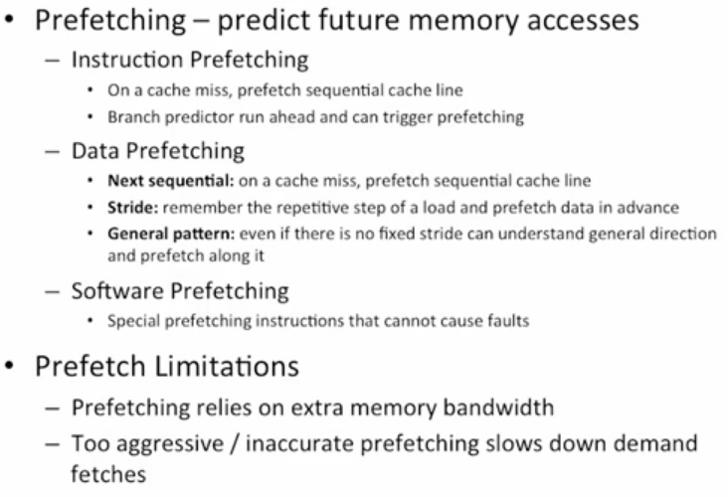
Prefetching

Slide 51
Compiler Prefetching
Insert prefetch instructions before data is needed
Non-faulting: prefetch doesn’t cause exceptions
Register prefetch
  Loads data into register
Cache prefetch
  Loads data into cache
Combine with loop unrolling and software pipelining

