Slide 1
Parallel Prefix Sums and Scans
Martin Burtscher
Department of Computer Science

Slide 2
Exclusive Prefix Sum
Given a sequence of values (integer or real)
Compute the sequence whose values are the sum of all previous values in the original sequence
The “exclusive” prefix sum excludes the current position (hence, the first entry is zero)
0
1
2
3
4
5
6
7
3
2
0
7
-6
1
-9
5
0
1
2
3
4
5
6
7
0
3
5
5
12
6
7
-2

Slide 3
Inclusive Prefix Sum
Given a sequence of values (integer or real)
Compute the sequence whose values are the sum of all previous values in the original sequence
The “inclusive” prefix sum includes the current position (hence, the first entry is not zero)
0
1
2
3
4
5
6
7
3
2
0
7
-6
1
-9
5
0
1
2
3
4
5
6
7
3
5
5
12
6
7
-2
3

Slide 4
Prefix Scans
A prefix scan is a generalization of the prefix sum where the operation doesn’t have to be addition
Given array A = [a₀, a₁, a₂, …, a_{n-1}], an associative binary operator “¤”, and identity element “I”
The exclusive scan of A yields [I, a₀, (a₀ ¤ a₁), (a₀ ¤ a₁ ¤ a₂), …, (a₀ ¤ a₁ ¤ … ¤ a_{n-2})]
The inclusive scan of A yields [a₀, (a₀ ¤ a₁), (a₀ ¤ a₁ ¤ a₂), …, (a₀ ¤ a₁ ¤ … ¤ a_{n-1})]

Slide 5
Associative Binary Scan Operators
Operator | Identity element | Example
+ | 0 | X + 0 = X
Min | Maximum Representative value | Min(X, ∞) = X
Max | Minimum Representative value | Max(X, -∞) = X
Multiply | 1 | X * 1 = X
Logical Or | FALSE | X || FALSE = X
Logical AND | TRUE | X && TRUE = X

Slide 6
Scan Example: Maximum
Input sequence of values
Exclusive maximum scan
The identity element is minus infinity
0
1
2
3
4
5
6
7
3
-2
8
5
4
9
-5
11
0
1
2
3
4
5
6
7
-∞
3
3
8
8
8
9
9

Slide 7
Serial Computation of Prefix Sum
Array B = exclusive prefix sum of array A
Array B = inclusive prefix sum of array A
B[0] = 0;
for (i = 1; i < n; i++) {
B[i] = B[i - 1] + A[i – 1];
}
O(n) work n - 1 additions
B[0] = A[0];
for (i = 1; i < n; i++) {
B[i] = B[i - 1] + A[i];
}
O(n) work n - 1 additions

Slide 8
Naïve Parallel Prefix Sum Algorithm
Add source values and place sum into destination
a₀
a₁
a₂
a₃
a₄
a₅
a₆
a₇
a₀
Σ(a₀..a₁)
Σ(a₁..a₂)
Σ(a₂..a₃)
Σ(a₃..a₄)
Σ(a₄..a₅)
Σ(a₅..a₆)
Σ(a₆..a₇)
a₀
Σ(a₀..a₁)
Σ(a₀..a₂)
Σ(a₀..a₃)
Σ(a₁..a₄)
Σ(a₂..a₅)
Σ(a₃..a₆)
Σ(a₄..a₇)
a₀
Σ(a₀..a₁)
Σ(a₀..a₂)
Σ(a₀..a₃)
Σ(a₀..a₄)
Σ(a₀..a₅)
Σ(a₀..a₆)
Σ(a₀..a₇)

Slide 9
Naïve Parallel Prefix Sum Code
Parallelizable inclusive prefix sum
The inner loop can be run in parallel
for (dist = 1; dist < n; dist *= 2) {
for (int i = n - 1; i >= dist; i--) {
B[i] += B[i - dist];
}
}
O(n log n) work
for (dist = 1; dist < n; dist *= 2) {
parallel_for (int i = n - 1; i >= dist; i--) {
temp = B[i] + B[i - dist];
barrier();
B[i] = temp;
}
}
O(log n) steps

Slide 10
Parallel Exclusive Prefix Sum (Step 1)
O(log n) steps (serial requires O(n) steps)
O(n) work (serial also performs O(n) work)
a₀
Σ(a₀..a₁)
a₂
Σ(a₀..a₃)
a₄
Σ(a₄..a₅)
a₆
Σ(a₀..a₇)
a₀
Σ(a₀..a₁)
a₂
Σ(a₀..a₃)
a₄
Σ(a₄..a₅)
a₆
Σ(a₄..a₇)
a₀
Σ(a₀..a₁)
a₂
Σ(a₂..a₃)
a₄
Σ(a₄..a₅)
a₆
Σ(a₆..a₇)
a₀
a₁
a₂
a₃
a₄
a₅
a₆
a₇

Slide 11
Parallel Exclusive Prefix Sum (Step 2)
O(log n) steps, O(n) work
a₀
Σ(a₀..a₁)
a₂
Σ(a₀..a₃)
a₄
Σ(a₄..a₅)
a₆
Σ(a₀..a₇)
a₀
Σ(a₀..a₁)
a₂
Σ(a₀..a₃)
a₄
Σ(a₄..a₅)
a₆
0
a₀
Σ(a₀..a₁)
a₂
0
a₄
Σ(a₄..a₅)
a₆
Σ(a₀..a₃)
a₀
0
a₂
Σ(a₀..a₁)
a₄
Σ(a₀..a₃)
a₆
Σ(a₀..a₅)
0
a₀
Σ(a₀..a₁)
Σ(a₀..a₂)
Σ(a₀..a₃)
Σ(a₀..a₄)
Σ(a₀..a₅)
Σ(a₀..a₆)

Slide 12
Prefix Sum Usage
Prefix sums are fundamental building blocks
Help parallelize many seemingly serial algorithms
Applications
Buffer allocation
Radix sort
Quicksort
String comparison
Lexical analysis
Run-length encoding
Histograms
Polynomial evaluation
Stream compaction
etc.

Slide 13
Example 1: Irregular Allocations
Assume 100-inch sausage to feed 10 people
We know how much each person wants in inches
[3, 5, 2, 7, 28, 4, 3, 0, 8, 1]
How to cut the sausage quickly (and what’s left)?
Method 1: cut the sections sequentially: 3 inches first, 5 inches second, 2 inches third, etc. (serial)
Method 2: calculate prefix sum (parallel)
[3, 8, 10, 17, 45, 49, 52, 52, 60, 61] (39 inches left)
Example by Mohamed Zahran

Slide 14
Example 2: Fibonacci Numbers
Fibonacci sequence F_{n} is defined as follows:
F_{n+1} = F_{n} + F_{n-1}
Sequence: 0, 1, 1, 2, 3, 5, 8, 13, 21, 34, 55, 89, 144, 233, 377, 610, 987, 1597, …
Alternative formulation using matrix multiplication
Multiplication by this matrix is associative operation
$\left[\begin{aligned}\text{F}\text{n}\text{+1} \\ \text{F}\text{n}\end{aligned}\right]$ = $\left[\begin{matrix}1 & 1 \\ 1 & 0\end{matrix}\right]$ $\left[\begin{aligned}\text{F}\text{n} \\ \text{F}\text{n}\text{−1 }\end{aligned}\right]$

Slide 15
Example 2: Fibonacci Numbers cont.
Can compute all F_{n} in parallel using prefix scan
Input sequence is as follows
$\left[\left(\begin{matrix}1 & 1 \\ 1 & 0\end{matrix}\right),\left(\begin{matrix}1 & 1 \\ 1 & 0\end{matrix}\right),\left(\begin{matrix}1 & 1 \\ 1 & 0\end{matrix}\right),\left(\begin{matrix}1 & 1 \\ 1 & 0\end{matrix}\right),…,\left(\begin{matrix}1 & 1 \\ 1 & 0\end{matrix}\right)\right]$
Operator is matrix multiplication
Result is upper left entry of final 2x2 matrix
For n = 8, this computes the following values
Sequence: 0, 1, 1, 2, 3, 5, 8, 13, 21, 34, 55, 89, 144, 233, 377, 610, 987, 1597, …

Slide 16
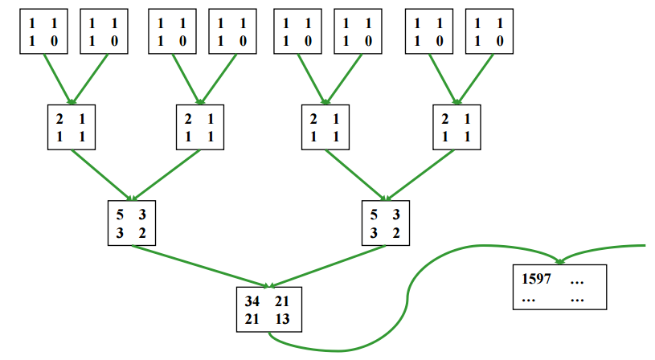
Example 2: Fibonacci Numbers cont.

Slide 17
Example 3: Filtering Values
Say we only want values greater or equal to 5 sequence = 3, 5, 2, 7, 9, 4, 3, 0, 8, 1
Check condition in parallel, yielding 0 or 1 filter = 0, 1, 0, 1, 1, 0, 0, 0, 1, 0
Compute exclusive prefix sum of filter in parallel prefixsum = 0, 0, 1, 1, 2, 3, 3, 3, 3, 4
Assign values in parallel
if (filter[i] != 0) out[prefixsum[i]] = sequence[i];
out[0] = 5, out[1] = 7, out[2] = 9, out[3] = 8

