Slide 1
Computational Science Algorithms

Slide 2
Computational science
Simulations of physical phenomena
  fluid flow over aircraft (Boeing 777)
  fatigue fracture in aircraft bodies
  evolution of galaxies
  ….
Two main approaches
  continuous models: fields and differential equations (eg. Navier-Stokes equations, Maxwell’s equations,…)
  discrete models: particles and forces (eg. gravitational forces)
Paradox
  most differential equations cannot be solved exactly
    must use numerical techniques that convert calculus problem to matrix computations: discretization
    approximation
  n-body methods are straight-forward
    but need to use a lot of bodies to get accuracy
    must find a way to reduce O(N²) complexity of obvious algorithm
    approximate the contribution of distant bodies
Motto:
  “All exact science is dominated by the idea of approximation.”
  Bertrand Russell

Slide 3
Methods
MVM
Explicit
Iterative
methods
(Jacobi,CG,..)
Finite-difference
Implicit
Ax=b
Direct
methods
(Cholesky,LU)
Finite-element
Mesh generation
and refinement
Continuous
Models
Physical
Phenomena
Spectral
FFT
Discrete
Models
Spatial decomposition
trees

Slide 4
Roadmap
Solving sparse linear systems (Ax=b)
Finite-differences
  Ordinary differential equations
  Partial differential equations
Barnes-Hut method
  Example of n-body method for discrete model

Slide 5
Solving linear systems
Linear system: Ax = b
  A is matrix, b is vector
  x is vector of unknowns
Two approaches
  direct methods: Cholesky, LU, LU with pivoting
    factorize A into product of lower and upper triangular matrices A = LU
    solve two triangular systems: LU x = b
      Ly = b
      Ux = y
    problems:
      even if A is sparse, L and U can be quite dense (“fill”)
      no useful information is produced until the end of the procedure
  iterative methods: Jacobi, Gauss-Seidel, CG, GMRES
    guess an initial approximation x₀ to solution
    error is Ax₀ – b (called residual)
    repeatedly compute better approximation x_{i+1} from residual (Ax_{i} – b)
    terminate when approximation is “good enough”

Slide 6
Iterative method: Jacobi iteration
Linear system
4x+2y=8
3x+4y=11
Exact solution is (x=1,y=2)
Jacobi iteration for finding approximations to solution
  guess an initial approximation
  iterate
    use first component of residual to refine value of x
    use second component of residual to refine value of y
For our example
  x_{i+1} = (8 - 2y_{i})/4
  y_{i+1} = (11 - 3x_{i})/4
  for initial guess (x₀=0,y₀=0)
i 0 1 2 3 4 5 6 7
x 0 2 0.625 1.375 0.8594 1.1406 0.9473 1.0527
y 0 2.75 1.250 2.281 1.7188 2.1055 1.8945 2.0396

Slide 7
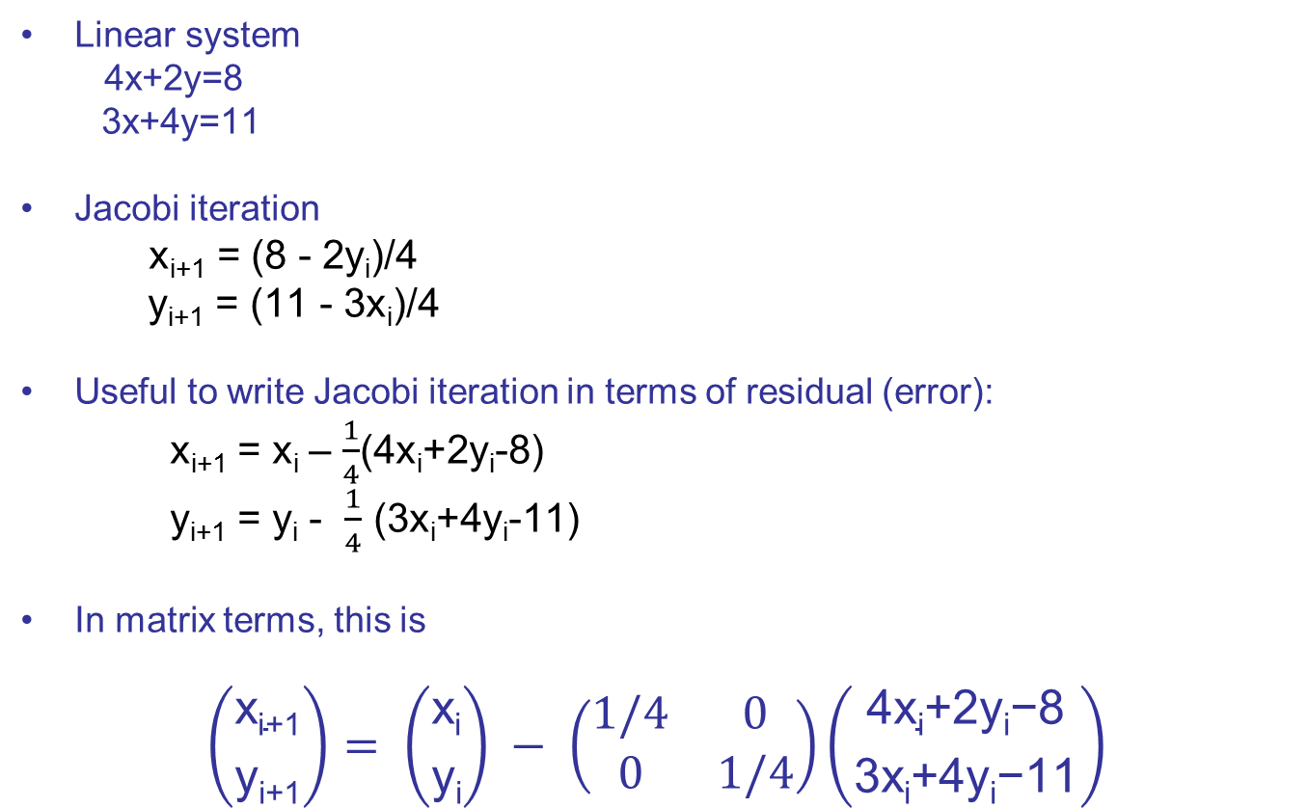
Jacobi iteration: matrix notation
Linear system
4x+2y=8
3x+4y=11
Jacobi iteration
  x_{i+1} = (8 - 2y_{i})/4
  y_{i+1} = (11 - 3x_{i})/4
Useful to write Jacobi iteration in terms of residual (error):
  x_{i+1} = x_{i} – $\frac{1}{4}$(4x_{i}+2y_{i}-8)
  y_{i+1} = y_{i} - $\frac{1}{4}$ (3x_{i}+4y_{i}-11)
In matrix terms, this is
$$\left({\text{x}\text{i}\text{+1} \atop \text{y}\text{i}\text{+1}}\right)= \left({\text{x}\text{i} \atop \text{y}\text{i}}\right) − \left(\begin{matrix}1/4 & 0 \\ 0 & 1/4\end{matrix}\right)\left({\text{4}\text{xi}\text{+2}\text{yi}\text{−8} \atop \text{3}\text{xi}\text{+4}\text{yi}\text{−11}}\right)$$

Slide 8
Jacobi iteration: general picture
Linear system Ax = b
Jacobi iteration
  x_{i+1} = x_{i} – M⁻¹(Ax_{i} – b) (where M is the diagonal of A)
Key operation:
  matrix-vector multiplication
Caveat:
  Jacobi iteration does not always converge
  even when it converges, it usually converges slowly
  there are faster iterative methods available: CG,GMRES,..
  what is important from our perspective is that key operation in all these iterative methods is matrix-vector multiplication

Slide 9
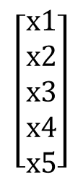
MVM: graph interpretation
Graph interpretation:
  Each node i has two values (labels) x(i) and y(i)
  Each node i updates its label y using the x value from each out-neighbor j, scaled by the label on edge (i,j)
  Topology-driven, unordered algorithm
Observation:
  Graph perspective shows dense MVM is special case of sparse MVM
  What is interpretation of y = A^{T}x ?
2
a
1
c
b
f
5
4
d
e
3
g
1 2 3 4 5
1
2
3
4
5
0 a f 0 0
0 0 0 c 0
0 0 0 e 0
0 0 0 0 d
0 b 0 0 g
$$\left[\begin{aligned}x1 \\ x2 \\ x3 \\ x4 \\ x5\end{aligned}\right]$$
A
x

Slide 10
MVM implementation with sparse matrix representations
Coordinate storage
  for P = 1 to NZ do
  Y(A.row(P))=Y(A.row(P)) + A.val(P)*X(A.column(P))
CRS storage
  for I = 1 to N do
  for JJ = A.rowptr(I) to A.rowPtr(I+1)-1 do
  Y(I)=Y(I)+A.val(JJ)*X(A.column(J)))

Slide 11
Finite-differences

Slide 12
Ordinary differential equations
Consider the ode
  u‘(t) = -3u(t)+2
  u(0) = 1
This is called an initial value problem
  initial value of u is given
  compute how function u evolves for t > 0
Using elementary calculus, we can solve this ode exactly
  u(t) = 1/3 (e^{-3t}+2)
2/3

Slide 13
Problem
For general ode’s, we may not be able to express solution in terms of elementary functions
In most practical situations, we do not need exact solution anyway
  enough to compute an approximate solution, provided
    we have some idea of how much error was introduced
    we can improve the accuracy as needed
General solution:
  convert calculus problem into algebra/arithmetic problem
    discretization: replace continuous variables with discrete variables
    in finite differences,
      time will advance in fixed-size steps: t=0,h,2h,3h,…
      differential equation is replaced by difference equation

Slide 14
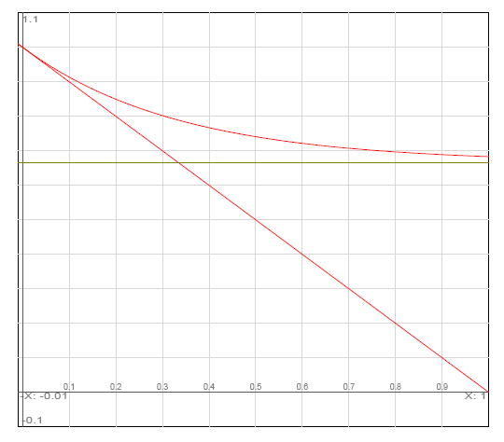
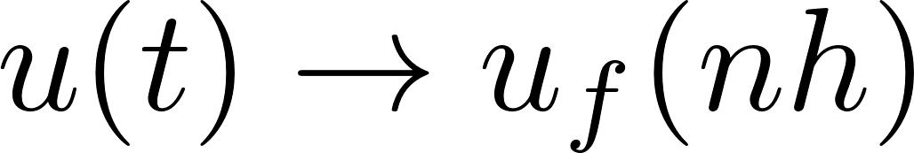
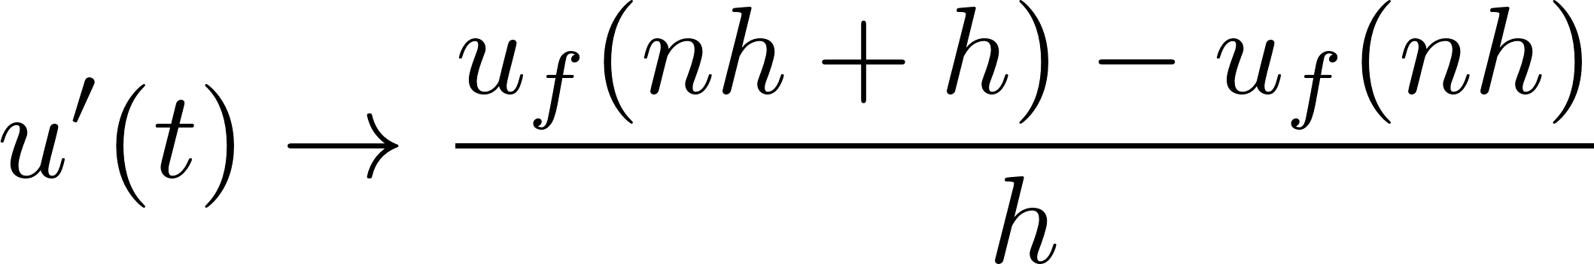
Forward-Euler method
Replace continuous time with discrete time-steps and derivative with forward difference to get a difference equation
Replacing derivative with difference is essentially the inverse of how derivatives were probably introduced to you in elementary calculus
x
x
x
x
nh-h
nh
nh+h

Slide 15
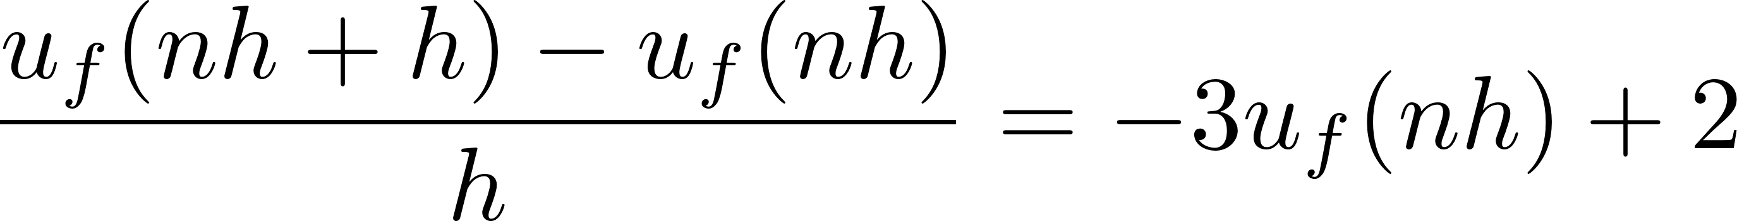
Back to ode
Original ode
  u’(t) = -3u(t)+2
After discretization using Forward-Euler:
After rearrangement, we get difference equation
  u_{f}(nh+h) = (1-3h)u_{f}(nh)+2h
We can now compute values of u_{f} at t = h,2h,3h,…:
  u_{f}(0) = 1
  u_{f}(h) = (1-h)
  u_{f}(2h) = (1-2h+3h²)
  …..

Slide 16
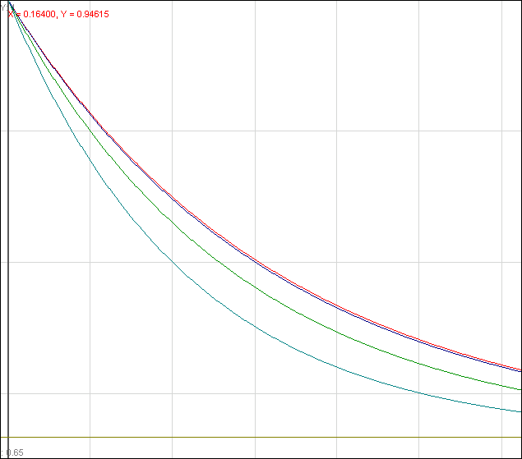
Tabulation
Numerical solution
  Choose a value for h
  Tabulate the values of u_{f} at t = nh for n = 0,1,2,…, using the recurrence formula
Question: how do you choose the step size h?
  Small h is more accurate but also more computationally intensive
  If we assume we want to estimate the value of u at t = T, we will need O(T/h) evaluations of the recurrence formula
Important property of forward-Euler:
  Numerical solution is stable only if h is “small enough”
  If h is too big, numerical estimate will blow up
  Recurrence formula is a feedback loop and error introduced at one time step gets amplified by the recurrence formula
x
o
x
x
o
x
x
x
exact solution
o
x
h=0.01
o
h=0.1
h=.2
h=1/3

Slide 17
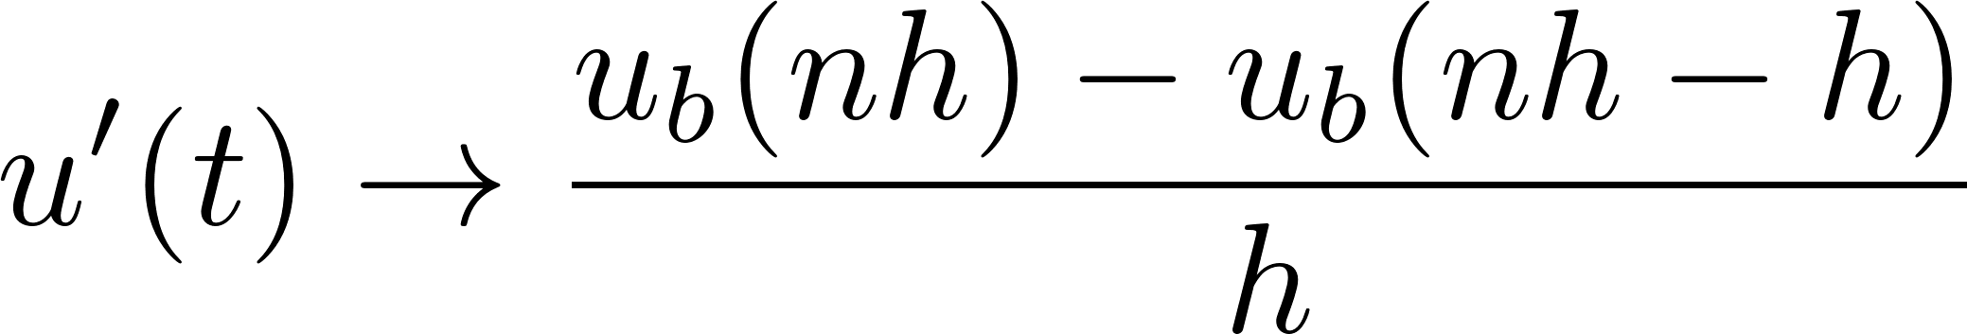
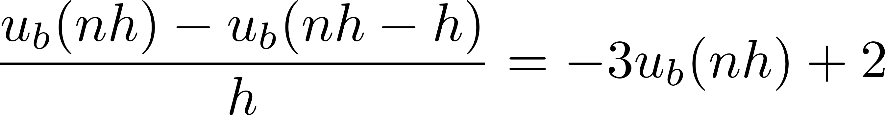
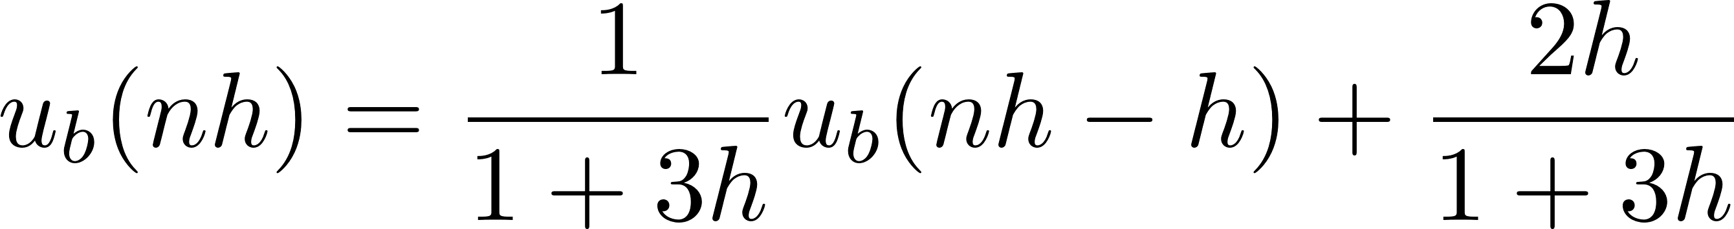
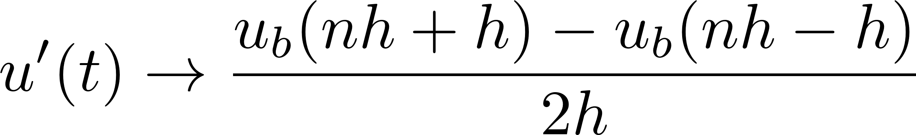
Backward-Euler method
Replace derivative with backward difference
For our ode, we get
Backward-Euler is unconditionally stable
  Solution does not blow up even for large values of h, although it may not be accurate
Another formula: centered differences
h=1000
h=0.1
h=0.01
exact solution
x
x
x
x
nh-h
nh
nh+h

Slide 18
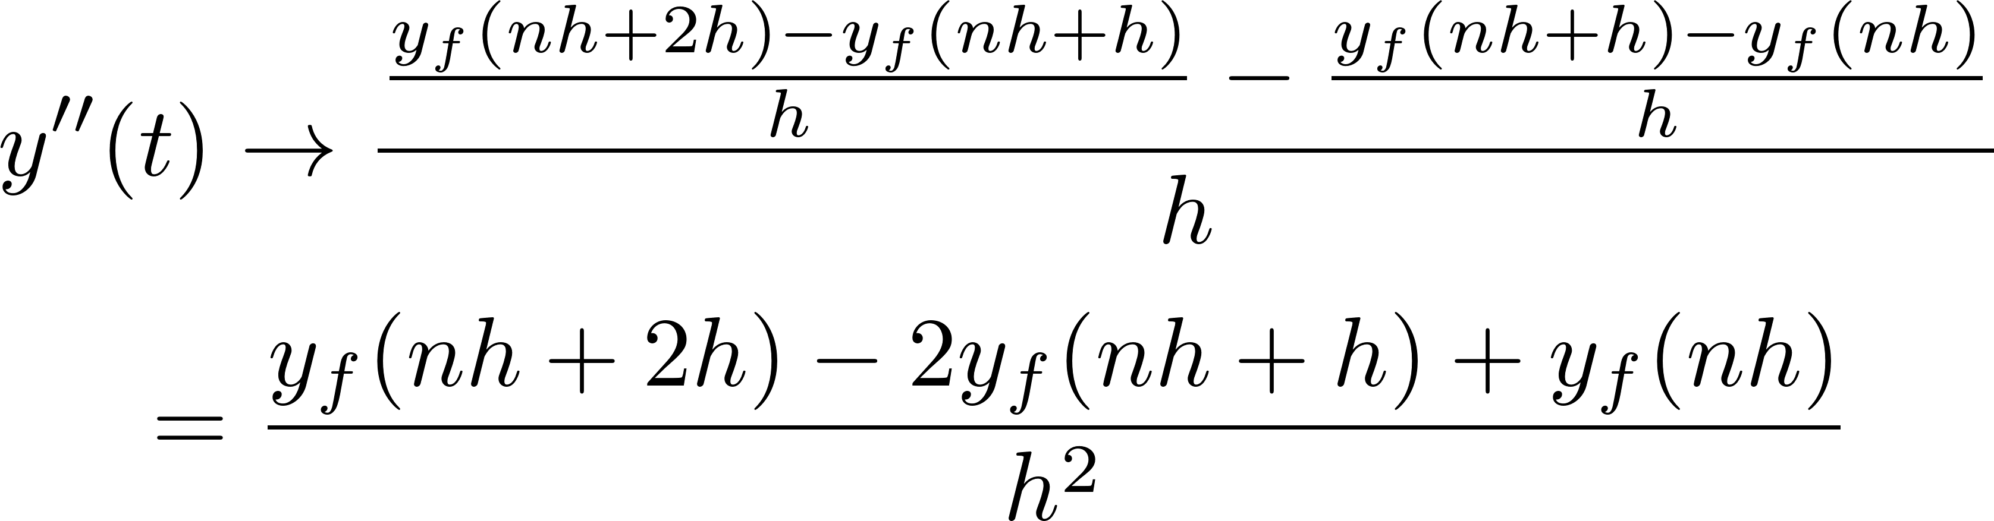
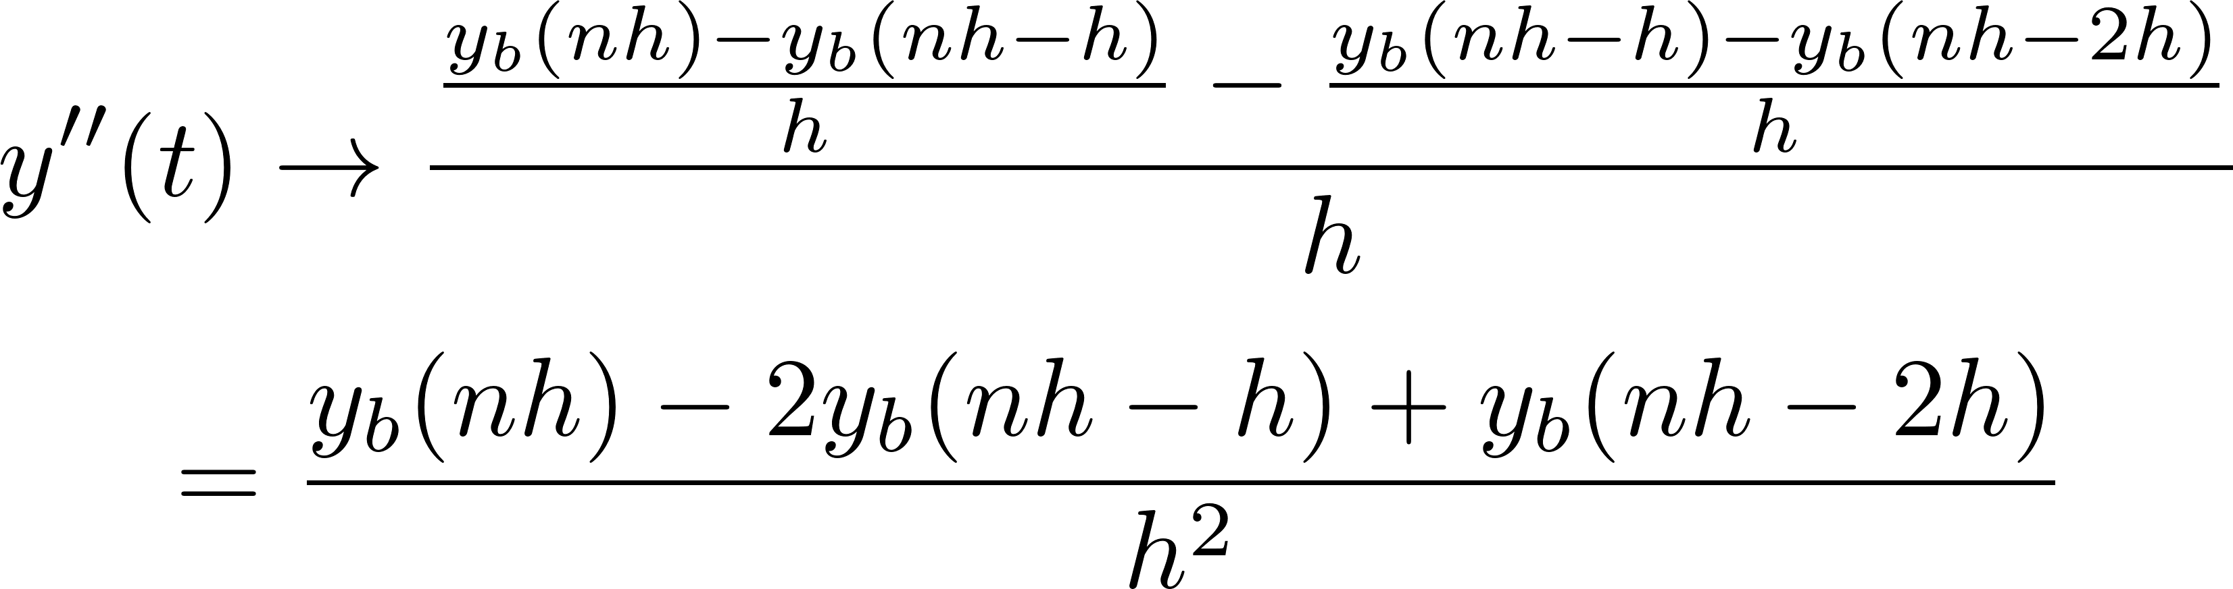
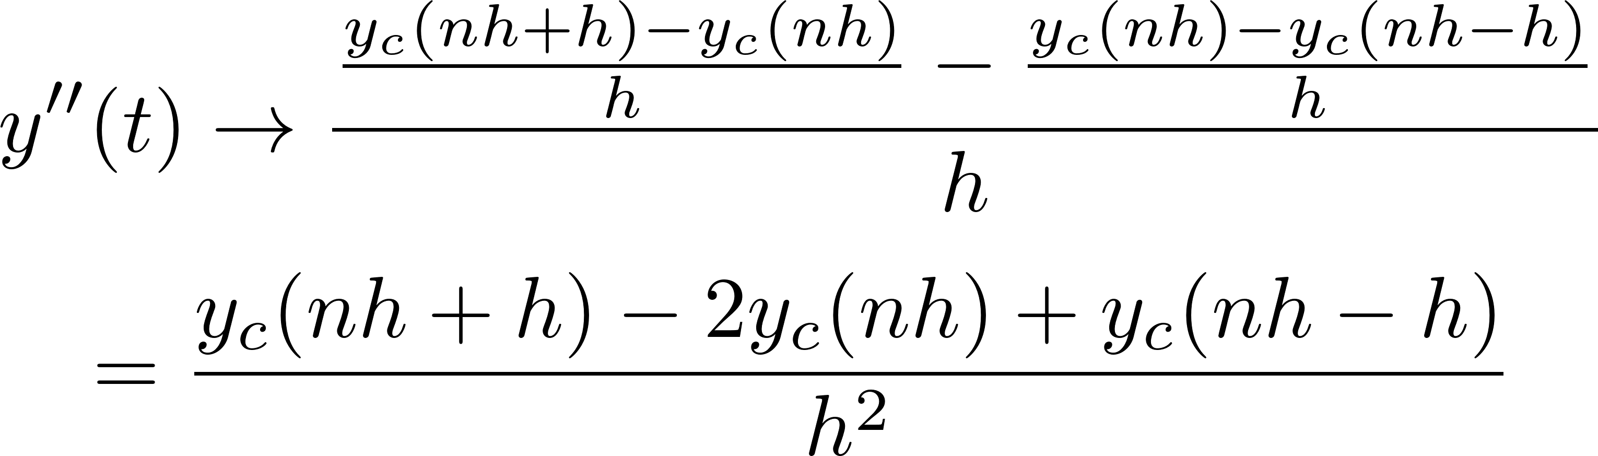
Higher-order difference formulas
Basic idea: same as first-order differences
Second-order forward difference
Second-order backward difference
Second-order centered difference
nh-h
nh
nh+h
t → nh
y(t) → y_{a}(nh)

Slide 19
General comments
Many other discretization schemes have been developed in literature (e.g. Runge-Kutta)
Figures of merit for discretization schemes
  Stability: can approximate solution blow up?
  Accuracy: how small does step size have to be for approximate solution to be “close enough” to exact solution?
Obvious extension to systems of ode’s
  Backward-Euler and centered differences require solution of linear systems at each time-step.
  Forward-Euler does not.
  Sometimes known as implicit and explicit methods; implicit methods require linear solves at each time-step.

Slide 20
Finite-differences: partial differential equations

Slide 21
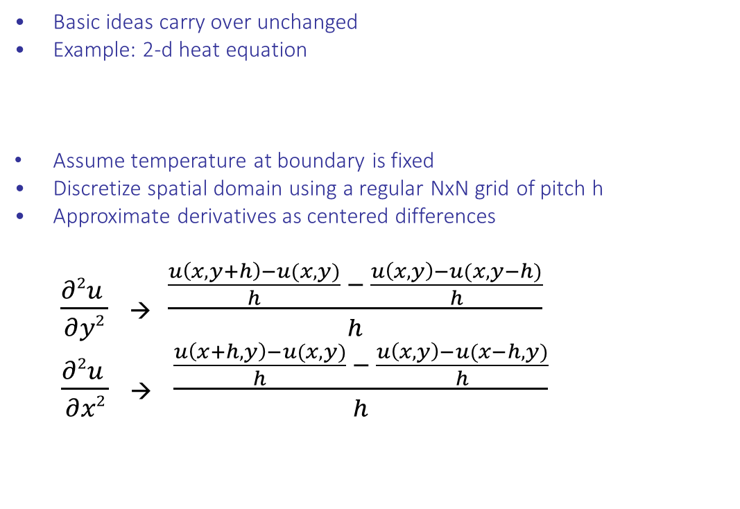
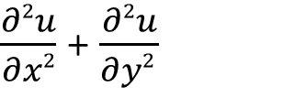
Finite-difference methods for solving
partial differential equations
Basic ideas carry over unchanged
Example: 2-d heat equation
Assume temperature at boundary is fixed
Discretize spatial domain using a regular NxN grid of pitch h
Approximate derivatives as centered differences
$\frac{∂2u }{∂y2}$ → $\frac{\frac{u\left(x,y+h\right)−u(x,y)}{h} − \frac{u\left(x,y\right)−u(x,y−h)}{h}}{h}$
$\frac{∂2u }{∂x2}$ → $\frac{\frac{u\left(x+h,y\right)−u(x,y)}{h} − \frac{u\left(x,y\right)−u(x−h,y)}{h}}{h}$
y
$\frac{∂2u}{∂x2}$ + $\frac{∂2u}{∂y2 }$
= f(x,y)
(x,y+h)
(x-h,y)
(x,y)
(x+h,y)
(x,y-h)
h
h
x
5-point stencil

Slide 22
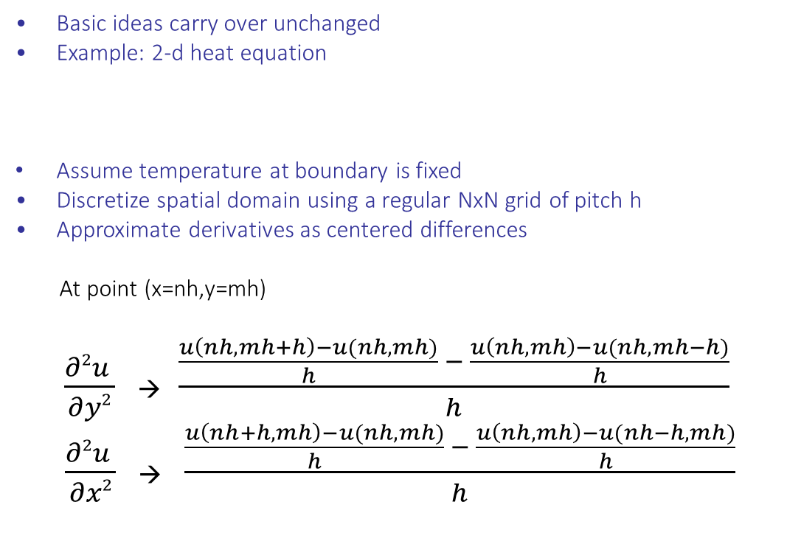
Finite-difference methods for solving
partial differential equations
Basic ideas carry over unchanged
Example: 2-d heat equation
Assume temperature at boundary is fixed
Discretize spatial domain using a regular NxN grid of pitch h
Approximate derivatives as centered differences
At point (x=nh,y=mh)
$\frac{∂2u }{∂y2}$ → $\frac{\frac{u\left(nh,mh+h\right)−u(nh,mh)}{h} − \frac{u\left(nh,mh\right)−u(nh,mh−h)}{h}}{h}$
$\frac{∂2u }{∂x2}$ → $\frac{\frac{u\left(nh+h,mh\right)−u(nh,mh)}{h} − \frac{u\left(nh,mh\right)−u(nh−h,mh)}{h}}{h}$
y
$\frac{∂2u}{∂x2}$ + $\frac{∂2u}{∂y2 }$
= f(x,y)
(nh,mh+h)
(nh-h,mh)
(nh,mh)
(nh+h,mh)
(nh,mh-h)
h
x
5-point stencil

Slide 23
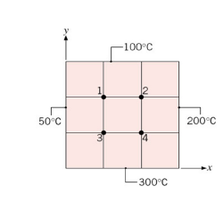
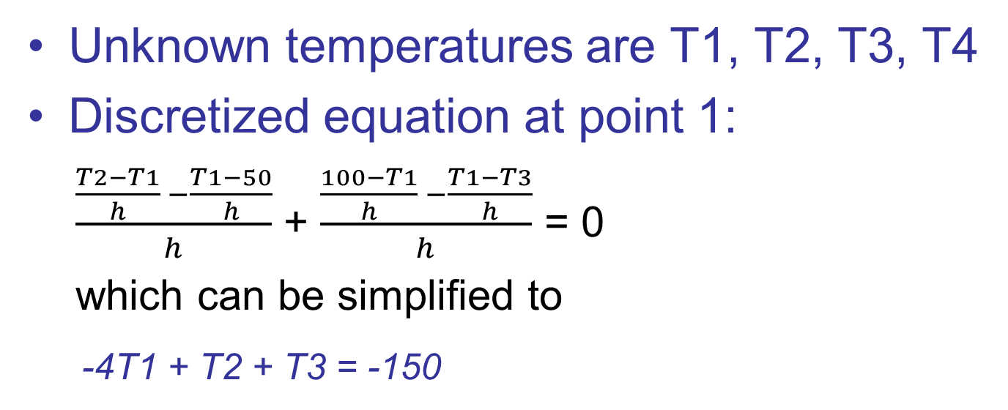
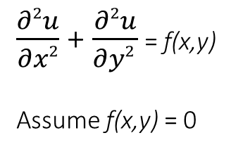
Example
$\frac{∂2u}{∂x2}$ + $\frac{∂2u}{∂y2 }$ = f(x,y)
Assume f(x,y) = 0

Slide 24
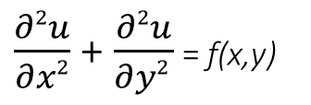
Example (contd)
$\frac{∂2u}{∂x2}$ + $\frac{∂2u}{∂y2 }$ = f(x,y)
Assume f(x,y) = 0
-4T1 + T2 + T3 = -150
T1 – 4T2 + T4 = -300
T1 - 4T3 + T4 = -350
T2 + T3 - 4T4 = -500
-4 1 1 0
1 -4 0 1
1 0 -4 1
0 1 1 -4
T1
T2
T3
T4
-150
-300
-350
-500
=

Slide 25
General picture: matrix notation
System of (N-1)x(N-1) difference equations
in terms of the unknowns at the (N-1)x(N-1) interior points
for all interior points (ih,jh)
u(ih,jh+h)+u(ih,jh-h)+u(ih+h,jh)+u(ih-h,jh) – 4u(ih,jh) = h² f(ih,jh)
(i,j+1)
Matrix notation: use natural order for u’s
(i-1,j)
(i,j)
(i+1,j)
………………………………
………………………………
………………………………
………………………………
0..1 0..0 1 -4 1 0..0 1 0…0.
0..0 0 1 0..0 1 -4 1 0..0 1 0.
………………………………
………………………………
……………………………...
….
u(i-1,j)
….
u(i,j-1)
u(i,j)
u(i,j+1)
.....
u(i+1,j)
……
…….
f(ih,jh)
……..
=
h²
(i,j-1)
5-point stencil
(matrix indices)
Pentadiagonal sparse matrix
Matrix is known at compile-time and has simple structure.

Slide 26
Implementation
One approach:
  Represent matrix in one of the sparse formats studied earlier such as compressed sparse-roow
  Perform Jacobi iteration using sparse MVM, as shown on Slide 8/9
Better approach:
  Exploit the fact that the non-zero structure is very simple (penta-diagonal) and all non-zero entries are known when you are writing the code
  “In-line” the non-zero entries into the code so you need storage only for the old and new temperature values and not for the matrix

Slide 27
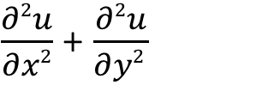
Example (contd)
N
$\frac{∂2u}{∂x2}$ + $\frac{∂2u}{∂y2 }$
= f(x,y)
N
Assume f(x,y) = 0
1
current
next
5-point stencil
-4T1 + T2 + T3 = -150
T1 – 4T2 + T4 = -300
T1 - 4T3 + T4 = -350
T2 + T3 - 4T4 = -500
T1^{n+1} = ¼ (T2^{n} + T3^{n} + 100 + 50)
T2^{n+1} = ¼(T1^{n} + T4^{n} + 100 + 200)
T3^{n+1} = ¼(T1^{n} + T4^{n} + 300 + 50)
T4^{n+1} = ¼(T2^{n} + T3^{n} + 300 + 200)
Jacobi
Solution: T1 = 119, T2 = 156, T3 = 169, T4 = 206

Slide 28
Implementation
Data structures
  temperature values at a given iteration can be stored in a NxN matrix
  use two matrices, current and next
Algorithm
  compute values in next using values in current
  operator: five-point stencil
  switch between current and next in successive iterations
Questions:
  where is the parallelism in this algorithm?
  is there spatial locality? temporal locality?
N
N
1
current
next
5-point stencil

Slide 29
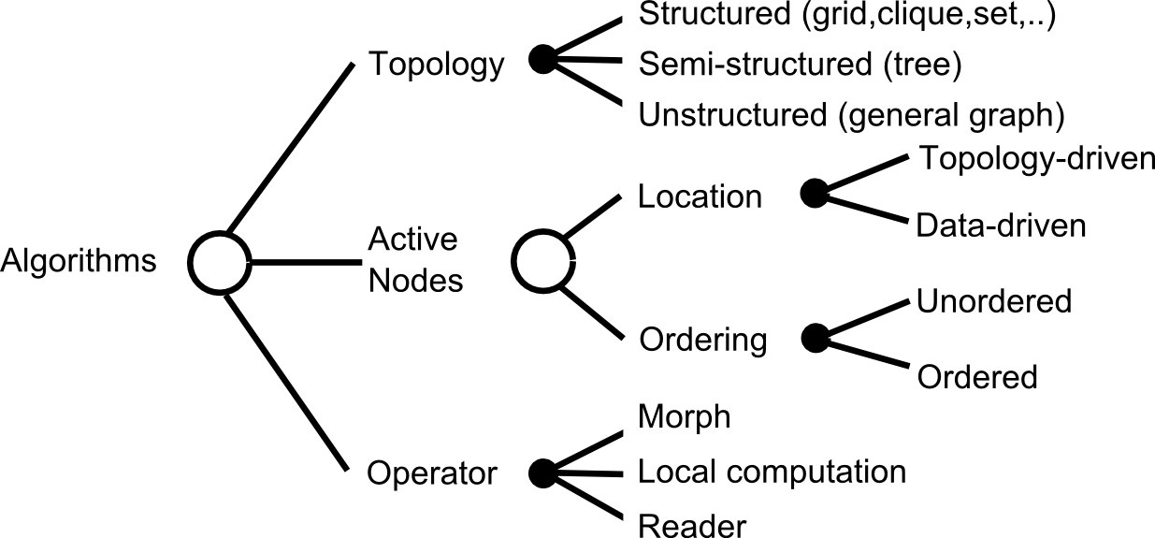
TAO analysis: algorithm abstraction
current
next
5-point stencil
Jacobi
Topology: structured (grid)
Active nodes: topology-driven (all nodes of next grid), unordered
Operator: local computation for next, reader for current
What graph algorithm does this remind you of?

Slide 30
Summary
Finite-difference methods
  can be used to find approximate solutions to ode’s and pde’s
  Explicit methods: (e.g.) forward-Euler require matrix-vector multiplication
  Implicit methods: (e.g.) backward-Euler or centered differences require solving linear system
Many large-scale computational science simulations use these methods
Time step or grid step needs to be constant and is determined by highest-frequency phenomenon
  can be inefficient for when frequency varies widely in domain of interest

Slide 31
Big picture
MVM
Explicit
Iterative
methods
(Jacobi,CG,..)
Finite-difference
Implicit
Ax=b
Direct
methods
(Cholesky,LU)
Finite-element
Continuous
Models
Physical
Models
Discrete
Models

Slide 32
Discrete models:
Barnes Hut algorithm

Slide 33
Introduction
Physical system simulation (time evolution)
  System consists of bodies
  “n” is the number of bodies
  Bodies interact via pair-wise forces
Many systems can be modeled in these terms
  Galaxy clusters (gravitational force)
  Particles (electric force, magnetic force)

Slide 34
Barnes Hut Idea
Precise force calculation
  Requires O(n²) operations (O(n²) body pairs)
Barnes and Hut (1986)
  Algorithm to approximately compute forces
    Bodies’ initial position & velocity are also approximate
  Requires only O(n log n) operations
  Idea is to “combine” far away bodies
  Error should be small because force ∼ 1/r²

Slide 35
Barnes Hut Algorithm
Set bodies’ initial position and velocity
Iterate over time steps
  Subdivide space until at most one body per cell
    Record this spatial hierarchy in an octree
  Compute mass and center of mass of each cell
  Compute force on bodies by traversing octree
    Stop traversal path when encountering a leaf (body) or an internal node (cell) that is far enough away
  Update each body’s position and velocity

Slide 36
Build Tree (Level 1)
Subdivide space until at most one body per cell

Slide 37
Build Tree (Level 2)
Subdivide space until at most one body per cell

Slide 38
Build Tree (Level 3)
Subdivide space until at most one body per cell

Slide 39
Build Tree (Level 4)
Subdivide space until at most one body per cell

Slide 40
Build Tree (Level 5)
Subdivide space until at most one body per cell

Slide 41
Compute Cells’ Center of Mass
For each internal cell, compute sum of mass and weighted average
of position of all bodies in subtree; example shows two cells only

Slide 42
Compute Forces
Compute force, for example, acting upon green body

Slide 43
Compute Force (short distance)
Scan tree depth first from left to right; green portion already completed

Slide 44
Compute Force (down one level)
Red center of mass is too close, need to go down one level

Slide 45
Compute Force (long distance)
Yellow center of mass is far enough away

Slide 46
Compute Force (skip subtree)
Therefore, entire subtree rooted in the yellow cell can be skipped

Slide 47
Pseudocode
Set bodySet = ...
foreach timestep do {
Octree octree = new Octree();
foreach Body b in bodySet {
octree.Insert(b);
}
OrderedList cellList = octree.CellsByLevel();
foreach Cell c in cellList {
c.Summarize();
}
foreach Body b in bodySet {
b.ComputeForce(octree);
}
foreach Body b in bodySet {
b.Advance();
}
}

Slide 48
Complexity
Set bodySet = ...
foreach timestep do { // O(n log n)
Octree octree = new Octree();
foreach Body b in bodySet { // O(n log n)
octree.Insert(b);
}
OrderedList cellList = octree.CellsByLevel();
foreach Cell c in cellList { // O(n)
c.Summarize();
}
foreach Body b in bodySet { // O(n log n)
b.ComputeForce(octree);
}
foreach Body b in bodySet { // O(n)
b.Advance();
}
}

Slide 49
TAO: top-down tree building
Topology: set (particles) + tree (oct-tree)
Active nodes: particles
Ordering: unordered
Operator:
  morph for tree
  label computation for particles
Neighborhoods: particle + path from root to insertion point

Slide 50
TAO: tree summarization
Topology: tree
Active nodes: topology-driven
Ordering: ordered (children first, priority is determined by tree level)
Operator: label computation

Slide 51
TAO: force computation
Topology: tree (oct-tree) + set (particles)
Active nodes: particles
Ordering: unordered
Operator:
  reader for tree
  label computation for particles

Slide 52
TAO: Advancing bodies
Topology: set (particles)
Active nodes:
  Particles, topology-driven
Operator: label computation
Ordering: unordered

Slide 53
Summary
MVM
Explicit
Iterative
methods
(Jacobi,CG,..)
Finite-difference
Implicit
Ax=b
Direct
methods
(Cholesky,LU)
Finite-element
Mesh generation
and refinement
Continuous
Models
Physical
Phenomena
Spectral
FFT
Discrete
Models
Spatial decomposition
trees

