Slide 1
NVIDIA GPUs and
CUDA Programming

Slide 2
GPU Heterogeneous Computing
Host
Memory
Global
Memory
50 GB/s
PCIe Bus
8 GB/s
1.8 TB/s
CPU
GPU
Host
Executes host program
Device
Executes kernel program
Device has large number of cores
Blackwell: ~20K CUDA cores, 576 tensor cores, …
Explicit data transfer between host and device (cudaMemcpy)
Newer GPUs have Unified Virtual Addressing (UVA) that provides a single address space between host and GPU, but we won’t worry about this

Slide 3
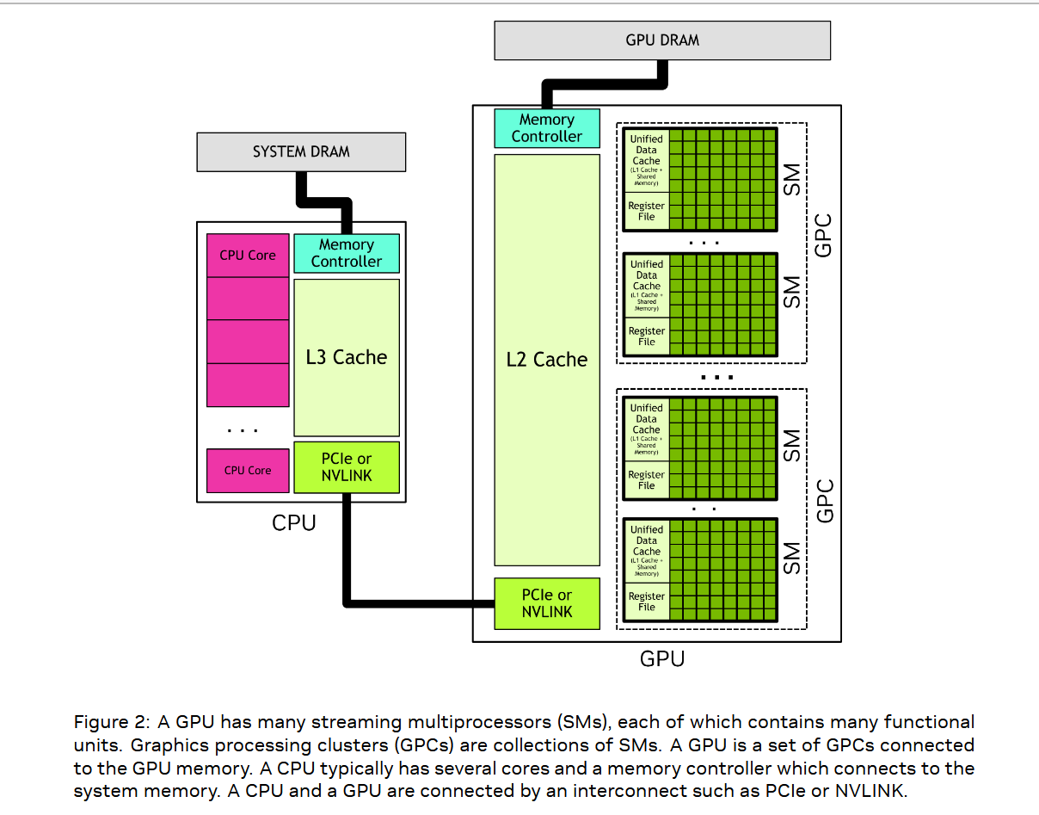
GPU architectures are complex
Global memory
Unified L1 cache
Shared-memory
(software-controlled buffer)
Massive register file

Slide 4
Goal of lectures
Introduce core ideas over 3 lectures
Relate core ideas to CPU concepts
Provide historical perspective: what is new in GPUs?

Slide 5
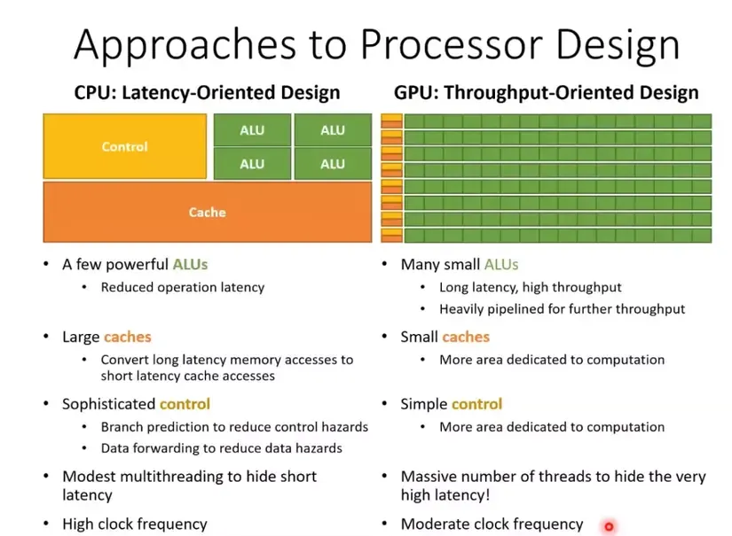
Latency avoidance
Latency tolerance
If you have enough parallelism, you can cover long memory latencies.
The Operational Mechanism of CPU-GPU, CisMine Ng

Slide 6
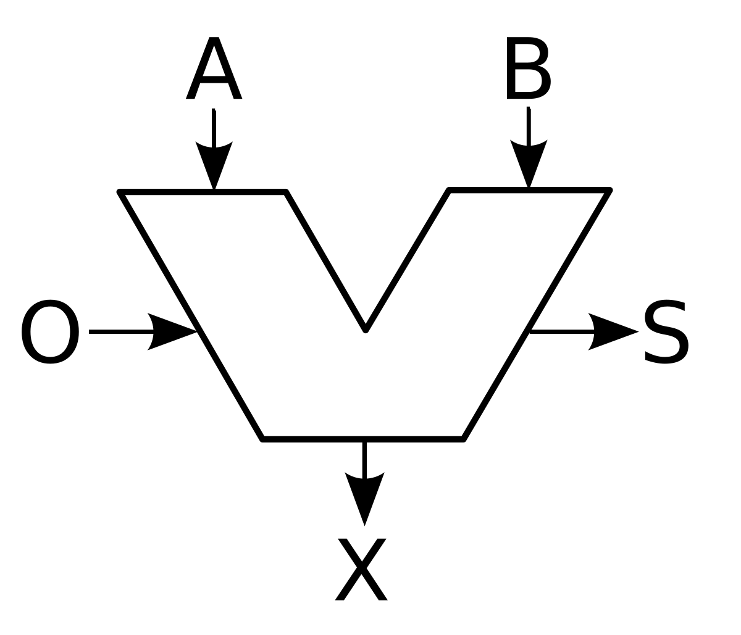
Architectural support for latency-tolerant computing
Conventional cores
Latency-tolerant cores
Register
File
PC
Register
File
PC
Register
File
PC
Register
File
PC
ROB
ROB
L1 cache
L1 cache
L1 cache
L2 cache
L2 cache
Conventional cores: latency-avoidance through ROB+cache
running multiple threads on same core requires thread context-switching
Latency-tolerant cores: latency-tolerance through parallelism + duplicating thread context
This Photo by Unknown Author is licensed under CC BY-SA
This Photo by Unknown Author is licensed under CC BY-SA

Slide 7

Seymour Cray’s view
(courtesy Sid Chatterjee)

Slide 8
Latency-tolerance is not new
Time-sharing systems (CTSS (1961), ITS (1967),..)
  Multiple users on one machine at the same time
  Switch between jobs if current job is doing I/O
  Keeps processor busy, provided time to switch between jobs is small
Dataflow computing (Jack Dennis, 1974)
  Dynamic scheduling of operations in program, based on operand availability
Tagged-token dataflow computing (Arvind, 1978)
  Evolution of Dennis’s static dataflow model
Denelcor HEP (Burton Smith, 1981)
  Coarse-grain dataflow machine with full/empty bits on memory locations

Slide 9
CUDA programs
CUDA program = Host program + kernels
Host program
  Begins execution of program (main)
  Orchestrates data transfers to and from device
  Copy-in copy-out
  Invokes kernel programs
Kernel program
  Specifies work to be performed by one thread (like pThreads)
  Thread name is used to assign different work to different threads

Slide 10
Organization
Baseline GPU
CUDA core only (no tensor cores)
Identical threads
Global memory
Latency tolerance by context-switching
Warps: “liquid vectors”
Co-scheduling of threads
Thread divergence
Global memory accesses from warps
Optimization: think like a vector
Thread blocks
Shared-memory: software-controlled cache
Programming examples
Architecture Details
Caveat: NVIDIA keeps changing hardware and programming model,
so some information may be out of date

Slide 11

Execution model
...
...
…
...
0
1
2
Some number of identical threads
Device memory (aka global memory) accessible to all threads
In-order execution of instructions in each thread
Hardware implements latency tolerance
Tracks operand availability for all threads
Executes ready threads on hardware cores
Zero-overhead context switches
Synchronization instructions for coordination

Slide 12
Programming model: like pThreads but…
...
...
…
...
0
1
2
Must specify what code runs on CPU and what runs on device
Decorators on functions
Must specify number of execution threads when you invoke kernel (≤ 1024)
myKernel<<< 1, m >>>(arg1, … ); //m threads
Name space for threads: threadIdx.x
threadIdx is short for thread index
Transfer data explicitly between host and device: cudaMemcpy()
“Copy-in copy-out”
Allocate and deallocate space on device
cudaMalloc(name, size): allocates space on device
host uses name to perform I/O using cudaMemcpy
cudaFree(name): deallocate space

Slide 13
CUDA Function Declarations
Executed on the:
Only callable from the:
_device_ float DeviceFunc()‏
device
device
_global_ void KernelFunc()‏
device
host
_host_ float HostFunc()‏
host
host
Executed on host, callable from device: not supported
_global_ defines a kernel function, must return void
_device_ and _host_ can be used together

Slide 14
First CUDA example
Program to compute
  C = A+B on GPU,
  where A,B,C are 1-D arrays in host memory
Kernel program:
  Thread i will compute C[i] = A[i]+B[i]

Slide 15
#define N 256
__global__ void vecAdd(int *A, int *B, int *C) {
int i = threadIdx.x;
C[i] = A[i] + B[i];
}
int main (int argc, char **argv ) {
int size = N *sizeof( int);
int *a,*b,*c, *devA, *devB, *devC;
cudaMalloc( (void**)&devA, size );
cudaMalloc( (void**)&devB, size );
cudaMalloc( (void**)&devC, size );
a = (int*)malloc(size);
b = (int*)malloc(size);
c = (int*)malloc(size);
cudaMemcpy( devA, a, size, cudaMemcpyHostToDevice);
cudaMemcpy( devB, b, size, cudaMemcpyHostToDevice);
vecAdd<<<1, N>>>(devA, devB, devC);
cudaMemcpy( &c, devC ,size, cudaMemcpyDeviceToHost);
cudaFree( devA); cudaFree( devB); cudaFree( devC);
free( a ); free( b ); free( c );
return (0);
}
kernel
Who am I?
Allocate space on device for arrays
Copy data to device
Execute kernel on N threads

Slide 16
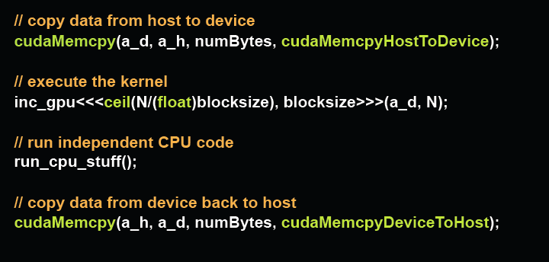
Detail: host-device asynchrony
Kernel calls are non-blocking
Control returns to host immediately
Enables host to do work while GPU is computing
cudaMemcpy is blocking
  Begins after all previous CUDA calls are complete
  Returns control to host after copy is complete

Slide 17
Thread synchronization
Atomic operations on integers (mostly)
  Reduction operations on signed/unsigned ints
    add, sub, min, max, ...
    and, or, xor
    increment, decrement
  Exchange, compare and swap
Atomic add on floats and doubles
void __syncthreads();
Barrier
17

Slide 18
Organization
Baseline GPU
CUDA core only (no tensor cores)
Identical threads
Global memory
Latency tolerance by context-switching
Warps: “liquid vectors”
Single-instruction Multiple Data (SIMD) machines
Co-scheduling of threads
Thread divergence
Global memory accesses from warps
Optimization: think like a vector
Thread blocks
Shared-memory: software-controlled cache
Programming examples
Architecture Details

Slide 19
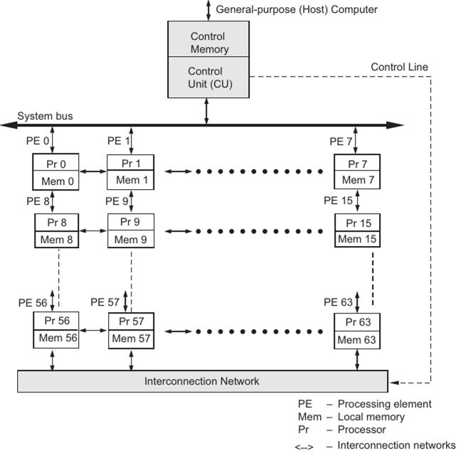
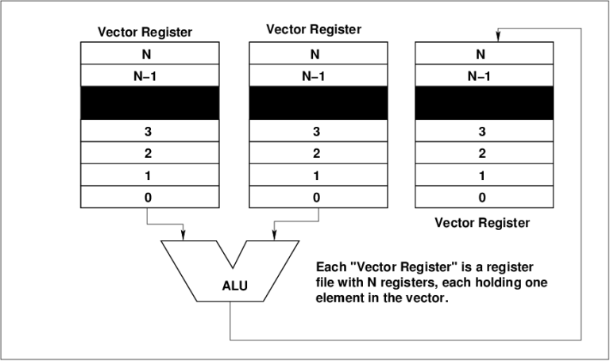
SIMD machines
Array processors (spatial SIMD)
Vector processors (temporal SIMD)
1974
ILLIAC IV (Dan Slotnik, UIUC)
Array processor 64 SIMD processors, one control unit
1975
Cray-1 (Seymour Cray)
Vector processor, vector registers, heavily pipelined ALUs, load-store instruction set
1985
Connection machine (Danny Hillis, MIT)
Array processor, one-bit processor, hypercube network
Later versions became MIMD processors

Slide 20
Vector Instructions
0
2.1
0
4.1
0
6.2
1
3.2
1
1.1
1
4.3
+
→
….
….
….
31
8.8
31
1.4
31
10.2
V2
V1
V1
Vector register may hold 32 floats or doubles
Vector instructions: perform operations element-wise on contents of vector registers
V1 ← vadd( V2, V1) //add contents of vector registers V2 and V1
element- by-element and store resulting vector in V1

Slide 21
Masked Vector Instructions (I)
0
2.1
0
4.1
0
0
2.1
1
3.2
1
1.1
1
1
4.3
+
→
….
….
….
….
31
8.8
31
1.4
1
31
10.2
V2
V1
VM
(Mask register)
V1
Mask registers: 32 bit registers
Each bit is interpreted as true (1) or false (0)
Some architectures have one implicit mask register (like vector condition code)
Masked vector operations
Mask register bits determine which vector elements participate in operation
Called predicated execution
V1 ← vadd(V2,V1) | VM

Slide 22
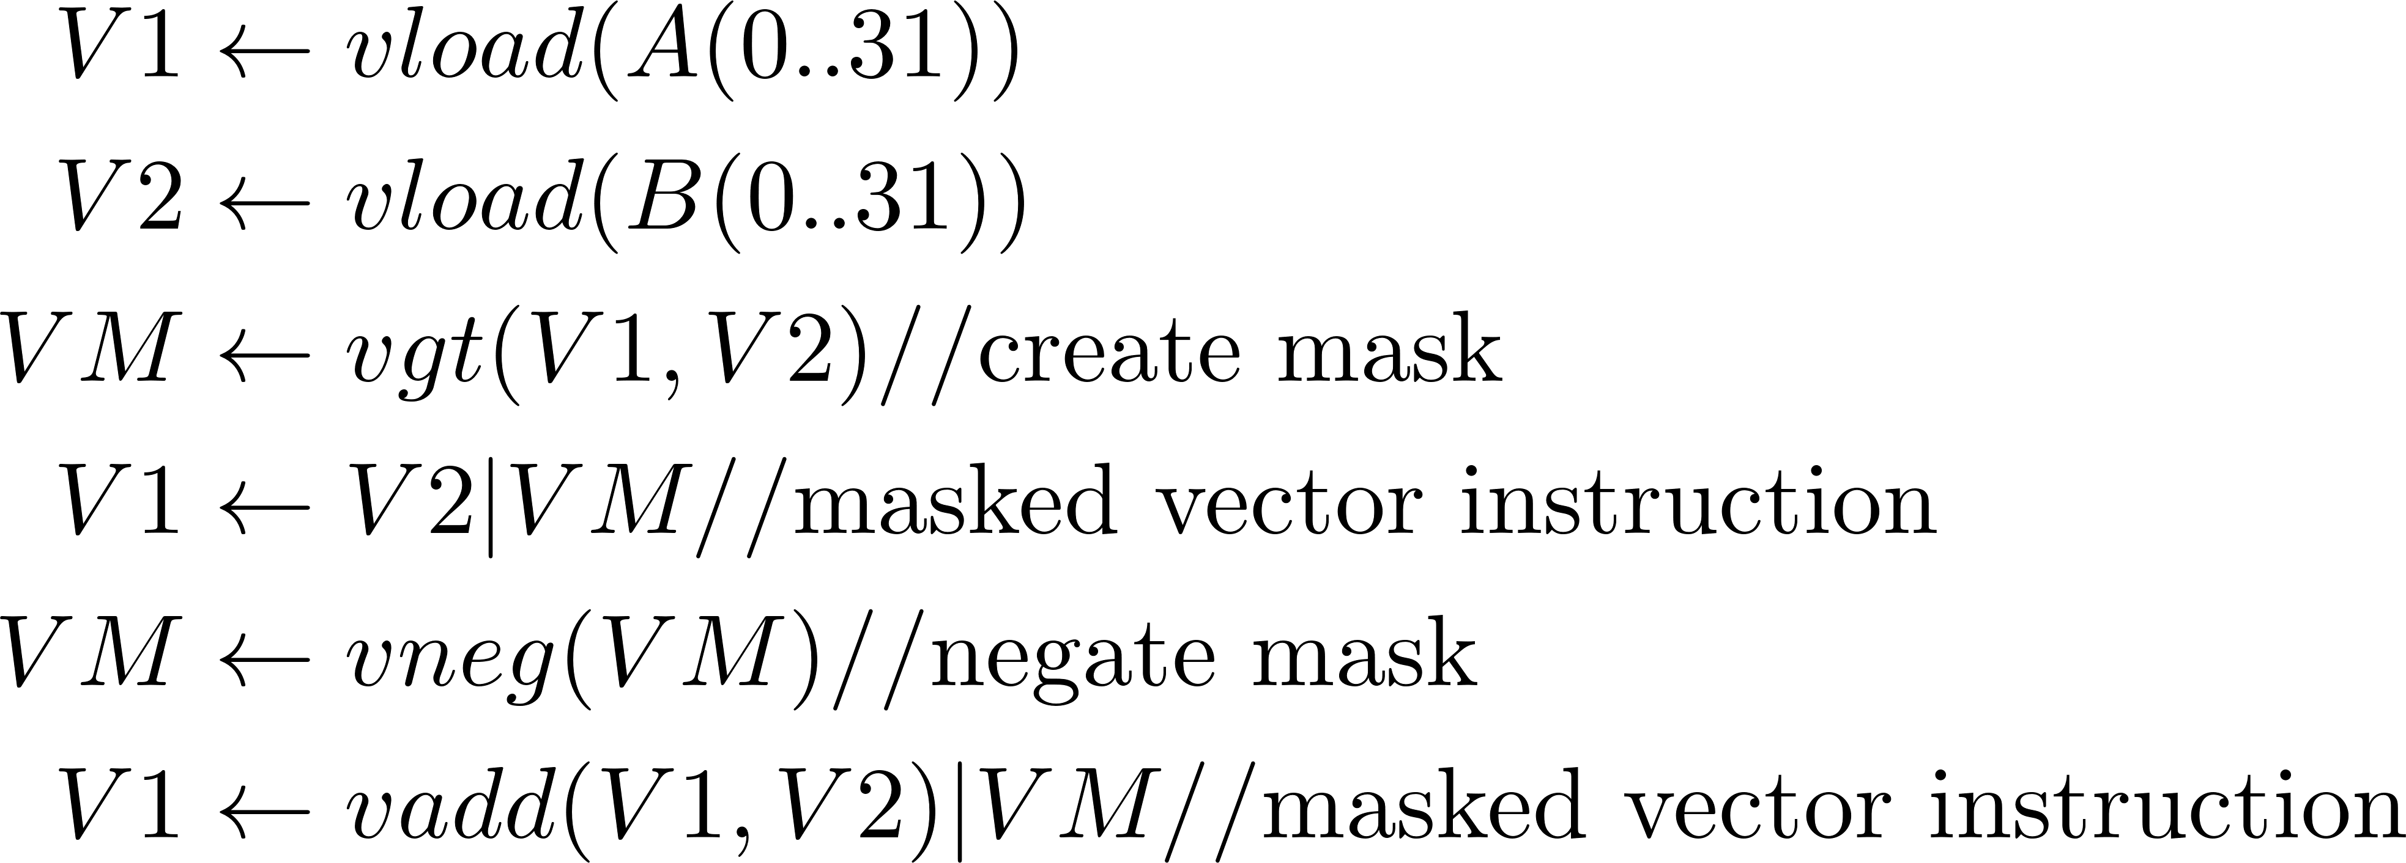
Masked Vector Instructions (II)
Many conditionals can be vectorized using masked vector instructions
for (i=0;i < 32;i++)
{if (A(i) > B(i))
then A(i) = B(i);
else A(i) = A(i)+B(i);
}
Source code
Vectorized assembly code
Control divergence: execute both sides of conditional for all iterations,
using masks turn off irrelevant control flow paths

Slide 23
Load/store patterns
Stride 1
0
Stride 4
1
0
2
5
3
2
4
5
gather
Dense matrix
scatter
Sparse matrix
Stride 1: row-wise access of dense array stored in row-major order
Stride k: column-wise access of dense array stored in row-major order
Scatter/gather: arises in sparse matrix-vector multiply
Vector equivalent of register-indirect addressing mode
Vector specifies indices in larger vector for gather/scatter

Slide 24
Banked memory
32 memory banks
address
0
1
31
Line#
32
33
63
Address
bus
64
65
95
…
…
…..
…
Bank
(5 bits)
Data bus
…
64 bits-
4096 bits
0
32 words (line)
31
Given address, 32 words are read out at a time
Scalar loads: bank bits are used to select relevant word from line
Vector loads: let us look at gather
- determine the lines containing addresses (like radix-sort)
- read lines out sequentially and extract data from relevant addresses
- assemble into sequential buffer and ship back to processor
Vector loads: aligned, stride 1 accesses are best
- only one line needs to be read from memory; no assembly required

Slide 25
Warps: co-scheduling of threads
Warp 0
Warp 1
Warp n
PC
PC
PC
...
...
…
...
0
1
2
31
32
33
63
Threads are statically partitioned by id into warps of 32 threads
Threads in given warp share a PC so they execute instructions in “lock-step”
At each step, thread either executes instruction or is turned off
Recall: predicated execution, vector mask registers (CRAY machines)
Intuition: analog of vector instructions
Effective vector length for instruction is < 32 if some threads are turned off
Known as single-instruction-multiple-thread (SIMT)

Slide 26
Latency tolerance
Processor implements zero-overhead warp scheduling
Any warp whose next instruction has its operands ready is eligible for execution
Eligible warps are selected for execution using scheduling policy
Latency tolerance implemented by switching between warps
Warp that is not ready takes up space but not execution time
…
…
t0 t1 t2 … t31
Warps
Streaming Multiprocessor
Instruction L1
Instruction Fetch/Dispatch
Shared Memory
SP
SP
SP
SP
SFU
SFU
SP
SP
SP
SP
SFU: Special Functional Unit

Slide 27
Warps: liquid vectors
Warp 0
Warp 1
Warp n
...
...
…
...
0
1
2
31
32
33
63
Thread divergence: at conditional, threads in given warp may follow different paths
Correctness: control paths executed serially one at a time by relevant subset of threads
Performance: best if all threads in warp follow same path
Load/store: each thread in warp will usually have different addresses
Correctness: hardware can perform scatter/gather to global memory
Performance: better if there is spatial locality
Performance: “think like a vector”

Slide 28
Avoiding thread divergence
Example with divergence:
    if (threadIdx.x > 2) { }
    This creates two different control flow paths for threads
    Threads 0 and 1 in first warp follow different path than rest of the threads
Example without divergence:
    if (threadIdx.x / WARP_SIZE > 2) { }
    Also creates two different control paths for threads but threads in first two warps follow the same control flow path
    Branch granularity is a whole multiple of warp size; all threads in any given warp follow the same path
    Remember: warps that are not scheduled for execution take up space but not execution time
Think like a vector
Organize work so that work done by all threads in given warp is similar
Notes:
WARP_SIZE

Slide 29
Global memory accesses
Global memory (DRAM) is off-chip
  only one address per memory transaction
  each load transaction brings some number of aligned, contiguous bytes from memory (call them lines)
  hardware automatically combines requests to same line from different threads in warp (coalescing)
  multiple lines processed sequentially
  number of memory transactions = number of unique lines required to satisfy requests of all active threads in warp
  worst case: unaligned scatter/gather to different lines
Optimization:
  spatial locality: memory requests from a warp should be contiguous so they can be coalesced (think like a vector)
  (eg) stride-one access across threads in a warp is good
  (eg) use structs of arrays rather than array of structs
Global
Memory
GPU

Slide 30

Examples of coalesced memory accesses
Warp accesses should have spatial locality
Examples:
i) 32 threads in warp access contiguous aligned 4-byte words (floats)
Generates 4 coalesced accesses of 32 bytes each
ii) 4 coalesced accesses even for more complex patterns such as
Contiguous 4x32 bytes in which some threads access same word
Threads access some permutation of 4x32 byte segment

Slide 31
Coalescing: detail
Global memory requests from warp can be loads, stores or atomics
Two or more threads in warp can specify the same address: what should happen?
Load requests to same address: multicast
Stores to same address: one thread will win
Atomics to same address: serialize

Slide 32
Example: parallel reduction
Given array of values, reduce them to a single value in parallel
Examples
  Sum reduction: sum of all values in the array
  Max reduction: maximum of all values in the array
Typical parallel implementation: divide-and-conquer
GPU implementation
  Avoid thread divergence
  Coalesce global memory accesses

Slide 33
CPU implementation
Array to be
reduced
Colors represent threads
Small number of threads/cores each with its own cache
Divide array in contiguous blocks and give each block to one thread
After each thread is done, it performs an atomic add to a global var
Exploits spatial locality: stride-1 accesses to cache
GPU
- Memory accesses will not be coalesced
- 1024 threads, so atomic adds will become bottleneck

Slide 34


GPU implementation
Thread
0
255
Array size = 512
Step 1
Thread
0
127
Step 2
Large number of threads organized as warps
Assume array size < 2048 (1024 threads*2)
Divide array in half, update left half with 2 element sums
Each thread adds 2 elements
Thread 0 adds elements 0 and 256, thread 2 adds elements 1 and 257, etc.
Recurse
Global memory coalescing
As you recurse, entire warps are shut down so thread divergence only in last active warp

Slide 35
Last steps of recursion
Thread 0
0
1
2
3
…
13
14
15
16
17
18
19
1
0+16
15+31
3
4

Slide 36
#include <stdio.h>
#include <cuda_runtime.h>
__global__ void sum(int *a, int n) {
int tid = threadIdx.x;
int size = n; //keeps track of size of remaining array to be reduced
for (int stride = (n+1)/2; stride != 1; stride = (stride +1)/2)
{__syncthreads();
if (tid < size/2){
a[tid] = a[tid] + a[tid+stride];
size = stride;
printf("\n tid = %d stride = %u a[tid] is %d", tid, stride, a[tid]);
}
}
}
int main (void){
int *devA, *a;
int aSize = 10;
int size = aSize*sizeof(int);
a = (int*)malloc(size);
for (int i = 0; i < aSize; i++) {a[i] = i+1;}
cudaMalloc((void **)&devA, size);
cudaMemcpy(devA, a, size, cudaMemcpyHostToDevice);
sum<<<1,20>>>(devA,aSize);
cudaMemcpy(a, devA, size, cudaMemcpyDeviceToHost);
printf("\n Sum is %i", a[0]+a[1]);
return 0;
}
LeetGPU
Compiling...
Executing...
tid = 0 stride = 5 a[tid] is 7
tid = 1 stride = 5 a[tid] is 9
tid = 2 stride = 5 a[tid] is 11
tid = 3 stride = 5 a[tid] is 13
tid = 4 stride = 5 a[tid] is 15
tid = 0 stride = 3 a[tid] is 20
tid = 1 stride = 3 a[tid] is 24
tid = 0 stride = 2 a[tid] is 31
Sum is 55
Exit status: 0

Slide 37
Organization
Baseline GPU
CUDA core only (no tensor cores)
Identical threads
Global memory
Latency tolerance by context-switching
Warps: “liquid vectors”
Co-scheduling of threads
Thread divergence
Global memory accesses from warps
Optimization: think like a vector
Thread blocks
Shared-memory: software-controlled cache
Programming examples
Architecture Details

Slide 38
Thread blocks
Block 0
Block 1
Block n
...
...
…
...
0
1
2
0
1
2
0
1
2
New picture
Threads can be partitioned into blocks by programmer
Block size under control of programmer
myKernel<<< n, m >>>(arg1, … ); //n blocks of m threads each
2D name space for threads <blockId, threadId>
Maximum of 1024 threads in thread block
As before, threads within each block executed in warps
Shared memory associated with each block
Software-controlled cache for data from global memory
Implemented on-chip so huge bandwidth and low latency
Once thread block is scheduled for execution on hardware, it stays resident until all its threads complete

Slide 39
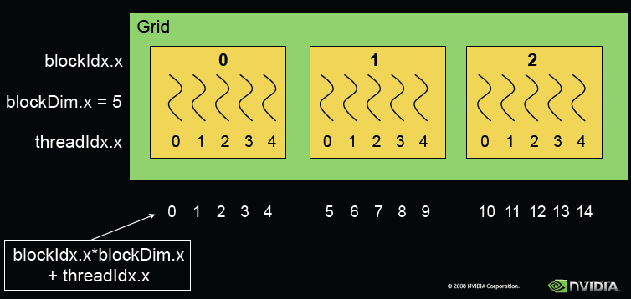
Mapping 2D thread name to 1D name
Common programming pattern: map <blockId, threadId> to a globalID
Use globalID in array programs to assign work

Slide 40
Exposed Memory Hierarchy
Global memory:
  Read/written by host and GPU threads
  Used to transfer data back and forth between host and GPU
  Relatively slow: 400-800 cycles
Constant memory:
  Read/written by host
  Read by GPU threads
  Used to transfer read-only information
Shared memory:
  On-chip memory per thread block
  Like a software managed cache
  Faster than global memory:1-4 cycles
Registers:
  Read/written by thread
  Private to each thread
Block
Block
Shared Memory
Shared Memory
Registers
Registers
Registers
Registers
Thread
Thread
Thread
Thread
Host
Global Memory
Constant Memory
Notes:
Global, constant, and texture memory spaces are persistent across kernels called by the same application.

Slide 41
CUDA Variable Type Qualifiers
Variable declaration | Memory | Scope | Lifetime
__device__ __local__ int LocalVar; | local | thread | thread
__device__ __shared__ int SharedVar; | shared | block | block
__device__ int GlobalVar; | global | grid | application
__device__ __constant__ int ConstantVar; | constant | grid | application
__device__ is optional when used with __local__, __shared__, or __constant__
Automatic variables without any qualifier reside in a register
  Except arrays that reside in local memory
  Thread-local memory and spilled automatic variables is allocated in global memory

Slide 42
Copying data from global to shared memory
__global__ void kernel(float *gArray) {
__shared__ float sArray[256]; //Shared by all threads in block
int i = threadIdx.x; // Get thread index
if (i < 256) {
sArray[i] = gArray[i];//Each thread copies one float from //global to shared memory
}
__syncthreads(); // Synchronize threads
// Now sArray can be used for further computations
}
__synchthreads(): barrier only for threads in thread block

Slide 43
Optimizing memory accesses
Optimizing accesses from a warp to shared and global memory is critical
Different techniques needed
  global: memory coalescing
  shared: avoid bank conflicts
Difference arises from architectural features
  global memory (off-chip DRAM): only one address per memory bus transaction
  shared memory (on-chip): 32 different addresses can be presented in parallel from warp to memory

Slide 44
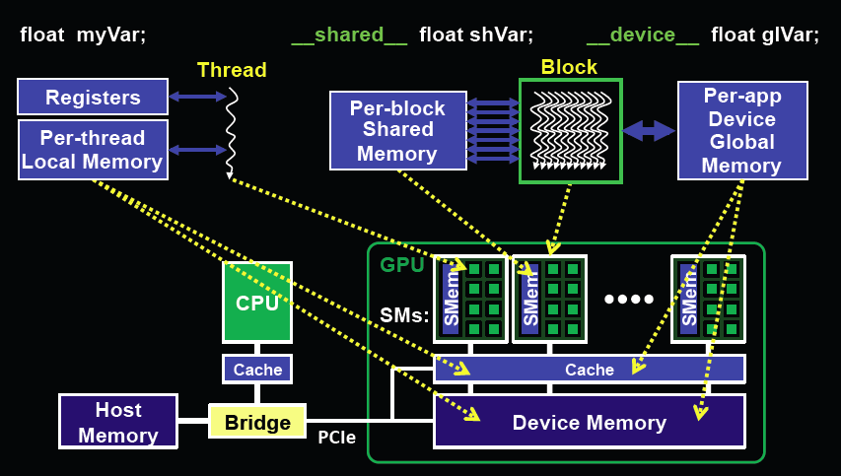
Optimizing memory accesses
Shared memory (on-chip): warp can send 32 distinct addresses in parallel
Global memory (off-chip): one memory address per transaction

Slide 45
Banks and bank conflicts
Shared-memory implemented as banks
  Blackwell: 32 banks
  Each bank can load/store 4 bytes/cycle
  Successive 32-bit words assigned to successive banks
Warp can issue 32 addresses at once to
shared-memory since shared-memory is on-chip
Multiple simultaneous accesses to same bank
result in bank conflict
  Conflicting accesses are serialized
Bank 0
Bank 1
Bank 2
Bank 3
Bank 4
Bank 5
Bank 6
Bank 7
Bank 31

Slide 46
Bank Addressing Examples
No Bank Conflicts
  Linear addressing: stride = 1
No Bank Conflicts
  Random 1:1 Permutation
Thread 0
Bank 0
Thread 0
Bank 0
Thread 1
Bank 1
Thread 1
Bank 1
Thread 2
Bank 2
Thread 2
Bank 2
Thread 3
Bank 3
Thread 3
Bank 3
Thread 4
Bank 4
Thread 4
Bank 4
Thread 5
Bank 5
Thread 5
Bank 5
Thread 6
Bank 6
Thread 6
Bank 6
Thread 7
Bank 7
Thread 7
Bank 7
Thread 31
Bank 31
Thread 31
Bank 31

Slide 47
Bank Addressing Examples
2-way Bank Conflicts
  Linear addressing, stride = 2
8-way Bank Conflicts
  Linear addressing, stride = 8
Thread 0
Bank 0
Thread 0
x8
Bank 0
Thread 1
Bank 1
Thread 1
Bank 1
Thread 2
Bank 2
Thread 2
Bank 2
Thread 3
Bank 3
Thread 3
Thread 4
Bank 4
Thread 4
Bank 5
Thread 5
Bank 7
Bank 6
Thread 6
Bank 8
Bank 7
Thread 7
x8
Bank 9
Thread 16
Thread 17
Thread 18
Thread 19
Bank 31
Thread 31
Bank 31

Slide 48
Summary of bank conflicts
Shared memory is as fast as registers if there are no bank conflicts (although bandwidth is much higher for registers)
The fast case:
  If all threads of warp access different banks, there is no bank conflict
  If all threads of warp access the same address, there is no bank conflict (broadcast)
The slow case:
  Bank Conflict: multiple threads in warp access the same bank
  Must serialize the accesses
  Cost = max # of simultaneous accesses to a single bank

Slide 49
Organization
Baseline GPU
CUDA core only (no tensor cores)
Identical threads
Global memory
Latency tolerance by context-switching
Warps: “liquid vectors”
Co-scheduling of threads
Thread divergence
Global memory accesses from warps
Optimization: think like a vector
Thread blocks
Shared-memory: software-controlled cache
Programming example
Architecture Details

Slide 50
Matrix Multiplication
Simple MMM that illustrates
  Global and shared memory usage
  Block ID, thread ID usage
  2D name space for threads within a block
    (threadIdx.y, threadIdx.x)
    Threads mapped to warps in “row-major order”
Assume square matrix (NxN) for simplicity
Host creates matrices A,B,C in global memory
Device computes C = C+A*B, copying tiles of A and B into shared-memory
Cost of copying data from global memory to shared-memory amortized by reuse
Blocking square MMM by a factor of B reduces memory transfers by factor of B

Slide 51
Tiled Multiply
bx
0
1
2
tx
Each thread block computes one square sub-matrix C_{sub} of size NBxNB
Each thread
  copies one element of A and B
  computes one element of C_{sub}
0
NB-1
1
B
2
m
k
A
C
0
m
NB
0
C_{sub}
1
k
ty
2
NB
N
by
1
2
N
N

Slide 52
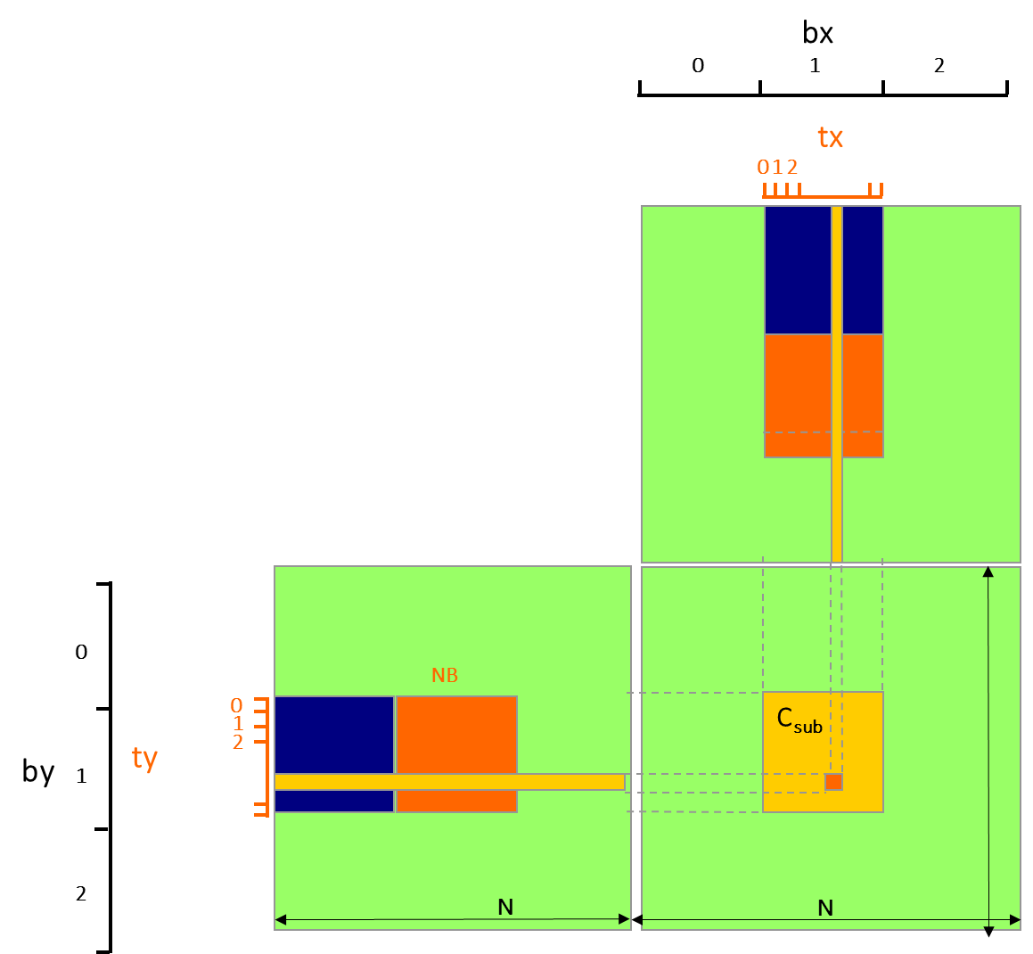
Tiled Matrix Multiplication Kernel
__global__ void MatrixMulKernel(float*A, float* B, float* C, int N)
{
__shared__float As[NB][NB]; //shared by all threads in thread block
__shared__float Bs[NB][NB]; //shared by all threads in thread block
int bx = blockIdx.x; int by = blockIdx.y;
int tx = threadIdx.x; int ty = threadIdx.y;
// Identify the row and column of C element for thread to work on
int Row = by * NB + ty;
int Col = bx * NB + tx;
// Loop over A and B tiles required to compute the C element
float Cvalue = 0;
for (int m = 0; m < N/NB; ++m) { //block number
// Collaborative loading of A and B tiles into shared memory
As[ty][tx] = A[Row*N + (m*NB+ tx)];
Bs[ty][tx] = B[Col + (m*NB + ty)*N];
__syncthreads();
for (int k = 0; k < TILE_WIDTH; ++k)
Cvalue += As[ty][k] * Bs[k][tx];
__synchthreads();
C[Row*Width+Col] = Cvalue; //Update C in global memory
}
}
m

Slide 53
Tiling Size Effects (G80)
Notes:
Mention that we’re limited from large tile sizes by thread context maximums.

Slide 54
G80 Shared Memory and Threading
Each SM in G80 has 16KB shared memory
  SM size is implementation dependent!
  For TILE_WIDTH = 16, each thread block uses 2*256*4B = 2KB of shared memory.
  Can potentially have up to 8 Thread Blocks actively executing
    This allows up to 8*512 = 4,096 pending loads. (2 per thread, 256 threads per block)
  The next TILE_WIDTH 32 would lead to 2*32*32*4B= 8KB shared memory usage per thread block, allowing only up to two thread blocks active at the same time
Using 16x16 tiling, we reduce the accesses to the global memory by a factor of 16
  The 86.4B/s bandwidth can now support (86.4/4)*16 = 347.6 GFLOPS!

Slide 55
Organization
Baseline GPU
CUDA core only (no tensor cores)
Identical threads
Global memory
Latency tolerance by context-switching
Warps: “liquid vectors”
Co-scheduling of threads
Thread divergence
Global memory accesses from warps
Optimization: think like a vector
Thread blocks
Shared-memory: software-controlled cache
Programming example
Architecture Details

Slide 56
Hierarchical Organization of Threads
Grid has global memory.
Blocks in grid are usually independent.
Grid
Block has id, per-block shared memory.
Detail: block id can be 1D,2D,3D.
CUDA: blockIdx.x, blockIdx.y,blockId.z
CUDA: sync_threads for synchronizing all
threads in block.
…..
Block
Block
Block
…..
SIMT: liquid vector
Share a PC
Not in programming model but recently…
Performance: thread/memory divergence
…..
Warp
Warp
Warp
…..
Thread has id, registers
thread-private local memory.
Detail: thread id can be 1D,2D,3D.
CUDA: threadIdx.x,threadIdx.y,threadIdx.z
…..
Thread
Thread
Thread
…..
Notes:
Global, constant, and texture memory spaces are persistent across kernels called by the same application.

Slide 57
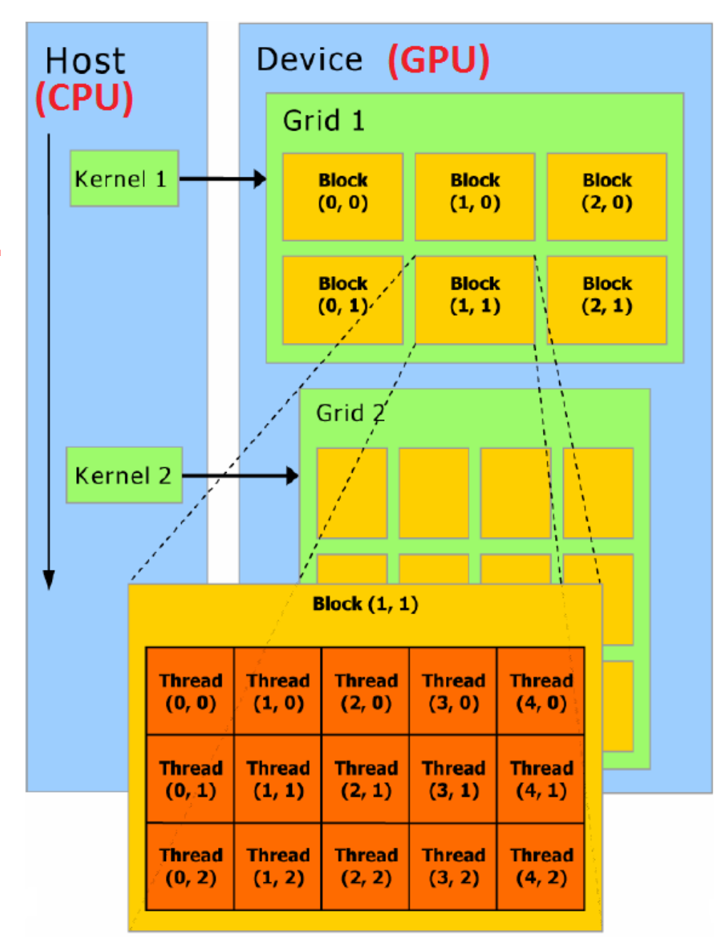
Hierarchical Organization of Threads: Declarations
dim3: built-in 3-integer vector type
default value = 1
dim3 dimGrid(4,2,1)
4 blocks in x direction, 2 in y direction
dim3 dimBlock(16,32,2)
total # of threads = 16x32x2 = 1024 (max)
Kernel call:
dim3 dimBlock(16, 16); // 256 threads per block
dim3 dimGrid(num_blocks_x, num_blocks_y);
// Total number of blocks
<<<n,m>>> gives you n blocks with m threads
Notes:
Global, constant, and texture memory spaces are persistent across kernels called by the same application.

Slide 58
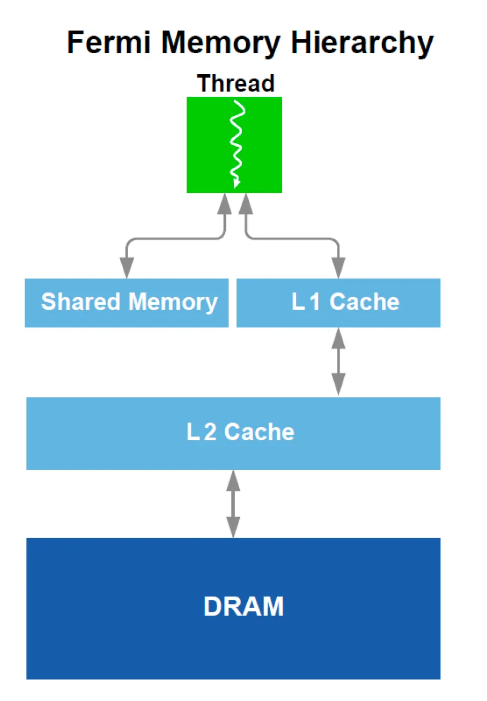
Thread memory hierarchy (Fermi)
Notes:
Mention that we’re limited from large tile sizes by thread context maximums.

Slide 59
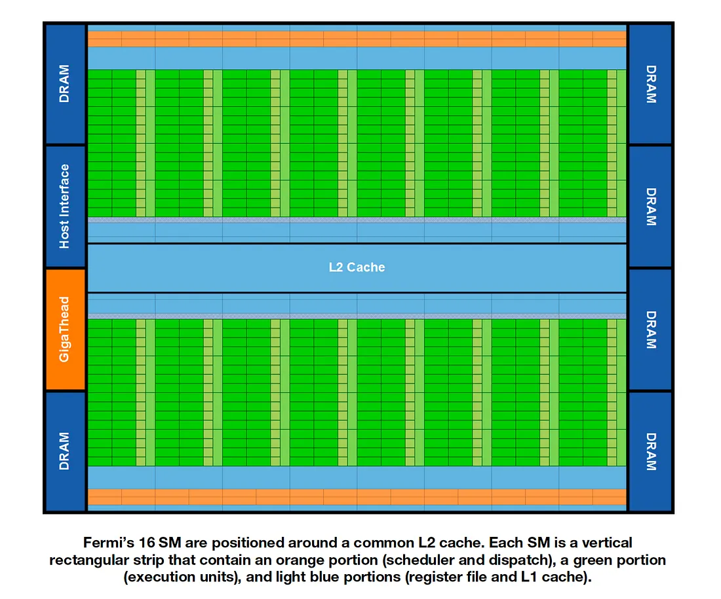
Hardware Details (Fermi)
SM: streaming
multiprocessor
Notes:
Mention that we’re limited from large tile sizes by thread context maximums.

Slide 60
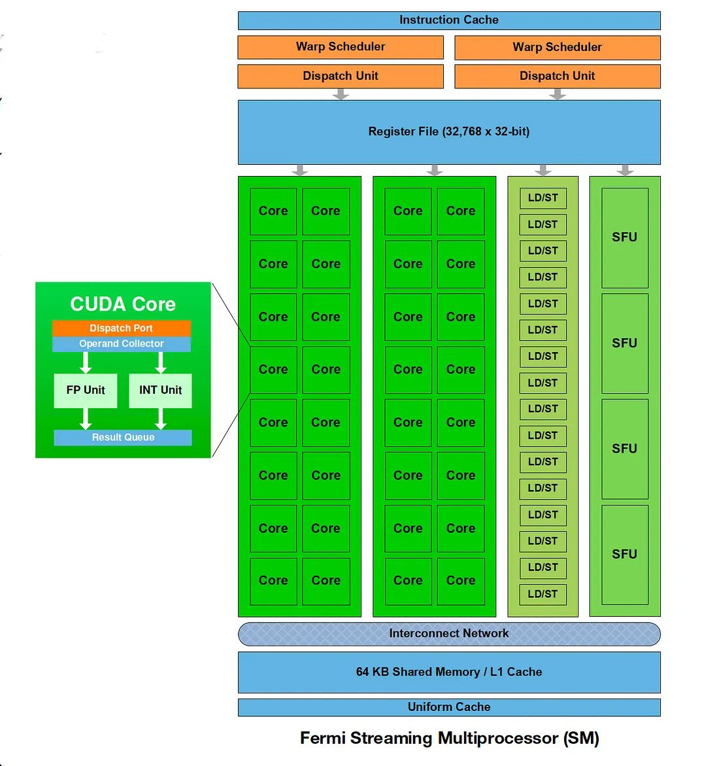
Streaming Multiprocessor (Fermi)
32 cores
Notes:
Mention that we’re limited from large tile sizes by thread context maximums.

Slide 61
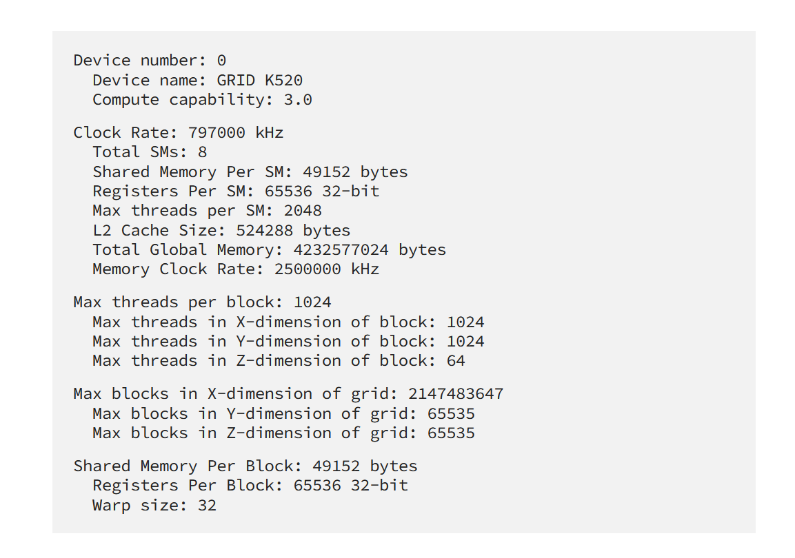
Some Typical Numbers
https://medium.com/@smallfishbigsea/basic-concepts-in-gpu-computing-3388710e9239
Notes:
Mention that we’re limited from large tile sizes by thread context maximums.

Slide 62
Summary of C extensions
Declspecs
  global, device, shared, local, constant
Keywords
  threadIdx, blockIdx
  gridDim, blockDim
Intrinsics
  __syncthreads
Runtime API
  Memory, symbol, execution management
Kernel launch
__device__ float filter[N];
__global__ void convolve (float *image) {
__shared__ float region[M];
...
region[threadIdx] = image[i];
__syncthreads()
...
// Allocate GPU memory
void *myimage = cudaMalloc(bytes)
// 100 blocks, 10 threads per block
convolve<<<100, 10>>> (myimage);

Slide 63
Useful links
Glossary of GPU terms
https://docs.modular.com/glossary/
Excellent tutorial from Modular
https://puzzles.modular.com/introduction.html
In-depth analysis of NVIDIA Blackwell
https://arxiv.org/html/2507.10789v2

Slide 64
Summary
Lots of threads: lightweight startup/shutdown
  Algorithms: should have lots of parallelism
Warp-based execution: SIMT
  Not part of original CUDA programming model but NVIDIA has now given up and exposed warps in the programming model
  Performance: think like a vector
    Map work to threads to avoid thread divergence
    Global memory access coalescing
Latency-tolerance: mask memory latency by switching between warps
Exposed memory hierarchy managed by software
  Programming model: explicit data movement between host and device, and between global and shared-memory in thread blocks
  Performance: avoid bank conflicts

Slide 65
Terminology
Graphics Processing Unit (GPU)
  special processors (accelerators) designed to speed up graphics applications
General-purpose GPUs (GPGPU)
  GPUs that have been massaged so that they can be used for both graphics and general-purpose applications
  we will just refer to them as GPU’s
Compute Unified Device Architecture (CUDA)
  NVIDIA programming model for their GPU’s
Open Computing Language (OpenCL)
  One attempt to define standard for programming heterogeneous processors: multicores + GPUs + other accelerators
Kernel
  a function/loop that is executed on GPU
  a program will usually consist of a sequence of kernels interspersed with code that is executed on the host device (CPU)

Slide 66



Key features of GPUs
Lots of threads
  (eg) NVIDIA Fermi streaming processor has
    512 cores
    24,576 threads
  lightweight threads: managed by hardware, start-up cost is small
SIMT execution
  groups of threads (warp) operate in SIMD
  Siamese twins: 32 threads joined at hip
  threads in warp are co-scheduled for execution
  compare: vector instruction
Latency-tolerant architecture
  processor time-slices between warps to mask memory and synchronization latencies
  similar: time-sharing, dataflow
  contrast: latency-avoidance architectures (caches)

Slide 67
General grid/block specification
__global__ void KernelFunc(...);
dim3 DimGrid(100, 50); // 5000 thread blocks
dim3 DimBlock(4, 8, 8); // 256 threads per block
size_t SharedMemBytes = 64; // 64 bytes of shared memory
KernelFunc<<< DimGrid, DimBlock, SharedMemBytes >>>(...);
Obtaining block ID: blockIdx.x, blockIdx.y
Obtaining thread ID: threadIDx.x, threadIdx.y, threadIdx.z
Obtaining dimensions of grid and block: gridDim, blockDim

Slide 68
#define N 256
__global__ void vecAdd(int *A, int *B, int *C) {
int i = threadIdx.x;
C[i] = A[i] + B[i];
}
int main (int argc, char **argv ) {
int size = N *sizeof( int);
int *a,*b,*c, *devA, *devB, *devC;
cudaMalloc( (void**)&devA, size );
cudaMalloc( (void**)&devB, size );
cudaMalloc( (void**)&devC, size );
a = (int*)malloc(size);
b = (int*)malloc(size);
c = (int*)malloc(size);
cudaMemcpy( devA, a, size, cudaMemcpyHostToDevice);
cudaMemcpy( devB, b, size, cudaMemcpyHostToDevice);
vecAdd<<<1, N>>>(devA, devB, devC);
cudaDeviceSynchronize();
cudaMemcpy( &c, devC ,size, cudaMemcpyDeviceToHost);
cudaFree( devA); cudaFree( devB); cudaFree( devC);
free( a ); free( b ); free( c );
return (0);
}
Executed on device
Executed on host

Slide 69
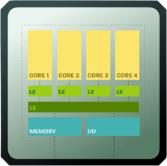
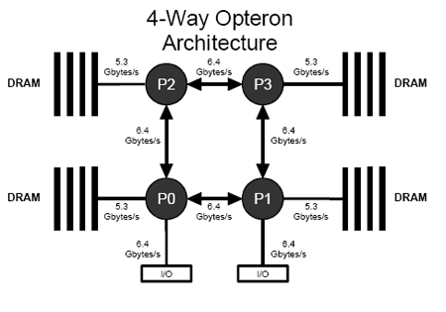
Organization of threads
Even on multicore processors
  threads are organized physically in a hierarchy
  storage is associated with multiple levels of this hierarchy
    (eg) threads in same chip can share L2 or L3 cache
Difference
  data is automatically moved by hardware from one cache to another
  so association between threads and cache does not have to be exposed to programming model
Exposed memory hierarchy of GPU
  data movement must be orchestrated by programmer
  so association between threads and storage is exposed to programming model

Slide 70
Hierarchical Organization of Threads
Hierarchy reflects both SIMT and exposed memory hierarchy
Programming model implication
Grid
Grid has global memory.
Blocks in grid are usually independent.
Block has id, per-block shared memory.
Detail: block id can be 1D,2D,3D.
CUDA: blockIdx.x, blockIdx.y,blockId.z
CUDA: sync_threads for synchronizing all
threads in block.
…..
Block
Block
Block
…..
…..
Warp
Warp
Warp
…..
Not reflected in programming model.
Performance: thread/memory divergence
…..
Thread has id, registers, PC,
thread-private local memory.
Detail: thread id can be 1D,2D,3D.
CUDA: threadIdx.x,threadIdx.y,threadIdx.z
…..
Thread
Thread
Thread
Notes:
Global, constant, and texture memory spaces are persistent across kernels called by the same application.

Slide 71
Co-scheduling of threads
Even on multicore processors
  threads are organized physically in a hierarchy
  storage is associated with multiple levels of this hierarchy
    (eg) threads in same chip can share L2 or L3 cache
Difference
  data is automatically moved by hardware from one cache to another
  so association between threads and cache does not have to be exposed to programming model
Exposed memory hierarchy of GPU
  data movement must be orchestrated by programmer
  so association between threads and storage is exposed to programming model

Slide 72
Allocating memory in
GPU global memory for data
Use CUDA malloc routines:
int size = N *sizeof( int); // space for N integers
int *devA, *devB, *devC; // devA, devB, devC ptrs
cudaMalloc((void**)&devA, size);
cudaMalloc((void**)&devB, size );
cudaMalloc((void**)&devC, size );

Slide 73
2. Creating input data in “host” (CPU)
Use regular C malloc routines or static variables and compute:
int *a, *b, *c;
…
a = (int*)malloc(size);
b = (int*)malloc(size);
c = (int*)malloc(size);

Slide 74
3. Transferring data from host (CPU) to device (GPU)
Use CUDA routine cudaMemcpy
cudaMemcpy( devA, &A, size, cudaMemcpyHostToDevice);
cudaMemcpy( devB, &B, size, cudaMemcpyHostToDevice);
where devA and devB are pointers to destination in device and A and B are pointers to host data

Slide 75
5. Wait for kernel call(s) to complete
cudaDevicesynchronize()
Kernel calls are asynchronous so host must wait till device is done before it can move data from device to host

Slide 76
6. Transferring data from device (GPU) to host (CPU)
Use CUDA routine cudaMemcpy
cudaMemcpy( &C, devC, size, cudaMemcpyDeviceToHost);
where devC is a pointer in device and C is a pointer in host.

Slide 77
7. Free memory in device and host
Use CUDA cudaFree routine:
cudaFree( devA);
cudaFree( devB);
cudaFree( devC);
free( a );
free( b );
free( c );

Slide 78
Blocks and thread IDs
Common programming pattern: map block-local threadIDs to a global thread ID
Useful in many array programs for assigning work: see next slide

Slide 79
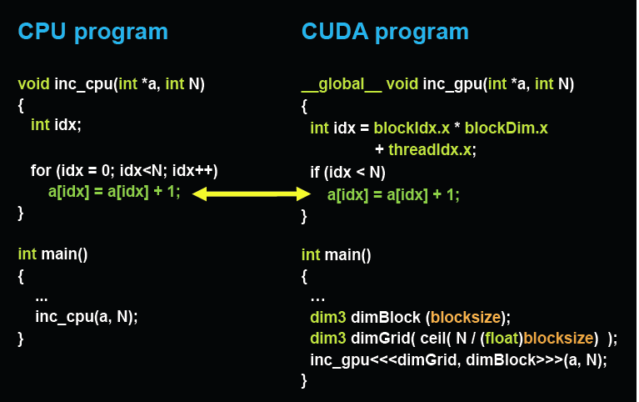
Using blockId and threadId

Slide 80
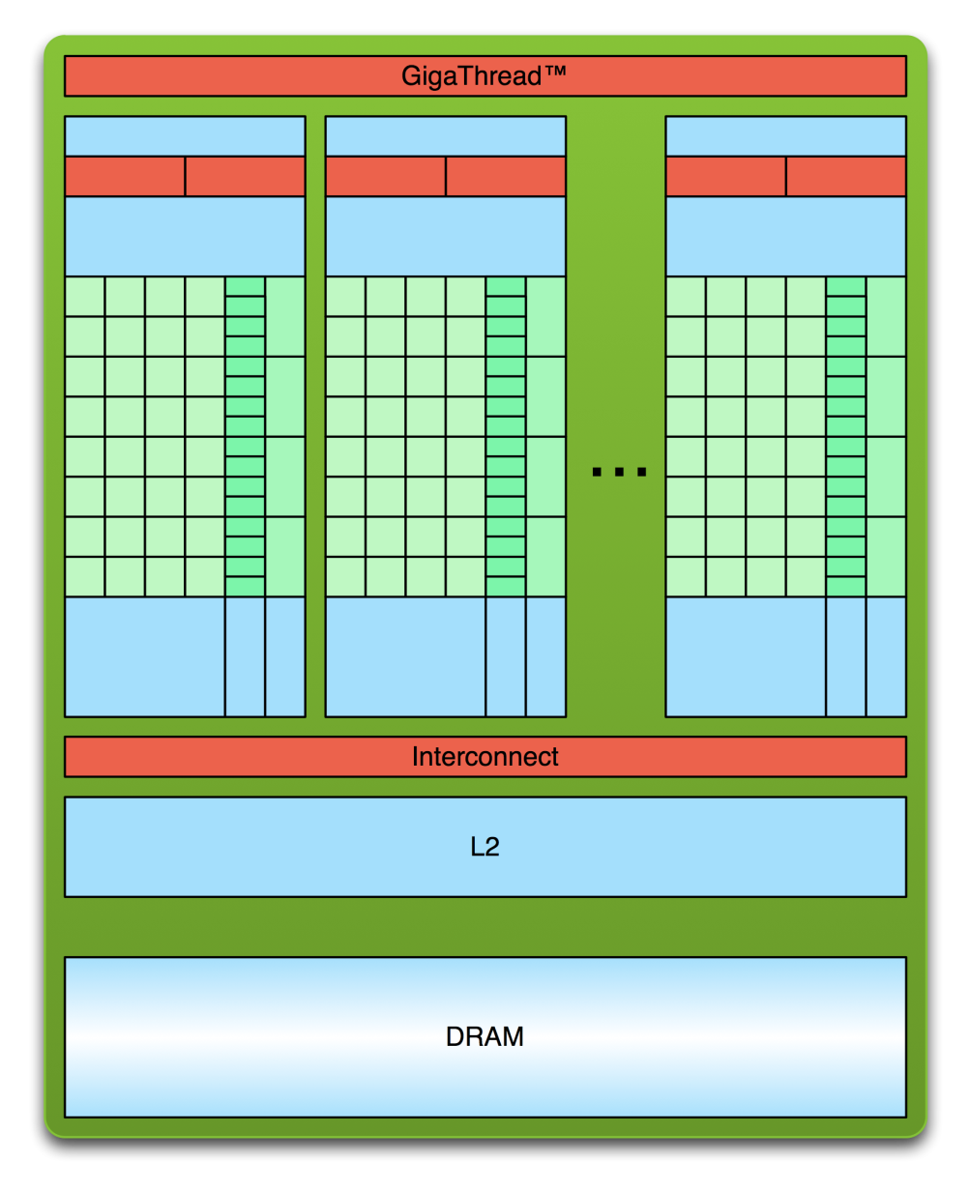
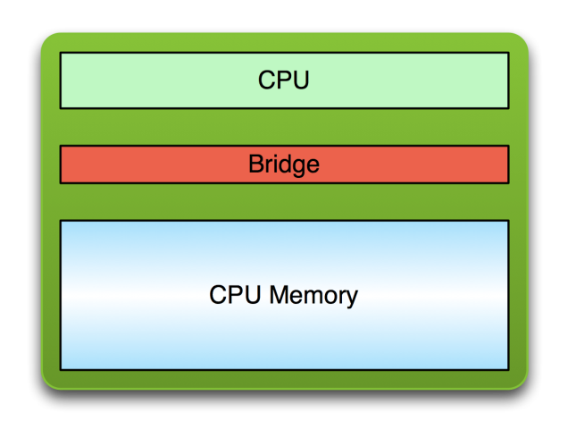
Simple Processing Flow
PCI Bus
Copy input data from CPU memory to GPU global memory (cudaMemcpy)

Slide 81
Simple Processing Flow
PCI Bus
Copy input data from CPU memory to GPU global memory
Load GPU program (kernel) and execute, caching data on chip for performance

Slide 82
Simple Processing Flow
PCI Bus
Copy input data from CPU memory to GPU global memory
Load GPU program and execute,
caching data on chip for performance
Copy results from GPU global memory to CPU memory (cudaMemcpy)

Slide 83
Basic CUDA program structure
int main (int argc, char **argv ) {
1. Allocate memory space in device (GPU) for input and output data (cudaMalloc)
2. Create input data in host (CPU)
3. Copy input data to GPU global memory (cudaMemcpy)
4. Call kernel routine to execute on GPU
5. Transfer output data from GPU global memory to CPU memory (cudaMemcpy)
6. Free memory space in device (GPU) (cudaFree)
7. Free memory space in host (CPU)
return value;
}
3-4-5 could be repeated many times

Slide 84
Calling kernel routine to execute on device (GPU)
CUDA introduces a syntax addition to C:
Triple angle brackets mark call from host code to device code. Contains organization and number of threads in two parameters:
myKernel<<< n, m >>>(arg1, … );
n and m: # of thread blocks, # of threads in a block.
For now, we will set n = 1, so one block, and N threads in this block.
arg1, … , -- arguments to routine myKernel typically pointers to device memory obtained previously from cudaMalloc.
Control returns to host before kernel call has completed

Slide 85
Declaring Kernel Routine
#define N 256
__global__ void vecAdd(int *A, int *B, int *C) { // Kernel definition
int i = threadIdx.x;
C[i] = A[i] + B[i];
}
int main() {
…
vecAdd<<<1, N>>>(devA,devB,devC);
…
}
Who am I?
One block with N threads

Slide 86
Synchronization
void __syncthreads();
Synchronizes all threads in a thread block
Barrier: once all threads in thread block have reached this point, execution resumes normally
Allowed in conditional constructs only if the conditional is uniform across the entire thread block
Notes:
Atomic Operations?

Slide 87
Warps: co-scheduling of threads
Warp 0
Warp 1
Warp n
...
...
…
...
0
1
2
31
32
33
63
Threads are partitioned into warps of 32 threads
Threads in given warp share a PC so they execute instructions in “lock-step”
At each step, thread either executes instruction or is turned off
Intuition: like vector instruction
Known as single-instruction-multiple-thread (SIMT)
“Effective vector length” varies between 1 and 32 depending on how many threads in warp are turned off
Performance: minimize thread divergence by ensuring all threads in given warp take the same path through program
Unlike vector load/store, each thread in warp can issue a different address for load/store
Performance: addresses from threads in given warp should have spatial locality to reduce number of memory transactions per instruction

Slide 88
Vector Reduction with Bank Conflicts
Array elements
0
1
2
3
4
5
6
7
8
9
10
11
1
0+1
2+3
4+5
6+7
8+9
10+11
2
0...3
4..7
8..11
3
0..7
8..15
iterations

Slide 89
Optimizing global memory accesses
Global memory (DRAM) is off-chip
  only one address per memory transaction
  each load transaction brings some number of aligned, contiguous bytes (say 32 Bytes) from memory (call them lines)
  hardware automatically combines requests to same line from different threads in warp (coalescing)
  multiple lines processed sequentially
Optimization:
  try to ensure that memory requests from a warp can be coalesced
  (eg) stride-one access across threads in a warp is good (see picture)
  (eg) use structure of arrays rather than array of structures
Not coalesced
Md
Thread 1
Thread 2
WIDTH
Coalesced
Nd
H
T
D
I
W

Slide 90
Coalescing: detail
Global memory requests from warp can be loads, stores or atomics
Two or more threads in warp can specify the same address: what should happen?
Load requests to same address: multicast
Stores to same address: one thread will win
Atomics to same address: serialize

Slide 91
Shortcomings of the implementation
Assume we have already loaded array into
  __shared__ float partialSum[]
  unsigned int t = threadIdx.x;
  for (unsigned int stride = 1;
  stride < blockDim.x; stride *= 2)
  {
  __syncthreads();
  if (t % (2*stride) == 0)
  partialSum[t] += partialSum[t+stride];
  }
BAD: Divergence due to interleaved branch decisions

Slide 92
Key ideas (hardware)
Device has large number of cores
  Blackwell: ~20K CUDA cores, 576 tensor cores, ..
  Focus on CUDA cores
Host and device do not have a shared address space
  Requires explicit data transfer between host and device (cudaMemcpy)
  Device works only on data in its own address space.
  Newer GPUs have Unified Virtual Addressing (UVA) but we won’t worry about this

Slide 93
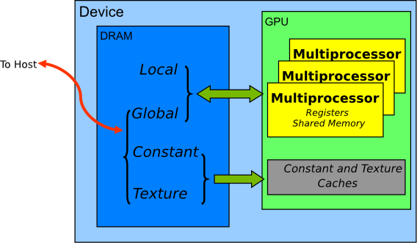
Memory spaces on GPU
https://docs.nvidia.com/cuda/cuda-c-best-practices-guide/index.html

Slide 94
Linear Addressing
s=1
Given
__shared__ float a[256];
float foo = a[baseIndex + s * threadIdx.x];
This is bank-conflict-free only if s is relatively prime to number of banks
  16 on G80, so s must be odd
Thread 0
Bank 0
Thread 1
Bank 1
Thread 2
Bank 2
Thread 3
Bank 3
Thread 4
Bank 4
Thread 5
Bank 5
Thread 6
Bank 6
Thread 7
Bank 7
Thread 15
Bank 15
s=3
Thread 0
Bank 0
Thread 1
Bank 1
Thread 2
Bank 2
Thread 3
Bank 3
Thread 4
Bank 4
Thread 5
Bank 5
Thread 6
Bank 6
Thread 7
Bank 7
Thread 15
Bank 15

Slide 95
A Vector Reduction Example
Assume in-place reduction
  The original vector is in device global memory
  Each iteration brings the partial sum vector closer to the final sum
  The final solution will be in element 0

Slide 96
A simple implementation
  unsigned int t = threadIdx.x;
  for (unsigned int stride = 1; stride < blockDim.x; stride *= 2)
  {
  __syncthreads();
  if (t % (2*stride) == 0)
  partialSum[t] += partialSum[t+stride];
  }

Slide 97
Some Observations
In each iteration, two control flow paths will be sequentially traversed for each warp
  Threads that perform addition and threads that do not
  Threads that do not perform addition may cost extra cycles depending on the implementation of divergence
No more than half of threads will be executing at any time
  All odd index threads are disabled right from the beginning!
  On average, less than ¼ of the threads will be activated for all warps over time
  After the 5th iteration, entire warps in each block will be disabled, poor resource utilization but no divergence
    This can go on for a while, up to 4 more iterations (512/32=16= 2⁴), where each iteration only has one thread activated until all warps retire

Slide 98
A better implementation
  unsigned int t = threadIdx.x;
  for (unsigned int stride = blockDim.x / 2; stride > 1; stride /= 2)
  {
  __syncthreads();
  if (t < stride)
  partialSum[t] += partialSum[t+stride];
  }

Slide 99
Some Observations About the New Implementation
Only the last 5 iterations will have divergence
Entire warps will be shut down as iterations progress
  For 512 threads, 4 iterations to shut down all but one warp
  Better resource utilization

Slide 100
Matrix Multiplication
A simple matrix multiplication example that illustrates the basic features of memory and thread management in CUDA programs
  Local, register and shared memory usage
  Thread ID usage
  Memory data transfer API between host and device
  Assume square matrix for simplicity

Slide 101
Square Matrix Multiplication
P = M * N of size WIDTH x WIDTH
Without tiling:
  One thread calculates one element of P
  M and N are loaded WIDTH times from global memory
N
WIDTH
M
P
WIDTH
WIDTH
WIDTH

Slide 102
Memory Layout of a Matrix in C
M_{0,0}
M_{1,0}
M_{2,0}
M_{3,0}
M_{0,1}
M_{1,1}
M_{2,1}
M_{3,1}
M_{0,2}
M_{1,2}
M_{2,2}
M_{3,2}
M_{0,3}
M_{1,3}
M_{2,3}
M_{3,3}
M
M_{0,0}
M_{1,0}
M_{2,0}
M_{3,0}
M_{0,1}
M_{1,1}
M_{2,1}
M_{3,1}
M_{0,2}
M_{1,2}
M_{2,2}
M_{3,2}
M_{0,3}
M_{1,3}
M_{2,3}
M_{3,3}

Slide 103
Step 1: Matrix Multiplication
A Simple Host Version in C
// Matrix multiplication on the (CPU) host in single precision
void MatrixMulOnHost(float* M, float* N, float* P, int Width)‏
{
for (int i = 0; i < Width; ++i)‏
for (int j = 0; j < Width; ++j) {
float sum = 0;
for (int k = 0; k < Width; ++k) {
float a = M[i * Width + k];
float b = N[k * Width + j];
sum += a * b;
}
P[i * Width + j] = sum;
}
}
N
k
j
WIDTH
M
P
i
WIDTH
k
WIDTH
WIDTH

Slide 104
Step 2: Input Matrix Data Transfer
(Host-side Code)‏
void MatrixMulOnDevice(float* M, float* N, float* P, int Width)‏
{
int size = Width * Width * sizeof(float);
float* Md, Nd, Pd;
…
1. // Allocate and Load M, N to device memory
cudaMalloc(&Md, size);
cudaMemcpy(Md, M, size, cudaMemcpyHostToDevice);
cudaMalloc(&Nd, size);
cudaMemcpy(Nd, N, size, cudaMemcpyHostToDevice);
// Allocate P on the device
cudaMalloc(&Pd, size);

Slide 105
Step 3: Output Matrix Data Transfer
(Host-side Code)‏
2. // Kernel invocation code – to be shown later
…
3. // Read P from the device
cudaMemcpy(P, Pd, size, cudaMemcpyDeviceToHost);
// Free device matrices
cudaFree(Md); cudaFree(Nd); cudaFree (Pd);
}

Slide 106
Step 4: Kernel Function
// Matrix multiplication kernel – per thread code
__global__ void MatrixMulKernel(float* Md, float* Nd, float* Pd, int Width)‏
{
// Pvalue is used to store the element of the matrix
// that is computed by the thread
float Pvalue = 0;

Slide 107
Step 4: Kernel Function (cont.)‏
for (int k = 0; k < Width; ++k)‏ {
float Melement = Md[threadIdx.y*Width+k];
float Nelement = Nd[k*Width+threadIdx.x];
Pvalue += Melement * Nelement;
}
Pd[threadIdx.y*Width+threadIdx.x] = Pvalue;
}
Nd
k
tx
WIDTH
Md
Pd
ty
ty
WIDTH
k
tx
WIDTH
WIDTH

Slide 108
Step 5: Kernel Invocation
(Host-side Code)
// Setup the execution configuration
dim3 dimGrid(1, 1);
dim3 dimBlock(Width, Width);
// Launch the device computation threads!
MatrixMulKernel<<<dimGrid, dimBlock>>>(Md, Nd, Pd, Width);

Slide 109
Only One Thread Block Used
Nd
One Block of threads compute matrix Pd
  Each thread computes one element of Pd
Each thread
  Loads a row of matrix Md
  Loads a column of matrix Nd
  Performs one multiply and one addition for each pair of Md and Nd elements
  Compute to off-chip memory access ratio close to 1:1 (not very high)‏
Size of matrix limited by the number of threads allowed in a thread block
Grid 1
Block 1
Thread
(2, 2)‏
48
WIDTH
Md
Pd

Slide 110
Step 7: Handling Arbitrary Sized Square Matrices
Have each 2D thread block compute a (TILE_WIDTH)² sub-matrix (tile) of the result matrix
  Each has (TILE_WIDTH)² threads
Generate a 2D Grid of (WIDTH/TILE_WIDTH)² blocks
Nd
WIDTH
Md
Pd
You still need to put a loop around the kernel call for cases where WIDTH/TILE_WIDTH is greater than max grid size (64K)!
by
TILE_WIDTH
ty
WIDTH
bx
tx
WIDTH
WIDTH

Slide 111
A Small Example
Block(0,0)
Block(1,0)
P_{0,0}
P_{1,0}
P_{2,0}
P_{3,0}
TILE_WIDTH = 2
P_{0,1}
P_{1,1}
P_{2,1}
P_{3,1}
P_{0,2}
P_{1,2}
P_{2,2}
P_{3,2}
P_{0,3}
P_{1,3}
P_{2,3}
P_{3,3}
Block(0,1)
Block(1,1)

Slide 112
Revised Matrix Multiplication Kernel using Multiple Blocks
__global__ void MatrixMulKernel(float* Md, float* Nd, float* Pd, int Width)
{
// Calculate the row index of the Pd element and M
int Row = blockIdx.y*TILE_WIDTH + threadIdx.y;
// Calculate the column idenx of Pd and N
int Col = blockIdx.x*TILE_WIDTH + threadIdx.x;
float Pvalue = 0;
// each thread computes one element of the block sub-matrix
for (int k = 0; k < Width; ++k)
Pvalue += Md[Row*Width+k] * Nd[k*Width+Col];
Pd[Row*Width+Col] = Pvalue;
}

Slide 113
G80 Block Granularity Considerations
For Matrix Multiplication using multiple blocks, should I use 8X8, 16X16 or 32X32 blocks?
  For 8X8, we have 64 threads per Block. Since each SM can take up to 768 threads, there are 12 Blocks. However, because each SM can only take up to 8 Blocks, only 512 threads will go into each SM!
  For 16X16, we have 256 threads per Block. Since each SM can take up to 768 threads, it can take up to 3 Blocks and achieve full capacity unless other resource considerations overrule.
  For 32X32, we have 1024 threads per Block. Not even one can fit into an SM!

Slide 114
How about performance on G80?
All threads access global memory for their input matrix elements
  Two memory accesses (8 bytes) per floating point multiply-add
  4B/s of memory bandwidth/FLOPS
  4*346.5 = 1386 GB/s required to achieve peak FLOP rating
  86.4 GB/s limits the code at 21.6 GFLOPS
The actual code runs at about 15 GFLOPS
Need to drastically cut down memory accesses to get closer to the peak 346.5 GFLOPS
Grid
Block (0, 0)
Block (1, 0)
Shared Memory
Shared Memory
Registers
Registers
Registers
Registers
Thread (0, 0)
Thread (1, 0)
Thread (0, 0)
Thread (1, 0)
Host
Global Memory
Constant Memory

Slide 115
Matrix Multiplication using
Shared Memory

Slide 116
Thread divergence
What happens if threads within warp want to take different execution paths?
  Common case: conditional branch which evaluates to different values in different threads of warp
Compiler/hardware: execution paths are serialized
  All control paths taken by threads in a warp are executed one at a time until they all converge again
  Threads for which path is irrelevant will be turned off
Guarantees correctness but performance problem

Slide 117
Reduction with Thread Divergence
Thread 0
Thread 2
Thread 4
Thread 6
Thread 8
Thread 10
0
1
2
3
4
5
6
7
8
9
10
11
1
0+1
2+3
4+5
6+7
8+9
10+11
2
0...3
4..7
8..11
3
0..7
8..15
iterations
Array elements

