Slide 1
Distributed-memory Programming using MPI

Slide 2
Overview of lecture
Distributed-memory machines (aka clusters)
Distributed-memory programming with MPI
Message Passing Interface
Key concepts
Process groups and processes
SPMD execution model
Communication
Point-to-point communication
Collective communication
Important MPI API functions

Slide 3
Shared and distributed memory
Shared-memory m/c
All processors/cores share a single address space
Communication: loads and stores to memory
Synchronization: atomic operations
Analogy: bulletin board, GoogleDoc
Distributed-memory m/c (aka cluster)
Each processor has its own address space
Communication: send and receive messages
Synchronization: implemented using communication
Analogy: sending email or letters
Real-life complexity
Modern clusters like Frontera built by interconnecting multicore machines
Shared-memory within each machine
Distributed-memory across machines
More complexity: accelerators in each machine
Shared-memory machine
Distributed-memory machine

Slide 5
Why build clusters?
More compute
Adding more machines to network gives you more computational power
Shared-memory: packaging constraints and difficulty of scaling cache-coherence to large numbers of cores mean that in practice, shared-memory CPUs have <100 cores
More memory
Adding more machines to network gives you more DRAM capacity, so you can solve larger problems
Shared-memory: packaging constraints limit the amount of DRAM on most machines to a few hundred GB
Together, this is called scale-out

Slide 6
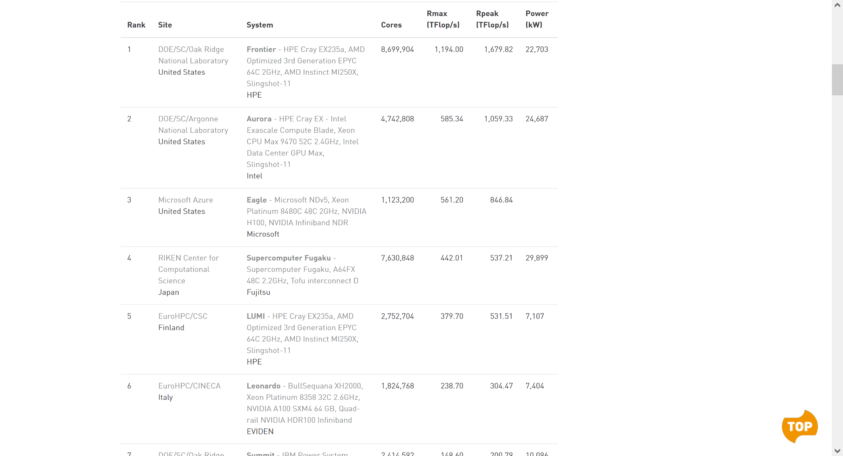
Top 500 List (Nov 2023)

Slide 7
What applications need clusters?
Data sets that are too large for a single machine
Example: Climate Simulations might need 56.26 TB of input data
Computation that takes too long on a single machine
Example: Many of the @Home projects need massive amounts of computational power but not much disk space.
Images from ALCF Incite Program: https://www.alcf.anl.gov/

Slide 8
How Do I Solve Big Problems?
Stage input data on high capacity storage
Distribute data across multiple machines interconnected by a high speed network
Perform computation on the input data while communicating with other processes
Write the output to stable storage for analysis (sometimes by another distributed program!)

Slide 9
Why Can’t I Program This Like Before?
Previously, we were using a shared memory model (pThreads, OpenMP)
All memory is addressable.
There are some programming models that simulate this even with distributed memory (Parallel Global Address Space – PGAS).
Now we are thinking of machines as distinct nodes with their own local memory.
Only local memory is accessible.
Other memory must be retrieved via passing messages.

Slide 10
How Would I Have Done This Before MPI?
Somehow launch a bunch of processes on a bunch of nodes.
Use BSD sockets (or similar) to communicate data.
Perform computation.
Repeat. Repeat. Repeat.
MPI makes all of the above easier.

Slide 11
What Does MPI Do for Me?
mpiexec will launch your processes.
Simple functions like MPI_SEND and MPI_RECV will do data transfers.
Fancy functions like MPI_REDUCE will even do some computation for you.

Slide 12
How Do I Use MPI
2 Steps:
Compile your code with the compiler wrapper for your language.
C – mpicc, C++ - mpic++, Fortran – mpifort
e.g. mpicc –o my_prog my_prog.c
This will automatically link with all of the right libraries. Acts just like your normal compiler (e.g. compiler flags).
Run your code with mpiexec (or something else – mpirun, srun, aprun).
mpiexec –n 4 ./my_prog
This will take care of launching your program multiple times and connecting all of them up.
I’ll refer to this as a job for the rest of these slides.

Slide 13
Key MPI concepts

Slide 14
Process groups
0
1
2
MPI_COMM_WORLD
3
At start, MPI creates a group of n processes (in this case, 4)
Value of n is command-line parameter to program
Useful to give names to process groups and to processes within group
Communicator: name for process group (for now)
Top level communicator is called MPI_COMM_WORLD
Rank: name for a process within a process group
Rank is integer 0,1,2,..
Pair (Communicator, Rank) uniquely identifies a process
Understood by application program and MPI library
No distinction between opaque handles and short names unlike in pThreads
Two MPI calls
MPI_Comm_size(communicator): number of processes in communicator
MPI_Comm_rank(communicator,&var): returns rank in var

Slide 15
SPMD Execution Model
/*The Parallel Hello World Program*/
#include <stdio.h>
#include <mpi.h>
main(int argc, char **argv)
{
int node;
MPI_Init(&argc,&argv);
MPI_Comm_rank(MPI_COMM_WORLD, &node);
printf("Hello World from Node %d\n",node);
MPI_Finalize();
}
Initialize MPI system
What is my rank?
Shutdown MPI system
Single-Program Multiple-Data (SPMD) model of execution
All processes execute program but may branch on rank
Each process has its own copy of all variables: argc, argv, node

Slide 16
Starting MPI Program
2
Machine A
1
Execute on node1:
mpirun –n 4 mpi_hello
mpi_hello (rank 0)
Machine B
mpi_hello (rank 1)
Machine C
Start MPI, create 4 processes all of which execute program in mpi_hello executable.
Command may differ between installations.
mpi_hello (rank 2)
Machine D
mpi_hello (rank 3)

Slide 17
Timing program execution
#include <stdio.h>
#include <mpi.h>
/*MPI_Wtime calls can be placed anywhere between MPI_Init and MPI_Finalize calls.*/
main(int argc, char **argv)
{
int node;
double mytime; /*declare a variable to hold the time returned*/
MPI_Init(&argc,&argv);
mytime = MPI_Wtime();/*get time just before work to be timed*/
MPI_Comm_rank(MPI_COMM_WORLD, &node);
printf("Hello World from Node %d\n",node);
mytime = MPI_Wtime() - mytime;
printf("Timing from node %d is %lf seconds.\n",node,mytime);
MPI_Finalize();
}

Slide 18
Communication
1
0
2
3
Point-to-point communication
One process sends message to another process
Message data type: int, float etc. but also arrays or structs
Collective communication within process group
All processes in process group participate in communication
Example: broadcast value from some process (called root of broadcast) to all other processes in process group
Example: barrier

Slide 19
Point-to-point communication
Blocking send/receive
Both sending and receiving processes must be ready for communication to happen (rendezvous)
Analogy: phone call
Whoever arrives first waits for the other one to arrive
Combines communication and synchronization
Nonblocking send/receive
Like a phone call with voice-mail
Sending process pushes out data to receiving process without worrying about state of receiving process
If message arrives before receiving process is ready to receive, MPI layer buffers message (note: overhead in copying data from buffer to application)
Complication: sender can send multiple messages before receiver is ready
Decouples communication and synchronization
Permits overlap of computation and communication
Asynchronous send/receive
More complex version of nonblocking send/receive to avoid buffering in MPI layer

Slide 22
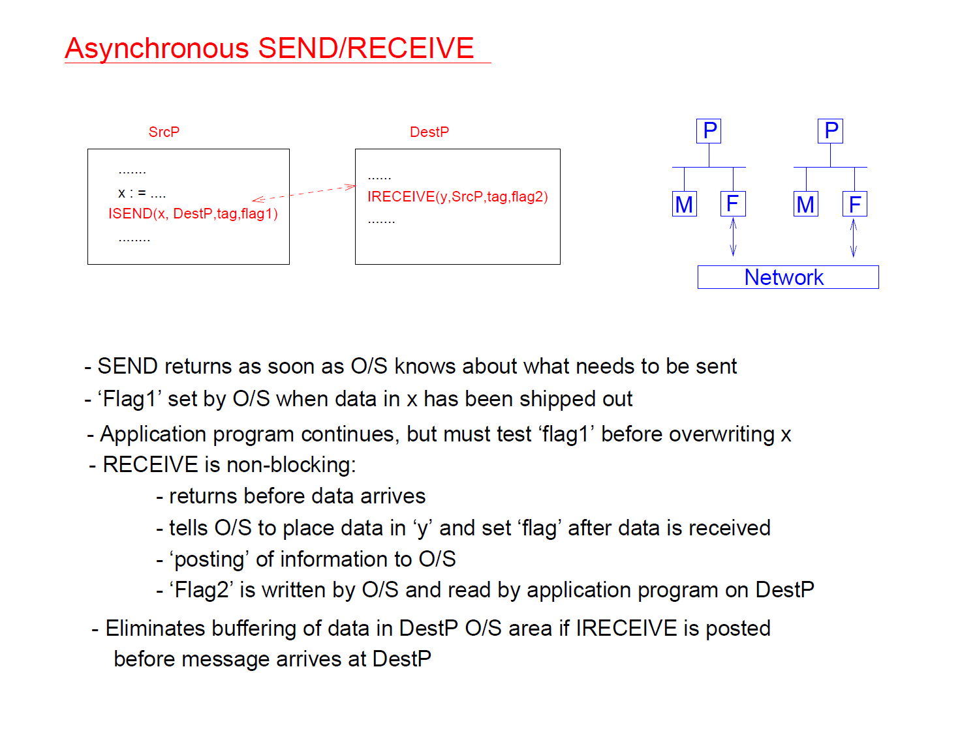

Slide 23
Collective communication (I)
One-to-all broadcast
One process sends data to all other processes in process group
Sending process is called root of broadcast
All-to-one reduction
Each process in process group provides one value
Reduction operation (+,*,…) is applied to these values and result is stored at root of reduction
All-reduce: result of reduction is stored at all processes
All-to-all broadcast
Every process sends a value to every other process
Barrier
All processes in process group must arrive at barrier before any process can continue
Gather
Each process in process group provides one value
Values are collected at root process into an array in rank order
Scatter
Reverse of gather

Slide 24
Collective communication (II)
Parallel Broadcast
Parallel Reduction
Collective communication calls implemented using point-to-point communication
Efficient implementations
Exploit parallelism
Optimize for communication network
Example: broadcast on a ring (reduction is similar)
Simple approach: root process sends message to every other process serially
Better approach: use a “phone-tree” divide-and-conquer approach
Root process (say 0) sends data to process halfway across ring (say 4)
Processes 0 then handles processes 1,2,3 and process 4 handles 5,6,7 in parallel
Use idea recursively

Slide 25
MPI communication calls

Slide 26
Specifying data for communication
Message data to be sent/received is specified by a triple
starting address, count, MPI_Datatype
Count
allows an array of values to be sent in a message
MPI_Datatype: MPI’s names for basic datatypes
MPI_INT, MPI_LONG, MPI_FLOAT, MPI_DOUBLE, MPI_CHAR, …
Communication between heterogeneous machines: MPI provides representation translation if needed

Slide 27
Sending data
Fortran:
MPI_SEND (buf, count, datatype, dest, tag, comm, ierr)
<type> buf(*)integer :: count,
datatype, ierr,dest, tag, comm
C:
int MPI_Send (void* buf, int count, MPI_Datatype datatype,
int dest, int tag, MPI_Comm comm)
MPI_Send performs a blocking send of the specified data (“count” copies of type “datatype,” starting at address “buf”) to the specified destination (rank “dest” within communicator “comm”), with message ID “tag”
Note: In MPI, blocking send returns when it is safe to overwrite the data buffer. This could mean data has been copied into an O/S buffer for transmission or that it has been sent etc. There are other versions that block till message has been received.
Notes:
Sending Data
It is called a “blocking” send because the caller is blocked until the send operation completes. That does not mean the data has arrived at the destination, only that the send buffer can be overwritten.

Slide 28
Receiving data
Fortran:
MPI_RECV (buf, count, datatype, source, tag, comm,
status, ierr)
<type> buf(*)
integer :: count, datatype, ierr, source,
tag, comm, status(MPI_STATUS_SIZE)
C:
int MPI_Recv (void* buf, int count, MPI_Datatype datatype,
int source, int tag, MPI_Comm comm, MPI_Status* status)
MPI_Recv performs a blocking receive of specified data from specified source whose parameters match the send; information about transfer is stored in “status”
Notes:
Receiving Data
MPI_Recv performs a blocking receive of the specified data from the specified source:
The caller is blocked until the message is received.

Slide 29
Send/receive example
int world_rank;
MPI_Comm_rank(MPI_COMM_WORLD, &world_rank);
int world_size;
MPI_Comm_size(MPI_COMM_WORLD, &world_size);
int number;
if (world_rank == 0) {
number = -1;
MPI_Send(&number, 1, MPI_INT, 1, 0, MPI_COMM_WORLD);
}
else if (world_rank == 1) {
MPI_Recv(&number, 1, MPI_INT, 0, 0, MPI_COMM_WORLD,
MPI_STATUS_IGNORE);
printf("Process 1 received number %d from process 0\n", number);
}

Slide 30
Barrier
MPI_Barrier(MPI_Comm comm)
Example:
MPI_Barrier(MPI_COMM_WORLD)

Slide 31
Broadcast
Fortran:
MPI_BCAST (buf, count, datatype, root, comm, ierr)
<type> buf(*)
integer :: count, datatype, root, comm, ierr
C:
int MPI_Bcast (void* buf, int count, MPI_Datatype datatype,
int root, MPI_Comm comm)
All processes in process group must execute Bcast call.
Root process: send data in specified buffer to all other processes in the process group
All other processes: receive that data in the specified locations
In MPI, all collective calls are blocking. All processes in process group have to execute Bcast before any process can move beyond Bcast.
Notes:
Simply put, this will broadcast (hence the name) the data from the current process to all other ones (including itself).

Slide 32
MPI_Bcast example
MPI_COMM_WORLD
#include <mpi.h>
int main(int argc, char *argv[]) {
int nprocs, myrank, msg[] = {0,0,0,0};
MPI_Init(&argc, &argv);
MPI_Comm_size(MPI_COMM_WORLD, &nprocs);
MPI_Comm_rank(MPI_COMM_WORLD, &myrank);
if (myrank == 0)
for (int i=0; i<4; i++) msg[i] = 1;
MPI_Bcast(msg, 4, MPI_INT, 0, MPI_COMM_WORLD);
MPI_Finalize();
}
Rank 0
msg
1
1
1
1
Rank 1
msg
0
0
0
0
msg
1
1
1
1
MPI_BCAST
Rank 2
msg
0
0
0
0
msg
1
1
1
1
Notes:
Broadcast can be used for scalar as well as arrays.

Slide 33
Reduction
Fortran:
MPI_REDUCE (sendbuf, recvbuf, count, datatype, operation,
root, comm, ierr)
<type> sendbuf(*), recvbuf(*)
integer :: count, datatype, operation, root, comm, ierr
C:
int MPI_Reduce (void* sendbuf, void* recvbuf, int count,
MPI_Datatype datatype, MPI_Op op, int root, MPI_Comm comm)
MPI_Reduce performs specified reduction operation “op” on specified data from sendbuf from all processes and places result in process “root” only.
Predefined reduction operations: MPI_MAX, MPI_MIN, MPI_SUM, MPI_LAND, MPI_BAND, MPI_LOR, MPI_BOR, MPI_LXOR, MPI_BXOR, MPI_MAXLOC, MPI_MINLOC
MPI_Allreduce places result in all processes (avoid unless necessary)

Slide 34
MPI_Reduce Example
#include <mpi.h>
int main(int argc, char* argv[]) {
int msg, sum, nprocs, myrank;
MPI_Init(&argc,&argv);
MPI_Comm_size(MPI_COMM_WORLD, &nprocs);
MPI_Comm_rank(MPI_COMM_WORLD, &myrank);
sum = 0;
msg = myrank;
MPI_Reduce(&msg, &sum, 1, MPI_INT, MPI_SUM, 0,
MPI_COMM_WORLD);
MPI_Finalize();
}
MPI_COMM_WORLD
Rank 0
sum
3
0 + 1 + 2
msg
0
Rank 1
msg
1
MPI_REDUCE
Rank 2
msg
2
Notes:
MPI_REDUCE Example
This looks like a correctly executing program! Because there is no IO, we cannot check.

Slide 35
Example: average across processes
int myrank, numprocs;
double mytime,avgtime;
MPI_Comm_rank(MPI_COMM_WORLD, &myrank);
MPI_Comm_size(MPI_COMM_WORLD, &numprocs);
MPI_Barrier(MPI_COMM_WORLD); /*synchronize all processes*/
mytime = MPI_Wtime(); /*get time just before work section */
work();
mytime = MPI_Wtime() - mytime;/*get time just after work*/
/*compute average timing across all processes*/
MPI_Reduce(&mytime, &avgtime, 1, MPI_DOUBLE, MPI_SUM, 0,MPI_COMM_WORLD);
if (myrank == 0) {
avgtime /= numprocs;
printf("Avg: %lf\n", avgtime);
}

Slide 36
Compute pi
#include <stdio.h>
#include <math.h>
#include "mpi.h"
double f(a)
double a;
{
return (4.0 / (1.0 + a*a));
}
int main(argc,argv)
int argc;
char *argv[];
{
int done = 0, n, myid, numprocs, i;
double PI25DT = 3.141592653589793238462643;
double mypi, pi, h, sum, x;
double startwtime, endwtime;
int namelen;
char processor_name[MPI_MAX_PROCESSOR_NAME];
MPI_Init(&argc,&argv);
MPI_Comm_size(MPI_COMM_WORLD,&numprocs);
MPI_Comm_rank(MPI_COMM_WORLD,&myid);
MPI_Get_processor_name(processor_name,&namelen);
fprintf(stderr,"Process# %d with name %s on %d processors\n",
myid, processor_name, numprocs);
………………..see next slide
MPI_Finalize();
return 0;
}

Slide 37
n = 0;
while (!done) //keep performing numerical integration till user says to stop
{
if (myid == 0)
{
scanf("%d",&n);
printf("Number of intervals: %d (0 quits)\n", n);
startwtime = MPI_Wtime();
}
MPI_Bcast(&n, 1, MPI_INT, 0, MPI_COMM_WORLD);
if (n == 0)
done = 1;
else
{
h = 1.0 / (double) n;
sum = 0.0;
for (i = myid + 1; i <= n; i += numprocs)
{
x = h * ((double)i - 0.5);
sum += f(x);
}
mypi = h * sum;
MPI_Reduce(&mypi, &pi, 1, MPI_DOUBLE, MPI_SUM, 0, MPI_COMM_WORLD);
if (myid == 0)
{
printf("pi is approximately %.16f, Relative Error is %16.8e\n",
pi, (double)100 * (pi - PI25DT)/PI25DT);
endwtime = MPI_Wtime();
printf("wall clock time = %f\n",
endwtime-startwtime);
}
}
}

Slide 38
Computing with matrices
1-D partitioning
Each machine gets some number of rows or columns
Assignment of rows/columns to machines
Block
Cyclic
Block-cyclic
P0
P1
Block-row partitioning

Slide 39
Computing with matrices
2-D partitioning
Matrix is blocked like a chessboard
Each machine gets one block
More complex 2-D partitions exist but this gives you the basic idea
P0
P1
P2
P3
Block-block partitioning

Slide 47
MPI Groups, Communicators and Topologies

Slide 48
Groups and communicators
MPI provides routines for
defining new process groups from subsets of existing process groups
creating a new communicator for a new process group
organizing process groups into virtual topologies:
most common use: permits processes within a group to be given “multidimensional ranks” rather than the standard 0...n-1 ranks

Slide 49
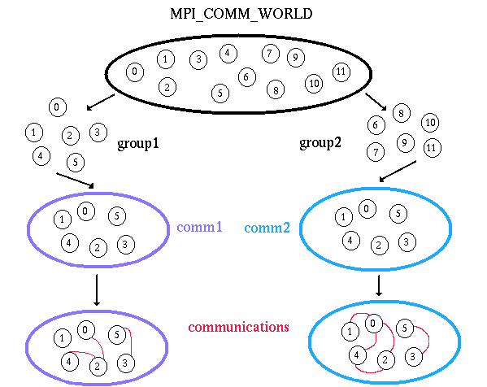
Groups and communicators

Slide 50
Groups and communicators
Group:
ordered set of processes
each process in group has a unique integer id called its rank within that group
process can belong to more than one group
rank is always relative to a group
groups are “opaque objects”
use only MPI provided routines for manipulating groups
Communicators:
all communication must specify a communicator
from the programming viewpoint, groups and communicators are equivalent
communicators are also “opaque objects”
Groups and communicators are dynamic objects and can be created and destroyed during the execution of the program

Slide 51
Typical usage
Extract handle of global group from MPI_COMM_WORLD using MPI_Comm_group
Form new group as a subset of global group using MPI_Group_incl or MPI_Group_excl
(eg) MPI_Group_excl ( MPI_Group group, int n, int *ranks,MPI_Group *newgroup )
% n: number of elements in array ranks
Create new communicator for new group using MPI_Comm_create
Determine new rank in new communicator using MPI_Comm_rank
Conduct communications using any MPI message passing routine
When finished, free up new communicator and group (optional) using MPI_Comm_free and MPI_Group_free

Slide 52
main(int argc, char **argv) {
int me, count, count2;
void *send_buf, *recv_buf, *send_buf2, *recv_buf2;
MPI_Group MPI_GROUP_WORLD, grprem;
MPI_Comm commNew;
static int ranks[] = {0};
MPI_Init(&argc, &argv);
MPI_Comm_group(MPI_COMM_WORLD, &MPI_GROUP_WORLD);
MPI_Comm_rank(MPI_COMM_WORLD, &me);
MPI_Group_excl(MPI_GROUP_WORLD, 1, ranks, &grprem);
MPI_Comm_create(MPI_COMM_WORLD, grprem, &commNew);
if(me != 0){ /* compute on commslave */
MPI_Reduce(send_buf,recv_buff,count, MPI_INT, MPI_SUM, 0, commNew);
}
/* zero falls through immediately to this reduce, others do later... */
MPI_Reduce(send_buf2, recv_buff2, count2, MPI_INT, MPI_SUM, 0, MPI_COMM_WORLD);
MPI_Comm_free(&commNew);
MPI_Group_free(&MPI_GROUP_WORLD);
MPI_Group_free(&grprem);
MPI_Finalize();
}

Slide 53
#include “mpi.h”
#include <stdio.h>
#define NPROCS 8
int main(argc,argv)
int argc;
char *argv[]; {
int rank, new_rank, sendbuf, recvbuf, numtasks, ranks1[4]={0,1,2,3}, ranks2[4]={4,5,6,7};
MPI_Group orig_group, new_group;
MPI_Comm new_comm;
MPI_Init(&argc,&argv);
MPI_Comm_rank(MPI_COMM_WORLD, &rank);
MPI_Comm_size(MPI_COMM_WORLD, &numtasks);
sendbuf = rank;
/* Extract the original group handle */
MPI_Comm_group(MPI_COMM_WORLD, &orig_group);
/* Divide tasks into two distinct groups based upon rank */
if (rank < NPROCS/2) {
MPI_Group_incl(orig_group, NPROCS/2, ranks1, &new_group);
}
else {
MPI_Group_incl(orig_group, NPROCS/2, ranks2, &new_group);
}
/* Create new new communicator and then perform collective communications */
MPI_Comm_create(MPI_COMM_WORLD, new_group, &new_comm);
MPI_Allreduce(&sendbuf, &recvbuf, 1, MPI_INT, MPI_SUM, new_comm);
MPI_Group_rank (new_group, &new_rank);
printf("rank= %d newrank= %d recvbuf= %d\n",rank,new_rank,recvbuf);
MPI_Finalize();
}
Sample output:
rank= 7 newrank= 3 recvbuf= 22
rank= 0 newrank= 0 recvbuf= 6
rank= 1 newrank= 1 recvbuf= 6
rank= 2 newrank= 2 recvbuf= 6
rank= 6 newrank= 2 recvbuf= 22
rank= 3 newrank= 3 recvbuf= 6
rank= 4 newrank= 0 recvbuf= 22
rank= 5 newrank= 1 recvbuf= 22
0 1 2 3 4 5 6 7
new_group
new_group
0 1 2 3
4 5 6 7
0 1 2 3
0 1 2 3
new_comm
new_comm

Slide 54
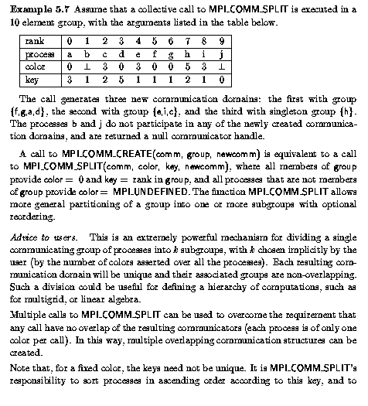
General splitting of communicators
MPI_Comm_split(MPI_Comm comm, int color, int key, MPI_Comm *newcomm)
This is a very powerful routine
for splitting a communicator into
some number of smaller communicators
(depending on color) and assigning ranks
within the new communicators
Will be useful for 2D MVM:
split MPI_COMM_WORLD twice,
once to define row communicators
and once to define column communicators
use row & column indices in Cartesian
topology as colors for calls to Comm_split

Slide 55
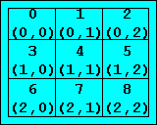
Virtual topologies
Current view of group/communicator: one dimensional numbering
In many algorithms, it is convenient to view the processes as
being arranged in a grid of some number of dimensions
One approach: perform the translation from grid co-ordinates
to 1D numbers yourself
Hard to write the program
Even harder to read the program
MPI solution:
routines for letting you view processes as if they were organized in grid of some dimension
MPI also permits you to organize processes logically into general graphs but we will not worry about this
Key routines:
MPI_Cart_Create: create a grid from an existing 1D communicator
MPI_Cart_get: my grid coordinates
MPI_Cart_rank: grid coordinates → 1D rank
MPI_Cart_shift: offset in some grid dimension → 1D rank of sender and receiver

Slide 56
Routines
int MPI_Cart_create ( MPI_Comm comm_old, int ndims, int *dims, int *periods,
int reorder, MPI_Comm *comm_cart )
comm_old: input communicator
ndims: number of dimensions of grid
dims: integer array of size ndims specifying number of processes in each dimension
periods: logical array of size ndims specifying whether grid is periodic in each dimension
reorder: rankings may be reordered (true) or not (false)

Slide 57
#include <mpi.h>
#include <stdio.h>
#define NP 3
main(int argc, char **argv){
/* Grid setup for 3x3 Grid */
……..
/* MPI Cartesian Grid information */
int ivdim[2] = {NP,NP}, ivper[2]={1,1}; //ivper: periodic in both dimensions
int ivdimx[2], ivperx[2], mygrid[2];
MPI_Init(&argc, &argv);
MPI_Comm_size(MPI_COMM_WORLD, &npes);
MPI_Comm_rank(MPI_COMM_WORLD, &mype);
/* Create Cartesian Grid and extract information */
MPI_Cart_create(MPI_COMM_WORLD,2,ivdim ,ivper, 0,&igcomm);
MPI_Cart_get( igcomm,2,ivdimx,ivperx, mygrid); //mygrid: my grid coordinates
MPI_Cart_shift( igcomm,1,1, &isrca,&idesa); //column offset of +1
myrow=mygrid[0]; mycol=mygrid[1];
printf("A (%d) [%d,%d]: %2d ->%2d\n",mype,myrow,mycol,isrca,idesa);
MPI_Finalize();
}

Slide 58
Output
mype | [myrow,mycol] | isrca | idsta
0 | [0,0] | 2 | 1
1 | [0,1] | 0 | 2
2 | [0,2] | 1 | 0
3 | [1,0] | 5 | 4
4 | [1,1] | 3 | 5
5 | [1,2] | 4 | 3
6 | [2,0] | 8 | 7
7 | [2,1] | 6 | 8
8 | [2,2] | 7 | 6
(eg) for process 0, src = 2 means
it will receive from 2 during the shift
and dst = 1 means it will send to
1 during shift

Slide 59
Summary of lecture
Distributed-memory machines (aka clusters)
Key concepts in distributed-memory programming
Process groups and processes
SPMD execution model
Communication
Point-to-point communication
Collective communication
Important MPI API functions

