Slide 1
Vector processing and Auto-vectorization
Some slides taken from David Padua (UIUC) tutorial on auto-vectorization

Slide 2
Organization
Single Instruction Multiple Data (SIMD) processing
Array processors
Vector processors
Vector ISAs
Vector registers
Vector functional units
Vector length register
Masked vector instructions
Vector memory operations
Banked memory systems
Stride 1, stride k
Scatter-gather
Auto-vectorization: compiler-generated vector code

Slide 3
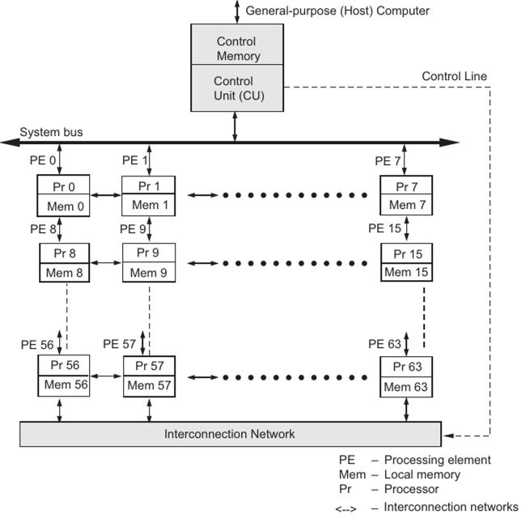
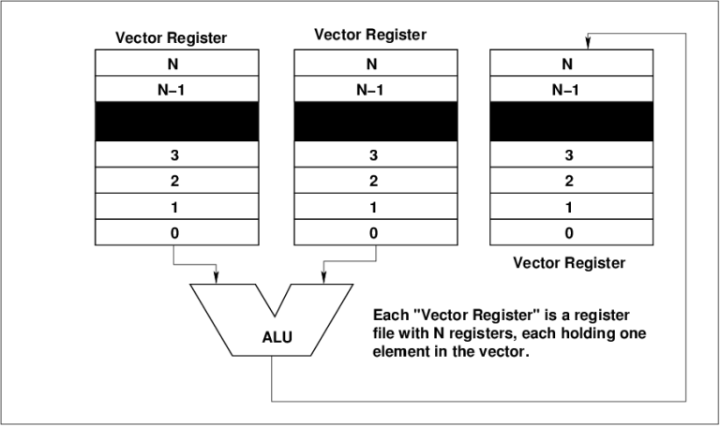
SIMD History
ILLIAC IV (Dan Slotnik, UIUC)
Array processor w/64 processors, one control unit
Connection machine (Danny Hillis, MIT)
Array processor, one-bit processor, hypercube network
Later versions became MIMD processors
1974
1985
1975
~2000
Cray-1 (Seymour Cray)
Vector processor, vector registers (64 elements), heavily pipelined ALUs, load-store instruction set
Short vectors: Intel MMX, SSE, AVX
SSE: 128 bit registers, 2-16 packed elements (depending on data type)
Vector processors (temporal SIMD)
ALUs are heavily pipelined for throughput
ILLIAC IV (spatial SIMD)

Slide 4
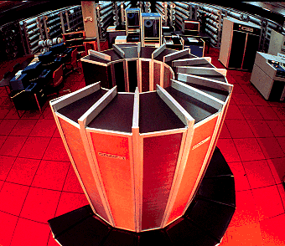
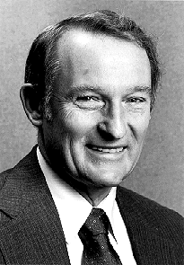
Cray-1 (1975)
Seymour Cray (1925-1996)
64-bit, 160 Mflops, 8MB memory
5.5 tonnes, $10 million
“Anyone can build a fast CPU. The trick is to build a fast system.”

Slide 5
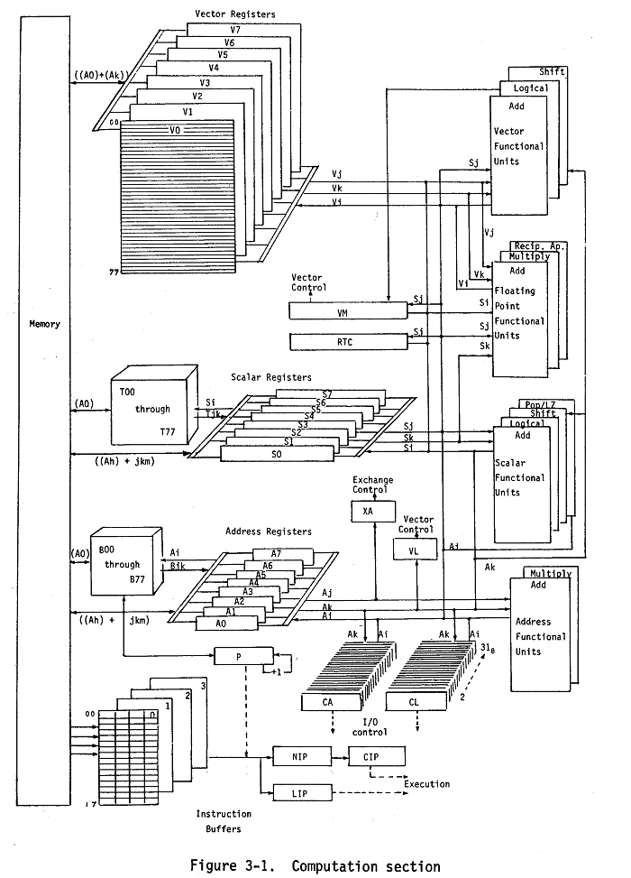
Cray-1 block diagram

Slide 6
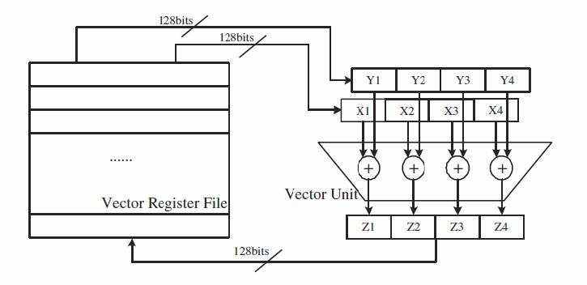
One slide summary of vector computing
//vector length=4
ld r1, addr1
ld r2, addr2
add r3, r1, r2
st r3, addr3
ldv vr1, addr1
ldv vr2, addr2
addv vr3, vr1, vr2
stv vr3, addr3
n
times
n/4
times
for (i=0; i<n; i++)
c[i] = a[i] + b[i];
Scalar code
Source code
Vector code
32 bits
32 bits
Y1
X1
Register File
Scalar Unit
+
Vector Unit
…
Z1
32 bits
Advantages: reduced instruction/data bandwidth, power

Slide 7
Vector ISAs

Slide 8
Vector Arithmetic Instructions
0
2.1
0
4.1
0
6.2
1
3.2
1
1.1
1
4.3
+
→
….
….
….
31
8.8
31
1.4
31
10.2
V2
V1
V3
Let’s keep it simple for now: assume vector registers have 32 elements that can be ints, floats, doubles, booleans,..
Vector instructions: perform operations element-wise on contents of vector registers
Example: addv v3, v2, v1 //add floating-point numbers in vector registers v2 and v1
//element-by-element and store resulting values in v3

Slide 9
Vector Length Register (VLR)
0
2.1
0
4.1
0
6.2
1
3.2
1
1.1
1
4.3
vlr
+
→
2
….
….
….
31
8.8
31
1.4
31
V2
V1
V3
Vector Length Register (vlr) determines how many elements participate in vector operation
Implicit operand in all vector instructions
If vlr =2, instruction addv v3, v2, v1 will update first two elements of v3 with result and leave other elements of v3 unchanged
ISA has instructions for writing vlr

Slide 10
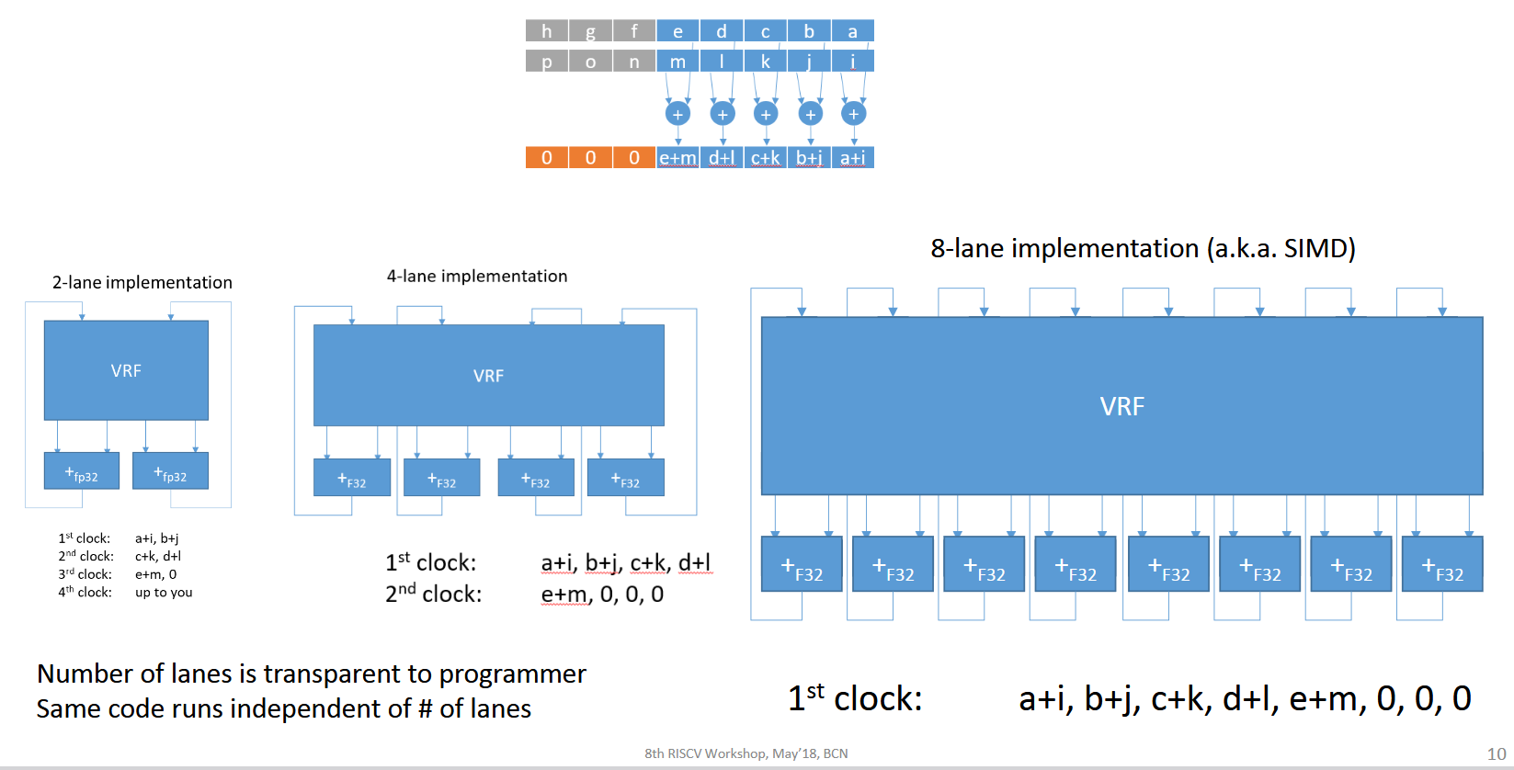
Implementation detail: lanes
8 element vector registers, VLR=5
Asanovic & Espasa, RISC V workshop, 2018

Slide 11
Masked Vector Instructions (I)
0
2.1
0
4.1
0
0
2.1
1
3.2
1
1.1
1
1
4.3
+
→
….
….
….
….
31
8.8
31
1.4
1
31
10.2
V2
V1
VM
(Mask register)
V2
Mask registers: 32-bit registers
Each bit is interpreted as true (1) or false (0) Some architectures have an implicit mask register (like vector condition code)
Masked vector operations: predicated execution
Mask register bits determine which vector elements participate in operation
Example: addv v2, v2, v1 | vM

Slide 12
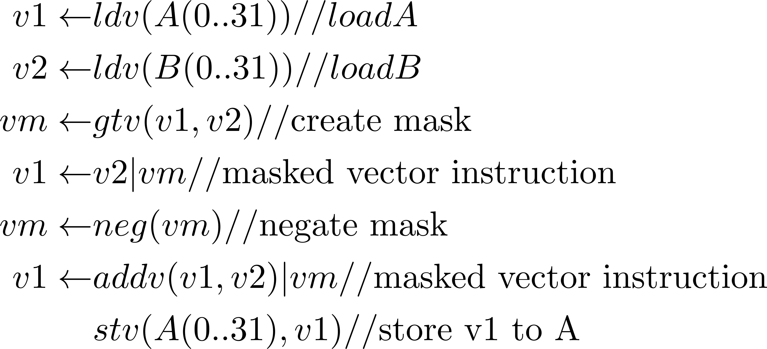
Masked Vector Instructions (II)
Many conditionals can be vectorized using masked vector instructions
for (i=0;i < 32;i++)
{if (A(i) > B(i))
then A(i) = B(i);
else A(i) = A(i)+B(i);
}
Source code
Vectorized assembly code
Control divergence: we are executing both sides of conditional for all iterations, using masks to execute only the relevant control flow path in each iteration

Slide 13
Vector load/store
Stride 1
0
Stride 4
1
0
2
5
3
2
4
Indices
5
gather
Dense matrix
Data
Sparse matrix
scatter
Stride 1: (e.g.) row-wise access of dense array stored in row-major order
Example: ldv v1, r1 //scalar register r1 contains starting address, vlr controls length
Stride k: (e.g.) column-wise access of dense array stored in row-major order
Example: ldsv v1, r1, r2//scalar register r2 is stride
Scatter/gather: arises in sparse matrix-vector multiply
Vector equivalent of register-indirect addressing mode Vector specifies indices in data vector for gather/scatter Some architectures do not support scatter/gather directly in ISA (Cray, Intel SSE)

Slide 14
Banked Interleaved Memory
32 memory banks
address
0
1
31
Line#
32
33
63
Address
bus
64
65
95
…
…
…..
…
Bank
(5 bits)
Data bus
Banked memory: set of memory modules (banks) that can operate independently While one bank is busy, you can access locations in other banks Interleaving: addresses are mapped in round-robin fashion to banks
Vector load of 32 words: Stride 1: fastest since all banks operate in parallel Stride k: slower because some banks may have to supply multiple words Scatter-gather: slowest since it requires shuffling of data

Slide 15
Auto-vectorization

Slide 16
Key ideas
Vector code generation: innermost for-loops → vector code
Single statement that can be implemented using vector load/arithmetic/store
Loop iteration count less than vector register length
Two key enabling transformations
Loop strip-mining: handling arbitrary loop iteration counts
Loop distribution: creating loops with single statements
Loop distribution legality: loop dependence graph
Reduction/scan
Pattern recognition
Compiler directives
Aliasing
Alignment
Dependences

Slide 17
Stripmining
What if vector length is larger than vector register size (vrsize)?
vector
vrsize
vrsize
……..
left-over
piece
/* MATLAB-like notation for vectorized code */
for (k=0; k<n; k+=vrsize){
A(k:k+vrsize-1) = A(k:k+vrsize-1) + 1.0
}
for (i=0; i<n; i++){
A(i) = A(i) + 1.0
}
/* assume n is a multiple of vsize */
for (k=0; k<n; k+=vrsize){
for (i=k; i<k+vrsize; i++){
A(i) = A(i) + 1.0
}
}
compile to one
vector instruction

Slide 18
Loop distribution/fission
Convert an innermost loop with several statements in its body into a sequence of loops, each with one statement in its body. Advantage: it may be possible to vectorize each loop.
for (i=0; i<LEN; i++) {
a[i]= b[i] + c[i];
d[i] = a[i]+ 1.0;
}
for (i=0; i<LEN; i++)
a[i]= b[i] + c[i];
for (i=0; i<LEN; i++)
d[i] = a[i]+ 1.0;
Loop distribution is not always legal.
for (i=0; i<LEN; i++) {
a[i]= d[i-1] + c[i];
d[i] = a[i]+ 1.0;
}
Loop distribution is not legal for this loop.
Intuition: dependences from instance of S1 in iteration i to instance of S2 in iteration i, and instance of S2 in iteration I to instance of S1 in iteration i+1
S1:
S2:
General approach for legality of distribution: build loop dependence graph

Slide 19
Recall: Definition of Dependence
A statement S is said to be data dependent on statement T if
T executes before S in the original sequential/scalar program
S and T access the same data item
At least one of the accesses is a write.

Slide 20
Data Dependence (straight-line code)
Flow dependence (True dependence)
S1
S1: X = A+B
S2: C= X+A
S2
Anti dependence
S1
S1: A = X + B
S2: X= C + D
S2
Output dependence
S1: X = A+B
S2: X= C + D
S1
S2
Notes:
Anti dependence and output dependence are also called named dependences, because by renaming the variable X we could remove the dependence

Slide 21
Dependences in Loops (I)
Dependences in loops are easy to understand if the loops are unrolled. Now the dependences are between statement “instances” or “executions.”
for (i=0; i<n; i++){
a[i] = b[i] + 1;
c[i] = a[i] + 2;
}
S1
S2
Notes:
We compute dependences between the different executions of the statements.

Slide 22
Dependences in Loops (I)
Dependences in loops are easy to understand if loops are unrolled. Now the dependences are between statement “executions”
for (i=0; i<n; i++){
a[i] = b[i] + 1;
c[i] = a[i] + 2;
}
S1
S2
i=0
i=1
i=2
S1: a[0] = b[0] + 1
S2: c[0] = a[0] + 2
S1: a[1] = b[1] + 1
S2: c[1] = a[1] + 2
S1: a[2] = b[2] + 1
S2: c[2] = a[2] + 2
Notes:
We compute dependences between the different executions of the statements.

Slide 23
Dependences in Loops (I)
Dependences in loops are easy to understand if loops are unrolled. Now the dependences are between statement “executions”
for (i=0; i<n; i++){
a[i] = b[i] + 1;
c[i] = a[i] + 2;
}
S1
S2
i=0
i=1
i=2
S1: a[0] = b[0] + 1
S2: c[0] = a[0] + 2
S1: a[1] = b[1] + 1
S2: c[1] = a[1] + 2
S1: a[2] = b[2] + 1
S2: c[2] = a[2] + 2
Notes:
We compute dependences between the different executions of the statements.

Slide 24
Dependences in Loops (I)
Dependences in loops are easy to understand if loops are unrolled. Now the dependences are between statement “executions”
for (i=0; i<n; i++){
a[i] = b[i] + 1;
c[i] = a[i] + 2;
}
S1
S2
iteration:
0
1
2
3
…
instances of S1:
S1
S1
S1
S1
…
instances of S2:
S2
S2
S2
S2
Notes:
We compute dependences between the different executions of the statements.

Slide 25
Dependences in Loops (I)
Dependences in loops are easy to understand if loops are unrolled. Now the dependences are between statement “executions”
for (i=0; i<n; i++){
a[i] = b[i] + 1;
c[i] = a[i] + 2;
}
S1
S2
iteration:
0
1
2
3
…
instances of S1:
S1
S1
S1
S1
…
instances of S2:
S2
S2
S2
S2
Loop independent dependence
Notes:
We compute dependences between the different executions of the statements.

Slide 26
Dependences in Loops (I)
Dependences in loops are easy to understand if loops are unrolled. Now the dependences are between statement “executions”
for (i=0; i<n; i++){
a[i] = b[i] + 1;
c[i] = a[i] + 2;
}
S1
S2
iteration:
0
1
2
3
…
instances of S1:
S1
S1
S1
S1
S1
…
instances of S2:
S2
S2
S2
S2
S2
For the whole loop
Notes:
We compute dependences between the different executions of the statements.

Slide 27
Dependences in Loops (I)
Dependences in loops are easy to understand if loops are unrolled. Now the dependences are between statement “executions”
for (i=0; i<n; i++){
a[i] = b[i] + 1;
c[i] = a[i] + 2;
}
S1
S2
iteration:
0
1
2
3
…
instances of S1:
S1
S1
S1
S1
S1
…
0
instances of S2:
S2
S2
S2
S2
S2
For the whole loop
Notes:
We compute dependences between the different executions of the statements.

Slide 28
Dependences in Loops (I)
Dependences in loops are easy to understand if loops are unrolled. Now the dependences are between statement “executions”
for (i=0; i<n; i++){
a[i] = b[i] + 1;
c[i] = a[i] + 2;
}
S1
S2
distance
iteration:
0
1
2
3
…
instances of S1:
S1
S1
S1
S1
S1
…
0
instances of S2:
S2
S2
S2
S2
S2
For the whole loop
Notes:
We compute dependences between the different executions of the statements.

Slide 29
Dependences in Loops (I)
Dependences in loops are easy to understand if loops are unrolled. Now the dependences are between statement “executions”
for (i=0; i<n; i++){
a[i] = b[i] + 1;
c[i] = a[i] + 2;
}
S1
S2
For the dependences shown here, we assume
that arrays do not overlap in memory (no aliasing).
Compilers must know that there is no aliasing in order to
vectorize.
Notes:
We compute dependences between the different executions of the statements.

Slide 30
Dependences in Loops (II)
for (i=1; i<n; i++){
a[i] = b[i] + 1;
c[i] = a[i-1] + 2;
}
S1
S2
Notes:
We compute dependences between the different executions of the statements.

Slide 31
Dependences in Loops (II)
Dependences in loops are easy to understand if loops are unrolled. Now the dependences are between statement “executions”
for (i=1; i<n; i++){
a[i] = b[i] + 1;
c[i] = a[i-1] + 2;
}
S1
S2
i=1
i=2
i=3
S1: a[1] = b[1] + 1
S2: c[1] = a[0] + 2
S1: a[2] = b[2] + 1
S2: c[2] = a[1] + 2
S1: a[3] = b[3] + 1
S2: c[3] = a[2] + 2
Notes:
We compute dependences between the different executions of the statements.

Slide 32
Dependences in Loops (II)
Dependences in loops are easy to understand if loops are unrolled. Now the dependences are between statement “executions”
for (i=1; i<n; i++){
a[i] = b[i] + 1;
c[i] = a[i-1] + 2;
}
S1
iteration:
1
2
3
4
…
instances of S1:
S1
S1
S1
S1
…
instances of S2:
S2
S2
S2
S2
Notes:
We compute dependences between the different executions of the statements.

Slide 33
Dependences in Loops (II)
Dependences in loops are easy to understand if loops are unrolled. Now the dependences are between statement “executions”
for (i=1; i<n; i++){
a[i] = b[i] + 1;
c[i] = a[i-1] + 2;
}
S1
iteration:
1
2
3
4
…
instances of S1:
S1
S1
S1
S1
…
instances of S2:
S2
S2
S2
S2
Loop carried dependence
Notes:
We compute dependences between the different executions of the statements.

Slide 34
Dependences in Loops (II)
Dependences in loops are easy to understand if loops are unrolled. Now the dependences are between statement “executions”
for (i=1; i<n; i++){
a[i] = b[i] + 1;
c[i] = a[i-1] + 2;
}
S1
iteration:
1
2
3
4
…
instances of S1:
S1
S1
S1
S1
S1
…
instances of S2:
S2
S2
S2
S2
S2
For the whole loop
Notes:
We compute dependences between the different executions of the statements.

Slide 35
Dependences in Loops (II)
Dependences in loops are easy to understand if loops are unrolled. Now the dependences are between statement “executions”
for (i=1; i<n; i++){
a[i] = b[i] + 1;
c[i] = a[i-1] + 2;
}
S1
iteration:
1
2
3
4
…
instances of S1:
S1
S1
S1
S1
S1
…
1
instances of S2:
S2
S2
S2
S2
S2
For the whole loop
Notes:
We compute dependences between the different executions of the statements.

Slide 36
Dependences in Loops (II)
Dependences in loops are easy to understand if loops are unrolled. Now the dependences are between statement “executions”
for (i=1; i<n; i++){
a[i] = b[i] + 1;
c[i] = a[i-1] + 2;
}
S1
distance
iteration:
1
2
3
4
…
instances of S1:
S1
S1
S1
S1
S1
…
1
instances of S2:
S2
S2
S2
S2
S2
For the whole loop
Notes:
We compute dependences between the different executions of the statements.

Slide 37
Dependences in Loops (III)
for (i=0; i<n; i++){
a = b[i] + 1;
c[i] = a + 2;
}
S1
S2

Slide 38
Dependences in Loops (III)
for (i=0; i<n; i++){
a = b[i] + 1;
c[i] = a + 2;
}
S1
S2
i=0
i=1
i=2
S1: a= b[0] + 1
S2: c[0] = a + 2
S1: a = b[1] + 1
S2: c[1] = a + 2
S1: a = b[2] + 1
S2: c[2] = a+ 2

Slide 39
Dependences in Loops (III)
for (i=0; i<n; i++){
a = b[i] + 1;
c[i] = a + 2;
}
S1
S2
i=0
i=1
i=2
S1: a= b[0] + 1
S2: c[0] = a + 2
S1: a = b[1] + 1
S2: c[1] = a + 2
S1: a = b[2] + 1
S2: c[2] = a+ 2
Loop independent dependence
Loop carried dependence

Slide 40
Dependences in Loops (III)
for (i=0; i<n; i++){
a = b[i] + 1;
c[i] = a + 2;
}
S1
S2
iteration:
0
1
2
3
…
instances of S1:
S1
S1
S1
S1
instances of S2:
S2
S2
S2
S2

Slide 41
Dependences in Loops (III)
for (i=0; i<n; i++){
a = b[i] + 1;
c[i] = a + 2;
}
S1
S2
iteration:
0
1
2
3
…
instances of S1:
S1
S1
S1
S1
S1
instances of S2:
S2
S2
S2
S2
S2

Slide 42
Loop dependence graph and vectorization
Main idea: A statement inside a loop which is not in a cycle of the dependence graph can be vectorized.
for (i=0; i<n; i++){
a[i] = b[i] + 1;
}
S1
a[0:n-1] = b[0:n-1] + 1;
S1

Slide 43
Loop dependence graph and vectorization
Main idea: A statement inside a loop which is not in a cycle of the dependence graph can be vectorized.
for (i=1; i<n; i++){
a[i] = b[i] + 1;
c[i] = a[i-1] + 2;
}
a[1:n] = b[1:n] + 1;
c[1:n] = a[0:n-1] + 2;
S1
S2
S1
1
S2

Slide 44
Loop dependence graph and transformations
When cycles are present, vectorization can sometimes be achieved by:
Separating (distributing) statements not in a cycle
Removing dependences
Pattern recognition and algorithm change: reduction, scan, etc.

Slide 45
Partial loop distribution
for (i=1; i<n; i++){
b[i] = b[i] + c[i];
a[i] = a[i-1]*a[i-2]+b[i];
c[i] = a[i] + 1;
}
S1
S2
S3
S1
S2
b[1:n-1] = b[1:n-1] + c[1:n-1];
for (i=1; i<n; i++){
a[i] = a[i-1]*a[i-2]+b[i];
}
c[1:n-1] = a[1:n-1] + 1;
S3
Find strongly connected components in loop dependence graph (Tarjan, Kosaraju)
A statement in component by itself w/o self-loop may be vectorizable

Slide 46
Scalar Expansion
for (int i=0;i<n;i++){
t = a[i];
a[i] = b[i];
b[i] = t;
}
for (int i=0;i<n;i++){
t[i] = a[i];
a[i] = b[i];
b[i] = t[i];
}
S1
S1
S2
S2
S3
S3
S1
S1
S2
S2
S3
S3
Promote scalar to vector to eliminate anti- and output-dependences
More storage, less locality, so need to understand cost and benefit

Slide 47
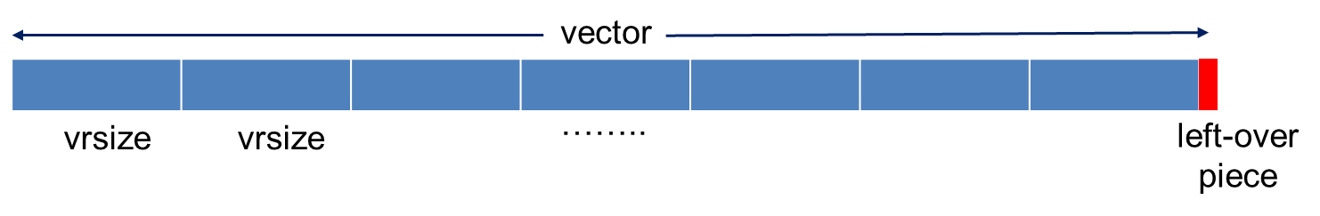
Reductions
Source code
flow,anti,output
sum = 0
for (i=0; i<N; i++)
S: sum = sum+ A(i)
S
Vector code: if + is associative
//use v0 as accumulator for partial sums
ldv v0, A(0..vrsize-1)
ldv v1, A(vrsize..2*vrsize -1)
addv v0, v0, v1
repeat till done
………
+
v0

Slide 48
Compiler directives
Alignment
Aliasing
Intrinsics

Slide 49
Data Alignment (SSE short vectors)
Vector loads/stores load/store 128 consecutive bits to a vector register.
Data addresses need to be 16-byte (128 bits) aligned to be loaded/stored
Intel platforms support aligned and unaligned load/stores
IBM platforms do not support unaligned load/stores
Is &b[0] 16-byte aligned?
void test1(float *a,float *b,float *c)
{
for (int i=0;i<LEN;i++){
a[i] = b[i] + c[i];
}
0
1
2
3
b
vector load loads b[0] … b[3]
Notes:
16-byte aligned means you have a memory address that is a multiple of 16.
The last four fits of the address are 0.

Slide 50
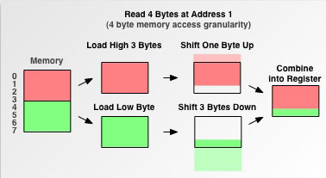
Why data alignment may improve efficiency
Vector load/store from aligned data requires one memory access
Vector load/store from unaligned data requires multiple memory accesses and some shift operations
Reading 4 bytes from address 1
requires two loads

Slide 51
Data Alignment
To know if a pointer is 16-byte aligned, the last digit of the pointer address in hex must be 0.
Note that if &b[0] is 16-byte aligned, and is a single precision array, then &b[4] is also 16-byte aligned
__attribute__ ((aligned(16))) float B[1024];
int main(){
printf("%p, %p\n", &B[0], &B[4]);
}
Output:
0x7fff1e9d8580, 0x7fff1e9d8590

Slide 52
Data Alignment
In many cases, the compiler cannot statically know the alignment of the address in a pointer
The compiler assumes that the base address of the pointer is 16-byte aligned and adds a run-time checks for it
if the runtime check is false, then it uses another code (which may be scalar)

Slide 53
Data Alignment
Manual 16-byte alignment can be achieved by forcing the base address to be a multiple of 16.
__attribute__ ((aligned(16))) float b[N];
float* a = (float*) memalign(16,N*sizeof(float));
When the pointer is passed to a function, the compiler should be aware of where the 16-byte aligned address of the array starts.
void func1(float *a, float *b, float *c) {
__assume_aligned(a, 16);
__assume_aligned(b, 16);
__assume_aligned(c, 16);
for int (i=0; i<LEN; i++) {
a[i] = b[i] + c[i];
}
Notes:
Even if a, b, and c where declared with the align attribute, the compiler may not know.
float *a = (float*) memalign(16, N*sizeof(float));
….
func1(a,b,c)

Slide 54
Data Alignment - Example
float A[N] __attribute__((aligned(16)));
float B[N] __attribute__((aligned(16)));
float C[N] __attribute__((aligned(16)));
void test(){
for (int i = 0; i < N; i++){
C[i] = A[i] + B[i];
}}

Slide 55
Data Alignment - Example
float A[N] __attribute__((aligned(16)));
float B[N] __attribute__((aligned(16)));
float C[N] __attribute__((aligned(16)));
void test1(){
__m128 rA, rB, rC;
for (int i = 0; i < N; i+=4){
rA = _mm_load_ps(&A[i]);
rB = _mm_load_ps(&B[i]);
rC = _mm_add_ps(rA,rB);
_mm_store_ps(&C[i], rC);
}}
void test2(){
__m128 rA, rB, rC;
for (int i = 0; i < N; i+=4){
rA = _mm_loadu_ps(&A[i]);
rB = _mm_loadu_ps(&B[i]);
rC = _mm_add_ps(rA,rB);
_mm_storeu_ps(&C[i], rC);
}}
void test3(){
__m128 rA, rB, rC;
for (int i = 1; i < N-3; i+=4){
rA = _mm_loadu_ps(&A[i]);
rB = _mm_loadu_ps(&B[i]);
rC = _mm_add_ps(rA,rB);
_mm_storeu_ps(&C[i], rC);
}}
Nanosecond per iteration
 | Core 2 Duo | Intel i7 | Power 7
Aligned | 0.577 | 0.580 | 0.156
Aligned (unaligned ld) | 0.689 | 0.581 | 0.241
Unaligned | 2.176 | 0.629 | 0.243

Slide 56
Aliasing
Two solutions to informing compiler there is no aliasing
static and global arrays
__restrict__ attribute
Notes:
Also, too many checks for the runtime to include checks.

Slide 57
Aliasing
Static and Global arrays
__attribute__ ((aligned(16))) float a[LEN];
__attribute__ ((aligned(16))) float b[LEN];
__attribute__ ((aligned(16))) float c[LEN];
void func1(){
for (int i=0; i<LEN; i++)
a[i] = b[i] + c[i];
}
int main() {
…
func1();
}
Notes:
Also, too many checks for the runtime to include checks.

Slide 58
Aliasing
__restrict__ keyword
void func1(float* __restrict__ a,float* __restrict__ b, float* __restrict__ c) {
__assume_aligned(a, 16);
__assume_aligned(b, 16);
__assume_aligned(c, 16);
for int (i=0; i<LEN; i++)
a[i] = b[i] + c[i];
}
int main() {
float* a=(float*) memalign(16,LEN*sizeof(float));
float* b=(float*) memalign(16,LEN*sizeof(float));
float* c=(float*) memalign(16,LEN*sizeof(float));
…
func1(a,b,c);
}
Notes:
Also, too many checks for the runtime to include checks.

Slide 59
Intrinsics (SSE): using vector ops in high-level code
#define n 1024
__attribute__ ((aligned(16))) float a[n], b[n], c[n];
int main() {
for (i = 0; i < n; i++) {
c[i]=a[i]*b[i];
}
}
#include <xmmintrin.h>
#define n 1024
__attribute__((aligned(16))) float a[n], b[n], c[n];
int main() {
__m128 rA, rB, rC;
for (i = 0; i < n; i+=4) {
rA = _mm_load_ps(&a[i]);
rB = _mm_load_ps(&b[i]);
rC= _mm_mul_ps(rA,rB);
_mm_store_ps(&c[i], rC);
}}

Slide 60
Books on auto-vectorization
Kennedy, K. and Allen, J. R. 2002 Optimizing Compilers for Modern Architectures: a Dependence-Based Approach. Morgan Kaufmann Publishers Inc.
U. Banerjee. Dependence Analysis for Supercomputing. Kluwer Academic Publishers, Norwell, Mass., 1988.
60

