Slide 1
Data-parallelism
Data parallel algorithms: Hillis and Steele, CACM 1986
Parallel prefix computation: Ladner and Fischer, JACM 1980
Prefix sums and their applications: Blelloch 1987

Slide 2
Organization
Properties of functions
commutativity
associativity
Data-parallel operations: bulk operations on data
map, reduce, reduce-by-key, filter
scan: exclusive, inclusive, segmented scan
Work-efficient parallel implementations of scan
small number of threads (compared to size of data)
large number of threads
Applications of scan
implementing filter
parallel quick-sort

Slide 3
Properties of functions
f: DxD → D
Function takes two arguments from set D
Returns element of D
Example: +,*: ℜxℜ → ℜ
Not an example: division (why?)
Commutative function: f(x,y) = f(y,x)
Examples: +, * (even in floating-point arithmetic)
Not commutative: matrix multiplication
Associative function: f(x,f(y,z)) = f(f(x,y),z))
Intuitively, we can parenthesize the operands any way
Examples: +, * on real numbers, matrix multiplication
Not associative: floating-point +, *
Reduction operation: both commutative and associative
Example: +, * on real numbers

Slide 4
Map and Reduce
map(f, [x₁,x₂,…,x_{n}]) = [f(x₁),f(x₂),…,f(x_{n})]
Type of f: D→D’
Example: map(isPos?, [3,-2,0]) = [true,false,false]
reduce(f, [x₁,x₂,…,x_{n}]) = f(…f(f(x₁,x₂),x₃)…x_{n})
Type of f: DxD→D
f is associative (e.g. +,*)
Example: reduce(+,[3,-2,0]) = 1

Slide 5
Reduce-by-key and Filter
reduce-by-key
Input: sequence of <key,value> pairs
Output: sequence of <key, value> pairs where value is result of reducing input values with that key
Example: reduce-by-key(+,[<red,-2>,<blue,8>,<red,1>]) = [<red,-1>,<blue,8>]
filter(p, [x₁,x₂,…,x_{n}]) = subsequence of input elements for which p is true
Type of p: D→bool
Example: filter(isPos?, [-1,2,3]) = [2,3]

Slide 6
Scan
scan(f, [x₁,x₂,…,x_{n}]) = [x₁,f(x₁,x₂), f(f(x₁,x₂),x₃),…,]
Type of f: DxD→D, f is associative
Example: scan(*, [-1,2,4]) = [-1,-2,-8]
Intuition: generalized running sum (aka prefix sum)
This is called inclusive scan: i^{th} element of output is “sum” of input elements 1 through i
Exclusive scan: 0th element is identity element for f, and i^{th} element of output is “sum” of input elements 1 through i-1
Example: exclusiveScan(+,[-1,2,4]) = [0,-1,1]

Slide 7
Parallelization
Parallel implementation of reduce & reduce-by-key
Key principle: divide-and-conquer
p threads: divide input array among p threads by blocks
Each thread performs operation on its block and writes partial result to array of size p (for reduce-by-key, size k*p if k is the number of keys)
One thread computes answer from array of partial results
Problem: what if p becomes large? Last step is bottleneck!
Filter is more difficult to parallelize: How big is output array? Where do elements go in output array?
Example: filter(isPos?, [-1,2,3,5]) = [2,3,5]
How big should partial result array be?
Where should second thread start writing its partial result?
Thread 1
Thread 2

Slide 8
Reduction for large p
………..
sum=0
………..
sum=-7
sum=7
sum=-5
………..
-15
8
3
4
-13
8
Input array
As p increases, summing the partial results becomes bottleneck
Solution: tree reduction (parallelize recursively)
binary tree
leaves contain input values
internal nodes contain partial results (sum)
root has result of reduction
level-by-level execution for efficiency
number of threads halved at each level
Sequential cutoff: leaves should be small blocks of values for efficiency
Used on GPUs and distributed-memory machines

Slide 9
Scan
2 | 4 | 6 | 8 | 1 | 5 | 9 | 8
input
fromLeft
fromLeft
0
output
2 | 6 | 12 | 20 | 21 | 26 | 35 | 43
Serial implementation:
//fromLeft is sum of all elements to left of current element
fromLeft = 0
for i = 1 to n
{output[i] = input[i] + fromLeft;
fromLeft = output[i];
}

Slide 10
Parallelization: two threads
2 | 4 | 6 | 8 | 1 | 5 | 9 | 8
Up-sweep
Thread 1
sum
Thread 2
sum (discard)
2 | 4 | 6 | 8 | 1 | 5 | 9 | 8
Down-sweep
Thread 1
Thread 2
fromLeft = 0
fromLeft = 20
2 | 6 | 12 | 20 | 21 | 26 | 35 | 43
Up-sweep: compute sum of each sub-array in parallel
Down-sweep:
Thread 1: fromLeft = 0
Thread 2: fromLeft = sum from Thread 1
Compute prefix-sum for each sub-array in parallel, using fromLeft values for initialization
2x work on two threads, so no speedup but now generalize!

Slide 11
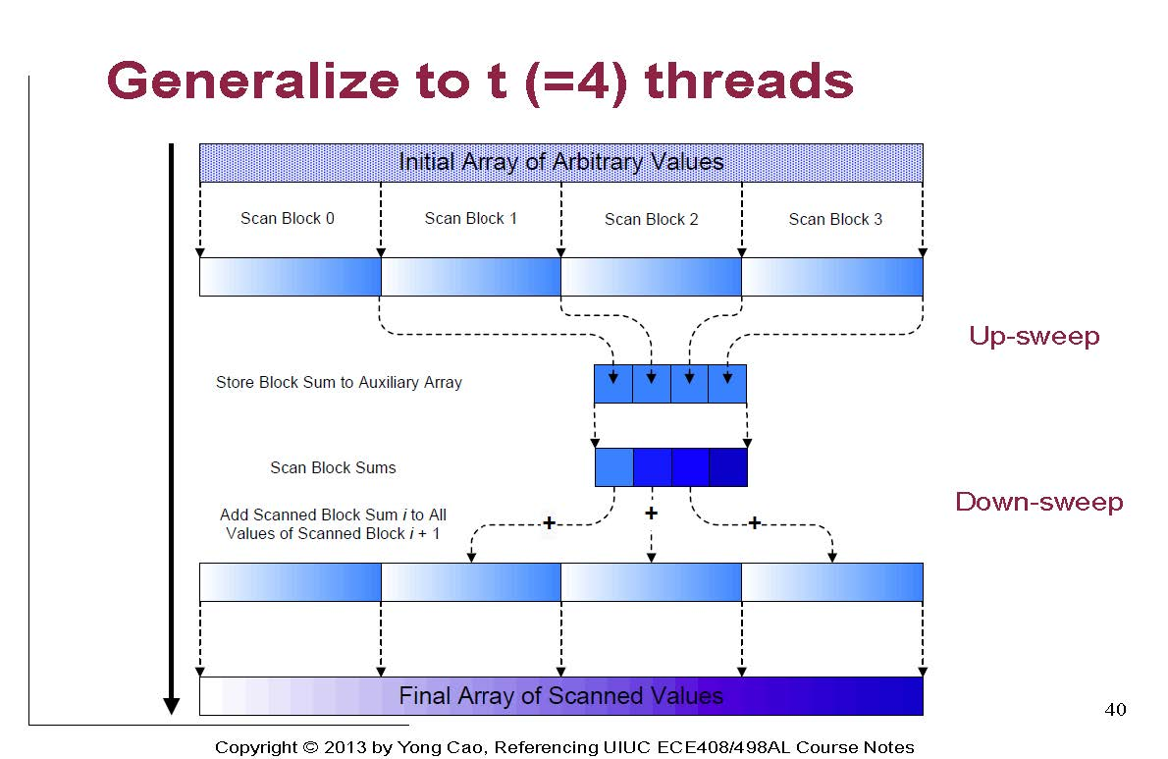
Serial or recursive scan

Slide 12
In the limit
fL=0
fL=1
………..
0
fL=0
-7
fL=-7
1
fL=1
………..
-15
8
3
5
-13
8
Input array
Binary tree with input array elements at leaves
Assume sum has been computed at all nodes like in reduction by up-sweep
Generalize fromLeft to all nodes in tree (call it fL)
fL(leafNode) = fromLeft(leafNode)
fL(internalNode) = fromLeft (L) where L is leftmost leaf that is descendant of internalNode
Recursive (top-down) definition of fL
fL(root) = 0
All other nodes, assuming fL(parent) has been computed
fL(leftChild) = v
fL(rightChild) = v+sum(leftChild)
fL= v
x
v
fL=
v+sum(x)
fL=

Slide 13
Example
sum = 43 fL = 0
sum = 20 fL = 0
sum = 23 fL = 20
sum = 6 fL = 0
sum = 14 fL = 6
sum = 6 fL = 20
sum = 17 fL = 26
sum=2 fL=0 | sum=4 fL=2 | sum=6 fL=6 | sum=8 fL=12 | sum=1 fL=20 | sum=5 fL=21 | sum=9 fL=26 | sum=8 fL=35
2 | 4 | 6 | 8 | 1 | 5 | 9 | 8
input
2 | 6 | 12 | 20 | 21 | 26 | 35 | 43
output

Slide 14

Putting it all together
Binary tree in which input elements are leaves
Each node has two fields
sum: contribution to sum from descendant leaves
fL: fromLeft value of leftmost descendant leaf
Up-sweep:
Bottom-up traversal order
Same as reduce but partial sums are saved in sum
Down-sweep:
Compute fL entries in top-down traversal order
At each leaf, add fL value to input value
O(n) work, O(log(n)) span (assuming p>n/2)
Efficiency: sequential cut-off
Instead of dividing down to 2 elements, stop when input blocks are “small enough”
Generalization: segmented scan

Slide 15
Generalizing prefix-sum
min, max of elements to left of i^{th} element in array
any associative function
Is there some element to left of i^{th} element that satisfies some property?
map followed by OR
Count of elements to left of i^{th} element that satisfy some property

Slide 16
filter
Given predicate p(x) and input sequence (array), produce output array containing subsequence of elements that satisfy the predicate.
Example: filter(isPos?, [-2,3,-1,3,4]) = [3,3,4]
Easy to perform map to find elements that satisfy predicate but how to determine positions in output array in parallel?

Slide 17
Solution
map over input elements to determine output elements
Call the result BV (BV[i] = 1 if input[i] survives, and 0 otherwise)
prefix-sum of BV treating bits in BV as integers 0 and 1 Call the result place
map over input elements to place survivors in output array
if (BV(i)) then output[place[i]] = input[i]
Example: filter even elements from input
input
2 | 4 | 9 | 8 | 1 | 5 | 9 | 6
BV
1 | 1 | 0 | 1 | 0 | 0 | 0 | 1
place
1 | 2 | 2 | 3 | 3 | 3 | 3 | 4
output
2 | 4 | 8 | 6

Slide 18
Application: Parallel Quicksort

Slide 19
Quicksort
Given array of size n
1. Pick pivot element
2. Partition elements:
elements less than pivot (subarray L)
pivot
elements greater than pivot (subarray G)
3. Recursively sort subarrays L and G
Sequential complexity: T(n) = n + 2T(n/2) = O(nlog(n))
If we perform partitioning serially but perform recursive sorting calls in parallel: T(n) = n + T(n/2) = O(n)
Can we do better?
partition
recursive sorts

Slide 20
Parallel partitioning
Need auxiliary array of size n
1. Use filter to copy elements less than pivot to left portion of auxiliary array
2. Place pivot in auxiliary array
3. Use filter to copy elements greater than pivot to right portion of auxiliary array
Both filters can be done simultaneously (exercise for you)
pivot
8 | 1 | 3 | -3 | -6 | 4 | 2
Input
1 | -3 | -6
after filter 1
1 | -3 | -6 | 2 | 8 | 3 | 4
after filter 2

Slide 21
Time
Sequential quicksort: T(n) = n + 2T(n/2) = O(nlog(n))
Parallel quicksort: T(n) = log(n) + T(n/2) = O(log²(n))
filter
two parallel sorts of half the input size

Slide 22
Other applications of scan
Many seemingly sequential problems can be parallelized using scan
Sklansky, Kogge-Stone adders
Lexical analysis (finite-state automata simulation)
Evaluating polynomials
Quicksort, radix sort
Finding depth of all nodes in tree

Slide 23
Final comments on data-parallel constructs (I)
Useful programming patterns
If you can express algorithm using the patterns, parallelism is transparent
Not always easy: think about data-parallel Barnes-Hut
Some kinds of parallelism do not fit into data-parallelism paradigm
Parallelism in data-driven algorithms like delta-stepping SSSP
Amorphous data-parallelism
Task parallelism: the two parallel recursive calls to quicksort

Slide 24
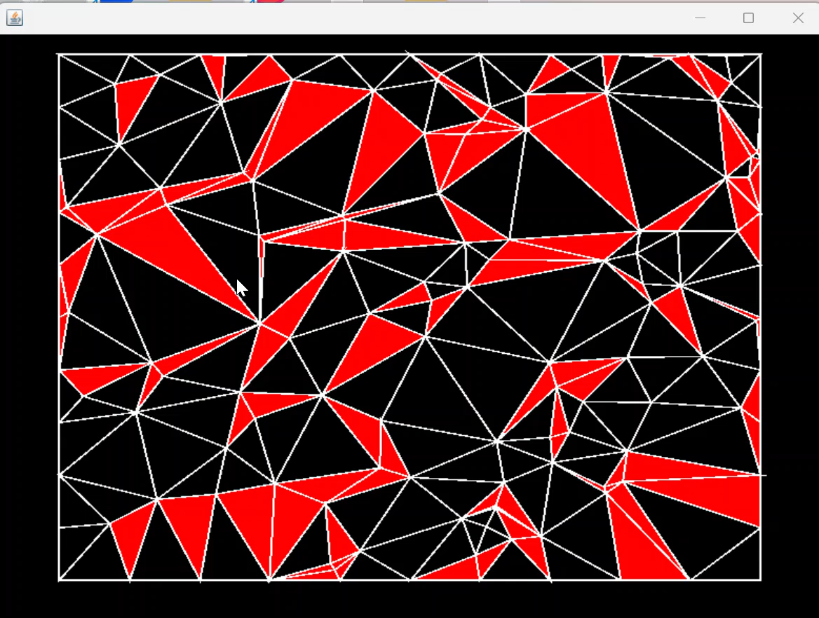
Delaunay mesh refinement: Amorphous Data-parallelism

Slide 25
Final comments (II)
How about as constructs in programming languages?
Need powerful compiler support
Materialization: many intermediate arrays created, which can be avoided in handwritten code or with compiler support
Example: reduce(+, map(f, arrayA)) (like pThreads π example)
Naïve implementation materializes result of map
Optimized hand implementation avoids materialization
Block arrayA between threads Each thread performs map on its block and immediately reduces those values locally Global reduction of per-thread values
Dematerialization required if you program with “higher order functions”
Examples: relational algebra, functional languages (Haskell), MATLAB, APL,..

