Slide 1
Graph Algorithms

Slide 2
Overview
Graphs are very general data structures
  data structures such as dense and sparse matrices, sets, multi-sets, etc. can be viewed as representations of graphs
Algorithms on matrices/sets/etc. can usually be interpreted as graph algorithms
  but it may or may not be useful to do this
  sparse matrix algorithms can be usefully viewed as graph algorithms
Some graph algorithms can be interpreted as matrix algorithms
  but it may or may not be useful to do this
  may be useful if graph structure is fixed

Slide 3
Graph-matrix duality
Graph (V,E) as a matrix
  Choose an ordering of vertices
  Number them sequentially
  Fill in |V|x|V| matrix
  Called “incidence matrix” of graph
Observations:
  Diagonal entries: weights on self-loops
  Symmetric matrix ←→ undirected graph
  Lower triangular matrix ←→ no edges from lower numbered nodes to higher numbered nodes
  Dense matrix ←→ clique (edge between every pair of nodes)
2
a
1
c
b
f
5
4
d
e
3
g
1 2 3 4 5
1
2
3
4
5
0 a f 0 0
0 0 0 c 0
0 0 0 e 0
0 0 0 0 d
0 b 0 0 g

Slide 4
Matrix-vector multiplication
Matrix computation: y = Ax
Graph interpretation:
  Each node i has two values (labels) x(i) and y(i)
  Each node i updates its label y using the x value from each of its neighbors j, scaled by the label on edge (i,j)
Observation:
  Graph perspective shows dense MVM is just a special case of sparse MVM
2
a
1
c
b
f
5
4
d
e
3
g
1 2 3 4 5
1
2
3
4
5
0 a f 0 0
0 0 0 c 0
0 0 0 e 0
0 0 0 0 d
0 b 0 0 g
A

Slide 5
Graph set/multiset duality
Set/multiset is isomorphic to a graph
  labeled nodes
  no edges
“Opposite” of clique
Algorithms on sets/multisets can be viewed as graph algorithms
Usually no particular advantage to doing this but it shows generality of graph algorithms
{a,c,f,e,b}
Set
c
a
f
b
e
Graph

Slide 6
Graph algorithm examples
Problem: single-source shortest-path (SSSP) computation
Formulation:
  Given an undirected graph with positive weights on edges, and a node called the source
  Compute the shortest distance from source to every other node
Variations:
  Negative edge weights but no negative weight cycles
  All-pairs shortest paths
Applications:
  GPS devices for driving directions
  social network analyses: centrality metrics
A
5
5
0
B
2
7
6
E
2
3
C
3
9
1
9
D
4
2
7
1
F
2
8
H
Node A is the source

Slide 7
SSSP Problem
Many algorithms
  Dijkstra (1959)
  Bellman-Ford (1957)
  Chaotic relaxation (1969)
  Delta-stepping (1998)
Common structure:
  Each node has a label d containing shortest known distance to that node from source
    Initialized to 0 for source and infinity for all other nodes
  Key operations:
    relax-edge(u,v):
    if d[v] > d[u]+w(u,v)
    then d[v] ← d[u]+w(u,v)
    relax-node(u):
    relax all edges connected to u
A
5
∞
0
B
2
7
∞
E
C
∞
∞
3
9
1
G
D
2
∞
4
∞
1
F
2
∞
H

Slide 8
SSSP algorithms (I)
Dijkstra’s algorithm (1959):
  priority queue of nodes, ordered by shortest distance known to node
  iterate over nodes in priority order
  node is relaxed just once
  work-efficient: O(|E|*lg(|V|))
Active nodes:
  nodes in PQ: level has been lowered but node has not yet been relaxed
Key data structures:
  Graph
  Work set/multiset: ordered
    Priority queue
Parallelism in algorithm
  Edges connected to node can be relaxed in parallel
  Difficult to relax multiple nodes from priority queue in parallel
  Little parallelism for sparse graphs
A
5
5
0
B
2
7
E
3
6
C
2
1
9
G
D
3
4
2
1
7
F
2
H
<F,7>
<A,0>
<C,2>
<D,3>
<B,5>
<B,5>
<E,6>
Priority queue

Slide 9
SSSP algorithms (II)
Chaotic relaxation (1969):
  use set to track active nodes
  iterate over nodes in any order
  nodes can be relaxed many times
    may do more work than Dijkstra
Key data structures:
  Graph
  Work set/multiset: unordered
Parallelization:
  process multiple nodes from work-set
  need concurrent data structures
    concurrent set/multiset: ensure elements are added and removed from set correctly
    synchronization at graph nodes: ensure simultaneous updates to a node happen correctly (see next slide)
A
0
5
5
0
B
2
7
15
E
C
3
2
1
9
G
D
12
3
4
2
1
F
16
2
H
A
E
B
F
D
C
D
Set

Slide 10
SSSP algorithms (II contd.)
Need for synchronization at graph nodes
  Suppose nodes B and C are relaxed simultaneously
  Both relaxations may update value at D
    Value at D is infinity
    Relax-C operation reads this value and wants to update it to 3.
    At the same time, Relax-D operation reads D’s value and wants to update it to 12
    If the two updates are not sequenced properly, final value at D after both relaxations may be 12, which is incorrect
  One solution: ensure that the “read-modify-write” in edge relaxation is “atomic” – no other thread can read or write that location while the read-modify-write is happening
Also need synchronization at node being relaxed to ensure its value is not changed by some other core when the node relaxation is going on
A
0
5
5
0
B
2
7
E
∞
C
3
9
2
1
∞
G
D
∞
4
2
1
∞
F
2
∞
H
B
C
Set

Slide 11
SSSP algorithms (III)
A
Bellman-Ford (1957):
  Iterate over all edges of graph in any order, relaxing each edge
  Do this |V| times
  O(|E|*|V|)
Parallelization
  Iterate over set of edges
  Inspector-executor: use graph matching to generate a conflict-free schedule of edge relaxations after input graph is given
  Edges in a matching do not have nodes in common so they can be relaxed without synchronization
  Barrier synchronization between successive stages in schedule
5
0
B
2
7
E
C
3
1
9
G
D
4
2
1
F
2
H
Conflict-free schedule
1. {(A,B),(C,D),(E,H)},
2. {(A,C),(B,D),(E,G),(F,H)},
3. {(D,E),(G,H)}
4. {(D,F)}

Slide 12
Matching
Given a graph G = (V,E), a matching is a subset of edges such that no edges in the subset have a node in common
  (eg) {(A,B),(C,D),(E,H)}
  Not a matching: {(A,B),(A,C)}
Maximal matching: a matching to which no new edge can be added without destroying matching property
  (eg) {(A,B),(C,D),(E,H)}
  (eg) {(A,C),(B,D)(E,G),(F,H)}
  Can be computed in O(|E|) time using a simple greedy algorithm
Maximum matching: matching that contains the largest number of edges
  (eg) {(A,C),(B,D)(E,G),(F,H)}
  Can be computed in time O(sqrt(|V|)|E|)
A
5
0
B
2
7
E
C
3
9
1
G
D
4
2
1
F
2
H
Conflict-free schedule
1. {(A,B),(C,D),(E,H)},
2. {(A,C),(B,D),(E,G),(F,H)},
3. {(D,E),(G,H)}
4. {(D,F)}

Slide 13
SSSP algorithms (IV)
Delta-stepping (1998)
  variation of chaotic relaxation
  active nodes currently closer to source are more likely to be chosen for processing from set
Work-set/multiset:
  Parameter: Δ
  Sequence of sets
  Nodes whose current distance is between nΔ and (n+1)Δ are put in the n^{th} set
  Nodes in each set are processed in parallel
  Nodes in set n are completed before processing of nodes in set (n+1) are started
Δ = 1: Dijkstra
Δ = : Chaotic relaxation
Picking an optimal Δ :
  depends on graph and machine
  Do experimentally
A
0
5
B
2
7
E
C
3
1
9
G
D
4
2
1
∞
F
2
H
Δ
Δ
Δ

Slide 14
Abstraction of graph algorithms
Operator formulation
  Active elements: nodes or edges where there is work to be done
  Operator: computation at active element
    Activity: application of operator to active element
    Neighborhood: graph elements read or written by activity
  Ordering: order in which active elements must appear to have been processed
    Unordered algorithms: any order is fine (eg. chaotic relaxation)
    Ordered algorithms: algorithm-specific order (eg. Dijkstra)
: active node
: neighborhood

Slide 15
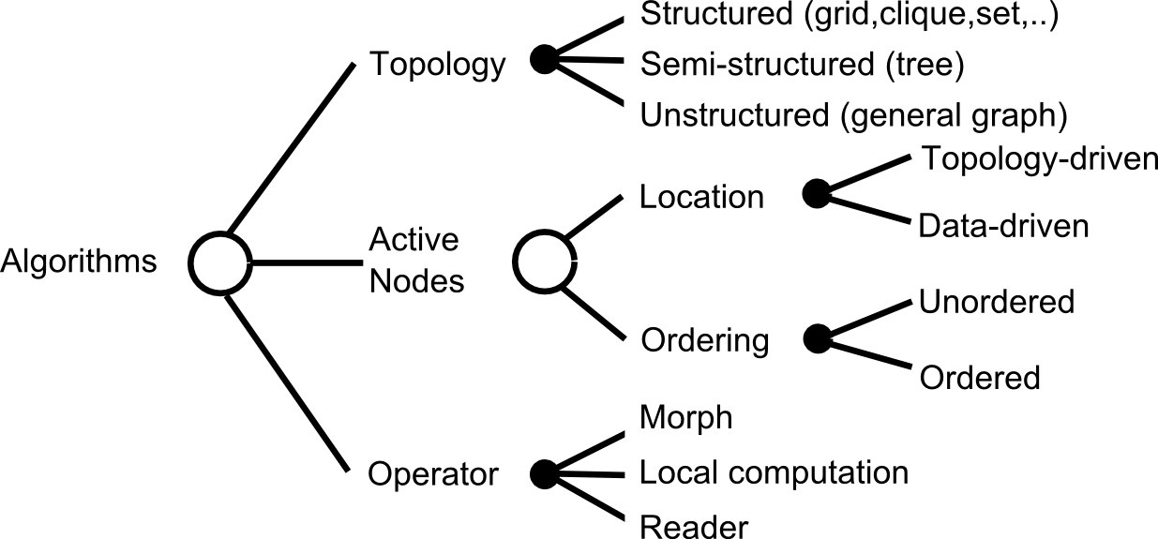
TAO analysis: algorithm abstraction
: active node
: neighborhood
Dijkstra SSSP: general graph, data-driven, ordered, local computation
Chaotic relaxation SSSP: general graph, data-driven, unordered, local computation
Bellman-Ford SSSP: general graph, topology-driven, unordered, local computation
Delta-stepping SSSP: general graph, data-driven, ordered, localcomputation

Slide 16
Infrastructure for graph algorithms
Concurrent data structures:
  Concurrent graph data structure
  Concurrent set/bag, priority queue
  Can be very complex to implement
One software architecture:
  Exploit Wirth’s equation:
    Program = Algorithm + Data Structure
    Parallel program = Parallel algorithm + Parallel data structure
      = Operator + Schedule + Parallel data structure
  Provide a library of concurrent data structures
  Programmer specifies
    operator
    schedule for applying operator at different active elements
This is the approach we use in the Galois project

Slide 17
Summary
Graph algorithms are more complex than most computational science algorithms
  Work may be created dynamically
  Different orders of doing work may result in different amounts of work
  Parallelism may not be known until runtime
  Underlying graph structure may change dynamically
SSSP algorithms illustrate most of this complexity so the SSSP problem is a good model problem for the study of parallel graph algorithms
Operator formulation and TAO analysis are useful abstractions for understanding parallelism in algorithms
Galois project: software architecture is based on these ideas
  Library of concurrent data structures written by expert programmers
  Joe programmer writes C++ code to specify operator and schedule

