Slide 1

Introduction to the Operator Formulation
Ian Henriksen (adapted materials from Keshav Pingali)
The University of Texas at Austin

Slide 2
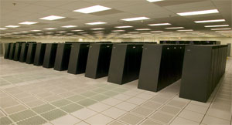
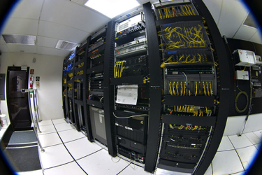


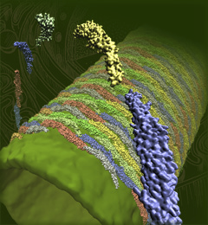


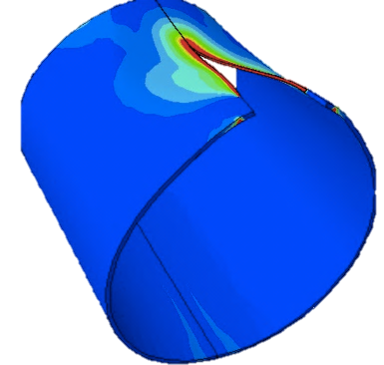

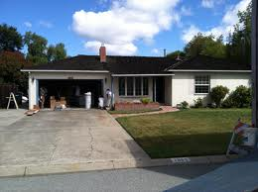

Parallel Computing Is Changing
Old World
New World
Platforms
Dedicated clusters versus cloud, mobile
People
Small number of scientists and engineers versus large number of self-trained parallel programmers
Data
Structured (vector, dense matrix) versus unstructured, sparse

Slide 3
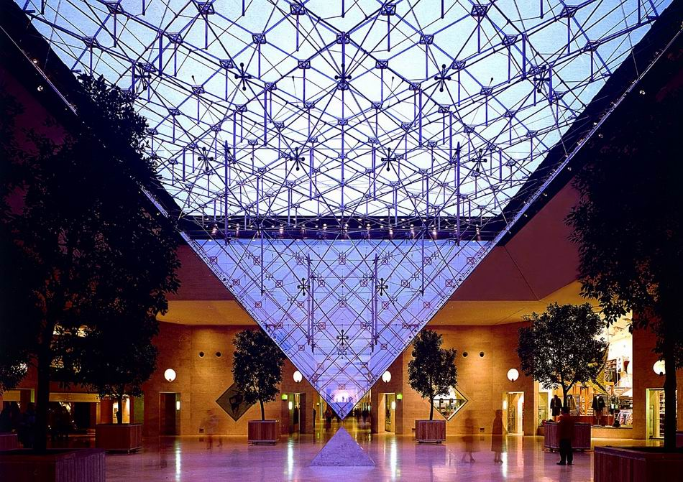
The Search for “Scalable” Parallel Programming Models
Tension between productivity and performance
support large number of application programmers with small number of expert parallel programmers
performance comparable to hand-optimized codes
Galois project
data-centric abstractions for parallelism and locality
operator formulation of algorithms
Joe
Stephanie

Slide 4


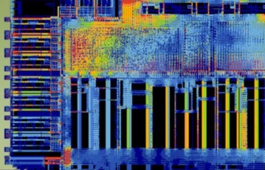

Some Projects Using Galois
BAE Systems (RIPE DARPA program)
intrusion detection in computer networks
data-mining in hierarchical interaction graphs
HP Enterprise
[ICPE 2016,MASCOTS 2016] workloads for designing enterprise systems
FPGA tools
[DAC’14] “Parallel FPGA Routing based on the Operator Formulation”, Moctar and Brisk
[IWLS’18] “Parallel AIG Rewriting” Andre Reis et al. (UFRGS, Brazil), Alan Mishchenko (UCB), et al.
Multi-frontal finite-elements for fracture problems
Maciej Paszynski, Krakow
2017 DARPA HIVE Graph Challenge Champion

Slide 5
Parallelism: Old world
Functional languages
map f (e₁,e₂,…,e_{n})
Imperative languages
for i = 1, N
y[i] = a*x[i] +y[i]
for i = 1, N
y[i] =a*x[i] + y[i-1]
for i = 1,N
y[2*i] = a*x[i] + y[2*i-1]
Key idea
find parallelism by analyzing algorithm or program text
major success: auto-vectorization in compilers (Kuck, UIUC)

Slide 6
Parallelism: Old world (contd.)
Mesh m = /* read in mesh */
WorkList wl;
wl.add(m.badTriangles());
while (true) {
if (wl.empty()) break;
Element e = wl.get();
if (e no longer in mesh)
continue;
Cavity c = new Cavity();
c.expand();
c.retriangulate();
m.update(c);//update mesh
wl.add(c.badTriangles());
}
Static analysis techniques
points-to and shape analysis
Fail to find parallelism
may be there is no parallelism in program?
may be we need better static analysis techniques?
Computation-centric view of parallelism

Slide 7
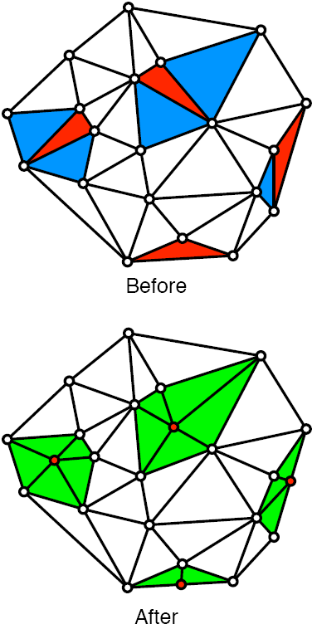
Parallelism: New world
Parallelism:
Bad triangles whose cavities do not overlap can be processed in parallel
Parallelism must be found at runtime
Data-centric view of algorithm
Active elements: bad triangles
Operator: local view
{Find cavity of bad triangle (blue);
Remove triangles in cavity;
Retriangulate cavity and update mesh;}
Schedule: global view
Processing order of active elements
Algorithm = Operator + Schedule
Parallel data structures
Graph
Worklist of bad triangles
Delaunay mesh refinement
Red Triangle: badly shaped triangle
Blue triangles: cavity of bad triangle

Slide 8
Overview
Shared-memory
Architecture: chip has some number of cores (e.g., Intel Skylake has up to 18 cores depending on the model) with common memory
Application program is decomposed into a number of threads, which run on these cores; data structures are in common memory
Threads communicate by reading and writing memory locations
Programming systems: pThreads, OpenMP, Intel TBB
Distributed-memory
Architecture: network of machines (Stampede II: 4,200 KNL hosts) with no common memory
Application program and data structures are partitioned into processes, which run on machines
Processes communicate by sending and receiving messages
Programming: MPI communication library

Slide 9
Low-level Shared Memory Programming

Slide 10
Threads
Software analog of cores
Each thread has its own PC, SP, registers, and stack
All threads share heap and globals
Runtime system handles mapping of threads to cores
if there are more threads than cores, runtime system will time-slice threads on cores
HPC applications: usually #threads = #cores
portability: number of threads is usually a runtime parameter

Slide 11
Thread Basics: Creation and Termination
Creating threads:
void func(std::string msg){
std::cout << msg << std::endl;
}
int main() {
std::thread t(func, "Hi");
t.join();
}
Thread created with a function to run and arguments to pass to it.
Main thread waits at t1.join() for thread t to finish.
Shared data has to be managed using locks and atomic instructions.

Slide 12
OpenMP
Extensions to C++/C/Fortran
Programmers indicate parallel for loops
Runs on its own thread pool
Nesting parallel regions works

Slide 13
CUDA
GPUs are ubiquitous and powerful
Extensions to C++/C/Fortran
Direct control of thread blocks/grids
Explicit placement of data in CPU/GPU memory, shared memory, texture cache, etc.

Slide 14
Distributed-memory programming

Slide 15
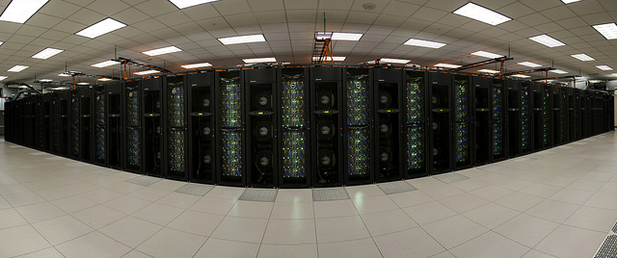
Clusters and data-centers
TACC Stampede 2 cluster
4,200 Intel Knights Landing nodes, each with 68 cores
1,736 Intel Xeon Skylake nodes, each with 48 cores
100 Gb/sec Intel Omni-Path network with a fat tree topology employing six core switches

Slide 16
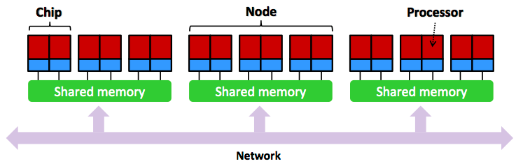
Cartoon picture of cluster

Slide 17
Typical latency numbers
From: Latency numbers every HPC programmer should know
L1 cache reference/hit 1.5 ns 4 cycles
Floating-point add/mult/FMA operation 1.5 ns 4 cycles
L2 cache reference/hit 5 ns 12 ~ 17 cycles
L3 cache hit 16-40 ns 40-300 cycles
256MB main memory reference 75-120 ns TinyMemBench on "Broadwell" E5-2690v4
Send 4KB message between hosts 1-10 μs MPICH on 10-100Gbps
Read 1MB sequentially from disk 5,000,000 ns 5 ms ~200MB/sec hard disk (seek time would be additional latency)
Random Disk Access (seek+rotation) 10,000,000 ns 10 ms
Send packet CA->Netherlands->CA 150,000,000 ns 150 ms
Locality is important.

Slide 18
Basic MPI constructs
Rank
0
1
………..
Master
Flat name space of processes
Rank:process ID
MPI_COMM_SIZE
how many processes are there in the world?
MPI_COMM_RANK
what is my logical number (rank) in this world?
MPI_SEND (var, receiverRank)
specify data to be sent in message and who will receive it
data can be an entire array (with stride)
MPI_RECV (var, senderRank)
whom to receive from and where to store received data

Slide 19
Programming Model
Single Program Multiple Data (SPMD) model
Program is executed by all processes
Use conditionals to specify that only some processes should execute a statement
to execute only on master:
if (rank == 0) then …;

Slide 20
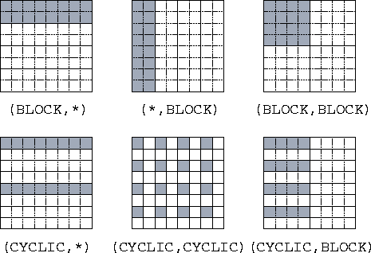
Data structures
Since there is no global memory, data structures have to partitioned between processes
No MPI support: entirely under the control of application program
Common partitioning strategies for dense arrays
block row, block column, 2D blocks, etc.

Slide 21
Summary
Low-level shared-memory and distributed-memory programming in pThreads and MPI can be very tedious
Higher-level abstractions are essential for productivity
Major problems
efficient implementation
performance modeling: changing a few lines in the code can change performance dramatically
Lots of work left for Stephanies

Slide 22
Operator formulation of algorithms
Active node/edge:
site where computation is needed
Operator:
local view of algorithm
computation at active node/edge
neighborhood: data structure elements read and written by operator
Schedule:
global view of algorithm
unordered algorithms:
active nodes can be processed in any order
all schedules produce the same answer but performance may vary
ordered algorithms:
problem-dependent order on active nodes
: active node
: neighborhood

Slide 23
von Neumann programming model
state
……….
update
initial
state
final
state
Program counter
where
Program
Execution
what
State update: assignment statement
(local view)
when
Schedule: control-flow constructs
(global view)
von Neumann bottleneck [Backus 79]

Slide 24
Data-centric programming model
state
update
…..
Active nodes
where
Program
Execution
what
State update: operator
(local view)
when
Schedule: ordering between active nodes
(global view)

Slide 25
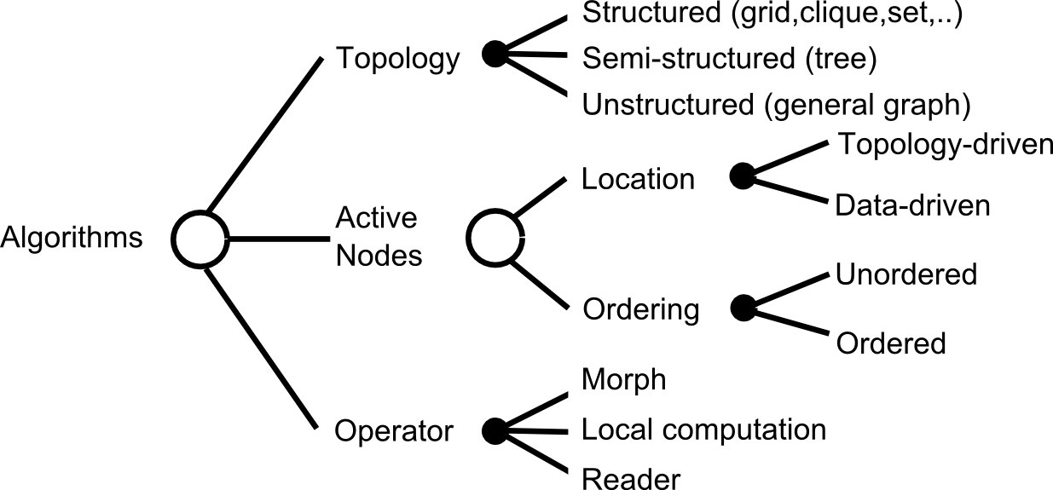
TAO terminology for algorithms
Label computation
Active nodes
Topology-driven algorithms
Algorithm is executed in rounds
In each round, all nodes/edges are initially active
Iterate till convergence
Data-driven algorithms
Some nodes/edges initially active
Applying operator to active node may create new active nodes
Terminate when no more active nodes/edges in graph
Operator
Morph: may change the graph structure by adding/removing nodes/edges
Label computation: updates labels on nodes/edges w/o changing graph structure
Reader: makes no modification to graph

Slide 26
Algorithms we have studied
Mesh generation
Delaunay mesh refinement: data-driven, unordered
SSSP
Chaotic relaxation: data-driven, unordered
Dijkstra: data-driven, ordered
Delta-stepping: data-driven, ordered
Bellman-Ford: topology-driven, unordered
Machine learning
Page-rank: topology-driven, unordered
Matrix completion using SGD: topology-driven, unordered
Computational science
Stencil computations: topology-driven, unordered

Slide 27

Parallelization of Delaunay mesh refinement
Each mutable data structure element (node, triangle,..) has an ID and a mark
What threads do:
nhoodElements ← {}
Get active element from worklist, acquire its mark and add element nhoodElements
Iteratively expand neighborhood, and for each data structure element in neighborhood, acquire its mark and add element to nHoodElement
When neighborhood expansion is complete, apply operator
If there are newly created active elements, add them to the worklist
Release marks of elements in nhoodElements set
If any mark acquisition fails, release marks of all elements in nhoodElements and put active element back on worklist
Optimistic (speculative) parallelization

Slide 28
Parallelization of stencil computation
What threads do:
there are no conflicts so each thread just applies operator to its active nodes
Good policy for assigning active nodes to threads:
divide grid into 2D blocks and assign one block to each thread
this promotes locality
Static parallelization: no need for speculation
A_{t}
A_{t+1}
Jacobi iteration, 5-point stencil
//Jacobi iteration with 5-point stencil
//initialize array A
for time = 1, nsteps
for <i,j> in [2,n-1]x[2,n-1]
temp(i,j)=0.25*(A(i-1,j)+A(i+1,j)+A(i,j-1)+A(i,j+1))
for <i,j> in [2,n-1]x[2,n-1]:
A(i,j) = temp(i,j)

Slide 29
Questions
Why can we parallelize some algorithms statically while other algorithms have to parallelized at run time using optimistic parallelization?
Are there parallelization strategies other than static and optimistic parallelization?
What is the big picture?

Slide 30
Binding time
Useful concept in programming languages
When do you have the information you need to make some decision?
Example: type-checking
Static type-checking: Java, ML
type information is available in the program
type correctness can be checked at compile-time
Dynamic type-checking: Python, Matlab
types of objects are known only during execution
type correctness must be checked at runtime
Binding time for parallelization
When do we know the active nodes and neighborhoods?

Slide 31
Parallelization strategies: Binding Time
Compile-time
Static parallelization (stencil codes, FFT, dense linear algebra)
3
After input
is given
Inspector-executor (sparse Cholesky,
Bellman-Ford)
2
4
During program
execution
Interference graph (DMR, chaotic SSSP)
1
After program
is finished
Optimistic
Parallelization (Time-warp)
“The TAO of parallelism in algorithms” Pingali et al, PLDI 2011

Slide 32
Inspector-Executor
Figure out what can be done in parallel
after input has been given, but
before executing the actual algorithm
Useful for topology-driven algorithms on graphs
algorithm is executed in many rounds
overhead of preprocessing can be amortized over many rounds
Basic idea:
determine neighborhoods at each node
build interference graph
use graph coloring to find sets of nodes that can be processed in parallel without synchronization
Example:
sparse Cholesky factorization
we will use Bellman-Ford (in practice Bellman-Ford is implemented differently)

Slide 33
Inspector-Executor
A
{A,B,C}
A
{A,B,C}
{B,A,D}
B
{B,A,D}
B
{E,D,G,H}
{C,A,D}
{E,D,G,H}
E
{C,A,D}
E
C
C
{E,G,H}
D
{E,G,H}
D
{D,C,B,E,F}
G
{D,C,B,E,F}
G
{F,D,H}
F
{F,D,H}
F
H
H
Neighborhoods of activities
Interference graph

Slide 34
Inspector-Executor
A
B
{D}
{E,A}
{F}
{G,B}
{H,C}
E
C
D
G
F
H
Neighborhoods of activities
Nodes in a set can be done in parallel
Use barrier synchronization between sets

Slide 35
Shared-memory Galois System

Slide 36
Galois system
Parallel program = Operator + Schedule + Parallel data structures
Ubiquitous parallelism:
small number of expert programmers (Stephanies) must support large number of application programmers (Joes)
cf. SQL
Galois system:
Stephanie: library of concurrent data structures and runtime system
Joe: application code in sequential C++
Galois set iterator for highlighting opportunities for exploiting ADP
Joe: Operator + Schedule
Stephanie: Parallel data structures
and runtime system

Slide 37
Hello graph Galois Program
#include “Galois/Galois.h”
#include “Galois/Graphs/LCGraph.h”
struct Data { int value; float f; };
typedef Galois::Graph::LC_CSR_Graph<Data,void> Graph;
typedef Galois::Graph::GraphNode Node;
Graph graph;
struct P {
void operator()(Node n, Galois::UserContext<Node>& ctx) {
graph.getData(n).value += 1;
}
};
int main(int argc, char** argv) {
graph.structureFromGraph(argv[1]);
Galois::for_each(graph.begin(), graph.end(), P());
return 0;
}
Data structure
Declarations
Operator
Galois Iterator

Slide 38
Parallel execution of Galois programs
Application (Joe) program
Sequential C++
Galois set iterator: for each
New elements can be added to set during iteration
Optional scheduling specification (cf. OpenMP)
Highlights opportunities in program for exploiting amorphous data-parallelism
Runtime system
Ensures serializability of iterations
Execution strategies
Optimistic parallelization
Interference graphs
Application Program
Master thread
main()
….
for each …..{
…….
…….
}
.....
i₁
i₃
i₂
i₄
Workset
of active nodes
i₅
Graph
Concurrent
data structures
Notes:
Consistency vs isolation

Slide 39
Performance Studies

Slide 40
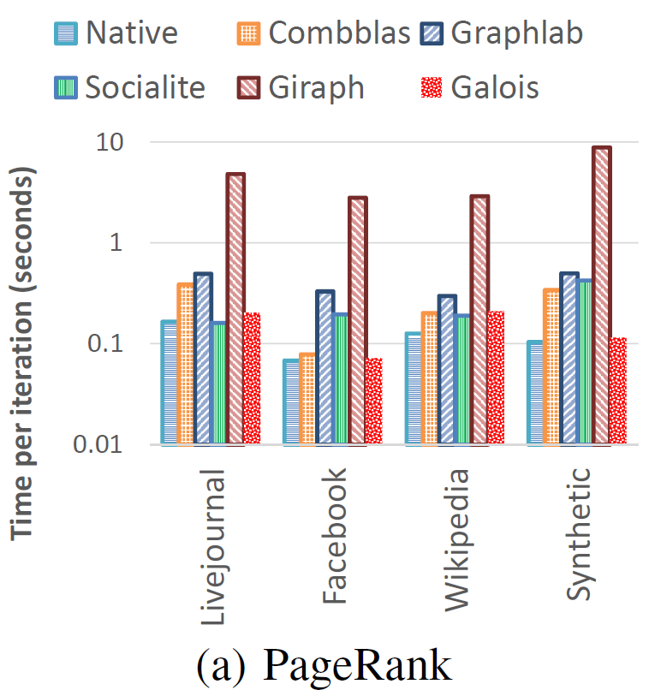
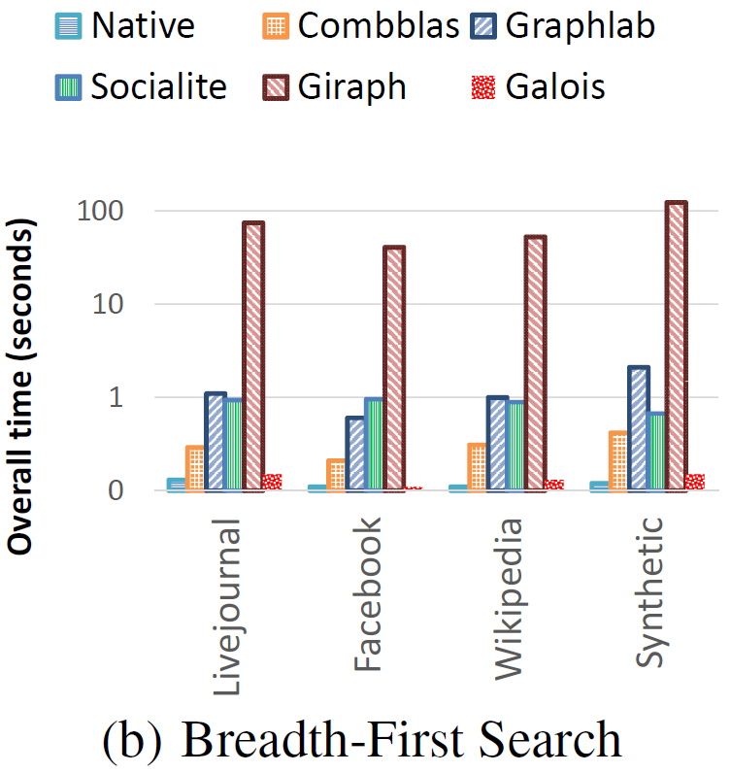
Galois vs Other Graph Frameworks
Intel Study: Galois vs. Graph Frameworks
“Navigating the maze of graph analytics frameworks” Nadathur et al SIGMOD 2014

Slide 41
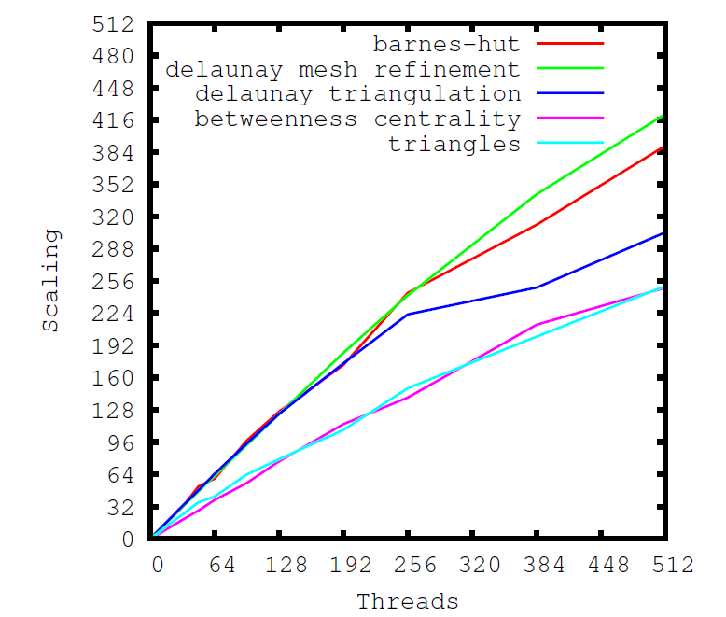
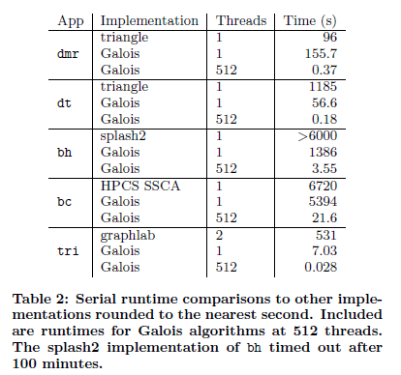
Galois: Performance on SGI Ultraviolet

Slide 42
FPGA Tools
Moctar & Brisk, “Parallel FPGA Routing based on the Operator Formulation” DAC 2014

Slide 43
Summary
Finding parallelism in programs
binding time: when do you know the active nodes and neighborhoods
range of possibilities from static to optimistic
optimistic parallelization can be used for all algorithms but in general, early binding is better
Shared-memory Galois implements some of these parallelization strategies
focus: irregular programs

Slide 44
Galois tutorial
https://iss.oden.utexas.edu/projects/galois/api/current/tutorial.html

