Slide 1
Dependences and
Loop Transformations

Slide 3
Our focus: perfectly-nested loops

Slide 4
Overview of lecture
We have seen two loop transformations for locality enhancement
  Permutation
  Tiling
Many other transformations
  Skewing, reveral, scaling…
Code generation: given a loop nest and a transformation,
  Determine if the transformation is legal (does not violate dependences).
  If so, generate the transformed loop nest.
More difficult problem: synthesis of transformation
  Given a loop nest and a performance objective such as locality enhancement, synthesize a good transformation.

Slide 5
FOR
FOR

Slide 6
Issue 1: (example)
FOR
FOR
FOR
FOR

Slide 8
History
Dependence and code generation problems used to be solved using heuristics (1965-1990)
  GCD test, Banerjee test, etc.
  Pattern matching to generate code
Today we use powerful integer linear programming (ILP) techniques (1990-)
  Complemented by heuristics to quickly handle simple problems
  Use full-blown power of ILP calculator very sparingly

Slide 9
Integer Linear Programming

Slide 11
Linear inequalities
2 3 4
1 -1 3
is equivalent to
2x + 3y + 4z ≤ 4
x – y + 3z ≤ 1
X
Y
Z
4
1
≤

Slide 14
Geometric intuition for ILP problems
Given a convex polyhedron, solve two problems.
Enumerate all the integer points in polyhedron
  Fourier-Motzkin elimination
  Used to generate code for transformed loop nest
Decision problem: is there an integer point within the polyhedron?
  Cutting plane method (Gomory 1958)
  Used to determine if transformation is legal
In compilers, we deal with underdetermined systems
  No solution or many solutions

Slide 15
Fourier-Motzkin Elimination

Slide 22
74/13

Slide 26
Solving decision problem
ILP calculators: variations of cutting plane method (Gomory 1958)
In practice, we use simple tests like GCD test to handle easy cases
  (e.g.) equation 2x + 4y = 5 does not have integer solutions because lhs must be an even number for any integer values of x and y but rhs is an odd number
  Generalization: if GCD of lhs coefficients does not divide rhs, equation has no solutions
  Given a system of equalities and inequalities, use GCD test to quickly determine if some equality has no solution; otherwise use ILP calculator
Dependence tests (1965-1990)
  Cottage industry in inventing more general tests than GCD

Slide 27
Treatment of equalities
In principle, we need to consider only inequalities
  Convert equality (A = B) to conjunction of two inequalities (A ≤ B) and (B ≤ A)
Better approach for decision problem
  Solve equalities first using integer Gaussian elimination to find parametric solution (remember: underdetermined systems)
  Substitute parametric solution into inequalities and then solve system of inequalities using cutting plane method
Integer Gaussian elimination
  Rich theory for solving Diophantine equations going back more than 2000 years (Greeks, Hindus)

Slide 28
Using ILP for Dependence Analysis

Slide 29
FOR
FOR

Slide 30
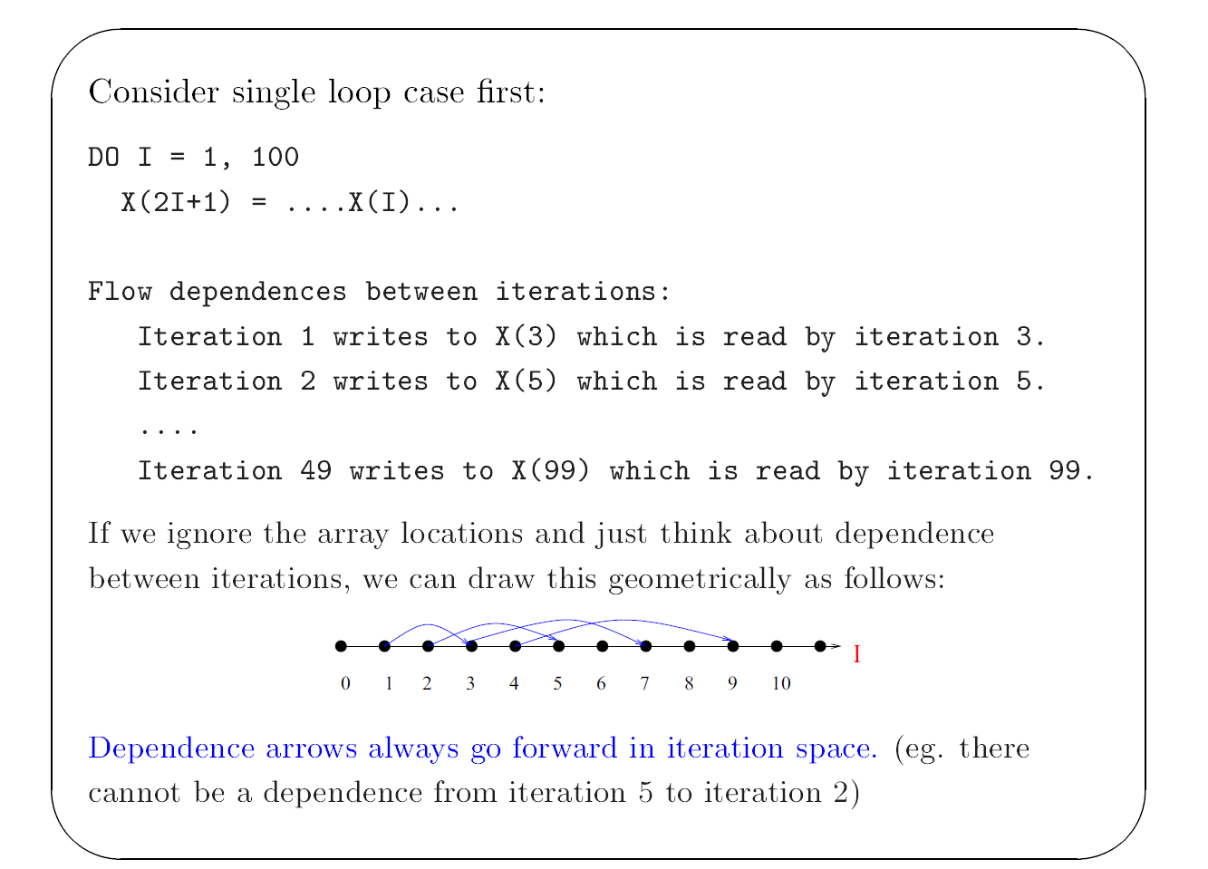
Dependence Example
FOR

Slide 34
Connection to ILP
Dependence problem becomes an ILP problem if
  Array subscripts are affine functions of loop variables
  Loop bounds are affine functions of outer loop variables
Examples: “regular programs”
  Most dense linear algebra algorithms like BLAS routines, Cholesky factorization, LU without pivoting
  Stencil codes: finite differences
Counter-examples: “irregular programs”
  Dense linear algebra with pivoting
  Spare matrix codes, graph algorithms

Slide 40
Summary
Problem of determining whether a dependence exists between two iterations of a loop nest can be framed as an ILP problem
  Assumptions: affine loop bounds and array subscripts
Solve decision problem using ILP calculator augmented with simpler tests like GCD to filter out easy cases

Slide 41
Dependence Relation and
Dependence Abstractions

Slide 42
Overview
Dependence relation
  Closed form expression that gives all dependences for a given loop nest, not just a yes/no answer for existence of dependence
  Can be computed using ILP calculator
  Too expensive to compute for most programs
Dependence abstractions
  Distance vectors
  Direction vectors
  Dependence matrix

Slide 43
Formal view of dependence
FOR

Slide 44
FOR
FOR

Slide 45
Dependence arrows are lexicographically positive

Slide 46
FOR
FOR

Slide 47
Dependence abstractions
In practice, working with the full dependence relation for a loop nest is expensive and difficult
Usually, we use an abstraction of dependence relation
  Summary information about dependence
  Summary is an over-approximation of actual dependence relation
Two abstractions are popular
  Distance vectors
  Direction vectors
  Dependence matrix: collection of distance/direction vectors

Slide 55
Example

Slide 57
Dependence matrix

Slide 59
Unimodular transformations and
Transformation synthesis

Slide 60
Overview
Unimodular transformations
  Permutation, skewing, reversal
  These are linear transformations on iteration spaces and can be represented using integer matrices
  Special property: unimodular matrix
    Integer matrix with determinant of 1 or -1
    Integer equivalent of orthogonal matrix in numerical linear algebra
  Compositions of these transformations can be represented as unimodular matrices as well
Synthesizing unimodular transformations for locality enhancement
  Making a loop nest fully permutable to enable tiling

Slide 61
Permutation is linear transformation

Slide 62
Using dependence matrices to establish correctness of permutation

Slide 63
Loop permutation

Slide 76
Summary
Dependence relation
  Binary relation between points in iteration space
  Can be computed using ILP calculator
Dependence abstractions
  Summary of dependence relation
    Not as accurate but easier to compute and use
  Distance/direction vectors
    Put them together in dependence matrix
Unimodular transformations
  Can be represented using unimodular matrix
    permutation, skewing, reversal, compositions of these
  Synthesize unimodular transformations using dependence matrix as driver
    Making a loop nest fully permutable

