Slide 1
Solving fixpoint equations

Slide 2
Goal
Many problems in programming languages can be formulated as the solution of a set of mutually recursive equations:
D: set, f,g:DxD →D
  x = f(x,y)
  y = g(x,y)
Examples
  Parsing: first/follow sets in SLL(k) parsing
  PL semantics
  Dataflow analysis
General questions
  What assumptions on D, f, and g are sufficient to ensure that such a system of equations has a solution?
  If system has multiple solutions, which solution do we really want?
  How do we compute that solution?
Keywords:
  Assumptions on D: partially-ordered set (poset), semi-lattice, lattice, complete lattice,…
  Assumptions on functions f,g: monotonic, continuous, extensive,….
  Solutions: fixpoint, least fixpoint, greatest fixpoint,..

Slide 3
Example: SLL(1) parsing table
NULLABLE = {A,B,C} FIRST(A)={x,t,v,ε} FIRST(B)={t,ε} FIRST(C)={v,ε} FOLLOW(A)={$} FOLLOW(B)={v,$} FOLLOW(C)={$}
Example
  (start symbol is A)
  A → BC | x
  B → t | ε
  C → v | ε
NULLABLE, FIRST, FOLLOW computation can be formulated in terms of solving fixpoint equations

Slide 4

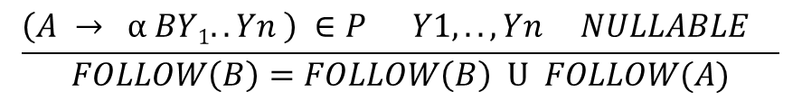
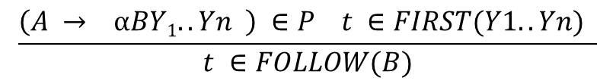
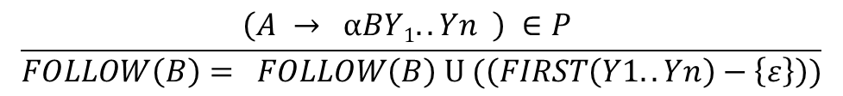
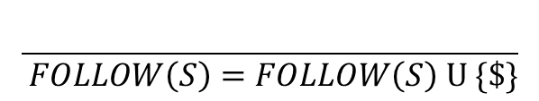
Equations for FOLLOW
FOLLOW(A) ⊆ T U {$}
$$\frac{}{ \$ ∈FOLLOW(S)}$$
$$\frac{}{ FOLLOW\left(S\right)=FOLLOW\left(S\right) U \{\$\}}$$
$$\frac{\left(A → αBY1..Yn \right) ∈P t ∈FIRST(Y1..Yn) }{t ∈FOLLOW(B)}$$
$$\frac{\left(A → αBY1..Yn \right) ∈P }{FOLLOW\left(B\right)= FOLLOW\left(B\right) U (\left(FIRST\left(Y1..Yn\right)−\left\{ε\right\}\right))}$$
$$\frac{\left(A → α BY1..Yn \right) ∈P Y1,..,Yn NULLABLE t ∈FOLLOW(A) }{t ∈FOLLOW(B)}$$
$$\frac{\left(A → α BY1..Yn \right) ∈P Y1,..,Yn NULLABLE }{FOLLOW\left(B\right)=FOLLOW\left(B\right) U FOLLOW(A)}$$

Slide 5
Computing FOLLOW sets
Example
(start symbol is A)
  A → BC | x
  B → t | ε
  C → v | ε
FOLLOW: N → 2^{T}
FOLLOW(A) = FOLLOW(A) U {$}
FOLLOW(B) = FOLLOW(B) U {v}
FOLLOW(B) = FOLLOW(B) U FOLLOW(A)
FOLLOW(C) = FOLLOW(C) U FOLLOW(A)
NULLABLE = {A,B,C} FIRST(A)={x,t,ε} FIRST(B)={t,ε} FIRST(C)={v,ε} FOLLOW(A)={$} FOLLOW(B)={v,$} FOLLOW(C)={$}

Slide 6
Simplifying equations
FOLLOW: N → 2^{T}
FOLLOW(A) = FOLLOW(A) U {$}
FOLLOW(B) = FOLLOW(B) U {v}
FOLLOW(B) = FOLLOW(B) U FOLLOW(A)
FOLLOW(C) = FOLLOW(C) U FOLLOW(A)
which is equivalent to
FOLLOW(A) = FOLLOW(A) U {$}
FOLLOW(B) = FOLLOW(B) U {v} U FOLLOW(A)
FOLLOW(C) = FOLLOW(C) U FOLLOW(A)
This system of equations has three unknowns
(FOLLOW(A),FOLLOW(B),FOLLOW(C)) and one equation for each unknown.
How do we solve it? If it has multiple solutions, which one do we want?

Slide 7
Game plan
Finite partially-ordered set with least element: D
Function f: D→D
Monotonic function f: D→D
Fixpoints of monotonic function f:D→D
  Least fixpoint
Solving equation x = f(x)
  Least solution is least fixpoint of f
Generalization to when D has a greatest element T
  Least and greatest solutions to equation x = f(x)
Generalization to systems of equations
Semi-lattices and lattices

Slide 8
Partially-ordered set
Set S with a binary relation < that is
  reflexive: x < x
  anti-symmetric: x < y and y < x ➔ x=y
  transitive: x < y and y < z ➔ x < z
Example: set of integers ordered by standard < relation
  poset generalizes this
Graphical representation of poset:
  Graph in which nodes are elements of S and relation < is shown by arrows
  Usually we omit transitive arrows to simplify picture
Not a poset:
  S = {a,b}, {a < a, b < b, a < b, b < a}
…
3
2
1
0
-1
-2
-3
..

Slide 9
Another example of poset
{a,b,c}
Powerset of any set ordered by set containment is a poset
In example shown to the left, poset elements are {}, {a}, {a,b},{a,b,c}, etc.
  x < y if x is a subset of y
{a,b} {a,c} {b,c}
{a} {b} {c}
{ }

Slide 10
Finite poset with least element
Poset in which
  set is finite
  there is a least element that is below all other elements in poset
Examples:
  Set of primes ordered by natural ordering is a poset but is not finite
  Factors of 12 ordered by natural ordering on integers is a finite poset with least element
  Powerset example from previous slide is a finite poset with least element ({ })
12
6
4
3
2
1

Slide 11
Domain
Since “finite partially-ordered set with a least element” is a mouthful, we will just abbreviate it to “domain”. So domain is a set S and an order relation ≤
  D = (S, ≤ )
Later, we will generalize the term “domain” to include other posets of interest to us in the context of dataflow analysis.

Slide 12
Functions on domains
If D is a domain, f:D→D
  a function maps each element of D to some element of D itself
Examples: for D = powerset of {a,b,c}
  f(x) = x U {a}
    so f maps { } to {a}, {b} to {a,b} etc.
  g(x) = x – {a}
  h(x) = {a} - x

Slide 13
Monotonic functions
Function f: D→D where D is a domain is monotonic if
  x < y ➔ f(x) < f(y)
Common confusion: people think f is monotonic if x < f(x). This is a different property called extensivity.
Intuition:
  think of f as an electrical circuit mapping input to output
  f is monotonic if increasing the input voltage causes the output voltage to increase or stay the same
  f is extensive if the output voltage is greater than or equal to the input voltage

Slide 14
Examples
Domain D is powerset of {a,b,c}
Monotonic functions: (x in D)
  x → { } (why?)
  x → x U {a}
  x → x – {a}
Not monotonic:
  x → {a} – x
    Why? Because { } is mapped to {a} and {a} is mapped to { }.
Extensivity
  x → x U {a} is extensive and monotonic
  x → x – {a} is not extensive but monotonic
Exercise: define a function on D that is extensive but not monotonic

Slide 15
Fixpoint of f:D→D
Suppose f: D→ D. A value x is a fixpoint of f if f(x) = x. That is, f maps x to itself.
Examples: D is powerset of {a,b,c}
  Identity function: x→x
    Every point in domain is a fixpoint of this function
  x → x U {a}
    {a}, {a,b}, {a,c}, {a,b,c} are all fixpoints
  x → {a} – x
    no fixpoints

Slide 16
Fixpoint theorem(I)
If D is a domain, ⊥ is its least element, and f:D→D is monotonic, then f has a least fixpoint that is the largest element in the sequence (chain)
  ⊥, f(⊥), f(f(⊥)), f(f(f(⊥))),….
Examples: for D = power-set of {a,b,c}, so ⊥ is { }
  Identity function: sequence is { }, { }, { }… so least fixpoint is { }, which is correct.
  x → x U {a}: sequence is { }, {a},{a},{a},… so least fixpoint is {a} which is correct

Slide 17
Proof of fixpoint theorem
Largest element of chain is a fixpoint:
  ⊥ < f(⊥) (by definition of ⊥)
  f(⊥) < f(f(⊥)) (from previous fact and monotonicity of f)
  f(f(⊥)) < f(f(f(⊥))) (same argument)
  we have a chain ⊥, f(⊥), f(f(⊥)), f(f(f(⊥))),…
  since the set D is finite, this chain cannot grow arbitrarily, so it has some largest element that f maps to itself. Therefore, we have constructed a fixpoint of f.
This is the least fixpoint
  let p be any other fixpoint of f
  ⊥ < p (from definition of ⊥)
  So f(⊥) < f(p) = p (monotonicity of f)
  similarly f(f(⊥)) < p etc.
  therefore all elements of chain are < p, so largest element of chain must be < p
  therefore largest element of chain is the least fixpoint of f.

Slide 18
Solving equations
If D is a domain and f:D→D is monotonic, then the equation x = f(x) has a least solution given by the largest element in the sequence ⊥, f(⊥), f(f(⊥)), f(f(f(⊥))), …
Proof: follows trivially from fixpoint theorem

Slide 19
Easy generalization
Proof goes through even if D is not a finite set but only has finite height
  no infinite chains
……..
……..

Slide 20
Another result
If D is a domain with a greatest element T and f:D→D is monotonic, then the equation x = f(x) has a greatest solution given by the smallest element in the descending sequence
T, f(T), f(f(T)), f(f(f(T))), …
Proof: left to reader

Slide 21
Functions with multiple arguments
If D is a domain, a function f(x,y):DxD→D that takes two arguments is said to be monotonic if it is monotonic in each argument when the other argument is held constant.
Intuition:
  electrical circuit has two inputs
  if you increase voltage on any one input keeping voltage on other input fixed, the output voltage stays the same or increases

Slide 22
Fixpoint theorem(II)
If D is a domain and f,g:DxD→D are monotonic, the following system of simultaneous equations has a least solution computed in the obvious way.
  x = f(x,y)
  y = g(x,y)
You can easily generalize this to more than two equations and to the case when D has a greatest element T.

Slide 23
Formalization: product constructor
Suppose D₁ = (S₁,≤₁) and D₂ = (S₂,≤₂) are domains.
Define D₁ x D₂ to be the following domain:
  Set: S₁ x S₂
    elements are pairs in which the first member is from S₁ and the second is from S₂
  Order relation: ≤
    <d₁,d₂> ≤ <d₃,d₄> if d₁ ≤₁ d₃ and d₂ ≤₂ d₄
System of equations is replaced with one equation
x = f(x,y) ➔ <x,y> = foo(<x,y>)
y = g(x,y) where foo is a monotonic function defined using f and g in the obvious way

Slide 24
Computing the least solution for a system of equations
Consider
  x = f(x,y,z)
  y = g(x,y,z)
  z = h(x,y,z)
Obvious iterative strategy: evaluate all equations at every step (Jacobi iteration)
  ⊥ f(⊥,⊥,⊥)
  ⊥ , g(⊥,⊥,⊥) , …..
  ⊥ h(⊥,⊥,⊥)
General approach is called round-robin scheduling of equations

Slide 25
Work-list based algorithm
Obvious point: it is not necessary to reevaluate a function if its inputs have not changed
Worklist based algorithm:
  initialize worklist with all equations
  initialize solution vector S to all ⊥
  while worklist not empty do
    get equation from worklist
    evaluate rhs of equation with current solution vector values and update entry corresponding to lhs variable in solution vector
    put all equations that use this variable in their RHS on worklist
You can show that this algorithm will compute the least solution to the system of equations

Slide 26
Power-set domains: U and ∩
Consider a power-set domain
  set union and intersection are monotonic functions
  so we can use them in systems of fixpoints equations
Example:
  f(x,y) = {a}
  Equations
  x = f(x,y)
  y = x U y
Can we generalize this to domains that are not power-sets?
{a,b,c}
{a,b} {a,c} {b,c}
{a} {b} {c}
{ }

Slide 27
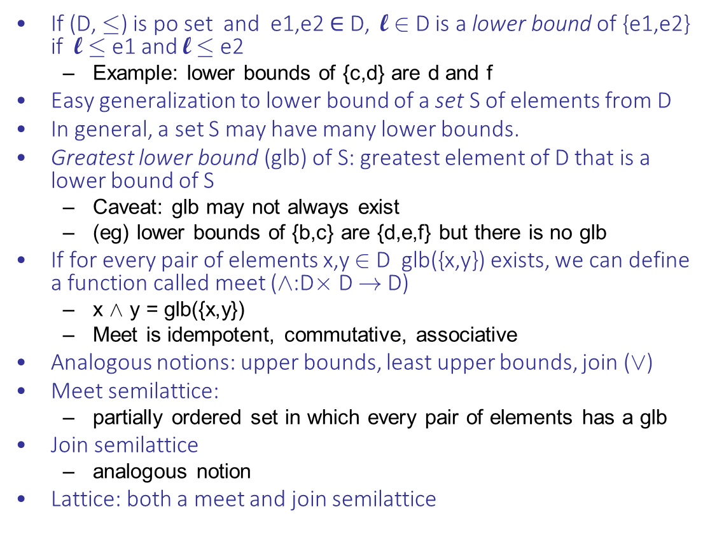
Join and meet
If (D, ·) is po set and e1,e2 $∈$D, l 2 D is a lower bound of {e1,e2} if l · e1 and l · e2
  Example: lower bounds of {c,d} are d and f
Easy generalization to lower bound of a set S of elements from D
In general, a set S may have many lower bounds.
Greatest lower bound (glb) of S: greatest element of D that is a lower bound of S
  Caveat: glb may not always exist
  (eg) lower bounds of {b,c} are {d,e,f} but there is no glb
If for every pair of elements x,y 2 D glb({x,y}) exists, we can define a function called meet (Æ:D£ D ! D)
  x Æ y = glb({x,y})
  Meet is idempotent, commutative, associative
Analogous notions: upper bounds, least upper bounds, join (Ç)
Meet semilattice:
  partially ordered set in which every pair of elements has a glb
Join semilattice
  analogous notion
Lattice: both a meet and join semilattice
a
b c
d e
f

Slide 28
Back to power-sets
Powerset of finite set under subset ordering is classical example of a lattice
Meet is set intersection
Join is set union
If you “flip” this lattice over, you get another lattice
  least element is {a,b,c}
  set union is meet
  set intersection is join
Examples of posets that are not lattices
  see previous slide
{a,b,c}
{a,b} {a,c} {b,c}
{a} {b} {c}
{ }

Slide 29
Fixpoint equations in lattices
If (D,·, Æ, Ç) is a finite lattice, it has a least and greatest element.
Meet and join functions are monotonic
Therefore, if (D,·,Æ,Ç) is a finite lattice, fixpoint theorem (II) applies even if some of the functions f,g etc. are Æ or Ç
Similarly, if (D,·,Ç) is a finite, join semi-lattice, fixpoint theorem (II) applies even if some of the functions are Ç

Slide 30
FIRST/FOLLOW set computation
Example
  S→ A$
  A → BC | x
  B → t | ε
  C → v | ε
FOLLOW: N → 2^{T}
FOLLOW(A) = FOLLOW(A) U {$}
FOLLOW(B) = FOLLOW(B) U {v} U FOLLOW(A)
FOLLOW(C) = FOLLOW(C) U FOLLOW(A)
Algorithm we gave in parsing lecture is just a special case of using Jacobi iteration to solve fixpoint equations
NULLABLE = {A,B,C} FIRST(A)={x,t,ε} FIRST(B)={t,ε} FIRST(C)={v,ε} FIRST(S)={x,t,v,$} FOLLOW(A)={$} FOLLOW(B)={v,$} FOLLOW(C)={$}

Slide 31
Things to think about
Does the equational system on previous slide have multiple solutions?
If so, why is the least solution the “right” one for our application?
If a system of fixpoint equations has multiple equations for an unknown, is the system still guaranteed to have a solution?
  Example: consider system
  x = f(x) //f and g are monotonic
  x = g(x)

Slide 32
Summary
Solving systems of simultaneous equations in which the underlying structure is a partially ordered set with various properties is basic to many problems in PL
  usually referred to as “fixpoint equations”
Given fairly reasonable conditions on the rhs functions and the partially ordered set, there are guaranteed to be solutions to such equations, and there are systematic ways of computing solutions
  keywords:
    join semi-lattice, meet semi-lattice, lattice,..
    monotonic functions, extensive functions, continuous functions,..
    round-robin algorithm, worklist algorithm

