Slide 1
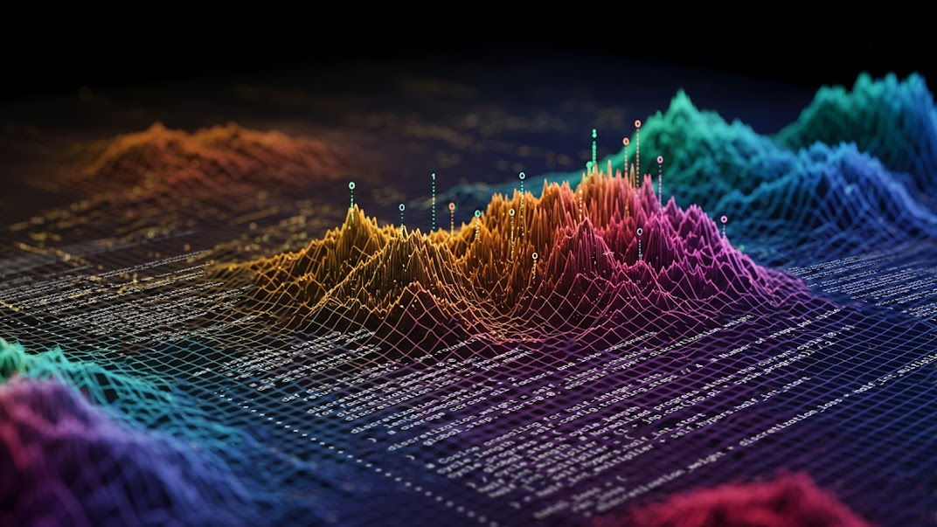
CS395T: Foundations of Machine Learning for Systems Researchers
Fall 2026
Attention, Transformers, and Large Language Models (LLMs)
Some material taken from Gianfranco Bilardi’s talk at Boost’24
and Sebastian Raschka’s blog.

Slide 2
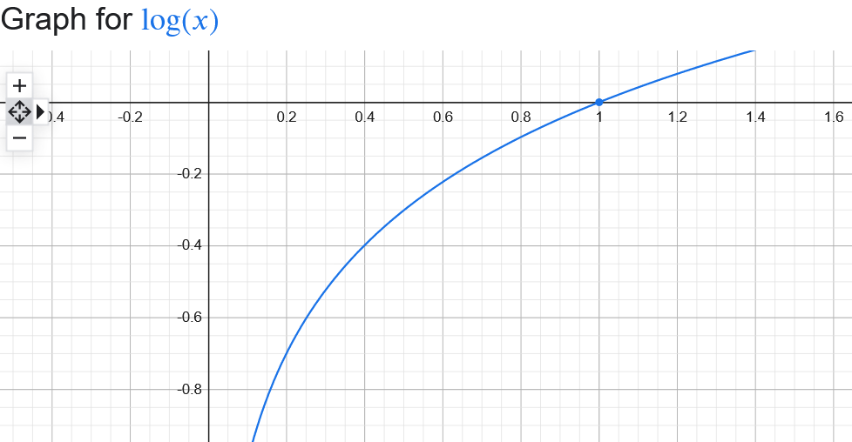

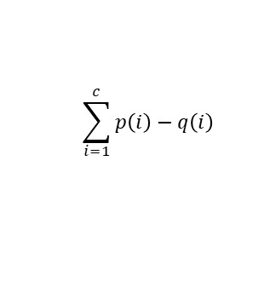
Review: Kullback-Leibler (KL) divergence KL(P||Q)
$$KL\left(P:π,Q:π\right)= \sum_{i=1}^{c}{p\left(i\right)(log⁡(p\left(i\right))}−log(q\left(i\right)))$$
Start with (c = number of classes, usually p = ground truth distribution)
Two key intuitions
  If p(i) is small for some i, we do not care that much about (p(i)-q(i))
  Any monotonically increasing function f can be used to massage values of p and q without changing the sign of the difference
    KL-divergence uses log (usually log₂)
    Intuition: penalize mistakes: large p(i), small q(i)
$$\sum_{i=1}^{c}{p\left(i\right)}−q\left(i\right)$$

Slide 3
Divergence is general concept
d: π×π→ℜ is divergence if
(i) d(P,Q) ≥ 0
(ii) d(P,Q) = 0 iff P=Q
Other divergences: L₁ norm, L₂ norm, Bregman
More general than metric
No need for symmetry or triangle inequality

Slide 4
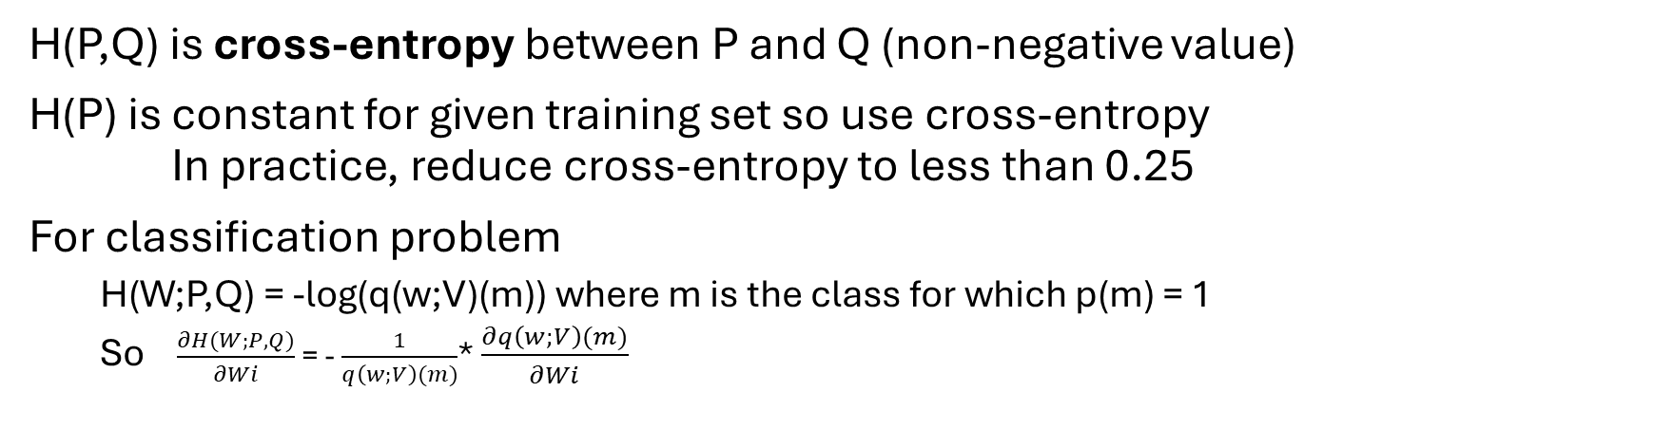

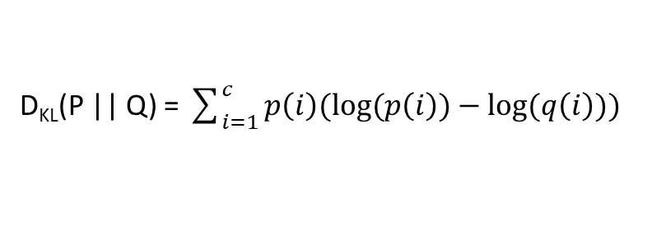
Cross-entropy(P,Q)
D_{KL}(P || Q) = $\sum_{i=1}^{c}{p\left(i\right)(log⁡(p\left(i\right))}−log(q\left(i\right)))$
$$=−\sum_{i=1}^{c}{p\left(i\right)\log\left(\frac{1}{p\left(i\right)}\right)}+\sum_{i=1}^{c}{p\left(i\right)\log\left(\frac{1}{q\left(i\right)}\right)}$$
= - H(P) + H(P,Q)
H(P,Q) is cross-entropy between P and Q (non-negative value)
H(P) is constant for given training set so use cross-entropy
In practice, reduce cross-entropy to less than 0.25
For classification problem
  H(W;P,Q) = -log(q(w;V)(m)) where m is the class for which p(m) = 1
  So $\frac{∂H(W;P,Q)}{∂Wi}$ = - $\frac{1}{q\left(w;V\right)(m)}$* $\frac{∂q\left(w;V\right)(m)}{∂Wi}$

Slide 5
Large Language Models:
Applications
Machine translation​
Program generation​
Chatbots​
Document summarization​
AI agents​
Semantics (meaning) seem essential for these tasks.
Amazingly, they can be done without explicit notion of meaning!

Slide 6
Three Major Discoveries
Semantics of words and sentences can be captured by vectors of real numbers (embeddings)
Efficiently computable statistical models for natural languages
Probabilistic generation produces meaningful text
“On the dangers of stochastic parrots: can language models be too big?” Emily Bender et al.

Slide 7
History
Exploiting statistical properties of language:
Cryptography: reconstruct a secret code (from al-Kindi, c.801-873 AD, and Caesar’s (100-46) codes, to computational cryptography (1970s-))
Compression: encode a text so that it occupies less space to save memory and bandwidth (information theory Shannon (1916-2001), source coding).
Error correction: efficiently encode a text to facilitate detection and elimination of alterations (Shannon, channel coding).

Slide 8
Outline of lecture
Statistical language models
Series of increasingly more sophisticated DNNs for translation
Embeddings: static and contextual (Zettlemoyer 2018)
Attention

Slide 9
Statistical Language Model
Token (word) vocabulary: T = {τ₁, . . . , τ_{|T |}}
Context = c₁ T * where c₁ is string called prompt
c₁ or c₁ x₁ x₂ .. where x_{t} ∈ T , t =1, 2, . . .
Language model: The conditional probabilities of the next token given a context
Pr [x_{t}|c₁ x₁ x₂ . . . x_{t−1}] = Pr [x_{t}|c_{t}] , t =1, 2, . . .
Text generation:
Prompt is <START>
Given context c_{t}, use model to produce probability vector and sample to pick next word x_{t}
Append x_{t} to c_{t} and repeat
Text translation:
Prompt is sentence to be translated followed by <START>

Slide 10

Building the language model
Analyze huge corpus of text and build next token table
context → probability vector ([p1, …, p|T |])
Oxford English Dictionary has > 200K words (|T |)
Number of probabilities for context of length t = |T |^{t+1}
Solution: train NN to compute probability vectors, given context

Slide 11
Running example: English Turkish
→
Source language: English, |S| words
Target language: Turkish, |U| words
Training data: English-Turkish sentence pairs
The cat ate the mouse . Kedi fareyi yedi .
First attempt:
Representation: encode words as one-hot vectors
Assume maximum sentence lengths in both languages is m.
Pad sentences (we will use xx) to extend all of them to length m.

Slide 12
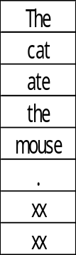
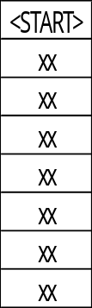
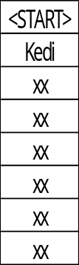

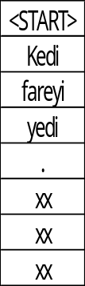
DNN1 (Training): one-hit encodings of source/target words
CE-Loss
CE-Loss
CE-Loss
Probability vector (|U|)
Probability vector (|U|)
Probability vector (|U|)
DNN
DNN
……..
DNN
Kedi
fareyi
<END>
m
m
m
m
|S|
|U|
|S|
|U|
|S|
|U|
Caution: input & output tokens presented in
parallel to DNN, not serially (pic is misleading)
Teacher forcing: predicted word is thrown away

Slide 13
DNN1 (Inference)
Kedi (|U|)
Sampler
Probability vector (|U|)
Autoregressive decoding:
- translated text produced sequentially
- translated text begins with <START>
- each word produced by DNN is appended to input to predict next word
Output is stochastic because of sampler
DNN
m
m
|S|
|U|

Slide 14
Drawbacks of one-hot encodings
Inefficient: sparse encodings
|S| and |U| are huge: > 200K
Does not generalize
Unclear what happens with word not seen during training
Solution: vector-space models of language (embeddings)

Slide 15
Vector-space models

Slide 16
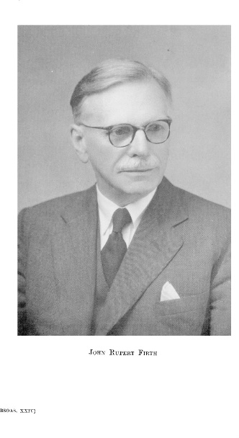
Central Idea in Modern NLP
“You shall know a word by the company it keeps.” J.R.Firth, English linguist (1957)
Firth’s work: basis for field of “distributional semantics”
– “linguistic items with similar distributions have similar meanings.”
Led to vector-space representations (embeddings) of words, sentences, documents, etc.

Slide 17

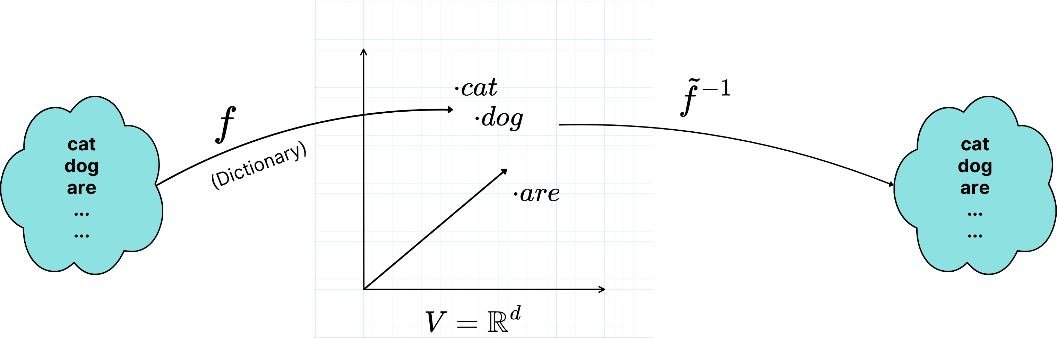
Vector-Space Models
Embedding maps token (word) to d-dimensional row-vector of reals
(e.g.) GloVe: Manning et al. 6 billion tokens, d = 50,100,200,300
|T |
Semantic feature space
Notes:
f: one-hot encoding -> embedding
O (one-hot vector) * W^(|T|*d ) = embedding

Slide 18
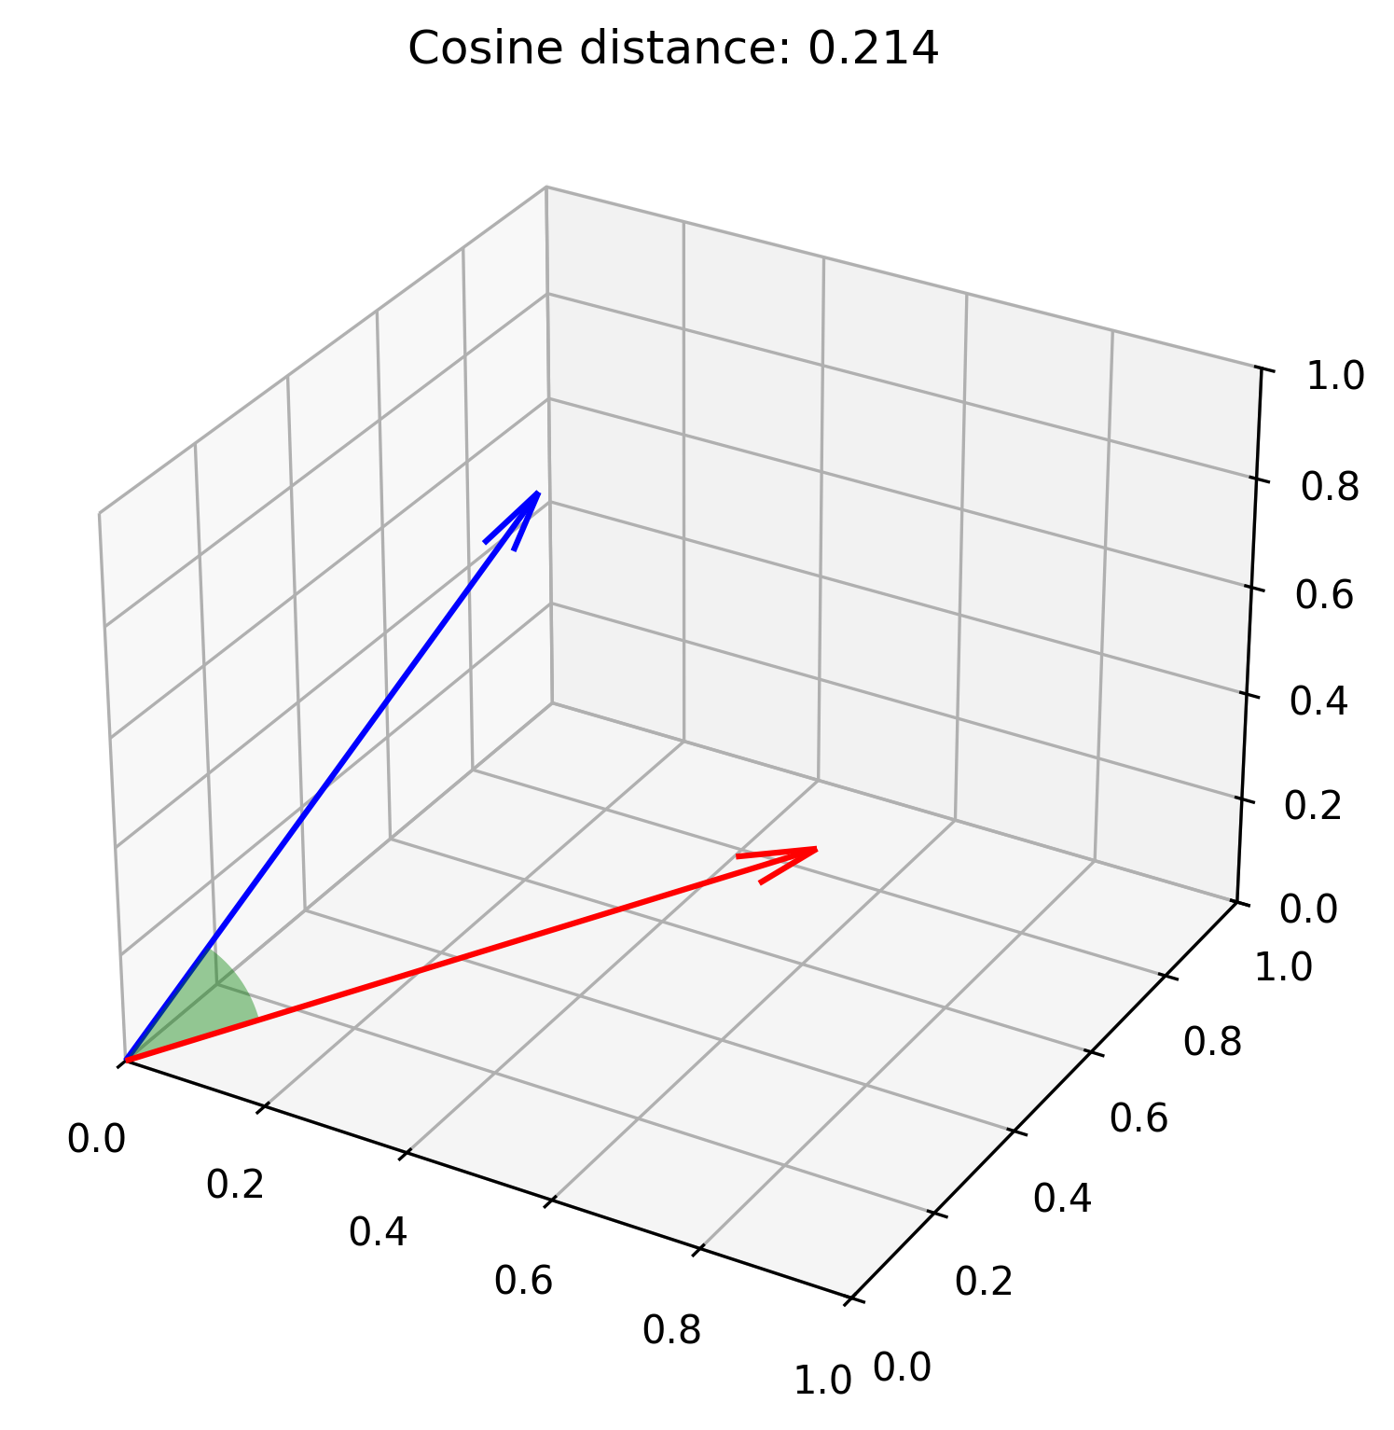
Three central assumptions about vector-space models
Principle of compositionality: representation of context is function of its word embeddings
  F(c) = γ(f(x₁),f(x₂),…,f(x_{k}))
Probability vector for next word for given context is function of representation of context
[p1,p2,…p|T|] = β(F(c))
Similarity/relevance of word y to word x is function of embeddings (cosine similarity, Euclidean distance, etc.)
A(x,y) = α(f(x),f(y))

Slide 19
Word2Vec: Continuous Bag of Words (CBOW)
The boy stood on the burning deck when all but he had fled.
Context for “stood”: 2 words to left and to right of occurrence
Vocabulary: V = {w₁,w₂,…,w_{|V|}} (set of words in corpus)
Goal: create vector space embeddings (E: V→ℜ^{n}) for words in corpus (E is function we want to learn)
CBOW: “a word is known by the company it keeps” John Firth
Context c_{i} for word occurrence o_{i} = set of words in neighborhood of o_{i}
Context embedding = average of embeddings of words in context
Training pairs: {<c_{i},w_{i}>}
Maximize alignment between embeddings of word and contexts in which it appears
Two words that show up in same contexts will have similar embeddings (“The boy jumped on the bus..”)
“Efficient implementations of word representations in vector space” Mikolov et al.

Slide 20
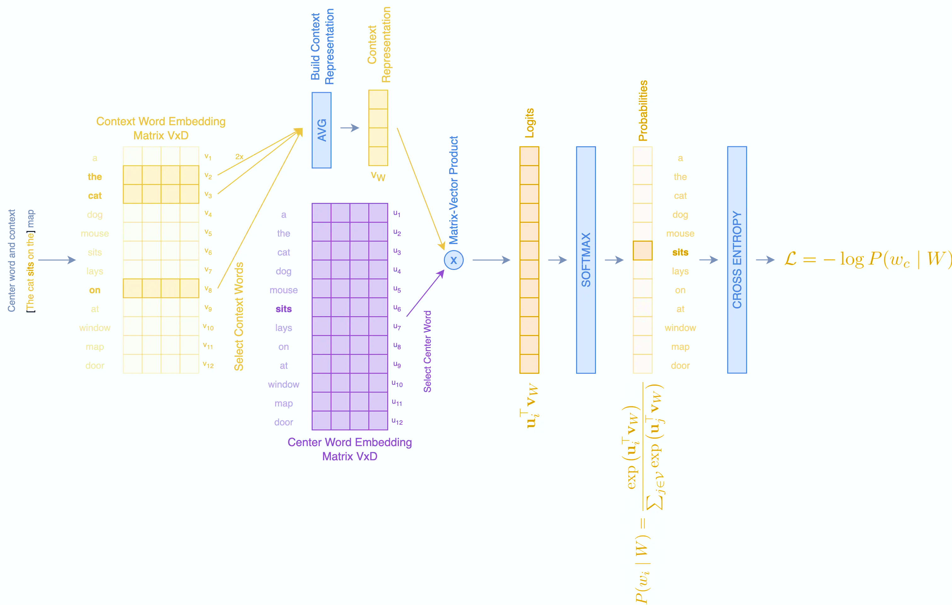
Word2Vec: Continuous Bag of Words (CBOW)
“Continuous bag of words” Tilo Flasche

Slide 21
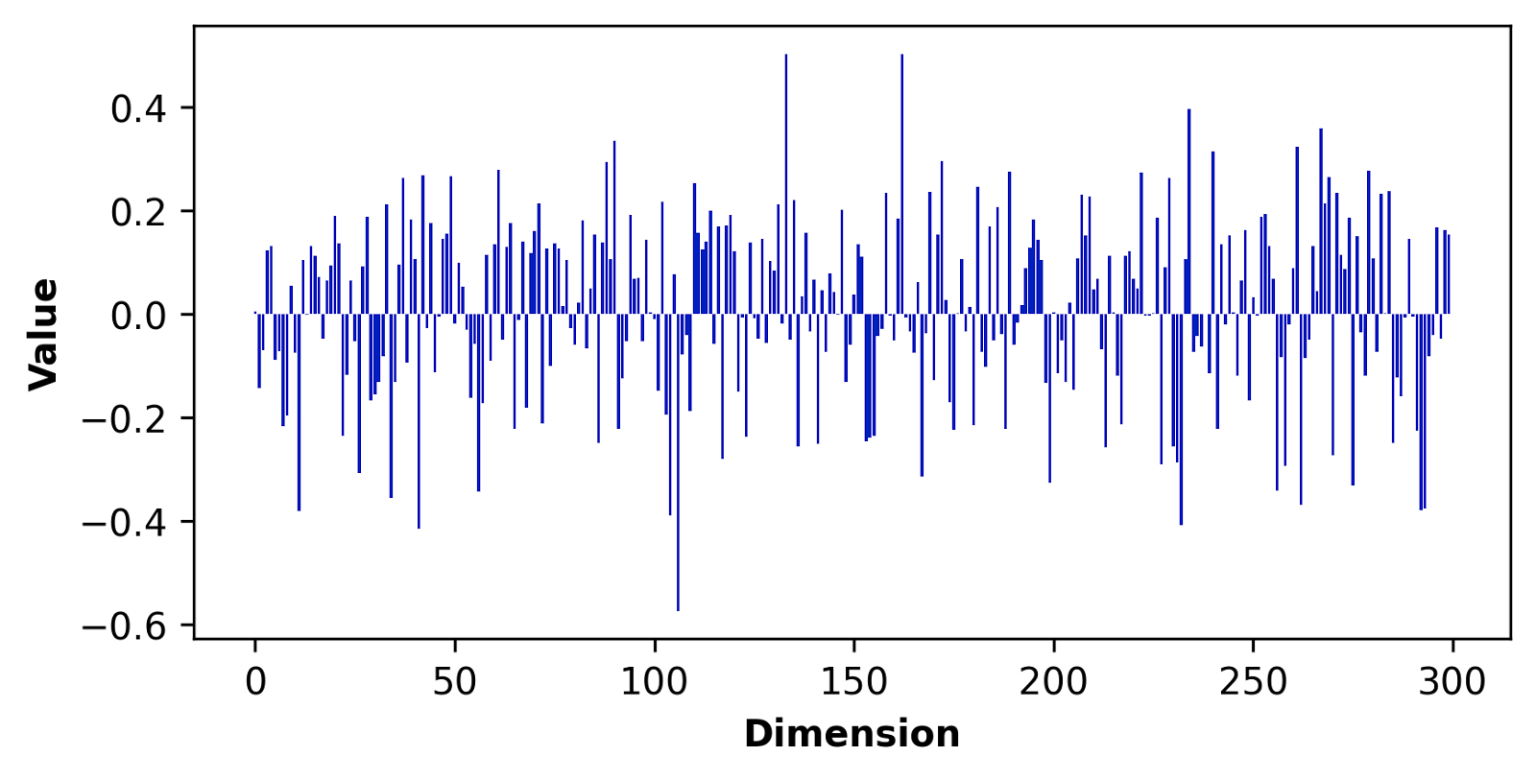
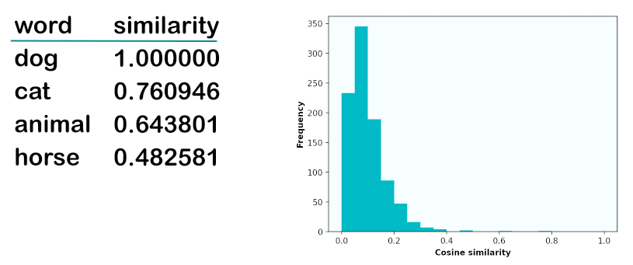
Word2Vec Embeddings
Embedding of “queen”
Cosine similarity (α) to “dog”
Pamela Fox: An introduction to Vector Embeddings

Slide 22
DNN2: Same as DNN1 but w/Embeddings
Kedi (|U|)
CE-Loss
Sampler
Probability vector (|U|)
Probability vector (|U|)
DNN
(implements β)
DNN
f
γ:
representation of context is concatenation of embeddings of its words
Output
embedding (d)
fareyi (|U|)
m
m
m
d
d
d
d
Training
Inference

Slide 23
Contextual Embeddings

Slide 24
Why contextual embeddings
Word embeddings from GloVe, Word2Vec etc. are static
  do not depend on task
  do not change during training/inference
Embeddings in transformers are contextual (Peters et al. 2018) and learned
  handle polysemy (e.g. “I bank only at my local bank.”)
  contextualized using attention
  initial embeddings for training can be random since they are learned
Easier to understand if initial embeddings come from GloVe etc.
  “Teaching is the art of telling fewer and fewer lies.”

Slide 25
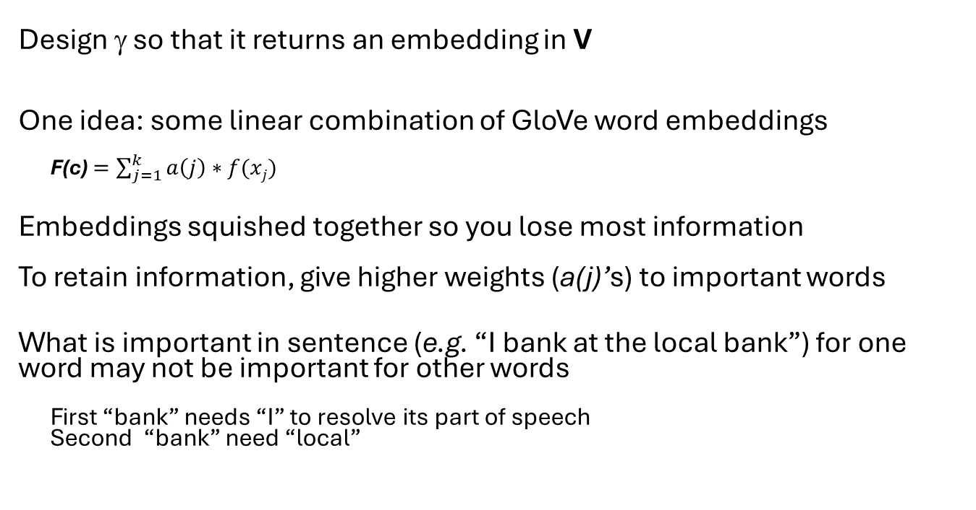
How to embed context in V?
Design γ so that it returns an embedding in V
One idea: some linear combination of GloVe word embeddings
F(c) $=\sum_{j=1}^{k}{a\left(j\right)∗f(xj)}$
Embeddings squished together so you lose most information
To retain information, give higher weights (a(j)’s) to important words
What is important in sentence (e.g. “I bank at the local bank”) for one word may not be important for other words
First “bank” needs “I” to resolve its part of speech
Second “bank” need “local”
Context: x₁ x₂ x₃ …x_{k}
  F(c) = γ(f(x₁),f(x₂),…,f(x_{k}))
F(c)
γ
f(x₁)
f(x₃)
f(x₂)
V

Slide 26
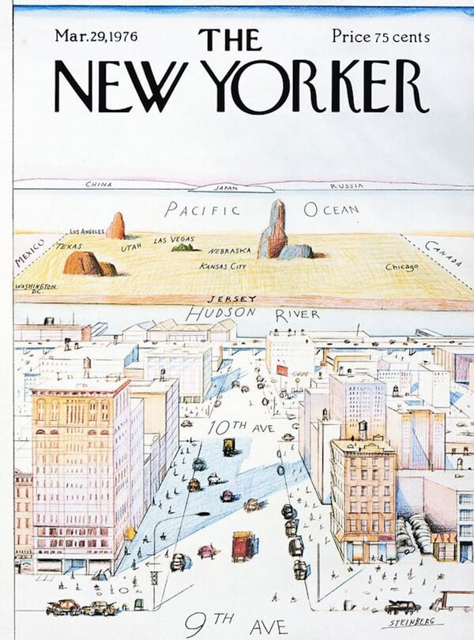
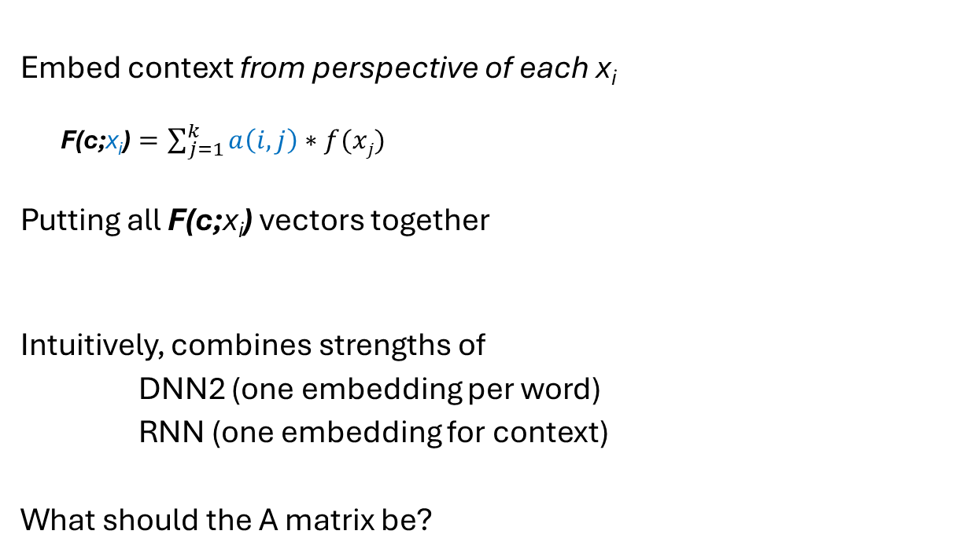
Refinement of idea
Embed context from perspective of each x_{i}
F(c;x_{i}) $=\sum_{j=1}^{k}{a\left(i,j\right)∗f(xj)}$
Putting all F(c;x_{i}) vectors together
Intuitively, combines strengths of
DNN2 (one embedding per word)
RNN (one embedding for context)
What should the A matrix be?
Context: x₁ x₂ x₃ …x_{k}
I bank only at my local bank
F(c;x₁)
F(c;x₃)
  Z^{kxd} = A^{kxk} X^{kxd} where X is matrix of word embeddings
f(x₁)
f(x₃)
F(c;x₂)
f(x₂)
V

Slide 27
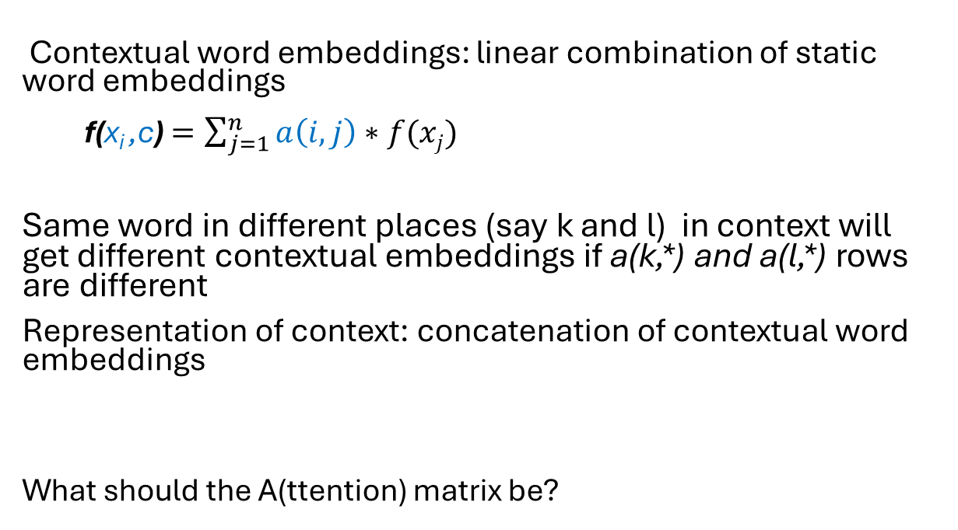
Implementation of contextual word embeddings
I bank only at my local bank
Contextual word embeddings: linear combination of static word embeddings
f(x_{i} ,c) $=\sum_{j=1}^{n}{a\left(i,j\right)∗f(xj)}$
Same word in different places (say k and l) in context will get different contextual embeddings if a(k,*) and a(l,*) rows are different
Representation of context: concatenation of contextual word embeddings
What should the A(ttention) matrix be?
Context: x₁ x₂ x₃ …x_{n}
f(c;x₁)
f(c;x₃)
f(x₃)
f(x₁)
f(c;x₂)
f(x₂)
  Z^{nxd} = A^{nxn} X^{nxd} where X is matrix of word embeddings
V

Slide 28
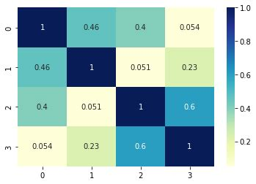
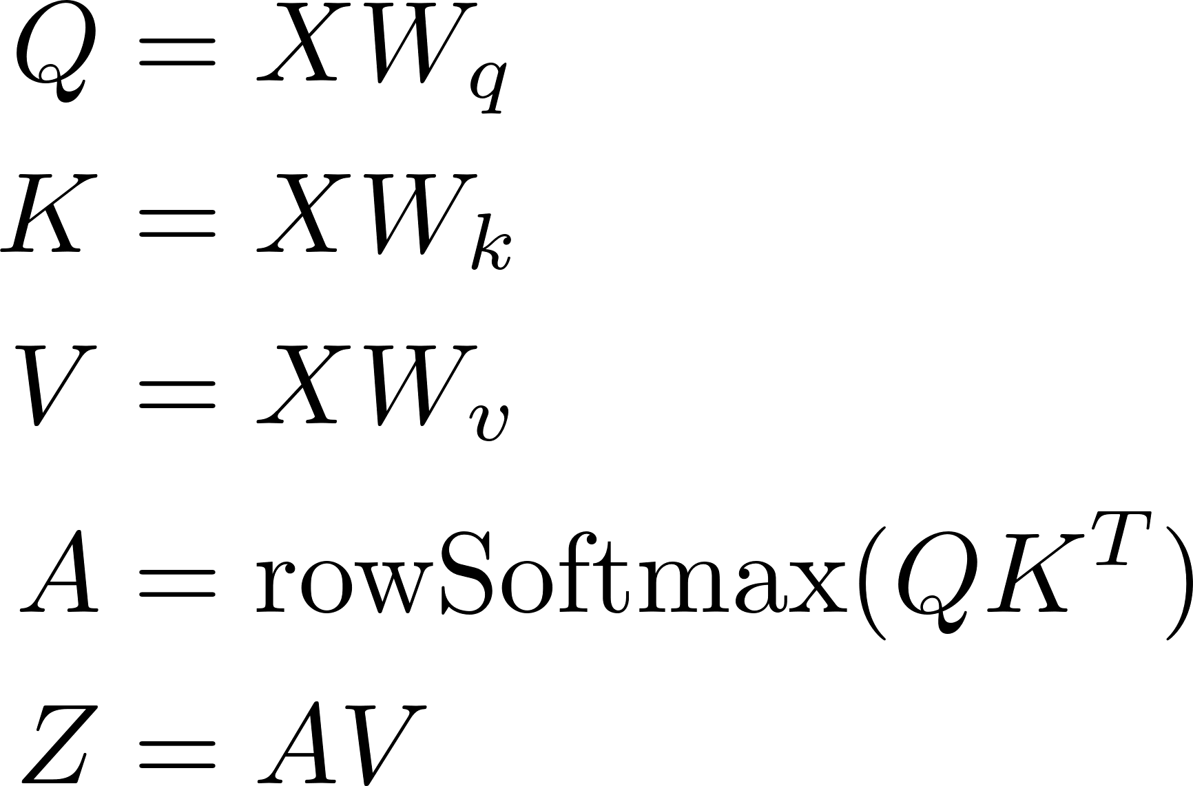
One choice: cosine similarity
Contextual embeddings are convex linear combinations of static embeddings
Step 1: Find cosine similarity between static embeddings of each pair of words in context (if embeddings are normalized, this is just dot product)
X: ℜ ^{n x d} (n words, embedding in ℜ^{d})
Logit matrix: XX^{T}
Step 2: Normalize values in each row using softmax
  Attention matrix A^{nxn}
Step 3: Compute contextual embeddings
Z = AX
This does not solve polysemy problem but provides intuition for attention
X occurs three times in computation
Transformers: X → Q,K,V via linear transforms
Linear transforms: learnt during training
words
words
Cosine similarity matrix
for four-word sentence

Slide 29
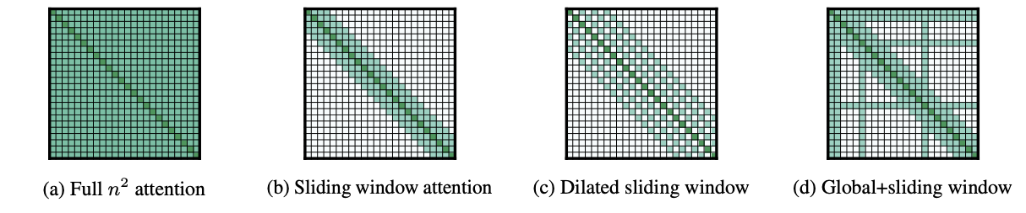
Attention Variants
(locality)

Slide 30
Attention terminology
Self-attention: between words in same context
Cross-attention: between words in different contexts
Masked self-attention: word attends only to words before it in sequence (attention matrix is lower triangular)

Slide 31
Transformers
“Attention is all you need,” Vaswani et al., 1706.03762v7.pdf

Slide 32
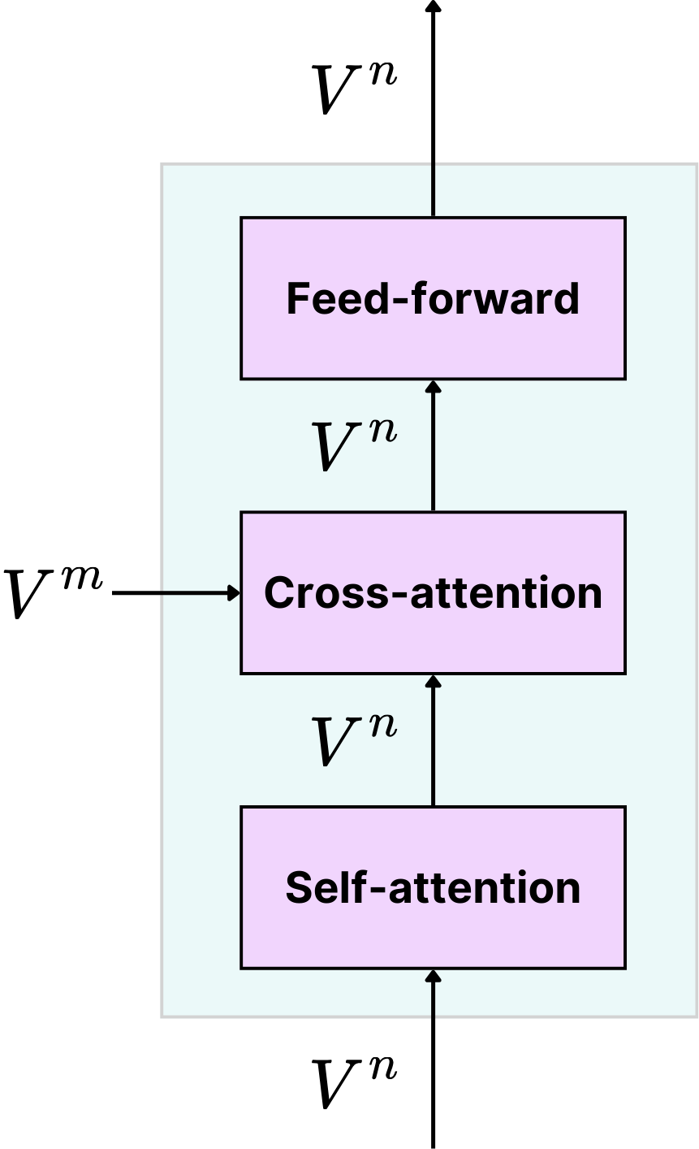
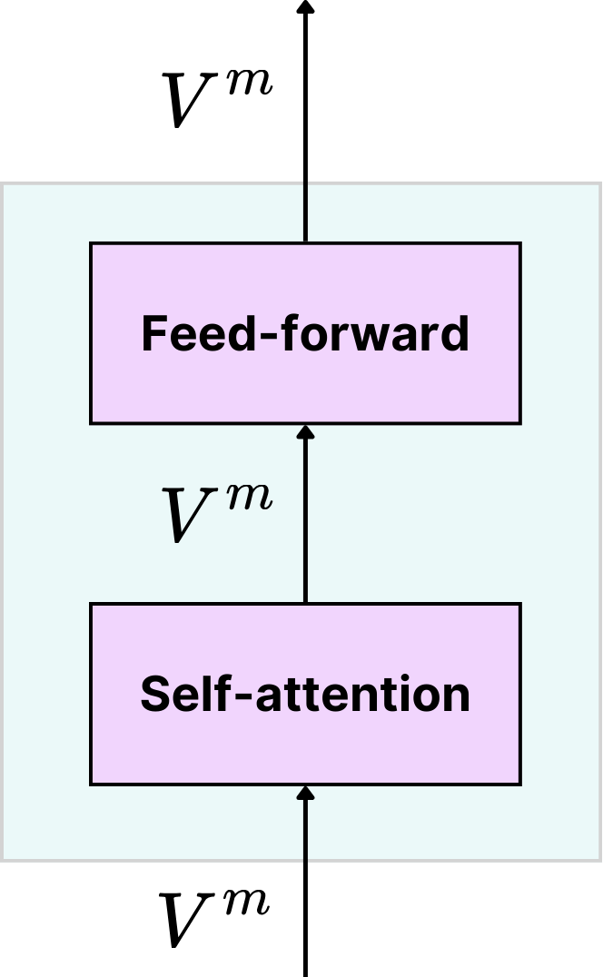
Transformer Block Diagram (Vaswani et al.)
Decoder
Encoder
Contextual
embeddings
Training: Turkish sentence
(masked self-attention)
Inference: current output
(compute self-attention
only for the latest word)
English sentence
Encoders and decoders can be stacked (blocks/layers)

Slide 33
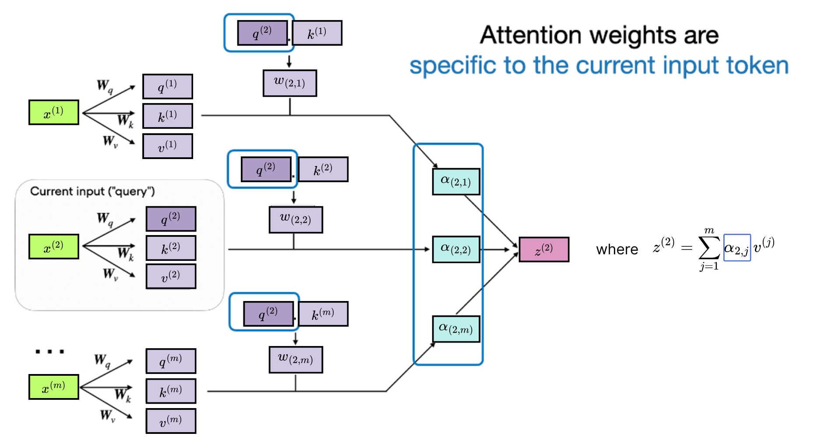
Encoder Self-attention
Linear transforms to generate
Query, Key, Value from embedding
From:
https://magazine.sebastianraschka.com/p/understanding-and-coding-self-attention
Input embeddings

Slide 34
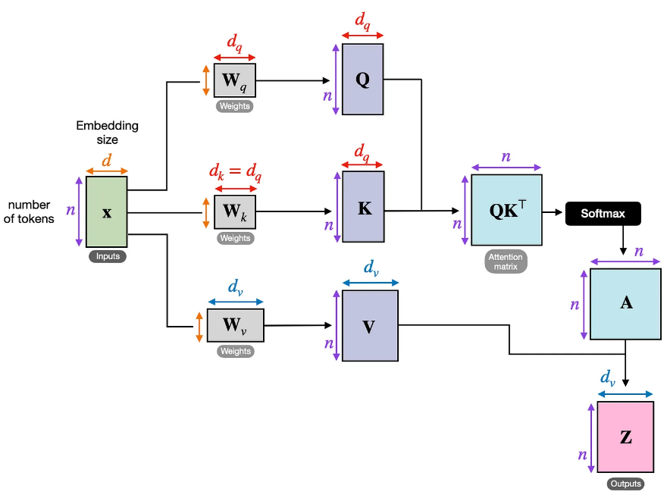

Self-attention
Logit
matrix
Attention
matrix
${d= d}_{v}$

Slide 35

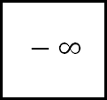
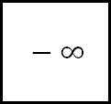
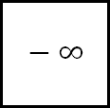
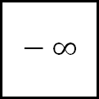

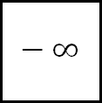
Decoder
Self-Attention
(training):
Masked
Self-attention
Entire output sentence is available but compute attention for a word using only words before it in sequence. Mimics what happens during inference.
Find cosine similarity matrix
Set values in upper triangle to -∞
Normalize values in each row with softmax to get attention matrix A^{nxn}
Compute contextual embeddings (Z) for all words
  Z^{nxd} = A^{nxn} X^{nxd}
words
$$− ∞$$
$$− ∞$$
$$− ∞$$
$$− ∞$$
$$− ∞$$
$$− ∞$$
words
Masked cosine similarity matrix
Cosine similarity matrix

Slide 36

Decoder Self-Attention (Inference): KV-cache
In each round, compute self-attention only for latest token
(intuition: append word to X)
KV-cache: keep K,V matrices and contextual embeddings for all previous output tokens
Compute key, query, value vectors for latest token & update K,Q,V
Compute contextual embedding for token and update Z
d
d
Attention
matrix
d
${d= d}_{v}$

Slide 37
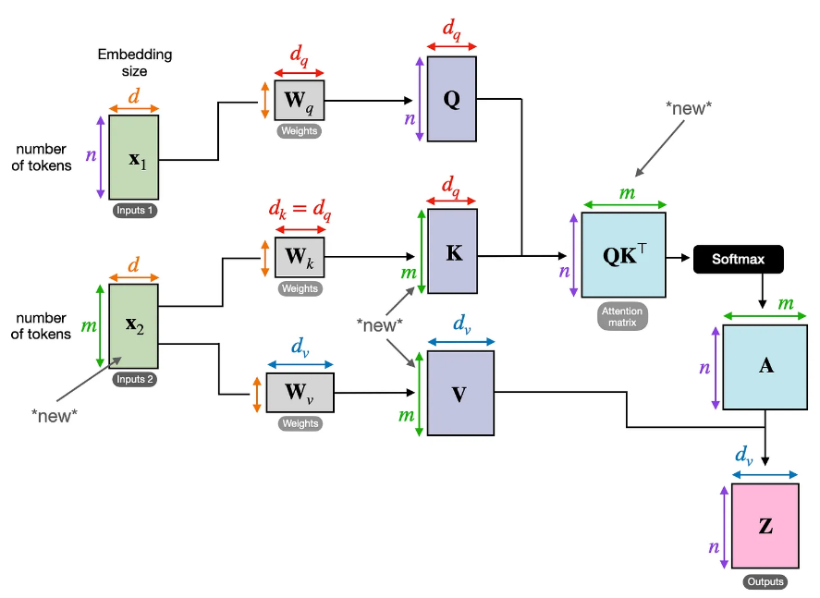

Cross-attention
English sentence
Turkish output so far
${d= d}_{v}$
Another design: send only W_{k} and W_{v} matrices from encoder to each decoder block/layer
Design shown in picture permits W_{k} and W_{v} matrices to be different in different layers

Slide 38
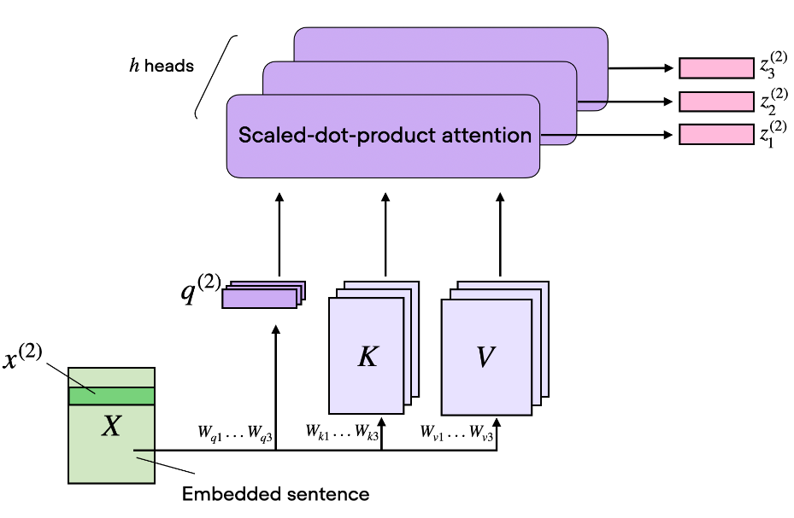
Multi-head attention
Divide embedding dimension d among h heads
Each Q,K,V etc. specializes on d/h dimensions
Concatenate outputs from heads to produce final contextual embeddings

Slide 39
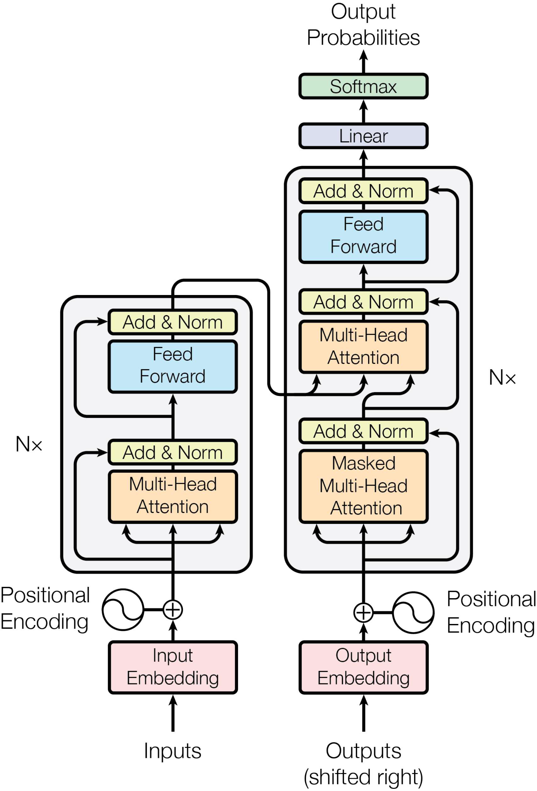
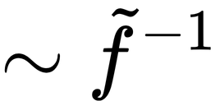
Transformer for
Translation
(Vaswani et al.)
(sampler not shown)
Contextualized embedding of
last word
Decoder
Encoder
Cross-attention:
input &output sequence
Self-attention:
input sequence
Masked self-attention:
output sequence

Slide 40
Computational Issues: Problem Size and Complexity
Hyper Parameters of (V)LLMs: representative values
size of token dictionary |T |: O(2¹⁷) = O(100, 000).
embedding dimension d: 2¹³ + 2¹² = 12, 288.
size of input window n: 2¹⁵ = 32, 768.
number of blocks N : ≥ 96 = 2⁶ + 2⁵.
number of attention heads H: 12288/128 = 96.
Learnable Parameters: W_{|T |} and, for each of the N levels, W_{Q}, W_{K}, W_{V} , W₁, b₁, W₂, b₂.
number of learnable parameters: O(|T |d + 5Nd² + l.o.t.) ≈ O(10¹¹−10¹²) floating point numbers (typically, 1FP = 2 bytes).
size of training set: O(10¹¹−10¹²) tokens (1 token ≈ 2 bytes).
computational effort for training: ??
computational effort for inference: ??
training cost: > 10⁸ USD for ChatGPT-4, according to Sam Altman (CEO of OpenAI).

Slide 41
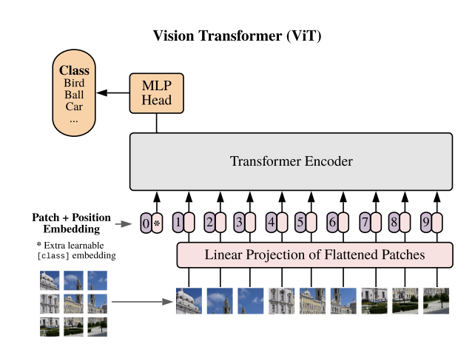
Vision Transformer (ViT)
https://docs.nvidia.com/nemo-framework/user-guide/latest/nemotoolkit/vision/vit.html

Slide 42
Summary
DNN1
Word: one-hot encoding
Context: concatenation of word encodings
Problems: dimensionality, generalization
DNN2
Word: task-agnostic embeddings (Word2Vec, GloVe)
Context: concatenation of word embeddings
Problems: polysemy
Contextual embeddings
Word: in-context embedding using attention
Context: concatenation of word embeddings
Problem: where does attention matrix come from?
Transformer
Learns attention matrix: cosine similarity after transforming context embedding
Omitted details: tokenization, positional encoding

Slide 43
Notes:
Train transformer
Slides
Encoder/decoder only (look at Dr. Krahenbuhl’s slides)

Slide 44
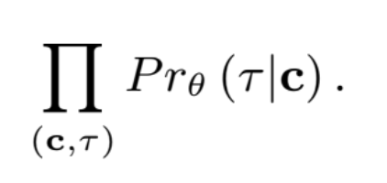
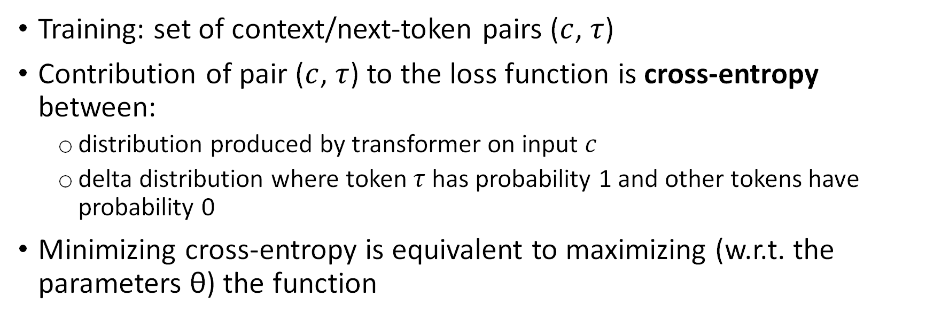
Training
Training: set of context/next-token pairs ($c$, $τ$)
Contribution of pair ($c$, $τ$) to the loss function is cross-entropy between:
  distribution produced by transformer on input $c$
  delta distribution where token $τ$ has probability 1 and other tokens have probability 0
Minimizing cross-entropy is equivalent to maximizing (w.r.t. the parameters θ) the function

Slide 45

Recurrent Neural Networks (RNNs)
Sequence to sequence translation first done using RNNs (2014)
Sequence to Sequence Learning with Neural Networks by Ilya Sutskever, et al
Words and sentences are embedded in same space
Input words are read sequentially
No explicit notion of attention
  Locality: implicitly, more attention paid to words closer to current input word

Slide 46
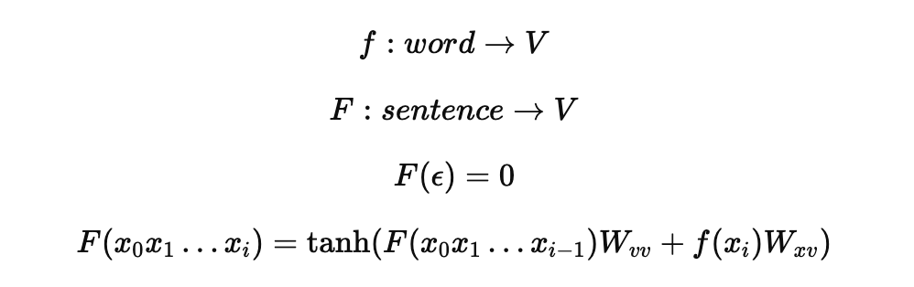
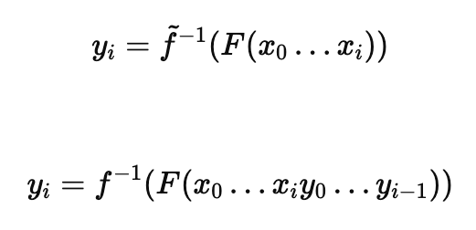
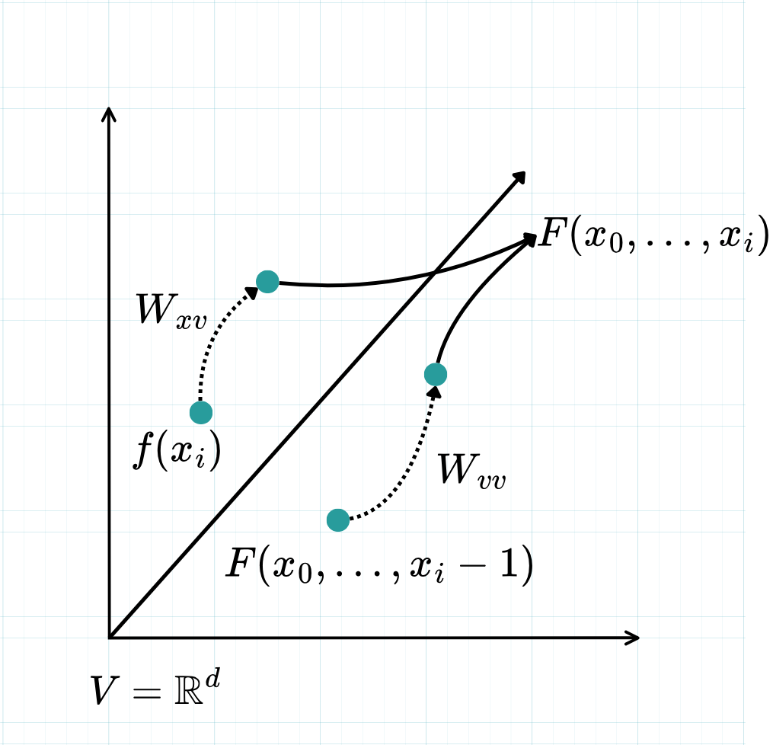
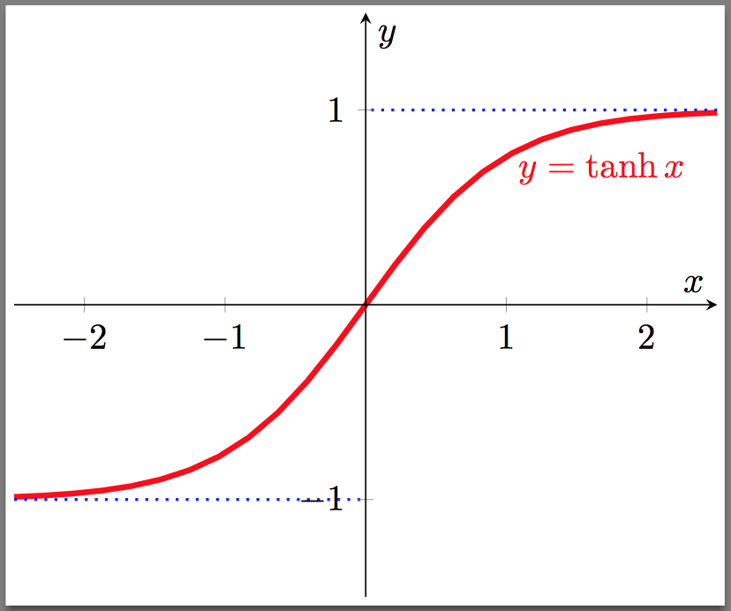
RNN embeddings
Online translation:
Encoder-decoder translation:

Slide 47
Attention
Introduced into RNNs by Bahdanau et al. (2014-2016)
Neural Machine Translation by Jointly Learning to Align and Translate
Transformer introduced at Google to overcome RNN limitations (2017)
  Sentences embedded in same space as words
  Sequential input
  Parallelism

Slide 48
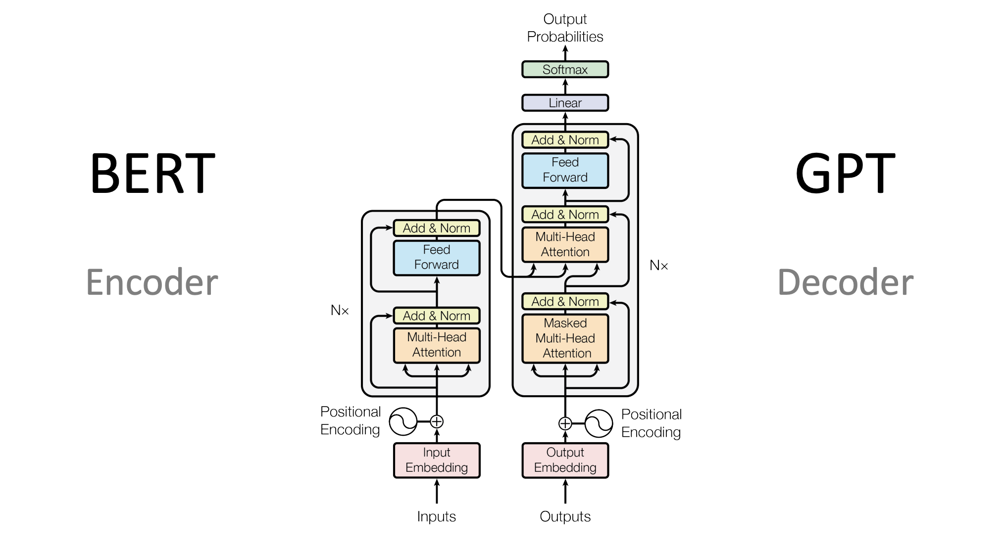
Encoder-Decoder

Slide 49
Strawman: DNN implementation (I)
One-hot encodings
of source & target
Loss
DNN
Kedi
m
m
|S|
|T|

Slide 50
Strawman: DNN implementation (II)
Loss
DNN
fareyi
One-hot encodings
of source & target
m
|S|
|T|

Slide 51
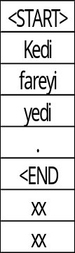
Strawman: DNN implementation (III)
Loss
DNN
xx
One-hot encodings
of source & target
m
|S|
|T|

Slide 52
Transformer for
Translation
(from Attention is..)
(sampler not shown)
Embedding of
next word
Encoder
Decoder

Slide 53
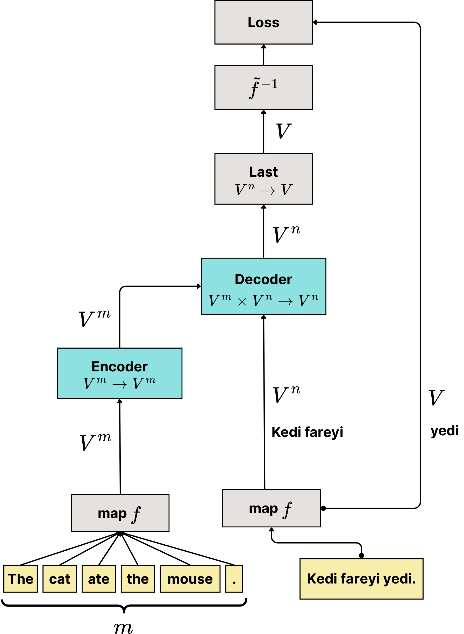
Abstraction of
Transformer

Slide 54
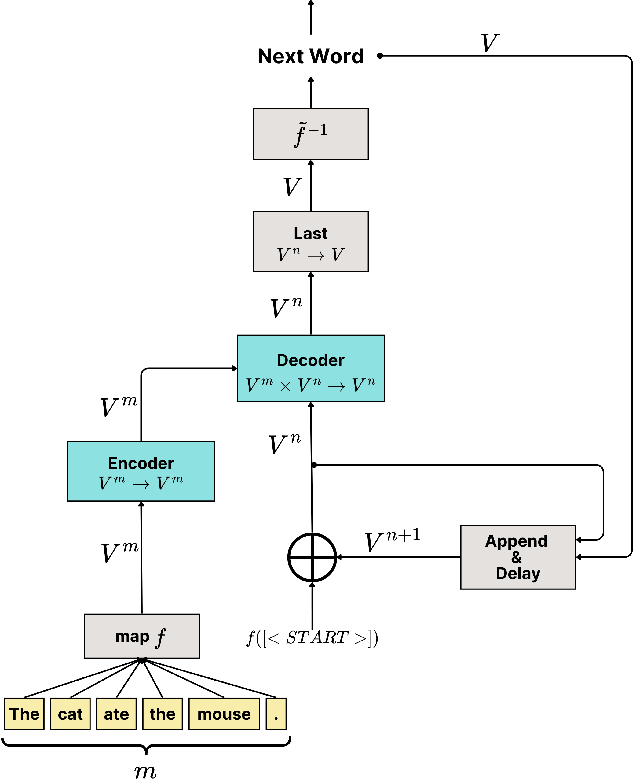
Abstraction of
Transformer
Sampler
β
[p(x₀),…,p(x_{|T|})] = β(F(c_{t}))
Generate
contextual
embeddings

Slide 55
Decoder Block
Notes:
Add masked self-attention

Slide 56
Strawman DNN2 (Training)
CE-Loss
CE-Loss
CE-Loss
Probability vector (|T|)
Probability vector (|T|)
Probability vector (|T|)
DNN
DNN
……..
DNN
https://arxiv.org/pdf/1902.06006
Kedi (|T|)
fareyi (|T|
<END> (|T|)
m
m
m
m
d
d
d
d
d
d
Kedi fareyi yedi .
Embeddings from GloVE or Word2Vec
for source & target words

Slide 57
To-do
Prettify slides
Indices starting at 1 not 0
Slides 15, 19, 29
Look at papers to see quiz questions – let know tomorrow for announcements
Misc:
MDP lecture
EPO
Talk in Bertinoro
FlashAttention / PagedAttention slides
Hand out assignment
List of term projects
PINNs

Slide 58
Vector-Space Embeddings
Embedding maps token (word) to d-dimensional row-vector of reals
(e.g.) GloVe: Manning et al. 6 billion tokens, d = 50,100,200,300
Semantic feature space
Notes:
f: one-hot encoding -> embedding
O (one-hot vector) * W^(|T|*d ) = embedding

Slide 59
Encoder-Decoder

Slide 60
DNN3 (Training)
CE-Loss
Probability vector (|T|)
DNN
mxd
mxd
Full
Self-attention
Masked
Self-attention
Kedi (|T|)
m
m
d
d

