Slide 1

CS395T: Foundations of Machine Learning for Systems Researchers
Fall 2026
Lecture 3: Memory Hierarchy Optimizations

Slide 2
Memory wall problem
Most programs that access a lot of data are memory-bound
  Latencies:
    Registers: 0 cycles, part of instruction execution
    L1 cache: 1-3 cycles
    L2 cache: 10-30 cycles
    DRAM: 100-300 cycles
Caches can reduce
  effective latency of memory accesses
  bandwidth needed between compute unit and memory
  but programs may need to be rewritten to take advantage of caching

Slide 3
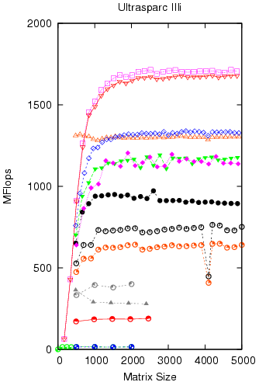
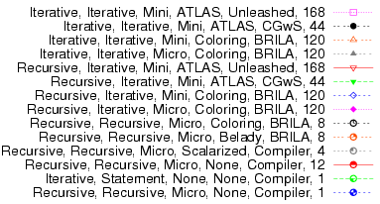
Do cache optimizations matter?
Study by Yotov et al.
Vendor BLAS
(multiple levels of blocking)
3 nested loops MMM
(no blocking)
6 MFlops
MMM for square matrices of various sizes
UltraSPARC III: peak 2 GFlops

Slide 4
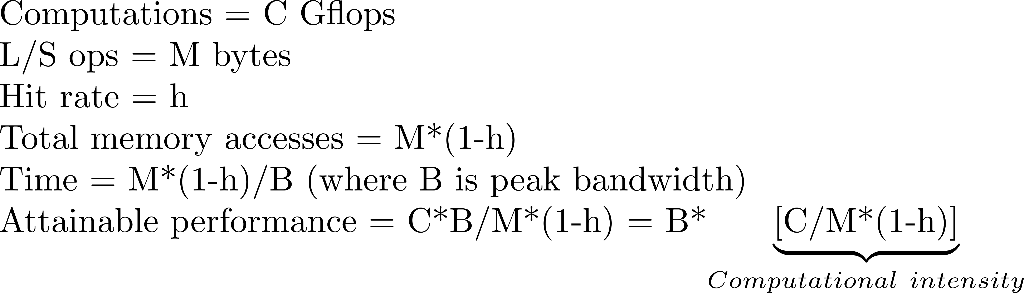
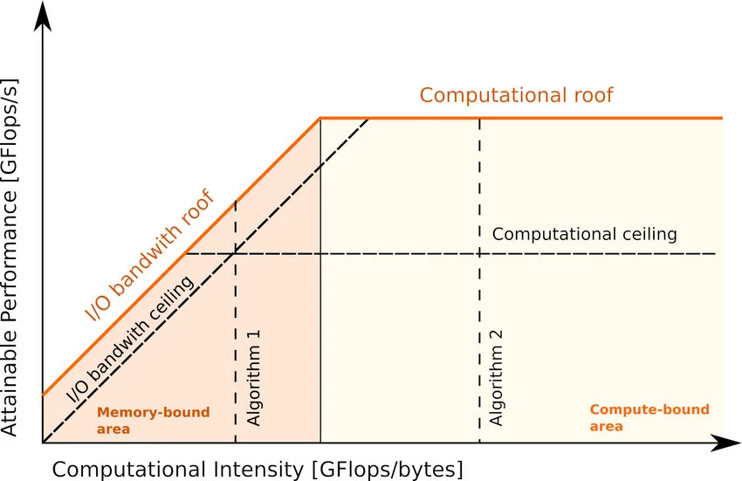
Roofline Model
Computational intensity
  Once some data has been loaded from DRAM into caches, registers etc., how many computations are performed on it?
  Abstraction of program execution
Performance diagnosis for program
  Memory-bound: computational intensity < ridge point
  Compute-bound: computational intensity > ridge point
y = memory-bandwidth*x
https://rtlearner.com/en/ai-architecture-13-roofline-model-analysis/#google_vignette

Slide 5
Increasing computational intensity
Semantics-agnostic transformations: increase h
  Loop transformations that ensure order of reads and writes to each location remain unchanged
  Oblivious to what is being computed
Semantics-aware transformations: increase h, reduce M
  May change result but programmer is OK with it
  Reduction operations (+,*,…)
  Quantization
  Model compression
Change algorithm
y = memory-bandwidth*x

Slide 6
Four key loop transformations (I)
Strip-mining: vectorization; does not change memory behavior
for i = 1,N for bi = 1,N,B
S for i = bi, min(bi+B-1,N)
S
Loop permutation: improve spatial locality
    for i = 1,N for j = 1,M
    for j = 1,M ⇒ for i = 1,N
    S S
Loop tiling/blocking: improve temporal locality
⇒
j
B
N
. . . . . .
B
. . . . . .
. . . . . .
for i = 1,N
for j = 1,N
S
⇒
for bi = 1,N,B
for bj = 1,N,B
for i = bi,min(bi+B-1,N)
for j = bj, min(bj+B-1,N)
S
. . . . . .
. . . . . .
1
. . . . . .
1
N
i

Slide 7
Four key transformation(II)
Loop/operator fusion + scalarization
very important for array/tensor languages like MATLAB, PyTorch
D = A+B+C where A,B,C are NxN matrices would be translated as
T = A+B
D = T+C
for i = 1, N
for j = 1, N
T(i,j) = A(i,j) + B(i,j)
for i = 1,N
for j = 1,N
D(i,j) = T(i,j) + C(i,j)
for i = 1, N
for j = 1, N
T(i,j) = A(i,j) + B(i,j)
D(i,j) = T(i,j) + C(i,j)
for i = 1, N
for j = 1, N
t = A(i,j) + B(i,j)
D(i,j) = t + C(i,j)
⇒
⇒
loop fusion
scalarization
Reduces amount of allocated memory and required bandwidth, improves temporal locality

Slide 8

Legality and profitability of loop transformations
Permutation, tiling and fusion are rescheduling transformations
  Change the order in which loop body instances are executed
Legality
  Not always legal
  Sophisticated techniques based on integer linear programming have been developed by compiler researchers
Profitability
  No general techniques available
  Need to model machine at some level
  AI/ML might help?

Slide 9
Goal of lecture
Develop quantitative and tractable cache abstractions to understand program performance
Study cache performance of matrix-vector multiplication (MVM) and matrix-matrix multiplication (MMM)
  simple but important kernels in computational science and machine learning
Understand program transformations for improving performance

Slide 10
Matrix-vector product
Code:
  for i = 1,N
  for j = 1,N
  y(i) = y(i) + A(i,j)*x(j)
Total number of references = 4N²
  Assumes all elements of A,x,y are stored in memory
  Smart compilers nowadays can register-allocate y(i) in the inner loop
  You can get this effect manually
  for i = 1,N
  temp = y(i)
  for j = 1,N
  temp = temp + A(i,j)*x(j)
  y(i) = temp
  To keep things simple, we will not do this, but our approach applies to this optimized code as well
j
x
i
y
A

Slide 11
Cache abstractions
Real caches are very complex
Science is all about tractable and useful abstractions (models) of complex phenomena
  models are usually approximations
Can we come up with cache abstractions that are both tractable and useful?
Focus:
  two-level memory model: cache + memory
  ignore prefetching: more significant omission

Slide 12
Key concept: stack distance
time
r₁
r₂
Address stream from processor
r₁ , r₂ : two memory references
  r₁ occurs earlier than r₂
stackDistance(r₁,r₂): number of distinct cache lines referenced between r₁ and r₂ [Mattson et al, IBM Systems Journal, 1970)

Slide 13
Modeling approach
First approximation:
  ignore conflict misses
  only cold and capacity misses
Most problems have some notion of “problem size”
  (eg) in MVM, size of matrix (N) is natural measure of problem size
Question: how does the miss ratio change as we increase the problem size?
Even this is hard, so estimate miss ratios at two extremes
  large cache model: problem size is small compared to cache capacity so only cold misses
  small cache model: problem size is large compared to cache capacity so both cold and capacity misses

Slide 14
Large and small cache models
Large cache model
  no capacity misses
  only cold misses
Small cache model
  cold misses: first reference to a line
  capacity misses: possible for succeeding references to a line
    let r₁ and r₂ be two successive references to a line
    assume r₂ will be a capacity miss if stackDistance(r₁,r₂) is some function of problem size
    argument: as we increase problem size, the second reference will become a miss sooner or later
For many problems, we can compute
  miss ratios for small and large cache models
  problem size transition point from large cache model to small cache model
    find the data element(s) that are reused with the largest stack distance
    compute largest problem size for which there are no capacity misses

Slide 15
MVM study
We will study five scenarios
  Scenario I
    i,j loop order, line size = 1 number
  Scenario II
    j,i loop order, line size = 1 number
  Scenario III
    i,j loop order, line size = b numbers
  Scenario IV
    j,i loop order, line size = b numbers
  Scenario V
    blocked code, line size = b numbers

Slide 16
Scenario I
Code:
  for i = 1,N
  for j = 1,N
  y(i) = y(i) + A(i,j)*x(j)
Inner loop is known as DDOT in NA literature if working on doubles:
  Double-precision DOT product
Cache line size
  1 number
Large cache model:
  Misses:
    A: N² misses
    x: N misses
    y: N misses
    Total = N²+2N
    Miss ratio = (N²+2N)/4N²
    ~ 0.25 + 0.5/N
j
x
i
y
A

Slide 17
Scenario I (contd.)
Address stream:
y(1) A(1,1) x(1) y(1) y(1) A(1,2) x(2) y(1)….. y(1) A(1,N) x(N) y(1) y(2) A(2,1) x(1) y(2)
Small cache model:
  A: N² misses
  x: N + N(N-1) misses (reuse distance=O(N))
  y: N misses (reuse distance=O(1))
  Total = 2N²+N
  Miss ratio = (2N²+N)/4N²
  ~ 0.5 + 0.25/N
Transition from large cache model to small cache model
  As problem size increases, when do capacity misses begin to occur?
  Subtle issue: depends on replacement policy (see next slide)
j
x
i
y
A

Slide 18
Scenario I (contd.)
Address stream:
y(1) A(1,1) x(1) y(1) y(1) A(1,2) x(2) y(1)….. y(1) A(1,N) x(N) y(1) y(2) A(2,1) x(1) y(2)
Question: as problem size increases, when do capacity misses begin to occur?
Depends on replacement policy:
  Optimal replacement:
    do the best job you can, knowing everything about computation
    only x needs to be cache-resident
    elements of A can be “streamed in” and tossed out after use
    So we need room for (N+2) numbers
    Transition: N+2 > C ➔ N ~C
  LRU replacement
    by the time we get to end of a row of A, first few elements of x are “cold” but we do not want them to be replaced
    Transition: (2N+2) > C ➔ N ~ C/2
Note:
  optimal replacement requires perfect knowledge about future
  most real caches use LRU or something close to it
  some architectures support “streaming”
    in hardware
    in software: hints to tell processor not to cache certain references
j
x
i
y
A

Slide 19
Miss ratio graph
1.0
miss
ratio
0.75
0.50
DDOT,b=1)
0.25
N
C/2
large cache model
small cache model
Jump from large cache model to small cache model will be more gradual in reality because of conflict misses

Slide 20
Scenario II
Code:
  for j = 1,N
  for i = 1,N
  y(i) = y(i) + A(i,j)*x(j)
Inner loop is known as AXPY in NA literature
Miss ratio picture exactly the same as Scenario I
  roles of x and y are interchanged
j
x
i
y
A

Slide 21
Scenario III
Code: assume A is stored in row-major order
  for i = 1,N
  for j = 1,N
  y(i) = y(i) + A(i,j)*x(j)
Cache line size
  b numbers
Large cache model:
  Misses:
    A: N²/b misses
    x: N/b misses
    y: N/b misses
    Total = (N²+2N)/b
    Miss ratio = (N²+2N)/4bN²
    ~ 0.25/b + 0.5/bN
j
x
i
y
A

Slide 22
Scenario III (contd.)
Address stream:
y(1) A(1,1) x(1) y(1) y(1) A(1,2) x(2) y(1)….. y(1) A(1,N) x(N) y(1) y(2) A(2,1) x(1) y(2)
Small cache model:
  A: N²/b misses
  x: N/b + N(N-1)/b misses (reuse distance=O(N))
  y: N/b misses (reuse distance=O(1))
  Total = (2N²+N)/b
  Miss ratio = (2N²+N)/4bN²
  ~ 0.5/b + 0.25/bN
Transition from large cache model to small cache model
  As problem size increases, when do capacity misses begin to occur?
  LRU: roughly when (2N+2b) = C
    N ~ C/2
  Optimal: roughly when (N+2b) ~ C ➔ N ~ C
So miss ratio picture for Scenario III is similar to that of Scenario I but the y-axis is scaled down by b
Typical value of b = 4 (SGI Octane)
j
x
i
y
A

Slide 23
Miss ratio graph
1.0
miss
ratio
0.75
0.50
0.50 (DDOT, b=1)
0.25
0.125 (DDOT,b=4)
N
C/2
large cache model
small cache model
Jump from large cache model to small cache model will be more gradual in reality because of conflict misses

Slide 24
Scenario IV
Code:
  for j = 1,N
  for i = 1,N
  y(i) = y(i) + A(i,j)*x(j)
Large cache model:
  Same as Scenario III
Small cache model:
  Misses:
  A: N²
  x: N/b
  y: N/b + N(N-1)/b = N²/b
  Total: N²(1+1/b) + N/b
  Miss ratio = 0.25(1+1/b) + 0.25/bN
Transition from large cache to small cache model
  LRU: Nb + N +b = C ➔ N ~ C/(b+1)
  optimal: N + 2b ~ C ➔ N ~ C
Transition happens much sooner than in Scenario III (with LRU replacement)
j
x
i
y
A

Slide 25
Miss ratios
Miss ratio
0.25(1+1/b)
DAXPY
0.75/b
0.50/b
DDOT
0.25/b
N
C/(b+1)
C/2

Slide 26
Scenario V
Intuition: perform blocked MVM so that data for each blocked MVM fits in cache
  One estimate for B: all data for block MVM must fit in cache
    B2 + 2B ~ C
    ➔ B ~sqrt(C)
  Actually, we can do better than this (see below)
Code: blocked code
  for bi = 1,N,B
  for bj = 1,N,B
  for i = bi,min(bi+B-1,N)
  for j = bj,min(bj+B-1,N)
  y(i)=y(i)+A(i,j)*x(j)
Choose block size B so
  you have large cache model while executing block
  B is as large as possible (to reduce loop overhead)
  for our example, this means B~c/2 for row-major order of storage and LRU replacement
Since entire MVM computation is sequence of block MVMs, miss ratio will be 0.25/b independent of N!
j
x
B
i
y
B

Slide 27
Scenario V (contd.)
Code: blocked code
  for bi = 1,N,B
  for bj = 1,N,B
  for i = bi,min(bi+B-1,N)
  for j = bj,min(bj+B-1,N)
  y(i)=y(i)+A(i,j)*x(j)
  Better code: interchange the two outermost loops and fuse bi and i loops
  for bj = 1,N,B
  for i = 1,N
  for j = bi,min(bi+B-1,N)
  y(i)=y(i)+A(I,j)*x(j)
  This has the same memory behavior as doubly-blocked loop but less loop overhead.
j
x
i
y
A

Slide 28
Miss ratios
Miss ratio
0.25(1+1/b)
DAXPY
0.75/b
0.50/b
DDOT
0.25/b
N
C/(b+1)
C/2

Slide 29
Notes
Strip-mining does not change the order in which loop body instances are executed
  always legal
Loop permutation and tiling do change the order in which loop body instances are executed
  not always legal
For MVM and MMM, they are legal, so there are many variations of these kernels that can be generated by using these transformations
  different versions have different memory behavior as we have seen

Slide 30
Matrix multiplication
We have studied MVM in detail.
In dense linear algebra, matrix-matrix multiplication is more important.
Everything we have learnt about MVM carries over to MMM fortunately, but more variations to consider since there are three matrices & three loops.

Slide 31
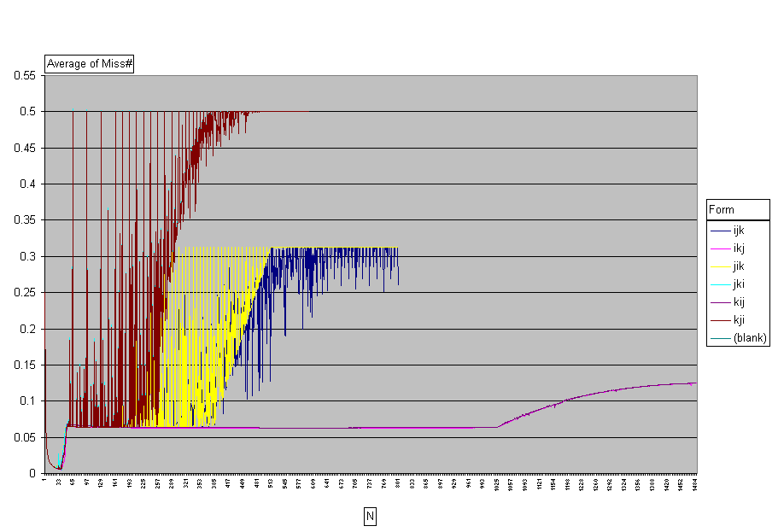
MMM miss ratios (simulated)
L1 Cache Miss Ratio for Intel Pentium III
  MMM with N = 1…1300
  16KB 32B/Block 4-way 8-byte elements

Slide 32
MMM
J
for I = 1, N//row-major storage
for J = 1, N
for K = 1, N
C(I,J) = C(I,J) + A(I,K)*B(K,J)
B
K
A
I
K
C
IJK version of matrix multiplication
Three loops: I,J,K
All six permutations of these loops compute the same values.
As in MVM, cache behavior of six versions is different

Slide 33
MMM
for I = 1, N//row-major storage
for J = 1, N
for K = 1, N
C(I,J) = C(I,J) + A(I,K)*B(K,J)
J
B
K
A
IJK version of matrix multiplication
I
K
C
K loop innermost
  A: good spatial locality
  C: good temporal locality
I loop innermost
  B: good temporal locality
J loop innermost
  B,C: good spatial locality
  A: good temporal locality
So we would expect IKJ/KIJ versions to perform best, followed by IJK/JIK, followed by JKI/KJI

Slide 34
MMM miss ratios (simulated)
L1 Cache Miss Ratio for Intel Pentium III
  MMM with N = 1…1300
  16KB 32B/Block 4-way 8-byte elements

Slide 35
Observations
Miss ratios depend on which loop is in innermost position
  so there are three distinct miss ratio graphs
Large cache behavior can be seen very clearly and all six version perform similarly in that region
Big spikes are due to conflict misses for particular matrix sizes
  notice that versions with J loop innermost have few conflict misses (why?)

Slide 36
IJK version (large cache)
for I = 1, N//row-major storage
for J = 1, N
for K = 1, N
C(I,J) = C(I,J) + A(I,K)*B(K,J)
B
K
A
K
C
Large cache scenario:
  Matrices are small enough to fit into cache
  Only cold misses, no capacity misses
  Miss ratio:
    Data size = 3 N²
    Each miss brings in b floating-point numbers
    Miss ratio = 3 N² /b*4N³ = 0.75/bN = 0.019 (b = 4,N=10)

Slide 37
IJK version (small cache)
for I = 1, N
for J = 1, N
for K = 1, N
C(I,J) = C(I,J) + A(I,K)*B(K,J)
B
K
A
K
C
Small cache scenario:
  Matrices are large compared to cache
    stack distance is not O(1) => miss
  Cold and capacity misses
  Miss ratio:
    C: N²/b misses (good temporal locality)
    A: N³ /b misses (good spatial locality)
    B: N³ misses (poor temporal and spatial locality)
    Miss ratio → 0.25 (b+1)/b = 0.3125 (for b = 4)

Slide 38
Miss ratios for other versions
for I = 1, N//row-major storage
for J = 1, N
for K = 1, N
C(I,J) = C(I,J) + A(I,K)*B(K,J)
B
K
A
K
C
IJK version of matrix multiplication
K loop innermost
  A: good spatial locality
  C: good temporal locality 0.25(b+1)/b
I loop innermost
  B: good temporal locality (N²/b + N³ +N³)/4N³ → 0.5
J loop innermost
  B,C: good spatial locality (N³/b + N³/b + N²/b)/4N³ → 0.5/b
  A: good temporal locality
So we would expect IKJ/KIJ versions to perform best, followed by IJK/JIK, followed by JKI/KJI

Slide 39
MMM experiments
Can we predict this?
L1 Cache Miss Ratio for Intel Pentium III
  MMM with N = 1…1300
  16KB 32B/Block 4-way 8-byte elements

Slide 40
Transition out of large cache
for I = 1, N//row-major storage
for J = 1, N
for K = 1, N
C(I,J) = C(I,J) + A(I,K)*B(K,J)
B
K
A
K
C
Find data element(s) reused with the largest stack distance
Determine condition on N for that to be less than cache capacity
For our problem:
  N² + N + b < C (with optimal replacement)
  N² + 2N < C (with LRU replacement)
  In either case, we get N ~ sqrt(C)
  For our cache, we get N ~ 45 which agrees quite well with data

Slide 41
Blocked code
j
k
B
B
B
i
A
C
As in blocked MVM, we actually need to
stripmine only two loops

Slide 42
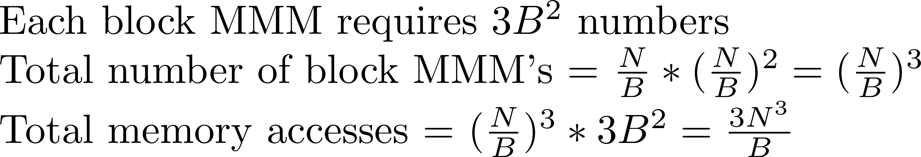
Back of envelope calculation
B
B
Rules of thumb:
i) Blocking square MMM by factor of B reduces volume of data moved between
memory and processor by a factor of B, provided B < sqrt(cache capacity)
ii) Stride-1 access reduces miss rates so effective latency of memory accesses
decreases. Volume of data moved between memory and processor may be reduced
by factor of L where L is the line size.

Slide 43
Summary
Programs have temporal and spatial locality
Exploiting spatial locality: stride-1 data accesses
Getting stride-1 data accesses:
  Try loop interchange/permutation
  Data structure transformations may help (transpose arrays)
Exploiting temporal locality: tiling/blocking
For MMM, blocking by a factor of B reduces memory accesses by a factor of B, provided block MMMs are in large cache region
(~ B < sqrt(cache capacity))
Key transformation: loop permutation and tiling/blocking
Determining optimal block size: models exist but need hyperparameter tuning in general

Slide 44
Caveats
Analytical model ignored prefetching
We considered two-level memory hierarchy
Real machines have multiple level memory hierarchies
In principle, need to block for all levels of memory hierarchy
In practice, matrix multiplication with very large matrices rare in computational science applications
      MMM shows up mainly in blocked matrix factorizations
      Therefore, it is enough to block for registers, and L1/L2 cache levels
    May not be the case in AI/ML applications (attention?)
Focus was on square dense matrices
Sparse matrices require different techniques
Even for non-square dense matrices, optimal block sizes may depend on matrix sizes

Slide 45
Advanced topics
I/O complexity of programs: Hong and Kung
  Given: algorithm (dataflow of computation)
  Memory model: two-level memory hierarchy
  Space of implementations: all legal sequential schedules of operations
  What is the minimum amount of data that must be moved by any schedule?
  I/O complexity bounds known for MMM, FFT, transpose etc.
Cache-oblivious algorithms: Frigo, Leiserson et al.
  Recursive, divide-and-conquer algorithms
  Perform “automatic blocking” through divide-and-conquer
  Claim: adapt automatically to memory hierarchy without needing cache parameters and achieve I/O complexity bound
  Reality: Yotov et al. analysis

