Slide 1
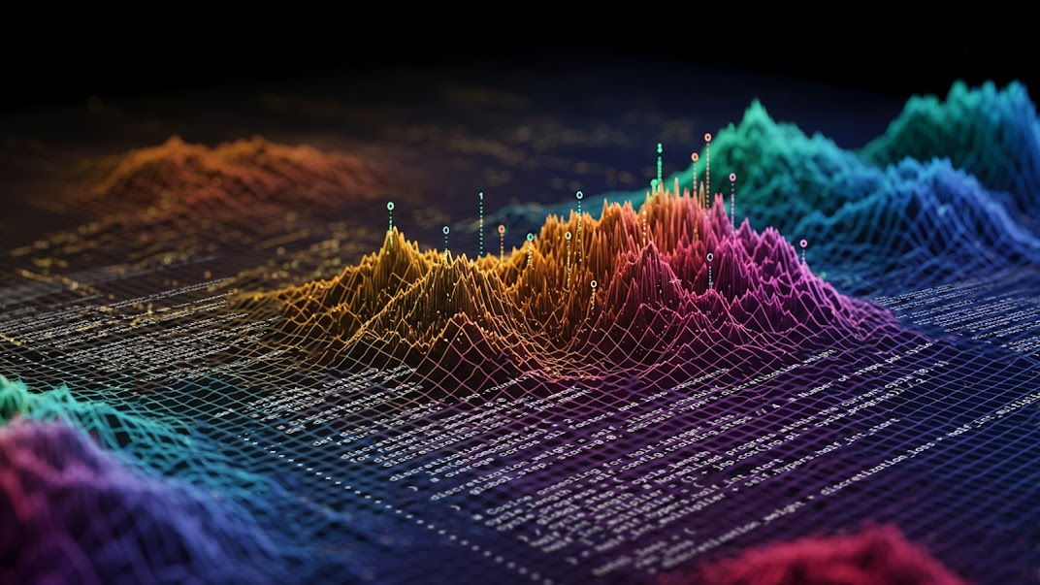
CS395T: Foundations of Machine Learning for Systems Researchers
Fall 2026
Lecture 1: Course Overview

Slide 2
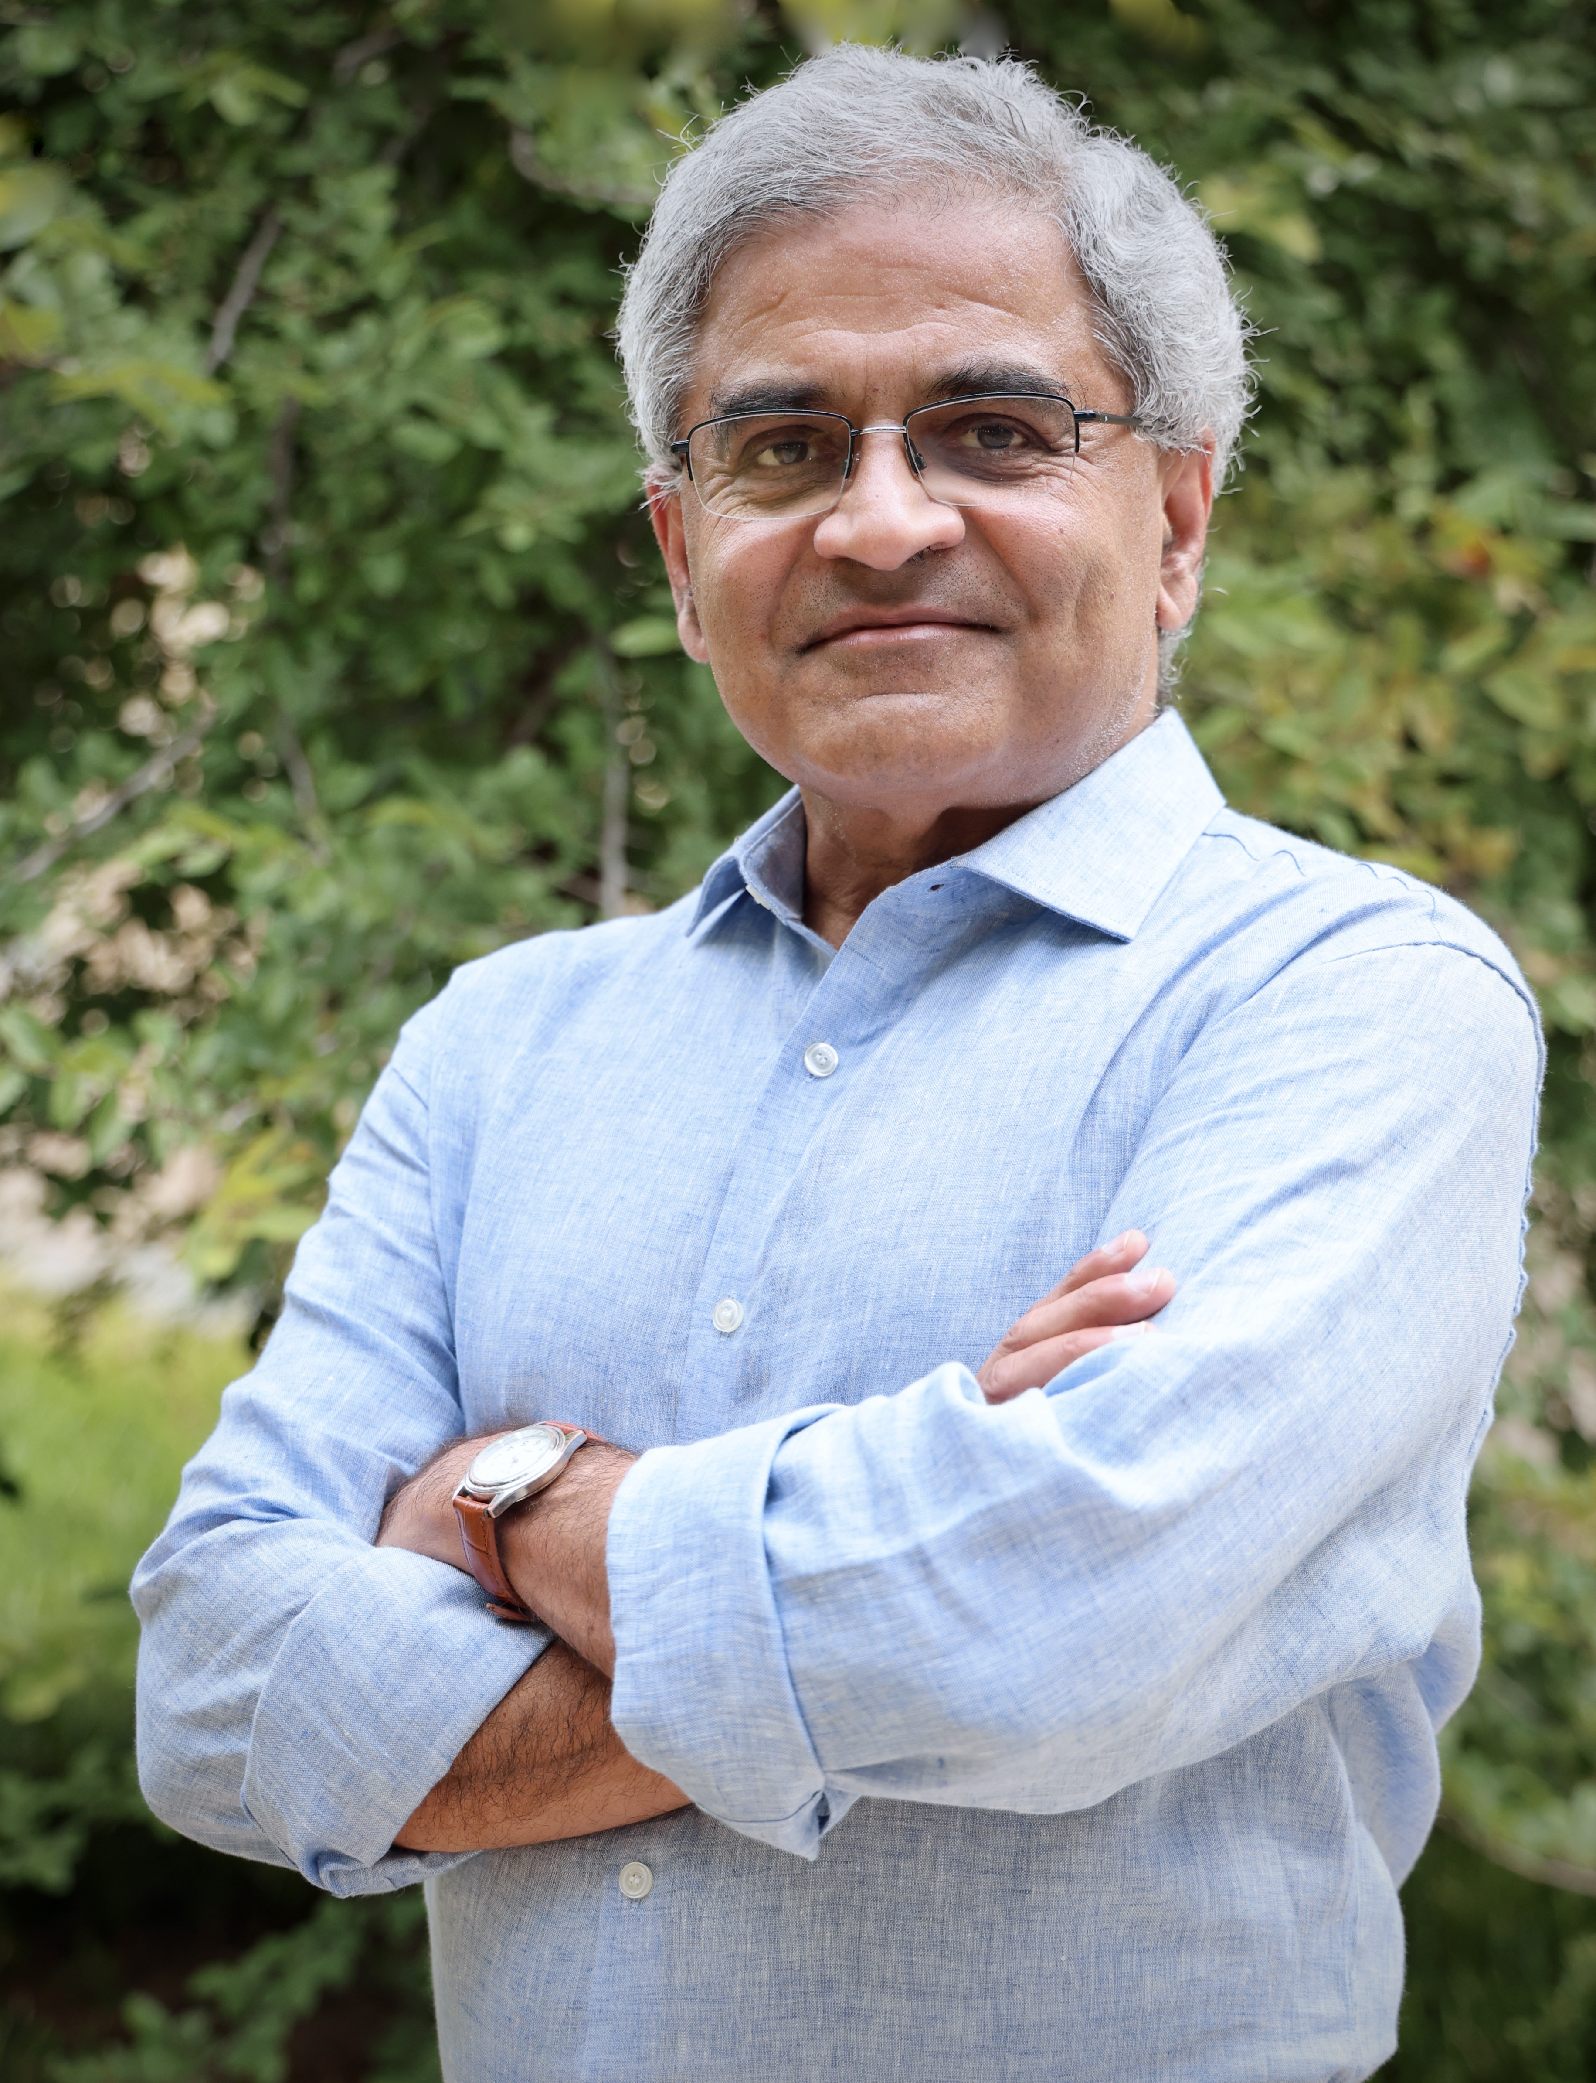
Keshav Pingali
W.A. “Tex” Moncrief Chair of Computing
  Department of Computer Science
  Oden Institute of Computational and Engineering Sciences
Research areas
  Parallel computing, high-performance graph analytics
  Programming languages and restructuring compilers
  Machine learning
Office: Peter O’Donnell Building (POB) 4.126
Email: pingali@cs.utexas.edu

Slide 3

Soumya Chaudhuri (TA)
2nd year MS student
  Department of Computer Science
Research areas
  Machine learning, systems
Email: sc74532@my.utexas.edu

Slide 4
Objectives of this course
Work across DL, RL, and evolutionary methods
Study classical techniques for obtaining high-performance on complex heterogeneous architectures
Study how to use all these methods to generate high-performance kernels
Neural
networks
Reinforcement
learning
Evolutionary
computing

Slide 5
What makes this course different (I)
Focus on challenging problem: generating high-performance kernels
  Unlike web-page generation for example, not much training data is available
  Underserved architectures
Opportunity
  Scalability, not efficiency, has been focus of ML researchers (DeepSeek)
  Domain knowledge of architectures and compilers give competitive advantage
Covers most major technologies used in cutting-edge AI systems
  Deep Learning — CNNs, RNNs, Transformers, LLMs
  Reinforcement Learning —MDPs, tabular methods, policy gradients
  Evolutionary Computation — genetic algorithms and neuroevolution

Slide 6
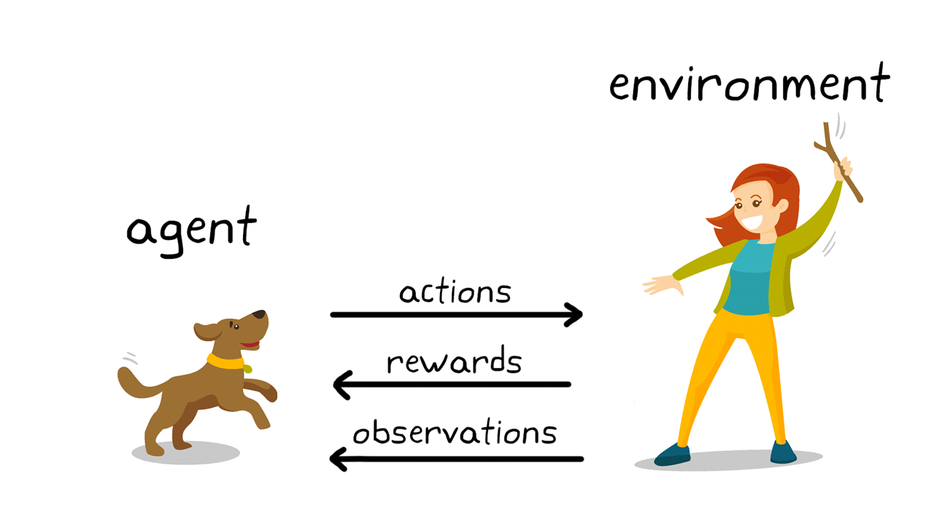
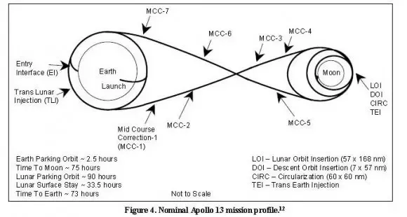
What makes this course different (IIa)
Standard presentations of RL: like training dogs, rewards for good behavior and punishment for bad behavior
Systems viewpoint: optimal control
  Sequence of actions under uncertainty to reach a goal while optimizing some objective function
Example: moon shot vs. gun shot
  Goal: reach the moon
  Burn minimal amount of fuel
  Uncertainty: imperfect modeling of rocket, gravitation, etc.
  Solution: series of mid-course corrections
Reinforcement learning
  Optimal control when you have little to no knowledge of the dynamics of system
  However, you are allowed to perform many experiments to build a working model of the dynamics
Reinforcement learning = Optimal control while learning system dynamics

Slide 7
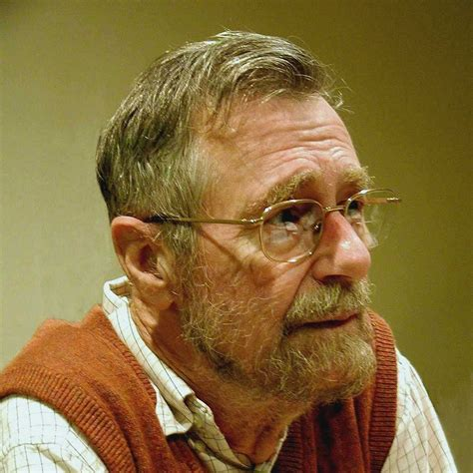
What makes this course different (IIb)
I will not
  use biological metaphors about neurons, synapses, training dogs, etc. ,
  talk philosophy,
  use complex math without providing intuition.
I will
  explain most concepts using paths in directed graphs,
  use pictures: lots of them.
  “Pictures are for weak minds.” Dijkstra

Slide 8
Prerequisites
Proficiency in Python
Familiarity with parallel programming at level of CS377P
  CPUs, memory hierarchy, GPUs, program optimization
Strong mathematical skills: calculus, statistics, and linear algebra
Coursework or equivalent experience in AI and ML at the level of CS 342 strongly recommended
Practical experience with training machine learning models will be useful.

Slide 9
Course Materials
Website for course:
  https://www.cs.utexas.edu/~pingali/CS395T/2026fa/index.html
  All lecture notes, announcements, papers, assignments will be posted there
Canvas:
  https://utexas.instructure.com/courses/1414520
  Announcements and grades will be posted there
Ed Discussion board:
  https://edstem.org/us/courses/100877/discussion
  Clarifications/additional information/questions for assignments, projects etc.

Slide 10
Lectures: division of labor
Core concepts: DNNs, RL, evolutionary computing, CPU/GPU architectures, memory hierarchy,…
  Presented by Professor Pingali, Soumya, and guest lecturers
Kernel generation papers
  Presented by students

Slide 11
Coursework
Presentations (40%)
  In-class paper presentation (30%)
  Paper review in NeurIPS style (10%)
Final project (50%)
  We will give you a list of suggested topics
  Feel free to come up with your own project relevant to course content
  Project proposal (5%)
  Final paper (25%)
  Final project presentation (20%)
Participation, quizzes, and project check-ins (10%)

Slide 12
Paper presentation and review guidelines
Paper presentation
  Each student will give one presentation.
  We will give you one or more papers to start from, but you should conduct a wider literature search for related papers.
  Go into depth on a couple of papers or do a "big picture" presentation.
  Presentations should be roughly 25 minutes in length.
Paper review
  Each paper presentation will be followed a 5-minute review delivered by another student.
  Students assigned as reviewers are expected to prepare a short critique of the presented paper in the style of a NeurIPS review (2025 guidelines can be found here for reference). Example review for FlashAttention paper can be found here.
Instructions are also in Ed.

Slide 13
To-do items
Complete the introductory survey on Ed Discussion by Thursday, August 27th (end of day)
Sign-up for a paper presentation, and for a peer review (for a different paper)
  Sign-up sheets are in Ed
  Complete sign-ups by next Thursday, September 3rd
  Email sc74532@my.utexas.edu with your choices as well

Slide 14
Kernel Generation Problem

Slide 15
Conceptually, big search problem
Given input program, space of semantically equivalent programs
I/O behavior is same
Find “best performing one” for given architecture
In general, impossible to find all these automatically (Rice’s theorem)
Limit ourselves to some subset
What is that subset?
Performance models: how do we know which variant is best?
Performance can depend on input sizes/data
x
Input
program
Best-performing
program
Programs I/O equivalent
to input program
All legal programs

Slide 16
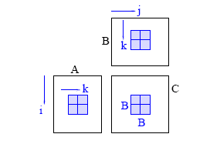
Traditional restructuring compiler techniques (I)
Suite of program transformations
Rewrite rules, usually at loop level
Correctness
Semantics agnostic: dependence analysis
Most numerical and ML operations
Pattern matching
Reduction operations (e.g. +,AND,…)
Flash Attention
Symbolic analysis: powerful but intractable
Fractal symbolic analysis
Menon & P. for blocking LU w/pivoting
Tiled MMM

Slide 17
Traditional restructuring compiler techniques (II): problems
Intermediate steps may generate
Poorly performing programs
Incorrect programs that get “fixed” by later steps
➔ Cannot rely on “monotonicity” of correctness and performance
Lack performance models to choose between variants
(e.g.) tile sizes: Yotov et al.
Best-performing variant may depend on input sizes/values
(e.g.) sparse matrix codes
x
Input
program
x
x
x
x
“Best”
program
Elementary transformation
like loop interchange or tiling

Slide 18

Another approach: LLMs
Factors contributing to rise of AI/ML
Algorithmic advances
  Backpropagation: improved efficiency of training neural networks, enabling more complex models.
  Transformers and Large Language Models
Big Data Availability
  Explosion of multi-modal data from sources like social media, sensors, and online transactions
Enhanced Computational Power
  Availability of powerful GPUs and specialized hardware accelerates training, allowing more complex models to be developed and deployed

Slide 19
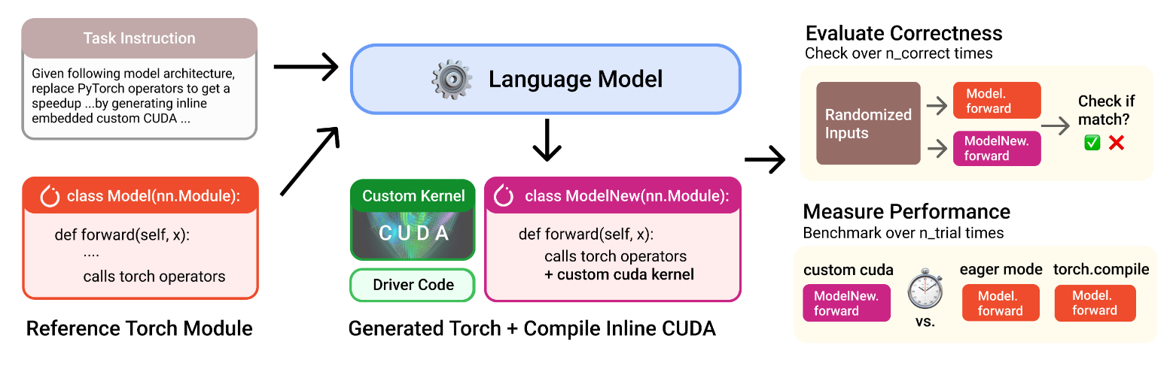
Kernelbench: Ouyang et al 2025
Evaluation suite: 250 tasks
Level 1: primitive operations (e.g. convolutions, MMM)
Level 2: sequence of operations (e.g. convolution + ReLU)
Level 3: full ML architectures (e.g. AlexNet)
More recent papers
Using RL to eliminate human-in-the-loop
Program representations for ML-driven kernel generation

Slide 20

Problems with LLM approach
Training data (code) is limited
Only 0.073% of code in The Stack v1.2 is CUDA
Problem is worse for programming models like AMD ROCm
Limited data for new architectures
Many new processors for training and inference
Not much knowledge on how to implement fast kernels on
underserved architectures

Slide 21
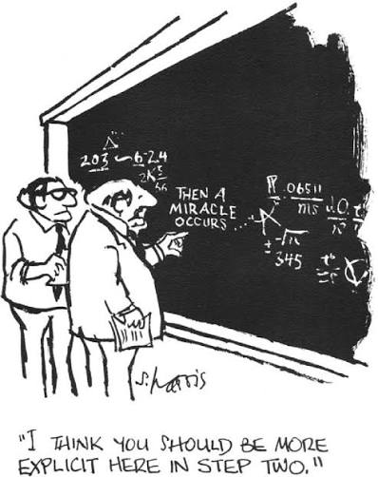
Combining domain-knowledge with AI/ML?
Caveat: Sutton’s bitter lesson is observation that in AI in the long run, general approaches that scale with available computational power tend to outperform ones based on domain-specific understanding because they are better at taking advantage of the falling cost of computation over time (wiki)
(e.g., chess, machine translation, speech recognition…)
The Bitter Lesson (Sutton)
Caveats to caveat: bitter lesson is lesson about knowledge acquisition
Does not apply if there is little training data
Bitter lesson says nothing about representation of knowledge
Traditional representation: set of rules with heuristics for choosing among them
New representation: coefficients (weights) that define a complex nonlinear function
Can traditional view be reconciled with Sutton’s bitter lesson?
Is attention an example of domain-specific understanding?

Slide 22
Summary
Work across DL, RL, and evolutionary methods
Study classical techniques for obtaining high-performance on complex heterogeneous architectures
Study how to use all these methods to generate high-performance kernels

Slide 23
Supplementary Material

Slide 24
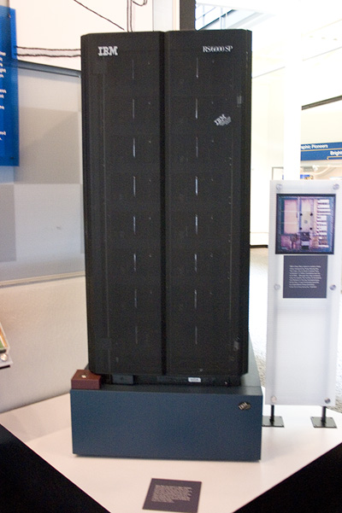
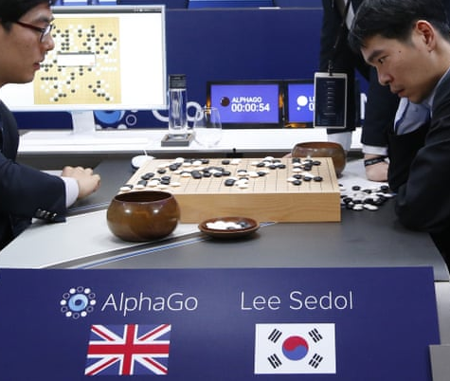
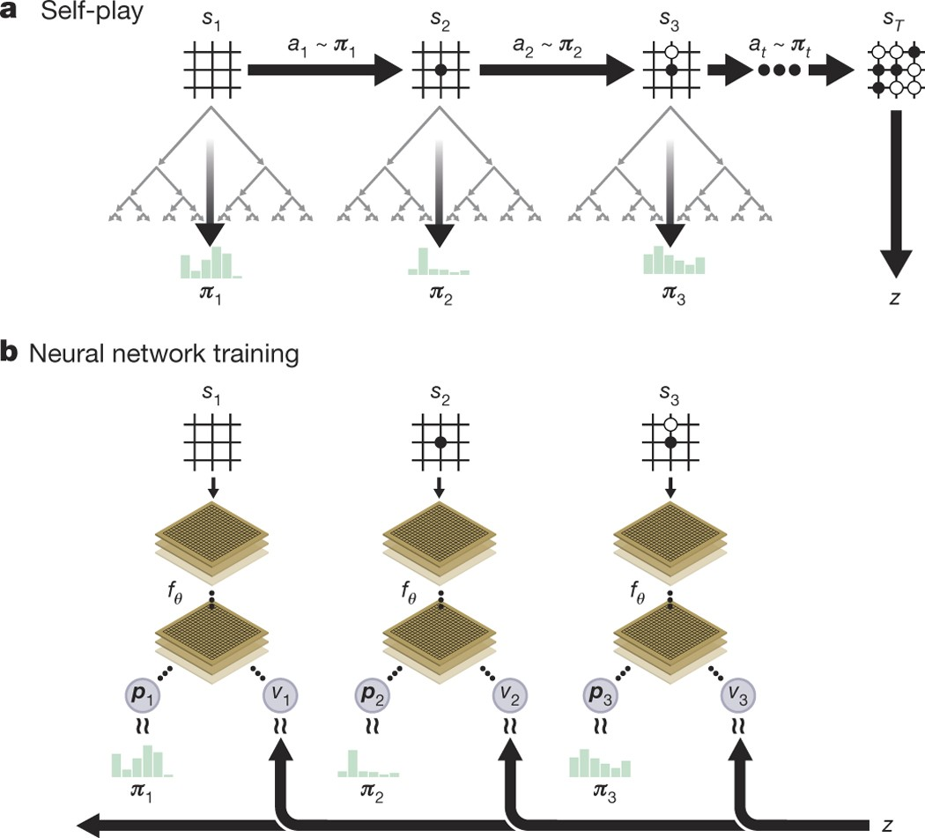
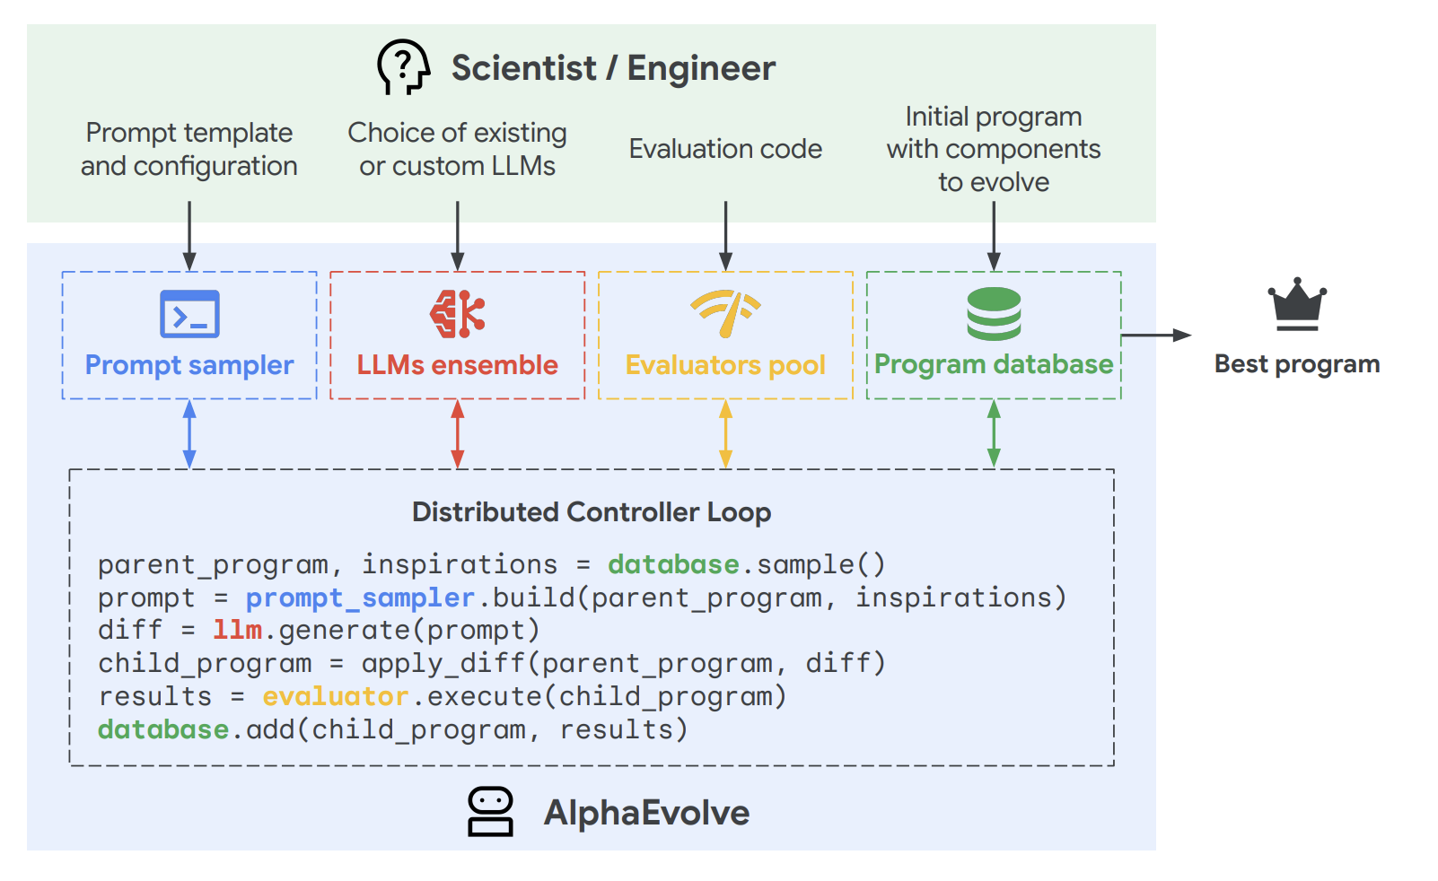
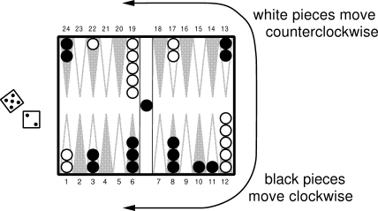
Progression of ML Systems
Systems complexity grows alongside ML sophistication
1991: TD-Gammon — Backgammon (NN+TD learning)
1997: Deep Blue — Chess (alpha-beta search)
2017: AlphaGo Zero — Go (CNNs + deep RL)
2025: AlphaEvolve — Inventing algorithms (LLM + evolutionary algorithms)
TD-Gammon (1991)
Deep Blue (1997)
AlphaGo (2016)
AlphaGo Zero (2017)
AlphaEvolve (2025)

Slide 25
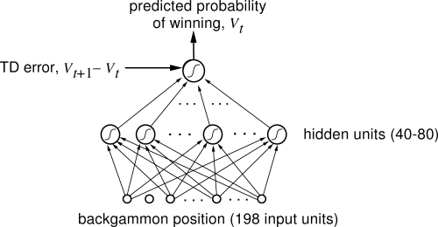
TD-Gammon (1991): NN+TD-learning
Exploited human game insights
Ran on IBM RS/6000 work-station (240 Mflops)

Slide 26
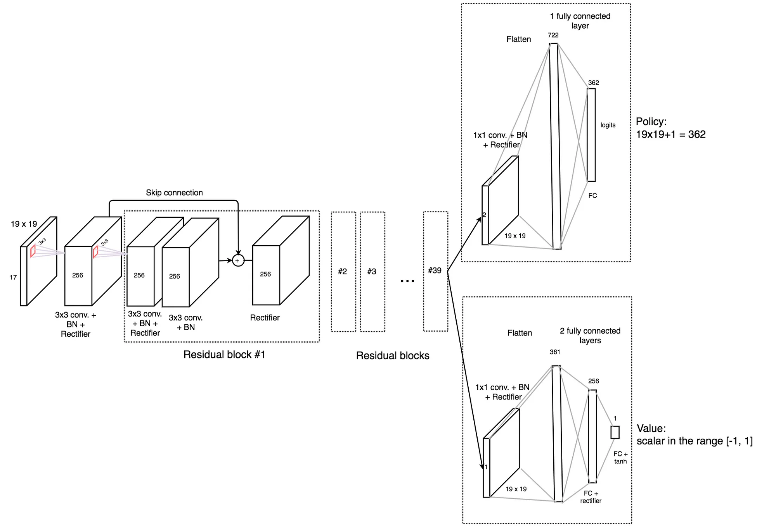
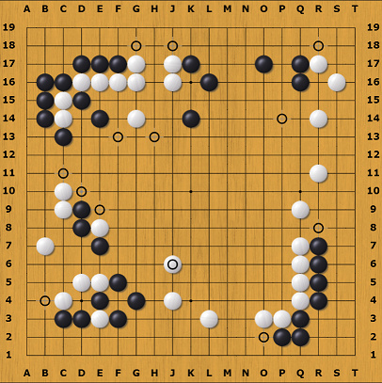
AlphaGo Zero (2017): CNN+Deep RL
Policy/value network for RL
19x19 board
Convolutional Neural Network
Learned by playing against itself
64 TPUs, trained over several days

Slide 27
AlphaGo Zero (2017)
Policy/value network for RL
8 channels: positions of the current player's stones from the last eight time steps
8 channels: positions of the other player's stones from the last eight time steps.
1 channel: all 1 if black is to move, and 0 otherwise.
Policy head outputs logit array of size 19x19 representing the logit of making a move in one of the points, plus the logit of passing.
Value head outputs number in range (-1,+1), representing expected score for current player.
-1 represents current player losing, and +1 winning.

Slide 28
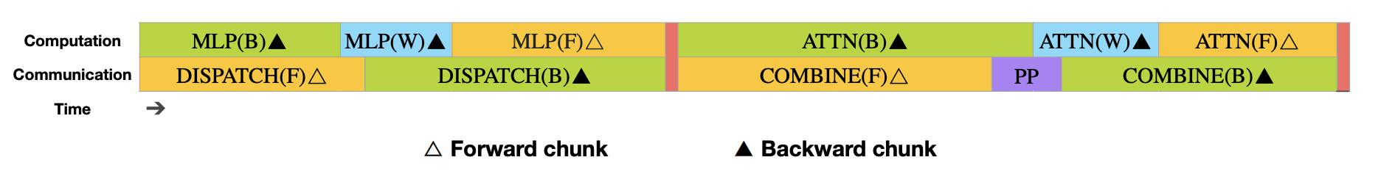
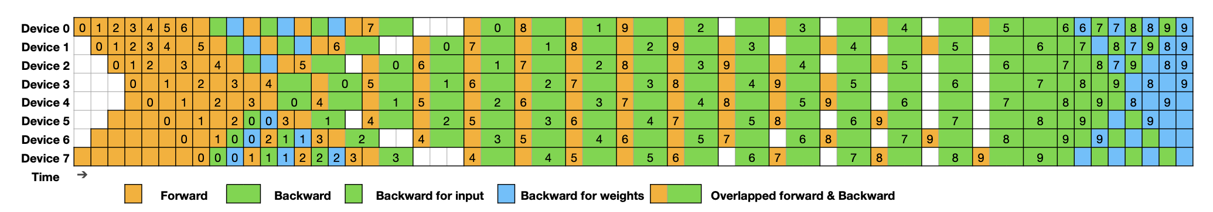
DeepSeek-v3 (2024)
Mixture of Experts architecture
Dynamic sparse attention
Optimized parallel implementation
  16-way Pipeline Parallelism (PP), 64-way Expert Parallelism (EP) spanning 8 nodes, and ZeRO-1 Data Parallelism (DP)
  Loss-aware load-balancing

Slide 29
AlphaEvolve (2025)
Uses LLMs and evolutionary computing to automate discovery and implementation of new algorithms
Combines two Gemini language models
  Gemini Flash: generates program candidates
  Gemini Pro: evaluates candidates
Top-performing candidates are evolved iteratively
Successes:
  Improved implementation of FlashAttention by 32.5%
  New algorithm for 4x4 complex matrix multiplications

