Slide 1


CS395T: Foundations of Machine Learning for Systems Researchers
Fall 2026
Lecture 2: Gradient Computation in
Abstract Neural Networks

Slide 2
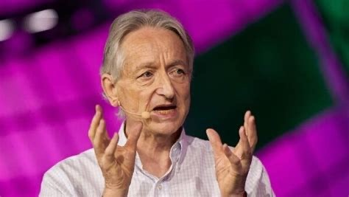

Optimization of DNNs: Turing Award citations (2018)
Backpropagation: In a 1986 paper, “Learning Internal Representations by Error Propagation,” co-authored with David Rumelhart and Ronald Williams, Hinton demonstrated that the backpropagation algorithm allowed neural nets to discover their own internal representations of data, making it possible to use neural nets to solve problems that had previously been thought to be beyond their reach. The backpropagation algorithm is standard in most neural networks today.
Improving backpropagation algorithms: LeCun proposed an early version of the backpropagation algorithm (backprop) and gave a clean derivation of it based on variational principles. His work to speed up backpropagation algorithms included describing two simple methods to accelerate learning time.
A Gentle Introduction to torch.autograd — PyTorch Tutorials 2.13.0+cu130 documentation

Slide 3
Goal of this lecture
Standard presentations of back propagation in neural networks
  Biological metaphors like neurons and synapses come in the way
  Properties of activation functions are distraction
  Chain rule of calculus: not obvious how to use it for complicated networks
Presentation in this lecture
  Abstraction for neural networks: parameterized programs
  Gradient computation in parameterized programs
    Abstraction (what?): sum over paths
    Implementation (how?): compositional algorithm on dataflow graph representation
  Handles complicated neural networks
    Nonlinear functions like sin(x), cos(x), sin(cos(x)), e^{cos(x)}
    Arbitrary DAGs including skip connections and weight sharing
    With small caveat, conditionals and loops

Slide 4
Organization
Basics:
  Partial derivatives, gradients, Jacobians
  Linear regression:
    Parameter optimization: solving linear systems
  Neural networks: parameter optimization requires solving non-linear systems
    Gradient descent
Parameterized programs: abstraction for neural networks
  Dataflow graph representation
  Function evaluation: forward propagation
  Computing gradients: back propagation
  Parameter optimization using gradient descent

Slide 5
Basic concepts:
Partial derivatives, gradients, Jacobians (I)
A B C
R0 R1
f
Convention:
  variables are written as capital letters (A,B,R0)
  variable values are written as corresponding small letters (a,b,r0)
Partial derivative of R0 wrt A:
𝛛𝑅0
𝛛𝐴
Function that tells you how much R0 changes if A is changed a small amount
Value of partial derivative depends on values of A,B,C (consider f(x) = x²)
Notation: ^{𝛛𝑅0} 𝑎, 𝑏, 𝑐 is value of partial derivative of R0 wrt A when input is (a,b,c)
𝛛𝐴
If value of A changes from a to (a+Δa), value of R0 changes by ^{𝛛𝑅0} 𝑎, 𝑏, 𝑐 ∗ Δ𝑎
𝛛𝐴

Slide 6

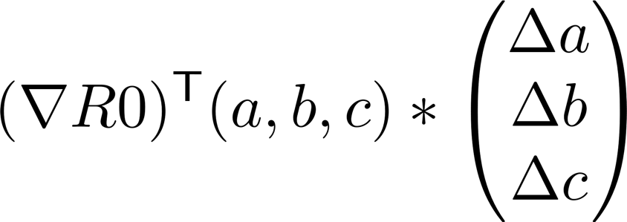
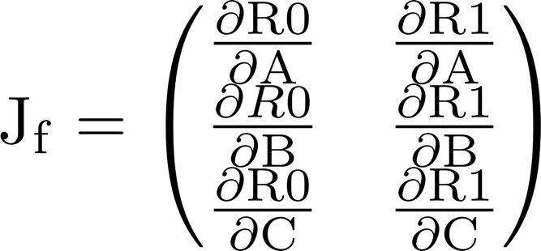
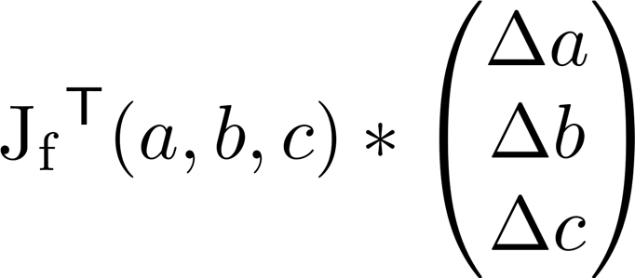
Basic concepts:
Partial derivatives, gradients, Jacobians (II)
A B C
𝑅₀
𝑅
f
1
Gradient of R0: ∇R0
  Column vector containing partial derivatives of R0
  If input changes from (a,b,c) to (a+Δa, b+Δb, c+Δc), R0 changes by
Jacobian of f: J_{f}
  Matrix whose columns are gradients of outputs
  If inputs change from (a,b,c) to to (a+Δa, b+Δb, c+Δc), outputs change by

Slide 7
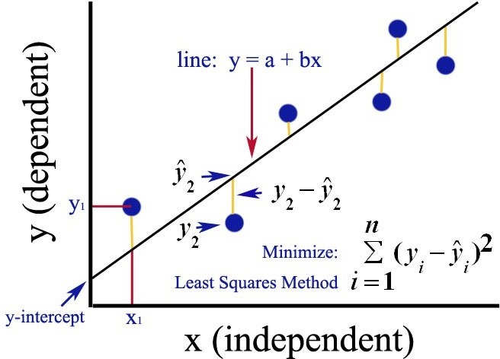
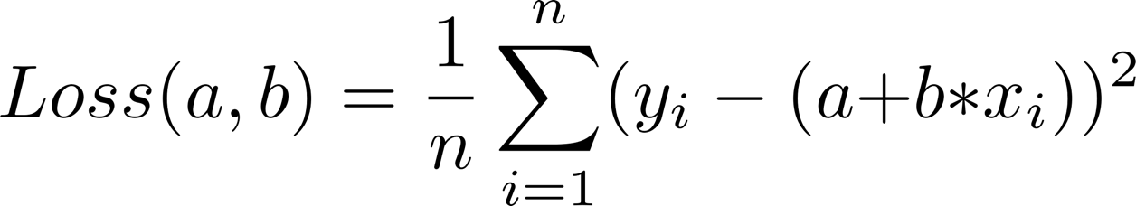
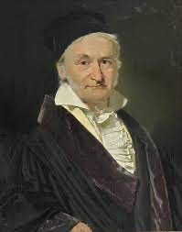

Given set of n training data samples {(x_{i},y_{i})}, find “best” line Y = a+b*X for given data
Model for training data
Model parameters: a and b
Generalization: model lets you predict y for x not in training sample
Parameter optimization:
linear regression
not
Scoring a proposal (a,b): loss function
  Compute total square error/residual
  Detail: we use mean square error (L2 loss)
Parameter values that minimize loss
  Conceptually, a big search problem
  Better solution: use gradients
    Set ∇ Loss(a,b) to zero
    Solve two linear equations
Karl Friedrich Gauss
Neural networks are more complicated
  Parameter optimization requires solving non-linear equations
  Popular method: gradient descent

Slide 8



Function minimization using gradient descent (I)
x
f(x) f’(x)
Problem: given function f(x), find x that minimizes f. Assumptions:
  f has minimum and first derivative, but no closed-form expression is available for function or derivative
  However, we can ask for the value of the function and its derivative at any point
In general, need iterative search

Slide 9
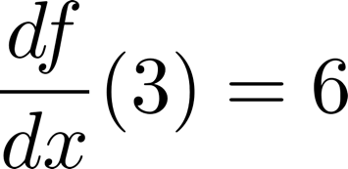
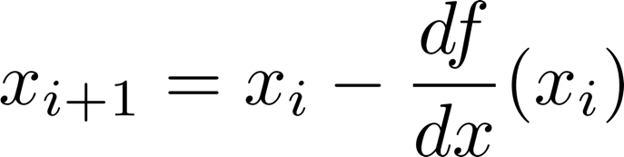
Function minimization using gradient descent (I)
y
9
Pick some value of x (say 3) and find f(x) (say 9)
  To see if we have a minimum, find gradient (say 6)
  Gradient not zero, so not at minimum
  Good point to try next?
Gradient gives us two pieces of information
  Sign:
3
x
gradient is positive, so increasing x increases function value
⇒ we should decrease x.
Magnitude:
x
f(x)
f’(x)
if the magnitude of gradient is small, close to the minimum
⇒ step size should be small
if magnitude of gradient is large, may be far from minimum
⇒ step size should be larger
This suggests an iterative scheme of the form

Slide 10
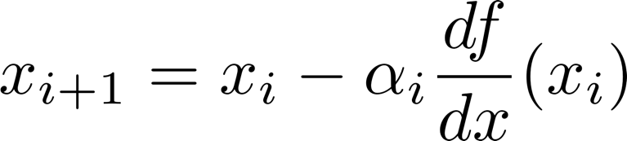
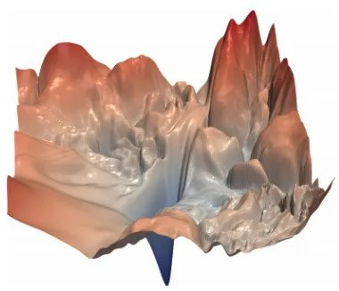
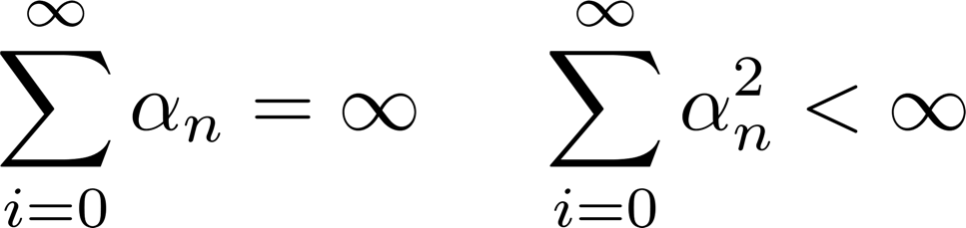

Function minimization using gradient descent (II)
y
Problem: when magnitude of derivative is large, step size will be big, and we may overshoot minimum
  Example: function is y = x² and x₀ is 3.
  May never converge
Solution: change iterative scheme to
  0<α_{i}<1 is a sequence of numbers called learning rate
  Convergence to minimum if sequence satisfies Robbins-Munro conditions
9
3
x
Safe but slow solution: set α_{i} to ¹
𝑖
Iterative scheme for multiple variable function:
Gradient descent finds local minimum, may not be global minimum
Hao Li et al.

Slide 11
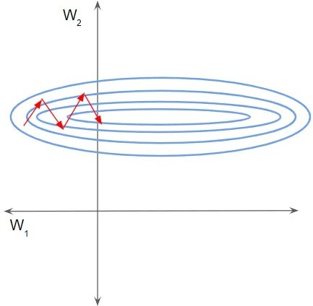
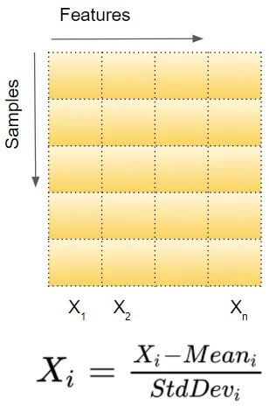
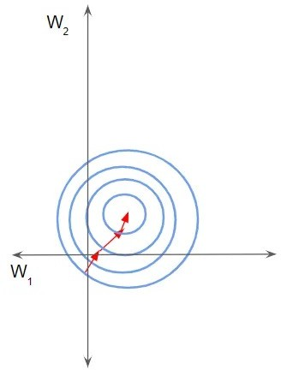
Variations on theme
x₂
x₂
x
Ketan Doshi
x₁
x₁
x₁: steps can be large
x₂: steps need to be small
Same learning rate for all dimensions (features) may lead to slow convergence
Two solutions
Change the data: batch normalization (see above) Ioffe & Szegedy 2015
Change the optimizer formula so each dimension has its own learning rate: Adagrad, AdamW,…
  https://www.slideshare.net/SebastianRuder/optimization-for-deep-learning

Slide 12

Optimizing MLP Weights

Slide 13
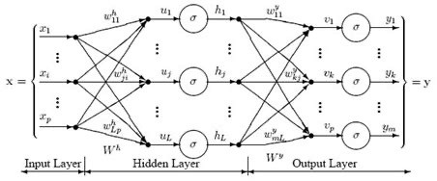
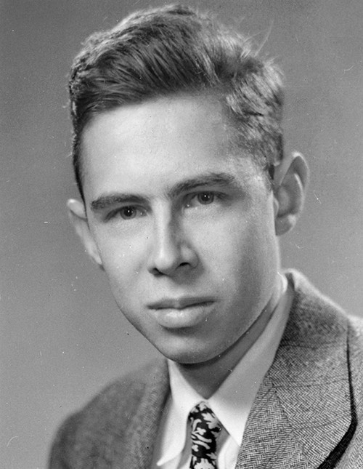
Multilayer Perceptron (MLP) Example
Frank Rosenblatt (Cornell) Inventor of Perceptron (1957)
Type: Inputs: x₁..x_{p}, outputs: y₁..y_{m} (all ℜ)
Scalar view:
  Each edge w_{ij} performs a multiplication with a real-valued parameter
  These values are added followed by non-linear operation σ such as tanh, ReLU etc. (known as activation functions)
Vector view:
  Input and output are vectors
  Each layer performs a dense matrix vector multiplication followed by pointwise (map)
non-linear operation σ
13

Slide 14




Loss
t
y_{t}
training data
Training MLPs
Optimization problem
  Training data: {(x_{t},y_{t})}
  What values of weights W^{h} and W^{y} minimize loss for given training data?
Gradient descent
  Compute derivative of loss w.r.t. each weight
  Use an optimizer from earlier discussion
Usual presentation of gradient computation: chain rule
Abstraction of MLP and more complex neural networks: parameterized programs

Slide 15
Parameterized program: running example
Type of desired function: real x real → real
Training data: set of N 3-tuples {(pi,qi,ti)}
Function R(P,Q) {
A = W0*P
B = f0(A,Q)
C = W1*B
D = W2*B
E = f1(C)
F = f2(D) R = f3(E,F)
return R}
Model
  Composition of
    base functions fi (may be nonlinear such as tanh, sigmoid, sin, cos, …)
    parameters Wi: real; assume no weight sharing so each weight occurs just once (VGGNet: 138 million parameters)
  Function written as R(w; pi,qi) where w is (w0,w1,w2)
Parameter optimization
– Square error for training sample (pi,qi,ti) = (ti – R(w;pi,qi))²
– Goal: choose (w0,w1,w2) to minimize mean square error (L2 loss)
Loss(w0,w1,w2) = ¹ ∑^{𝑁} (𝑡𝑖 − 𝑅 𝑤; 𝑝𝑖, 𝑞𝑖) ²
𝑁
𝑖=1

Slide 16
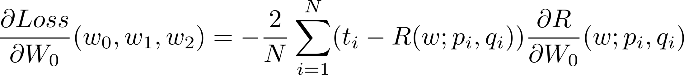
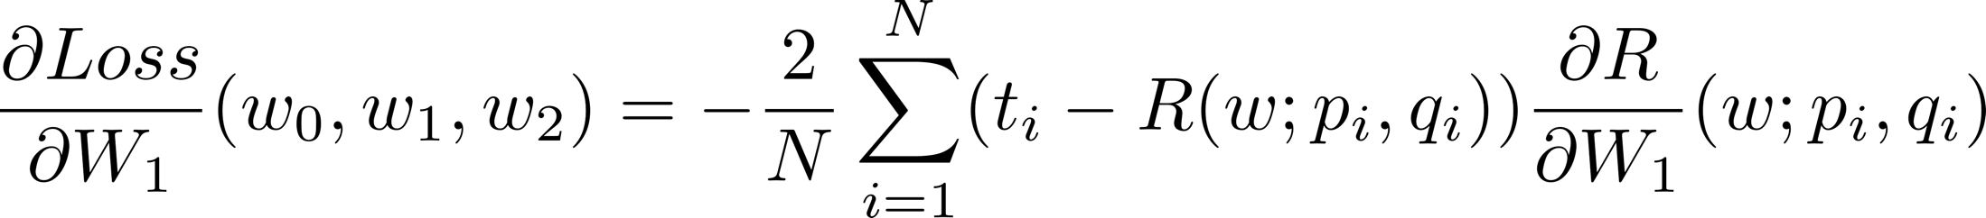
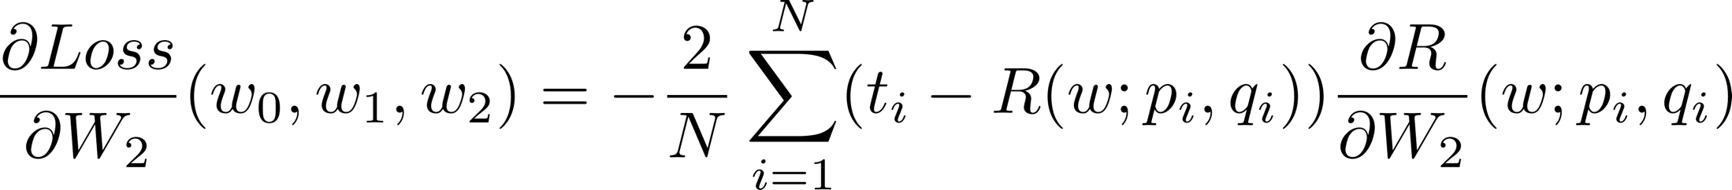

Parameter optimization
Find derivatives of Loss wrt W0,W1,W2:
Loss(w0,w1,w2) = ¹ ∑^{𝑁} (𝑡𝑖 − 𝑅 𝑤; 𝑝𝑖, 𝑞𝑖) ²
Function R(P,Q) {
A = W0*P
B = f0(A,Q)
C = W1*B
D = W2*B
E = f1(C)
F = f2(D) R = f3(E,F)
return R}
𝑁
𝑖=1
Derivatives are complex, non-linear functions
so use gradient-descent for parameter optimization
16

Slide 17
Parameterized program as flow graph
Function R(P,Q) {
  A = W0*P
  B = f0(A,Q)
  C = W1*B
  D = W2*B
  E = f1(C)
  F = f2(D)
  R = f3(E,F)
  return R}
W1
W0
E
f1
P
A
C
f0
B
f3
Q
R
f2
F
D
W2
Useful to represent multiplication by weights differently from functions fi
  Functions fi are fixed but weights change during training
Execution models:
  Sequential:
    Execute nodes sequentally in any topological order
  Parallel:
    Asynchronous dataflow: node executes when inputs are available
    Forward propagation: level-by-level schedule of vertices
All values at intermediate points (A,B,C,…) are stored
  Needed for gradient computations

Slide 18

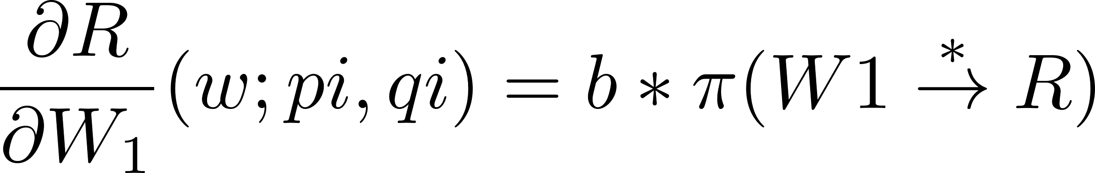


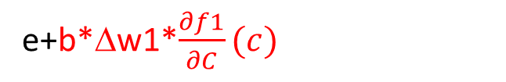
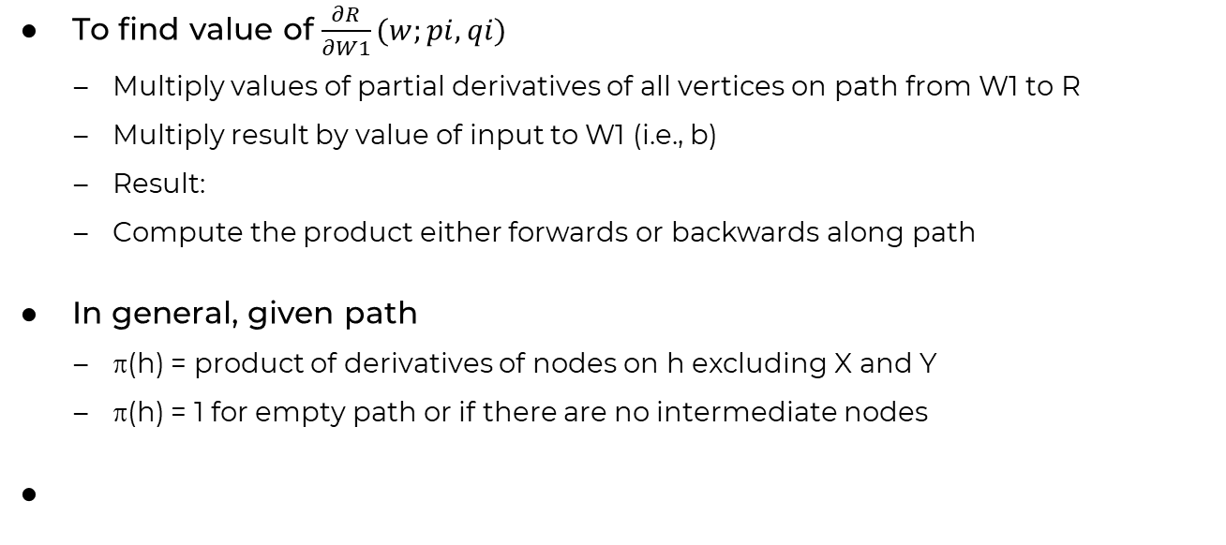
Value of $\frac{∂R}{∂W1}(w;pi,qi)$
w1
w1 + Δw1
W0
C
f1
e+b*Δw1*$\frac{∂f1}{∂C}(c)$
P
A
e
b
c + b*Δw1
E
c
f0
B
f3
Q
R
F
f2
r + b*Δw1*$\frac{∂f1}{∂C}(c)∗\frac{∂f3}{∂E}(e)$
r
D
W2
To find value of $\frac{∂R}{∂W1}(w;pi,qi)$
  Multiply values of partial derivatives of all vertices on path from W1 to R
  Multiply result by value of input to W1 (i.e., b)
  Result:
  Compute the product either forwards or backwards along path
In general, given path
  π(h) = product of derivatives of nodes on h excluding X and Y
  π(h) = 1 for empty path or if there are no intermediate nodes
b*$\frac{∂f1}{∂C}(c)∗\frac{∂f3}{∂E}(e)$

Slide 19
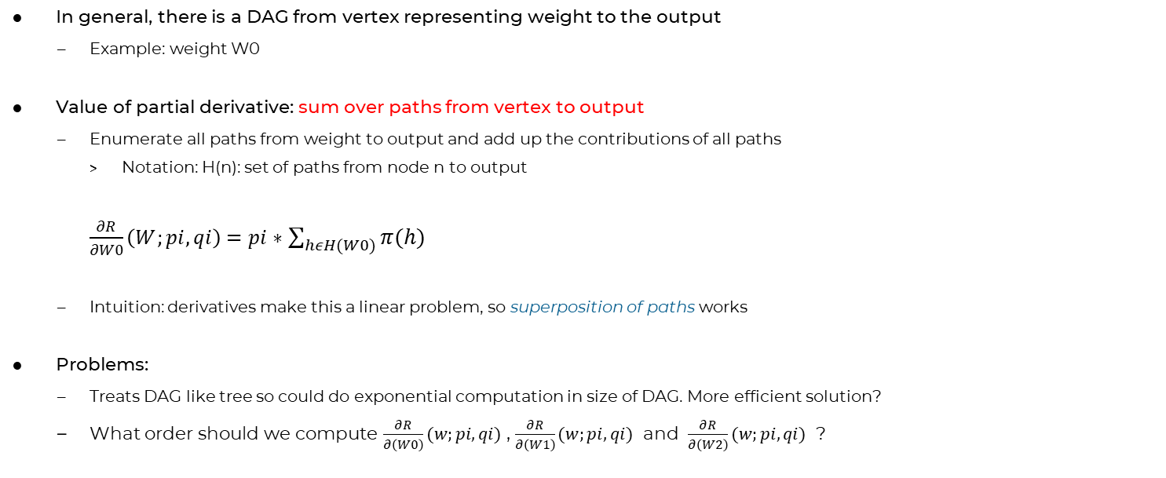
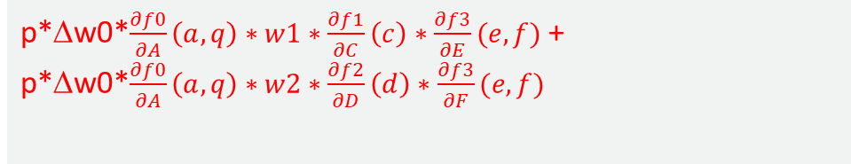

Value of $\frac{∂R}{∂W0}(w;pi,qi)$
W1
W0
E
f1
P
A
C
f0
B
f3
Q
R
f2
F
p*Δw0*$\frac{∂f0}{∂A}\left(a,q\right)∗w1∗\frac{∂f1}{∂C}\left(c\right)∗\frac{∂f3}{∂E}(e,f)$ +
p*Δw0*$\frac{∂f0}{∂A}\left(a,q\right)∗w2∗\frac{∂f2}{∂D}\left(d\right)∗\frac{∂f3}{∂F}(e,f)$
D
W2
In general, there is a DAG from vertex representing weight to the output
  Example: weight W0
Value of partial derivative: sum over paths from vertex to output
  Enumerate all paths from weight to output and add up the contributions of all paths
    Notation: H(n): set of paths from node n to output
    $\frac{∂R}{∂W0}\left(W;pi,qi\right)=pi∗$ $\sum_{hεH(W0)}{π(h)}$
  Intuition: derivatives make this a linear problem, so superposition of paths works
Problems:
  Treats DAG like tree so could do exponential computation in size of DAG. More efficient solution?
  What order should we compute $\frac{∂R}{∂\left(W0\right)}(w;pi,qi)$ , $\frac{∂R}{∂\left(W1\right)}(w;pi,qi)$ and $\frac{∂R}{∂\left(W2\right)}(w;pi,qi)$ ?

Slide 20
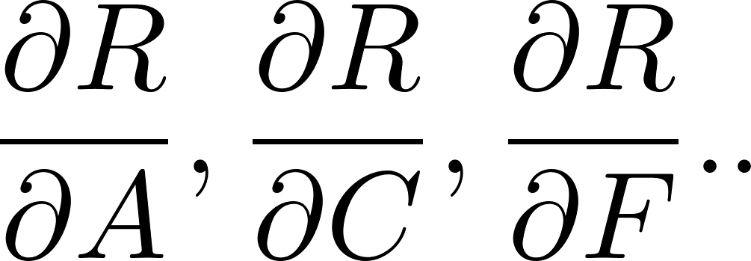



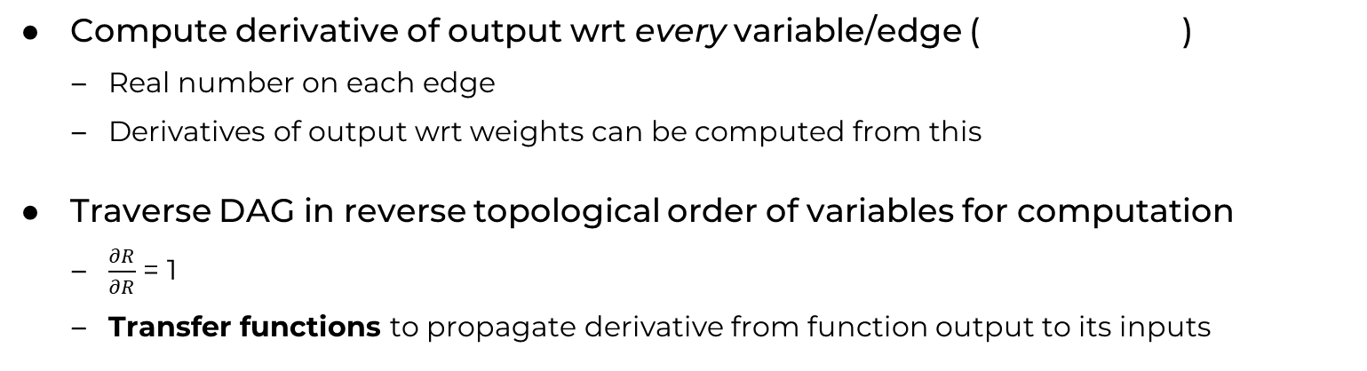


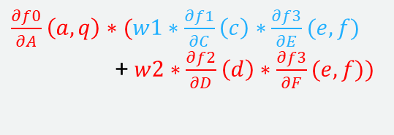

Efficient computation of all derivatives
$$\frac{∂f1}{∂C}\left(c\right)∗\frac{∂f3}{∂E}(e,f)$$
W1
W0
E
$$\frac{∂f3}{∂E}\left(e,f\right)∗1$$
f1
P
C
A
w1*$\frac{∂f1}{∂C}\left(c\right)∗\frac{∂f3}{∂E}(e,f)$
f0
B
f3
R
Q
w2*$\frac{∂f2}{∂D}\left(f\right)∗\frac{∂f3}{∂F}(e,f)$
1
f2
F
$\frac{∂f3}{∂F}\left(e,f\right)∗$ 1
$\frac{∂f0}{∂A}\left(a,q\right)∗(w1∗\frac{∂f1}{∂C}\left(c\right)∗\frac{∂f3}{∂E}(e,f)$
+ $w2∗\frac{∂f2}{∂D}\left(d\right)∗\frac{∂f3}{∂F}(e,f))$
D
W2
$$\frac{∂f2}{∂D}\left(f\right)∗\frac{∂f3}{∂F}(e,f)$$
Compute derivative of output wrt every variable/edge ( )
  Real number on each edge
  Derivatives of output wrt weights can be computed from this
Traverse DAG in reverse topological order of variables for computation
  $\frac{∂R}{∂R}$ = 1
  Transfer functions to propagate derivative from function output to its inputs

Slide 21
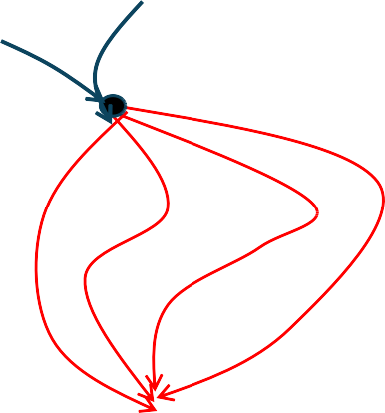

Summary of derivatives computation
At each point Q, compute v_{Q}: ℜ where
Called back-propagation in ML literature
Vanishing and exploding gradients
_{vQ =} 𝛛0𝑢𝑡𝑝𝑢𝑡
𝑊; 𝑝𝑖, 𝑞𝑖
^{= ∑}ℎ𝜖𝐻(Q) ^{𝜋(ℎ)}
v_{Q}
𝛛Q
Q
Small tweak to handle weight-sharing
Multiplying sequence of small or large numbers
Output
v_{in} = 1
x v
Wi
_{and} 𝛛 O𝑢𝑡𝑝𝑢𝑡 _{= vout*x}
v
v = wi*v
Output
in
v
in
out
𝛛𝖶𝑖
in
out
v1_{in}
x
^{v1}out
v_{in} = (v1_{out}+v2_{out})
f
v1_{in} = ^{𝛛𝑓} 𝑥, 𝑦 *v_{out}
v
in
^{v}out
𝛛𝑋
^{v2}out
Y
in/out refer to direction of dataflow in forward propagation
Back propagation: dataflow in reverse direction

Slide 22
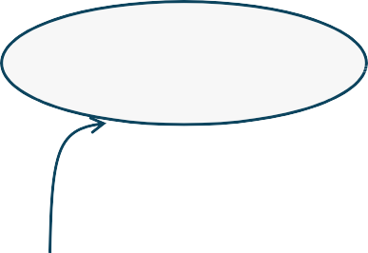
Back to running example
Optimization problem: choose Wi values to minimize loss
Function R(P,Q) {
A = W0*P
B = f0(A,Q)
C = W1*B
D = W2*B
E = f1(C)
F = f2(D) R = f3(E,F)
return R}
Loss(w0,w1,w2) =
1
𝑁
∑𝑁
(𝑡𝑖 − 𝑅 𝑤; 𝑝𝑖, 𝑞𝑖) ²
𝑖=1
Initialize weights to random values for #epochs do {
GradientVector = 0
for each training sample (pi,qi,ti) do {
perform forward propagation and compute
perform backpropagation and compute weight derivatives update GradientVector with products}
scale GradientVector by -2/N
use GradientVector to update weights using gradient descent step
}

Slide 23
Variations on theme (II)
How many training data samples should we use before updating weights?
  (Batch) Gradient-descent: use entire training data set to compute gradient.
    Disadvantage: learn only after all training data has been processed.
N
B
(Mini-)Batching: divide training data into subsets of size B, update weights after each subset is processed and use as initial weights for next subset.
  Disadvantage: choosing B? 50-256 is common.
  Useful to randomize training data set
Stochastic gradient-descent (SGD): B= 1. Can be noisier than previous approaches.
Initialization: we assumed random initialization
  Can also exploit prior (domain knowledge)
  He initialization
  Xavier (Glorot) initialization
•
Good discussion: https://arxiv.org/abs/1704.08863

Slide 24
Variations on theme (III)
Other loss functions
Regularization: add a term that penalizes weights that are not “desirable”
Example: Loss(w0,w1,w2) = ¹ ∑^{𝑁} (𝑡𝑖 − 𝑅 𝑊; 𝑝𝑖, 𝑞𝑖) ² + λ 𝑊
2
𝑁
𝑖=1
Called ridge regularization: penalizes large weight values Many other forms of regularization
Loss for classification problems
  KL-divergence, cross-entropy loss (see later)

Slide 25
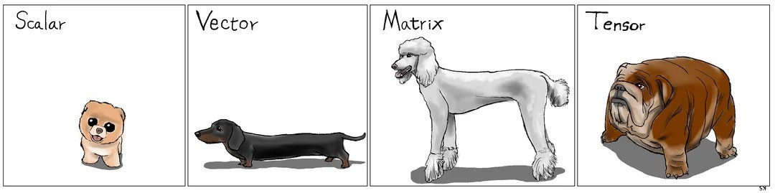
Generalization to vectors, matrices, tensors
How to understand data with dogs Karl Stratos (Reddit post)

Slide 26
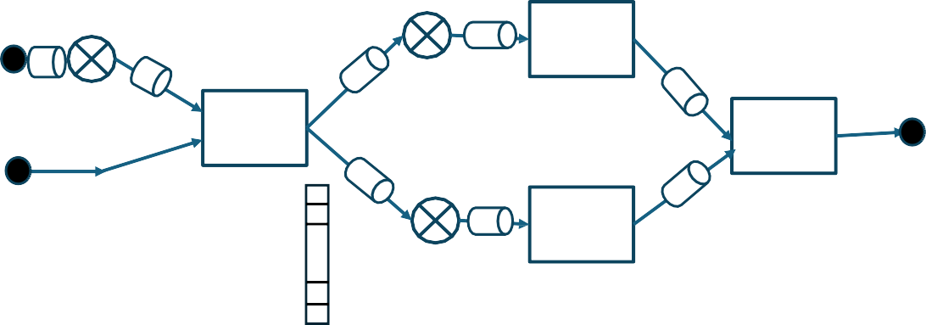
Generalization to vectors (matrices, tensors are similar)
W0
W1
f1
E
P
A C
f0 B
1
f3
Q
R
f2
F
W2
D
Programs
n
B
Inputs can be scalars or vectors, but output is still a scalar (loss)
Weight matrices (need not be square)
Function type: vector → vector
Compute gradients instead of derivatives
  Variable is vector of size n → gradient of output wrt this vector is also vector of size n
    Intuition: each dimension of gradient vector is derivative of output wrt value in that dimension
  Transfer functions: Jacobians instead of derivatives
• Useful to know matrix derivatives notation

Slide 27
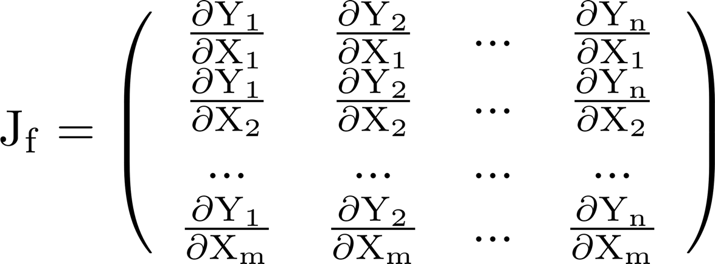
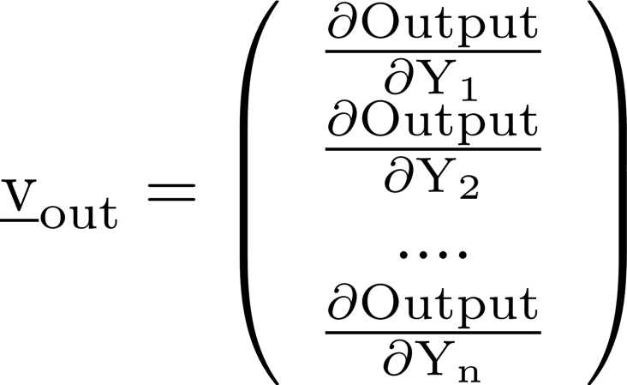
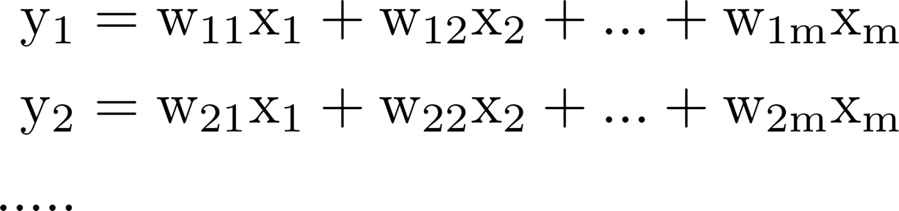
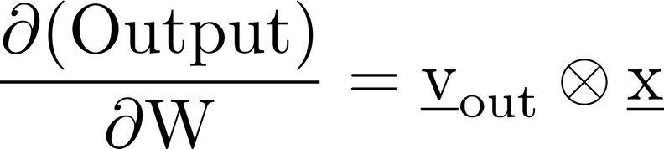
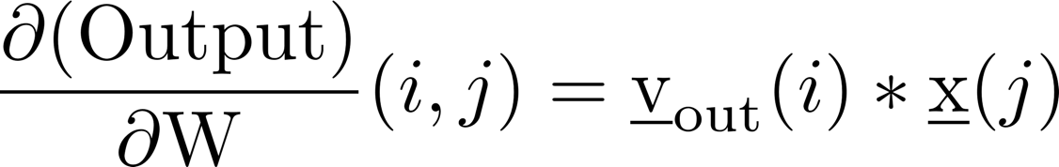
Transfer functions
_{x}m
^{v}in
_{y}n
vout
f
General function f
  v_{in} = J_{f} *v_{out}
Linear function W
  J_{f} = W^{T}
  v_{in} = W^{T}*v_{out}
  Derivatives of output wrt weights in W (will be a matrix)
(⊗ is outer-product)
(If w(i,j) changes a small amount, how much does the output change?)
27

Slide 28






Scalar case
W
v_{in} = w*v_{out}
Output
v_{in} = 1
x
^{v}in ^{v}out
v
in
𝛛 O𝑢𝑡𝑝𝑢𝑡
= ^{v}out^{*x}
Transfer Functions (scalar and
vector)
𝛛𝖶𝑖
^{v1}out
v1_{in}
x
Y
v_{in} = (v1_{out}+v2_{out})
f
_{v1in =} 𝛛𝑓
𝑥, 𝑦 *v_{out}
v
in
^{v}out
𝛛𝑋
^{v2}out
Vector case
W
v_{in} = W^{T}*v_{out}
Output
v_{in} = 1
x
^{v}in ^{v}out
v
in
𝛛 O𝑢𝑡𝑝𝑢𝑡
𝛛𝖶
= ^{v}out ^{⊗ x}
^{v1}out
x
v
^{v}in
v_{in} = (v1_{out}+v2_{out})
f
^{v}in ^{= J}f ^{*v}out
in
v
out
^{v2}out
28

Slide 29
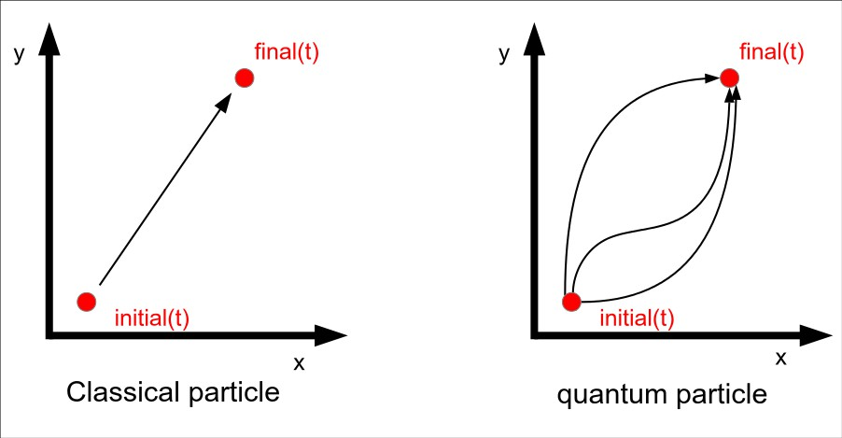
Path integral formulation
of quantum mechanics (Feynman)
Abstraction for neural networks: parameterized programs Gradient computation
Abstractly (what?): sum over paths (important idea in Physics)
Efficient computation (how?): compositional algorithm on dataflow graph representation
Handles complex nonlinear functions like sin(x), sin(cos(x)), e^{cos(x)}
Compositional rules handles complex neural networks with weight-sharing and irregular interconnections such as “skip connections”
With small caveat, easy to extend to conditionals and loops
Example of backward dataflow analysis used in compilers
Summary
29

Slide 30

30

