Slide 1
Fall 2025
Project Presentations
CS 395T: Foundations of Machine Learning for Systems Researchers

Slide 2
December 2nd Presentations
12.30pm | Aris Karatzikos, Michail Patsakis, Charalampos Koilakos | Adaptive speculative decoding for genomics
12.45pm | Aditya Patel | RL with Verifiable Rewards in LLMs
1.00pm | Justin Medich | RL for self-verifying code generation
1.15pm | Soumyabrata Chaudhuri, Ajay Yadav | Evolution for code generation
1.30pm | Mobina Tavangarifard | Collision detection for continuum manipulators

Slide 3
December 4th Presentations
12.30pm | Beto An, Reina Pradhan, Aryan Khatri | RL for self-verification in LLMs
12.45pm | Yingqi Cao, Kimonas Provatas, Akshatha Nayak, Ziyang Tan | Adaptive speculative decoding for inference in LLMs
1.00pm | Zijian Yi, Aditya Thimmaiah | RL for reasoning in LLMs
1.15pm | Nandita Jayanthi, Rachel Yamamoto | RL for video compression
1.30pm | Weijie Chen Lin, Darius Grassi | ML for decompilation

Slide 4
Slides for
December 2, 2025

Slide 5




Speculative decoding on Genomic LLMs
Accelerating inference on biological sequence models
Group Project Charalampos Koilakos – Michail Patsakis – Aris Karatzikos

Slide 6





Methods
Speculative decoding accelerates genomic LLM inference through a two-model system that maintains sequence quality while reducing computational cost.
GATCGT
AATTGC
TCGTCG
CATCAA
GATCGT
AATTGC
TCGTCG
CATCAA
Draft Model
Draft Model
Draft Model
Draft Model
Target Model
ATCGCA
GATCGT
AATTGC
TCGTCG
ATCGCA
GATCGT
AATTGC
TCGTCG
Speculative Decoding pipeline
Token selection and MC rejection sampling
Draft model generates L tokens (one block)
Draft model selects tokens based on Multinomial distributions of logits
Target model verifies these suggestions
Target model approves tokens based on Monte Carlo rejection sampling
One forward pass in slow target model compared to L forward passes
In case of rejection, residual sampling assures the use of true target distribution

Slide 7


















DNAGPT: Genomic Language Model
Model family
Why DNAGPT is a good fit for SpecDec
Architecture
Transformer decoder specifically adapted for DNA sequences
Small model is fast enough to propose many tokens quickly
Training Data
Large model is accurate enough to reliably filter proposed tokens
Extensive genomic sequences including human reference genome windows
High agreement between models leads to high acceptance rate and real speedup without degrading sequence quality
Trained on over 200 billion base pairs from all mammals
DNA Representation
Represents DNA using 6-mer tokens
Model Sizes
DNAGPT-0.1B
Lightweight draft model
Approximately 5x faster processing
DNAGPT-3B
High-accuracy target model
Designed for precise genomic analysis

Slide 8
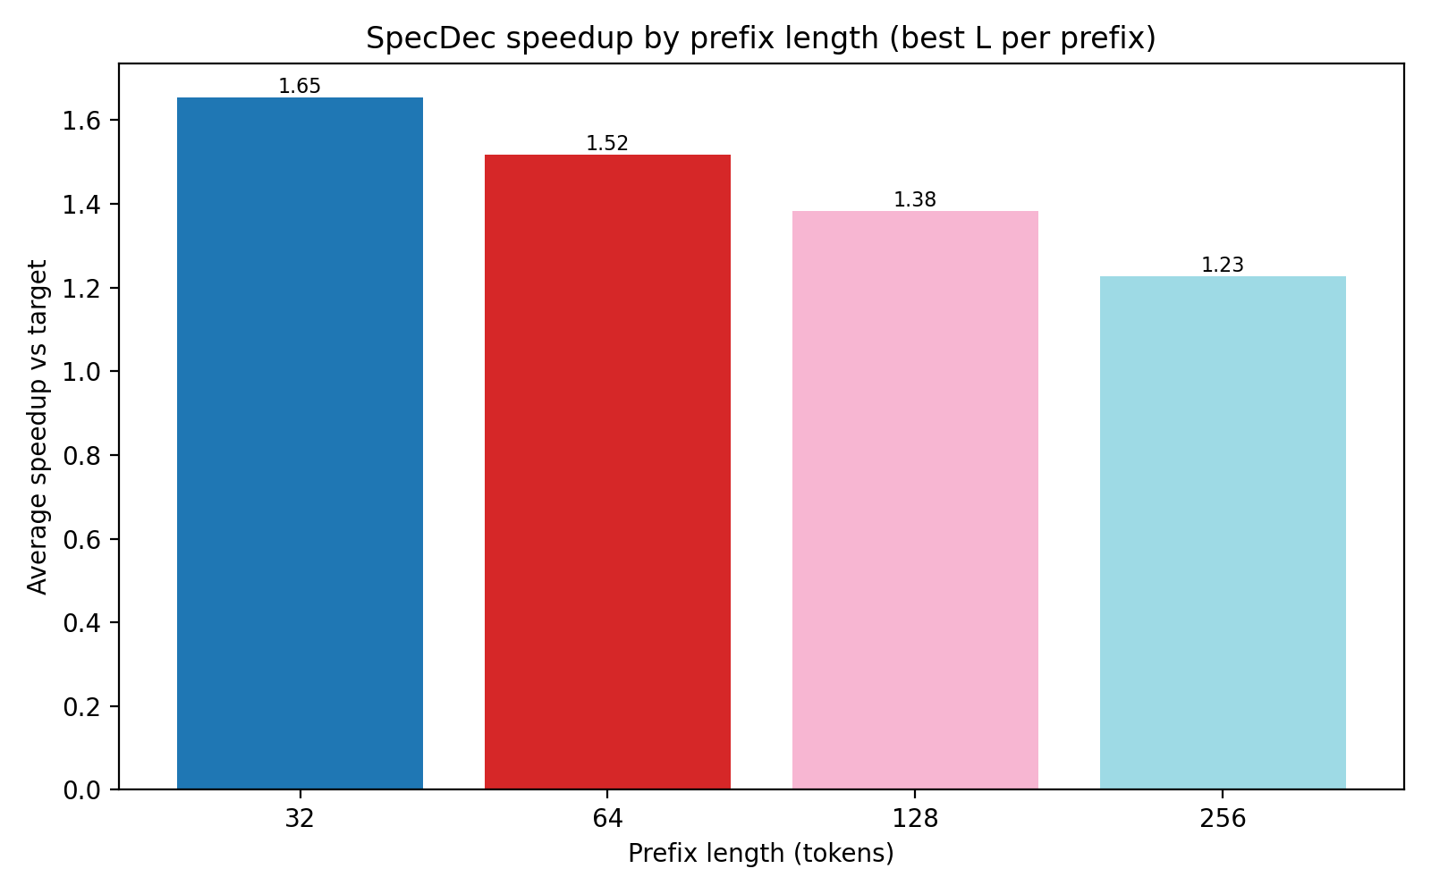

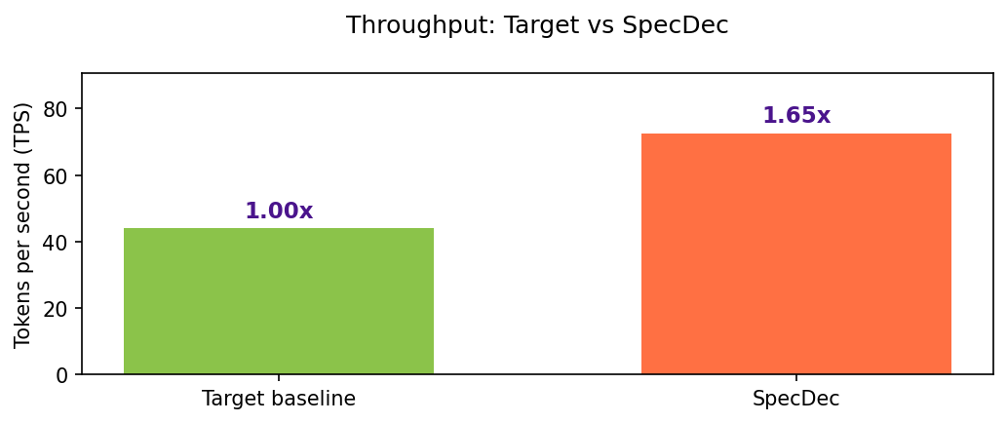
Experimental Results
Speculative decoding achieves consistent performance improvements while maintaining sequence quality.
Speedup Performance

Slide 9
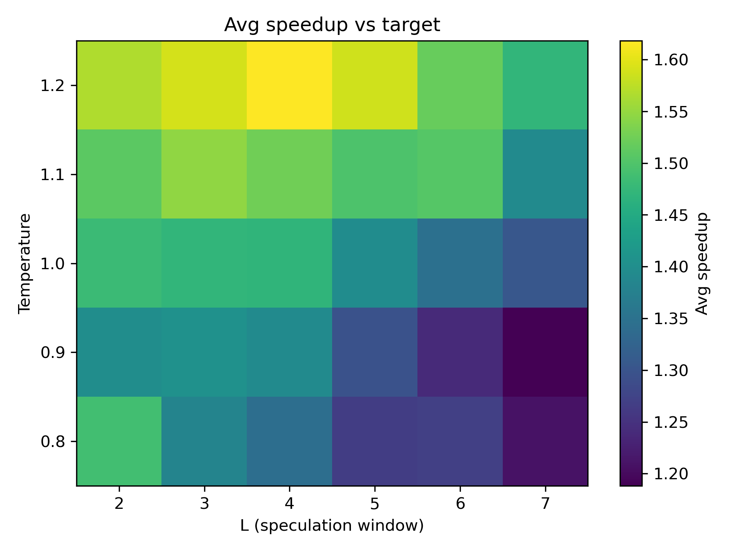



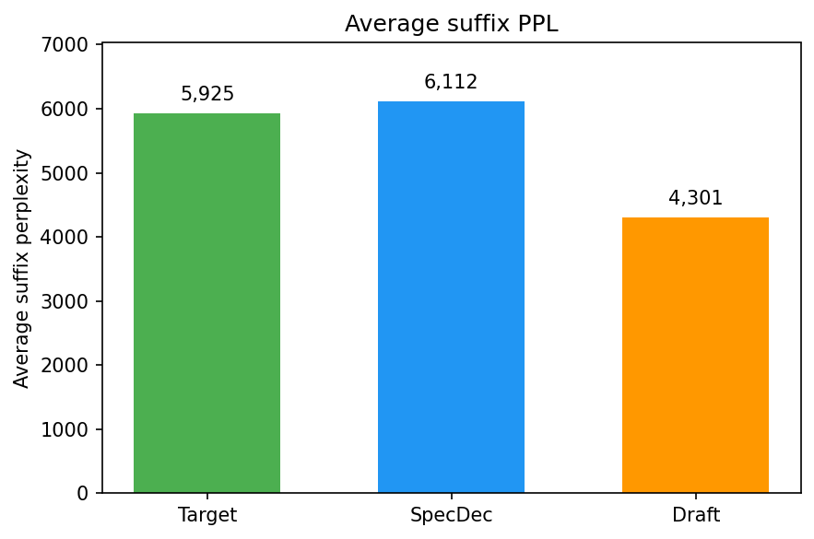
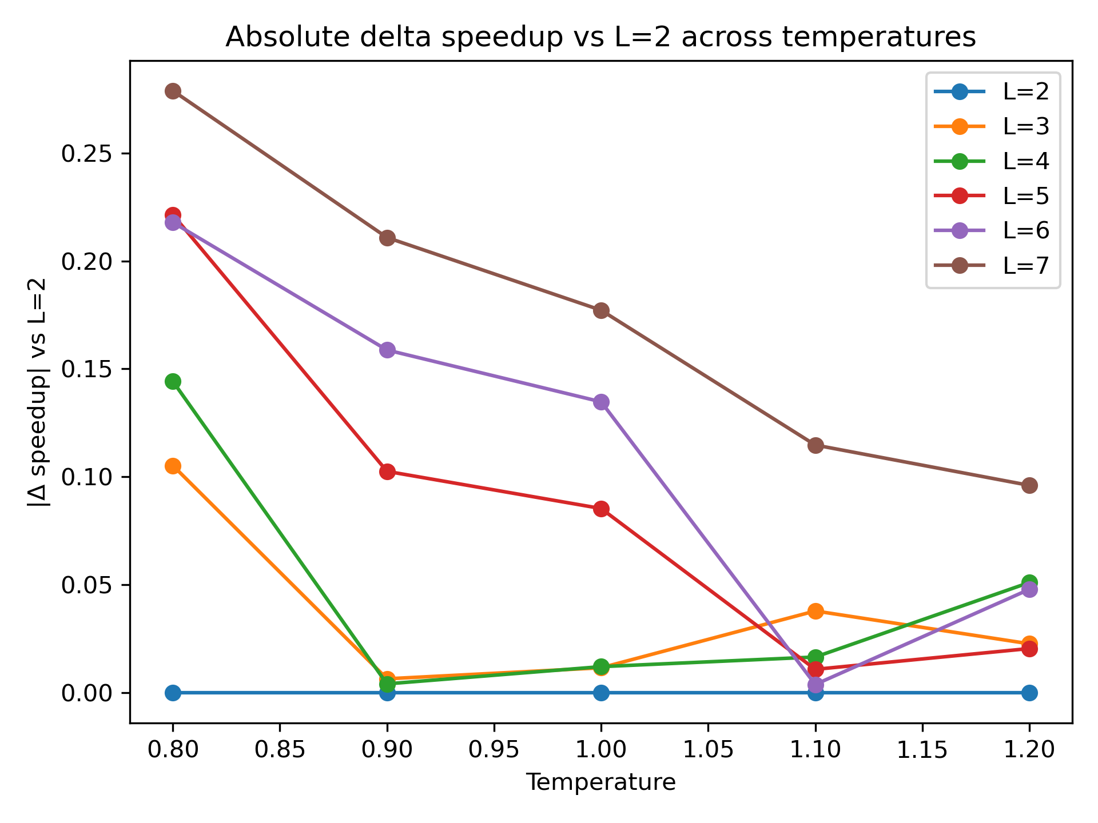
Experimental Results
Temperature Sweep analysis
Sequence Quality
We apply probabilistic acceptance without sacrificing sequence quality

Slide 10










Limitations
Key challenges in implementing speculative decoding for genomic LLMs:
Evo2
Deterministic acceptance - DNAGPT
Initial SOTA GLM we applied SpecDec
Repetitive unrealistic results for greedy token selection from target model
Complicated internal architecture (Hyena layers) that doesn’t support KV cache manipulation
Need for probabilistic selection with randomness applied
Mismatches in logits for block forward passes
Future Directions
Working on the internal functionality of Evo2/Vortex code to setup correctly the hyena states/forward block passes. Promising results on alignment and speedup between small/big models.

Slide 11
REINFORCEMENT LEARNING WITH VERIFIABLE REWARDS IN COMPACT LANGUAGE MODELS
Aditya Patel

Slide 12
Motivation
Problem:
Supervised fine-tuning (SFT) teaches models to mimic patterns, not correctness
Models receive same gradient whether answer is correct or slightly wrong
Critical gap for tasks with objective correctness (code, math)
Most RLVR work focuses on 10B+ parameter models
Important for practical, resource-constrained applications
Approach:
Apply Reinforcement Learning with Deterministic Rewards for a 500M Paramter Model
Use compilers and parsers for ground-truth feedback
Train with GRPO

Slide 13
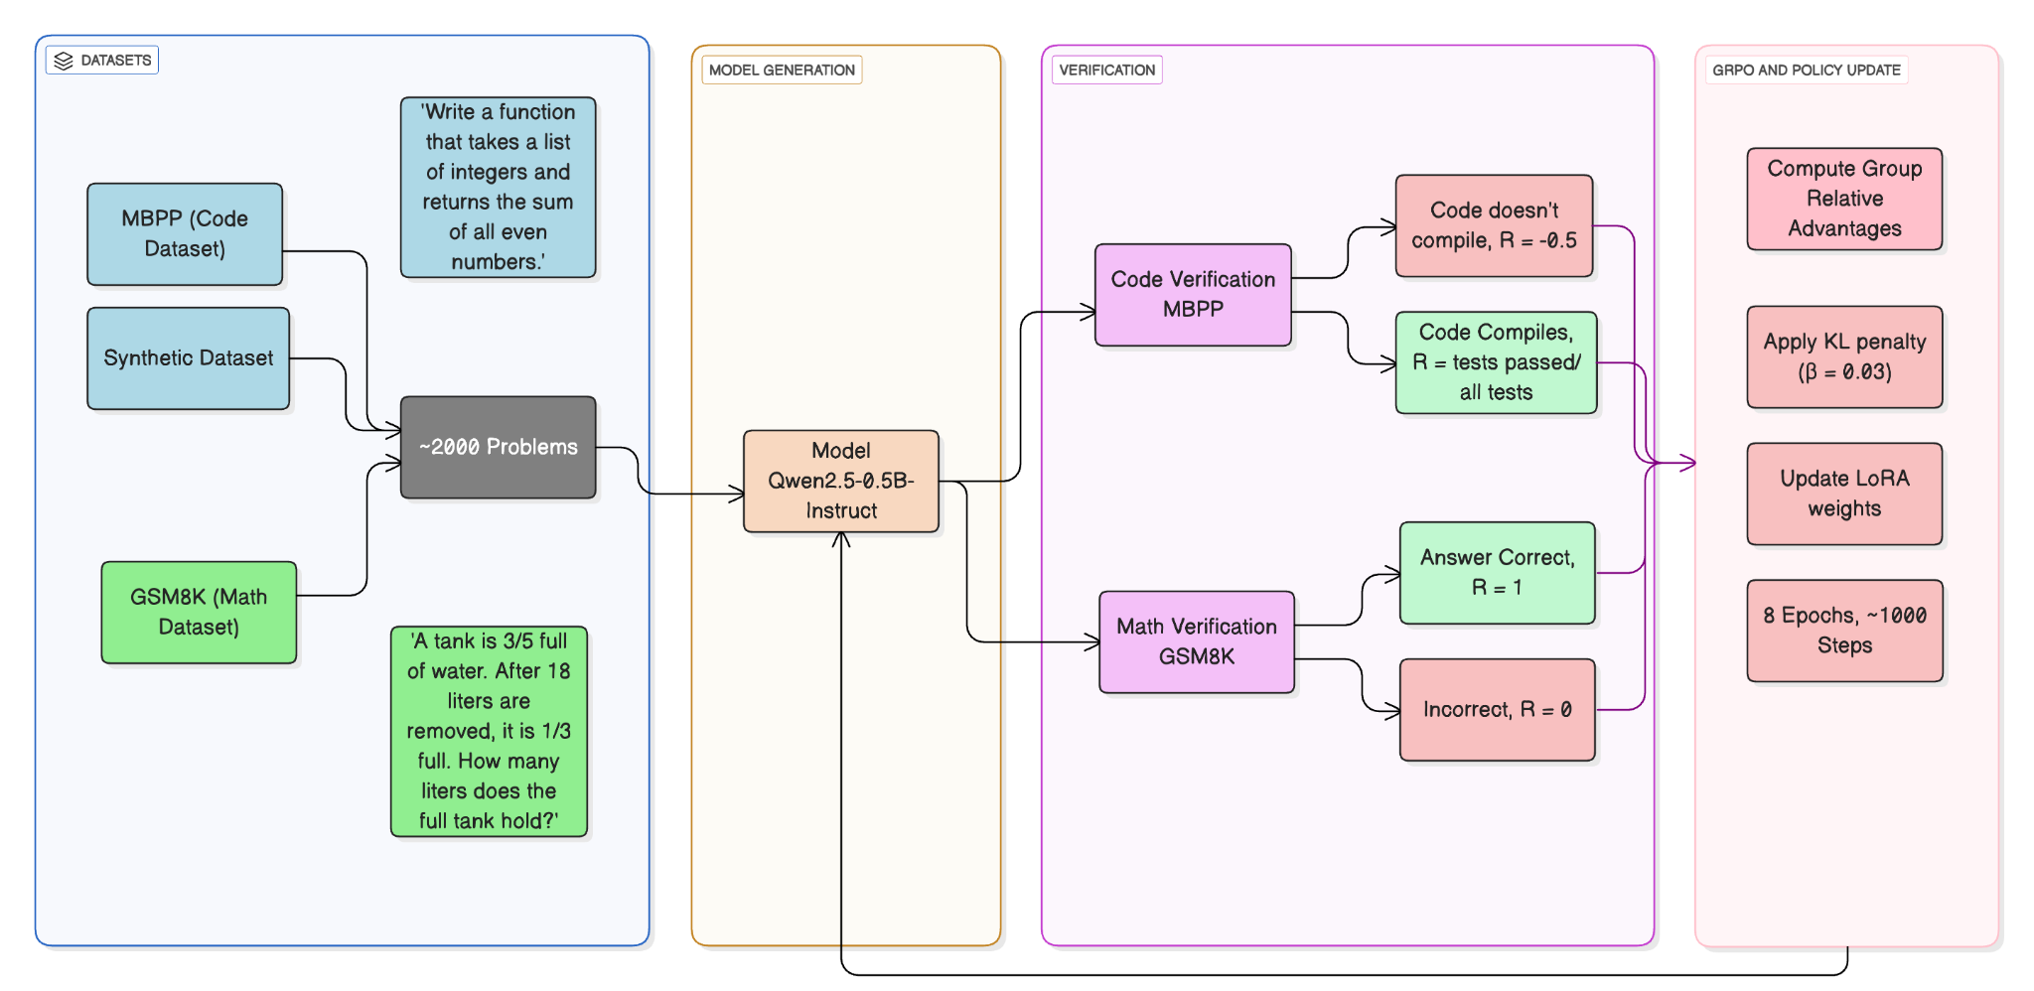
Training Methodology

Slide 14
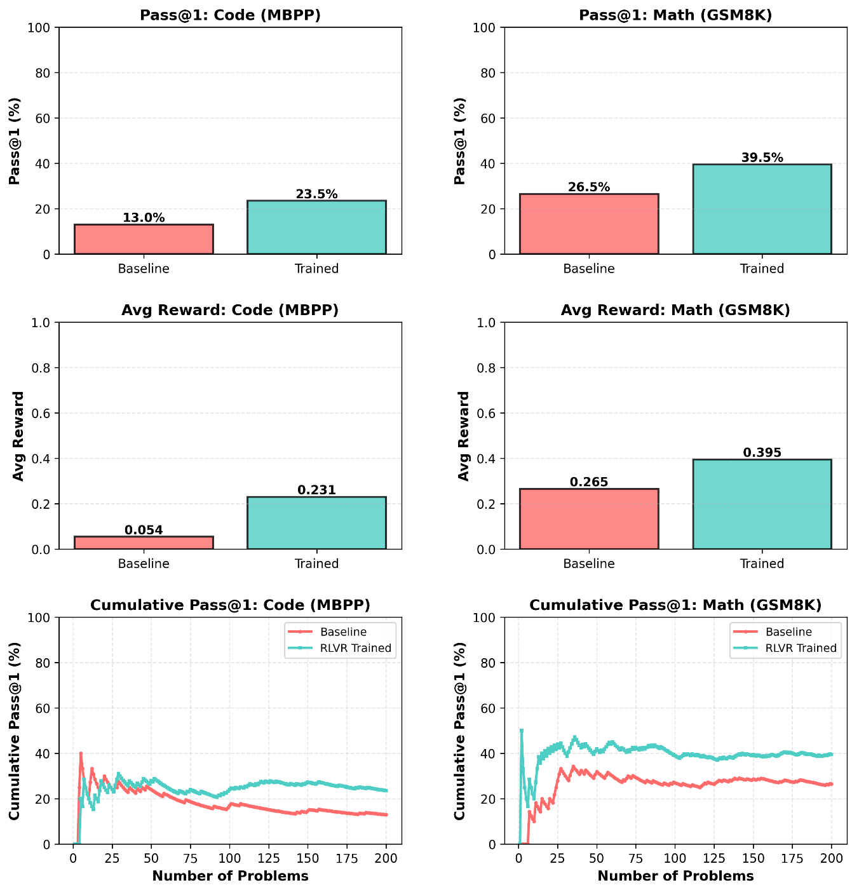
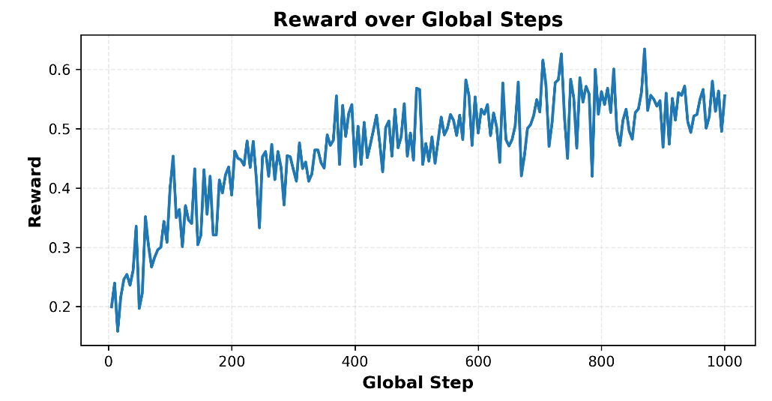
Training & Eval Results
Model | MBPP Pass@1 | MBPP Avg Reward | GSM8K Pass@1 | GSM8K Avg Reward
Baseline | 13.0% | 0.054 | 26.5% | 0.265
RLVR-Trained | 23.5% | 0.231 | 39.5% | 0.395
Δ (Improvement) | +10.5% | +0.176 | +13.0% | +0.130
Evaluation Results, Cumulative Pass@1%, Higher is better

Slide 15
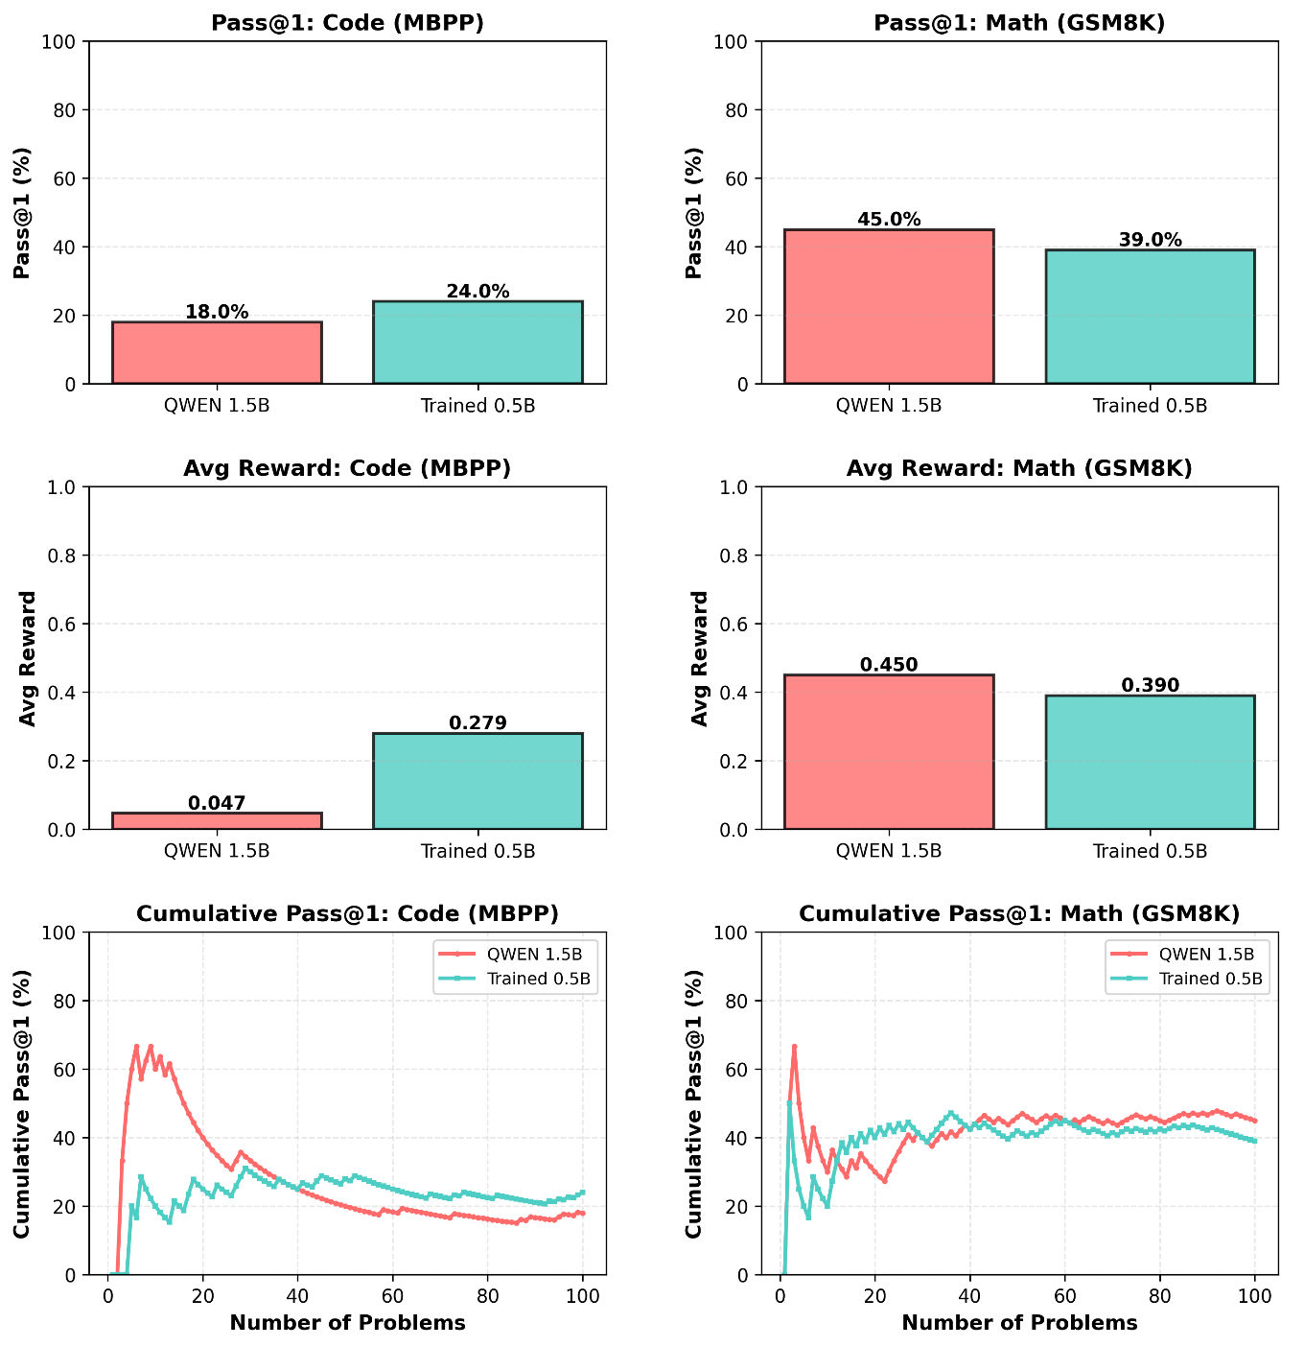
Comparison with Larger Baseline
This figure shows performance of the trained 0.5B model against the baseline 1.5B model from the same family
Qwen 2.5-1.5B Instruct Model vs 0.5B Trained Model
The trained model slightly outperformed the larger baseline on code problems, while underperforming on the math problems

Slide 16
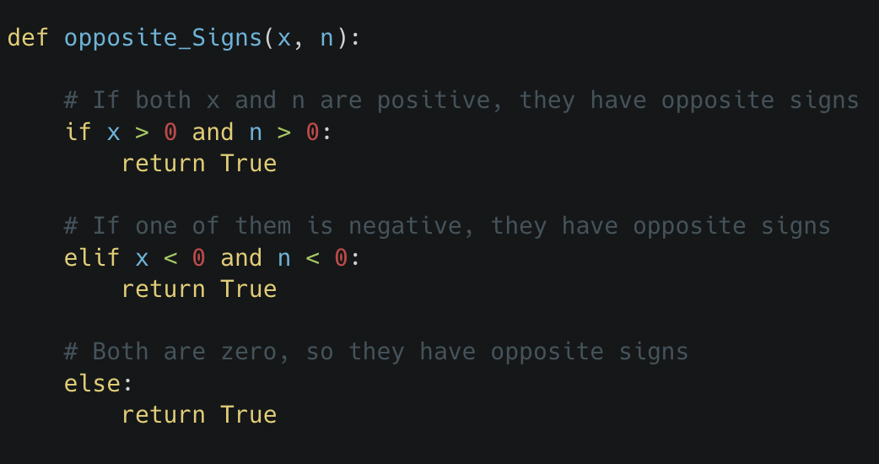
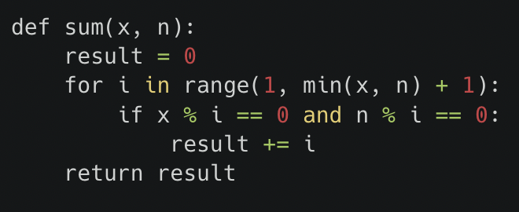
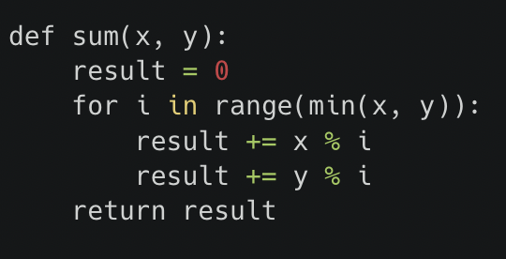
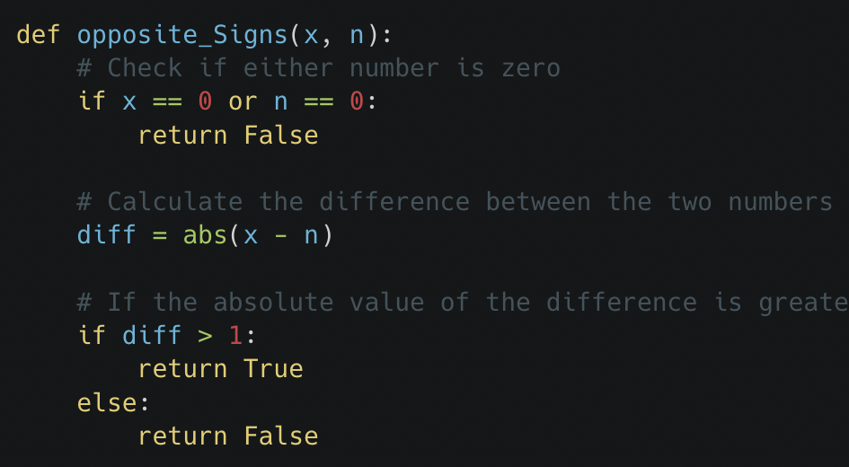
Qualitative Examples
Task: Write a python function to find the sum of common divisors of two given numbers.
Task: Write a python function to check whether the given two integers have opposite sign or not.
Trained Model- Reward=1
Trained Model- Reward=0.5
Baseline - Reward = 0
Baseline - Reward = 1

Slide 17
Challenges, Limitations, Takeaways
Challenges/ Limitations:
Limited training data (~2K problems) due to compute constraints
Low GPU utilization (26.6%) - sequential GRPO verification bottleneck
7.5% of the problems were answered correctly by the baseline and incorrectly by the trained model, no apparent reason
Constraints/Future work:
Did not test on harder benchmarks (MATH, SWE-Bench)
Single base model tested (Qwen2.5-0.5B)
Binary rewards for math (could use process-level rewards)
Ablation studies with different hyperparameters.
Key Takeaways:
Small models can benefit from verifiable rewards - bottleneck is training methodology, not just model size
Future direction: Scale to larger models, diverse architectures, fine-grained rewards

Slide 18


RL for self-verifying code generation
Justin Medich

Slide 19
Motivation
What is the project about?
Large Language Models generate code that look correct but can be logically wrong.
Current systems rely on external unit tests, with models lacking mechanisms to verify their own reasoning.
Newer Chain-of-Thought Models improve this by allowing more fine grained steps
My project trains an LLM to produce code + its own tests + predicted execution traces, then uses RL rewards to align these with ground-truth behavior.
Motivation:
Existing code models (CodeLlama, StarCoder, DeepSeek-Coder) achieve strong accuracy but still hallucinate logic.
Process-level reasoning rewards in math/logic (e.g., Process Reward Models, “Let’s Verify Step by Step”) show improved consistency.
Prior Work:
Execution-based RL for code: CodeRL, Chen et al., Reflexion — but rely on external tests.
Reasoning supervision: Process-level rewards, self-correction methods, explanation datasets (CodeExplain, CodeT5+).
Gap: No system rewards internal, verifiable reasoning steps such as variable-level traces.
Notes:
Abbhinav

Slide 20
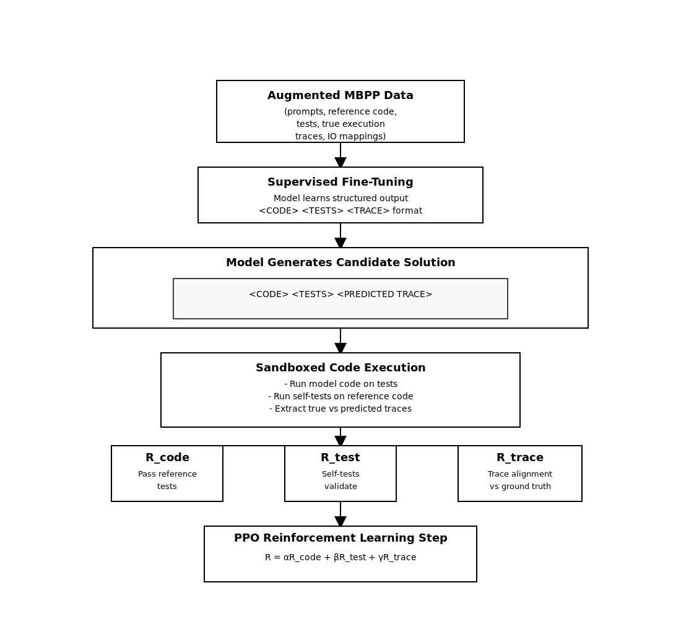
Implementation/Pipeline
PPO Training Loop
For each batch:
Model generates responses
Outputs are parsed with regular expressions → Extract <CODE>, <TESTS>, <TRACE>
Sandbox execution using a custom tracer:
Runs code on tests
Logs function calls, line events, return values
Caps at 100 traced function calls
Reward computation:
+ 0.1 correct format
+ 0.3 code executes
+ 0.4 tests pass
+ trace-match score (up to +0.2)
Penalties for mismatched or missing outputs
<TRACE>\nTest: assert sum_average(10)==(55, 5.5)\ncall sum_average({'number': '10'})\nline sum_average:2 locals={'number': '10'}\nline sum_average:3 locals={'number': '10', 'total': '0'}\nline sum_average:4 locals={'number': '10', 'total': '0', 'value': '1'}\nline sum_average:3 locals={'number': '10', 'total': '1', 'value': '1'} ....<\TRACE>

Slide 21
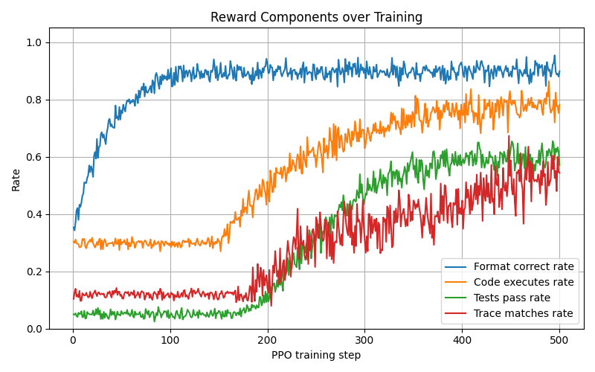
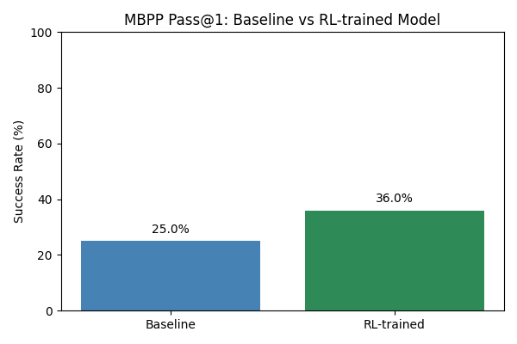
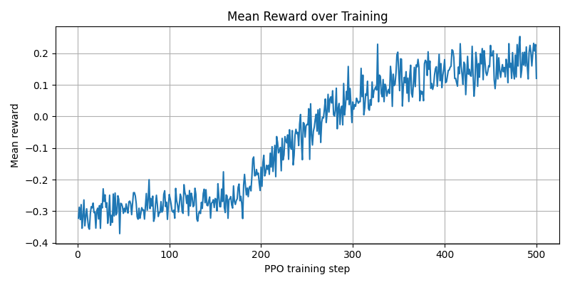
Results
For testing a validation set (100) from the baseline where 25% of prompts were Pass@1 successful was chosen

Slide 22
Example Improvement
"Write a python function to remove first and last occurrence of a given character from the string."
✖Baseline:
def remove_first_last(s):
return s[1:-1]
✅RL-Trained:
def remove_first_last_occurrence(s, ch):
indices = [i for i, c in enumerate(s) if c == ch]
if not indices:
return s
first = indices[0]
s = s[:first] + s[first+1:]
if len(indices) == 1:
return s
last = indices[-1] - 1
return s[:last] + s[last+1:]

Slide 23
Challenges & Takeaways
Challenges:
Sandbox execution is slow; RL with PPO is unstable without careful hyperparameter tuning.
Generating both code and tests increases output length which make credit assignment difficult.
Trace alignment is noisy, models may produce plausible but slightly mismatched traces.
Limitations:
MBPP is small-scale and trace-based RL might generalize poorly to complex, multi-file programs.
Traces only capture runtime state, not formal correctness proofs.
Small/mid-sized open-source models may lack capacity for deep reasoning.
Key Takeaways:
Verifiable process-level rewards offer a promising direction for improving LLM reasoning in executable domains.
Models can learn to self-verify through trace prediction and self-generated tests.
Combining trace supervision with execution feedback may reduce silent logical errors in code generation.

Slide 24

LLM-Driven Evolutionary Optimization for CUDA Kernels
TEAM
Ajay Yadav, Soumyabrata Chaudhuri (Soumya)
Notes:
Humans learn skills in sports, education, and training, but how do we evaluate skill levels? People could use coaches for evaluation but this Traditional evaluation is subjective and time-consuming; AI enables scalable and objective skill assessment.

Slide 25
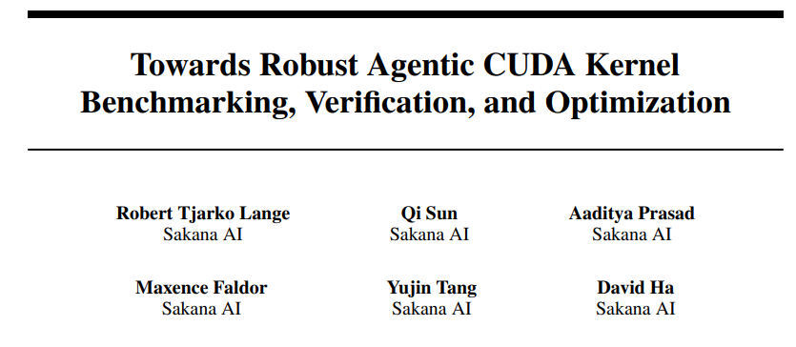
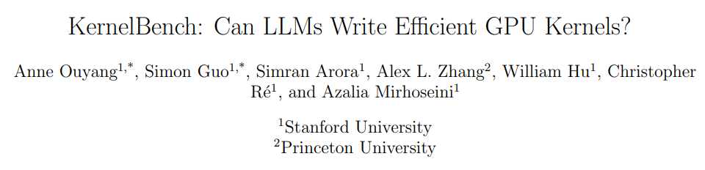
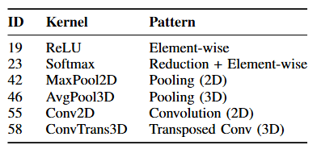
Inaugural Benchmark for Kernel Generation
Ambiguous Methodology
Our contributions:
Evaluation of OpenEvolve on six diverse CUDA kernels from KernelBench
Comparative study of feedback-driven vs baseline (no-feedback) evolutionary strategies
Insights into when error-feedback mechanisms help, and when naive openevolve performs sufficiently

Slide 26
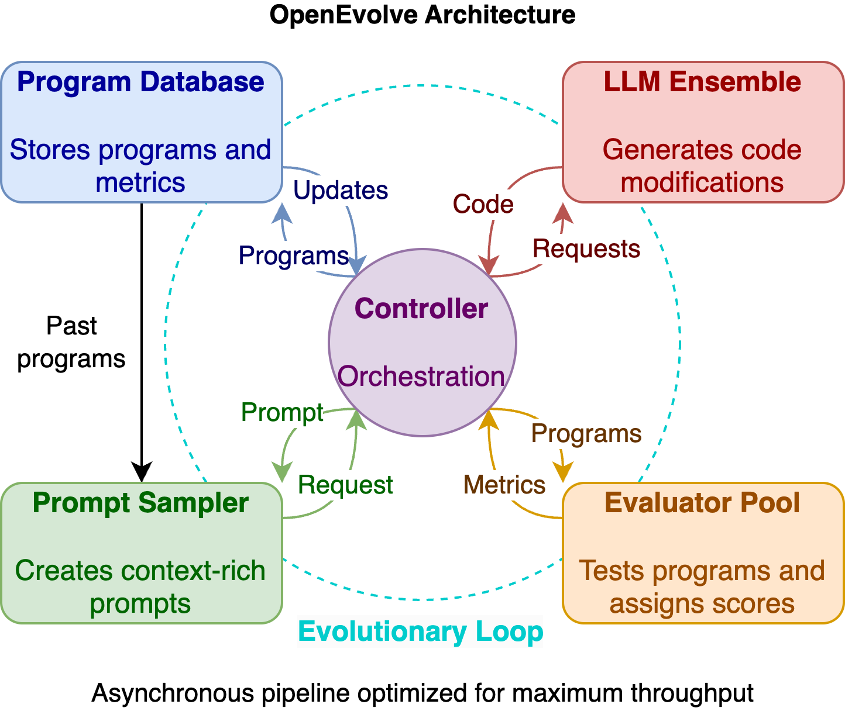
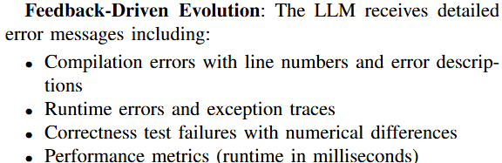
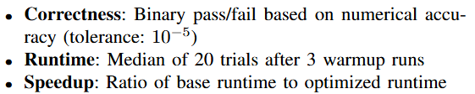
Methodology
Initial CUDA kernel
Error Feedback
OpenEvolve
Optimized CUDA kernel
(Similar to KernelBench)

Slide 27
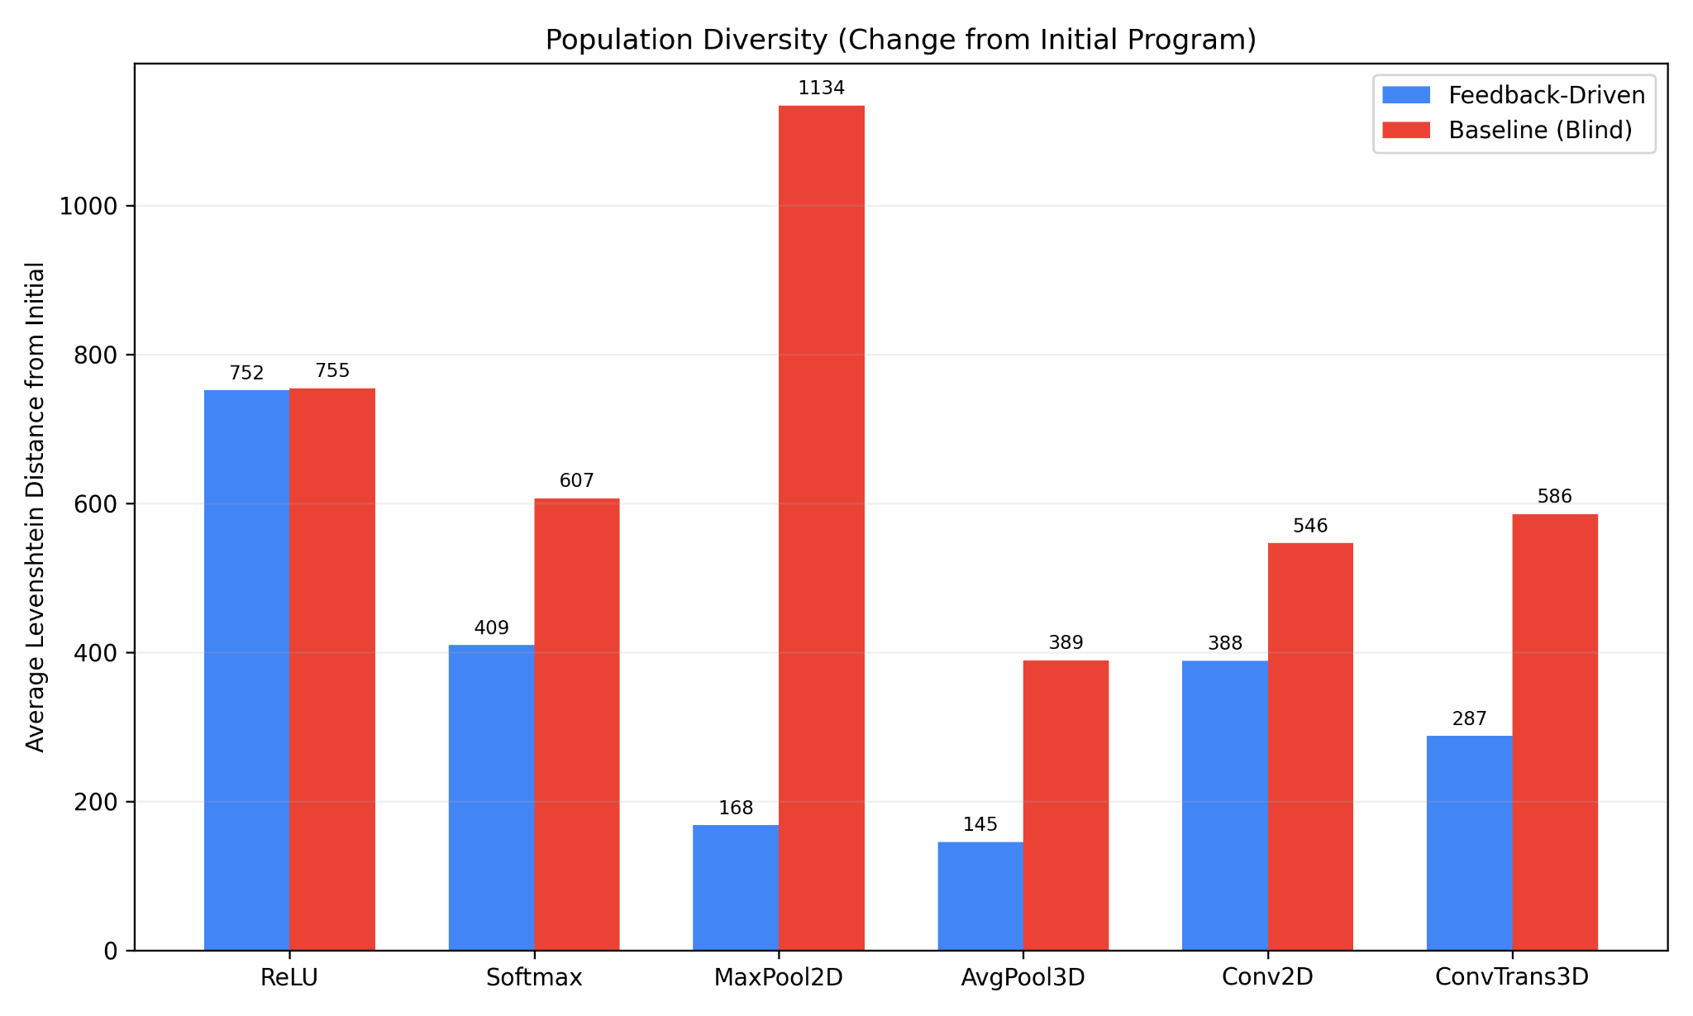
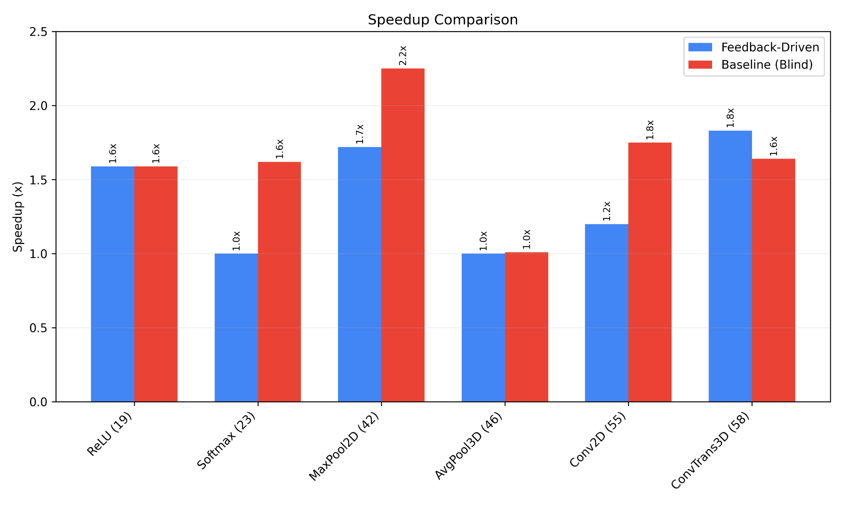
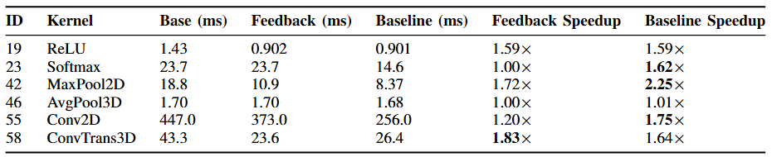
Quantitative Results

Slide 28
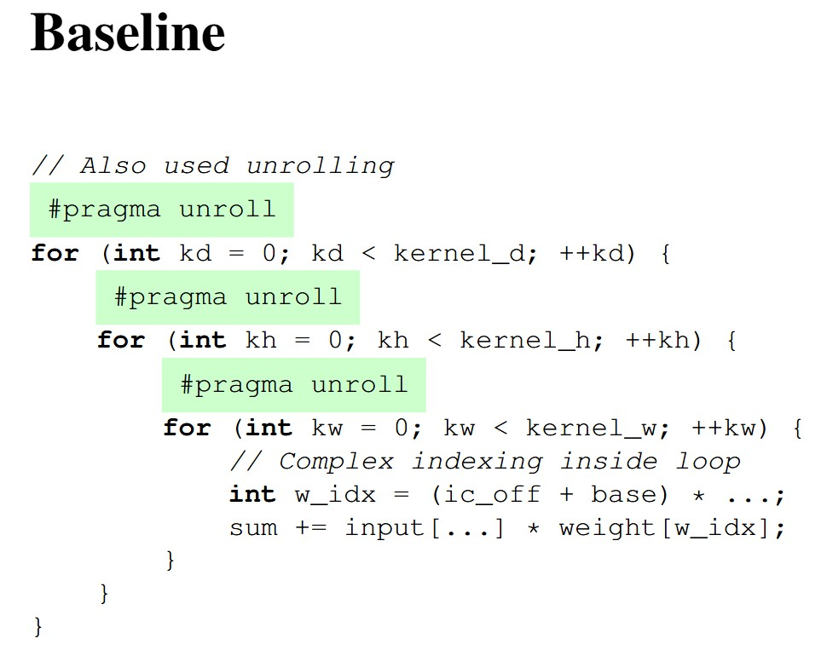
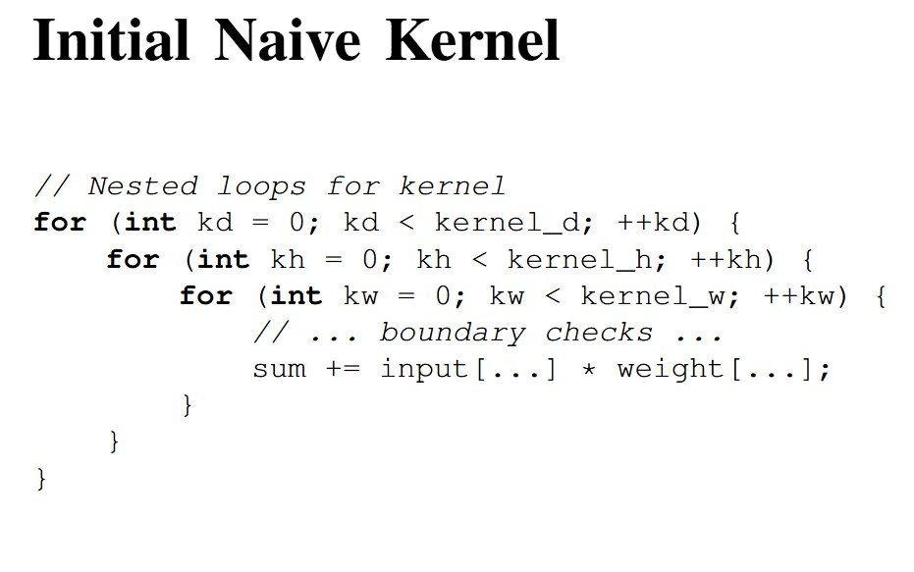
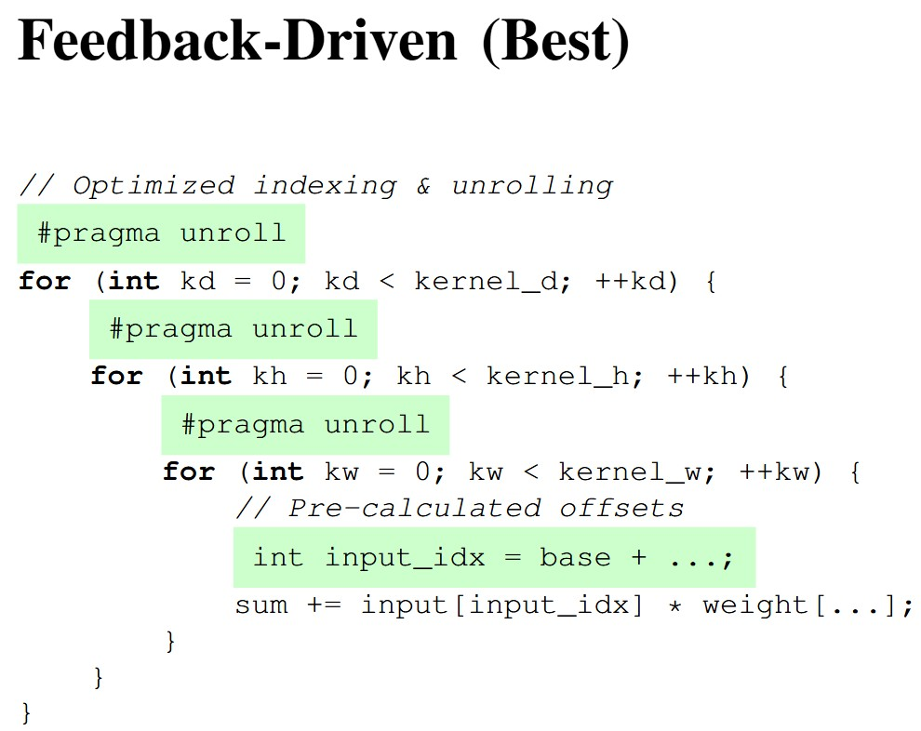
Qualitative Analysis (Conv3D)

Slide 29
Challenges & Limitations
• Restricted to 20 iterations per kernel due to computational constraints
• Single LLM model (Gemini 2.0 Flash) tested
• Fixed prompt engineering approach
• Evaluation on a single GPU architecture (H100)
Key Takeaways
Feedback guided evolution has higher compilation success and requires fewer attempts per successful program
Error-feedback evolution is most valuable for hard, structured CUDA kernels that require careful memory reasoning and iterative refinement, whereas baseline (unguided) evolution is sufficient and sometimes preferable for simpler or well-known optimization patterns where robustness, speed, or lower API cost matters.

Slide 30
Slides for
December 4, 2025

Slide 31
Mathnasium: RL using Lean4 for theorem proving
Aryan Khatri, Beto An, Reina Pradhan

Slide 32
1) Project motivation and prior work
LLMs can be good at math problems: Google DeepMind & OpenAI attained gold medal on IMO problems
Goal: use a formal proof language (Lean4) that programmatically verifies correctness to train an LLM to solve problems
DeepSeekMathProver took a similar approach, providing a reward for all or nothing correctness with a 671B model, and showed that RL improves performance on verifiable tasks
We applied RL using GRPO providing a reward for each correct step, rather than all or nothing feedback, on an 8B Qwen model with LoRA, with only 43M trainable parameters (0.5% increase)

Slide 33
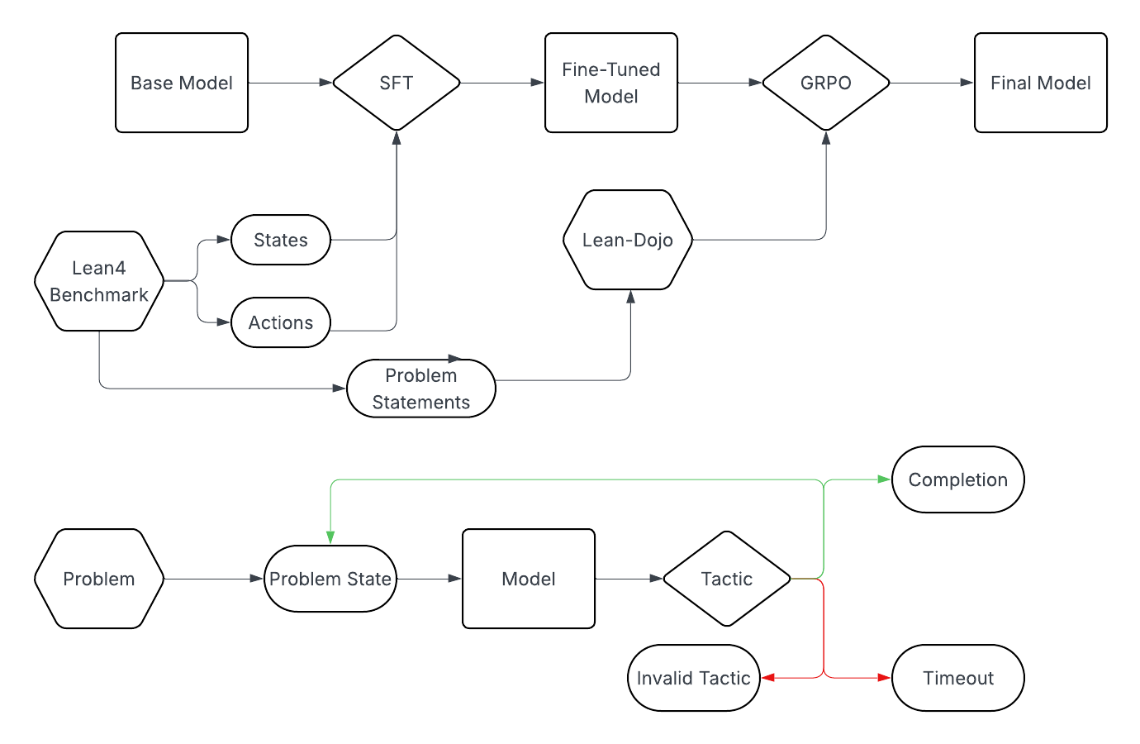
2) Method overview
SFT Implementation:
Cross Entropy loss on completion tokens
Base model: quantized to 4 bit
LoRA weights: 16 bit
num_params: 43M
0.5% parameter increase
RL Fine Tuning:
Maximize GRPO objective outlined in DeepSeekMath
Like PPO, except the Actor is an LLM and Advantage baseline is group mean reward
Base model: SFT model
No addition parameters

Slide 34
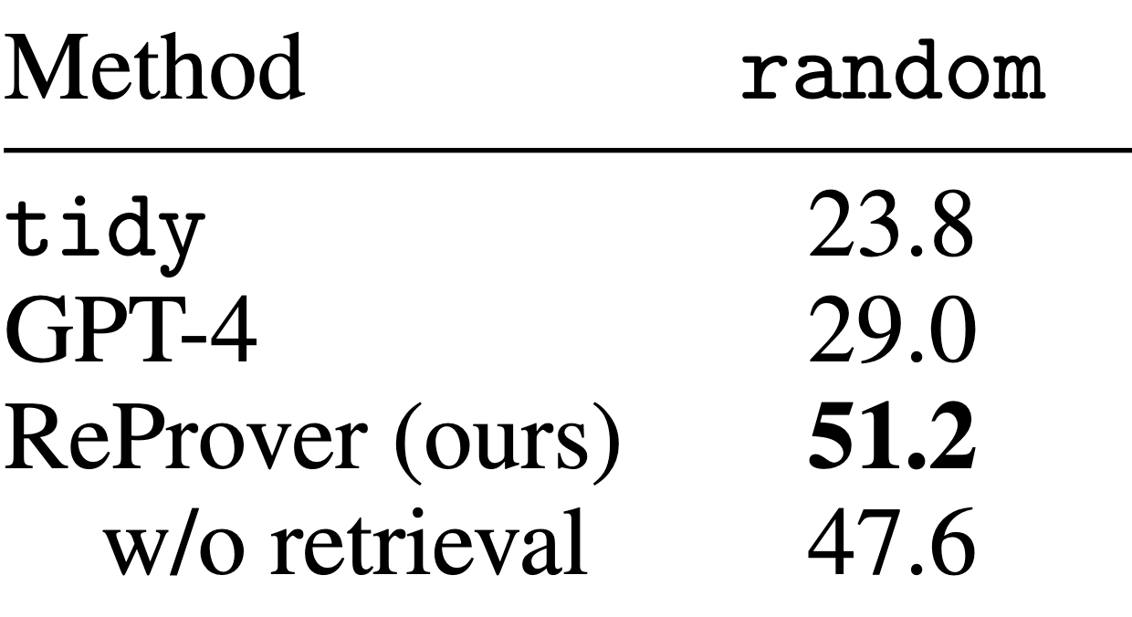
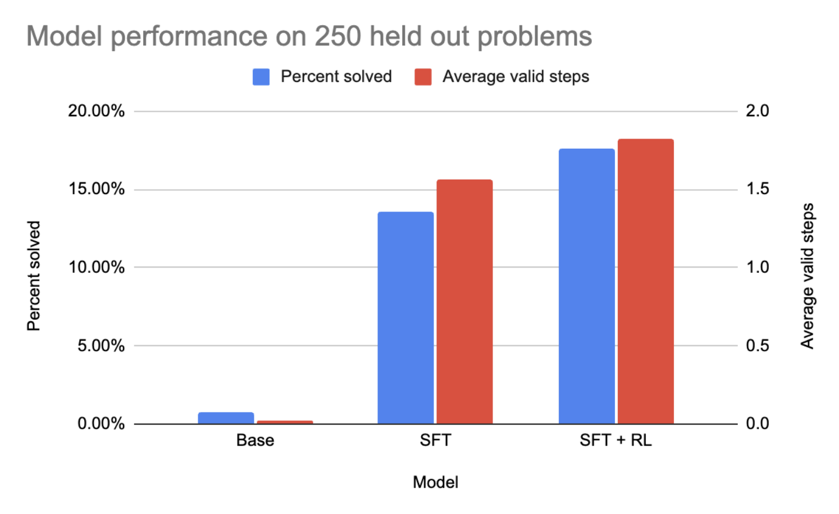
3) Key experimental results

Slide 35
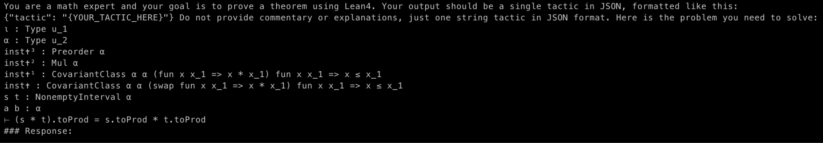
3) Demo
Base model output:
{"tactic": "apply mul_nonempty_interval_to_prod_eq_mul_to_prod; assumption"}
Outcome:
Lean error: "<stdin>:1:50: expected end of input"
SFT model output:
{"tactic": "simp only [toProd, coe_mul, coe_toProd, coe_toFinset, toFinset_mul]"}
Outcome:
Lean error: simp made no progress
SFT+RL model output:
{"tactic": "cases s"}
…
{"tactic": "cases t"}
…
{"tactic": "rfl"}
Outcome:
3 valid steps, proof complete

Slide 36
4) Challenges, limitations, takeaways
Base model has very little success so SFT is required to make RL useful
RL throughput is much lower than SFT
Lean4 startup time and environment stepping is slow
There is a lot of room for improved utilization and throughput
SFT significantly improves performance compared to base model, RL pushes performance even further

Slide 37
Adaptive Speculative Decoding for Inference in LLMs
Final Project for CS 395T: Foundations of Machine Learning for Systems Researchers (Fall 2025)
Kimonas Provatas, Akshatha Nayak, Yingqi Cao, and Ziyang Tan
The University of Texas at Austin

Slide 38
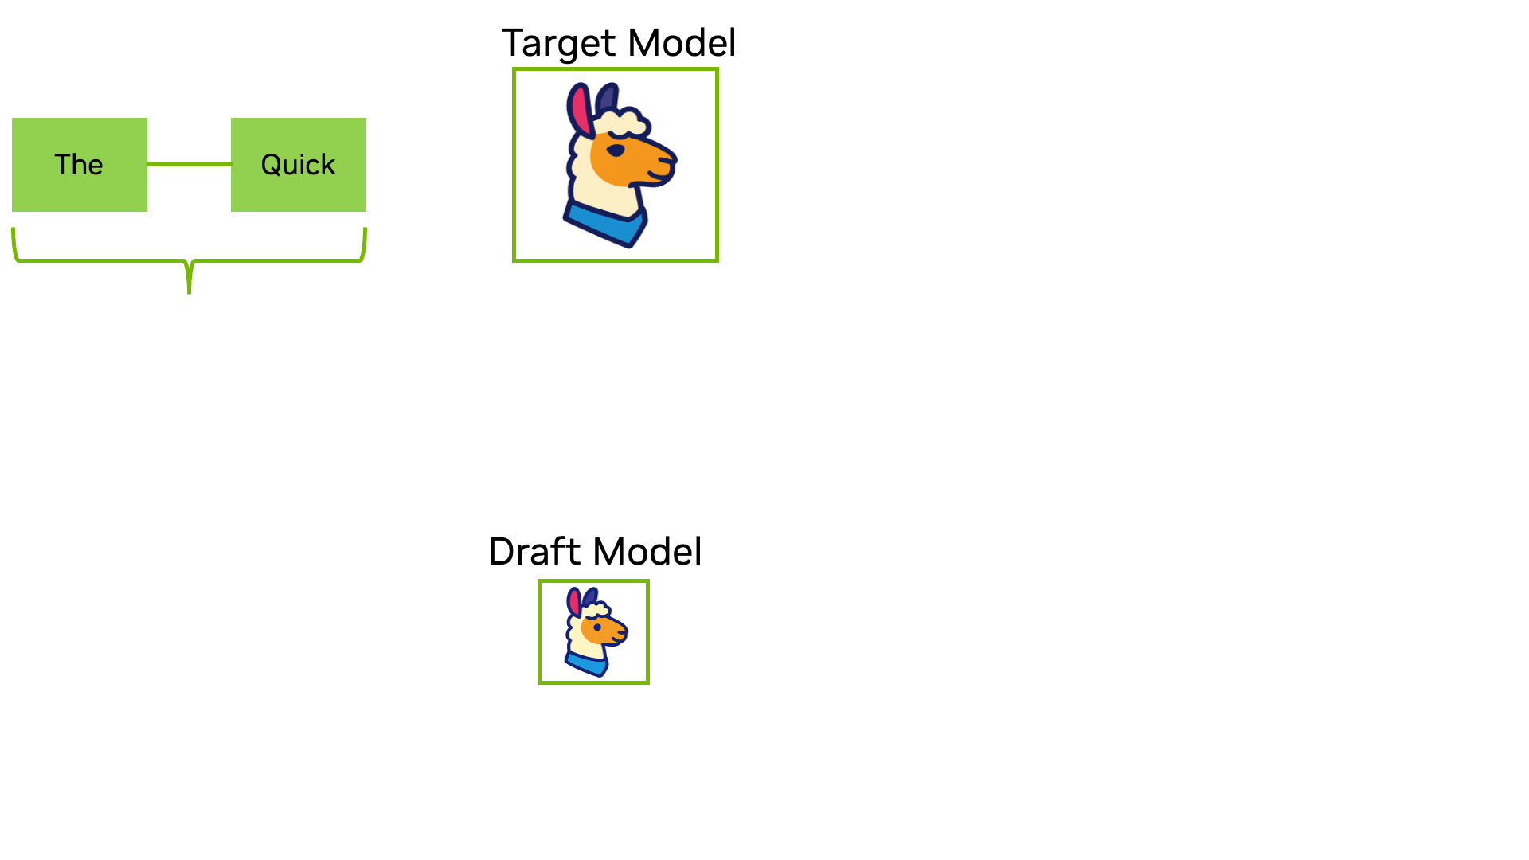
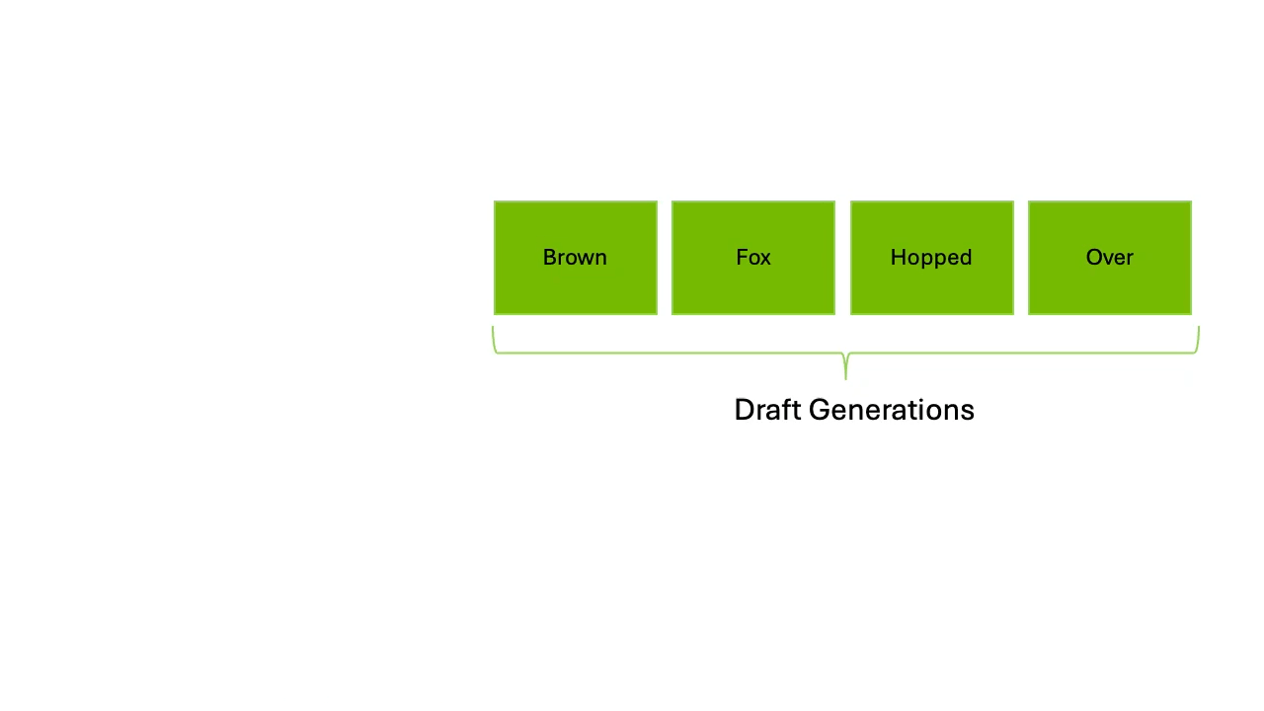
Background
Drafting Phase
Verification Phase
Speculative decoding is a pure speedup technique
We need models that have at least 3-4x difference in throughput to make it work
The naïve method is fixed size window L (L=4 in the ex.)
We need a method to understand when its performing well or not ( Controller )
We need a proxy metric for performance ( per window or per token )
Notes:
Intuition of cost
1) User experience + sacrifice of memory ( 2 models ) + some accuracy
2) Close models do not work
3) Bonus token
4) Adaptive L or Adaptive On/Off –-- ML or heuristics
5) Per window ( 2 distributions ) or Per token ( running ) --- acc rate, KL OR entropy

Slide 39
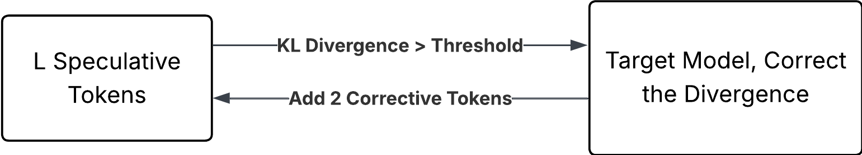
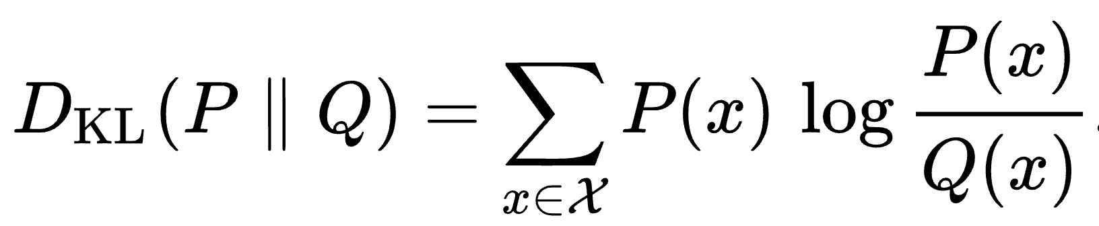
Methods: Overview
Baseline: No Spec Dec, Fixed Draft Length
Intuition: Draft model is the most effective if its distribution is close to the target.
Adaptive: The decoding task is alternating between the draft model and the target.
Let Draft model decodes and target model verifies..
Compute KL, Once the KL Divergence between the draft and target is too large.
Use target model to correct the sequence.
Hand back to the draft model.
Notes:
This slide gives a high-level overview of our method. First, the baseline is standard speculative decoding with a fixed draft length L. The draft model always proposes L tokens, the target verifies them once, and there is no extra controller or adaptivity.
The intuition is that speculation only works well when the draft model’s distribution stays close to the target’s. Once the draft drifts away, the acceptance rate drops and the speedup basically disappears. So our adaptive method adds a simple KL-based controller on top of the usual spec-dec pipeline. We still let the draft model decode a window of L speculative tokens. The target model then verifies this window as in normal speculative decoding. From that same forward pass we get both draft and target logits, so we can compute the KL divergence over this window.
If the mean KL is above a fixed threshold, we treat this as ‘the draft has drifted, and we immediately let the target model generate one more corrective token to realign the sequence. After those corrective tokens, control goes back to the draft model, and we repeat the same loop. So compared to the fixed-length baseline, the only change is this KL-based correction step that sometimes spends two extra target tokens when the draft has moved too far from the target.

Slide 40
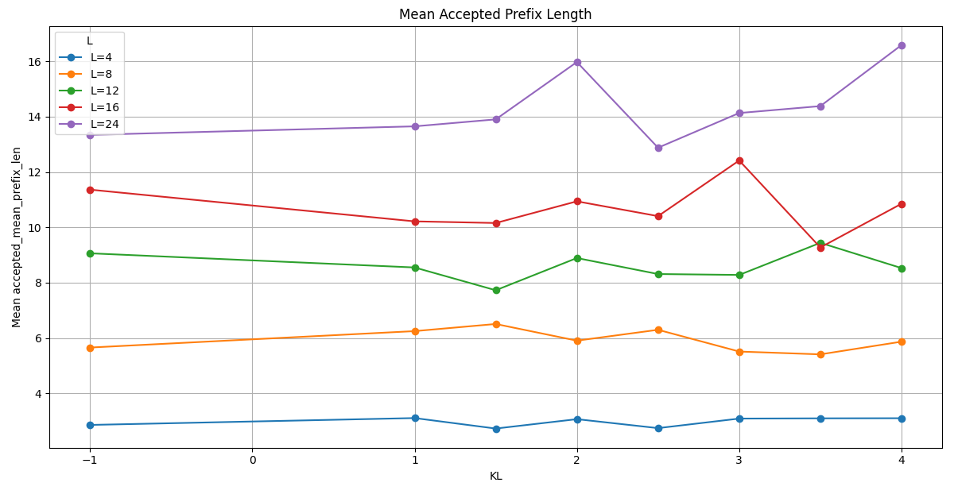
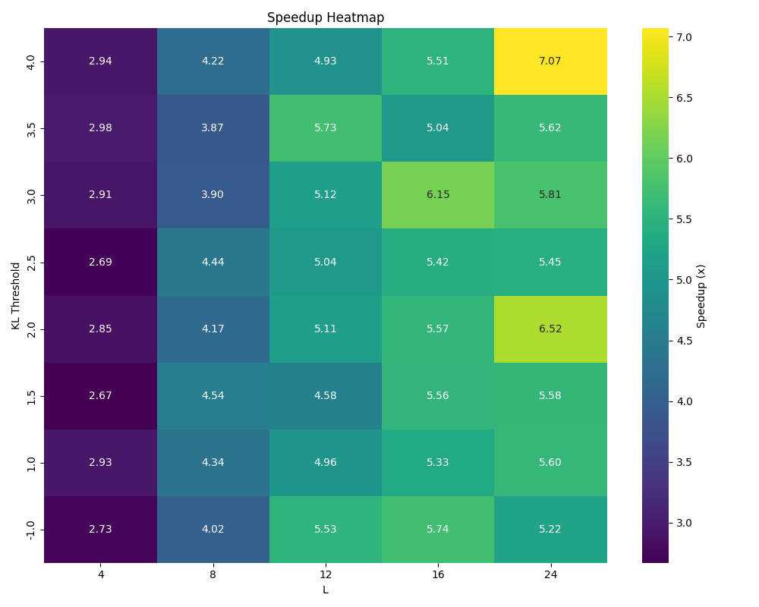
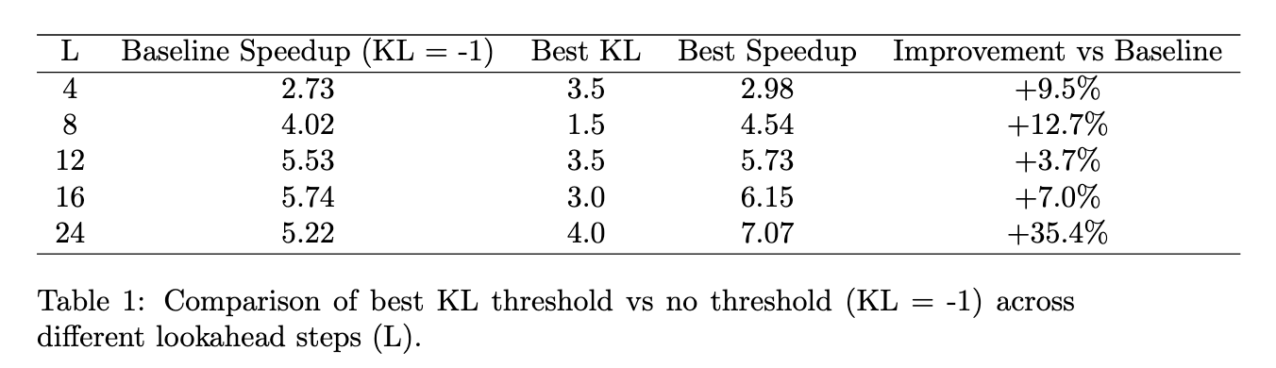
Results
Notes:
This is the result we get for our speculative decoding method.
In our experiment, the window length L and the KL divergence threshold are two hyperparameters that we can configure.
Different window size and the different threshold we use result in different number of token to be accepted in the experiment.
So it will result in different amount of invocation of the target model.
It will also affect the overall speedup.
The figure on the upper right shows the average length of the accepted tokens in the speculation window.
This figure shows the number of tokens being accepted in the window versus the KL divergence threshold we set, for 5 different window sizes.
The KL divergence window of negative one is the baseline.
One trend we can see in this figure is that with a larger window size, we are generally have higher number of accepted tokens in the window. And this is a very sensitive parameter.
The second figue we want to show is this heatmap on the left. Now the horizontal row is the window size, and the horizontal axis is the KL threshold. The overall speedup is color coded. With a more warmer size means a higher speedup.
This plot shows the speedup trends with two of the hyperparameter is we have in the Speculativ Decoding. One trend is that as we have higher window size, as we move towards the right of the heatmap, we have a higher speedup.
And also when we have higher KL threshold, we have higher speedup. So the region with high speedup are clustered at the upper right region.
(The effect of the KL threshold is noisy)
The table on the lower right is the comparison between the baseline speedup and the highest spedeup in our implementation, for different winodw lengths.
Next Kimon will show a demo video about our pipeline.

Slide 41
Challenges, Limitations & Key Takeaways
Online heuristic-based approach provides a simple, model-agnostic method for implementing ASD
Qwen, GPT, Llama
Reasonable alignment requirement between draft and target models
Similar prediction probabilities/logits, matching tokenization & vocabulary
Size trade-off: Draft model should be sufficiently smaller than the target model to see decent gains (~10x) but large enough to make good predictions
Heuristic selection trade-off: Conservative heuristics reduce failures but may limit acceleration when the draft model is highly accurate.
Future work:
Corrective step right now is hardcoded, but can be an additional hyperparameter.
Incorporating additional heuristic signals, such as token-level entropy can potentially improve speedup.

Slide 42


Slide 43
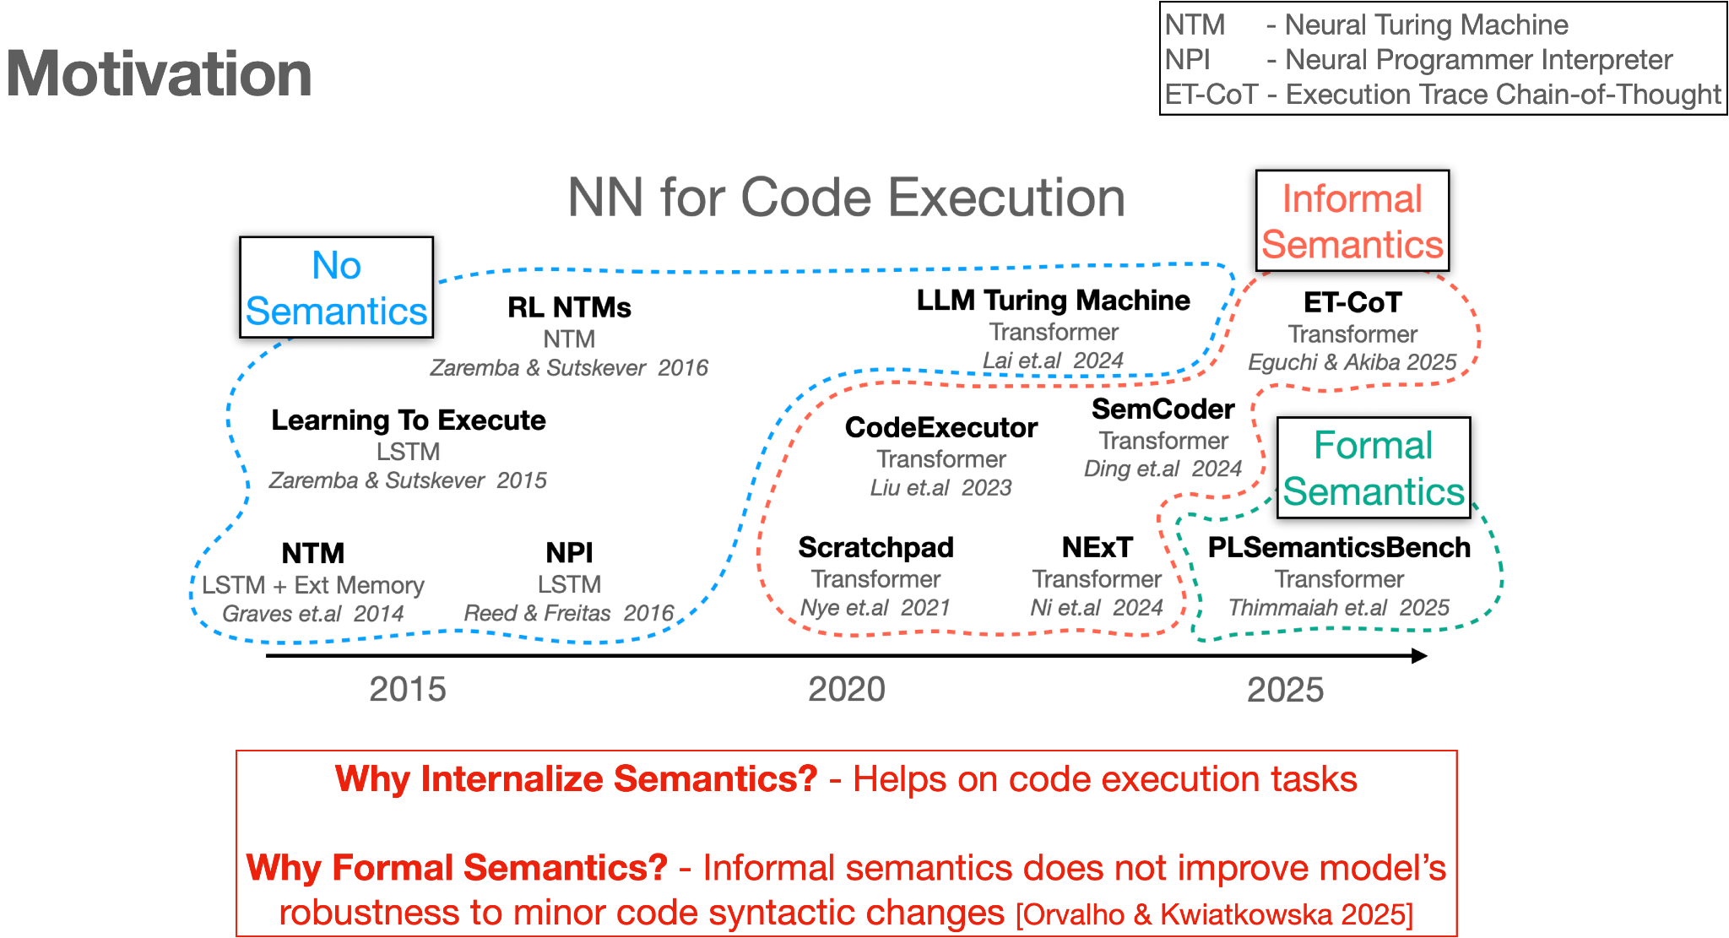

Slide 44
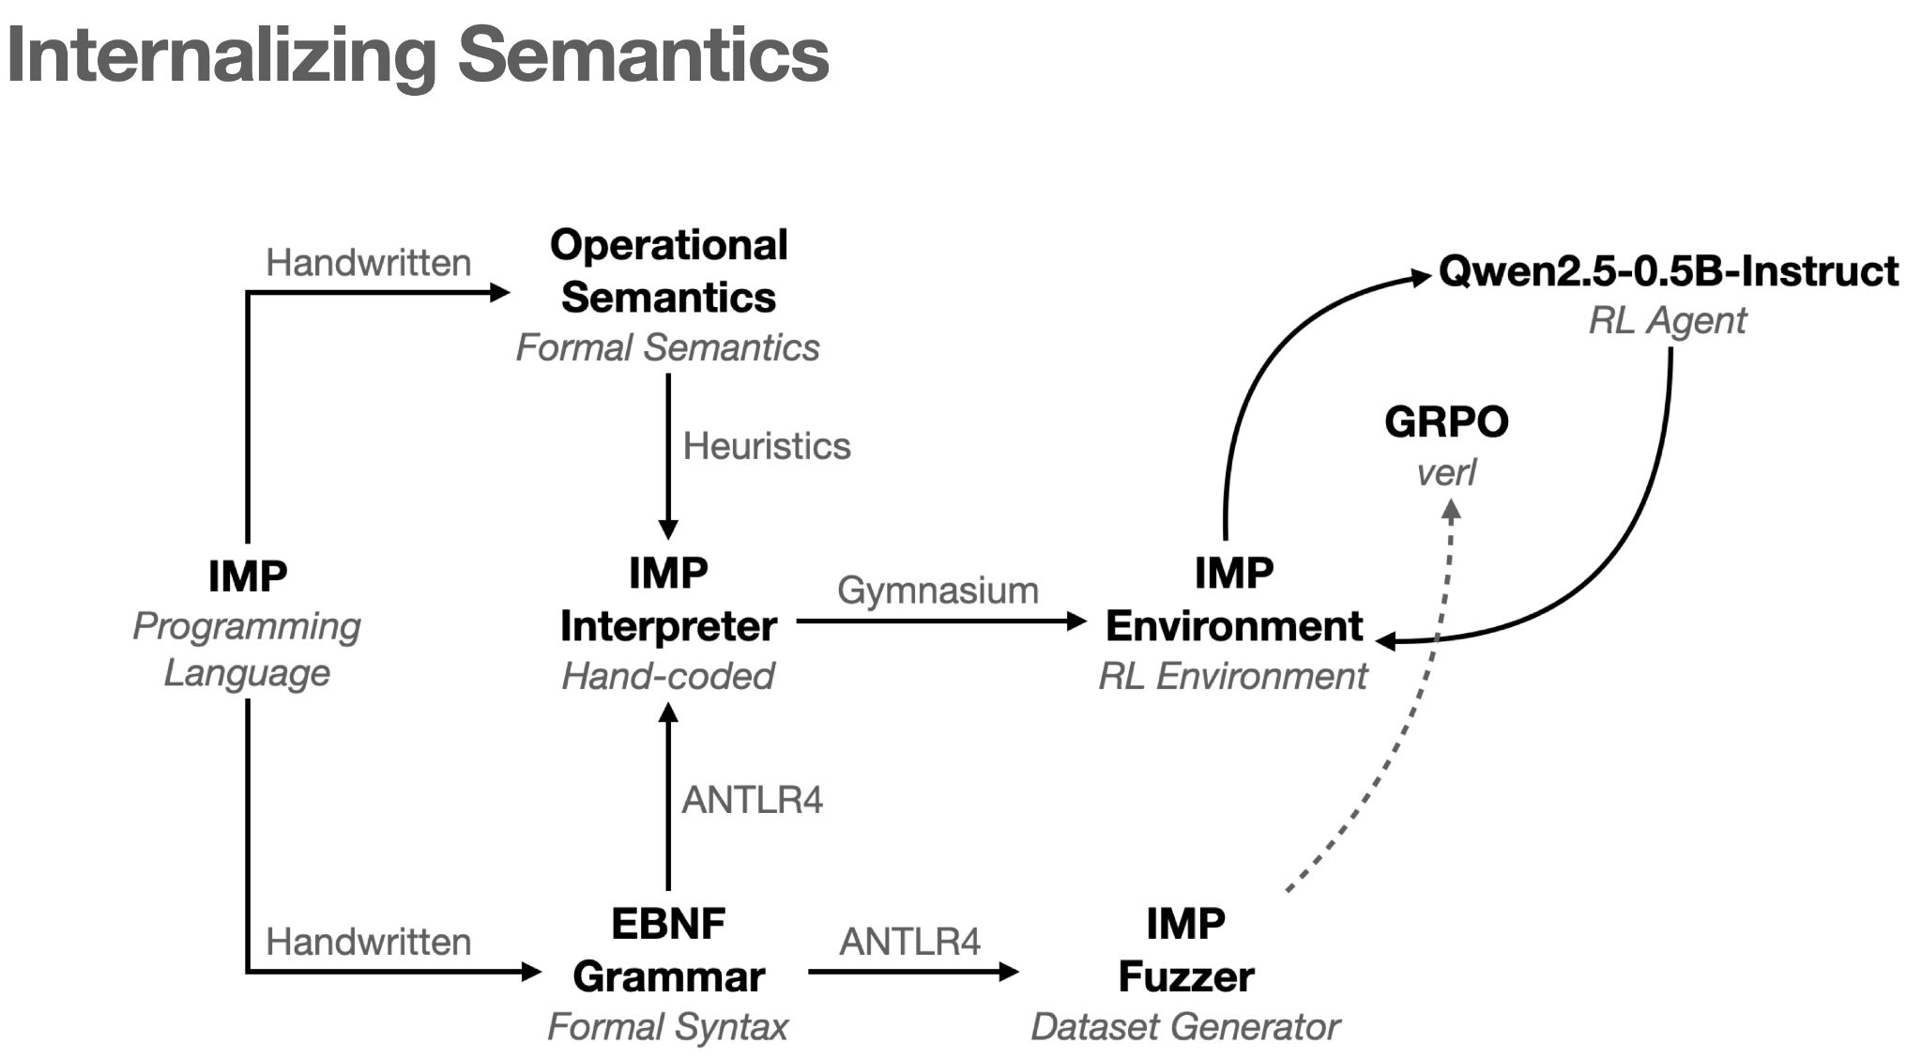

Slide 45
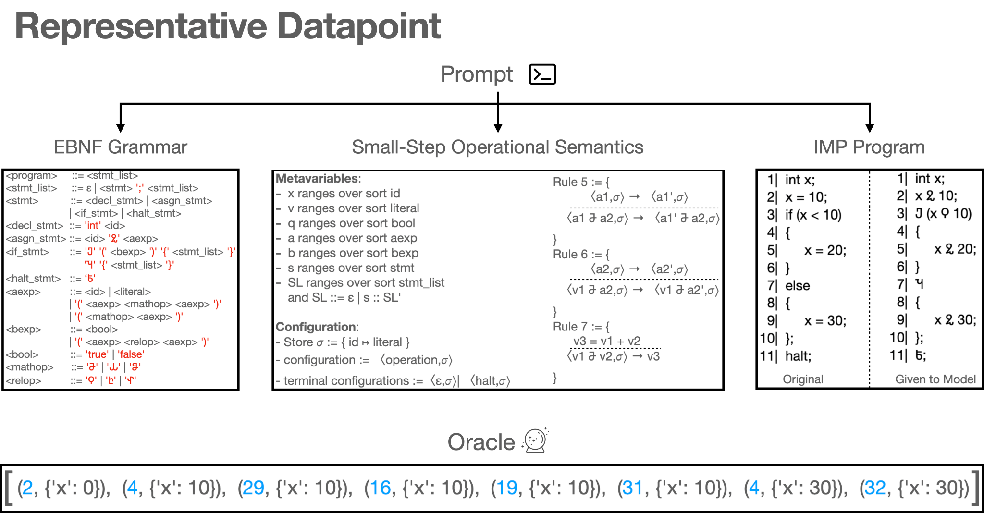

Slide 46
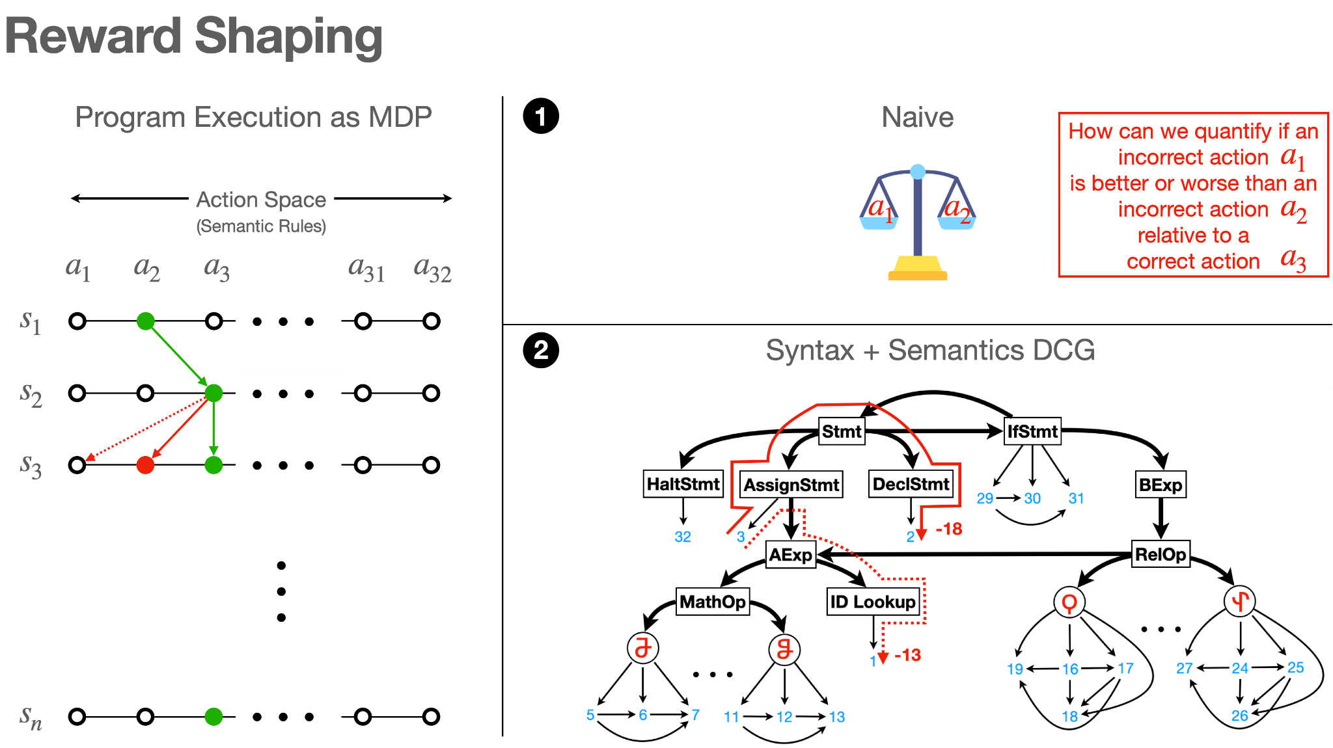

Slide 47
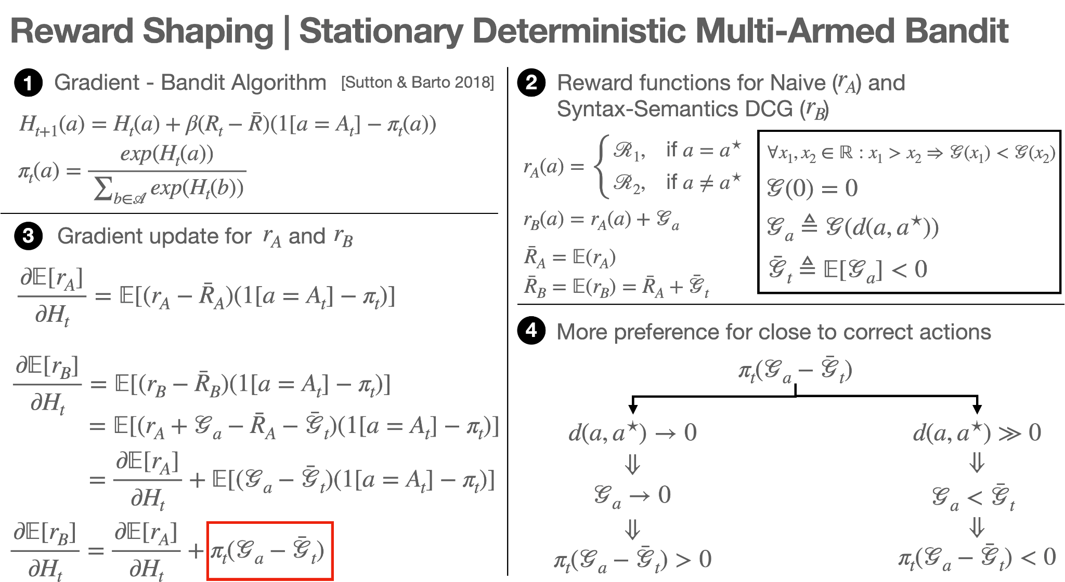

Slide 48
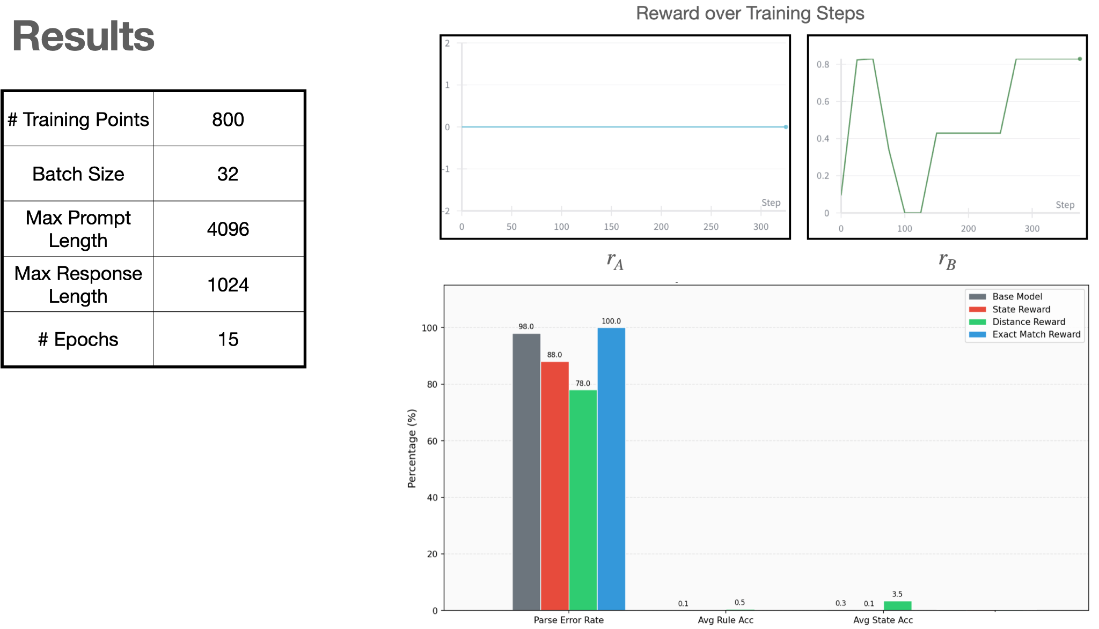
Base model: Qwen/Qwen2.5-0.5B-Instruct
Reward = 1 / (1 +distance)

Slide 49
Challenges & Takeways
Hard exploration problem is challenge for small models
Distance-based reward is better than exact match for semantic reasoning
Future work:
Validate our approach on larger models
Include state into reward

Slide 51

RL for Video Compression
12/4/2025
Nandita Jayanthi, Rachel Yamamoto
The University of Texas at Austin

Slide 52
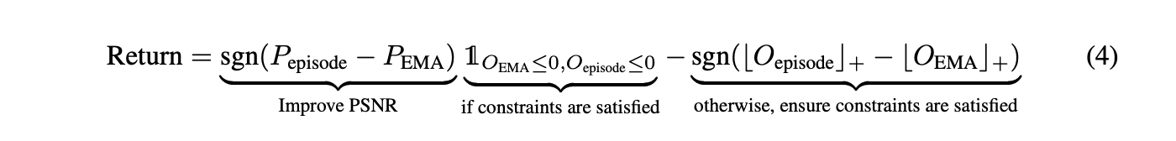
Motivation + Background
Goal: Use RL to choose QP values during video compression to directly maximize VMAF rather than just PSNR
IoT has limited bandwidth and videos take up a lot of space
Solution: compression
Trade-off between bitrate and quality
VP9 Video Compression
Video (en)co(der)dec(oder)
Dynamically changes bitrate: Two passed
1st pass: motion and complexity of scene
2nd pass: key frames + insert reference frames + QP selection
Past work: “MuZero with Self-competition for Rate Control in VP9 Video Compression”
RL for rate control(specialized QP selection)
Self-competition for rewards to guide performance improvement
QP: Quantization Parameter
PSNR: Peak Signal-to-Noise Ratio
VMAF: Video Multimethod Assessment Fusion(perceptual quality)
P_{episode}: PSNR across episode
P_{EMA}: Historic PSNR (exponential moving average)
O_{episode}: Overshoot of episode
O_{EMA}: Historic overshoot (exponential moving average)
sgn is {-1, 0, 1} based on difference between current overshoot and historic overshoot

Slide 53
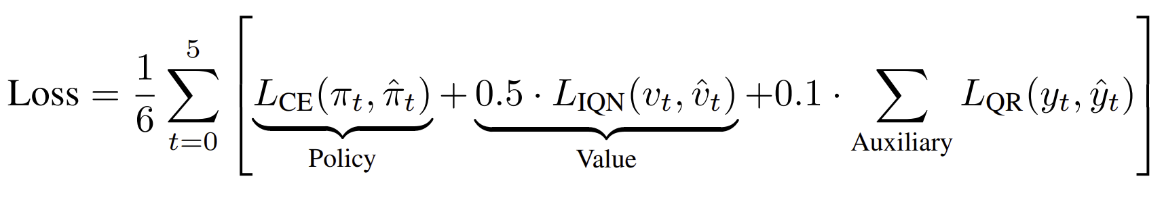
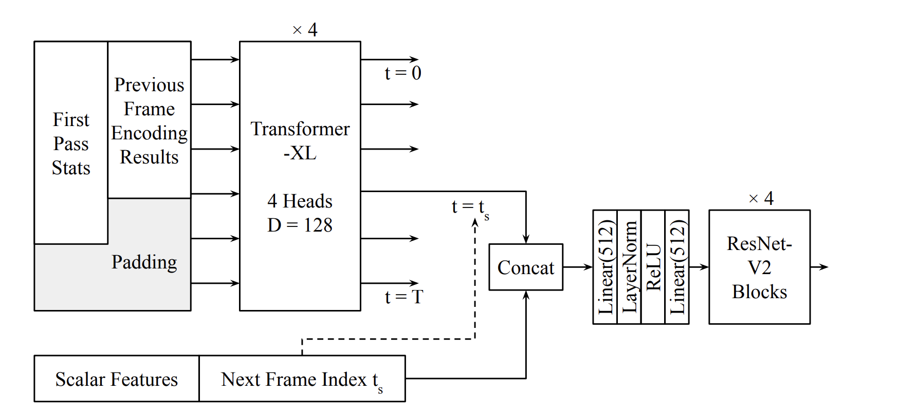
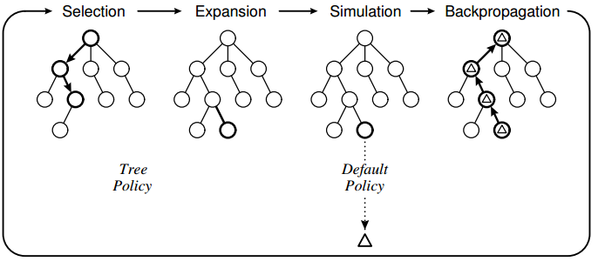


Implementation
Training Update
Per Frame
Representation Network
PSNR,
Bits Used
VMAF, PSNR,
Overshoot
Monte Carlo Tree Search
Prediction Network
Self-competition Reward
Dynamics Network
Per Episode/Video

Slide 54



Experimental Results
Difference in metrics of model optimizing VMAF versus model optimizing PSNR
Video Comparison:
PSNR left
VMAF right
because PSNR difference negligible but VMAF difference is noticeable, it’s better to optimize for VMAF in self-competition

Slide 55
Challenges/Limitations/Key Takeaways
Training Time
Each item in replay buffer takes a long time to create
Spending time encoding each frame for each step of RL takes time
Takeaway:
Train longer. Currently train for about 8-10 hours
Consider a distributed environment
Limited Space
Videos and their individual encoded frames take up space to store
Eventually will run out of memory
Video Types
Videos trained on were from Youtube’s shorts dataset (each video 5 seconds)
Takeaway: Differ in video length
Although the average difference in VMAF numerically looks good, the actual visual difference is very hard to see visually, so it may not matter in the long run which metric PSNR or VMAF to optimize for.

Slide 57
ML for ASM to C
Darius Grassi
Weijie Chen

Slide 58
Background
Rule-based (Hard to read)
Decompilation is a hard problem
Reverse engineering
Security (malware analysis)
Existing decompilation work
Rule-based: Ghidra (NSA)
NMT-based: TransCoder
Produce “pseudo C”
Structurally correct
Loss of variable names
Awkward loops, hard to read
Original
int test(int param_1,int param_2)
{
undefined4 local_20;
undefined4 local_c;
local_c = 1;
local_20 = param_2;
while (0 < local_20) {
local_c = local_c * param_1;
local_20 = local_20 + -1;
}
return local_c;
}
int test(int x, int y){
int res = 1;
while((y--) > 0){
res *= x;
}
return res;
}
Compiled
test:
endbr64
pushq %rbp
movq %rsp, %rbp
movl %edi, -20(%rbp)
movl %esi, -24(%rbp)
movl $1, -4(%rbp)
jmp .L2
.L3:
movl -4(%rbp), %eax
imull -20(%rbp), %eax
movl %eax, -4(%rbp)
.L2:
movl -24(%rbp), %eax
leal -1(%rax), %edx
movl %edx, -24(%rbp)
testl %eax, %eax
jg .L3
movl -4(%rbp), %eax
popq %rbp
ret
LLMs have learned human biases
Variable declaration
Naming schemes
Data types
But LLMs are black boxes
Huge amounts of parameters
Massive training data, potentially with original C
LLM
#include "out.h"
int test(int base, int exponent) {
int result = 1;
while (exponent > 0) {
result = result * base;
exponent--;
}
return result;
}
De-compiled
Our goal: Can we train a small specialized model to get Ghidra accuracy + LLM readability?

Slide 59

Methodology
We use AnghaBench as dataset. It's a collection of compilable functions mined from Github
We use a Bart Like model
22M param; 4 encode + decode layers
256 hidden dim.
4096 token context window
Tokenizer: Pre-trained GPT-2 BPE
file.c
gcc -O0 -S file.s
file.s
Clean
{file.c, file.s}
Gcc -O0; verbose, literal

Slide 60

Results
INPUT ASSEMBLY (Snippet):
endbr64
pushq %rbp
movq %rsp, %rbp
subq $48, %rsp
movq %rdi, -24(%rbp)
movq %rsi, -32(%rbp)
movq %rdx, -40(%rbp)
movq -24(%rbp), %rax
movq %rax, -8(%rbp)
GROUND TRUTH C (Snippet):
struct List {int dummy; } ;
int List_At (struct List*,int ) ;
int assign (int ,struct List*) ;
int c_int (struct List*) ;
__attribute__((used)) static void List_Set(var self, var key, var val) {
struct List* l = self;
assign(List_At(l, c_int(key)), val);
}
MODEL PREDICTION:
# int AssignList (int ,int ) ;
scalar_t__ is_assignList (int ,int ) ;
scalar_t__ is_assignList (int ,int ) ;
__attribute__((used)) static void
List(List *List,List *List,List *List)
{
List *List =List;
List *List =List;
List *List =List;
List = is_assignList(List,List);
List = is_assignList(List,List);
}
============================================================<end_token>

Slide 61

Limitations and Conclusions
Key Challenges:
Raw C data from Github is noisy, serves many different purposes
A smaller model struggles to learn high entropy inherent to ASM compared to GPT-4
Future Work:
Constrained decoding of valid C output from model
Pure text → CFG representation to learn structure better
Large models decompile simple C code easily

Slide 62
Collision detection for continuum manipulators
Mobina Tavangarifard

