Slide 1
Machine Learning for the
Rest of Us
Keshav Pingali
The University of Texas at Austin

Slide 2
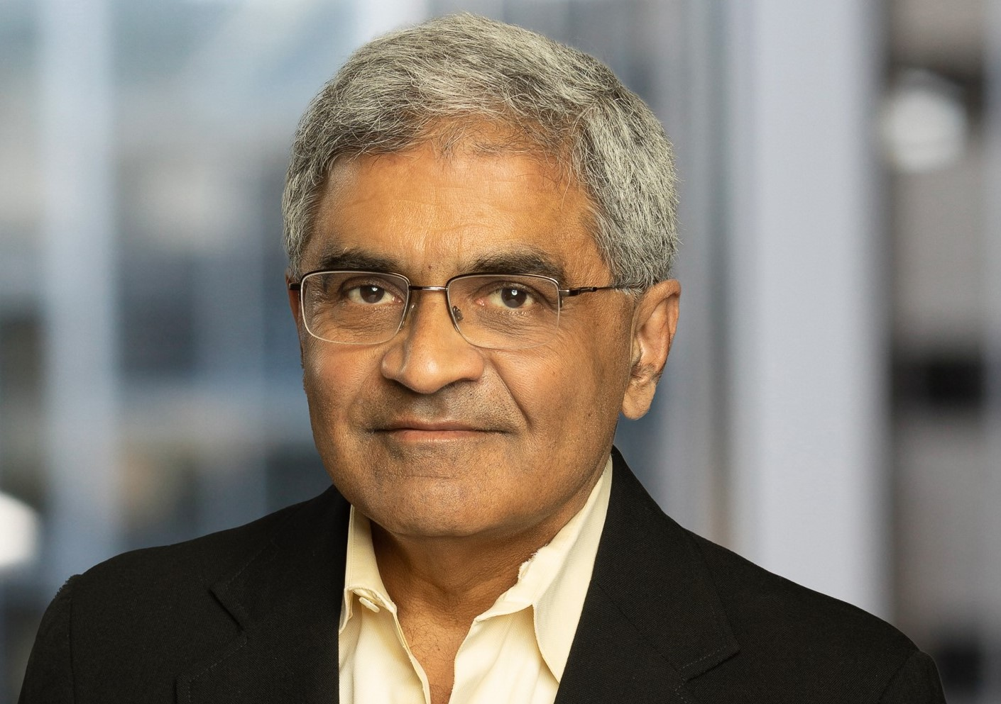
Keshav Pingali
W.A.”Tex” Moncrief Chair of Computing, University of Texas at Austin
  Department of Computer Science
  Oden Institute of Computational and Engineering Sciences
Education
  ScD: MIT, Cambridge, MA
  B.Tech.: Indian Institute of Technology, Kanpur
Research areas
  Parallel programming, programming languages, compilers, runtime systems
  Irregular algorithms such as graph analytics and finite-element mesh generation
Awards
  2024 ACM SIGPLAN Programming Languages Achievement Award
  2023 ACM/IEEE Computer Ken Kennedy Award
  2023 IEEE Computer Charles Babbage Award
  IEEE Life Fellow, Fellow of ACM, IEEE, AAAS, Academia Europaea
Favorite Italian
  Town: Sorrento
  Dish: Gnocchi Bolognese
  Drink: Spritz Aperol
  Author: Alberto Moravia

Slide 3

Lain (Zelal) Mustafaoglu
Graduate Research Assistant
  Department of Computer Science
  Oden Institute of Computational and Engineering Sciences
CEO and founder, Medexe Inc.
  Multimodal artificial medical intelligence (AMI)
Education
  B.S. University of Illinois
Research areas
  Artificial intelligence in health care
  Interdisciplinary applications of deep learning including cybersecurity and finance
Awards
  Valedictorian at University of Illinois
Favorite Italian
  Football team: SSC Napoli
  Dessert: Affogato al caffe
  Drink: Espresso Martini
  Musician: Robert “3D” Del Naja

Slide 4
Overview
What this course is not about
  Preparing you to do research in machine learning
  How to choose the right ML solution for your problem
What this course is about
  How should researchers in PL/systems understand ML techniques?
  What questions should you ask ML experts and what do you need to know to understand their answers?
I will not
  Talk philosophy
  Use biological metaphors about neurons, synapses, etc.
  Use complex formulas
I will
  Use pictures: lots of them (“Pictures are for weak minds.” Dijkstra)
  Explain most concepts using paths in directed graphs
  Present both neural architectures and reinforcement learning (Deep RL)

Slide 5
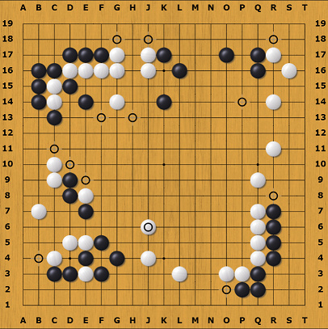
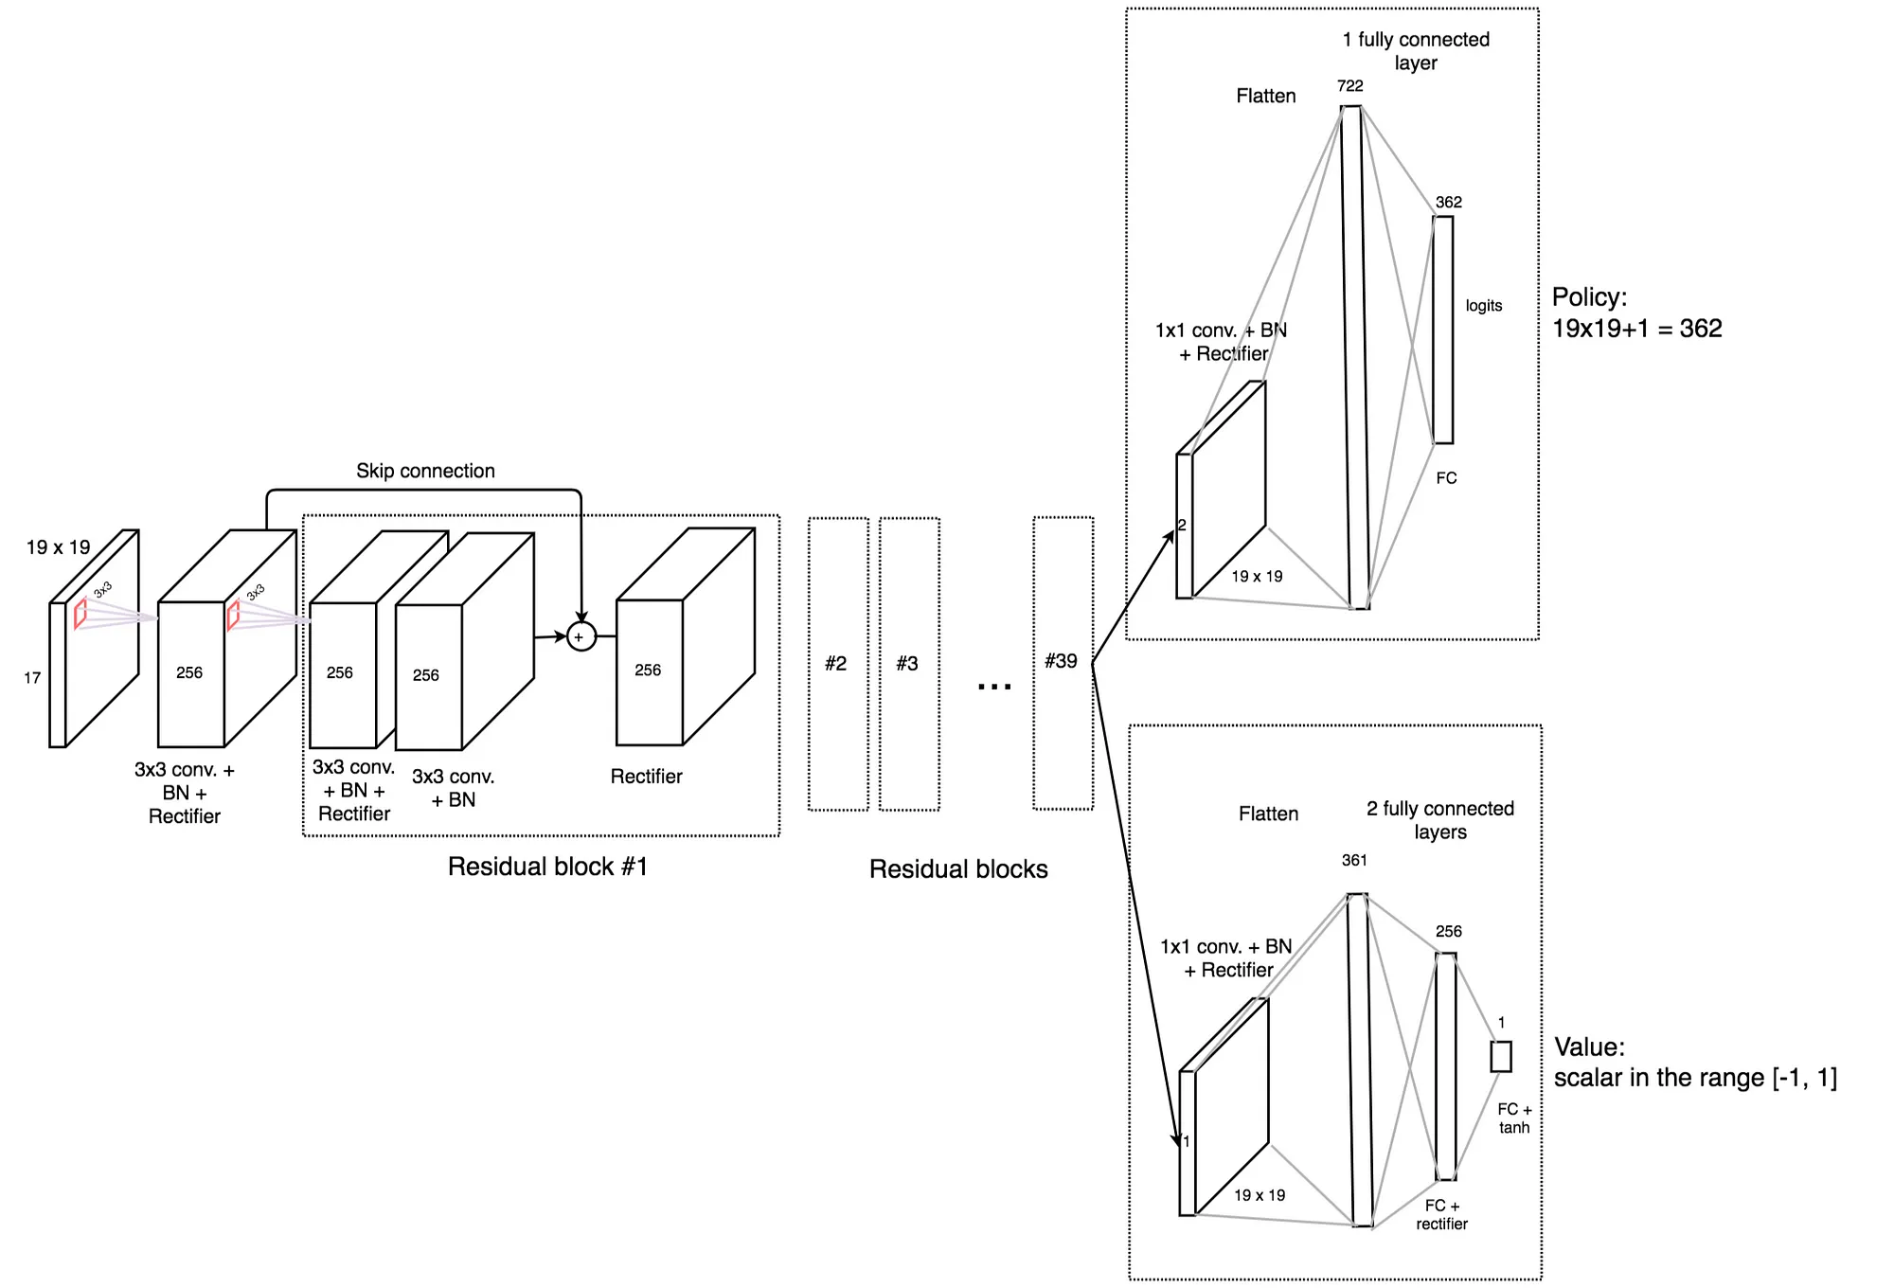
AlphaGo Zero (2017) uses Deep RL
Policy network for RL
Convolutional Neural Network

Slide 6
Organization
Lecture 1: Mathematical Background
  Multivariate calculus, Parameter optimization, Gradient descent
Lecture 2: Neural networks
  Multilayer Perceptrons (MLP) and Deep Neural Networks (DNN)
  Convolutional Neural Networks (CNNs)
  Recurrent Neural Networks (RNNs)
Lecture 3: Model-based reinforcement learning
  Markov Decision Processes
  Value and Policy Iterations
Lecture 4: Sampling-based methods for reinforcement learning
  Temporal-Difference (TD) Learning: TD(0), TD(n), SARSA, Q-learning, TD(λ)
  Monte Carlo methods
Lecture 5: Deep reinforcement learning (Deep RL)
  Function approximation
  Policy-gradient methods for policy optimization

Slide 7
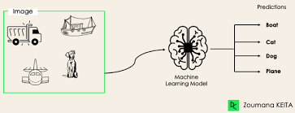
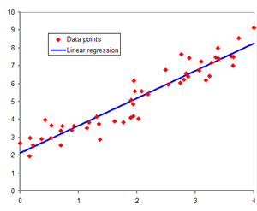
What I expect you to know
Basic calculus and matrix algebra
  Derivatives and integrals
Basic probability theory and statistics
  Distributions, expectations
Introductory concepts in machine learning
  Training data, test data
  Classification, regression
Image classification: Is it a cat or dog?
Regression: How does professor’s h-index
relate to his salary?

Slide 8
Lecture 1 :
Mathematical Background

Slide 9
Organization
Basics
  Partial derivatives, gradients, Jacobians
  Linear regression:
    Parameter optimization: solving linear systems
  Neural networks: parameter optimization requires solving non-linear systems
    Gradient descent
Parameterized programs: abstraction for neural networks
  Dataflow graph representation
  Function evaluation: forward propagation
  Computing gradients: back propagation
  Parameter optimization using gradient descent

Slide 10
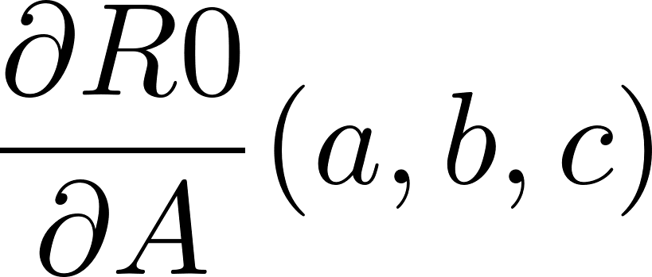
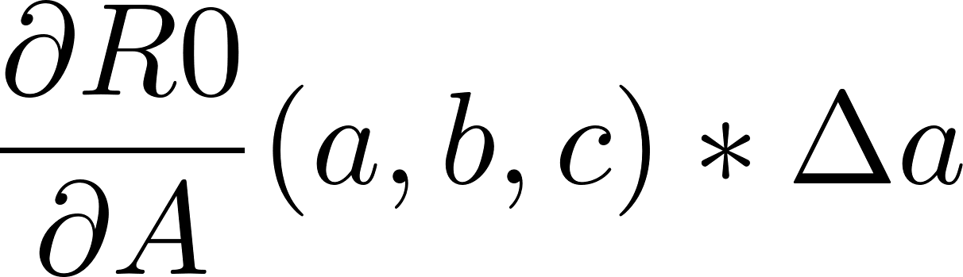
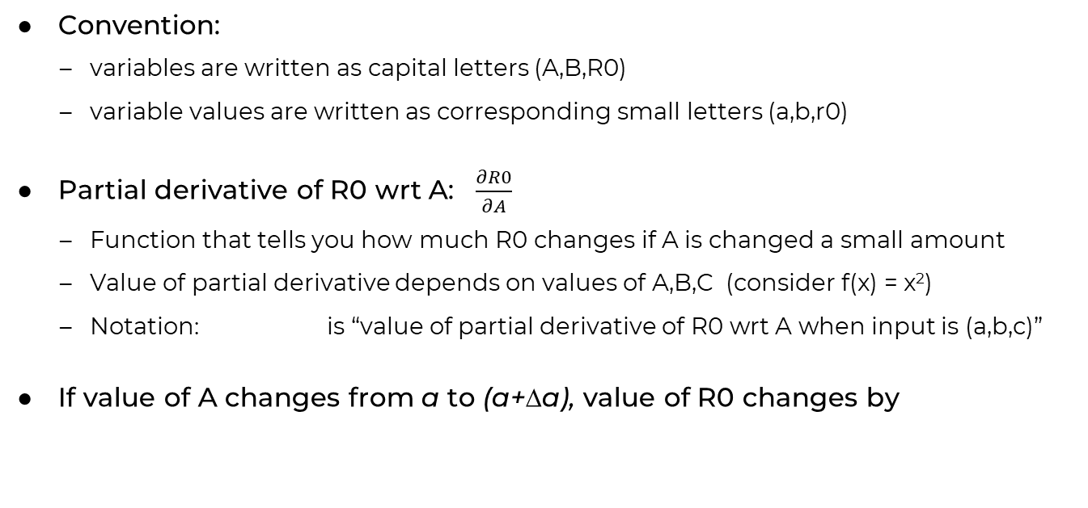
Basic concepts: partial derivatives, gradients, Jacobians (I)
A
R0
f
B
R1
C
Convention:
  variables are written as capital letters (A,B,R0)
  variable values are written as corresponding small letters (a,b,r0)
Partial derivative of R0 wrt A: $\frac{∂R0}{∂A}$
  Function that tells you how much R0 changes if A is changed a small amount
  Value of partial derivative depends on values of A,B,C (consider f(x) = x²)
  Notation: is “value of partial derivative of R0 wrt A when input is (a,b,c)”
If value of A changes from a to (a+Δa), value of R0 changes by

Slide 11

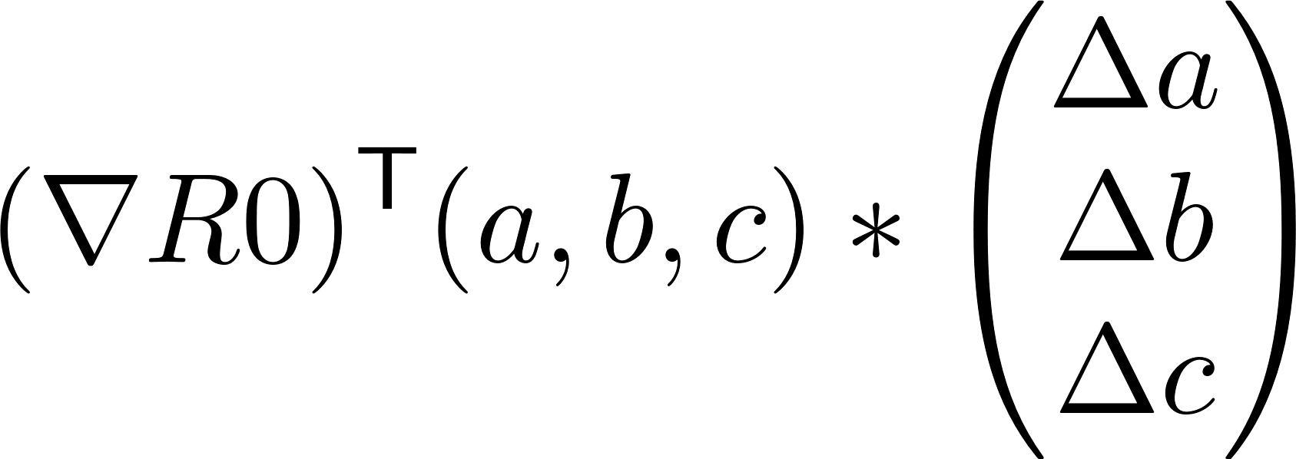
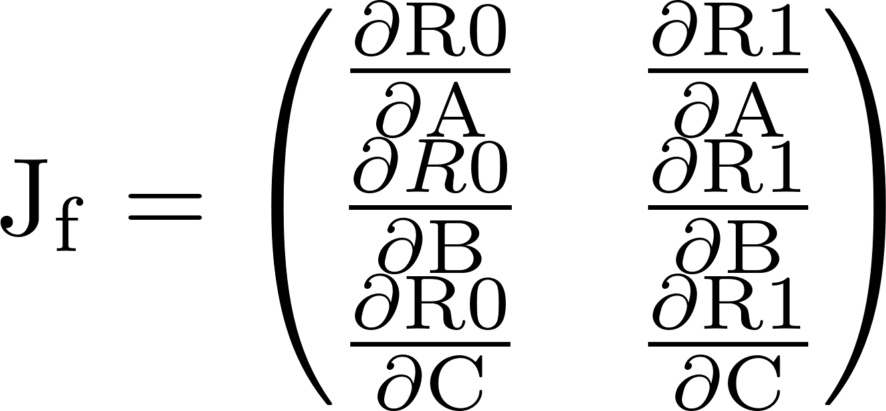
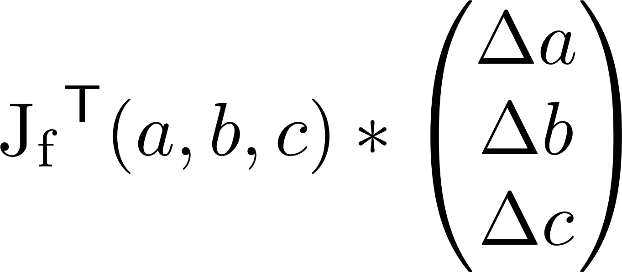
Basic concepts: partial derivatives, gradients, Jacobians (II)
A
R0
B
f
R1
C
Gradient of R0: ∇R0
  Column vector containing partial derivatives of R0
  If input changes from (a,b,c) to (a+Δa, b+Δb, c+Δc), R0 changes by
Jacobian of f: J_{f}
  Matrix whose columns are gradients of outputs
  If inputs change from (a,b,c) to to (a+Δa, b+Δb, c+Δc), outputs change by

Slide 12
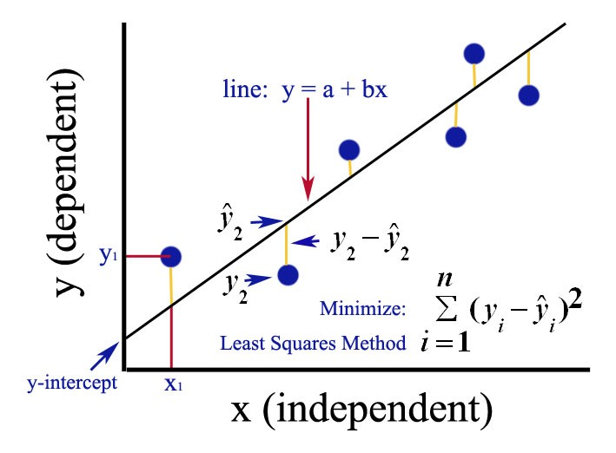
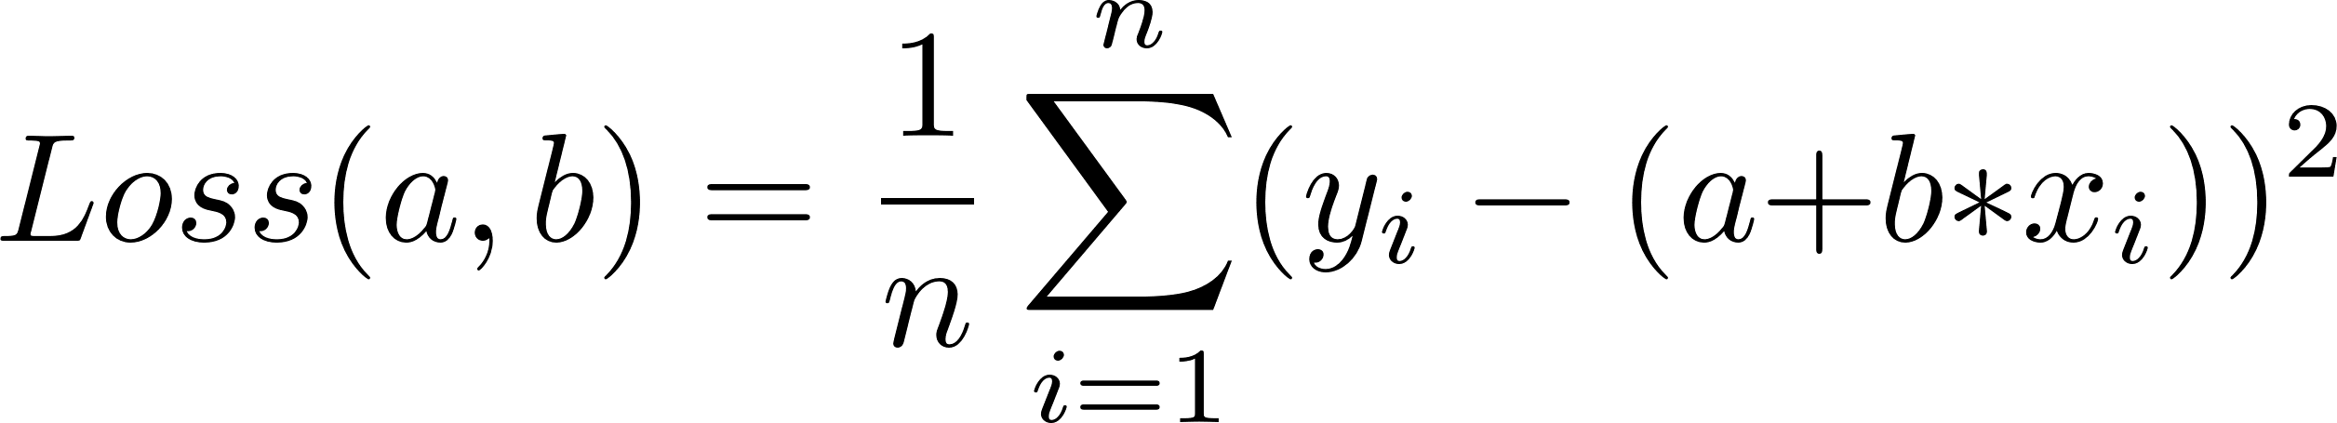
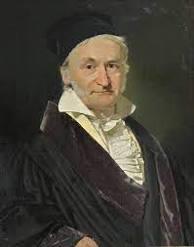
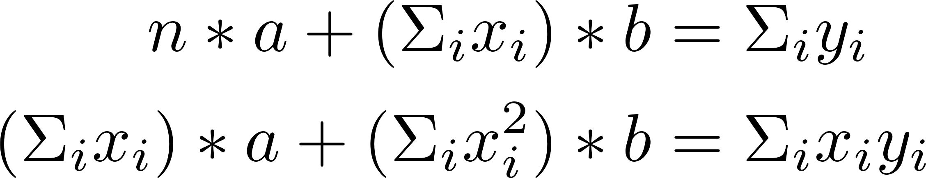
Parameter optimization: linear regression
Given set of n training data samples {(x_{i},y_{i})}, find “best” line Y = a+b*X for given data
  Model for training data
  Model parameters: a and b
  Generalization: model lets you predict y for x not in training sample
Scoring a proposal (a,b): loss function
  Compute total square error/residual
  Detail: we use mean square error (mse)
Parameter values that minimize loss
  Conceptually, a big search problem
  Better solution: use gradients
    Set ∇ Loss(a,b) to zero
    Solve two linear equations
Neural networks are more complicated
  Parameter optimization requires solving non-linear equations
  Popular method: gradient descent
Karl Friedrich Gauss

Slide 13
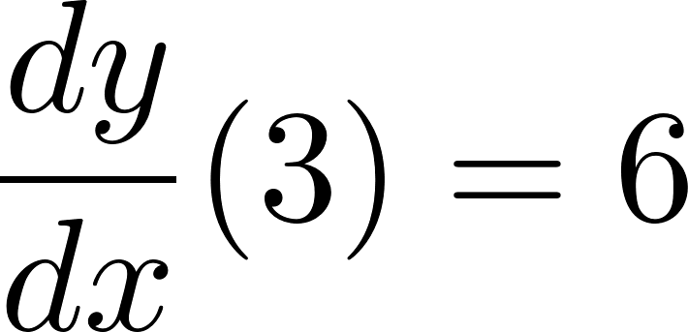



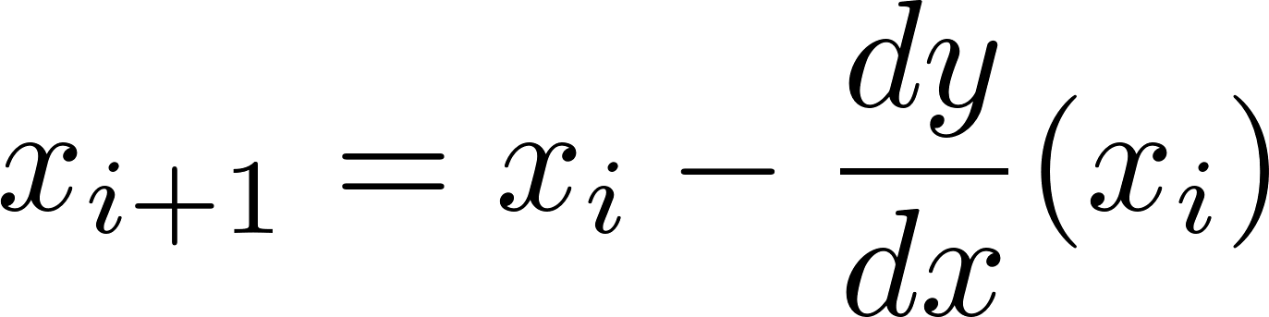
Function minimization using gradient descent (I)
y
9
x
f(x)
f’(x)
3
x
Problem: given function f(x), find x that minimizes f
  Assumptions:
    f has minimum and derivatives, but no closed-form expression is available for derivative
    However, we can ask for the value of the function and its derivative at any point
In general, must use iterative search
Since we have no prior information, pick some value of x (say 3) and get f(x) (say 9)
  To see if we have a minimum, get gradient, which is 6.
  Since gradient is not zero, we are not at minimum.
  What is a good point to try next?
Gradient gives us two pieces of information
  Sign: since gradient is positive, increasing x will increase function value so we should decrease x.
  Magnitude: if the magnitude of gradient is small, we are close to the minimum so step size should be small. Conversely if magnitude of gradient is large, we might be far from minimum so we can use a larger step size.
This suggests an iterative scheme of the form

Slide 14
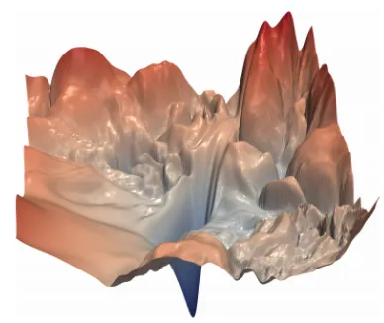
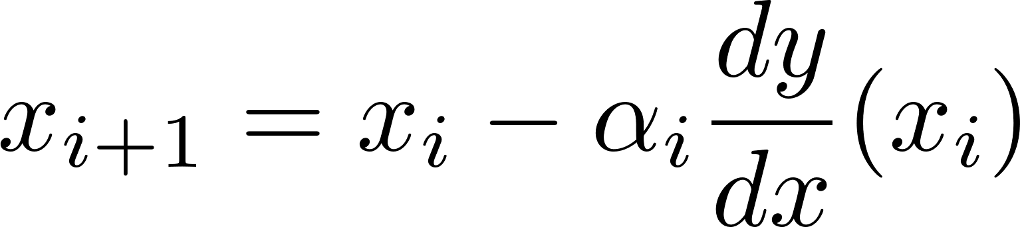
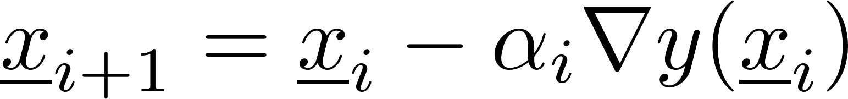
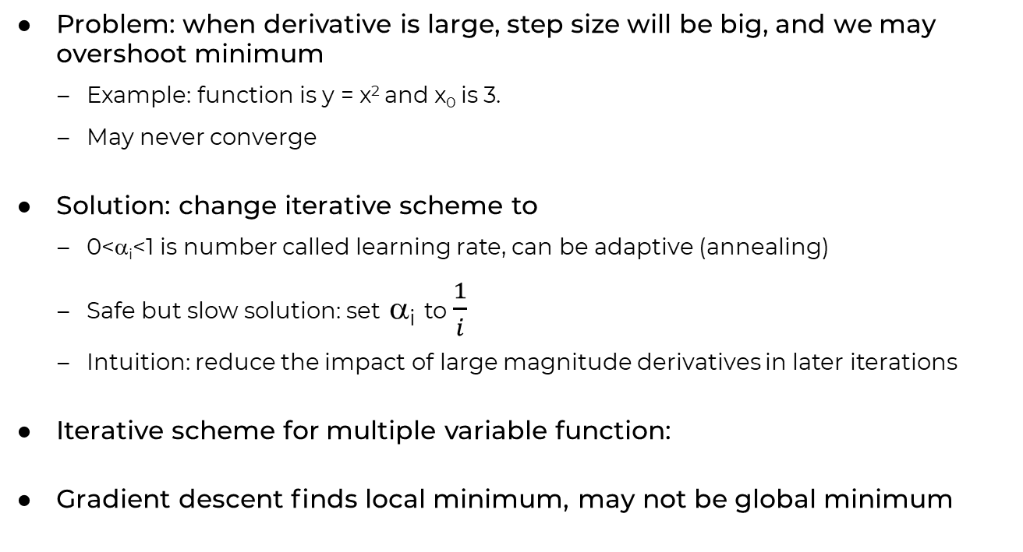
Function minimization using gradient descent (II)
y
9
3
x
Problem: when derivative is large, step size will be big, and we may overshoot minimum
  Example: function is y = x² and x₀ is 3.
  May never converge
Solution: change iterative scheme to
  0<α_{i}<1 is number called learning rate, can be adaptive (annealing)
  Safe but slow solution: set α_{i} to $\frac{1}{i}$
  Intuition: reduce the impact of large magnitude derivatives in later iterations
Iterative scheme for multiple variable function:
Gradient descent finds local minimum, may not be global minimum
Hao Li et al.

Slide 15
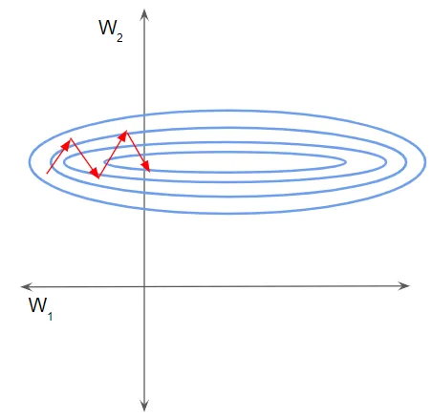
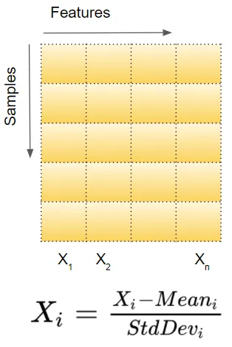
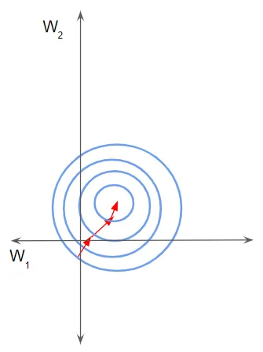
Variations on theme(I)
Ketan Doshi
Rate of convergence
  How fast is gradient changing?
    Curvature: second-derivative (Hessian in higher dimensions)
  Noisy values and gradients: penalty for inaccuracy
Data normalization
  Reshape optimization landscape to avoid “valleys”
Other iterative schemes: Adagrad, Nesterov momentum, Adam, ….
  Use different learning rates for different dimensions (Adagrad)
  Keep gradient in previous step and check for change in sign of any derivative (momentum)
  https://www.slideshare.net/SebastianRuder/optimization-for-deep-learning

Slide 16

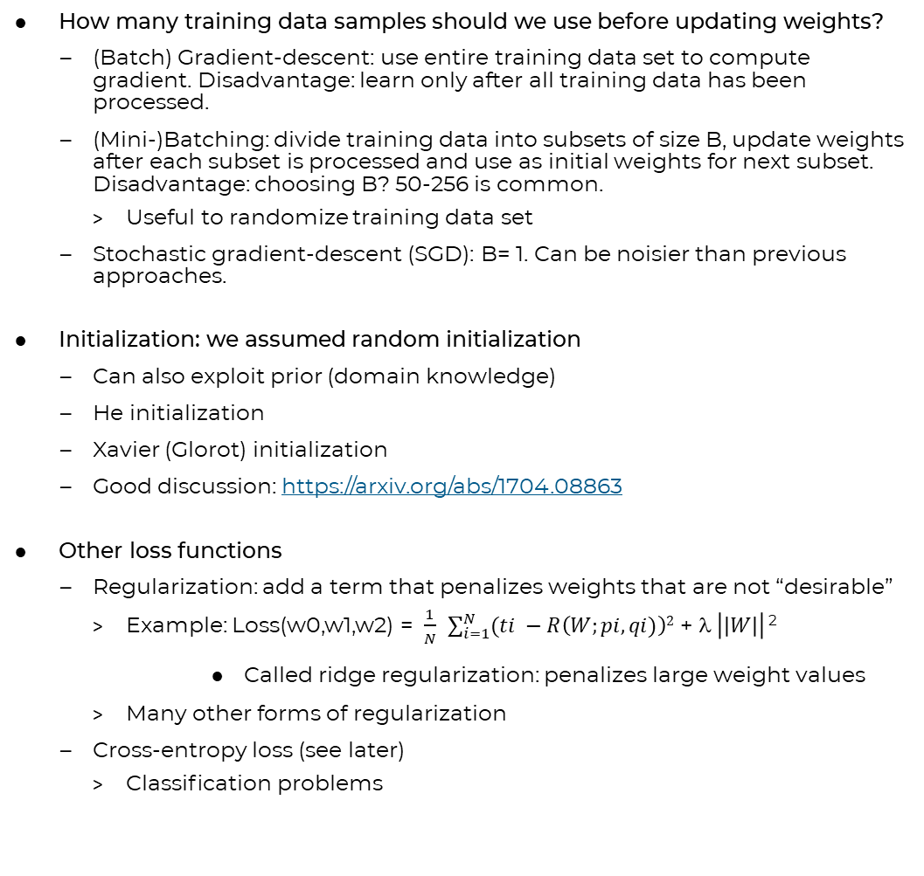
Variations on theme (II)
How many training data samples should we use before updating weights?
  (Batch) Gradient-descent: use entire training data set to compute gradient. Disadvantage: learn only after all training data has been processed.
  (Mini-)Batching: divide training data into subsets of size B, update weights after each subset is processed and use as initial weights for next subset. Disadvantage: choosing B? 50-256 is common.
    Useful to randomize training data set
  Stochastic gradient-descent (SGD): B= 1. Can be noisier than previous approaches.
Initialization: we assumed random initialization
  Can also exploit prior (domain knowledge)
  He initialization
  Xavier (Glorot) initialization
  Good discussion: https://arxiv.org/abs/1704.08863
Other loss functions
  Regularization: add a term that penalizes weights that are not “desirable”
    Example: Loss(w0,w1,w2) = $\frac{1}{N}$ $\sum_{i=1}^{N}{(ti −R\left(W;pi,qi)\right)2}$ + $ \left|\left|W\right|\right|$ ²
      Called ridge regularization: penalizes large weight values
    Many other forms of regularization
  Cross-entropy loss (see later)
    Classification problems
N
B

Slide 17
Computing Gradients
In
Parameterized Programs

Slide 18
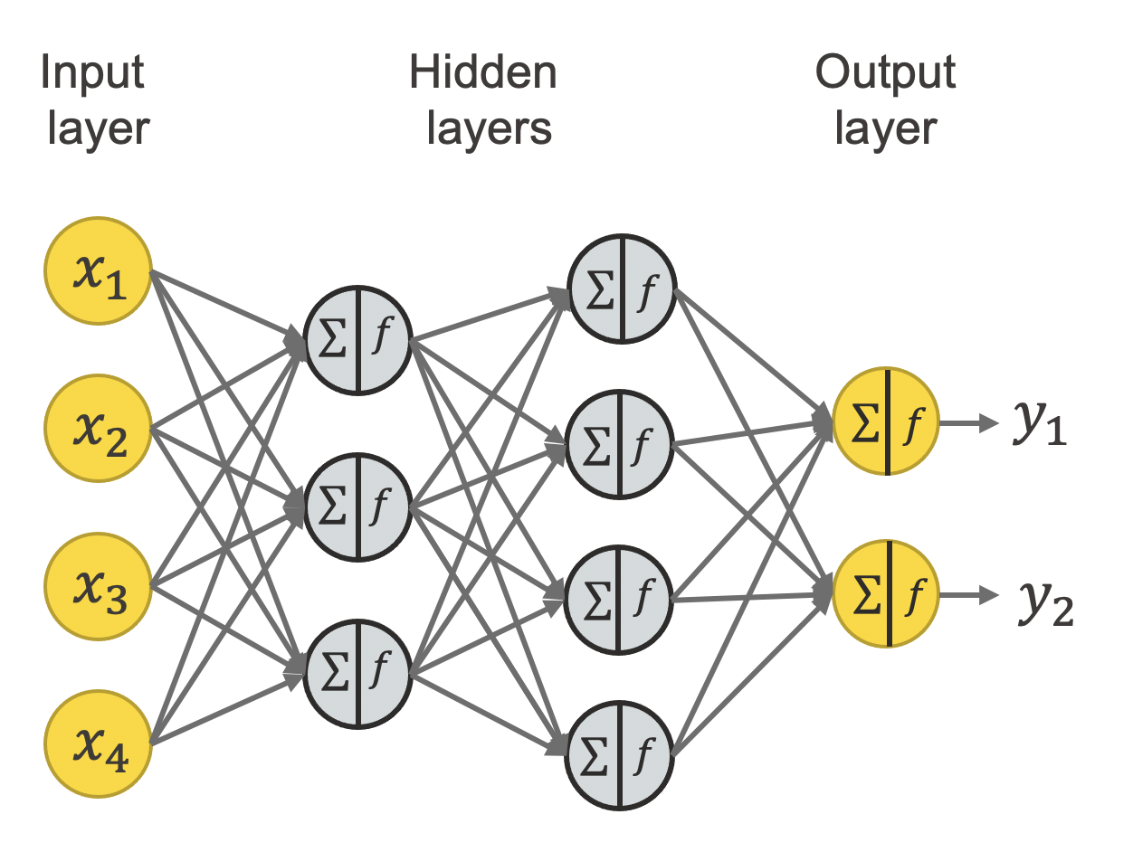
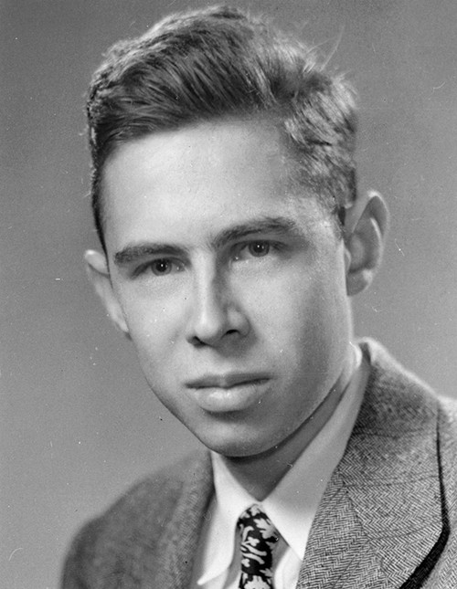
Multilayer Perceptron (MLP) Example
MVM
MVM
MVM
Frank Rosenblatt (Cornell)
Inventor of Perceptron
neuron
map
map
map
Type: Inputs: x₁..x₄, outputs: y₁,y₂ (all ℜ)
Scalar view:
  Each edge performs a multiplication with a real-valued parameter
  Each neuron adds its input values and applies a non-linear operation f such as tanh, ReLU etc. (known as activation functions)
Vector view:
  Each layer performs a dense matrix vector multiplication
  Followed by pointwise (map) non-linear operation f
Abstraction of MLP and more complex neural networks: parameterized programs

Slide 19
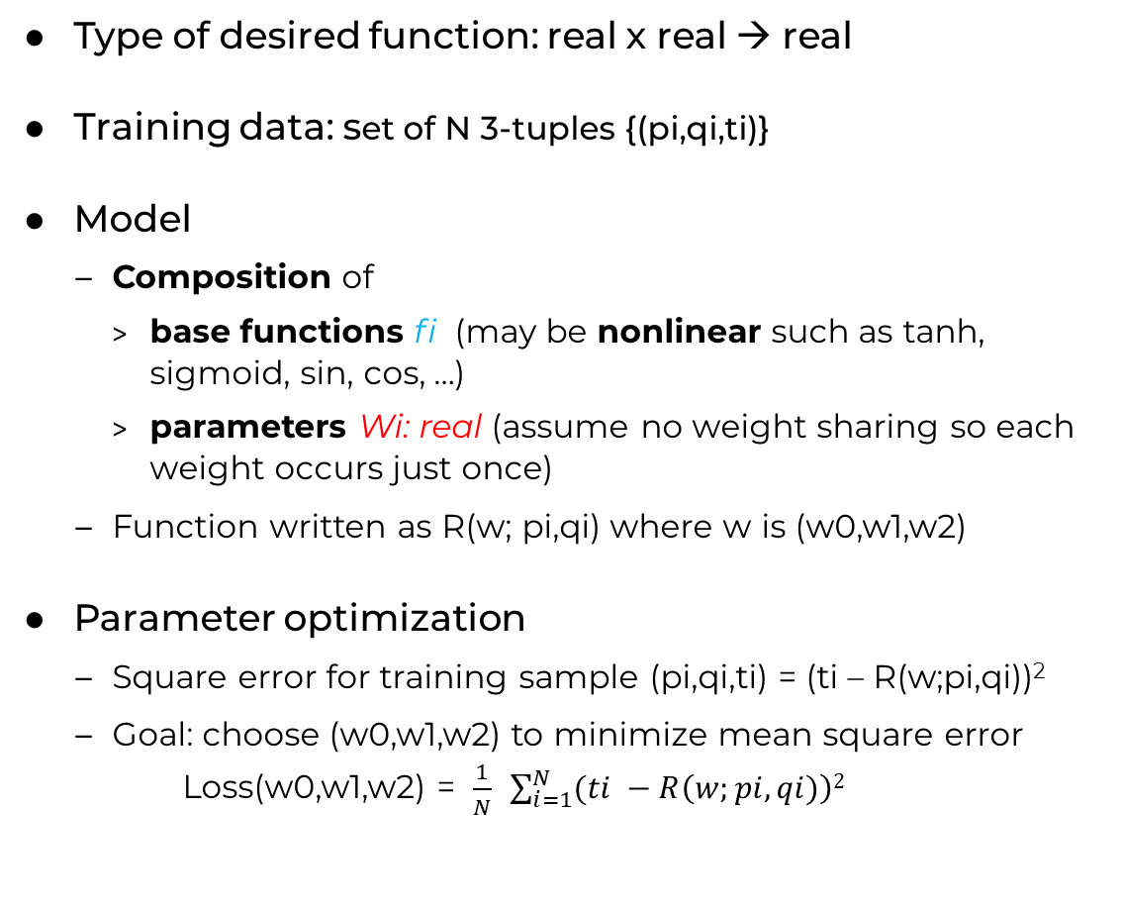

Parameterized program: running example
Type of desired function: real x real → real
Training data: set of N 3-tuples {(pi,qi,ti)}
Model
  Composition of
    base functions fi (may be nonlinear such as tanh, sigmoid, sin, cos, …)
    parameters Wi: real (assume no weight sharing so each weight occurs just once)
  Function written as R(w; pi,qi) where w is (w0,w1,w2)
Parameter optimization
  Square error for training sample (pi,qi,ti) = (ti – R(w;pi,qi))²
  Goal: choose (w0,w1,w2) to minimize mean square error
  Loss(w0,w1,w2) = $\frac{1}{N}$ $\sum_{i=1}^{N}{(ti −R\left(w;pi,qi)\right)2}$
Function R(P,Q) {
  A = W0*P
  B = f0(A,Q)
  C = W1*B
  D = W2*B
  E = f1(C)
  F = f2(D)
  R = f3(E,F)
  return R}

Slide 20
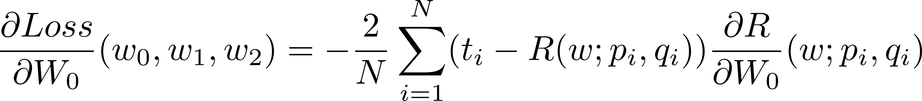


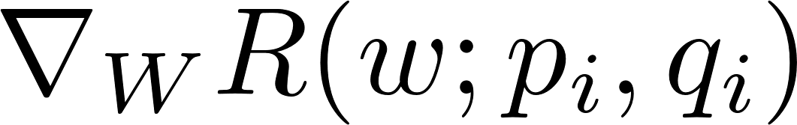

Parameter optimization
Find derivatives of Loss wrt W0,W1,W2
Loss(w0,w1,w2) = $\frac{1}{N}$ $\sum_{i=1}^{N}{(ti −R\left(w; pi,qi)\right)2}$
Function R(P,Q) {
  A = W0*P
  B = f0(A,Q)
  C = W1*B
  D = W2*B
  E = f1(C)
  F = f2(D)
  R = f3(E,F)
  return R}
Derivatives are complex, non-linear functions
so use gradient-descent for parameter optimization

Slide 21
Parameterized program as flow graph
Function R(P,Q) {
  A = W0*P
  B = f0(A,Q)
  C = W1*B
  D = W2*B
  E = f1(C)
  F = f2(D)
  R = f3(E,F)
  return R}
W1
W0
E
f1
P
A
C
f0
B
f3
Q
R
f2
F
D
W2
Useful to represent multiplication by weights differently from functions fi
  Functions fi are fixed but weights change during training
Execution models
  Sequential:
    Execute nodes sequentally in any topological order
  Parallel:
    Asynchronous dataflow: node executes when inputs are available
    Forward propagation: level-by-level schedule of vertices
All values at intermediate points (A,B,C,…) are stored
  Needed for gradient computations

Slide 22

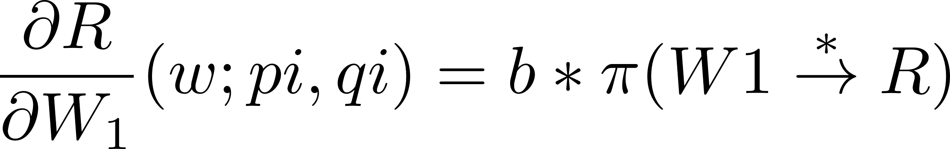



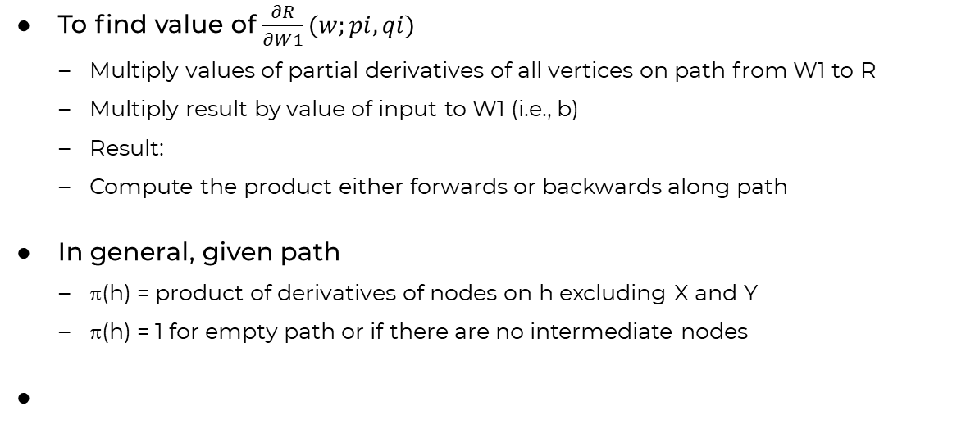
Value of $\frac{∂R}{∂W1}(w;pi,qi)$
w1
w1 + Δw1
W0
C
f1
e+b*Δw1*$\frac{∂f1}{∂C}(c)$
P
A
e
b
c + b*Δw1
E
c
f0
B
f3
Q
R
F
f2
r + b*Δw1*$\frac{∂f1}{∂C}(c)∗\frac{∂f3}{∂E}(e)$
r
D
W2
To find value of $\frac{∂R}{∂W1}(w;pi,qi)$
  Multiply values of partial derivatives of all vertices on path from W1 to R
  Multiply result by value of input to W1 (i.e., b)
  Result:
  Compute the product either forwards or backwards along path
In general, given path
  π(h) = product of derivatives of nodes on h excluding X and Y
  π(h) = 1 for empty path or if there are no intermediate nodes
b*$\frac{∂f1}{∂C}(c)∗\frac{∂f3}{∂E}(e)$

Slide 23
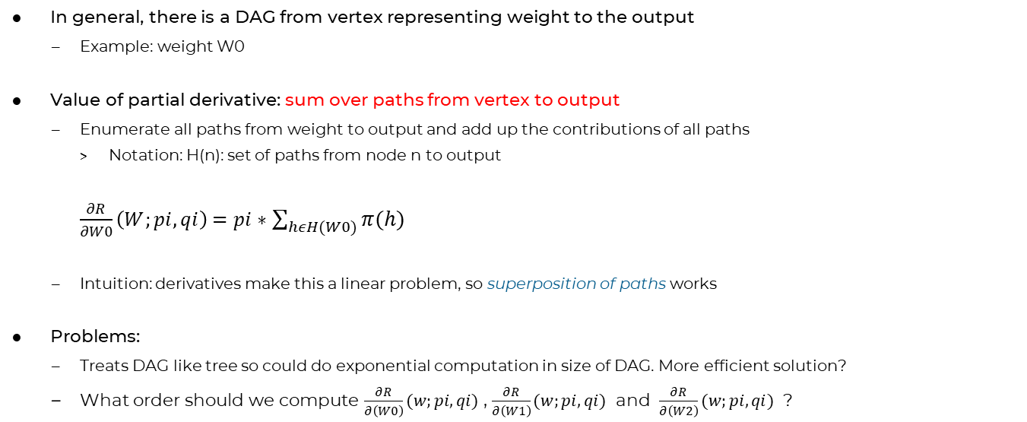
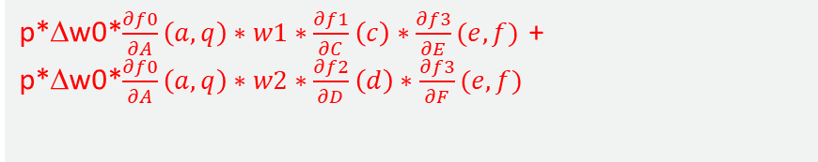

Value of $\frac{∂R}{∂W0}(w;pi,qi)$
W1
W0
E
f1
P
A
C
f0
B
f3
Q
R
f2
F
p*Δw0*$\frac{∂f0}{∂A}\left(a,q\right)∗w1∗\frac{∂f1}{∂C}\left(c\right)∗\frac{∂f3}{∂E}(e,f)$ +
p*Δw0*$\frac{∂f0}{∂A}\left(a,q\right)∗w2∗\frac{∂f2}{∂D}\left(d\right)∗\frac{∂f3}{∂F}(e,f)$
D
W2
In general, there is a DAG from vertex representing weight to the output
  Example: weight W0
Value of partial derivative: sum over paths from vertex to output
  Enumerate all paths from weight to output and add up the contributions of all paths
    Notation: H(n): set of paths from node n to output
    $\frac{∂R}{∂W0}\left(W;pi,qi\right)=pi∗$ $\sum_{hεH(W0)}{π(h)}$
  Intuition: derivatives make this a linear problem, so superposition of paths works
Problems:
  Treats DAG like tree so could do exponential computation in size of DAG. More efficient solution?
  What order should we compute $\frac{∂R}{∂\left(W0\right)}(w;pi,qi)$ , $\frac{∂R}{∂\left(W1\right)}(w;pi,qi)$ and $\frac{∂R}{∂\left(W2\right)}(w;pi,qi)$ ?

Slide 24
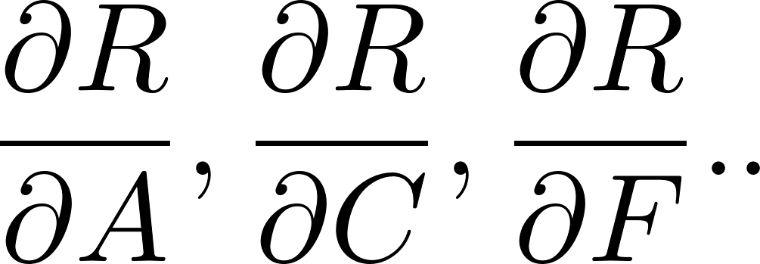



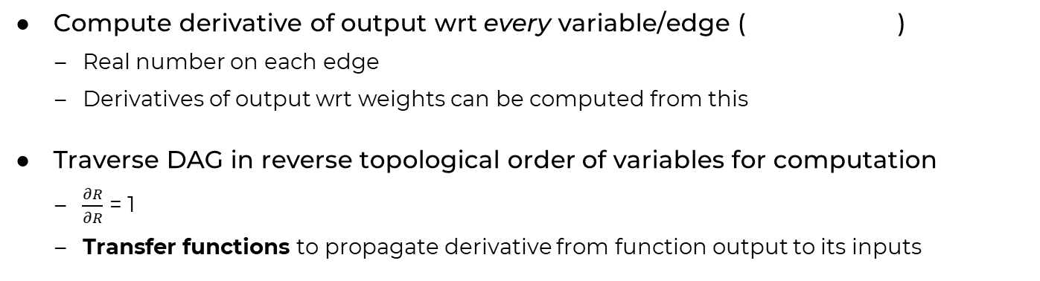


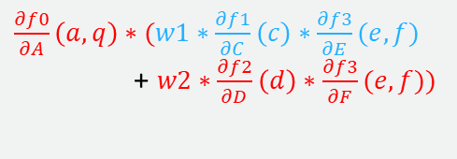

Efficient computation of all derivatives
$$\frac{∂f1}{∂C}\left(c\right)∗\frac{∂f3}{∂E}(e,f)$$
W1
W0
E
$$\frac{∂f3}{∂E}\left(e,f\right)∗1$$
f1
P
C
A
w1*$\frac{∂f1}{∂C}\left(c\right)∗\frac{∂f3}{∂E}(e,f)$
f0
B
f3
R
Q
w2*$\frac{∂f2}{∂D}\left(f\right)∗\frac{∂f3}{∂F}(e,f)$
1
f2
F
$\frac{∂f3}{∂F}\left(e,f\right)∗$ 1
$\frac{∂f0}{∂A}\left(a,q\right)∗(w1∗\frac{∂f1}{∂C}\left(c\right)∗\frac{∂f3}{∂E}(e,f)$
+ $w2∗\frac{∂f2}{∂D}\left(d\right)∗\frac{∂f3}{∂F}(e,f))$
D
W2
$$\frac{∂f2}{∂D}\left(f\right)∗\frac{∂f3}{∂F}(e,f)$$
Compute derivative of output wrt every variable/edge ( )
  Real number on each edge
  Derivatives of output wrt weights can be computed from this
Traverse DAG in reverse topological order of variables for computation
  $\frac{∂R}{∂R}$ = 1
  Transfer functions to propagate derivative from function output to its inputs

Slide 25

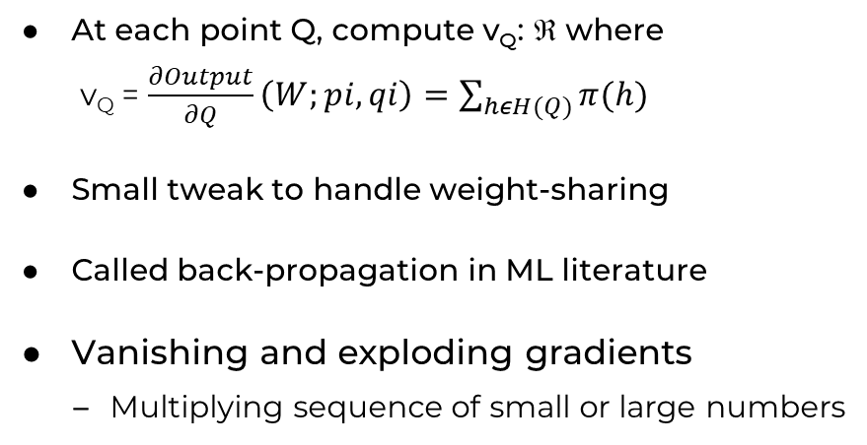

Summary of derivatives computation
v_{Q}
At each point Q, compute v_{Q}: ℜ where
  v_{Q} = $\frac{∂Output}{∂Q}\left(W;pi,qi\right)=\sum_{hεH(Q)}{π(h)}$
Small tweak to handle weight-sharing
Called back-propagation in ML literature
Vanishing and exploding gradients
  Multiplying sequence of small or large numbers
Q
Output
Wi
Output
v_{in} = 1
x
v_{in} = wi*v_{out} and $\frac{∂ Output}{∂Wi}=$
v_{out}*x
v_{in}
v_{in}
v_{out}
v1_{out}
v1_{in}
v_{in} = (v1_{out}+v2_{out})
x
f
v1_{in} = $\frac{∂f}{∂X}\left(x,y\right)$*v_{out}
v_{in}
v_{out}
v2_{out}
Y

Slide 26
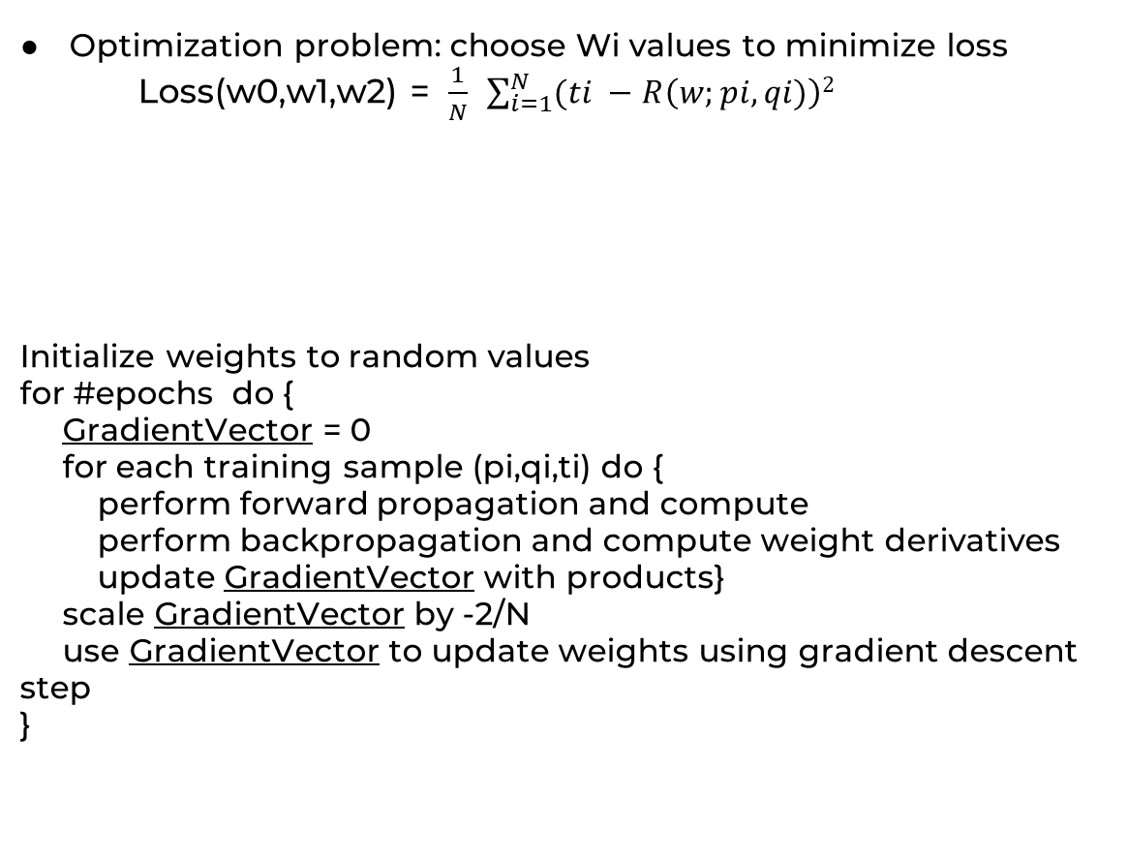
Back to running example
Optimization problem: choose Wi values to minimize loss
Loss(w0,w1,w2) = $\frac{1}{N}$ $\sum_{i=1}^{N}{(ti −R\left(w;pi,qi)\right)2}$
Initialize weights to random values
for #epochs do {
GradientVector = 0
for each training sample (pi,qi,ti) do {
perform forward propagation and compute
perform backpropagation and compute weight derivatives
update GradientVector with products}
scale GradientVector by -2/N
use GradientVector to update weights using gradient descent step
}
Function R(P,Q) {
  A = W0*P
  B = f0(A,Q)
  C = W1*B
  D = W2*B
  E = f1(C)
  F = f2(D)
  R = f3(E,F)
  return R}

Slide 27
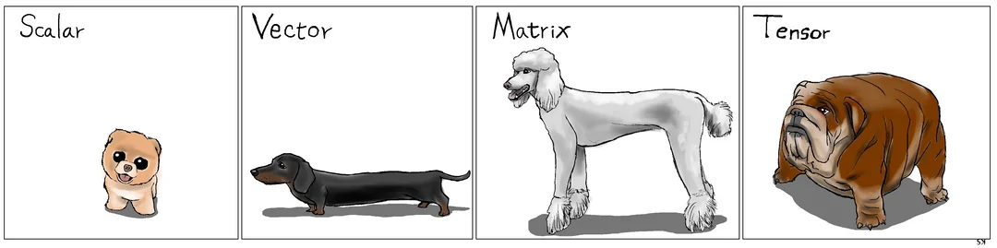
Generalization to vectors, matrices, tensors
How to understand data with dogs
Karl Stratos (Reddit post)

Slide 28
Generalization to vectors (matrices, tensors are similar)
W1
W0
E
f1
P
A
C
f0
B
f3
Q
R
f2
F
D
W2
Programs
  Inputs can be scalars or vectors, but output is still a scalar (loss)
  Weights ➔ Weight matrices
    Weight matrix need not be square
  Function type: vector → vector
Compute gradients instead of derivatives
  Variable is vector of size n ➔ gradient of output wrt this vector is also vector of size n
    Intuition: each dimension of gradient vector is derivative of output wrt value in that dimension
  Transfer functions: Jacobians instead of derivatives
Useful to know matrix derivatives notation

Slide 29
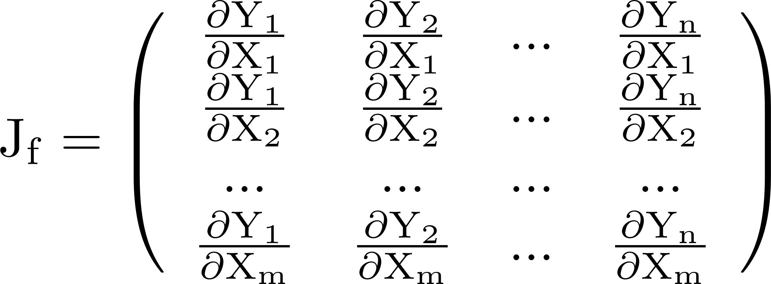
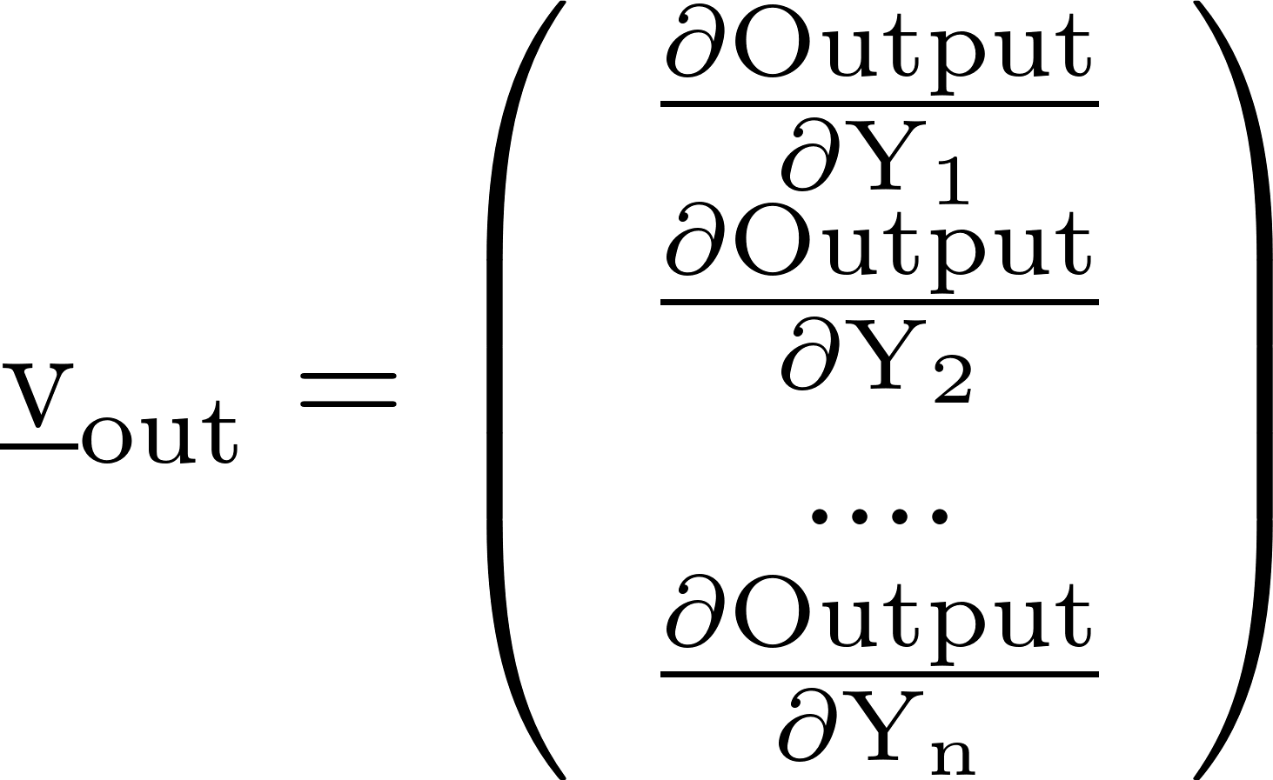
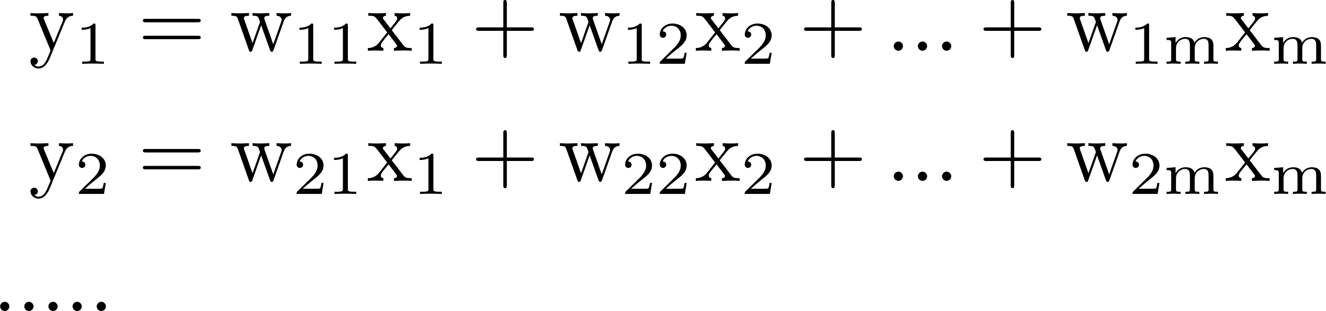
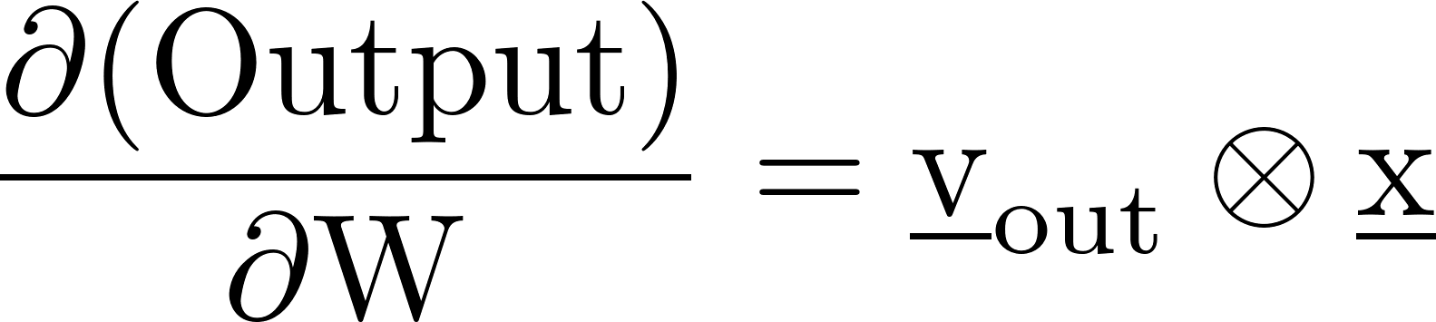
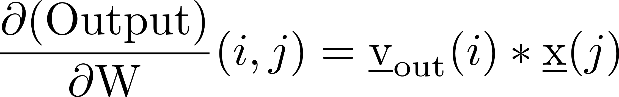
Transfer functions
x^{m}
y^{n}
f
v_{in}
v_{out}
General function f
  v_{in} = J_{f} *v_{out}
Linear function W
  J_{f} = W^{T}
  v_{in} = W^{T}*v_{out}
  Derivatives of output wrt weights in W (will be a matrix)
(⊗ is outer-product)
(If w(i,j) changes a small amount,
how much does the output change?)

Slide 30



Transfer Functions (scalar and vector)
Scalar case
W
Output
v_{in} = 1
x
v_{in} = w*v_{out} $\frac{∂ \left(Output\right)}{∂Wi}=$
v_{out}*x
v_{in}
v_{in}
v_{out}
v1_{out}
v1_{in}
v_{in} = (v1_{out}+v2_{out})
x
f
v1_{in} = $\frac{∂f}{∂X}\left(x,y\right)$*v_{out}
v_{in}
Y
v_{out}
v2_{out}
Vector case
x
W
v_{in} = W^{T}*v_{out} $\frac{∂ \left(Output\right)}{∂W}=$
Output
v_{in} = 1
v_{out} ⊗ x
v_{in}
v_{in}
v_{out}
v1_{out}
x
f
v_{in} = J_{f} *v_{out}
v_{in}
v_{in} = (v1_{out}+v2_{out})
v_{in}
v_{out}
v2_{out}

Slide 31
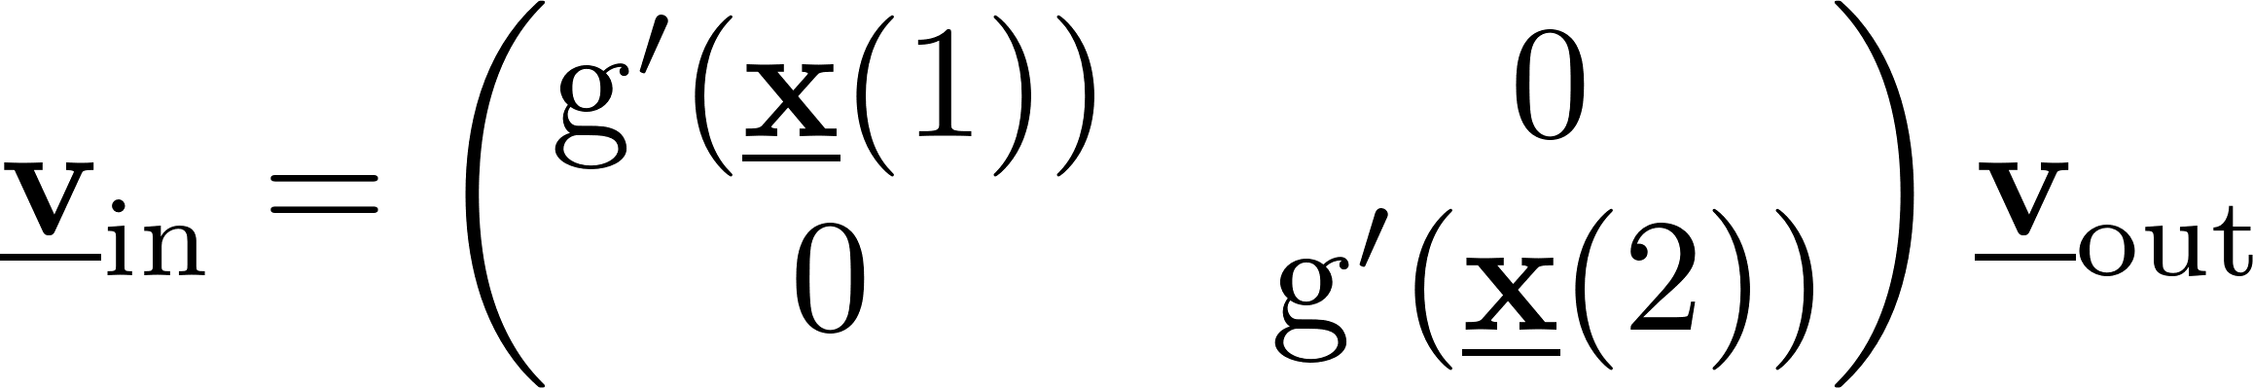
Important special cases
f
f
x
g
x
r
g
v_{out}
v_{out}
map
reduce
f: map (g: ℜ→ℜ)
  J_{f} = diagonal matrix with J_{f} (i,i) = g’(x(i))
f: reduce (r: ℜxℜ→ℜ)
  Called pooling in ML literature
  r = +, *, …
    J_{f} = (1,1,…,1)^{T} for +
  r = max, min, ….
    If max(x) = x(j), J_{f} = I(j) (where I(j) is the indicator vector with 1 in j^{th} position)

Slide 32
Summary
Standard presentations of gradients and back propagation
  Biological metaphors like neurons and synapses come in the way
  Properties of activation functions are distraction: enough to know we can compute value and gradient at any point
Presentation in this lecture
  Abstraction for neural networks: parameterized programs
  Gradient computation
    Abstractly (what?): sum over paths
    Efficient computation (how?): compositional algorithm on dataflow graph representation
  Handles complex neural networks with weight-sharing and irregular interconnections (such as “skip connections”) smoothly

