Slide 1
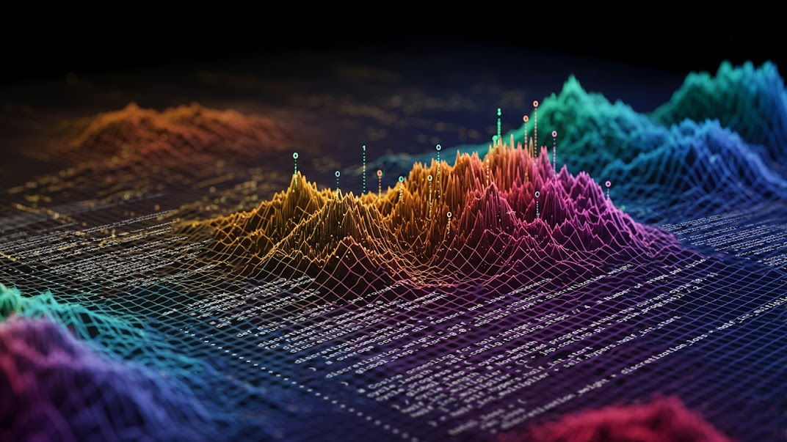
CS395T: Foundations of Machine Learning for Systems Researchers
Fall 2025
Lecture 1: Introduction

Slide 2
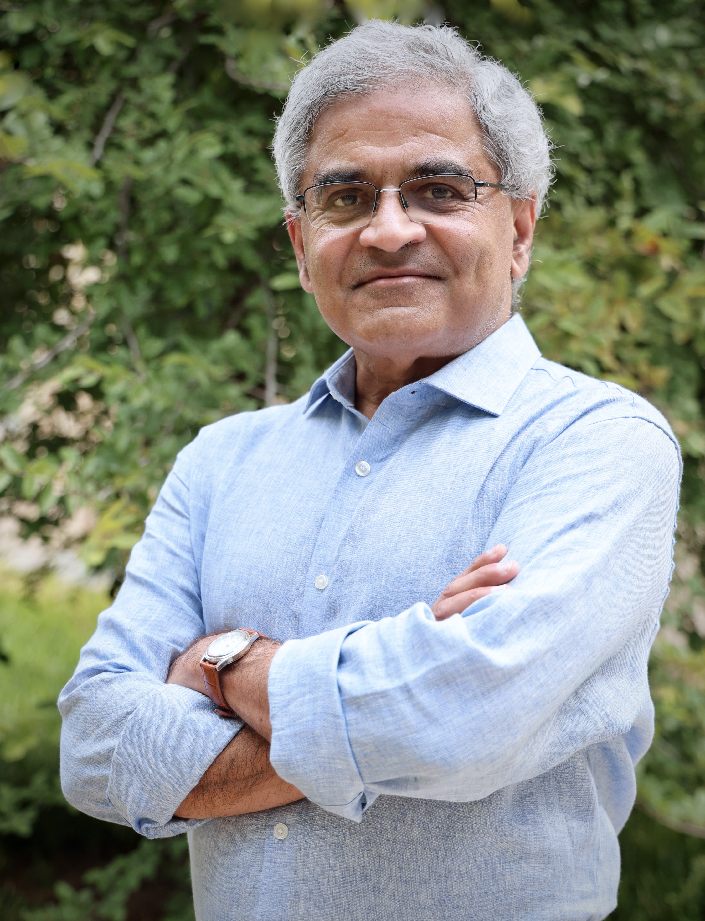
Keshav Pingali
W.A. “Tex” Moncrief Chair of Computing
  Department of Computer Science
  Oden Institute of Computational and Engineering Sciences
Research areas
  Parallel computing, high-performance graph analytics
  Programming languages and restructuring compilers
  Machine learning
Office: Peter O’Donnell Building (POB) 4.126
Email: pingali@cs.utexas.edu
Office hours: Friday 1-2 PM

Slide 3
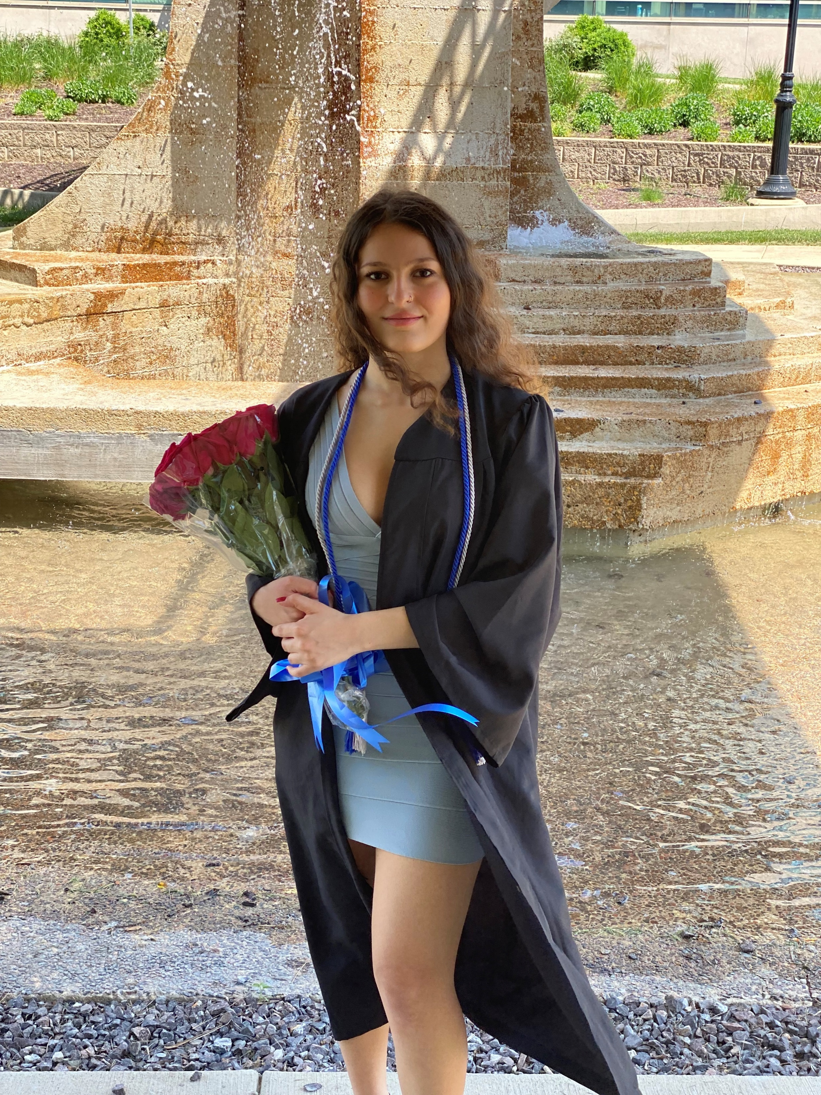
Lain (Zelal) Mustafaoglu (TA)
1st year PhD student
  Department of Computer Science
  Oden Institute of Computational and Engineering Sciences
Research areas
  Deep reinforcement learning, RLHF, evolutionary computation
Office: Peter O’Donnell Building (POB) 4.104
Email: zsm@utexas.edu
Office hours: Tuesday 2-3 PM

Slide 4

Factors contributing to rise of ML
Algorithmic advances
  Backpropagation: improved efficiency of training neural networks, enabling more complex models.
  Transformers and Large Language Models
Big Data Availability
  Explosion of multi-modal data from sources like social media, sensors, and online transactions
Enhanced Computational Power
  Availability of powerful GPUs and specialized hardware accelerates training, allowing more complex models to be developed and deployed

Slide 5
Objectives of this course
Understand neural networks, reinforcement learning, and evolutionary algorithms from perspective of systems builders
How do these techniques work?
How are they deployed in systems like AlphaGo, DeepSeek and AlphaEvolve?
How do we make them scale, behave predictably, and run efficiently?
What systems problems can we solve using these algorithms?
Neural
networks
Reinforcement
learning
Evolutionary
computing

Slide 6
What makes this course different (I)
Covers most major technologies used in cutting-edge AI systems
  Deep Learning — CNNs, RNNs, Transformers, LLMs
  Reinforcement Learning —MDPs, TD and Q-learning, policy gradients, large-scale distributed RL
    RLHF — using human feedback for rewards
    Imitation Learning — leveraging demonstrations for faster learning
  Evolutionary Computation — genetic algorithms and neuroevolution
Understand how these are deployed in end-to-end systems

Slide 7
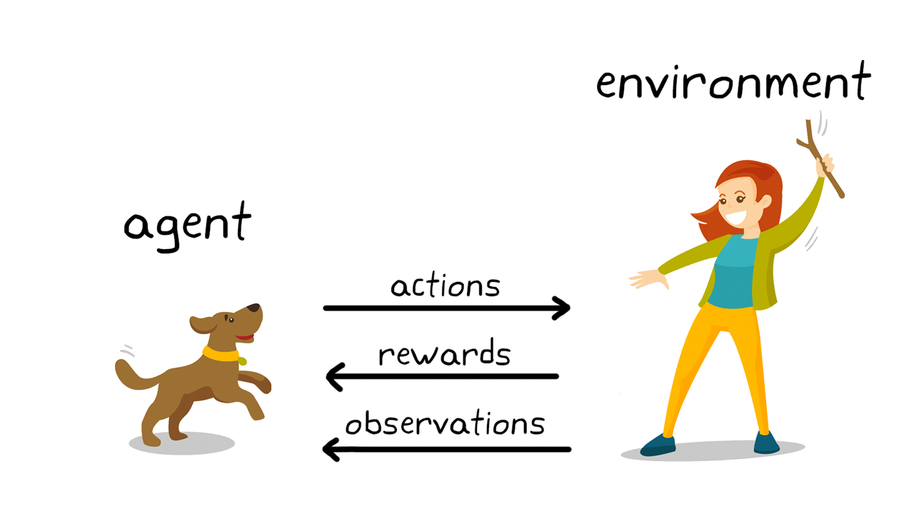
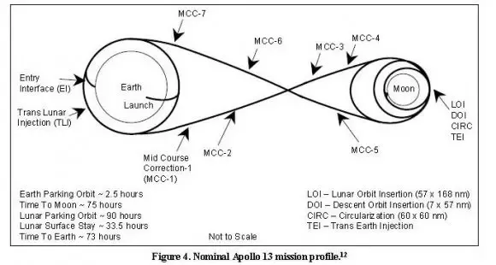
What makes this course different (II)
Standard presentation of reinforcement learning: agent takes actions and is rewarded by environment, like training a dog
Optimal control: sequence of actions under uncertainty to reach a goal while optimizing some objective function
Example: moon shot vs. gun shot
  Goal: reach the moon
  Burn minimal amount of fuel
  Uncertainty: imperfect modeling of rocket, gravitation, etc.
  Solution: series of mid-course corrections
Reinforcement learning
  Optimal control when you have little to no knowledge of the dynamics of system
  However, you are allowed to perform many experiments to build a working model of the dynamics
Reinforcement learning = Optimal control while learning system dynamics

Slide 8
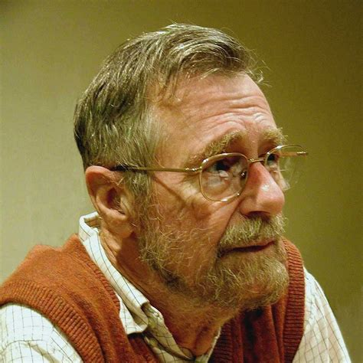
My approach
I will not
  use biological metaphors about neurons, synapses, training dogs, etc. ,
  talk philosophy,
  use complex math without providing intuition.
I will
  explain most concepts using paths in directed graphs,
  use pictures: lots of them.
  “Pictures are for weak minds.” Dijkstra

Slide 9
Lectures: division of labor
Core concepts: DNNs, RL, evolutionary computing, etc.
  Presented by Professor Pingali, Lain, and guest lecturers
Systems: DeepSeek, AlphaEvolve, IMPALA (distributed RL)
  Presented by students
I am not committed to these systems
  If you want to present other relevant systems, let us know

Slide 10
Prerequisites
Proficiency in Python
Familiarity with undergraduate-level algorithms and data structures
Strong mathematical skills: calculus, statistics, and linear algebra
Coursework or equivalent experience in AI and ML at the level of CS 342 strongly recommended
Practical experience with training machine learning models will be useful.

Slide 11
Course Materials
Website for course:
  https://www.cs.utexas.edu/~pingali/CS395TFall25/
  All lecture notes, announcements, papers, assignments will be posted there
Canvas:
  https://utexas.instructure.com/courses/1414520
  Announcements and grades will be posted there
Ed Discussion board:
  https://edstem.org/us/courses/81644/discussion
  Clarifications/additional information/questions for assignments, projects etc.

Slide 12
Coursework
Class presentations (25%)
  One in-class paper presentation by each student (20%)
  One paper review in NeurIPS style by each student (5%)
Three assignments (30% total, 10% each)
  One each on DNNs, reinforcement learning, evolutionary computing
Final project (45%)
  We will give you a list of suggested topics
  Feel free to come up with your own project relevant to course content
  Project proposal (5%)
  Final paper (20%)
  Final project presentation (15%)
Participation, introduction survey, and project check-ins (5%)

Slide 13
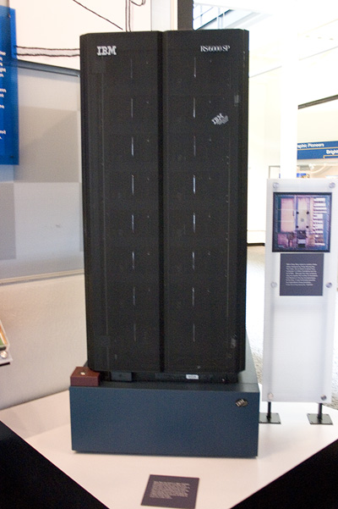
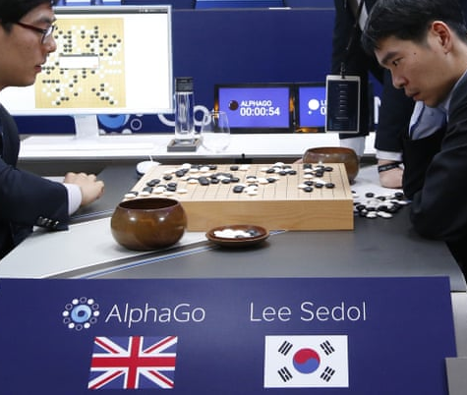
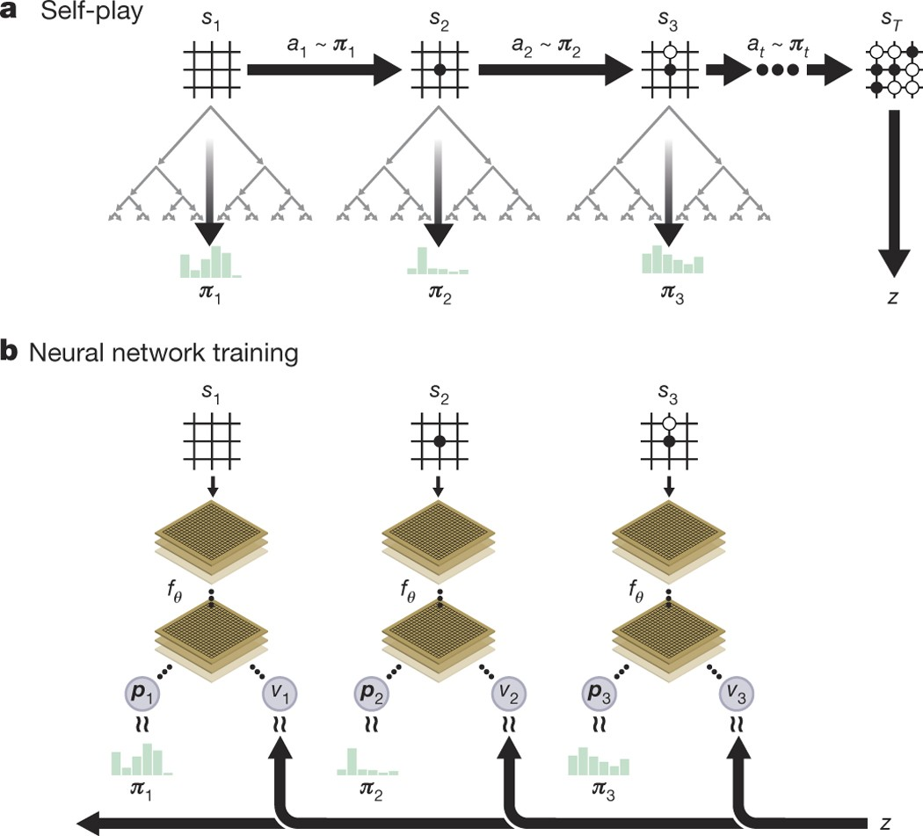
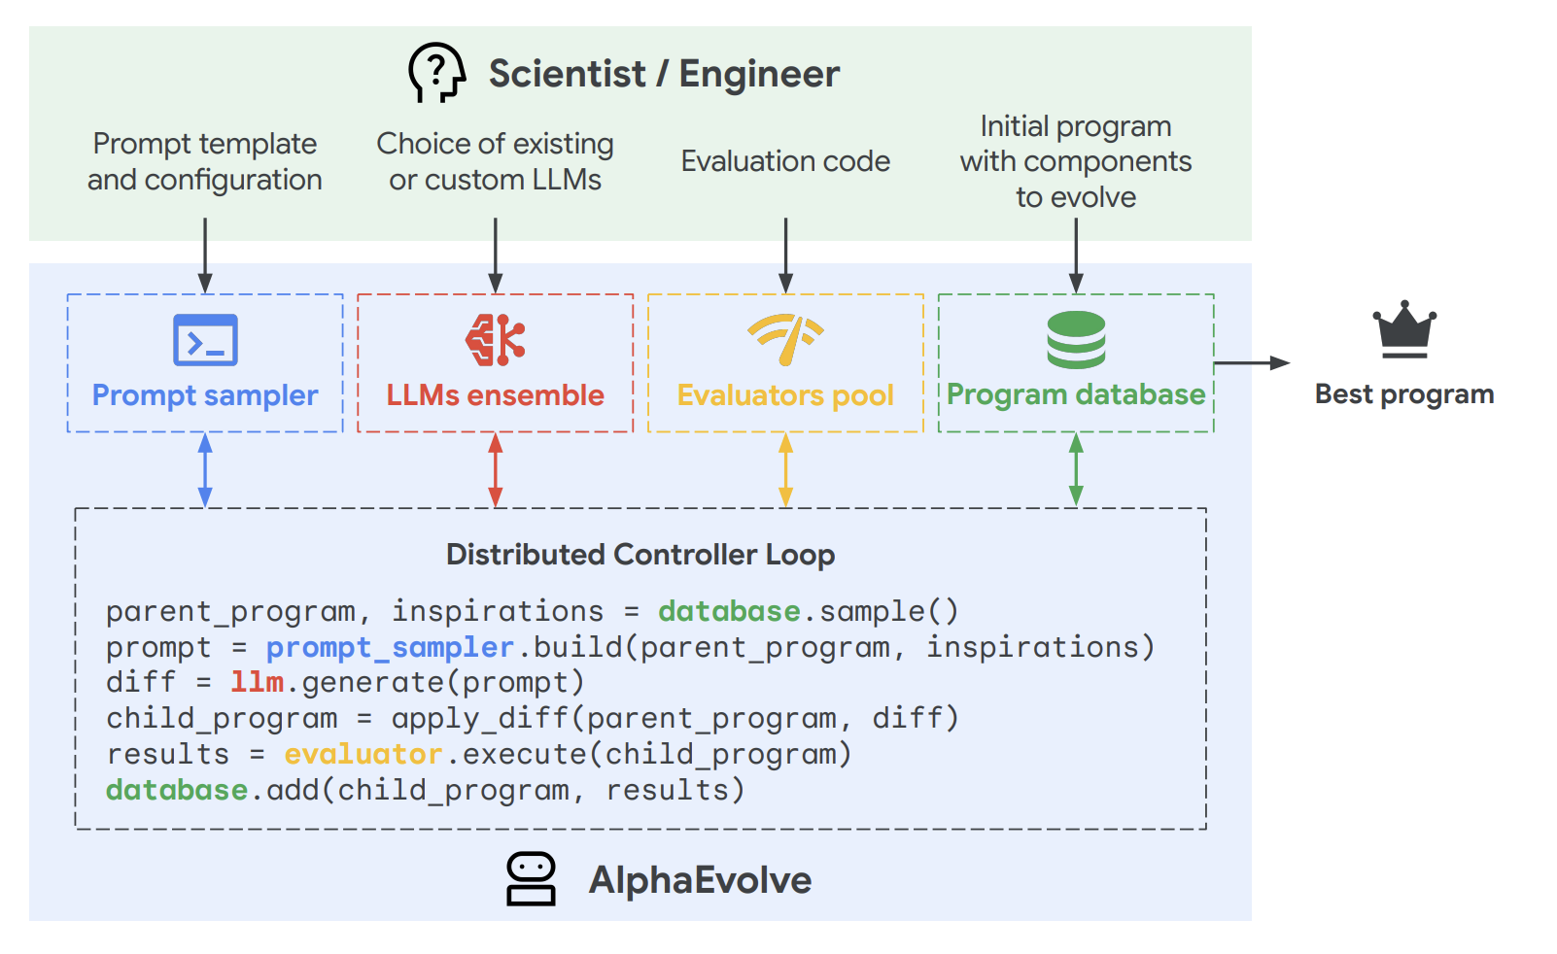
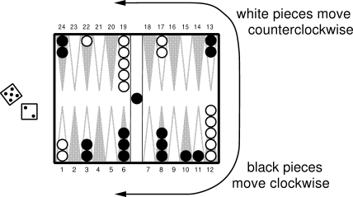
Progression of ML Systems
Systems complexity grows alongside ML sophistication
1991: TD-Gammon — Backgammon (NN+TD learning)
1997: Deep Blue — Chess (alpha-beta search)
2017: AlphaGo Zero — Go (CNNs + deep RL)
2025: AlphaEvolve — Inventing algorithms (LLM + evolutionary algorithms)
TD-Gammon (1991)
Deep Blue (1997)
AlphaGo (2016)
AlphaGo Zero (2017)
AlphaEvolve (2025)

Slide 14
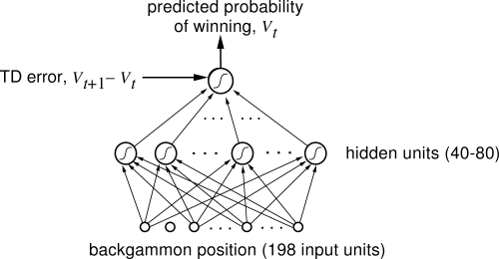
TD-Gammon (1991): NN+TD-learning
Exploited human game insights
Ran on IBM RS/6000 work-station (240 Mflops)

Slide 15
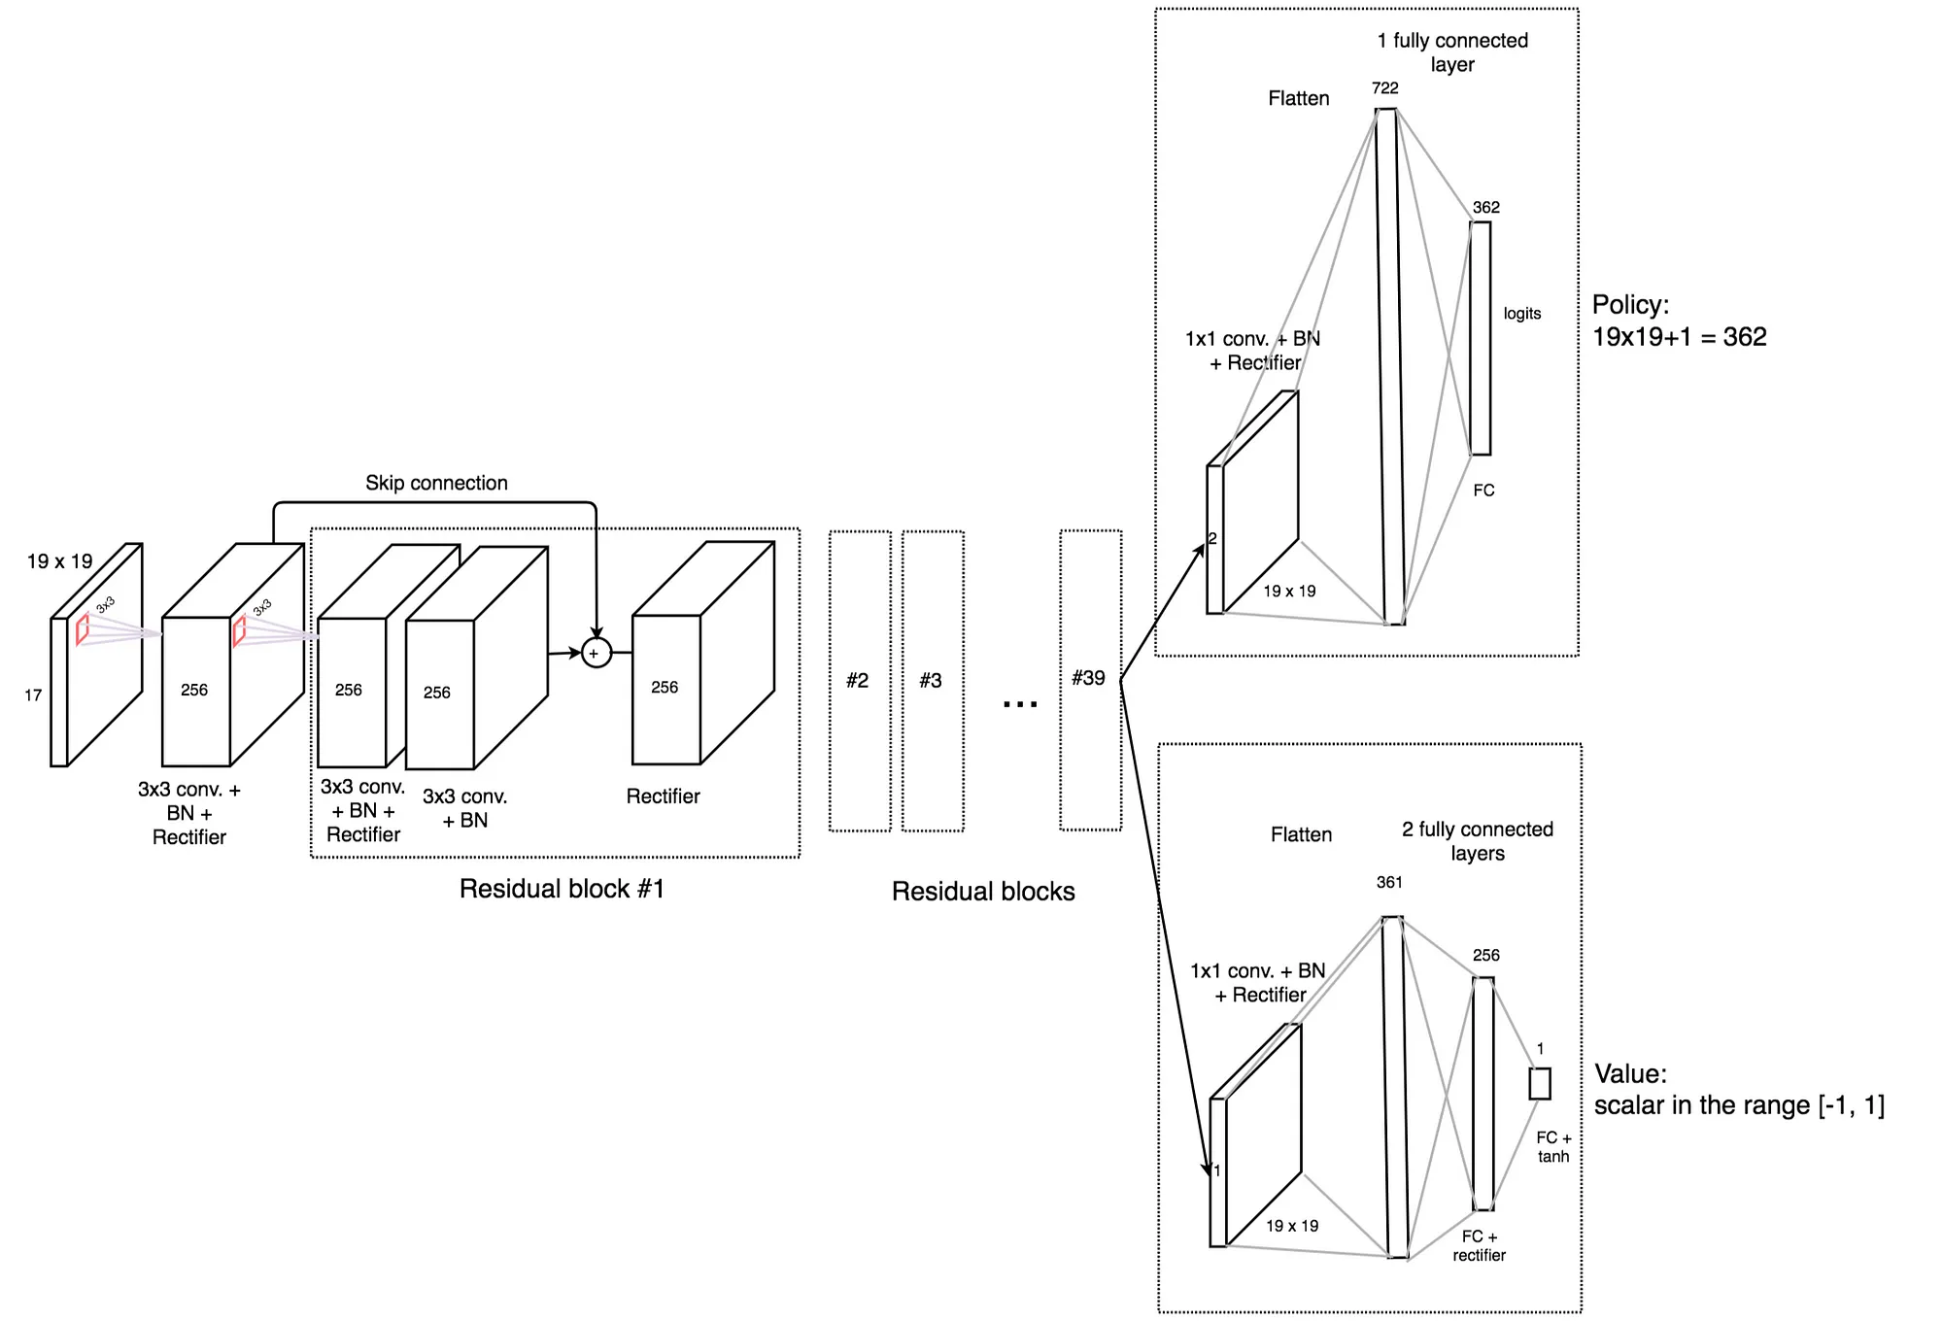
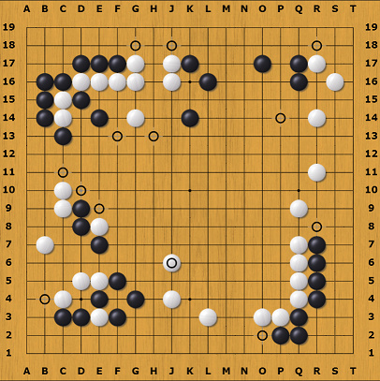
AlphaGo Zero (2017): CNN+Deep RL
Policy/value network for RL
19x19 board
Convolutional Neural Network
Learned by playing against itself
64 TPUs, trained over several days

Slide 16
AlphaGo Zero (2017)
Policy/value network for RL
8 channels: positions of the current player's stones from the last eight time steps
8 channels: positions of the other player's stones from the last eight time steps.
1 channel: all 1 if black is to move, and 0 otherwise.
Policy head outputs logit array of size 19x19 representing the logit of making a move in one of the points, plus the logit of passing.
Value head outputs number in range (-1,+1), representing expected score for current player.
-1 represents current player losing, and +1 winning.

Slide 17
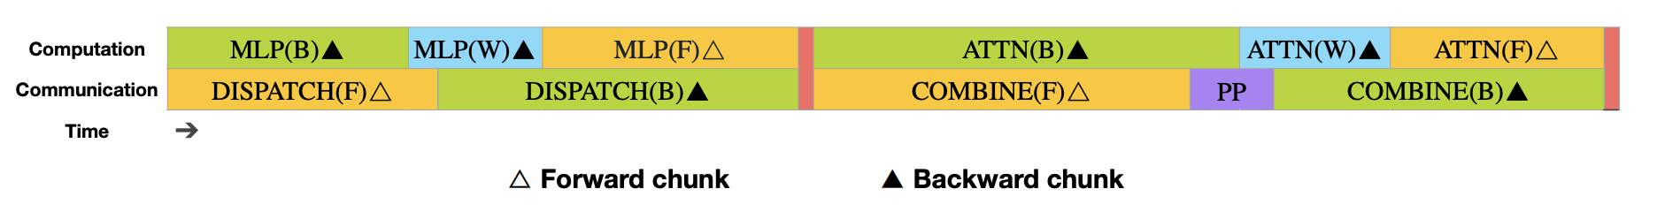
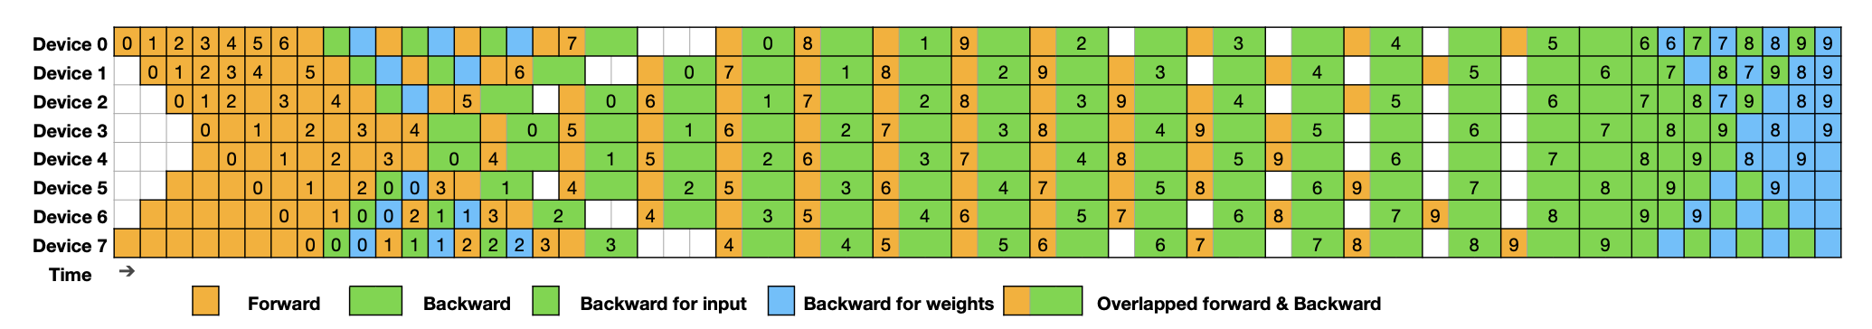
DeepSeek-v3 (2024)
Mixture of Experts architecture
Dynamic sparse attention
Optimized parallel implementation
  16-way Pipeline Parallelism (PP), 64-way Expert Parallelism (EP) spanning 8 nodes, and ZeRO-1 Data Parallelism (DP)
  Loss-aware load-balancing

Slide 18
AlphaEvolve (2025)
Uses LLMs and evolutionary computing to automate discovery and implementation of new algorithms
Combines two Gemini language models
  Gemini Flash: generates program candidates
  Gemini Pro: evaluates candidates
Top-performing candidates are evolved iteratively
Successes:
  Improved implementation of FlashAttention by 32.5%
  New algorithm for 4x4 complex matrix multiplications

Slide 19
Reminders
Complete the introductory survey on Ed Discussion by Thursday, August 28th (end of day)
Sign-up here for a paper presentation, and for a peer review (for a different paper)
  Excel sheet here and on the course website
  Complete sign-ups by next Tuesday, September 2nd
  Email zsm@utexas.edu with your choices as well

Slide 20
Summary
Work across DL, RL, and evolutionary methods
Approach ML as systems researchers — focusing on algorithms as well as pipelines, scalability, and optimization
Study how these technologies are deployed in important systems
Learn how to use these methods to solve problems in systems

