Slide 1
Essentials of AI for Life and Society
Peter Stone

Slide 2
Introduction to AI and Ethics of AI
Notes:
Title slide for lecture

Slide 3
Syllabus
How will attendance work for this class? What if we can’t make it that week?
How does class participation work and how will we be evaluated?
How will Perusall grading work? Do we need to achieve each rubric item to receive full credit?
Will the final project be a group project? When will more details about it be released?
What will be covered in this course? Will the content be technical? Or just ethical focused? Will we see live examples of machine learning without delving into the code?
What math will be involved in this course?
Notes:
Content slide

Slide 4
Defining Artificial Intelligence
A science and a set of computational technologies that are inspired by, but typically operate quite differently from, the ways people use their nervous systems and bodies to sense, learn, reason, and take action
NOT one thing
More than just deep learning
RL, NLP, vision, planning, symbolic reasoning, algorithmic game theory, computational social choice, human computation
Getting Computers to do the things they can't do yet
Once it works, it's engineering

Slide 5
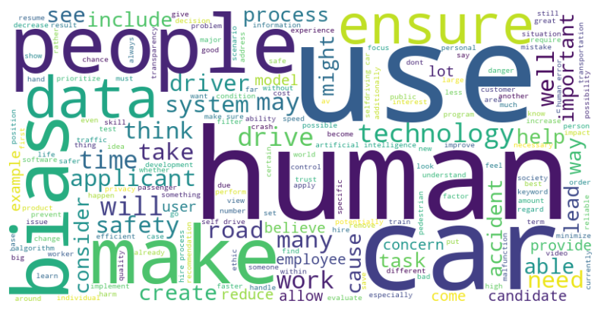

Slide 6
Role of AI in Society
Eesha: "I'm interested in seeing the implications of AI on daily life as we hear the corporate consequences a lot but not so much about our daily interactions with AI."
Rebecca: "I have yet to use [AI] other than where I need a quick question answered, which is helpful at times. Other than that knowing where it is useful and exploring those avenues is what intrigued me to take this course."
Reshmitha: “In many ways, AI has been helping us in small ways for so long. As someone with a phone app that tracks my sleep health and recommends things that will help my sleep, I've been positively impacted by the use of AI.”
Notes:
Content slide

Slide 7
Impact of AI on Jobs and Economy
Alex: “I'm curious to see what impacts the ‘AI Revolution’ will have on the workplace. Will there be a sudden influx of new jobs to replace the ones that will be replaced by AI, or will we see a complete restructuring of society as we know it?”
Discuss!
Notes:
Content slide

Slide 8
Some Themes to be Covered Later
Bias and fairness in AI algorithms
Misinformation and disinformation
AI Alignment and Existential Risks
Notes:
Content slide

Slide 9
Autonomous Vehicles
Samyog: “As a Ceo If I were to think about the potential risks and benefits of autonomous vehicles. I would see that these vehicles are still not fully completed and are very dangerous as anything can happen on the road.”
Are they more or less dangerous than human-driven cars?
How can we measure that?
How safe should they be before it’s OK to use them?
How safe should they be before they should be mandated?
Discuss!
Notes:
Content slide

Slide 10
Poll Who is the safest driver? - you - a random Uber driver - an autonomous taxi (e.g. Waymo or Cruise)

Slide 11
Next Week: AI and Society
Do readings and reflections by Tuesday
Sign up to be in studio at least once
Different ethical paradigms
The 100 Year Study on AI

Slide 12
Defining Artificial Intelligence
A science and a set of computational technologies that are inspired by, but typically operate quite differently from, the ways people use their nervous systems and bodies to sense, learn, reason, and take action
NOT one thing
More than just deep learning
RL, NLP, vision, planning, symbolic reasoning, algorithmic game theory, computational social choice, human computation
Getting Computers to do the things they can't do yet
Once it works, it's engineering

