Slide 1
Essentials of AI for Life and Society
Peter Stone

Slide 2
Bias and Fairness in AI Models
Notes:
Title slide for lecture

Slide 3
Defining Artificial Intelligence
A science and a set of computational technologies that are inspired by, but typically operate quite differently from, the ways people use their nervous systems and bodies to sense, learn, reason, and take action
NOT one thing
More than just deep learning
RL, NLP, vision, planning, symbolic reasoning, algorithmic game theory, computational social choice, human computation
Getting Computers to do the things they can't do yet
Once it works, it's engineering

Slide 4
Some Context
We’ve covered AI Paradigms and Applications:
Planning and Search; Probabilistic Modeling; Machine Learning
Intelligent Robotics; Computer Vision; NLP
Now on to societal implications:
Bias and fairness; Mis/disinformation; Workplace, Economics, and Policy; Alignment and Existential Threats
Notes:
Content slide

Slide 5
Some Context
We’ve covered AI Paradigms and Applications:
Planning and Search; Probabilistic Modeling; Machine Learning
Intelligent Robotics; Computer Vision; NLP
Now on to societal implications:
Bias and fairness; Mis/disinfor
Notes:
Content slide

Slide 6
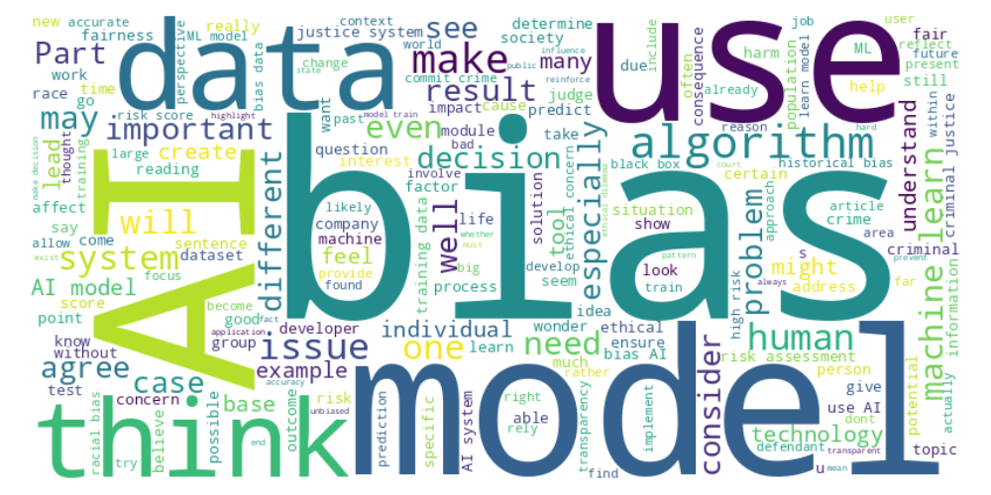
Perusall word cloud
Notes:
Content slide

Slide 7
Black box society
Coco : “I'm a little confused on the concept of the black box society. The speaker mentioned that the black box society is about showing more transparency to take more accountability over the models they create, but he also mentioned that sometimes it isn't possible because even the creators of such models may not know its innerworkings. I'd like to receive clarification on when might a programmer not understand how the model he/she creates works in its decision making process.”
Notes:
Content slide

Slide 8
Use in courtrooms
Kevin : “One question I have is how artificial intelligence was approved to be used in courtrooms. The legal system is very thorough about ensuring justice at every level so it shocks me to believe that AI was approved way back then for such an important task. Even now, we don't understand how artificial intelligence works as seen through their "black box". How was artificial intelligence approved for use even though we had no understanding of the AI's black box? It's hard to believe that such an underdeveloped technology was deployed for use in making such important decisions.”
Notes:
Content slide

Slide 9
Comparison to status quo
Maya : “These false positives and false negatives are already happening via human decisions by judges, though. the question is are these false decisions increased or decreased by machines?”
Isabelle : “Based on this week, it had me wondering that although AI is biased, it it more biased than a judge in court. Would AI receive a better public approval rating?
Notes:
Content slide

Slide 10
Historical iterative process
Tanner : “How do AI change through the problems of historical context into the future and modern day. Do people update with more training and take away past training or do they just continuously add the training even if its not relevant anymore”
Notes:
Content slide

Slide 11
How is AI biased with respect to…?
“AI” is not biased.
What AI system (e.g., algorithm + data + deployment...) are you referring to?
Nissi - “I'm still confused about ML biases. My question is, couldn't ML practitioners remove the biased data or get new data points that are not biased since they are aware of this problem?”
Notes:
Content slide

Slide 12
Positive bias
Shivani - “Personally, I sometimes have bias toward viewing AI as a positive tool with the efficiency that it brings to my daily life.”
Notes:
Content slide

Slide 13
Choice of features
Riya : “I'm curious to learn more about the criminal risk software Northpointe and why it's even necessary to use non-essential data like gender and race to assess risk of committing future crime. Shouldn't past criminal history, geographic location, and socioeconomic status be enough? Clearly, the model is being trained on visual data like their face which is leading to bias based on facial complexion, and it seems fairly easy to just eliminate this altogether.”
Is it sufficient to remove features that shouldn’t be used?
Notes:
Content slide

Slide 14
Poll ”Is it sufficient to remove features that shouldn’t be used?” - Yes - No

Slide 15
Fairness in Decision Making
Pranav : “This module...made me wonder how organizations actually deal with these biases: do they have set ways to check for fairness, or is that still something they're figuring out?”
Not enough to be oblivious to a feature.
Demographic parity?
Notes:
Content slide

Slide 16
Demographic parity
Assume we live in a country where brown-eyed people are typically (on average) 4 times wealthier than blue-eyed people
A bank is using software to determine who is most likely to pay back a $20,000 loan (assume wealthier people are more likely to be able to pay back loans)
100 people ask for loans, 50 with brown eyes, and 50 with blue eyes
Should we require that the same percentage of people in each set are approved for loans?
Is that fair? If so, why? If not, what would be? Discuss!
Notes:
Content slide

Slide 17
Equalized Opportunity/Odds
Match the true positive rates in both populations
Of the people who would pay back the loan, I give the same percentage of approvals
Also match the false positive rates in both populations
Of the people who would not pay back the loan, I give the same percentage of approvals
Notes:
Content slide

Slide 18
Poll ”which is the fairest of them all?” - Demographic parity - Equalized opportunity (matching true positive rates) - Equalized opportunity (also matching false positive rates) - None of these is fair

Slide 19
Bias in image generation (vs. decision making)
Kevin : “If most of the CEO's in the world are male, surely it would be make sense that an AI algorithm would make an image of a male CEO given the prompt... How would you fix something like that so both male and female CEOs are equally represented? By only feeding equal amounts of data on both sides?”
Notes:
Content slide

Slide 20
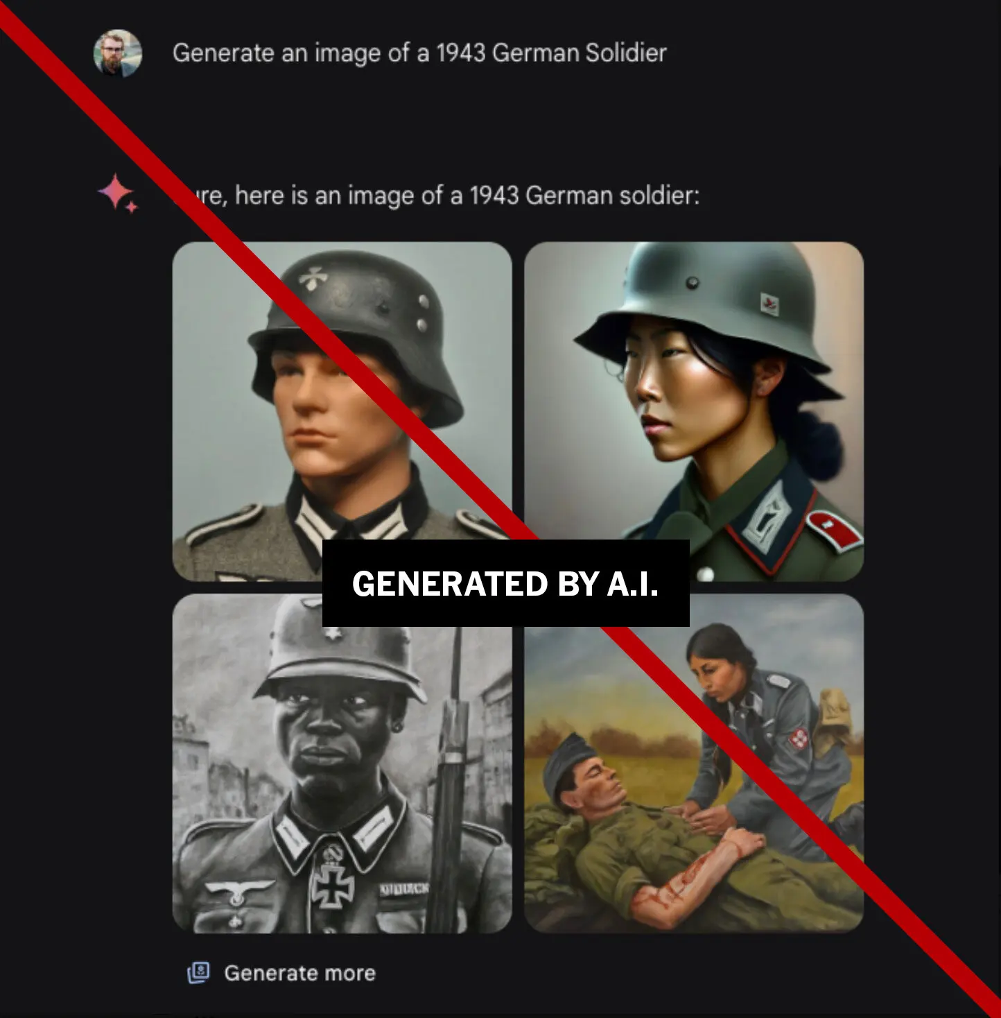
Efforts to be “unbiased” (Gemini in Feb. 2024)
Generate an image of a
1943 German soldier
Also: Black Vikings; a woman as the
Catholic pope; women NHL players;
the founders of Google depicted as
Asian men; and non-white people in a
scene of the U.S.’s Founding Fathers.
Did something go wrong here?
If so, what? Discuss!
Notes:
Content slide

Slide 21
The main question
When is it ethical to deploy an AI system?
What can be done to mitigate bias and systemic inequities in AI systems?
Discuss!
Notes:
Content slide

Slide 22
Mitigations
What can be done to mitigate bias and systemic inequities in AI systems?
Algorithmic monitoring
Human-in-the-loop
More diverse domain expertise
Greater AI literacy
Notes:
Content slide

Slide 23
Next: AI and Mis/Disinformation
Two readings
Lecture by Matt Lease
Homework 5 due 11/8
Sign up to attend class in person
Do readings on perusall and submit ethics reflection!

