Slide 1
Essentials of AI for Life and Society
Peter Stone

Slide 2
AI and Mis/Disinformation
Notes:
Title slide for lecture

Slide 3
Defining Artificial Intelligence
A science and a set of computational technologies that are inspired by, but typically operate quite differently from, the ways people use their nervous systems and bodies to sense, learn, reason, and take action
NOT one thing
More than just deep learning
RL, NLP, vision, planning, symbolic reasoning, algorithmic game theory, computational social choice, human computation
Getting Computers to do the things they can't do yet
Once it works, it's engineering

Slide 4
Some Context
We’ve covered AI Paradigms and Applications:
Planning and Search; Probabilistic Modeling; Machine Learning
Intelligent Robotics; Computer Vision; NLP
Now on to societal implications:
Bias and fairness; Mis/disinformation; Workplace, Economics, and Policy; Alignment and Existential Threats
Notes:
Content slide

Slide 5
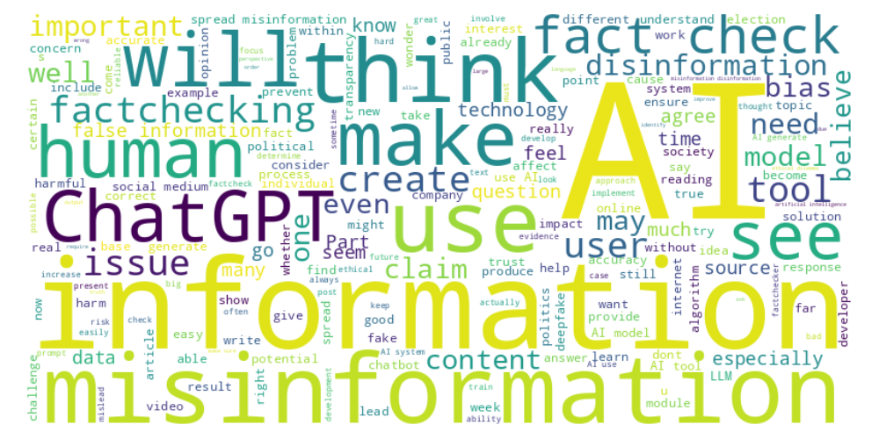
Perusall word cloud
Notes:
Content slide

Slide 6
Non-AI misinformation
Eesha : “Misinformation is inevitable and constantly surrounding us. Whether it comes from AI, social media, the news, or even people we interact with, we cannot deny the influence of misinformation on our life. When looking at something of such high prevalence, I wonder what causes AI misinformation to be weighted so differently than the other misinformation we see. Is it the fact that humans perceive AI as ‘all-knowing’ and interpret its data as factual compared to other sources? I would like to know more of the difference in how humans interpret AI vs. non-AI misinformation.”
Notes:
Content slide

Slide 7
Risk of privacy violations?
Pranav : “One key question is: how can we effectively balance transparency and user privacy when AI models disclose their sources? There was a lot of emphasis on the need for AI transparency, but it made me wonder about how we ensure that this transparency doesn’t compromise user data or violate privacy rights.”
Notes:
Content slide

Slide 8
Deepfakes
Arnav : “Most of these deepfakes that are being intentionally used for harm are used in political cases. Are there any other cases where deepfakes are commonly used for harmful intent?”
Marketing
Scams
Deepfakes are a relatively new capability
Should they be permitted? Should they be required to be labeled as fake? How do they impact the concept of “seeing is believing”?
Discuss!
Notes:
Content slide

Slide 9
Poll - Deepfakes should be banned - Deepfakes should be allowed, but only if they are clearly labeled as fake - Deepfakes should be allowed with no restrictions

Slide 10
Detection of AI generation
OpenAI’s “New AI classifier for indicating AI-written text” (January 2023)
“Our classifier is not fully reliable”
Correctly identifies 26% of AI-written text (true positives) as “likely AI-written,”
Incorrectly labeling human-written text as AI-written 9% of the time (false positives).
Notes:
Content slide

Slide 11
Watermarking
Ravi : “What are some steps we can take to determine if information is AI generated or not?”
Tracy : “I wonder if it is possible to have AI generated text label itself as being AI generated. A simple tag stating that it is AI generated could be easily removed, so it would probably have to be integrated into the text itself. Is it feasible for AI generated texts to always include some sort of recognizable pattern that could be used to distinguish it from other texts?”
Notes:
Content slide

Slide 12
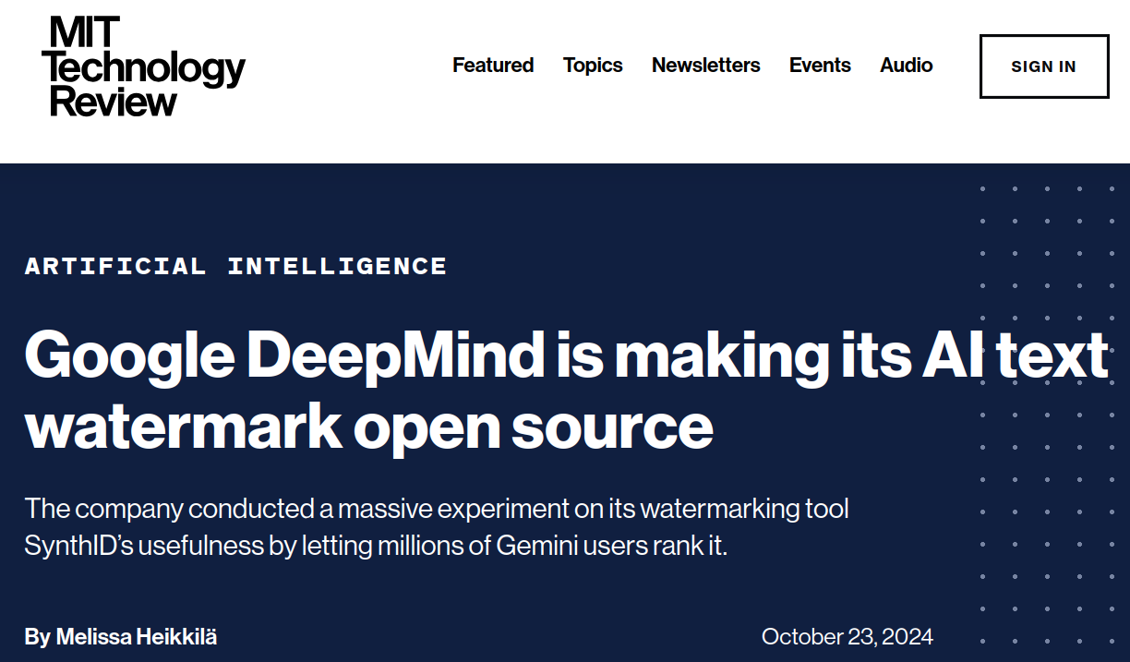
Watermarking
Notes:
Content slide

Slide 13
Watermarking
How does it work?
Jim’s favorite color is _______
(blue, .3) (green, .25) (red, .25) (purple, .2)
Instead of picking randomly, pick from top entries using a deterministic rule
For long sequences, it’s unlikely that text generated by a person would match that rule
Easily subvertible (e.g. “pineapple attack”)
Not necessarily in the interest’s of the companies
Notes:
Content slide

Slide 14
AI vs. AI
Olivia : “I would like to learn more about how the development of fact checking algorithms compare to other AI models. I am curious if the generation of AI models that can be potentially harmful or contain misinformation are easy to create and launched compared to fact checking and if so, why?”
Carly : “One thing that I was wondering about the Fact-Checking article: If AI can be utilized to fact check, then shouldn't LLM's have an integrated fact checker within themselves? This would mitigate the problems that LLMs have with misinformation and hallucinations. I believe implementing a two-step process like this would be beneficial for it's userbase. They could include links and cross-references to where it sourced its information from”
Notes:
Content slide

Slide 15
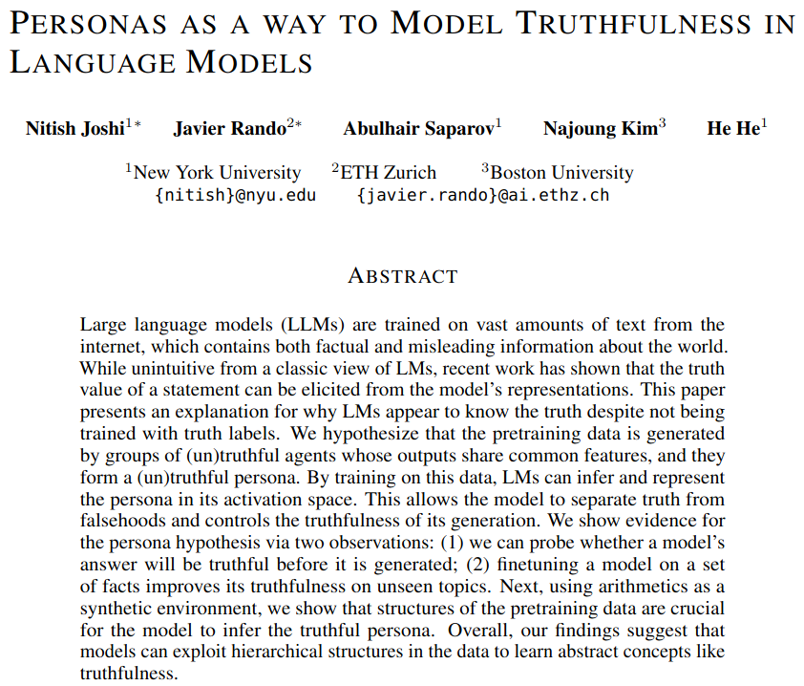
Do LLMs “know” what’s true?
Notes:
Content slide

Slide 16
Risk of censorship
Kaily : “I find that the AI's refusal to engage with certain disinformation narratives is a important aspect of its design. Retaining neutrality is crucial in AI ethics as it allows for the representation of diverse perspectives, especially in potentially polarizing topics like politics.”
Abiyu : “One big question is who should be responsible for controlling what gets shared online while also respecting people’s freedom to speak.”
Namuun : “For malinformation, who decides that the information is provided with malintent? I feel like malinformation opens the doors to censorship for those in control who do not like the information being shared”
Notes:
Content slide

Slide 17
Risk of censorship
Joseph : “This week’s topic on AI and disinformation has a few layers of irony, especially given the left-leaning bias that seems woven through the very fabric of these discussions. The idea that AI should be strictly controlled or monitored due to ‘misinformation’ often sounds like a way to keep viewpoints that don’t fit a particular agenda under a lid. The real ethical dilemma here might be how to ensure that AI doesn’t end up silencing certain perspectives—like those from conservative or rural backgrounds that often get dismissed or labeled as disinformation themselves. I can’t help but wonder if those pushing for ‘truth-checking’ in AI are simply looking for tools to control narratives that don’t align with theirs.
Is fact checking more harmful than helpful?
Discuss!
Notes:
Content slide

Slide 18
Poll ”The introduction of generative AI is making many things complicated. Deepfakes, misinformation, censorship… life was better before generative AI was introduced (just a few years ago!).” - Agree - Disagree

Slide 19
Is it worth it?
Yeejkoob : “If chatbots are structurally prone to providing disinformation, should chatbots be used anymore?”
Abdulmalik : “Why do we still keep LLMs up when they are causing such damage and are being used by terrorist groups and just for misdeeds as a whole? Is it going to be too hard for the government and businesses to take back certain AIs despite the damage it is causing?”
Discuss!
Notes:
Content slide

Slide 20
Next Week: Workplace Impacts, Economics, and Policy
Several readings
Lecture by Sherri Greenberg
Homework 5 due tomorrow! Final project due 12/6.
Sign up to attend class in person
Do readings on perusall and submit ethics reflection!

