Slide 1
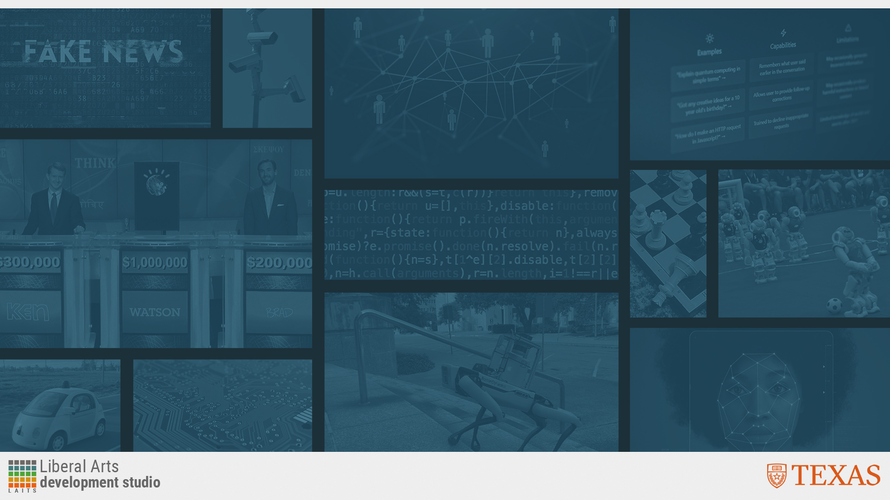
Essentials of AI for Life and Society
Peter Stone

Slide 2
AI and Society
Notes:
Title slide for lecture

Slide 3

Defining Artificial Intelligence
A science and a set of computational technologies that are inspired by, but typically operate quite differently from, the ways people use their nervous systems and bodies to sense, learn, reason, and take action
NOT one thing
  More than just deep learning
  RL, NLP, vision, planning, symbolic reasoning, algorithmic game theory, computational social choice, human computation
Getting Computers to do the things they can't do yet
  Once it works, it's engineering

Slide 4
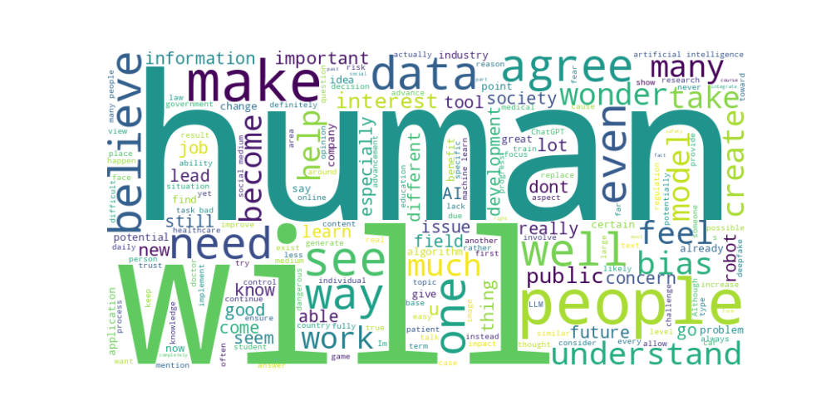
Perusall word cloud
Notes:
Content slide

Slide 5
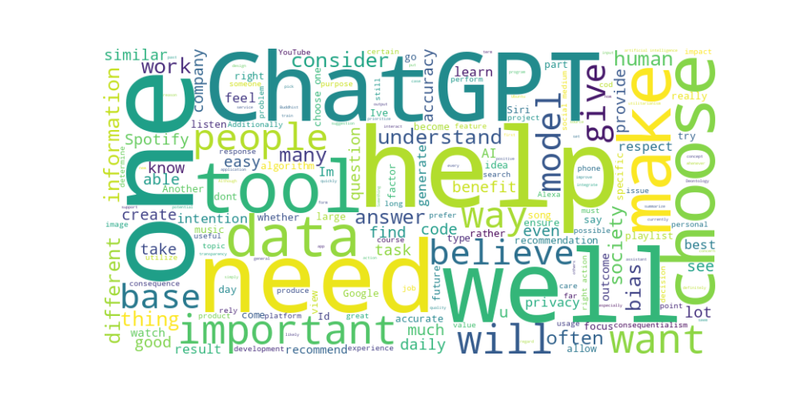
Ethics response word cloud
Notes:
Content slide

Slide 6
Common Questions
What is the current public sentiment towards AI?
Notes:
Content slide

Slide 7

Poll
Do you feel more concerned or excited about AI?
- Concerned
- Excited

Slide 8
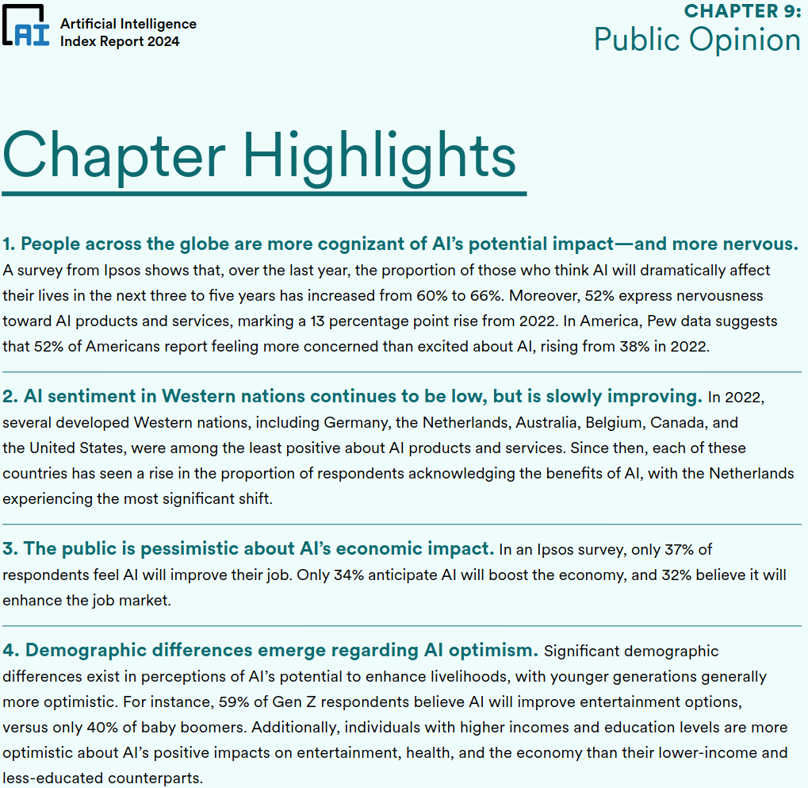
AI Index
Notes:
Content slide

Slide 9
Common Questions
What is the current public sentiment towards AI?
Would AI be considered more discriminatory than the average human being?
Why is it common for scientists and researchers to be reluctant to engage with the public?
Which groups stand to gain the most from AI?
What would happen if an incorrect prediction causes harm or loss of life? would the hospital be held accountable or would it fall on the AI developer?
Notes:
Content slide

Slide 10
Common Questions
What is the current public sentiment towards AI?
Would AI be considered more discriminatory than the average human being?
Why is it common for scientists and researchers to be reluctant to engage with the public?
Notes:
Content slide

Slide 11
Common Questions
Which groups stand to gain the most from AI?
What would happen if an incorrect prediction causes harm or loss of life? would the hospital be held accountable or would it fall on the AI developer?
Notes:
Content slide

Slide 12
California Bill
SB 1047 would make [very large] AI model developers liable for their harms — like making gun manufacturers liable for mass shootings — and would grant California’s attorney general the power to sue AI companies for hefty penalties if their technology was used in a catastrophic event.
Useful regulation for requiring responsible testing?
Thwart innovation by requiring too much risk and bureaucracy?
Discuss!
Notes:
Content slide

Slide 13
Ethics of releasing ChatGPT
Arthur: “​​ChatGPT's release was unethical and far too early. It's clear that the OpenAI team has not yet solved the issue of bias, and that bias very much lurks within their models.”
Jack: “Simply put, generative AI is a black box. If we don't understand how to align an AI system with human ethics like those discussed in the video, trusting it to make decisions for us or advise us in any way other than as a basic search engine or as a play-thing to be giggled at is unconscionable.”
Agree or disagree?
Based on what ethical framework(s)?
Discuss!
Notes:
Content slide

Slide 14
Use of Generative AI in Education
Coco: “I believe AI should mainly stay out of use in education. Students should learn how to use AI responsibly and learn about ethics of using AI, but in terms of doing work, I still believe students should be doing most of the heavy lifting. Learning doesn't occur without effort and practice and using ChatGPT could hinder such progress.”
Yuki: “In the future, if we officially incorporate AI as a learning tool into schooling, I wonder how we can prevent students from abusing AI usage. Students will try to find a way to avoid putting effort into assignments through AI.”
Eesha: “I feel like schools and colleges are not integrating AI and its benefits into use with the exception of vaguely reviewing ChatGPT. A lack of understanding of AI will definitely ...[be] harmful as the world shifts to increased dependency on data science.”
Discuss!
Notes:
Content slide

Slide 15
Use of Generative AI in Education
Coco: “I believe AI should mainly stay out of use in education. Students should learn how to use AI responsibly and learn about ethics of using AI, but in terms of doing work, I still believe students should be doing most of the heavy lifting. Learning doesn't occur without effort and practice and using ChatGPT could hinder such progress.”
Yuki: “In the future, if we officially incorporate AI as a learning tool into schooling, I wonder how we can prevent students from abusing AI usage. Students will try to find a way to avoid putting effort into assignments through AI.”
Eesha: “I feel like schools and colleges are not integrating AI and its benefits into use with the exception of vaguely reviewing ChatGPT. A lack of understanding of AI will definitely ...[be] harmful as the world shifts to increased dependency on data science.”
Discuss!
Tatianna: “It's interesting how people are terrified of new inventions and then later on, change their perspective because they rely on it. It is like judging a book by its cover is in our nature.”
Notes:
Content slide

Slide 16
Use of Generative AI in Education
Tatianna: “It's interesting how people are terrified of new inventions and then later on, change their perspective because they rely on it. It is like judging a book by its cover is in our nature.”
Notes:
Content slide

Slide 17
AI-based technology in medicine
Tracy: “Although this technology is impressive, I think many people would still want to see a trained pathologist for a proper diagnosis. Self-diagnosing technology requires the user to have the right amount of trust in the AI. Too much trust in the AI could lead to users believing in faulty or incomplete diagnoses while too little trust means that people would choose to bypass the AI altogether and see a human pathologist instead.”
Ameera: “This is definitely a concern to take care of quickly because if we implement an algorithm in health care that is biased, this could worsen health disparities and create health problems for those that it inaccurately represents, in ways such as providing inaccurate diagnoses to black people.”
Nathan: “I also want the AI to be objective and without bias so I know the information I get from the model is as standard and unbiased as possible.”
Notes:
Content slide

Slide 18
Impact of AI on Jobs and Economy
Discussed last time and more to come later
Notes:
Content slide

Slide 19
Ethical Frameworks
Satvik: “I believe that consequentialism would be the most helpful in shaping my perspective on AI… because it will allow me to compare the tangible benefits and harms of AI developments.”
Kavya: “I think that the deontology ethical framework would be the most helpful in sharing my perspective on AI because its guiding principle is based on intentions.”
Kevin: “I believe that the most helpful ethical framework is Ubuntu or ‘respect’... because I think that it is extremely important to keep in mind the values of the users who will be using this technology.”
Notes:
Content slide

Slide 20
Ethical Frameworks
Kelly: “I think virtue ethics would be most helpful in shaping my perspective on AI because it….has a guiding principle of golden mean or balance of all the different values.”
Kaily: “I think Hindu Ethics is really helpful in shaping my perspective in AI because I view AI technologies to be needed to help and improve already existing problems and solvers. AI technology should help consumers fulfil their duty,
Notes:
Content slide

Slide 21
Poll
Which ethical framework would most guide your adoption of an AI technology?
- Hindu ethics (duty)
- Confucian ethics (roles)
- Buddhist ethics (right actions)
- Islamic ethics (social conscience)
- Deontology (intentions)
- Consequentialism (outcomes)
- Distributive justice (difference principle)
- Virtue ethics (golden mean)
- Ethics of care (care)
- Ubuntu (respect)

Slide 22
Next Week: Planning and Search
Slightly more technical reading
Lecture from Joydeep Biswas
Ethics module on values-sensitive design
Do readings and reflection

