Slide 1
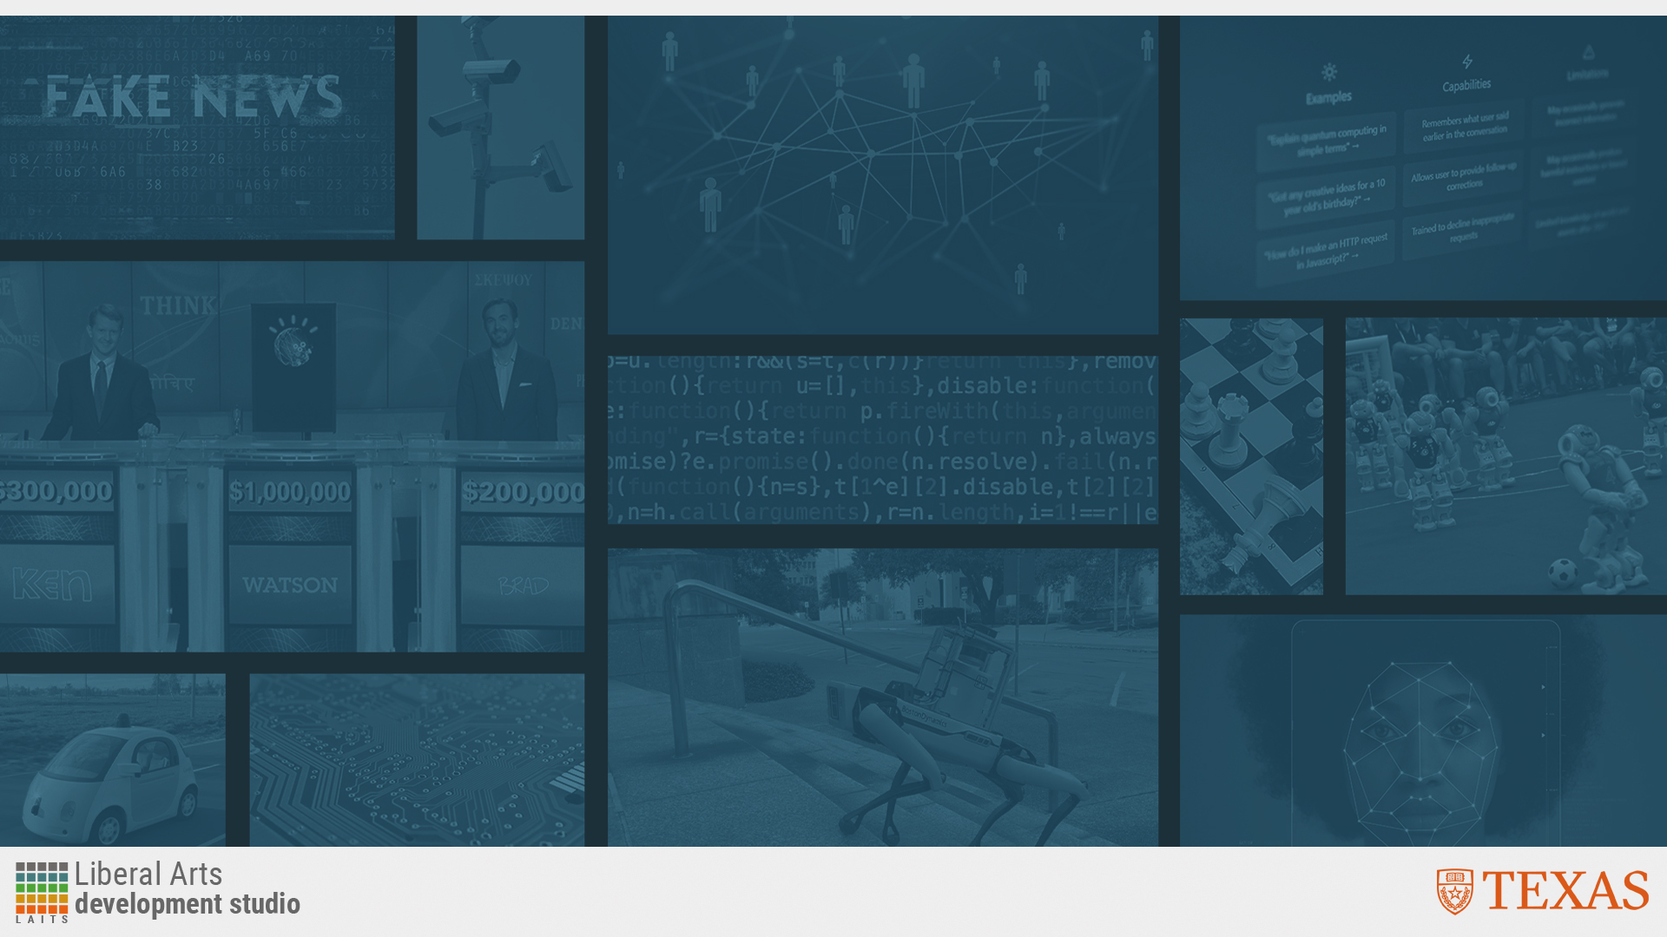
Essentials of AI for Life and Society
Peter Stone

Slide 2
Planning and Search
Notes:
Title slide for lecture

Slide 3

Defining Artificial Intelligence
A science and a set of computational technologies that are inspired by, but typically operate quite differently from, the ways people use their nervous systems and bodies to sense, learn, reason, and take action
NOT one thing
  More than just deep learning
  RL, NLP, vision, planning, symbolic reasoning, algorithmic game theory, computational social choice, human computation
Getting Computers to do the things they can't do yet
  Once it works, it's engineering

Slide 4
Some Context
Planning is one of the oldest focus areas for AI
It is very different from LLMs (ChatGPT)
There aren’t many (any?) readings aimed at the general public
  It’s OK if you found the discussion of Turing Machines a bit esoteric
  Computation underlies AI
  Turing Machines were introduced as a general model of computation when computers didn’t have sensors (“classical planning”)
  But they don’t cover all possible situations
Notes:
Content slide

Slide 5
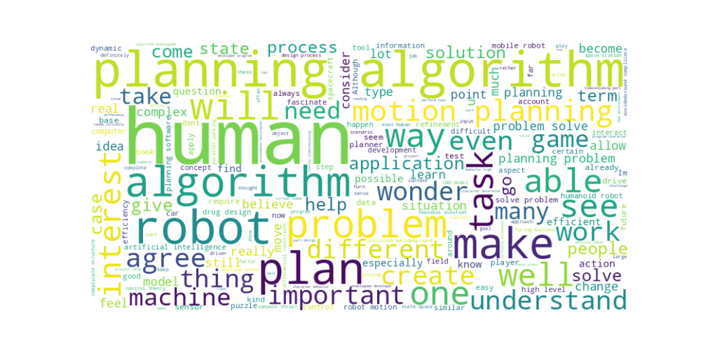
Perusal word cloud
Notes:
Content slide

Slide 6
Common Questions
Are we going to go more in-depth about Turing in this course? I'm curious to learn more about his life and work.
Does this area of Planning Algorithms rely on probability formulas/ concepts to arrive at solutions?
I wonder how many fields of mathematics are involved in this specific topic? Are there any other books that one can read up on that are outside of this text?
Notes:
Content slide

Slide 7
Feasibility vs. Optimality
Eesha: “It is pretty interesting that feasibility is a priority over optimality. It makes sense in theory as feasibility is a pre-requisite to making something more optimal, but I feel like when it comes to innovation, especially in the classroom, we always approach things based on what is most optimal and efficient.”
Hannah: “I certainly see the benefit of feasible solutions over no solutions at all, especially in instances in which the feasible solution is not far off from the potential optimal solution. However, I wonder if there are cases in which such a defined focus on finding a feasible solution limits the opportunities to discover an optimal solution that would be more efficient.”
Notes:
Content slide

Slide 8
Self-driving cars
Riya: Which kind of motion planning is used in self-driving cars?
Could not having spatial awareness be the reason that navigation is a challenge for AI/robotics?
Notes:
Content slide

Slide 9
Sealing Cracks in Automotive Assembly
What types of AI does the system use aside from trajectory planning? For example, if a car's body is cracked or malformed such that it cannot be sealed, is the robot able to identify this (computer vision) and inform a factory worker? Also, what is the speed at which it is able to perform this task?
Notes:
Content slide

Slide 10
Planning for Humanoid Robots
Amal: "I think people will be more comfortable around robots if they resemble humans physically, and hopefully eventually mentally as well."
Kelly: "I believe that humans will be more uncomfortable with the idea of robots resembling humans physically. It's kind of scary to think that you could be talking to someone, and it turns out they're a robot."
Notes:
Content slide

Slide 11

Poll
"I think people will be more comfortable around robots if they resemble humans”
- Agree
- Disagree

Slide 12
Planning for Humanoid Robots
Amal: "I think people will be more comfortable around robots if they resemble humans physically, and hopefully eventually mentally as well."
Kelly: "I believe that humans will be more uncomfortable with the idea of robots resembling humans physically. It's kind of scary to think that you could be talking to someone, and it turns out they're a robot."
Discuss!
Notes:
Content slide

Slide 13
Poll
"I think people will be more comfortable around robots if they resemble humans”
- Agree
- Disagree

Slide 14
Human vs. Machine Planning
Kaily: It’s interesting to see how humans and machines can both plan in different ways. Humans can act like algorithms by making plans from models, almost like they’re doing the planning themselves. I’m curious how human plans compare to machine plans, especially more changing situations? Are there times when one is substantially better than the other?
Ayush: “It really is incredible how difficult it is to get a machine to perform tasks that would be second nature to people. But when we do get the machine to do it, provided the algorithm is as correct as can be, they do it better than us.”
Notes:
Content slide

Slide 15
Human vs. Machine Planning
Namrata: “I think it is so interesting how tasks that we see as so easy are pretty complicated for robots as they have to think about all the small minute details like hitting obstacles”
Hans Moravec wrote in 1988: "it is comparatively easy to make computers exhibit adult level performance on intelligence tests or playing checkers, and difficult or impossible to give them the skills of a one-year-old when it comes to perception and mobility" – known as the AI Paradox
Notes:
Content slide

Slide 16
Thinking Fast and Slow
Nathan: “Personally, I use planning and algorithms to do basic everyday tasks that I gradually get better at through repetition, muscle memory, and routines. I think this eventually makes the processes you repeatedly do to be relatively efficient.”
Daniel:
- System 1 is fast, automatic, and intuitive, operating with little to no effort. This mode of thinking allows us to make quick decisions and judgments based on patterns and experiences.
- System 2 is slow, deliberate, and conscious, requiring intentional effort. This type of thinking is used for complex problem-solving and analytical tasks where more thought and consideration are necessary. [Planning!]
What’s a task that can move from System 2 to System 1? What’s one that can’t? (Or are there none)?
Discuss!
Notes:
Content slide

Slide 17
Ethics of Algorithmic Planning
In response to: "A planning algorithm could even be used to assess whether a sports utility vehicle tumbles sideways when stopping too quickly." on pg. 14
Megha: "How reliable is this algorithm? There is always a chance of wrong predictions or something out of the ordinary that could go wrong and cause a failure in the algorithm. But if the chances of reliability of this planning algorithm is high, this could potentially prevent a lot of driving accidents and wrecks in general."
Marcus: "The question is also an ethical one of whether it is better than a human. Although, the answer is simple: if it is, then employ it, and if not, do not."
Mohammad: "I agree with the fact that it is also an ethical question. One additional thing to consider is that even if the algorithm is better than a human, how will an accident be received by the public if the algorithm was at fault? People are used to humans making mistakes and singling them out, but in this case it would be interesting to see how things play out."
Reflecting on past weeks’ discussions…discuss!
Notes:
Content slide

Slide 18
Next Week: Intelligent Robotics
Readings:
  What are robots?
  Brooks’ 3 laws of robotics
  A recent NY Times Article on Killer Robots
Lecture by me
Ethics module on codes of ethics
Clips from “Robot and Frank”
Do readings on perusal and submit ethics reflection!
Lucy: “This is why robotics is a difficult field to master. The robot's relation to its environment and the sensor inputs that are measured are always changing, which is hard to model without complex calculations. Especially imagining how robotics must respond to unexpected stimuli (i.e. a robot being pushed over by a human and figuring out how to re-orient itself) makes it apparent why planning algorithms are so important for their adaptability.”

