Slide 1
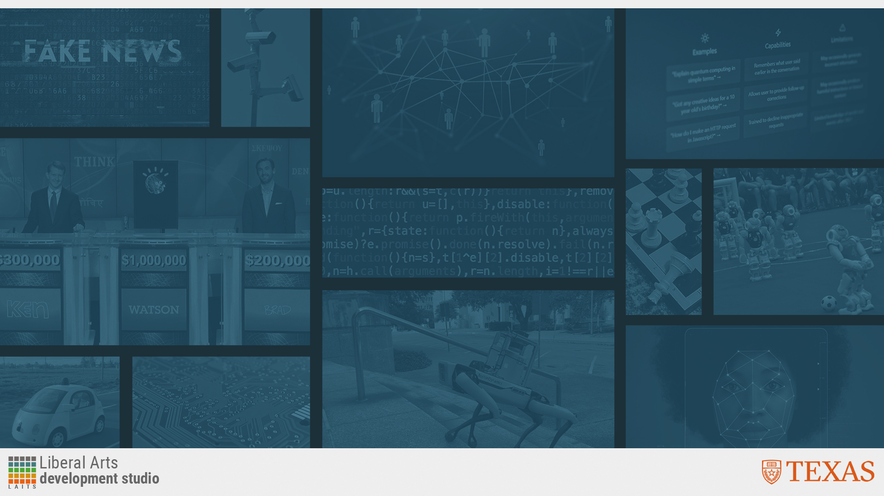
Essentials of AI for Life and Society
Peter Stone

Slide 2
Intelligent Robotics
Notes:
Title slide for lecture

Slide 3

Defining Artificial Intelligence
A science and a set of computational technologies that are inspired by, but typically operate quite differently from, the ways people use their nervous systems and bodies to sense, learn, reason, and take action
NOT one thing
  More than just deep learning
  RL, NLP, vision, planning, symbolic reasoning, algorithmic game theory, computational social choice, human computation
Getting Computers to do the things they can't do yet
  Once it works, it's engineering

Slide 4
Some Context
Not all robots are intelligent robots
Intelligent robots have often been the face of AI – in movies and books
Creating intelligent robots is harder than creating AI software (Brooks’ 3rd law)
It is an open question how robots can use LLMs (like ChatGPT)
Notes:
Content slide

Slide 5
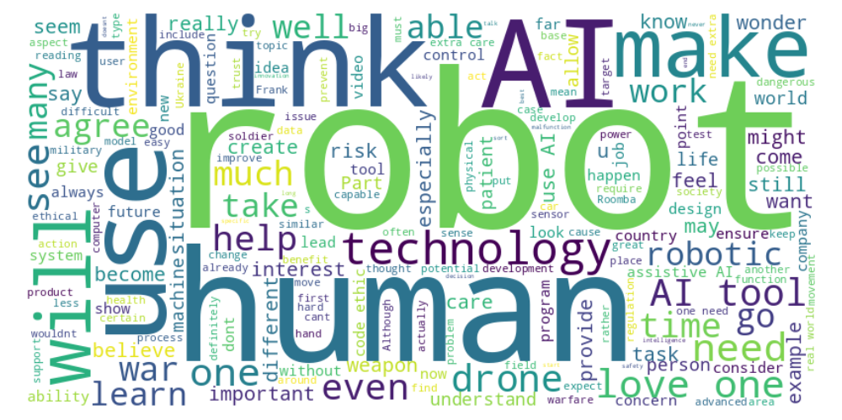
Perusal word cloud
Notes:
Content slide

Slide 6
What’s a robot?
Aaron: “Sometimes I think of a robot as anything that can take in an input and create an output.”
Brandon: “Is it of any relevance whether the ‘brain’ is inside or outside the robot?”
Reshmitha: “Roomba is something used very often in my household, but I never really acknowledged it as a robot due to it's lack of human features. Rather, I just viewed it as a tool.”
Notes:
Content slide

Slide 7
Research & Development Priorities
Justin: “Ventures that are useful in the long run sometimes get neglected by researchers, in favor of pursuing results that generate more hype. A robot doing a backflip will get more views than a paper demonstrating how a robot successfully cleaned the floor 8,354 times in a row.”
Notes:
Content slide

Slide 8
RoboCup
Maria: “When and where will the next RoboCup take place, and how can students access it?”
Notes:
Content slide

Slide 9
Robot and Frank
The Robot shoplifted to get on Frank’s good side, and lied to Frank about caring whether its memory was erased to get him to exercise.
It worked – Frank started taking care of himself again and became healthier.
Was the robot’s behavior ethical?
Discuss!
Notes:
Content slide

Slide 10

Poll
"In the end, Frank had to decide whether to erase the robot’s memory. Do you think he did?”
- Yes
- No

Slide 11
Robots for Elder Care
Setting the movie aside, what are the risk and benefits of using robots for elder care?
Olivia: “I believe that AI will never fully be able to replicate the care and compassion that the elderly need. Human interaction is a sacred and beautiful aspect of life and robots cannot fully encompass the importance and love that comes with that.”
Kathik: “I think an AI tool is much better than nothing at all. A lot of people live alone without anyone checking up on them at all times of the day, so using AI to address this problem could improve the quality of life drastically.”
Is this an area that should be pursued?
Discuss!
Notes:
Content slide

Slide 12
Killer Robots
Jenna: “It's one thing to consider technology being used as a weapon, but it's another when debating the ethics of the technology having independent control over its actions.”
Caitlyn: “I fear that war will drive people to act irrationally and people in power will cut corners on ethics/ regulations to try to end the war quicker.”
Notes:
Content slide

Slide 13
Poll
"Autonomous Lethal Weapons
Should be Banned”
- Agree
- Disagree

Slide 14
Autonomous Lethal Weapons
Victor: “What happens if [an AI powered] drone locks on to the wrong target and ends up harming someone it wasn't supposed to?”
Coco: “There is a chance that these technologies become so cheap and efficient that they replace humans in wars, and we'd carry out essentially proxy wars fully autonomously.”
Maria: "In my opinion, regulating powerful weapons like those discussed in this article will be very challenging. Especially because not all countries will agree on the same regulations or implement them uniformly.”
Should autonomous lethal weapons be banned?
Discuss!
Notes:
Content slide

Slide 15
Poll
"Autonomous Lethal Weapons
Should be Banned”
- Agree
- Disagree

Slide 16
Detachment from War
Sophie: "What really gets to me is the idea of detachment. Warfare has always been brutal, but there’s something deeply human about the decisions soldiers have to make, even in the worst of times. When you put AI into the equation, especially with autonomous weapons, you’re removing that human layer. It makes war feel like a video game, where the consequences aren’t as real for the person pulling the trigger—or, in this case, programming the machine. That scares me because war shouldn’t be something we approach lightly, and taking humans out of those critical moments feels like we’re losing something important."
Notes:
Content slide

Slide 17
Next Week: Probabilistic Modeling
Register to vote!
Readings:
  Basics of probability
  How do we perceive randomness, and how good are people at reasoning about probabilities?
Lecture by Roberto Martin-Martin
Ethics guidelines
Homework 3
Do readings on perusal and submit ethics reflection!

