Slide 1
Essentials of AI for Life and Society
Peter Stone
(guest lecturer today: Joydeep Biswas)

Slide 2
Computer Vision
Notes:
Title slide for lecture

Slide 3
Defining Artificial Intelligence
A science and a set of computational technologies that are inspired by, but typically operate quite differently from, the ways people use their nervous systems and bodies to sense, learn, reason, and take action
NOT one thing
More than just deep learning
RL, NLP, vision, planning, symbolic reasoning, algorithmic game theory, computational social choice, human computation
Getting Computers to do the things they can't do yet
Once it works, it's engineering

Slide 4
Some Context
Vision can be seen as an application area of AI
At first it was not done with machine learning
Today it is one of machine learning’s greatest successes
Vision vs. generation/graphics
Aaron: “I think my most common interaction with computer vision is using face ID when logging in to my iPhone as it uses the camera to recognize the details of my face and log me in. I use this technology multiple times a day without even realizing it.”
Notes:
Content slide

Slide 5
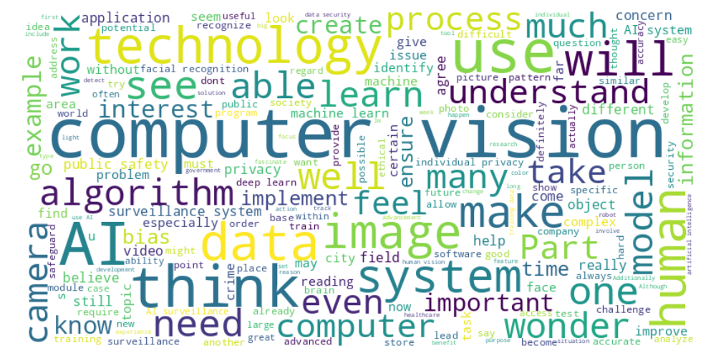
Perusal word cloud
Notes:
Content slide

Slide 6
Algorithms
Pranav: “How has the shift from manual coding and developer-driven solutions to automated deep learning in computer vision transformed industries reliant on image analysis, and what challenges might remain despite this progress?”
Riya: “Is there a specific deep learning model that works particularly well for computer vision or that was developed specifically for computer vision use cases?”
AlexNet/convolution
Notes:
Content slide

Slide 7
Data
Jayna: “It makes a lot of sense that the more data you gather, the better your probabilistic models will be at making accurate predictions. This is something I find particularly interesting because it shows how much machine learning and AI rely on having large, high-quality datasets to function correctly. The idea that statistical techniques can help us quantify uncertainty in predictions is also really important, as it highlights how these systems are designed to handle the inherent unpredictability of real-world conditions. This line reinforces my understanding that to develop effective AI systems, we not only need smart algorithms but also the right data to train them properly.”
Notes:
Content slide

Slide 8
Data
Andrew: “It's interesting to know that the more images/larger the data set, the more accurate the depiction is. I wonder if there is a statistical analysis of a diminishing return each image provides to the data set, although I'm sure it differs per set.”
Notes:
Content slide

Slide 9
Biological Plausibility
Nissi : “Is the goal of AI/computer vision to replicate the human brain?”
Kevin : “I'm wondering if companies are investing any money at all into figuring out how the visual system works or if it is better to continue investing in just computer vision. Would it be useful at all for engineers to understand how the human eye works or is it simply completely different from computer vision?”
Coco : “It's odd that we can claim to create artificial intelligence when we don't fully understand how natural intelligence works. There's no way to actually model artificial intelligence off natural intelligence without a comprehensive understanding of the mind.”
How important is understanding human vision for creating computer vision? Necessary? Useful? Irrelevant?
Discuss!
Notes:
Content slide

Slide 10
Optical Illusions
Nissi : Can AI and computer vision programs see past optical illusions that deceive the human eye?
Tracy : Should computer vision replicate the shortcuts our brains take with optical illusions, and would that be an advantage or disadvantage?
Computers have different optical illusions (changing a few pixels can turn a stop sign into a panda bear!)
Notes:
Content slide

Slide 11
Poll Do you believe AI will surpass human capabilities in object recognition within the next decade? - Yes, AI will definitely surpass human capabilities. - No, human abilities will always be superior.

Slide 12
How Good Will Algorithms Get?
Kaushik : "Will computer vision ever fully reach the level of human perception, or will there always be a gap?"
Ravi : How do we define a 'perfect' computer vision system, and what metrics should we use for evaluation?
Ethan : Will tests to determine if someone is human or a robot go away once bots can recognize images as well as humans?
Notes:
Content slide

Slide 13
Ongoing Progress
Megha : “I wonder if we can combine all of these computer vision types into one and have a singular robot that can accomplish all these tasks. I'm also curious to know how long this will take to achieve.”
Emeila : “With growing technology, the abilities of computer vision will become more advanced. How will this affect society?”
Victoria : “Isn't this risky? There have many cases in recent years where people who gained access to computer vision use it with bad intentions. … so why are regular people who don't know the risks of computer vision allowed to use it?”
If Computer Vision algorithms continue to improve, what opportunities most excite you? What risks most worry you?
Discuss!
Notes:
Content slide

Slide 14
Poll Which should be prioritized in the implementation of AI surveillance systems? - Public safety should come first. - Individual privacy should be prioritized.

Slide 15
Surveillance
Weston : Computer vision surveillance poses dystopian privacy issues, with risks of data breaches and the potential for government misuse despite possible crime reduction benefits.
Gael : “For citizens concerned about privacy I would let them be able to opt out of more advanced tracking techniques.”
If I’m sitting on my front porch and I see a crime, I can serve as an eyewitness in court. If I’m not there but my doorbell camera “sees” the crime, should it be able to serve as evidence in court?
If not, why not? What’s the difference? And if so, why isn’t it a privacy violation?
Discuss!
Notes:
Content slide

Slide 16
Poll Which should be prioritized in the implementation of AI surveillance systems? - Public safety should come first. - Individual privacy should be prioritized.

Slide 17
Mitigations
Tanner : What safeguards can be implemented to address privacy concerns with public surveillance?
Ahmed : Do existing measures like face blurring and data anonymization sufficiently protect privacy in AI surveillance systems?
Notes:
Content slide

Slide 18
Next Week: Machine Learning Fundamentals
2 Readings
Lecture by Adam Klivans
Homework 3 due 10/11
Do readings on perusall and submit ethics reflection!

