Slide 1
Essentials of AI for Life and Society
Peter Stone

Slide 2
Machine Learning Fundamentals
Notes:
Title slide for lecture

Slide 3
Logistics
Questions should be sent to cs309@utlists.utexas.edu
Don’t worry if Perusall grades aren’t syncing right away
2/3 = 100%, and will be fixed by end of semester
Notes:
Content slide

Slide 4
Defining Artificial Intelligence
A science and a set of computational technologies that are inspired by, but typically operate quite differently from, the ways people use their nervous systems and bodies to sense, learn, reason, and take action
NOT one thing
More than just deep learning
RL, NLP, vision, planning, symbolic reasoning, algorithmic game theory, computational social choice, human computation
Getting Computers to do the things they can't do yet
Once it works, it's engineering

Slide 5
Some Context
Machine learning has driven the recent progress in computer vision and AI in general
Many people (but not you!) consider ML and AI to be synonymous
An : “I have heard a lot about deep learning and machine learning, but honestly, I don't know how related these two are and how these two together can combine and create what we have as AI in the present day.”
Nobel prizes in physics and chemistry!
One reading was a bit technical
Notes:
Content slide

Slide 6
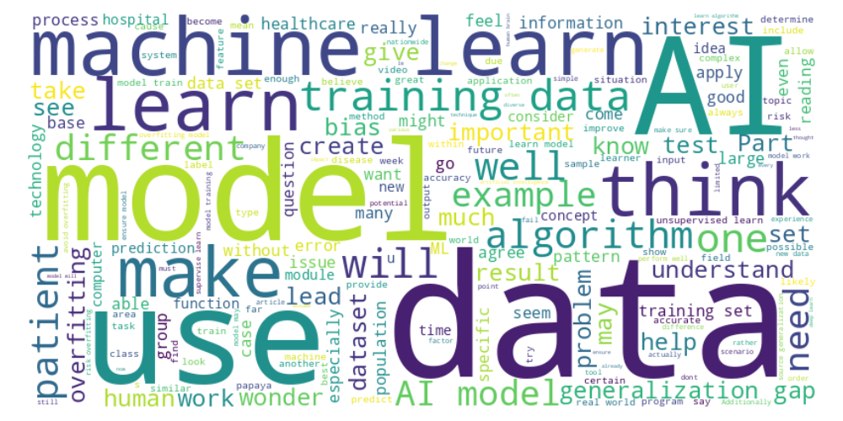
Perusal word cloud
Notes:
Content slide

Slide 7
ML vs. human learning
Jared : “An important question is how fast computers can learn from experience. It takes humans many years to develop enough observations and experiences to know how to react when they encounter certain situations. Even then, humans still often don't do this well and many still make seemingly obvious mistakes when certain outcomes are highly predictable. Would Machine Learning do this more efficiently?”
Notes:
Content slide

Slide 8
Data quantity
Kevin: “My question is about how much data we can possibly feed artificial intelligence. We obviously have large amounts of data so I'm wondering if we could essentially just feed it all into one model of artificial intelligence. Is this perhaps not possible because it would cost too much or is it not feasible to make this happen?”
Notes:
Content slide

Slide 9
Unsupervised Learning Applications
Article:
customer segmentation for movie/product/music recommendation; anomaly detection; social network analysis
Also:
group similar news stories; Identify similar patients
Damian : “PCA makes analysis more efficient, but how do we prevent losing important information in dimensionality reduction?”
Notes:
Content slide

Slide 10
Unsupervised Learning Applications
Damian : “How can using unsupervised learning in recommendation systems, like Netflix or Spotify, impact the user's behavior? What are the ethical considerations of this influence?”
Alex : “I wonder how these financial institutions draw a line between security and customer service. Would a person who has been frugal for 20 years and suddenly purchased an all-out vacation to a luxury destination be flagged for fraud? How do these institutions prevent unnecessary flags on accounts?”
Notes:
Content slide

Slide 11
Classification vs. Regression
Matilde : “Its interesting how the choice between classification and regression depends on the type of output you´re trying to predict. How often do real world problems require using a combination of both techniques?”
Select a medicine and choose a dose
Pass or shoot and how hard?
Notes:
Content slide

Slide 12
Bias in models
How do we deal with bias in ML? Is there a standard to prevent us from deploying biased models?
Notes:
Content slide

Slide 13
Image recognition
Miller : “Is this different from OCR or are they related since OCR is trained on hand written text to determine what the character is.”
Notes:
Content slide

Slide 14
Translation vs. NLP
Alexander : “Does this distinction between natural language processing and language translation imply that translators don't understand the language prompted with?”
What would it mean for an AI system to “understand” language?
How would we know?
Discuss!
Notes:
Content slide

Slide 15
Poll ”Current computer programs that use language do not ‘understand’ “ - Agree - Disagree

Slide 16
Data curation
Carly : “I did have a question about how the different "points" of data were labeled. He gives each of them a vector of coordinates and assigns each of them a color, "red" or "blue", which translates to them being either "spam" or "not spam". How would those coordinate points potentially be determined? If the categories we are judging the emails on are "spam" and "not spam", then what would the other two variables be that determine the 2 values given to each data point? Also, would it be possible for them to have more than 2 variables, and how would that look like if we were to attempt to plot that on a graph?”
Notes:
Content slide

Slide 17
More details
Pranita : “Could this increase to multiple-element sets more than the basic two element set? What would an example of that set look like?”
Caitlyn : “How do we know if the size of our domain set is sufficient?”
Coco : “What happens when the learner doesn't have all of these inputs? What should the learner do if they don't have complete sets for the domain, label, or training data?”
Mark : “What happens when their is a duplicate in the learning set?”
Notes:
Content slide

Slide 18
Ethics prompt
Disease data from local hospital with homogeneous population
Trained ML model works great at local hospital
Harry : “I also thought it was interesting that an AI can be too good at what it does, that it can't generalize. Although I do think that overfitting can be bad, it can also be good, since it would excel at one specific task. I think that as long as you don't misuse an overfitted AI, and are aware that it is overfitted, then using it would be fine.”
Most of you said the model has a generalization gap, so should not be rolled out nationally.
But there’s a chance it could save people’s lives.
Is it OK to just keep it to the local population? What next steps should be taken?
Discuss!
Notes:
Content slide

Slide 19
Using ChatGPT for Articles
Author’s Footnote: “Portions of this article were supplemented by GenerativeAI tools in its writing. This was used for outline mapping of commonconcepts and for certain selected definitions. The Author accepts sole responsibility for the content expressed in this writing.”
Kelsey : I wonder in the future when people need to write papers if it will be important to cite AI as a tool used for writing. Would it be considered plagiarism to use AI writing tools to improve/ inspire your writing without letting the audience know?
Discuss!
Notes:
Content slide

Slide 20
Poll ”It’s OK for writers to use ChatGPT to write publicly posted articles as long as they disclose it.” - Agree - Disagree

Slide 21
Next Week: Machine Learning Paradigms
1 Reading
Lecture by Ray Mooney
Homework 3 due tomorrow!
Homework 4 due 10/25
Do readings on perusall and submit ethics reflection!

