Slide 1
Essentials of AI for Life and Society
Peter Stone

Slide 2
Machine Learning Paradigms
Notes:
Title slide for lecture

Slide 3
Defining Artificial Intelligence
A science and a set of computational technologies that are inspired by, but typically operate quite differently from, the ways people use their nervous systems and bodies to sense, learn, reason, and take action
NOT one thing
More than just deep learning
RL, NLP, vision, planning, symbolic reasoning, algorithmic game theory, computational social choice, human computation
Getting Computers to do the things they can't do yet
Once it works, it's engineering

Slide 4
Some Context
Machine learning has driven the recent progress in computer vision and AI in general
Many people (but not you!) consider ML and AI to be synonymous
Nobel prizes in physics and chemistry!
There are several approaches to ML, each with a different inductive bias
This was just a very high-level
Notes:
Content slide

Slide 5
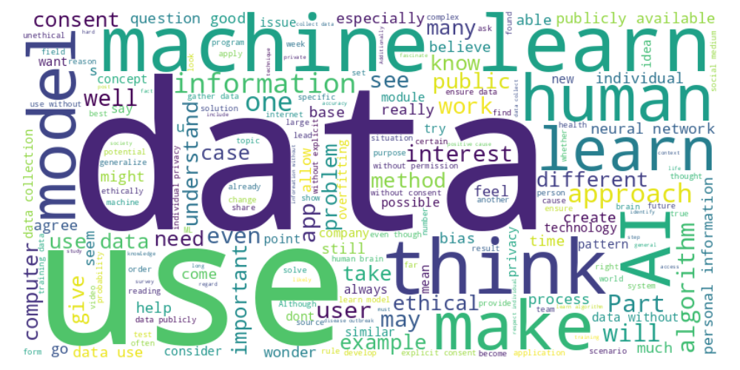
Perusal word cloud
Notes:
Content slide

Slide 6
Aleotoric Uncertainty (vs. Epistemic)
Carly : “Two different people may interpret this same scribble as either a 0 or a 6, so how would we expect a machine be able to tell what the ‘objective truth’ is?”
Kelly : “Even humans can never 100% correctly predict the future based on past experiences, so I wonder how machine learning will evolve close to that point. Can we ever determine if machine learning is cumulatively successful, or is that subjective?”
Notes:
Content slide

Slide 7
Bias and Overfitting
Anushka : “This is the first time I've seen a positive discussion about bias in machine learning. Normally, we talk about the importance of including sufficient data so the model doesn't reflect bias, but it makes sense that we need to include some sort of preconceived notions so there's context.”
Riya : “How do ML scientists effectively prevent overfitting? Is the key to preventing overfitting to use a large number of diverse datasets so the model is not finetuned or accustomed to any particular thing?”
Notes:
Content slide

Slide 8
Genetic Algorithms
How does it simulate evolution?
How do you balance exploration and exploitation?
Notes:
Content slide

Slide 9
New Paradigms
Joshua : “Considering how quickly new machine learning techniques are developed and proposed, what are the requirements for a newly pro
Notes:
Content slide

Slide 10
Hybrid methods
Alma-Elizabeth : “Are certain learning methods stronger in scenarios than others? If so, why exactly?”
Kevin : “One question I have is if there is any possibility of being able to combine two different machine learning methods. I'm unsure as to how realistic that option is but I would want to see if, for example, the Bayesian Probabilistic method can be combined with the Neural Network method. For example, neural networks may be good for problems for which we have a lot of data as they can recognize a very complex pattern but for smaller data sets where artificial intelligence may have to generalize and ‘guess’ on some aspects, Bayesian probability is better.”
Notes:
Content slide

Slide 11
The 5 tribes
Connectionist (neural networks)
Evolutionist (genetic algorithms)
Bayesian (probabilistic)
Analogist (nearest neighbor)
Symbolist (e.g. decision trees)
What are their strengths and weaknesses?
What’s a domain where one might work better than another?
How might they be combined?
Discuss!
Notes:
Content slide

Slide 13
Poll ”Public data on social media sites and public webpages can be used to train an app that prevents disease outbreaks“ - Agree - Disagree

Slide 14
Use of public data
Kaushik : “The mere availability of data does not excuse its use without permission; ethical data collecting requires a framework that places a high priority on individual rights and privacy.”
Akhil : “It should be common knowledge that using social media in any way is a security risk, and any user should know that their data is being tracked constantly.
Notes:
Content slide

Slide 15
Use of public data
Christian : “I think that, if the information is publicly available online, then the thing that matters most is WHERE exactly that information is from, and how it was put online in the first place….If there has been a data leak and the information is used for the app, that would have ethical issues. However, if the data was simply extracted from a public domain such as Twitter, Instagram, or any other public website, then there would be no problem in retrieving the data. After all, it is PUBLICLY available, and likely posted by that user to make it public.”
Notes:
Content slide

Slide 16
Depends on What it’s Used For?
Arnav : “I ... wonder what the legal distinctions are between scraping data from public domain sources and using that data for commercial vs. public health uses?”
Alma-Elizabeth : “Despite the app existing for good reasons, in the end, it is never ethical to use people’s information without their permission, even if it was posted publicly… thousands upon thousands of copyrighted characters are available on the internet, which are similarly public. Does that give anyone permission to utilize these characters? Of course not.”
Notes:
Content slide

Slide 17
Different Ethical Frameworks
Marcus : “Based upon consequentialist ethics, the data gathering was justified. The goal was both intended and would be effective for an overwhelmingly positive effect on society, and therefore consent is overwritten. [...]
Based upon deontological ethics, the data gathering would be inherently wrong, as privacy and consent would be moral goods that must not be broken. In that case, relying on a model that is evolutionary or reinforcement learning-based must be used, where big data is not necessarily required, but at the cost of performance and accuracy.”
Notes:
Content slide

Slide 18
Different Ethical Frameworks
Eesha : “My opinion is that if it comes to public health, there is slightly greater leniency as I apply a utilitarian framework to maximize benefits and health for most people. I believe that there should be some policy within the social media and websites that this application uses where the usage of personal information is provided in the terms and conditions, it is justified to use this information.”
Notes:
Content slide

Slide 19
Ethics Prompt
“Public data on social media sites and public webpages can be used to train an app that prevents disease outbreaks.”
Discuss!
Notes:
Content slide

Slide 20
Poll ”Public data on social media sites and public webpages can be used to train an app that prevents disease outbreaks“ - Agree - Disagree

Slide 21
What to do Instead?
Abiyu : “I want to learn more about better ways to collect data that respect people's privacy. Understanding these methods could lead to more responsible tech development.”
Notes:
Content slide

Slide 22
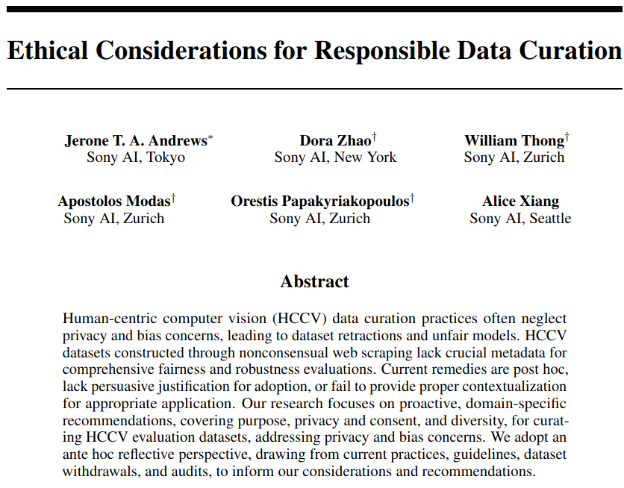
(NeurIPS 2023)
What do you think they recommended?
Discuss!
Notes:
Content slide

Slide 23
Recommendations
Purpose
Refrain from repurposing datasets; Create purpose statements
Consent and privacy
Obtain voluntary informed consent; Adopt techniques for consent revocation
Collect country of residence information; Redact privacy leaking image regions and metadata
Diversity
Obtain self-reported annotations; Provide open-ended response options
Acknowledge the mutability and multiplicity of identity; Collect age, pronouns, and ancestry
Collect phenotype & neutral performative features; Record environment & instrument information
Fair treatment & compensation for contributors; Recontextualize annotators as contributors
Collect aggregate data for commonly ignored groups
Notes:
Content slide

Slide 24
Tesla robot
Alba : “I also would like to understand more about the new robot that was released by Elon Musk this month, and if the world should be afraid of the new changes happening.”
Notes:
Content slide

Slide 25
Next Week: Natural Language Processing (Large Language Models)
Several readings
Lecture by Greg Durrett
Homework 4 due 10/25
Sign up to attend class in person
Do readings on perusall and submit ethics reflection!

