Slide 1
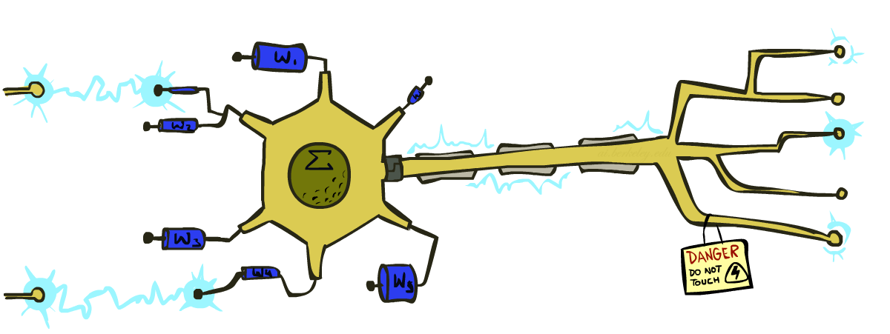
CS 188: Artificial Intelligence
Perceptrons
Instructors: Dan Klein and Pieter Abbeel --- University of California, Berkeley
[These slides were created by Dan Klein and Pieter Abbeel for CS188 Intro to AI at UC Berkeley. All CS188 materials are available at http://ai.berkeley.edu.]

Slide 2
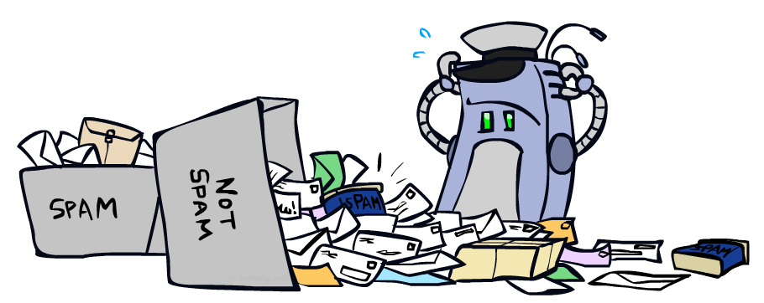
Error-Driven Classification

Slide 3
Errors, and What to Do
Examples of errors
Dear GlobalSCAPE Customer,
GlobalSCAPE has partnered with ScanSoft to offer you the latest version of OmniPage Pro, for just $99.99* - the regular list price is $499! The most common question we've received about this offer is - Is this genuine? We would like to assure you that this offer is authorized by ScanSoft, is genuine and valid. You can get the . . .
. . . To receive your $30 Amazon.com promotional certificate, click through to
http://www.amazon.com/apparel
and see the prominent link for the $30 offer. All details are there. We hope you enjoyed receiving this message. However, if you'd rather not receive future e-mails announcing new store launches, please click . . .

Slide 4
What to Do About Errors
Problem: there’s still spam in your inbox
Need more features – words aren’t enough!
  Have you emailed the sender before?
  Have 1M other people just gotten the same email?
  Is the sending information consistent?
  Is the email in ALL CAPS?
  Do inline URLs point where they say they point?
  Does the email address you by (your) name?
Naïve Bayes models can incorporate a variety of features, but tend to do best in homogeneous cases (e.g. all features are word occurrences)

Slide 5
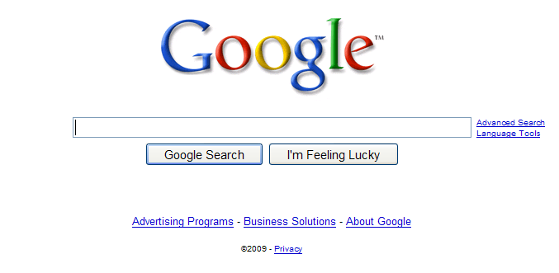
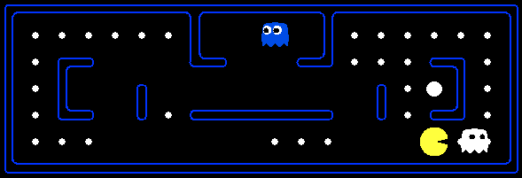
Later On…
Web Search
Decision Problems

Slide 6
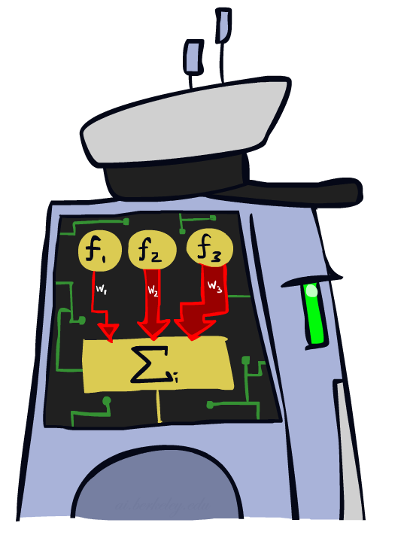
Linear Classifiers

Slide 7
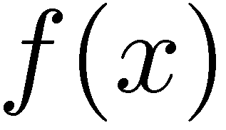

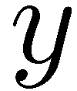

Feature Vectors
Hello,
Do you want free printr cartriges? Why pay more when you can get them ABSOLUTELY FREE! Just
# free : 2
YOUR_NAME : 0
MISSPELLED : 2
FROM_FRIEND : 0
...
SPAM
or
+
PIXEL-7,12 : 1
PIXEL-7,13 : 0
...
NUM_LOOPS : 1
...
“2”

Slide 8

Some (Simplified) Biology
Very loose inspiration: human neurons

Slide 9
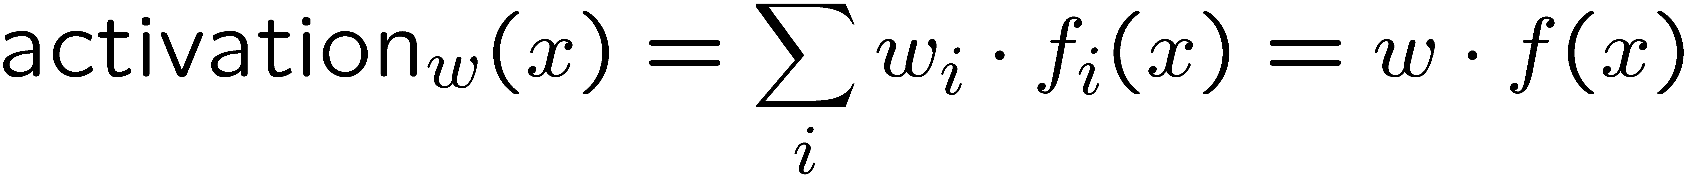
Linear Classifiers
Inputs are feature values
Each feature has a weight
Sum is the activation
If the activation is:
  Positive, output +1
  Negative, output -1
w₁
f₁
Σ
w₂
>0?
f₂
w₃
f₃

Slide 10

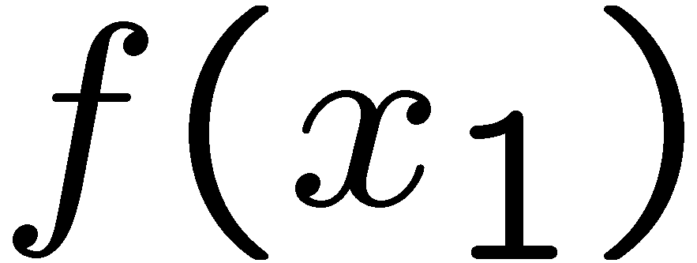
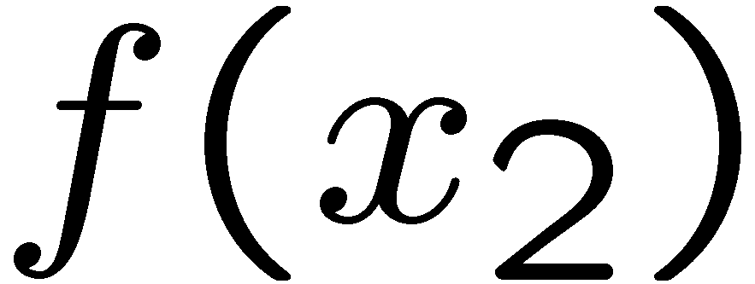
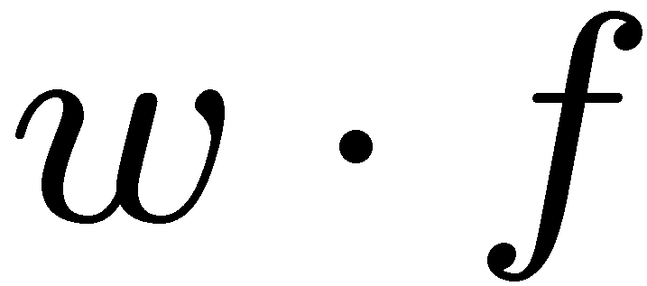
Weights
Binary case: compare features to a weight vector
Learning: figure out the weight vector from examples
# free : 4
YOUR_NAME :-1
MISSPELLED : 1
FROM_FRIEND :-3
...
# free : 2
YOUR_NAME : 0
MISSPELLED : 2
FROM_FRIEND : 0
...
# free : 0
YOUR_NAME : 1
MISSPELLED : 1
FROM_FRIEND : 1
...
Dot product positive means the positive class

Slide 11
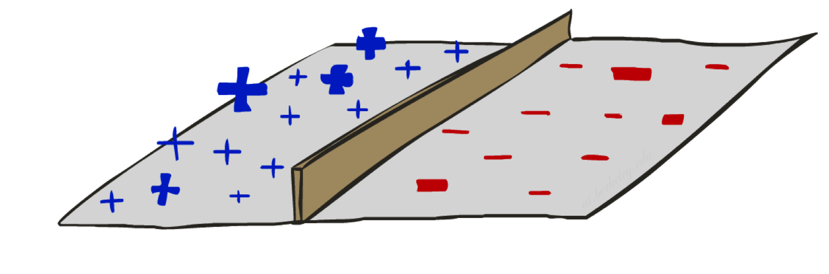
Decision Rules

Slide 12


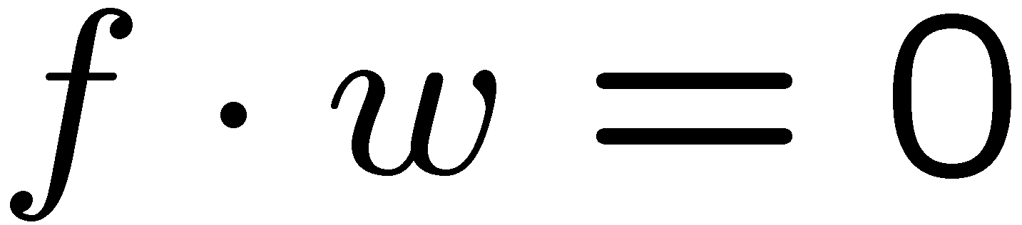
Binary Decision Rule
In the space of feature vectors
  Examples are points
  Any weight vector is a hyperplane
  One side corresponds to Y=+1
  Other corresponds to Y=-1
money
2
+1 = SPAM
1
BIAS : -3
free : 4
money : 2
...
0
-1 = HAM
0
1
free

Slide 13
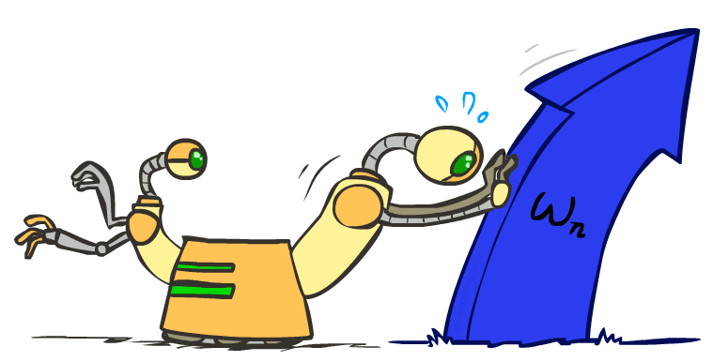
Weight Updates

Slide 14
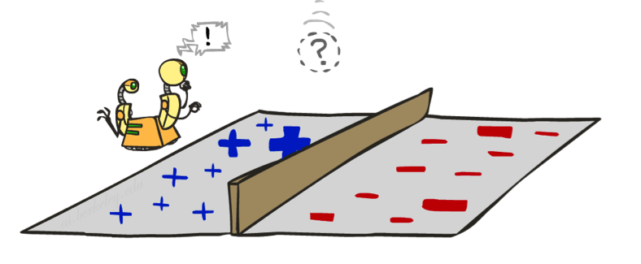
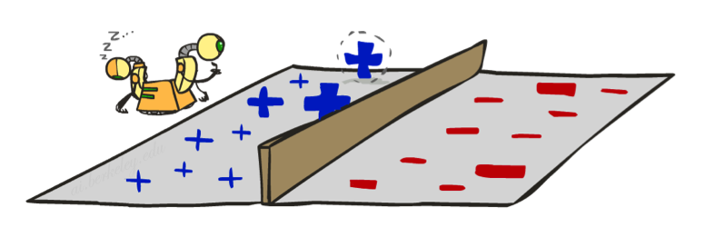
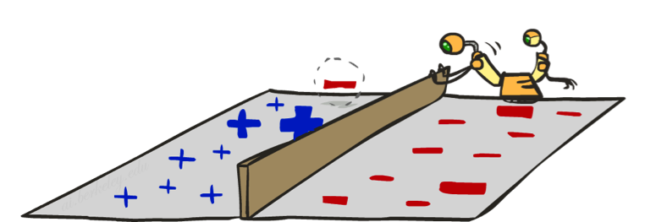
Learning: Binary Perceptron
Start with weights = 0
For each training instance:
  Classify with current weights
  If correct (i.e., y=y*), no change!
  If wrong: adjust the weight vector
Notes:
http://isl.ira.uka.de/neuralNetCourse/2004/VL_11_5/Perceptron.html

Slide 15
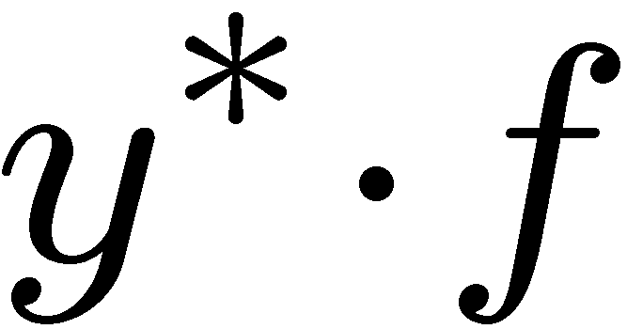
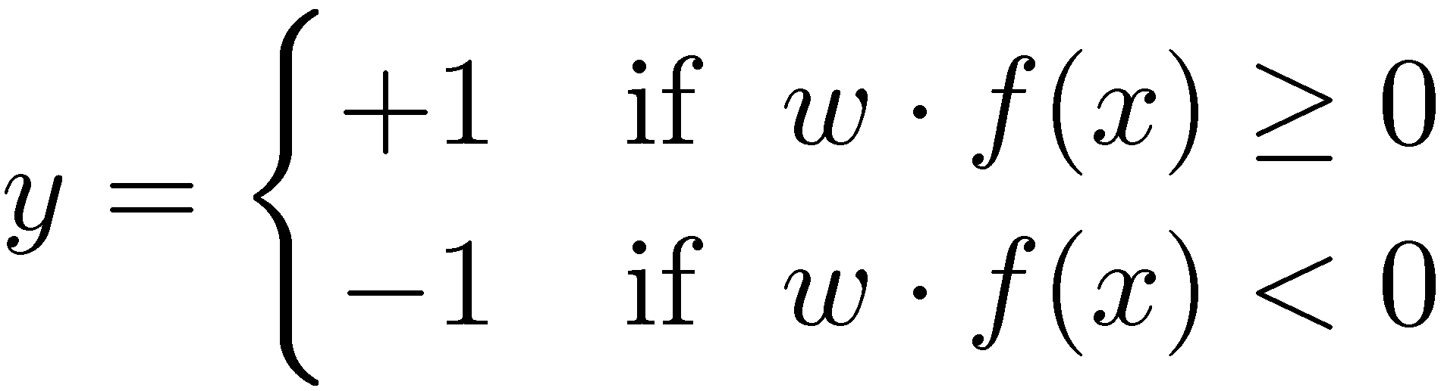

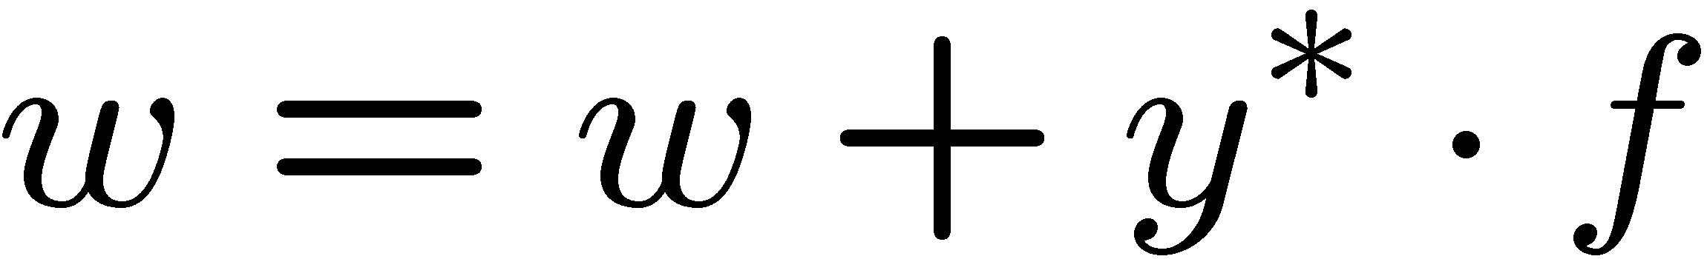
Learning: Binary Perceptron
Start with weights = 0
For each training instance:
  Classify with current weights
  If correct (i.e., y=y*), no change!
  If wrong: adjust the weight vector by adding or subtracting the feature vector. Subtract if y* is -1.
Notes:
http://isl.ira.uka.de/neuralNetCourse/2004/VL_11_5/Perceptron.html

Slide 16
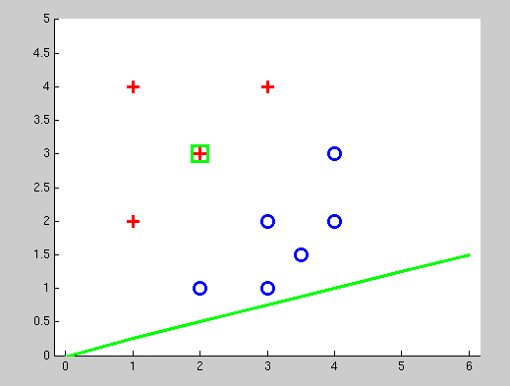
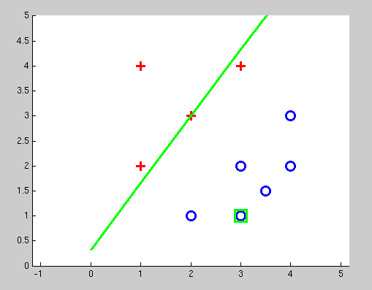
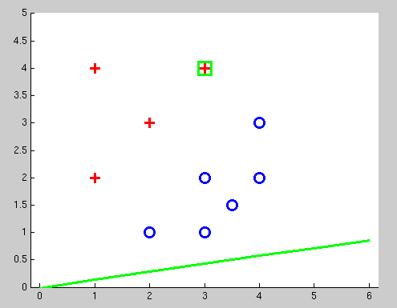
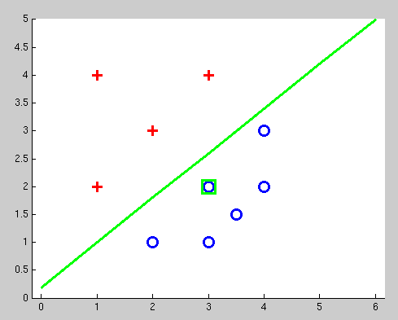
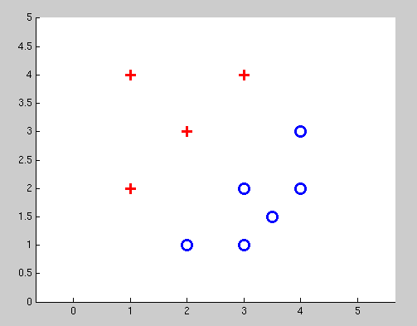
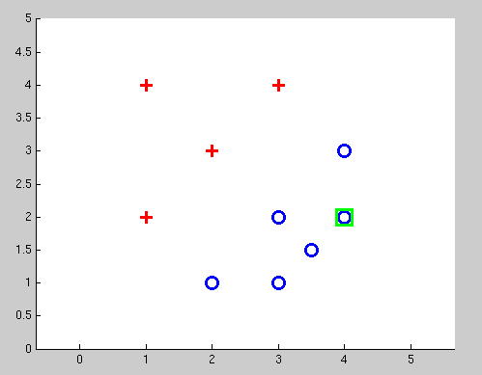
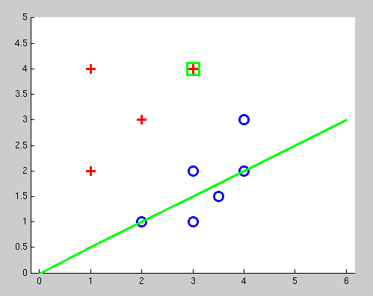
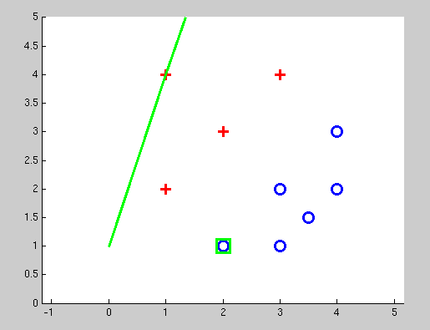
Examples: Perceptron
Separable Case

Slide 17
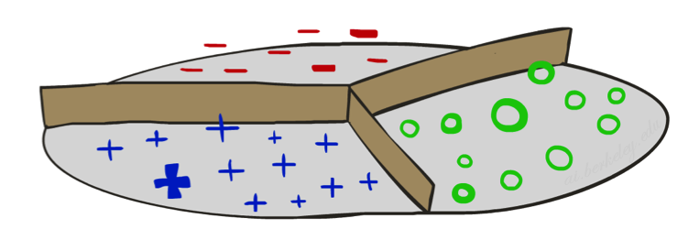


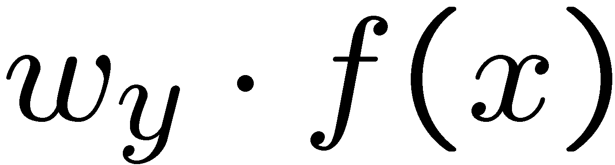


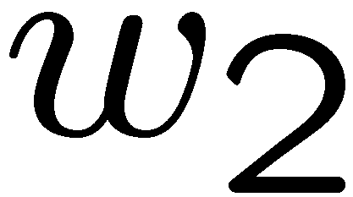
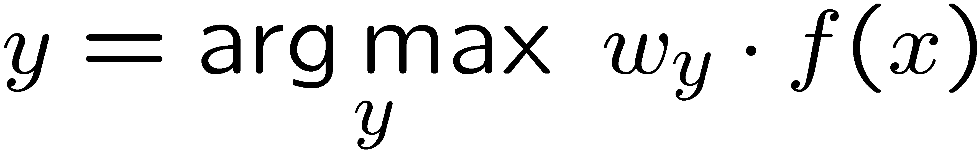
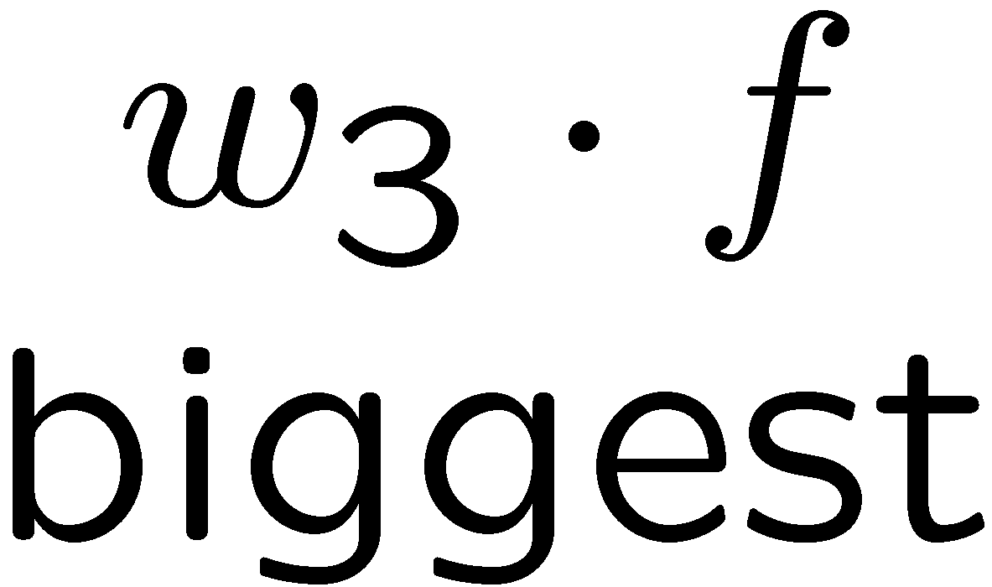
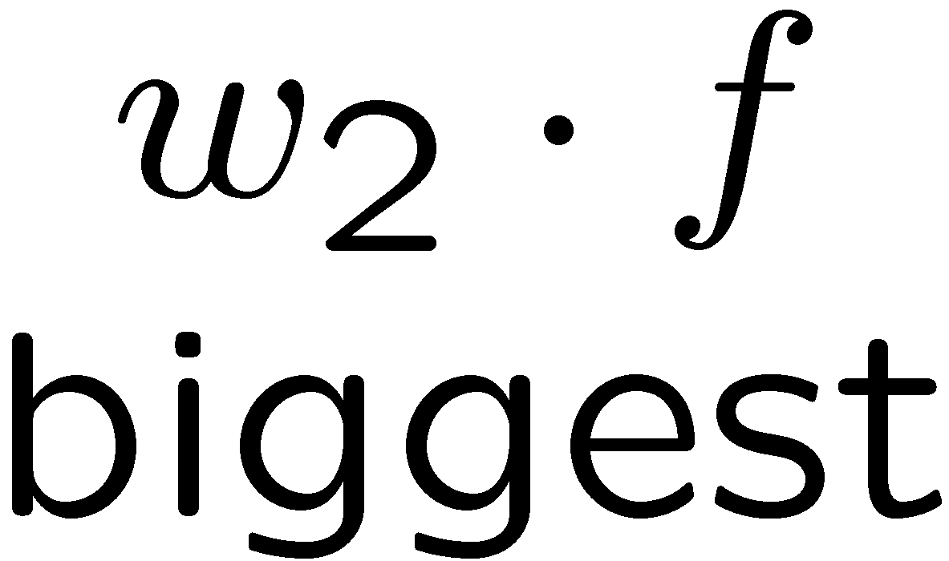
Multiclass Decision Rule
If we have multiple classes:
  A weight vector for each class:
  Score (activation) of a class y:
  Prediction highest score wins
Binary = multiclass where the negative class has weight zero

Slide 18

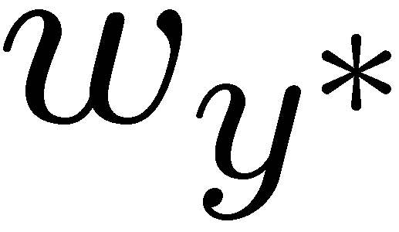

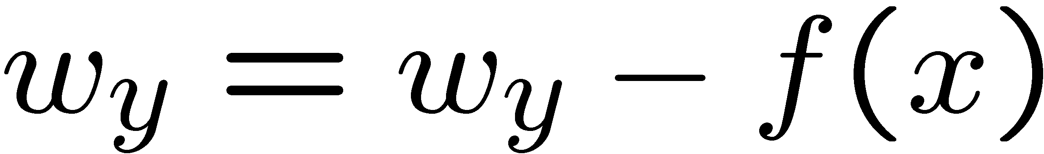
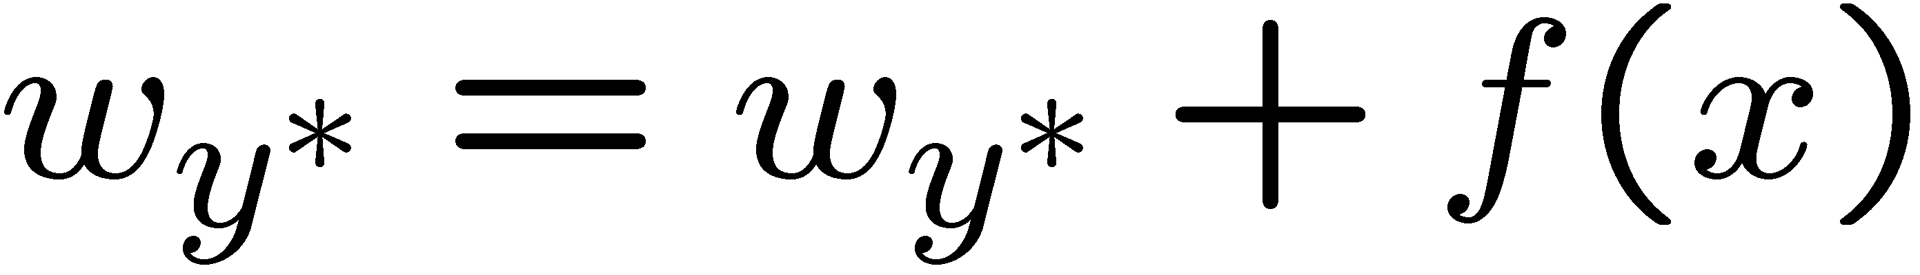
Learning: Multiclass Perceptron
Start with all weights = 0
Pick up training examples one by one
Predict with current weights
If correct, no change!
If wrong: lower score of wrong answer, raise score of right answer

Slide 19
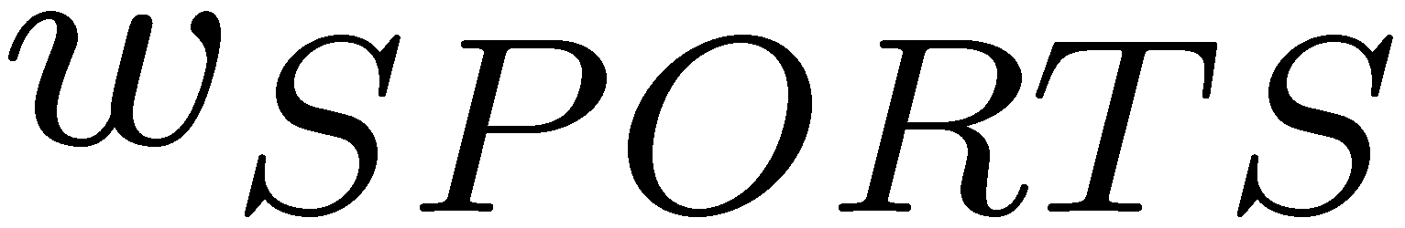


Example: Multiclass Perceptron
“win the vote”
“win the election”
“win the game”
BIAS : 1
win : 0
game : 0
vote : 0
the : 0
...
BIAS : 0
win : 0
game : 0
vote : 0
the : 0
...
BIAS : 0
win : 0
game : 0
vote : 0
the : 0
...

Slide 20
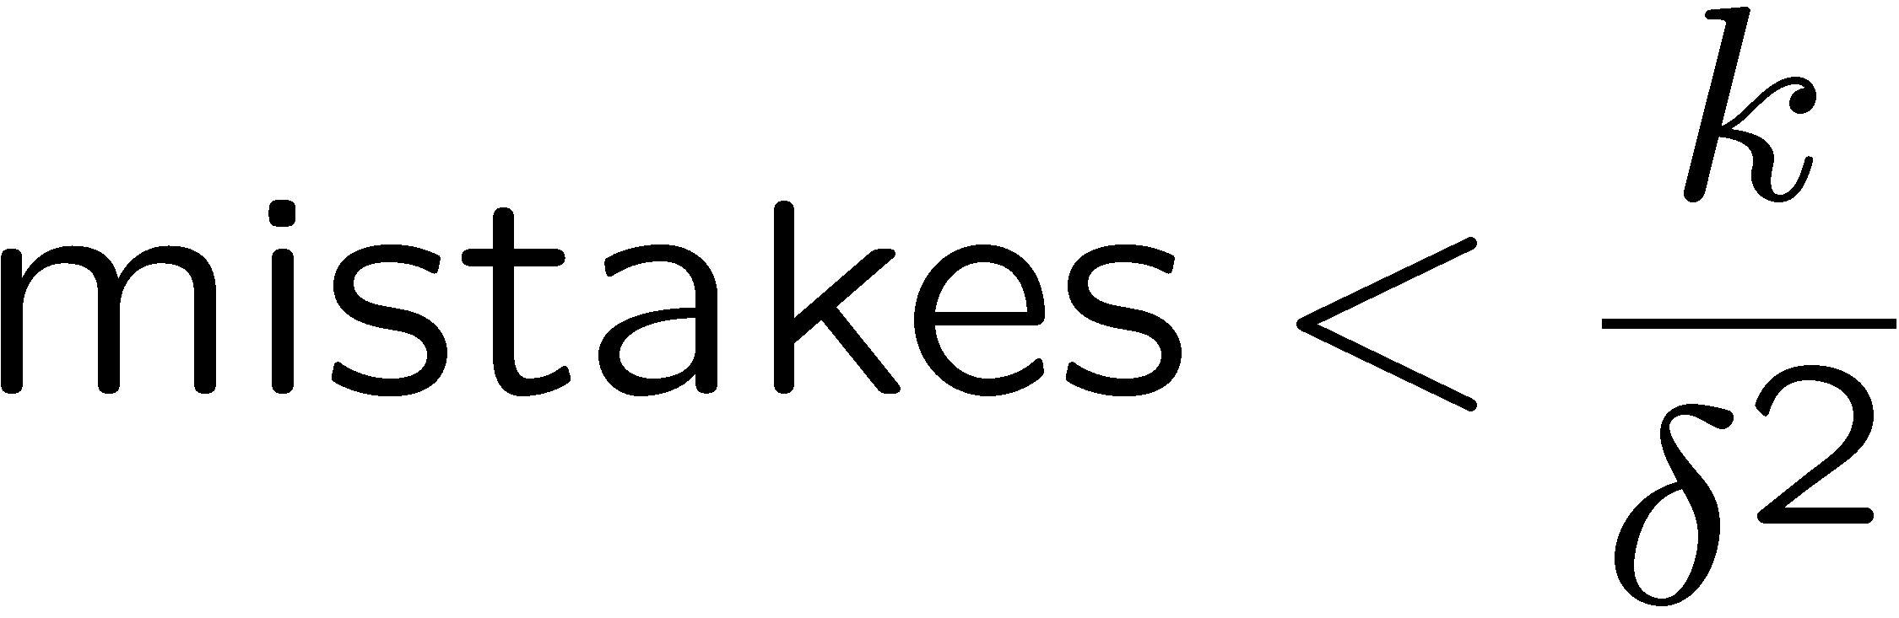
Properties of Perceptrons
Separable
Separability: true if some parameters get the training set perfectly correct
Convergence: if the training is separable, perceptron will eventually converge (binary case)
Mistake Bound: the maximum number of mistakes (binary case) related to the margin or degree of separability
Non-Separable

Slide 21
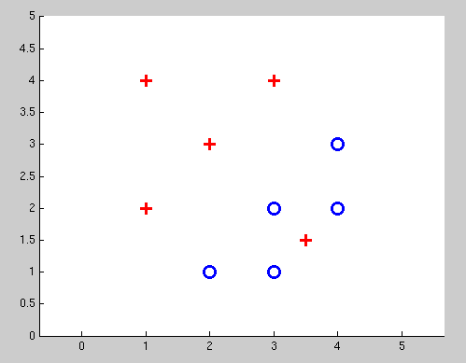
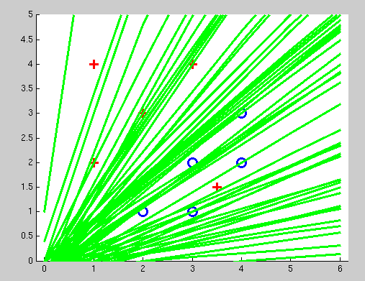
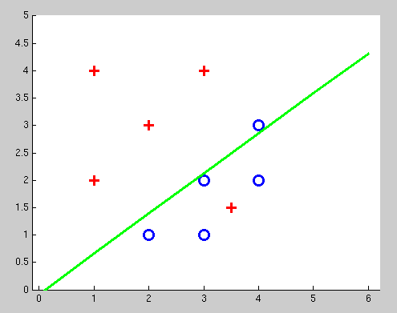
Examples: Perceptron
Non-Separable Case

Slide 22
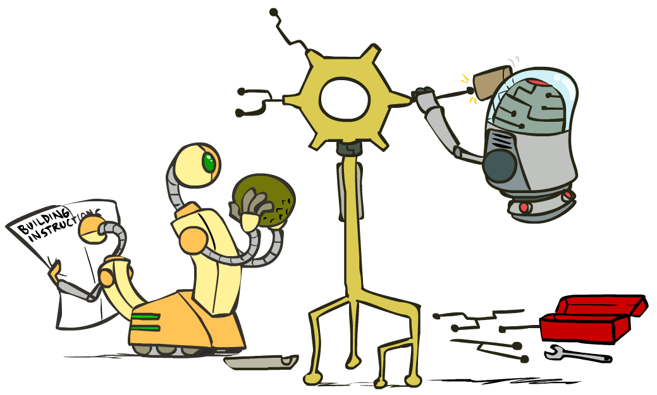
Improving the Perceptron

Slide 23
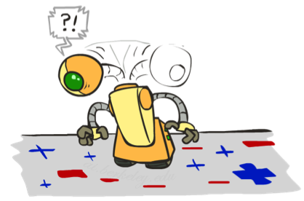
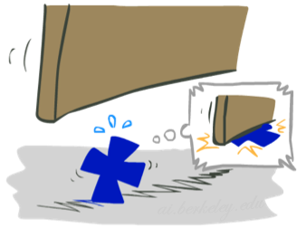

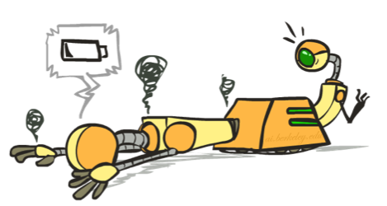




Problems with the Perceptron
Noise: if the data isn’t separable, weights might thrash
  Averaging weight vectors over time can help (averaged perceptron)
Mediocre generalization: finds a “barely” separating solution
Overtraining: test / held-out accuracy usually rises, then falls
  Overtraining is a kind of overfitting

Slide 24
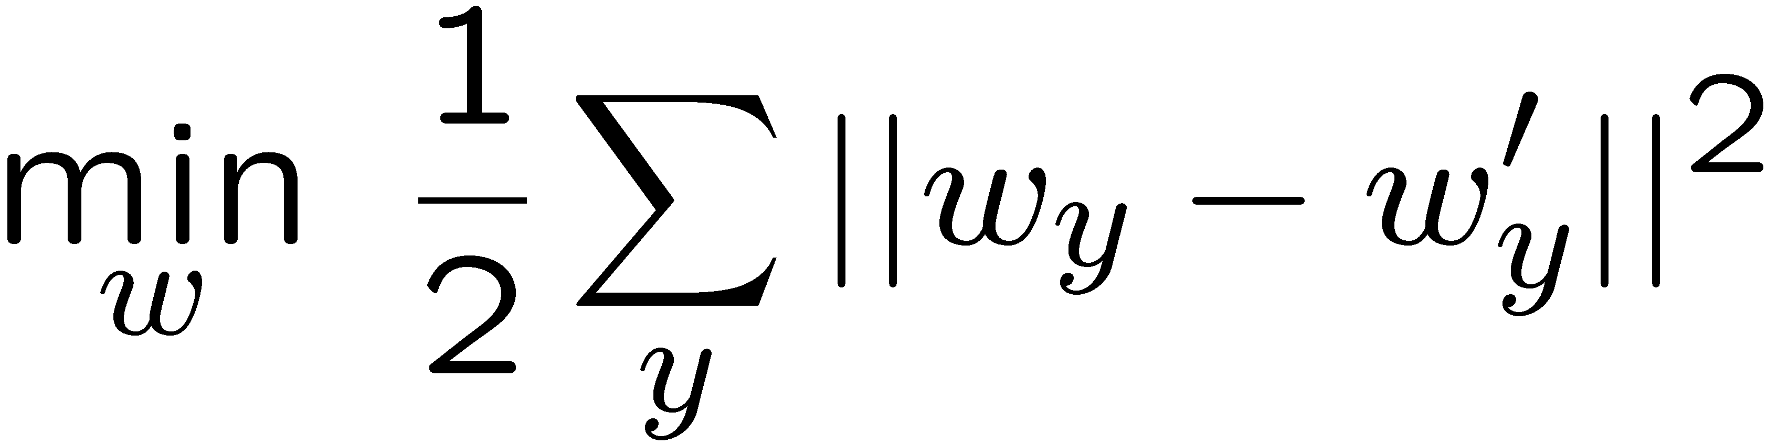
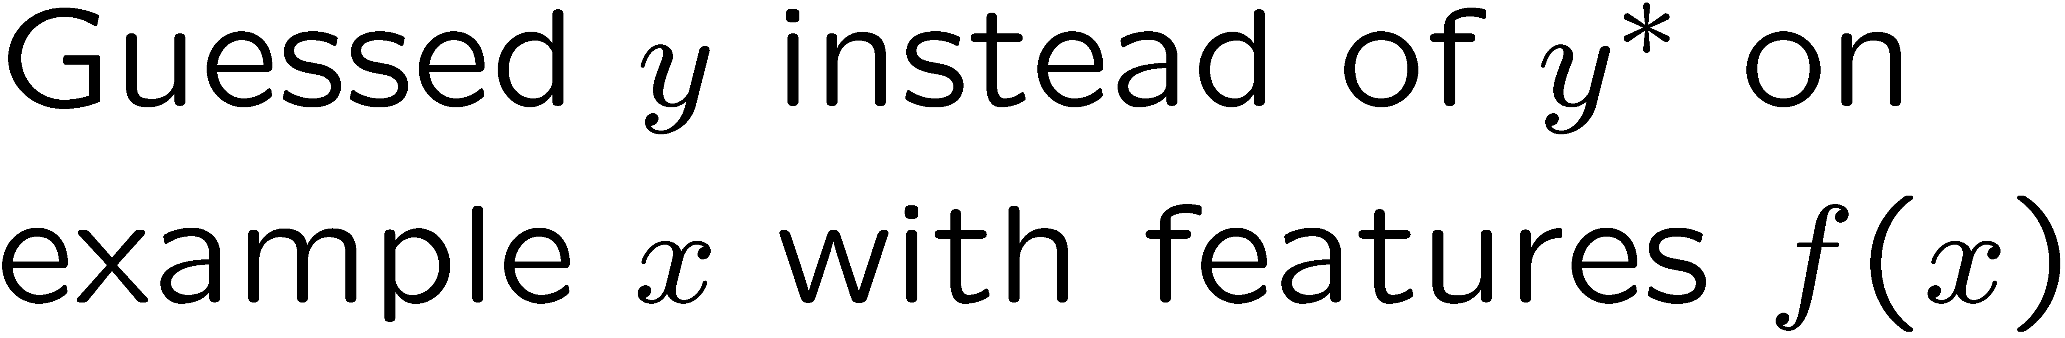
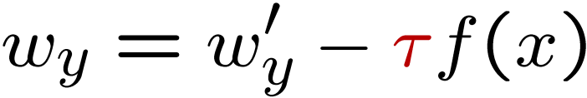
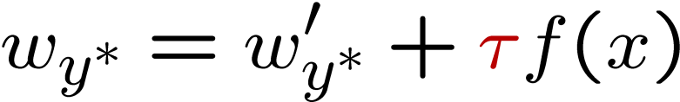
Fixing the Perceptron
Idea: adjust the weight update to mitigate these effects
MIRA*: choose an update size that fixes the current mistake…
… but, minimizes the change to w
The +1 helps to generalize
* Margin Infused Relaxed Algorithm

Slide 25





Minimum Correcting Update
min not τ=0, or would not have made an error, so min will be where equality holds

Slide 26




Maximum Step Size
In practice, it’s also bad to make updates that are too large
  Example may be labeled incorrectly
  You may not have enough features
  Solution: cap the maximum possible value of τ with some constant C
  Corresponds to an optimization that assumes non-separable data
  Usually converges faster than perceptron
  Usually better, especially on noisy data

Slide 27
Linear Separators
Which of these linear separators is optimal?

Slide 28


Support Vector Machines
Maximizing the margin: good according to intuition, theory, practice
Only support vectors matter; other training examples are ignorable
Support vector machines (SVMs) find the separator with max margin
Basically, SVMs are MIRA where you optimize over all examples at once
MIRA
SVM

Slide 29
Classification: Comparison
Naïve Bayes
  Builds a model training data
  Gives prediction probabilities
  Strong assumptions about feature independence
  One pass through data (counting)
Perceptrons / MIRA:
  Makes less assumptions about data
  Mistake-driven learning
  Multiple passes through data (prediction)
  Often more accurate

Slide 30

Web Search

Slide 31


Extension: Web Search
Information retrieval:
  Given information needs, produce information
  Includes, e.g. web search, question answering, and classic IR
Web search: not exactly classification, but rather ranking
x = “Apple Computers”

Slide 32
Feature-Based Ranking
x = “Apple Computer”
x,
x,

Slide 33








Perceptron for Ranking
Inputs
Candidates
Many feature vectors:
One weight vector:
  Prediction:
  Update (if wrong):

Slide 34

Apprenticeship

Slide 35


Pacman Apprenticeship!
Examples are states s
Candidates are pairs (s,a)
“Correct” actions: those taken by expert
Features defined over (s,a) pairs: f(s,a)
Score of a q-state (s,a) given by:
How is this VERY different from reinforcement learning?
“correct” action a*
[Demo: Pacman Apprentice (L22D1,2,3)]

Slide 36

Video of Demo Pacman Apprentice

Slide 37

CS 188: Artificial Intelligence
Kernels and Clustering
Instructors: Dan Klein and Pieter Abbeel --- University of California, Berkeley
[These slides were created by Dan Klein and Pieter Abbeel for CS188 Intro to AI at UC Berkeley. All CS188 materials are available at http://ai.berkeley.edu.]
Notes:
Please retain proper attribution, including the reference to ai.berkeley.edu. Thanks!

Slide 38

Case-Based Learning

Slide 39
Non-Separable Data

Slide 40


Case-Based Reasoning
Classification from similarity
  Case-based reasoning
  Predict an instance’s label using similar instances
Nearest-neighbor classification
  1-NN: copy the label of the most similar data point
  K-NN: vote the k nearest neighbors (need a weighting scheme)
  Key issue: how to define similarity
  Trade-offs: Small k gives relevant neighbors, Large k gives smoother functions
http://www.cs.cmu.edu/~zhuxj/courseproject/knndemo/KNN.html

Slide 41





Parametric / Non-Parametric
Parametric models:
  Fixed set of parameters
  More data means better settings
Non-parametric models:
  Complexity of the classifier increases with data
  Better in the limit, often worse in the non-limit
(K)NN is non-parametric
Truth
2 Examples
10 Examples
100 Examples
10000 Examples

Slide 42






Nearest-Neighbor Classification
Nearest neighbor for digits:
  Take new image
  Compare to all training images
  Assign based on closest example
Encoding: image is vector of intensities:
What’s the similarity function?
  Dot product of two images vectors?
  Usually normalize vectors so ||x|| = 1
  min = 0 (when?), max = 1 (when?)
0
1
2
0
1
2

Slide 43

Similarity Functions

Slide 44

Basic Similarity
Many similarities based on feature dot products:
If features are just the pixels:
Note: not all similarities are of this form

Slide 45


Invariant Metrics
Better similarity functions use knowledge about vision
Example: invariant metrics:
  Similarities are invariant under certain transformations
  Rotation, scaling, translation, stroke-thickness…
  E.g:
    16 x 16 = 256 pixels; a point in 256-dim space
    These points have small similarity in R²⁵⁶ (why?)
  How can we incorporate such invariances into our similarities?
This and next few slides adapted from Xiao Hu, UIUC

Slide 46



Rotation Invariant Metrics
Each example is now a curve in R²⁵⁶
Rotation invariant similarity:
s’=max s( r( ), r( ))
E.g. highest similarity between images’ rotation lines

Slide 47

Tangent Families
Problems with s’:
  Hard to compute
  Allows large transformations (e.g. 6 → 9)
Tangent distance:
  1st order approximation at original points.
    Easy to compute
    Models small rotations

Slide 48


Template Deformation
Deformable templates:
  An “ideal” version of each category
  Best-fit to image using min variance
  Cost for high distortion of template
  Cost for image points being far from distorted template
Used in many commercial digit recognizers
Examples from [Hastie 94]

Slide 49
A Tale of Two Approaches…
Nearest neighbor-like approaches
  Can use fancy similarity functions
  Don’t actually get to do explicit learning
Perceptron-like approaches
  Explicit training to reduce empirical error
  Can’t use fancy similarity, only linear
  Or can they? Let’s find out!

Slide 50

Kernelization

Slide 51

Perceptron Weights
What is the final value of a weight w_{y} of a perceptron?
  Can it be any real vector?
  No! It’s built by adding up inputs.
Can reconstruct weight vectors (the primal representation) from update counts (the dual representation)

Slide 52



Dual Perceptron
How to classify a new example x?
If someone tells us the value of K for each pair of examples, never need to build the weight vectors (or the feature vectors)!

Slide 53


Dual Perceptron
Start with zero counts (alpha)
Pick up training instances one by one
Try to classify x_{n},
If correct, no change!
If wrong: lower count of wrong class (for this instance), raise count of right class (for this instance)

Slide 54

Kernelized Perceptron
If we had a black box (kernel) K that told us the dot product of two examples x and x’:
  Could work entirely with the dual representation
  No need to ever take dot products (“kernel trick”)
Like nearest neighbor – work with black-box similarities
Downside: slow if many examples get nonzero alpha

Slide 55



Kernelized Perceptron Structure

Slide 56
Kernels: Who Cares?
So far: a very strange way of doing a very simple calculation
“Kernel trick”: we can substitute any* similarity function in place of the dot product
Lets us learn new kinds of hypotheses
* Fine print: if your kernel doesn’t satisfy certain technical requirements, lots of proofs break. E.g. convergence, mistake bounds. In practice, illegal kernels sometimes work (but not always).

Slide 57

Non-Linearity

Slide 58
Non-Linear Separators
Data that is linearly separable works out great for linear decision rules:
But what are we going to do if the dataset is just too hard?
How about… mapping data to a higher-dimensional space:
0
x
0
x
x²
0
x
This and next few slides adapted from Ray Mooney, UT

Slide 59
Non-Linear Separators
General idea: the original feature space can always be mapped to some higher-dimensional feature space where the training set is separable:
Φ: x → φ(x)

Slide 60



Some Kernels
Kernels implicitly map original vectors to higher dimensional spaces, take the dot product there, and hand the result back
Linear kernel:
Quadratic kernel:
RBF: infinite dimensional representation
Discrete kernels: e.g. string kernels

Slide 61
Why Kernels?
Can’t you just add these features on your own (e.g. add all pairs of features instead of using the quadratic kernel)?
  Yes, in principle, just compute them
  No need to modify any algorithms
  But, number of features can get large (or infinite)
  Some kernels not as usefully thought of in their expanded representation, e.g. RBF kernels
Kernels let us compute with these features implicitly
  Example: implicit dot product in quadratic kernel takes much less space and time per dot product
  Of course, there’s the cost for using the pure dual algorithms: you need to compute the similarity to every training datum

Slide 62

Recap: Classification
Classification systems:
  Supervised learning
  Make a prediction given evidence
  We’ve seen several methods for this
  Useful when you have labeled data

Slide 63

Clustering
Clustering systems:
  Unsupervised learning
  Detect patterns in unlabeled data
    E.g. group emails or search results
    E.g. find categories of customers
    E.g. detect anomalous program executions
  Useful when don’t know what you’re looking for
  Requires data, but no labels
  Often get gibberish

Slide 64

Clustering

Slide 65

Clustering
Basic idea: group together similar instances
Example: 2D point patterns
What could “similar” mean?
  One option: small (squared) Euclidean distance

Slide 66

K-Means

Slide 67

K-Means
An iterative clustering algorithm
  Pick K random points as cluster centers (means)
  Alternate:
    Assign data instances to closest mean
    Assign each mean to the average of its assigned points
  Stop when no points’ assignments change

Slide 68










K-Means Example

Slide 69

Segmentation as clustering
Depending on what we choose as the feature space, we can group pixels in different ways.
Grouping pixels based on intensity similarity
Feature space: intensity value (1-d)
Kristen Grauman
Notes:
69

Slide 70


K=2
K=3
quantization of the feature space; segmentation label map
Kristen Grauman

Slide 71

Segmentation as clustering
Depending on what we choose as the feature space, we can group pixels in different ways.
R=255
G=200
B=250
Grouping pixels based on color similarity
B
R=245
G=220
B=248
G
R=15
G=189
B=2
R=3
G=12
B=2
R
Feature space: color value (3-d)
Kristen Grauman
Notes:
71

Slide 72


K-Means as Optimization
Consider the total distance to the means:
Each iteration reduces phi
Two stages each iteration:
  Update assignments: fix means c, change assignments a
  Update means: fix assignments a, change means c
points
means
assignments

Slide 73




Phase I: Update Assignments
For each point, re-assign to closest mean:
Can only decrease total distance phi!

Slide 74


Phase II: Update Means
Move each mean to the average of its assigned points:
Also can only decrease total distance… (Why?)
Fun fact: the point y with minimum squared Euclidean distance to a set of points {x} is their mean

Slide 75

Initialization
K-means is non-deterministic
  Requires initial means
  It does matter what you pick!
  What can go wrong?
  Various schemes for preventing this kind of thing: variance-based split / merge, initialization heuristics

Slide 76

K-Means Getting Stuck
A local optimum:
Why doesn’t this work out like the earlier example, with the purple taking over half the blue?

Slide 77

K-Means Questions
Will K-means converge?
  To a global optimum?
Will it always find the true patterns in the data?
  If the patterns are very very clear?
Will it find something interesting?
Do people ever use it?
How many clusters to pick?

Slide 78




Example: K-means for feature quantization
Image 1
Image 2
Detecting local features
Kristen Grauman

Slide 79
Example: K-means for feature quantization
Map high-dimensional descriptors to “visual words” by quantizing the feature space
Patch descriptor feature space
Kristen Grauman

Slide 80

Example: K-means for feature quantization
Example visual words: each group of patches belongs to the same visual word
Kristen Grauman
Figure from Sivic & Zisserman, ICCV 2003

Slide 81

Agglomerative Clustering

Slide 82
Agglomerative Clustering
Agglomerative clustering:
  First merge very similar instances
  Incrementally build larger clusters out of smaller clusters
Algorithm:
  Maintain a set of clusters
  Initially, each instance in its own cluster
  Repeat:
    Pick the two closest clusters
    Merge them into a new cluster
    Stop when there’s only one cluster left
Produces not one clustering, but a family of clusterings represented by a dendrogram

Slide 83
Agglomerative Clustering
How should we define “closest” for clusters with multiple elements?
Many options
  Closest pair (single-link clustering)
  Farthest pair (complete-link clustering)
  Average of all pairs
  Ward’s method (min variance, like k-means)
Different choices create different clustering behaviors

Slide 84

Example: Google News
Top-level categories: supervised classification
Story groupings:
unsupervised clustering

Slide 85
Example: K-Means
[web demo]
  http://www.cs.washington.edu/research/imagedatabase/demo/kmcluster/

