Slide 1
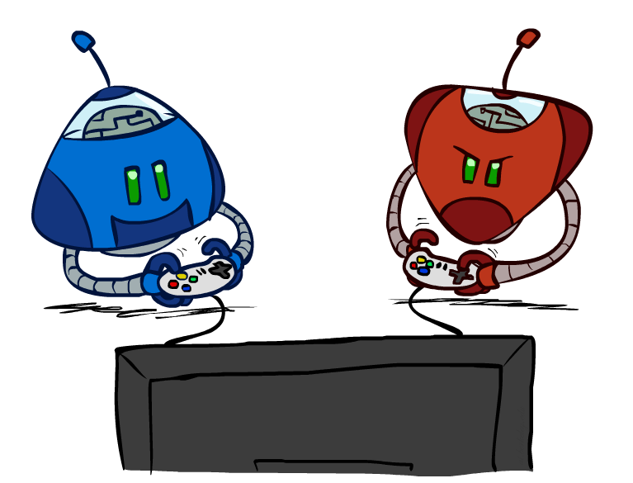
CS 188: Artificial Intelligence
Adversarial Search
Instructors: Dan Klein and Pieter Abbeel
University of California, Berkeley
[These slides were created by Dan Klein and Pieter Abbeel for CS188 Intro to AI at UC Berkeley. All CS188 materials are available at http://ai.berkeley.edu.]
Notes:
Please retain proper attribution, including the reference to ai.berkeley.edu. Thanks!

Slide 2
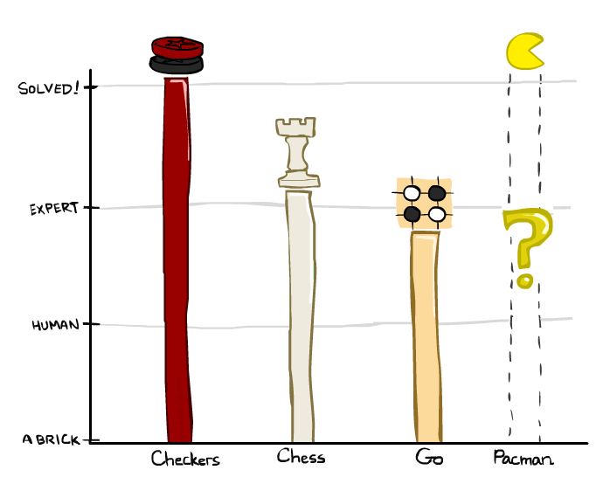
Game Playing State-of-the-Art
Checkers: 1950: First computer player. 1994: First computer champion: Chinook ended 40-year-reign of human champion Marion Tinsley using complete 8-piece endgame. 2007: Checkers solved!
Chess: 1997: Deep Blue defeats human champion Gary Kasparov in a six-game match. Deep Blue examined 200M positions per second, used very sophisticated evaluation and undisclosed methods for extending some lines of search up to 40 ply. Current programs are even better, if less historic.
Go: Human champions are now starting to be challenged by machines, though the best humans still beat the best machines. In go, b > 300! Classic programs use pattern knowledge bases, but big recent advances use Monte Carlo (randomized) expansion methods.
Pacman

Slide 3
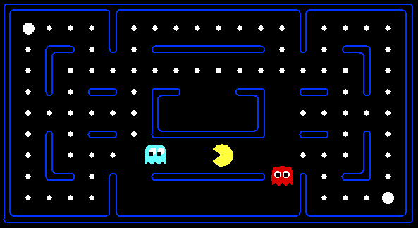
Behavior from Computation
[Demo: mystery pacman (L6D1)]

Slide 4

Video of Demo Mystery Pacman

Slide 5
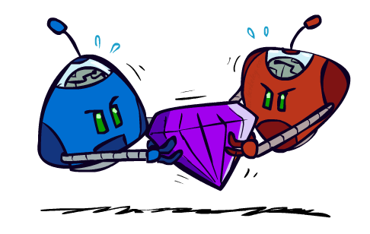
Adversarial Games

Slide 6
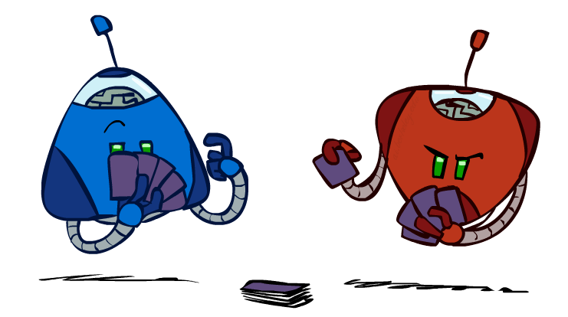
Types of Games
Many different kinds of games!
Axes:
  Deterministic or stochastic?
  One, two, or more players?
  Zero sum?
  Perfect information (can you see the state)?
Want algorithms for calculating a strategy (policy) which recommends a move from each state

Slide 7
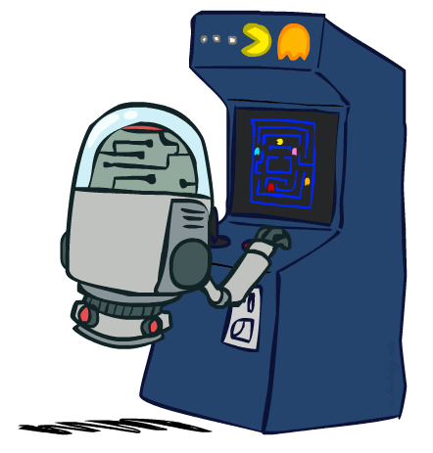
Deterministic Games
Many possible formalizations, one is:
  States: S (start at s₀)
  Players: P={1...N} (usually take turns)
  Actions: A (may depend on player / state)
  Transition Function: SxA → S
  Terminal Test: S → {t,f}
  Terminal Utilities: SxP → R
Solution for a player is a policy: S → A

Slide 8
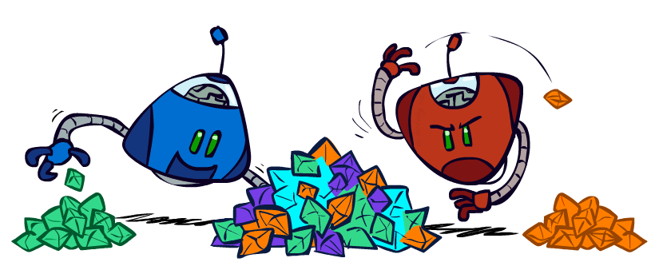
Zero-Sum Games
Zero-Sum Games
  Agents have opposite utilities (values on outcomes)
  Lets us think of a single value that one maximizes and the other minimizes
  Adversarial, pure competition
General Games
  Agents have independent utilities (values on outcomes)
  Cooperation, indifference, competition, and more are all possible
  More later on non-zero-sum games

Slide 9
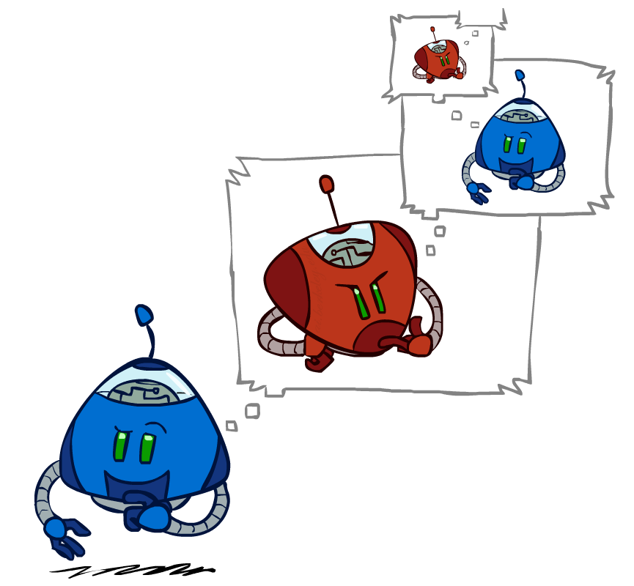
Adversarial Search

Slide 10
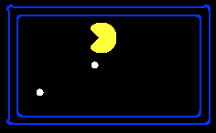
Single-Agent Trees
8
2
0
…
2
6
…
4
6

Slide 11
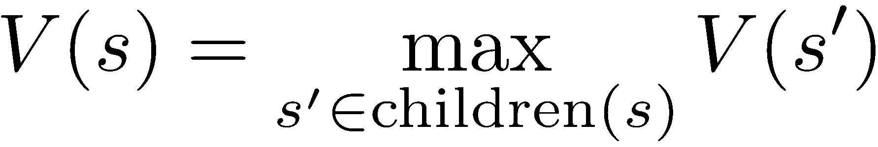
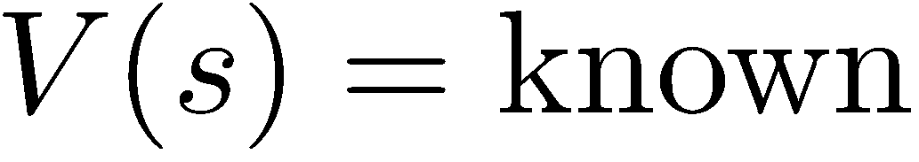
Value of a State
Value of a state: The best achievable outcome (utility) from that state
Non-Terminal States:
8
2
0
…
2
6
…
4
6
Terminal States:

Slide 12

Adversarial Game Trees
-20
-8
…
-18
-5
…
-10
+4
-20
+8

Slide 13
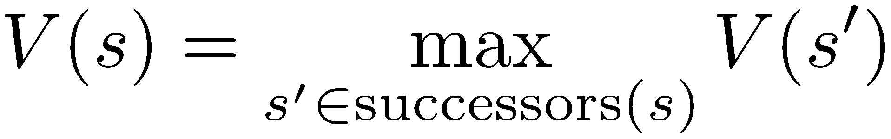
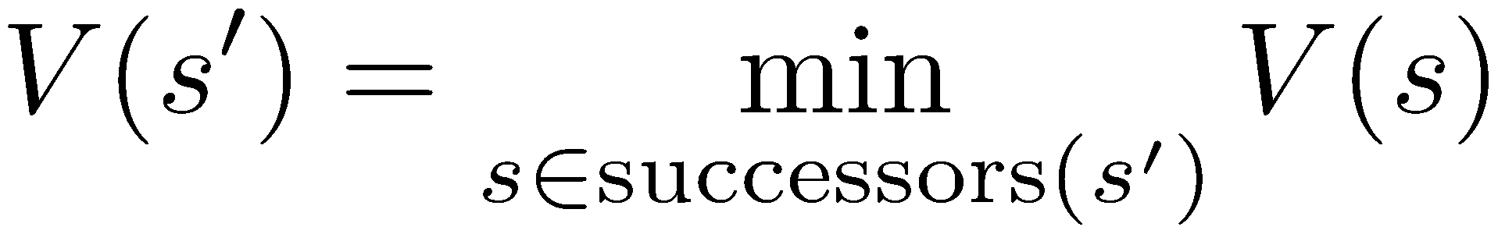
Minimax Values
States Under Agent’s Control:
States Under Opponent’s Control:
-8
-5
-10
+8
Terminal States:

Slide 14

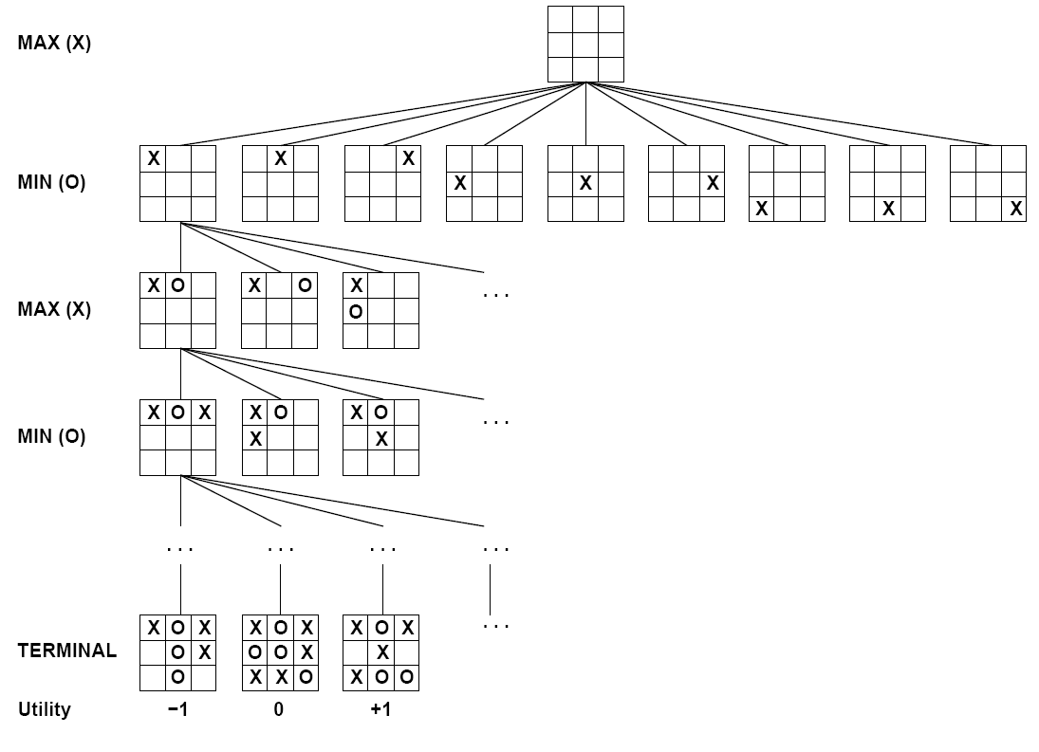

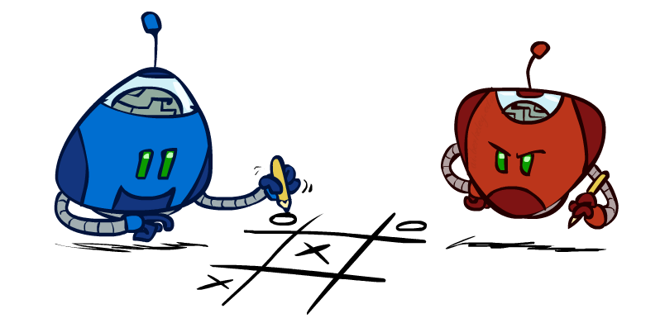
Tic-Tac-Toe Game Tree

Slide 15
Adversarial Search (Minimax)
Deterministic, zero-sum games:
  Tic-tac-toe, chess, checkers
  One player maximizes result
  The other minimizes result
Minimax search:
  A state-space search tree
  Players alternate turns
  Compute each node’s minimax value: the best achievable utility against a rational (optimal) adversary
Minimax values:
computed recursively
5
max
2
5
min
8
2
5
6
Terminal values:
part of the game

Slide 16
Minimax Implementation
def max-value(state):
  initialize v = -∞
  for each successor of state:
    v = max(v, min-value(successor))
  return v
def min-value(state):
  initialize v = +∞
  for each successor of state:
    v = min(v, max-value(successor))
  return v

Slide 17
Minimax Implementation (Dispatch)
def value(state):
  if the state is a terminal state: return the state’s utility
  if the next agent is MAX: return max-value(state)
  if the next agent is MIN: return min-value(state)
def max-value(state):
  initialize v = -∞
  for each successor of state:
    v = max(v, value(successor))
  return v
def min-value(state):
  initialize v = +∞
  for each successor of state:
    v = min(v, value(successor))
  return v
Notes:
Pick an order for two reasons: sequential processor and pruning

Slide 18
Minimax Example
3
12
8
2
4
6
14
5
2

Slide 19
Minimax Efficiency
How efficient is minimax?
  Just like (exhaustive) DFS
  Time: O(b^{m})
  Space: O(bm)
Example: For chess, b ≈ 35, m ≈ 100
  Exact solution is completely infeasible
  But, do we need to explore the whole tree?

Slide 20
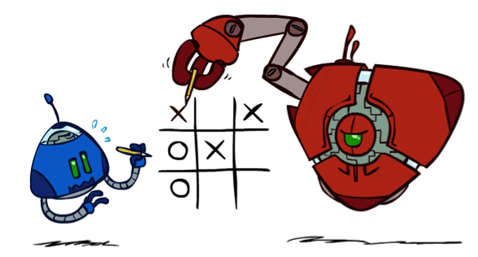
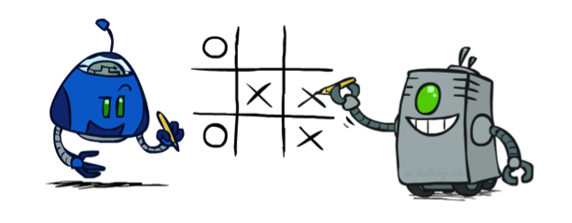
Minimax Properties
max
min
10
10
9
100
Optimal against a perfect player. Otherwise?
[Demo: min vs exp (L6D2, L6D3)]

Slide 21
Video of Demo Min vs. Exp (Min)

Slide 22
Video of Demo Min vs. Exp (Exp)

Slide 23

Resource Limits

Slide 24
Resource Limits
Problem: In realistic games, cannot search to leaves!
Solution: Depth-limited search
  Instead, search only to a limited depth in the tree
  Replace terminal utilities with an evaluation function for non-terminal positions
Example:
  Suppose we have 100 seconds, can explore 10K nodes / sec
  So can check 1M nodes per move
  α-β reaches about depth 8 – decent chess program
Guarantee of optimal play is gone
More plies makes a BIG difference
Use iterative deepening for an anytime algorithm
max
4
-2
4
min
-1
-2
4
9
?
?
?
?

Slide 25
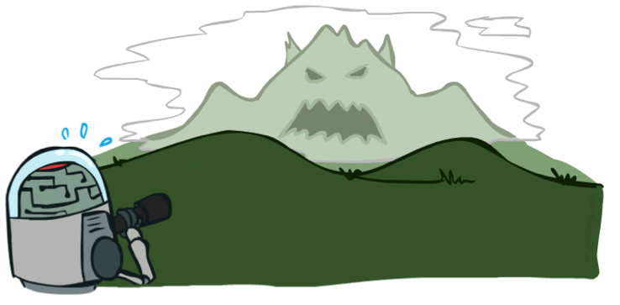

Depth Matters
Evaluation functions are always imperfect
The deeper in the tree the evaluation function is buried, the less the quality of the evaluation function matters
An important example of the tradeoff between complexity of features and complexity of computation
[Demo: depth limited (L6D4, L6D5)]

Slide 26
Video of Demo Limited Depth (2)

Slide 27
Video of Demo Limited Depth (10)

Slide 28
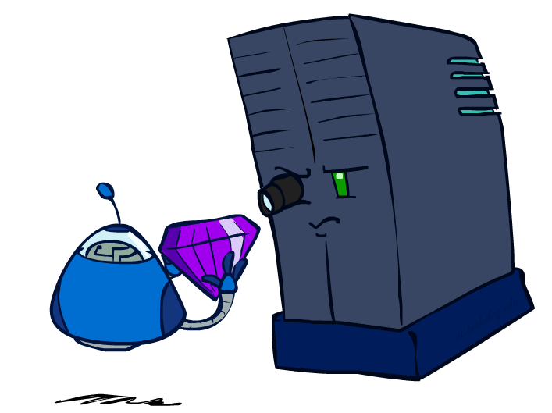
Evaluation Functions

Slide 29
Evaluation Functions
Evaluation functions score non-terminals in depth-limited search
Ideal function: returns the actual minimax value of the position
In practice: typically weighted linear sum of features:
e.g. f₁(s) = (num white queens – num black queens), etc.

Slide 30




Evaluation for Pacman
[Demo: thrashing d=2, thrashing d=2 (fixed evaluation function), smart ghosts coordinate (L6D6,7,8,10)]

Slide 31
Video of Demo Thrashing (d=2)

Slide 32
Why Pacman Starves
A danger of replanning agents!
  He knows his score will go up by eating the dot now (west, east)
  He knows his score will go up just as much by eating the dot later (east, west)
  There are no point-scoring opportunities after eating the dot (within the horizon, two here)
  Therefore, waiting seems just as good as eating: he may go east, then back west in the next round of replanning!

Slide 33
Video of Demo Thrashing -- Fixed (d=2)

Slide 34
Video of Demo Smart Ghosts (Coordination)

Slide 35
Video of Demo Smart Ghosts (Coordination) – Zoomed In

Slide 36
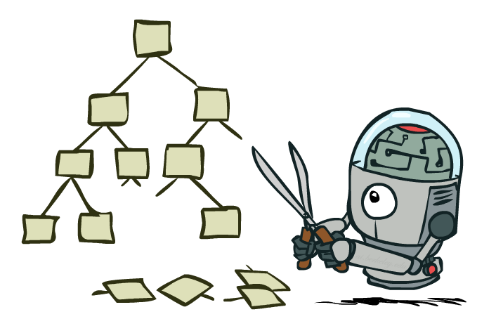
Game Tree Pruning

Slide 37
Minimax Example
3
12
8
2
4
6
14
5
2

Slide 38
Minimax Pruning
3
12
8
2
14
5
2

Slide 39
Alpha-Beta Pruning
General configuration (MIN version)
  We’re computing the MIN-VALUE at some node n
  We’re looping over n’s children
  n’s estimate of the childrens’ min is dropping
  Who cares about n’s value? MAX
  Let a be the best value that MAX can get at any choice point along the current path from the root
  If n becomes worse than a, MAX will avoid it, so we can stop considering n’s other children (it’s already bad enough that it won’t be played)
MAX version is symmetric
MAX
MIN
a
MAX
MIN
n

Slide 40
Alpha-Beta Implementation
  α: MAX’s best option on path to root
  β: MIN’s best option on path to root
def max-value(state, α, β):
  initialize v = -∞
  for each successor of state:
    v = max(v, value(successor, α, β))
    if v ≥ β return v
    α = max(α, v)
  return v
def min-value(state , α, β):
  initialize v = +∞
  for each successor of state:
    v = min(v, value(successor, α, β))
    if v ≤ α return v
    β = min(β, v)
  return v
Notes:
Pick an order for two reasons: sequential processor and pruning

Slide 41
Alpha-Beta Pruning Example
3
3
≤2
≤1
3
12
2
14
5
1
a is MAX’s best alternative here or above
b is MIN’s best alternative here or above
≥8
8

Slide 42
Alpha-Beta Pruning Properties
This pruning has no effect on minimax value computed for the root!
Values of intermediate nodes might be wrong
  Important: children of the root may have the wrong value
  So the most naïve version won’t let you do action selection
Good child ordering improves effectiveness of pruning
With “perfect ordering”:
  Time complexity drops to O(b^{m/2})
  Doubles solvable depth!
  Full search of, e.g. chess, is still hopeless…
This is a simple example of metareasoning (computing about what to compute)
max
min
10
10
0

Slide 43
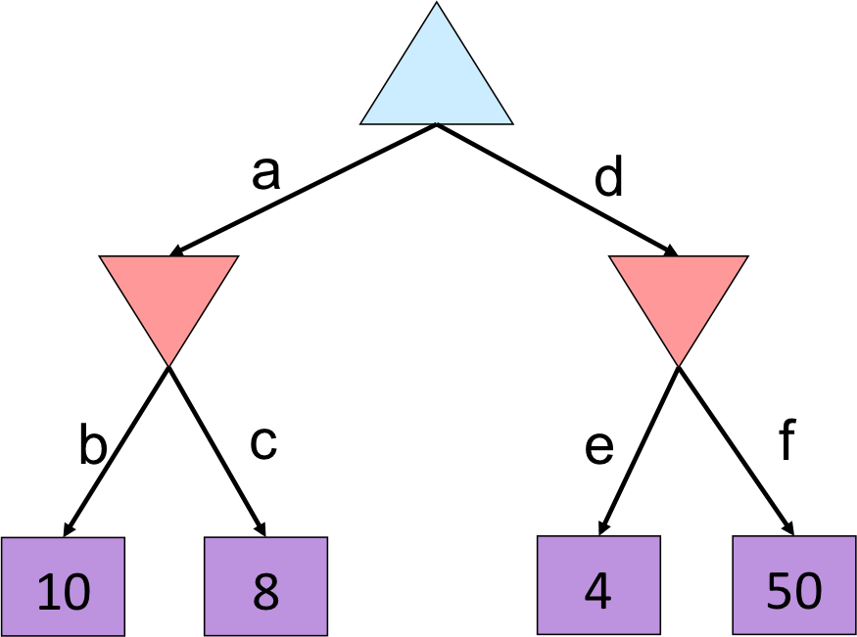
Quiz: alpha-beta pruning (1)

Slide 44
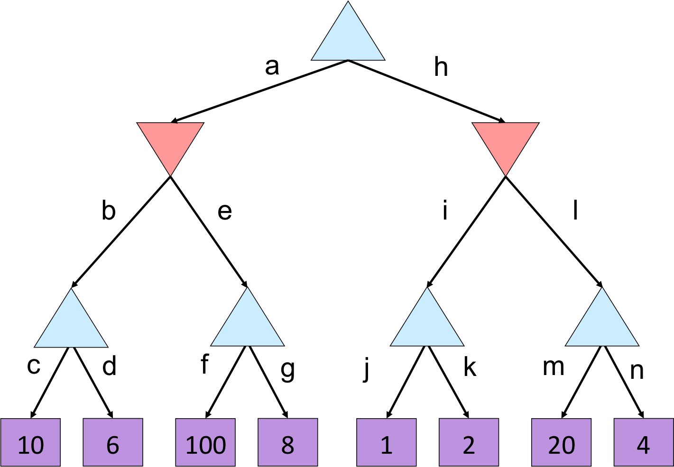
Quiz: alpha-beta pruning (2)

Slide 45
Quiz: alpha-beta pruning
10
10
<= 2
10
>=100
2

Slide 46
Next time: Uncertainty!
What if some other agents are not necessarily adversaries?
  Indifferent to you – e.g., a roll of a die
  Inept adversary that makes mistakes
Where do the terminal utilities come from?

Slide 47
Iterative Deepening
Iterative deepening uses DFS as a subroutine:
Do a DFS which only searches for paths of length 1 or less. (DFS gives up on any path of length 2)
If “1” failed, do a DFS which only searches paths of length 2 or less.
If “2” failed, do a DFS which only searches paths of length 3 or less.
….and so on.
Why do we want to do this for multiplayer games?
Note: wrongness of eval functions matters less and less the deeper the search goes!
b
…

Slide 48
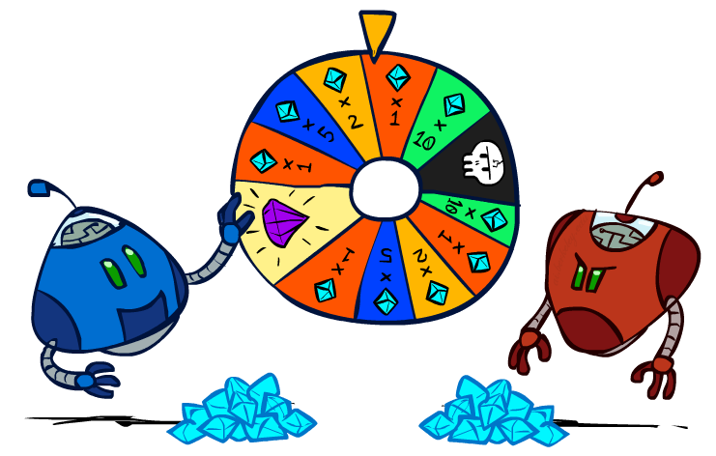
CS 188: Artificial Intelligence
Uncertainty and Utilities
Instructors: Dan Klein and Pieter Abbeel
University of California, Berkeley
[These slides were created by Dan Klein and Pieter Abbeel for CS188 Intro to AI at UC Berkeley. All CS188 materials are available at http://ai.berkeley.edu.]
Notes:
Please retain proper attribution, including the reference to ai.berkeley.edu. Thanks!

Slide 49
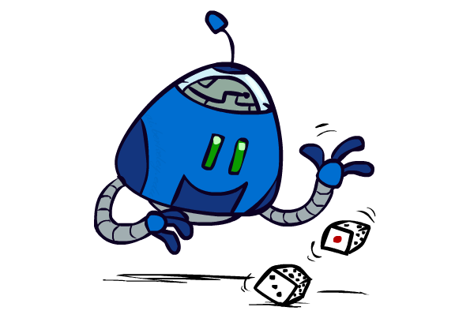
Uncertain Outcomes

Slide 50


Worst-Case vs. Average Case
max
min
10
10
9
100
Idea: Uncertain outcomes controlled by chance, not an adversary!
Notes:
At least 10, or otherwise just rather dead; or just 100, or otherwise rather dead; that’s yet something different than minimax or expectimax

Slide 51
Expectimax Search
Why wouldn’t we know what the result of an action will be?
  Explicit randomness: rolling dice
  Unpredictable opponents: the ghosts respond randomly
  Actions can fail: when moving a robot, wheels might slip
Values should now reflect average-case (expectimax) outcomes, not worst-case (minimax) outcomes
Expectimax search: compute the average score under optimal play
  Max nodes as in minimax search
  Chance nodes are like min nodes but the outcome is uncertain
  Calculate their expected utilities
  I.e. take weighted average (expectation) of children
Later, we’ll learn how to formalize the underlying uncertain-result problems as Markov Decision Processes
max
chance
10
10
4
10
5
9
7
100
[Demo: min vs exp (L7D1,2)]

Slide 52
Video of Demo Minimax vs Expectimax (Min)

Slide 53
Video of Demo Minimax vs Expectimax (Exp)

Slide 54
Expectimax Pseudocode
def value(state):
  if the state is a terminal state: return the state’s utility
  if the next agent is MAX: return max-value(state)
  if the next agent is EXP: return exp-value(state)
def max-value(state):
  initialize v = -∞
  for each successor of state:
    v = max(v, value(successor))
  return v
def exp-value(state):
  initialize v = 0
  for each successor of state:
  p = probability(successor)
    v += p * value(successor)
  return v
Notes:
Pick an order for two reasons: sequential processor and pruning

Slide 55
Expectimax Pseudocode
def exp-value(state):
  initialize v = 0
  for each successor of state:
  p = probability(successor)
    v += p * value(successor)
  return v
1/2
1/6
1/3
5
8
7
24
-12
v = (1/2) (8) + (1/3) (24) + (1/6) (-12) = 10

Slide 56
Expectimax Example
3
12
9
2
4
6
15
6
0

Slide 57
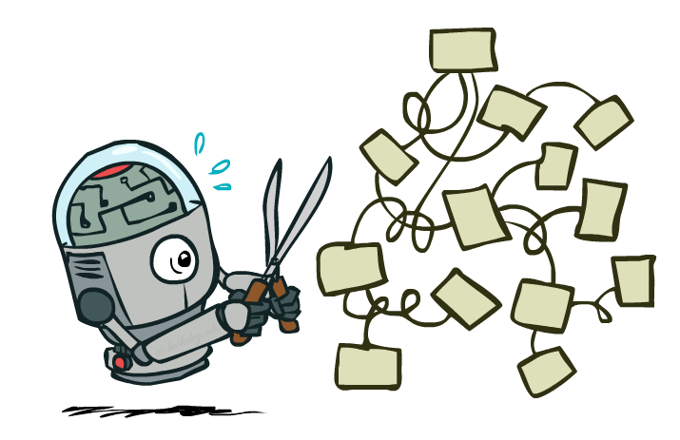
Expectimax Pruning?
3
12
9
2

Slide 58
Depth-Limited Expectimax
Estimate of true expectimax value (which would require a lot of work to compute)
400
300
…
…
492
362
…

Slide 59
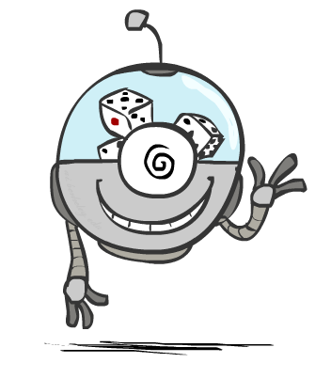
Probabilities

Slide 60
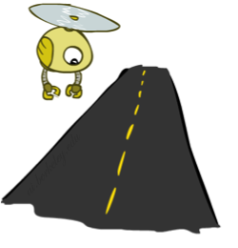
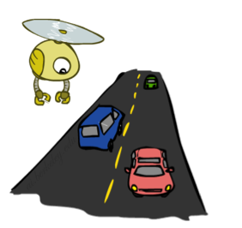
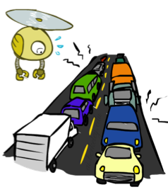
Reminder: Probabilities
A random variable represents an event whose outcome is unknown
A probability distribution is an assignment of weights to outcomes
Example: Traffic on freeway
  Random variable: T = whether there’s traffic
  Outcomes: T in {none, light, heavy}
  Distribution: P(T=none) = 0.25, P(T=light) = 0.50, P(T=heavy) = 0.25
Some laws of probability (more later):
  Probabilities are always non-negative
  Probabilities over all possible outcomes sum to one
As we get more evidence, probabilities may change:
  P(T=heavy) = 0.25, P(T=heavy | Hour=8am) = 0.60
  We’ll talk about methods for reasoning and updating probabilities later
0.25
0.50
0.25

Slide 61
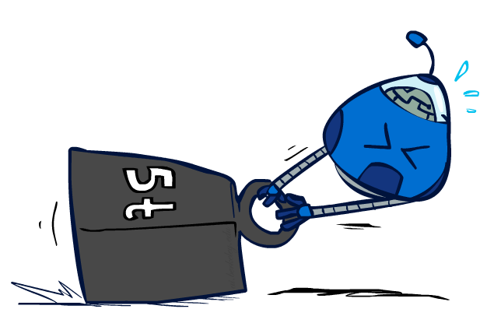
Reminder: Expectations
The expected value of a function of a random variable is the average, weighted by the probability distribution over outcomes
Example: How long to get to the airport?
Time:
20 min
30 min
60 min
+
+
35 min
x
x
x
Probability:
0.25
0.50
0.25

Slide 62
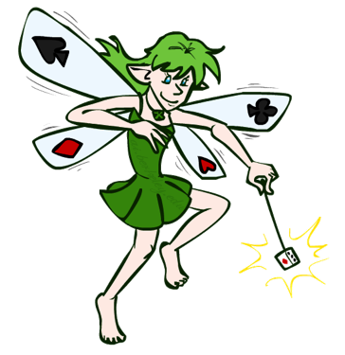
What Probabilities to Use?
In expectimax search, we have a probabilistic model of how the opponent (or environment) will behave in any state
  Model could be a simple uniform distribution (roll a die)
  Model could be sophisticated and require a great deal of computation
  We have a chance node for any outcome out of our control: opponent or environment
  The model might say that adversarial actions are likely!
For now, assume each chance node magically comes along with probabilities that specify the distribution over its outcomes
Having a probabilistic belief about another agent’s action does not mean that the agent is flipping any coins!

Slide 63
Quiz: Informed Probabilities
Let’s say you know that your opponent is actually running a depth 2 minimax, using the result 80% of the time, and moving randomly otherwise
Question: What tree search should you use?
Answer: Expectimax!
  To figure out EACH chance node’s probabilities, you have to run a simulation of your opponent
  This kind of thing gets very slow very quickly
  Even worse if you have to simulate your opponent simulating you…
  … except for minimax, which has the nice property that it all collapses into one game tree
0.1 0.9

Slide 64
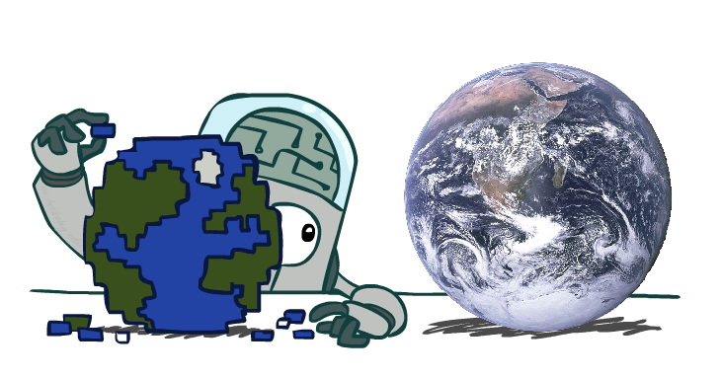
Modeling Assumptions

Slide 65
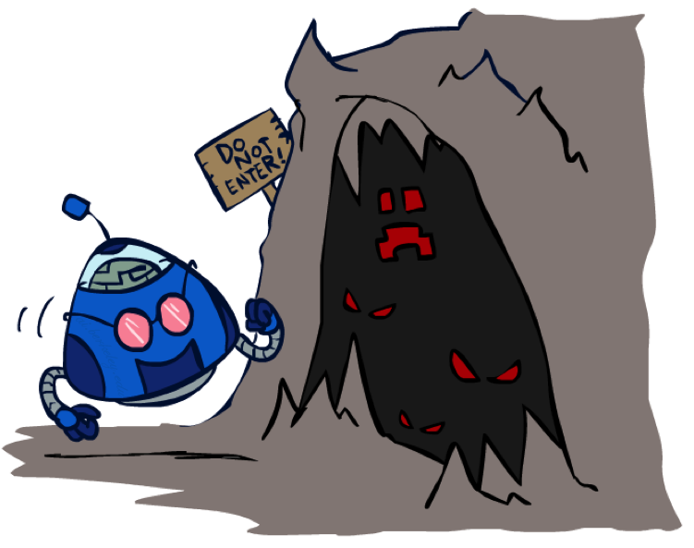
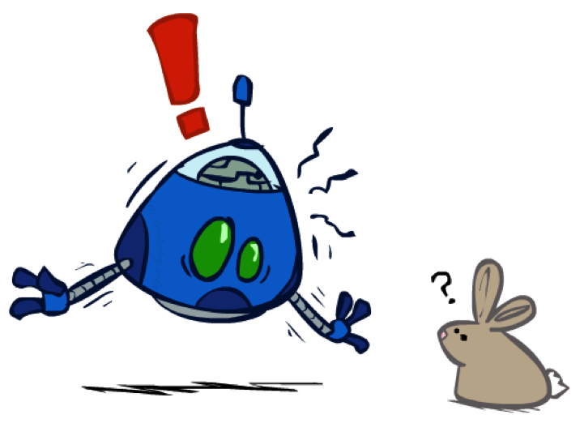
The Dangers of Optimism and Pessimism
Dangerous Optimism
Assuming chance when the world is adversarial
Dangerous Pessimism
Assuming the worst case when it’s not likely

Slide 66
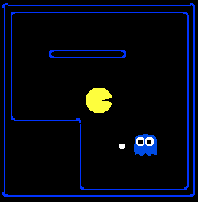
Assumptions vs. Reality
 | Adversarial Ghost | Random Ghost
Minimax Pacman | Won 5/5 Avg. Score: 483 | Won 5/5 Avg. Score: 493
Expectimax Pacman | Won 1/5 Avg. Score: -303 | Won 5/5 Avg. Score: 503
Results from playing 5 games
Pacman used depth 4 search with an eval function that avoids trouble
Ghost used depth 2 search with an eval function that seeks Pacman
[Demos: world assumptions (L7D3,4,5,6)]
Notes:
python pacman.py -g SmartGhost -l trapped2 -p ExpectimaxAgent -a depth=4,evalFn=better

Slide 67
Video of Demo World Assumptions
Random Ghost – Expectimax Pacman

Slide 68
Video of Demo World Assumptions
Adversarial Ghost – Minimax Pacman

Slide 69
Video of Demo World Assumptions
Adversarial Ghost – Expectimax Pacman

Slide 70
Video of Demo World Assumptions
Random Ghost – Minimax Pacman

Slide 71
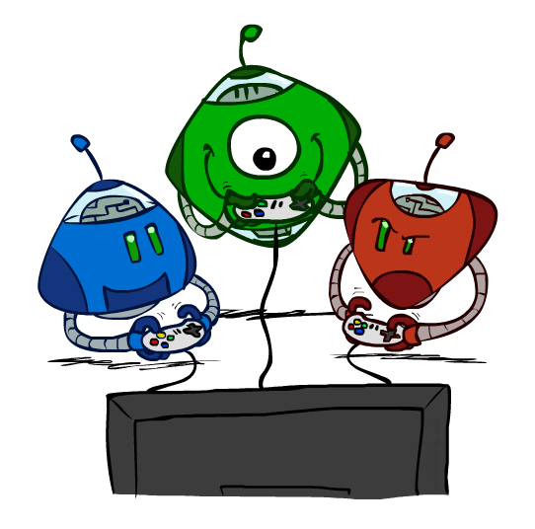
Other Game Types

Slide 72

Mixed Layer Types
E.g. Backgammon
Expectiminimax
  Environment is an extra “random agent” player that moves after each min/max agent
  Each node computes the appropriate combination of its children
Notes:
If it’s terminal or we reached our depth limit, return utility

Slide 73
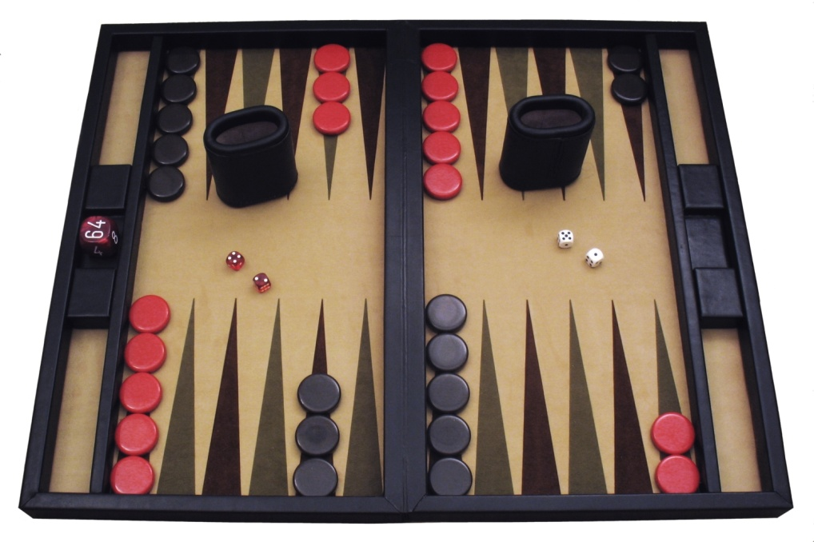
Example: Backgammon
Dice rolls increase b: 21 possible rolls with 2 dice
  Backgammon ≈ 20 legal moves
  Depth 2 = 20 x (21 x 20)³ = 1.2 x 10⁹
As depth increases, probability of reaching a given search node shrinks
  So usefulness of search is diminished
  So limiting depth is less damaging
  But pruning is trickier…
Historic AI: TDGammon uses depth-2 search + very good evaluation function + reinforcement learning:
world-champion level play
1st AI world champion in any game!
Image: Wikipedia

Slide 74
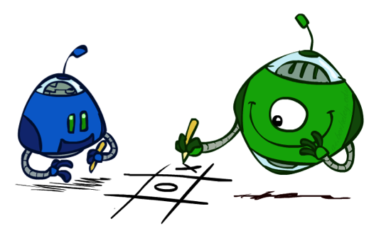
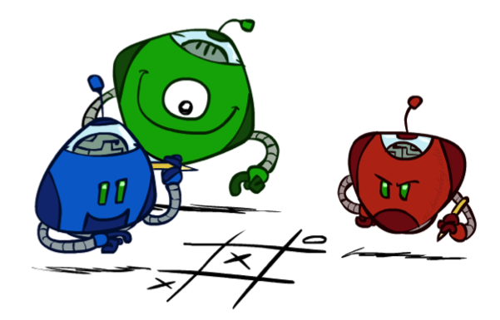
Multi-Agent Utilities
What if the game is not zero-sum, or has multiple players?
Generalization of minimax:
  Terminals have utility tuples
  Node values are also utility tuples
  Each player maximizes its own component
  Can give rise to cooperation and
  competition dynamically…
1,6,6
7,1,2
6,1,2
7,2,1
5,1,7
1,5,2
7,7,1
5,2,5

Slide 75
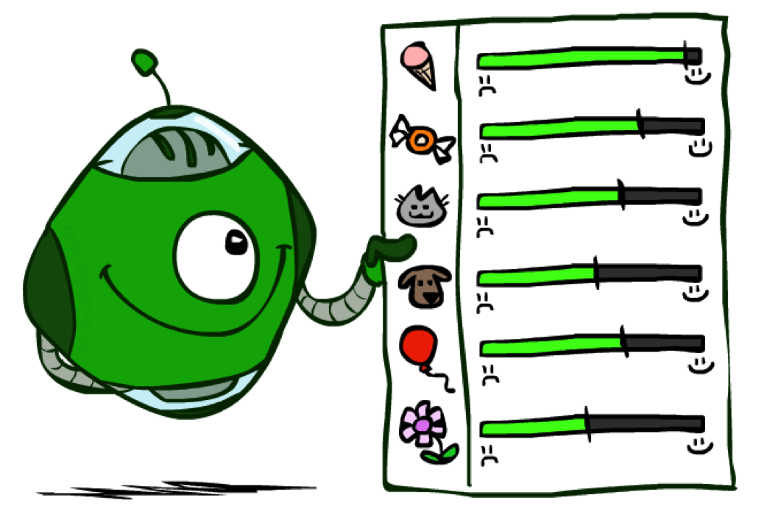
Utilities

Slide 76

Maximum Expected Utility
Why should we average utilities? Why not minimax?
Principle of maximum expected utility:
  A rational agent should chose the action that maximizes its expected utility, given its knowledge
Questions:
  Where do utilities come from?
  How do we know such utilities even exist?
  How do we know that averaging even makes sense?
  What if our behavior (preferences) can’t be described by utilities?

Slide 77
What Utilities to Use?
0
40
20
30
x²
0
1600
400
900
For worst-case minimax reasoning, terminal function scale doesn’t matter
  We just want better states to have higher evaluations (get the ordering right)
  We call this insensitivity to monotonic transformations
For average-case expectimax reasoning, we need magnitudes to be meaningful

Slide 78

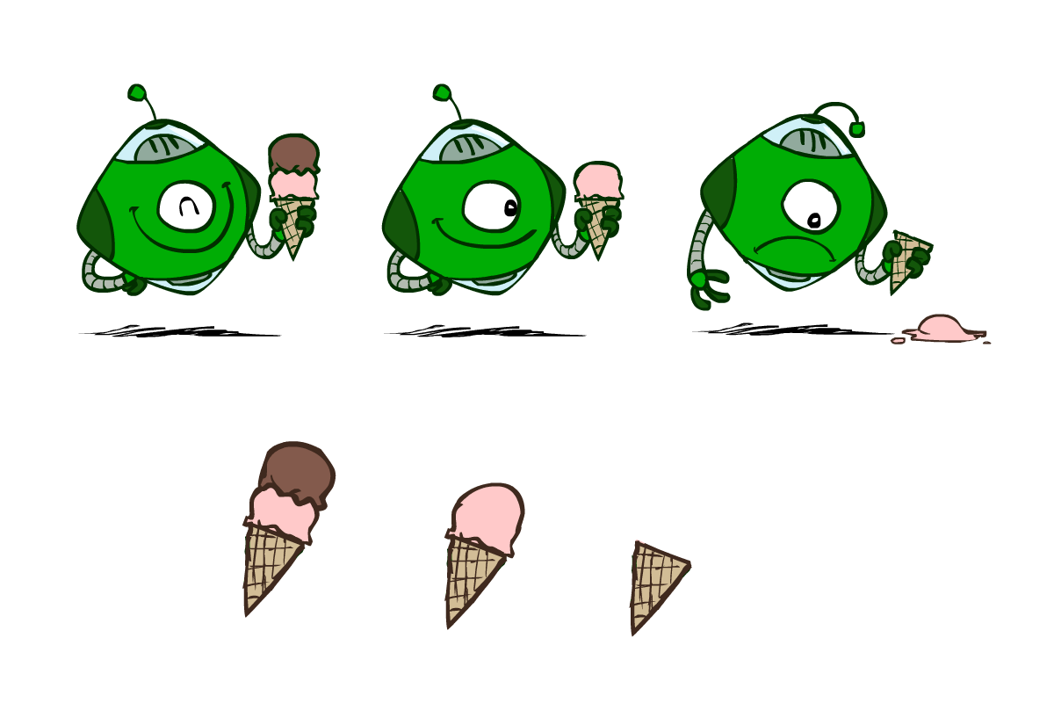
Utilities
Utilities are functions from outcomes (states of the world) to real numbers that describe an agent’s preferences
Where do utilities come from?
  In a game, may be simple (+1/-1)
  Utilities summarize the agent’s goals
  Theorem: any “rational” preferences can be summarized as a utility function
We hard-wire utilities and let behaviors emerge
  Why don’t we let agents pick utilities?
  Why don’t we prescribe behaviors?

Slide 79
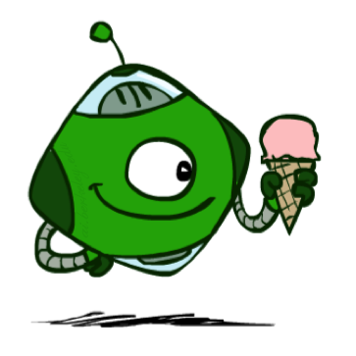
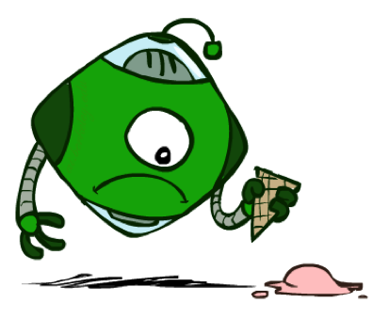
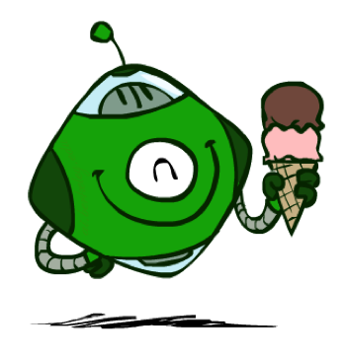
Utilities: Uncertain Outcomes
Getting ice cream
Get Single
Get Double
Oops
Whew!

Slide 80
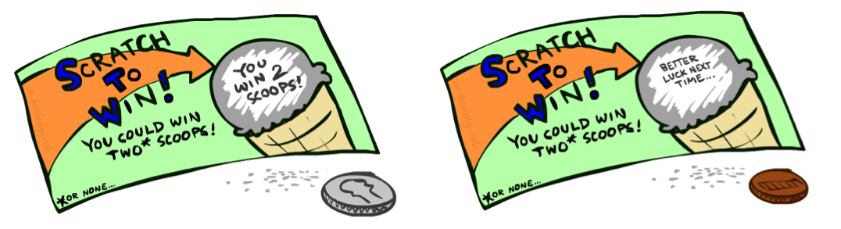
Preferences
A Prize
A Lottery
An agent must have preferences among:
  Prizes: A, B, etc.
  Lotteries: situations with uncertain prizes
Notation:
  Preference:
  Indifference:
A
p 1-p
A B

Slide 81
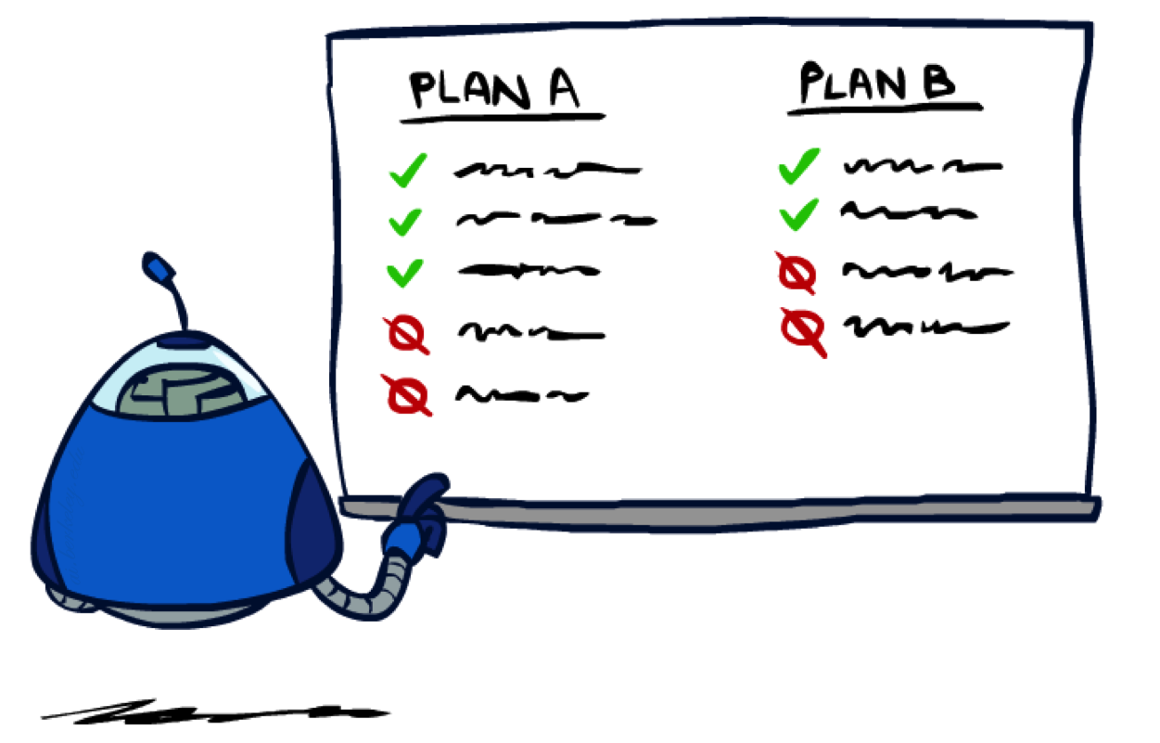
Rationality

Slide 82
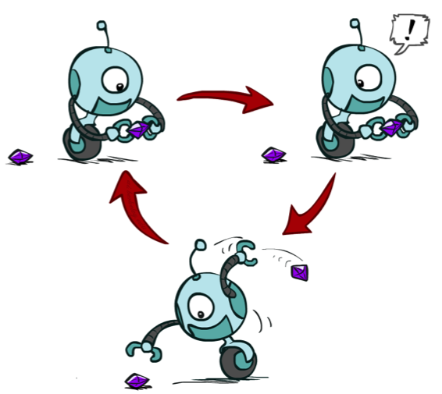
Rational Preferences
We want some constraints on preferences before we call them rational, such as:
For example: an agent with intransitive preferences can
be induced to give away all of its money
  If B > C, then an agent with C would pay (say) 1 cent to get B
  If A > B, then an agent with B would pay (say) 1 cent to get A
  If C > A, then an agent with A would pay (say) 1 cent to get C
Axiom of Transitivity:
Notes:
Apple, banana, carrot

Slide 83

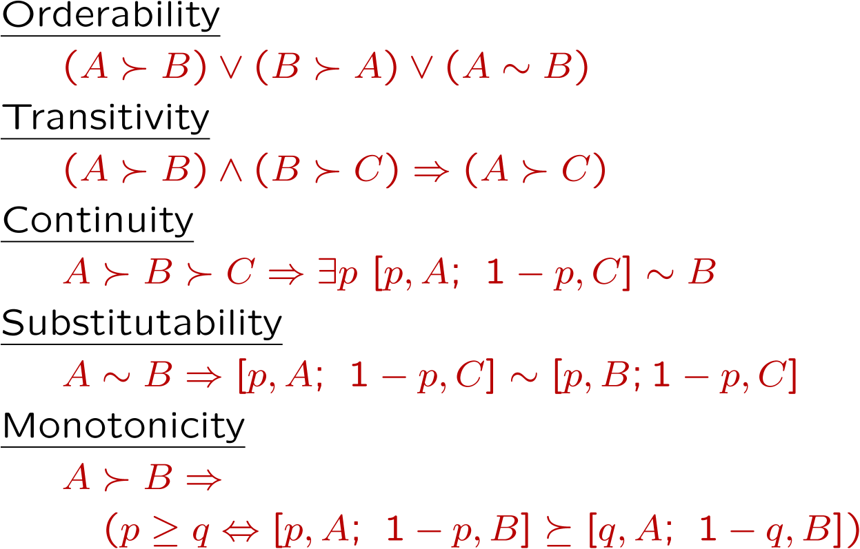
Rational Preferences
The Axioms of Rationality
Theorem: Rational preferences imply behavior describable as maximization of expected utility

Slide 84
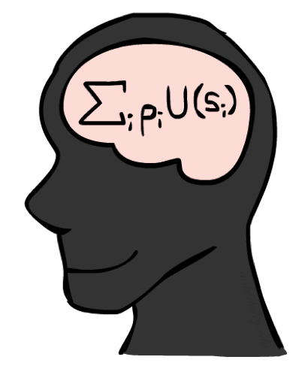
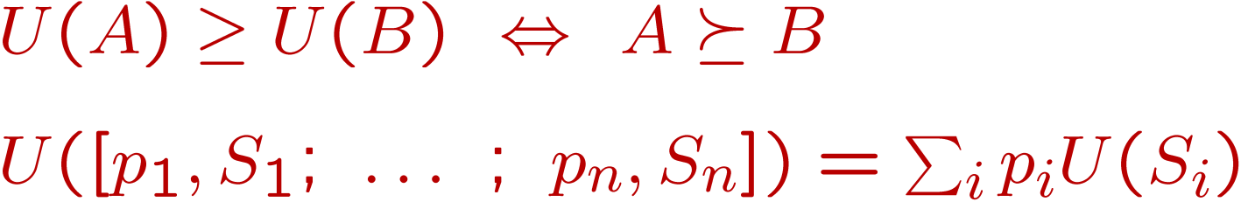
MEU Principle
Theorem [Ramsey, 1931; von Neumann & Morgenstern, 1944]
  Given any preferences satisfying these constraints, there exists a real-valued
  function U such that:
  I.e. values assigned by U preserve preferences of both prizes and lotteries!
Maximum expected utility (MEU) principle:
  Choose the action that maximizes expected utility
  Note: an agent can be entirely rational (consistent with MEU) without ever representing or manipulating utilities and probabilities
  E.g., a lookup table for perfect tic-tac-toe, a reflex vacuum cleaner

Slide 85

Human Utilities

Slide 86

Utility Scales
Normalized utilities: u₊ = 1.0, u₋ = 0.0
Micromorts: one-millionth chance of death, useful for paying to reduce product risks, etc.
QALYs: quality-adjusted life years, useful for medical decisions involving substantial risk
Note: behavior is invariant under positive linear transformation
With deterministic prizes only (no lottery choices), only ordinal utility can be determined, i.e., total order on prizes

Slide 87


Human Utilities
Utilities map states to real numbers. Which numbers?
Standard approach to assessment (elicitation) of human utilities:
  Compare a prize A to a standard lottery L_{p} between
    “best possible prize” u₊ with probability p
    “worst possible catastrophe” u₋ with probability 1-p
  Adjust lottery probability p until indifference: A ~ L_{p}
  Resulting p is a utility in [0,1]
Pay $30
0.999999 0.000001
No change
Instant death

Slide 88

Money
Money does not behave as a utility function, but we can talk about the utility of having money (or being in debt)
Given a lottery L = [p, $X; (1-p), $Y]
  The expected monetary value EMV(L) is p*X + (1-p)*Y
  U(L) = p*U($X) + (1-p)*U($Y)
  Typically, U(L) < U( EMV(L) )
  In this sense, people are risk-averse
  When deep in debt, people are risk-prone
Notes:
Draw Jensen’s for utility curve

Slide 89

Example: Insurance
Consider the lottery [0.5, $1000; 0.5, $0]
  What is its expected monetary value? ($500)
  What is its certainty equivalent?
    Monetary value acceptable in lieu of lottery
    $400 for most people
  Difference of $100 is the insurance premium
    There’s an insurance industry because people will pay to reduce their risk
    If everyone were risk-neutral, no insurance needed!
  It’s win-win: you’d rather have the $400 and the insurance company would rather have the lottery (their utility curve is flat and they have many lotteries)

Slide 90

Example: Human Rationality?
Famous example of Allais (1953)
  A: [0.8, $4k; 0.2, $0]
  B: [1.0, $3k; 0.0, $0]
  C: [0.2, $4k; 0.8, $0]
  D: [0.25, $3k; 0.75, $0]
Most people prefer B > A, C > D
But if U($0) = 0, then
  B > A ⇒ U($3k) > 0.8 U($4k)
  C > D ⇒ 0.8 U($4k) > U($3k)

Slide 91
Next Time: MDPs!

Slide 92
What are Probabilities?
Objectivist / frequentist answer:
  Averages over repeated experiments
  E.g. empirically estimating P(rain) from historical observation
  Assertion about how future experiments will go (in the limit)
  New evidence changes the reference class
  Makes one think of inherently random events, like rolling dice
Subjectivist / Bayesian answer:
  Degrees of belief about unobserved variables
  E.g. an agent’s belief that it’s raining, given the temperature
  E.g. pacman’s belief that the ghost will turn left, given the state
  Often learn probabilities from past experiences (more later)
  New evidence updates beliefs (more later)

Slide 93
Uncertainty Everywhere
Not just for games of chance!
  I’m sick: will I sneeze this minute?
  Email contains “FREE!”: is it spam?
  Tooth hurts: have cavity?
  60 min enough to get to the airport?
  Robot rotated wheel three times, how far did it advance?
  Safe to cross street? (Look both ways!)
Sources of uncertainty in random variables:
  Inherently random process (dice, etc)
  Insufficient or weak evidence
  Ignorance of underlying processes
  Unmodeled variables
  The world’s just noisy – it doesn’t behave according to plan!
Compare to fuzzy logic, which has degrees of truth, rather than just degrees of belief

