Slide 1
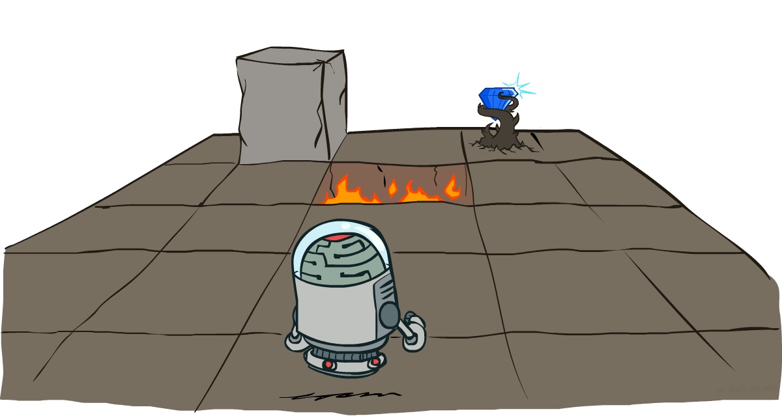
CS 188: Artificial Intelligence
Markov Decision Processes
Instructors: Dan Klein and Pieter Abbeel
University of California, Berkeley
[These slides were created by Dan Klein and Pieter Abbeel for CS188 Intro to AI at UC Berkeley. All CS188 materials are available at http://ai.berkeley.edu.]
Notes:
Please retain proper attribution, including the reference to ai.berkeley.edu. Thanks!

Slide 2
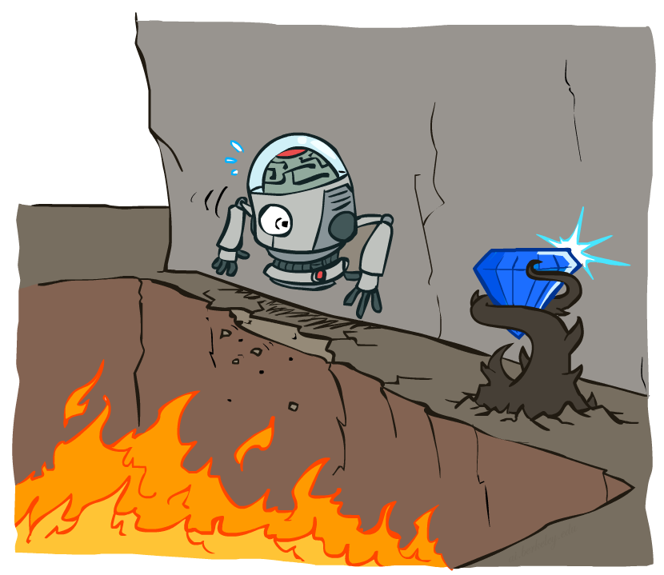
Non-Deterministic Search

Slide 3
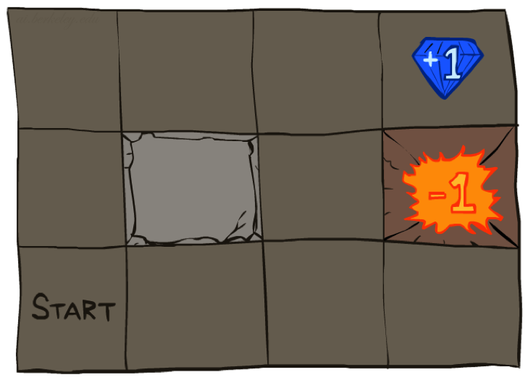




Example: Grid World
A maze-like problem
  The agent lives in a grid
  Walls block the agent’s path
Noisy movement: actions do not always go as planned
  80% of the time, the action North takes the agent North
  (if there is no wall there)
  10% of the time, North takes the agent West; 10% East
  If there is a wall in the direction the agent would have been taken, the agent stays put
The agent receives rewards each time step
  Small “living” reward each step (can be negative)
  Big rewards come at the end (good or bad)
Goal: maximize sum of rewards
Notes:
[cut demo of moving around in grid world program]

Slide 4
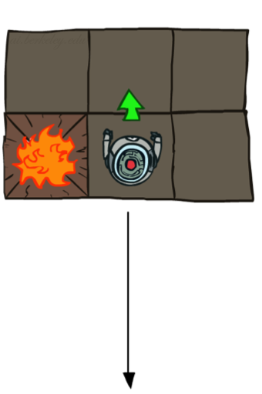
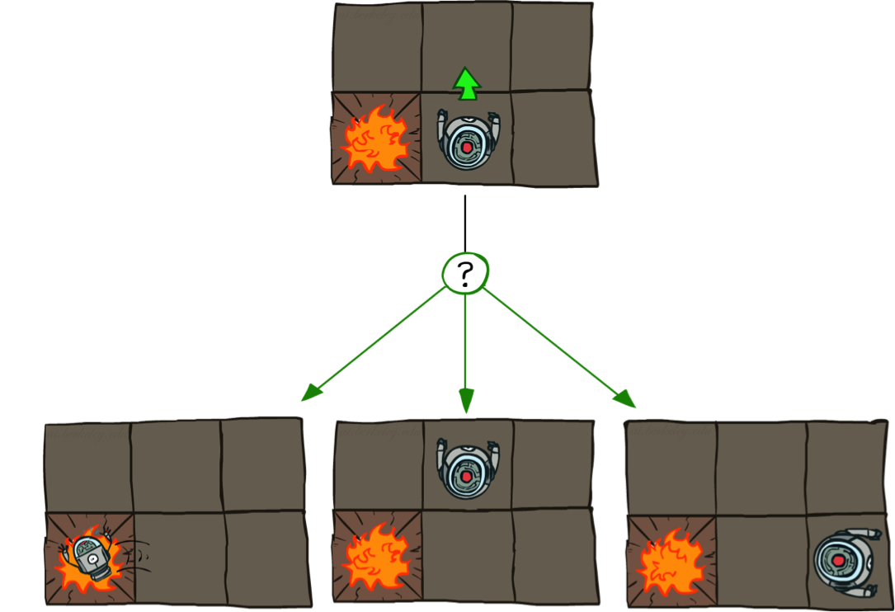
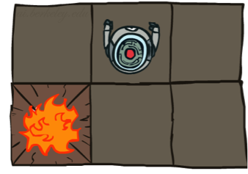
Grid World Actions
Deterministic Grid World
Stochastic Grid World

Slide 5
Markov Decision Processes
An MDP is defined by:
  A set of states s ∈ S
  A set of actions a ∈ A
  A transition function T(s, a, s’)
    Probability that a from s leads to s’, i.e., P(s’| s, a)
    Also called the model or the dynamics
  A reward function R(s, a, s’)
    Sometimes just R(s) or R(s’)
  A start state
  Maybe a terminal state
MDPs are non-deterministic search problems
  One way to solve them is with expectimax search
  We’ll have a new tool soon
[Demo – gridworld manual intro (L8D1)]
Notes:
In search problems: did not talk about actions, but about successor functions --- now the information inside the successor function is unpacked into actions, transitions and reward
Write out S, A, example entry in T, entry in R
Reward function different from the book : R(s,a,s’)
In book simpler for equations, but not useful for the projects.
Need to modify expectimax a tiny little bit to account for rewards along the way, but that’s something you should be able to do, and so you can already solve MDP’s (not in most efficient way)

Slide 6

Video of Demo Gridworld Manual Intro

Slide 7
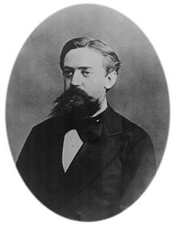

What is Markov about MDPs?
“Markov” generally means that given the present state, the future and the past are independent
For Markov decision processes, “Markov” means action outcomes depend only on the current state
This is just like search, where the successor function could only depend on the current state (not the history)
Andrey Markov (1856-1922)
Notes:
Like search: successor function only depended on current state
Can make this happen by stuffing more into the state;
Very similar to search problems: when solving a maze with food pellets, we stored which food pellets were eaten

Slide 8
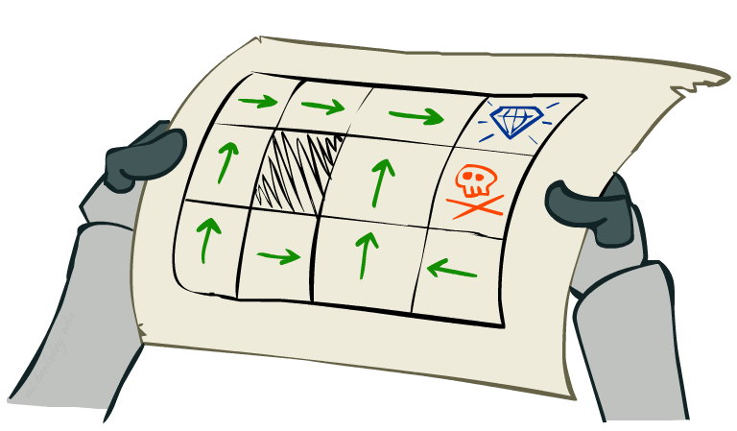
Policies
In deterministic single-agent search problems, we wanted an optimal plan, or sequence of actions, from start to a goal
For MDPs, we want an optimal policy π*: S → A
  A policy π gives an action for each state
  An optimal policy is one that maximizes expected utility if followed
  An explicit policy defines a reflex agent
Expectimax didn’t compute entire policies
  It computed the action for a single state only
Optimal policy when R(s, a, s’) = -0.03 for all non-terminals s
Notes:
Dan has a DEMO for this.

Slide 9
Optimal Policies
R(s) = -0.01
R(s) = -0.03
R(s) = -0.4
R(s) = -2.0
Notes:
R(s) = the “living reward”

Slide 10
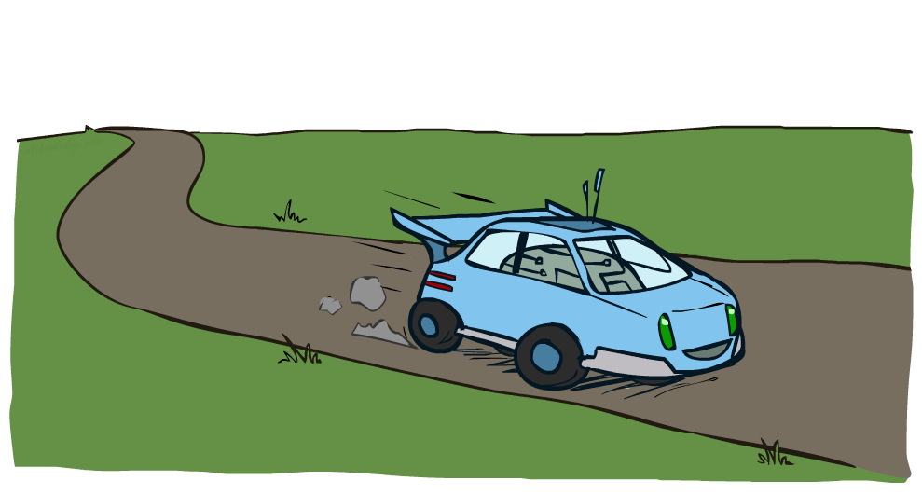
Example: Racing

Slide 11
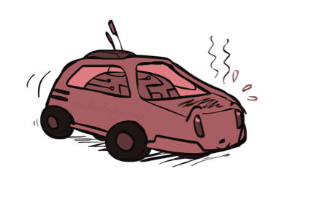
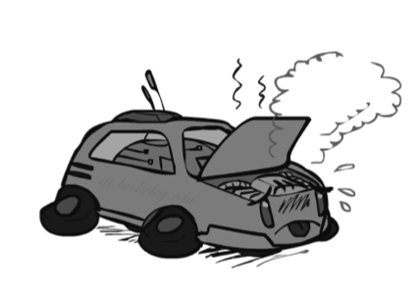
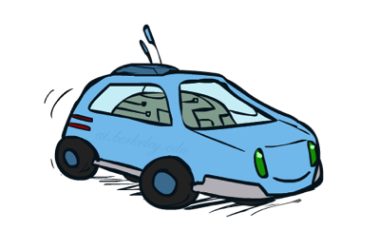
Example: Racing
A robot car wants to travel far, quickly
Three states: Cool, Warm, Overheated
Two actions: Slow, Fast
Going faster gets double reward
0.5
+1
1.0
Fast
Slow
-10
+1
0.5
Warm
Slow
Fast
0.5
+2
Cool
0.5
Overheated
+1
1.0
+2

Slide 12




Racing Search Tree

Slide 13
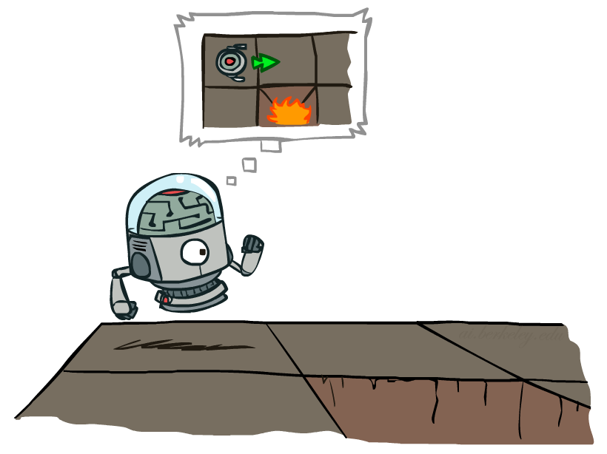

MDP Search Trees
Each MDP state projects an expectimax-like search tree
s
s is a state
a
(s, a) is a q-state
s, a
(s,a,s’) called a transition
T(s,a,s’) = P(s’|s,a)
R(s,a,s’)
s,a,s’
s’
Notes:
In MDP chance node represents uncertainty about what might happen based on (s,a) [as opposed to being a random adversary]
Q-state (s,a) is when you were in a state and took an action

Slide 14
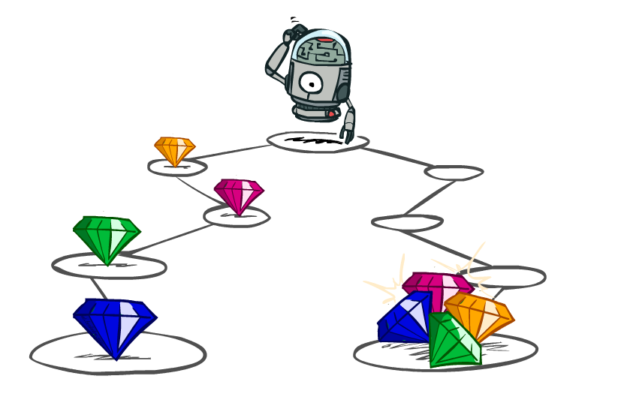
Utilities of Sequences

Slide 15
Utilities of Sequences
What preferences should an agent have over reward sequences?
More or less?
Now or later?
[1, 2, 2]
or
[2, 3, 4]
[0, 0, 1]
or
[1, 0, 0]

Slide 16
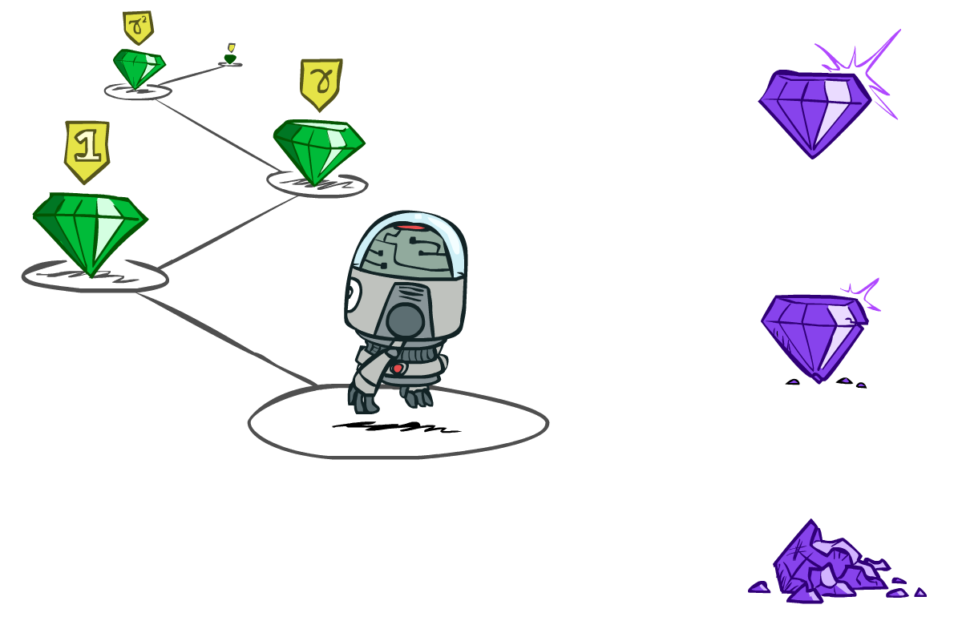

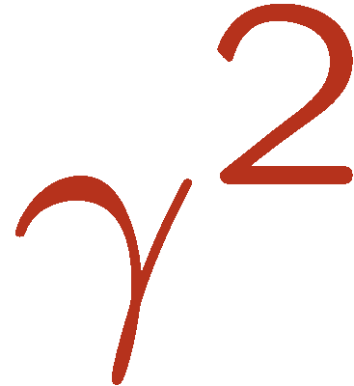

Discounting
It’s reasonable to maximize the sum of rewards
It’s also reasonable to prefer rewards now to rewards later
One solution: values of rewards decay exponentially
Worth Now
Worth Next Step
Worth In Two Steps

Slide 17

Discounting
How to discount?
  Each time we descend a level, we multiply in the discount once
Why discount?
  Sooner rewards probably do have higher utility than later rewards
  Also helps our algorithms converge
Example: discount of 0.5
  U([1,2,3]) = 1*1 + 0.5*2 + 0.25*3
  U([1,2,3]) < U([3,2,1])
Notes:
Rewards in the future (deeper in the tree) matter less
Interesting: running expectimax, if having to truncate the search, then not losing much; e.g., less then \gamma^d / (1-\gamma)

Slide 18
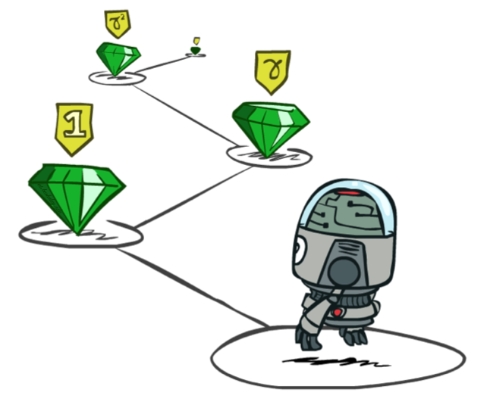
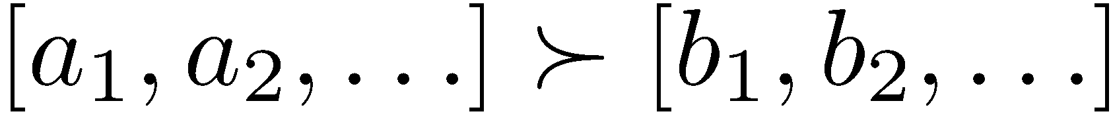
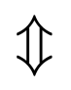
Stationary Preferences
Theorem: if we assume stationary preferences:
Then: there are only two ways to define utilities
  Additive utility:
  Discounted utility:

Slide 19


Quiz: Discounting
Given:
  Actions: East, West, and Exit (only available in exit states a, e)
  Transitions: deterministic
Quiz 1: For γ = 1, what is the optimal policy?
Quiz 2: For γ = 0.1, what is the optimal policy?
Quiz 3: For which γ are West and East equally good when in state d?

Slide 20

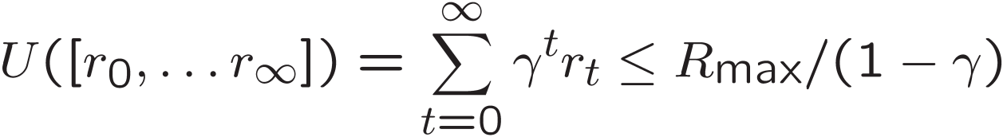
Infinite Utilities?!
Problem: What if the game lasts forever? Do we get infinite rewards?
Solutions:
  Finite horizon: (similar to depth-limited search)
    Terminate episodes after a fixed T steps (e.g. life)
    Gives nonstationary policies (π depends on time left)
  Discounting: use 0 < γ < 1
    Smaller γ means smaller “horizon” – shorter term focus
  Absorbing state: guarantee that for every policy, a terminal state will eventually be reached (like “overheated” for racing)

Slide 21
Recap: Defining MDPs
Markov decision processes:
  Set of states S
  Start state s₀
  Set of actions A
  Transitions P(s’|s,a) (or T(s,a,s’))
  Rewards R(s,a,s’) (and discount γ)
MDP quantities so far:
  Policy = Choice of action for each state
  Utility = sum of (discounted) rewards
s
a
s, a
s,a,s’
s’

Slide 22
Solving MDPs

Slide 23
Optimal Quantities
The value (utility) of a state s:
  V*(s) = expected utility starting in s and acting optimally
The value (utility) of a q-state (s,a):
  Q*(s,a) = expected utility starting out having taken action a from state s and (thereafter) acting optimally
The optimal policy:
  π*(s) = optimal action from state s
s
s is a state
a
(s, a) is a q-state
s, a
s,a,s’
(s,a,s’) is a
transition
s’
[Demo – gridworld values (L8D4)]
Notes:
[Note: this demo doesn’t show anything in action, just pops up V and Q values.]

Slide 24
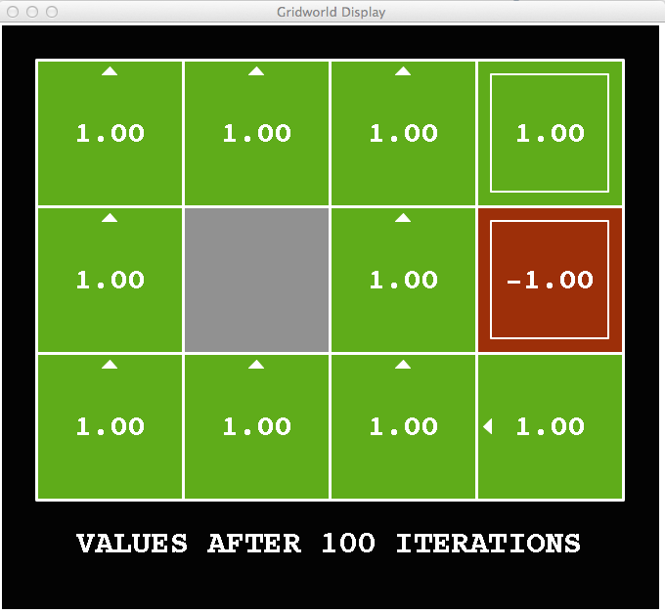
Snapshot of Demo – Gridworld V Values
Noise = 0
Discount = 1
Living reward = 0
Notes:
This demo doesn’t show anything in action, it just shows the V and Q values.

Slide 25
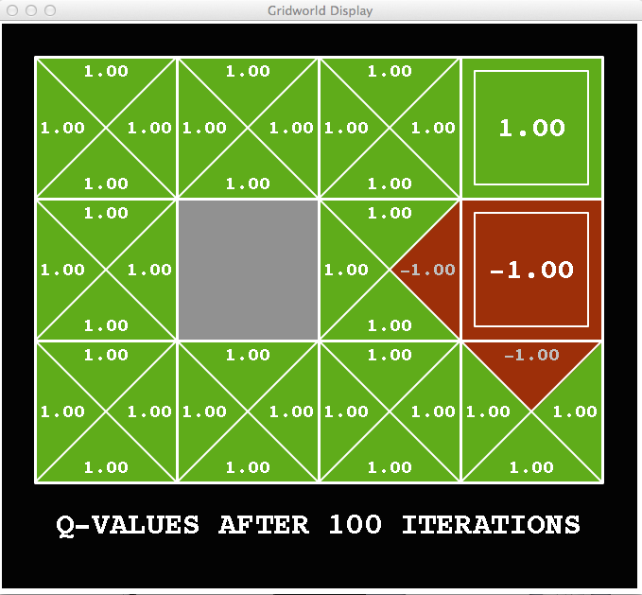
Snapshot of Demo – Gridworld Q Values
Noise = 0
Discount = 1
Living reward = 0
Notes:
This demo doesn’t show anything in action, it just shows the V and Q values.

Slide 26

Snapshot of Demo – Gridworld V Values
Noise = 0.2
Discount = 1
Living reward = 0
Notes:
This demo doesn’t show anything in action, it just shows the V and Q values.

Slide 27
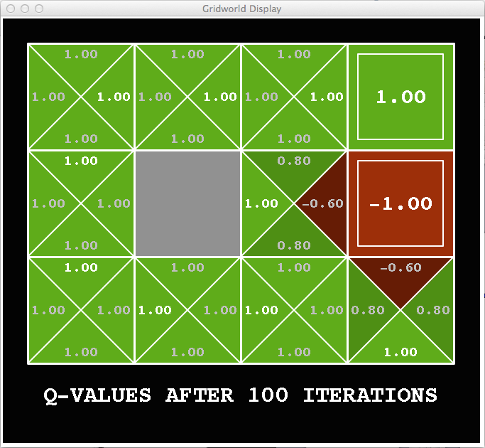
Snapshot of Demo – Gridworld Q Values
Noise = 0.2
Discount = 1
Living reward = 0
Notes:
This demo doesn’t show anything in action, it just shows the V and Q values.

Slide 28
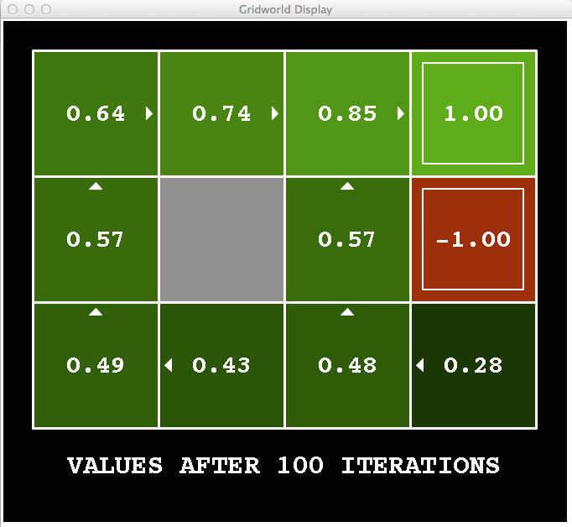
Snapshot of Demo – Gridworld V Values
Noise = 0.2
Discount = 0.9
Living reward = 0
Notes:
This demo doesn’t show anything in action, it just shows the V and Q values.

Slide 29
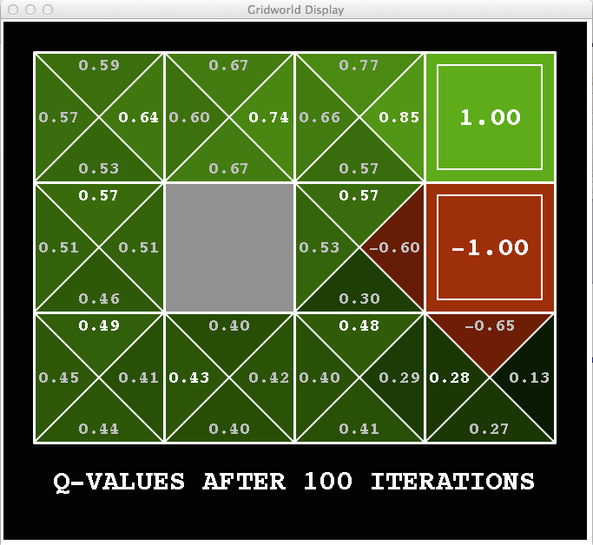
Snapshot of Demo – Gridworld Q Values
Noise = 0.2
Discount = 0.9
Living reward = 0
Notes:
This demo doesn’t show anything in action, it just shows the V and Q values.

Slide 30
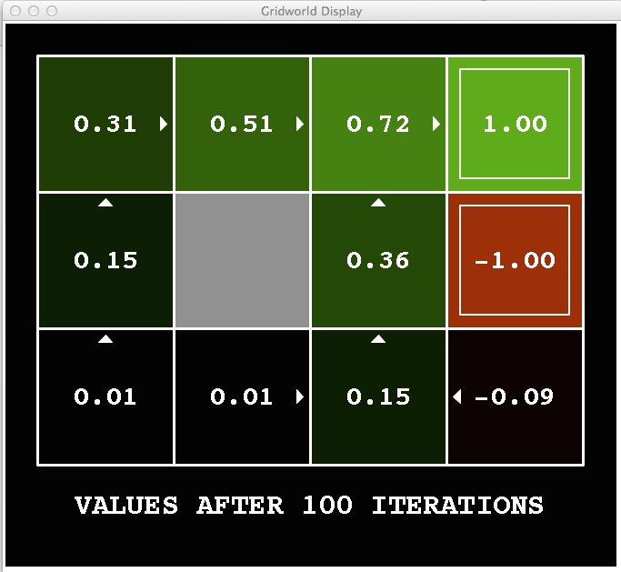
Snapshot of Demo – Gridworld V Values
Noise = 0.2
Discount = 0.9
Living reward = -0.1
Notes:
This demo doesn’t show anything in action, it just shows the V and Q values.

Slide 31
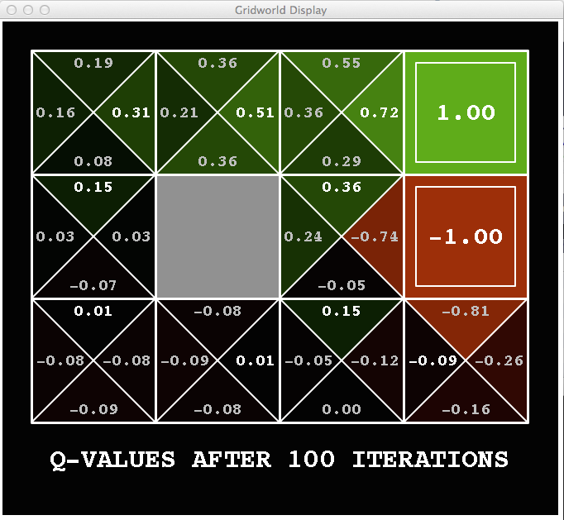
Snapshot of Demo – Gridworld Q Values
Noise = 0.2
Discount = 0.9
Living reward = -0.1
Notes:
This demo doesn’t show anything in action, it just shows the V and Q values.

Slide 32

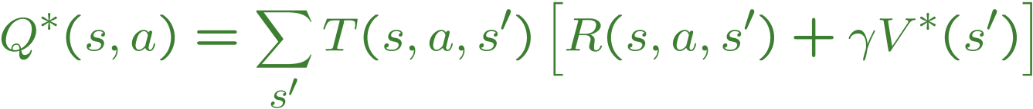
Values of States
Fundamental operation: compute the (expectimax) value of a state
  Expected utility under optimal action
  Average sum of (discounted) rewards
  This is just what expectimax computed!
Recursive definition of value:
s
a
s, a
s,a,s’
s’

Slide 33
Racing Search Tree

Slide 34


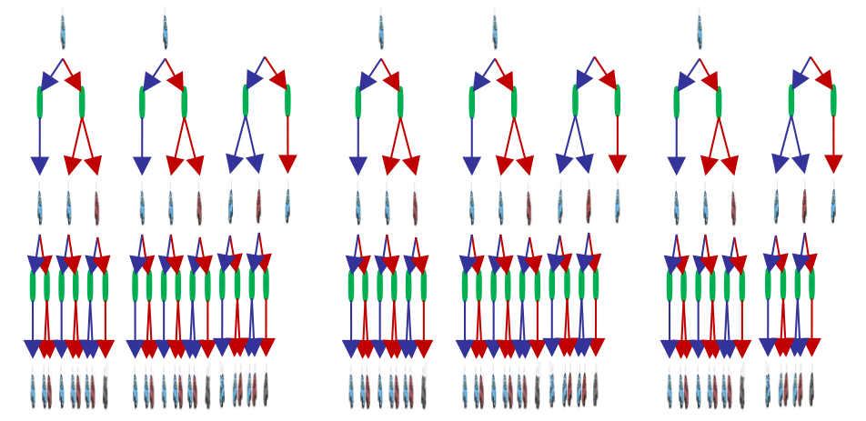

Racing Search Tree

Slide 35
Racing Search Tree
We’re doing way too much work with expectimax!
Problem: States are repeated
  Idea: Only compute needed quantities once
Problem: Tree goes on forever
  Idea: Do a depth-limited computation, but with increasing depths until change is small
  Note: deep parts of the tree eventually don’t matter if γ < 1

Slide 36


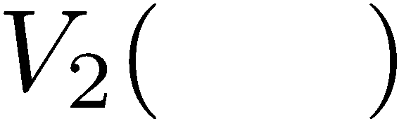


Time-Limited Values
Key idea: time-limited values
Define V_{k}(s) to be the optimal value of s if the game ends in k more time steps
  Equivalently, it’s what a depth-k expectimax would give from s
[Demo – time-limited values (L8D6)]
Notes:
This demo generates the time-limited values for gridworld as snapshotted onto the next slides.

Slide 37
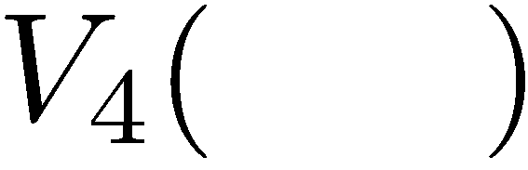

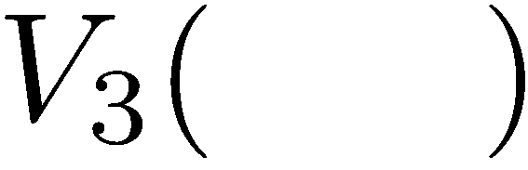
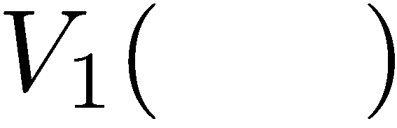
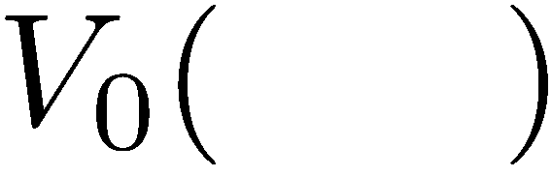
Computing Time-Limited Values

Slide 38
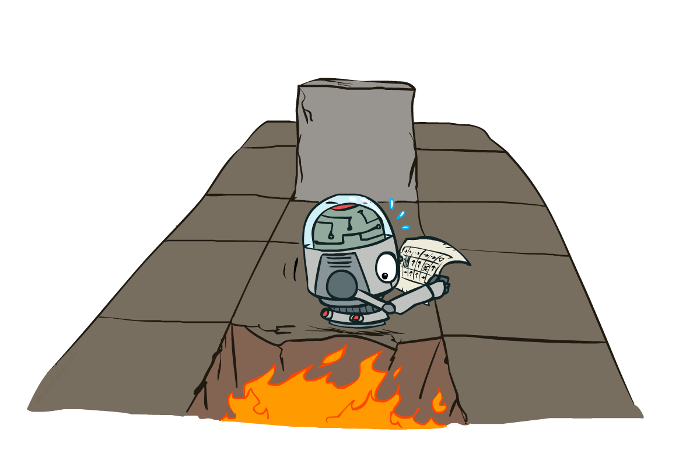
CS 188: Artificial Intelligence
Markov Decision Processes II
Instructors: Dan Klein and Pieter Abbeel --- University of California, Berkeley
[These slides were created by Dan Klein and Pieter Abbeel for CS188 Intro to AI at UC Berkeley. All CS188 materials are available at http://ai.berkeley.edu.]
Notes:
Please retain proper attribution, including the reference to ai.berkeley.edu. Thanks!

Slide 39
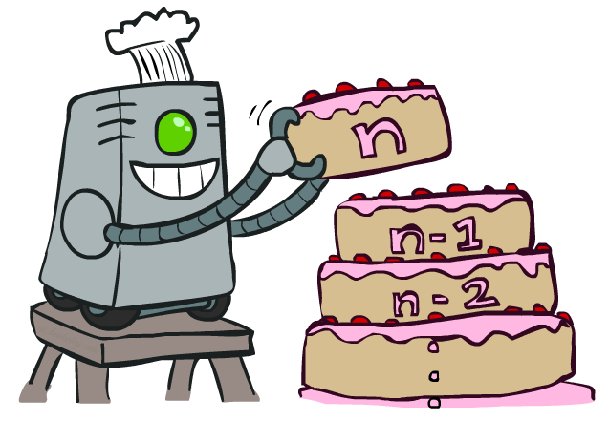
Value Iteration

Slide 40
Recap: MDPs
Markov decision processes:
  States S
  Actions A
  Transitions P(s’|s,a) (or T(s,a,s’))
  Rewards R(s,a,s’) (and discount γ)
  Start state s₀
Quantities:
  Policy = map of states to actions
  Utility = sum of discounted rewards
  Values = expected future utility from a state (max node)
  Q-Values = expected future utility from a q-state (chance node)
s
a
s, a
s,a,s’
s’

Slide 41
Optimal Quantities
The value (utility) of a state s:
  V*(s) = expected utility starting in s and acting optimally
The value (utility) of a q-state (s,a):
  Q*(s,a) = expected utility starting out having taken action a from state s and (thereafter) acting optimally
The optimal policy:
  π*(s) = optimal action from state s
s
s is a state
a
(s, a) is a q-state
s, a
s,a,s’
(s,a,s’) is a
transition
s’
[Demo: gridworld values (L9D1)]
Notes:
Demo just shows V and Q values, snapshots on next slides.

Slide 42

The Bellman Equations
How to be optimal:
Step 1: Take correct first action
Step 2: Keep being optimal

Slide 43

The Bellman Equations
Definition of “optimal utility” via expectimax recurrence gives a simple one-step lookahead relationship amongst optimal utility values
These are the Bellman equations, and they characterize optimal values in a way we’ll use over and over
s
a
s, a
s,a,s’
s’
Notes:
Let’s start by equations that characterize these quantities through mutual recursions. [step through this by writing on slide, one step at a time]
Recursive characterization of V* in terms of V*; not necessarily helpful; but it is a characterization.
Note: this is a set of equations that needs to be satisfied; but it could have multiple solutions (it does not, but at this stage of our knowledge it could).

Slide 44
Value Iteration
Bellman equations characterize the optimal values:
Value iteration computes them:
Value iteration is just a fixed point solution method
  … though the V_{k} vectors are also interpretable as time-limited values
V(s)
a
s, a
s,a,s’
V(s’)
Notes:
Discuss computational complexity: S * A * S times number of iterations
Note: updates not in place [if in place, it means something else and not even clear what it means]

Slide 45


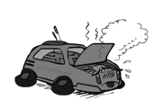
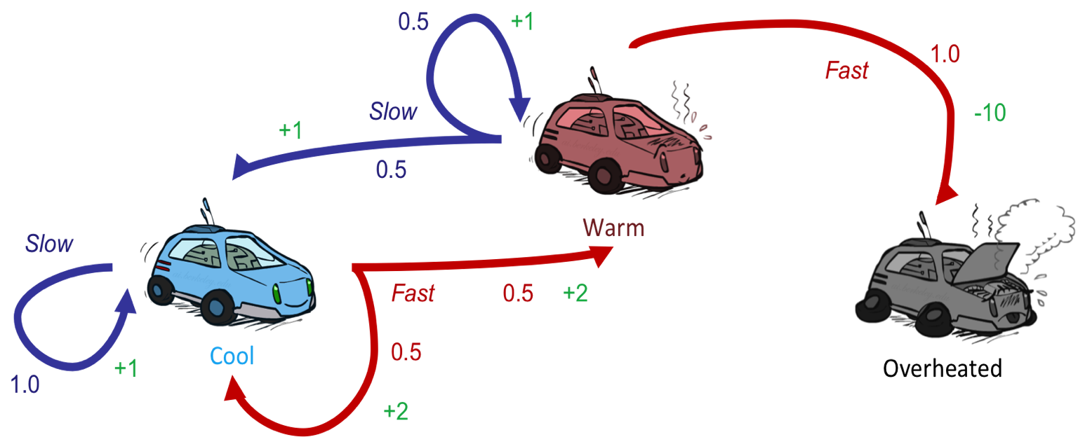
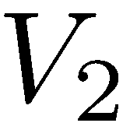
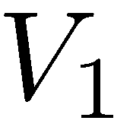
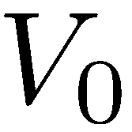
Example: Value Iteration
3.5 2.5 0
2 1 0
Assume no discount!
0 0 0

Slide 46
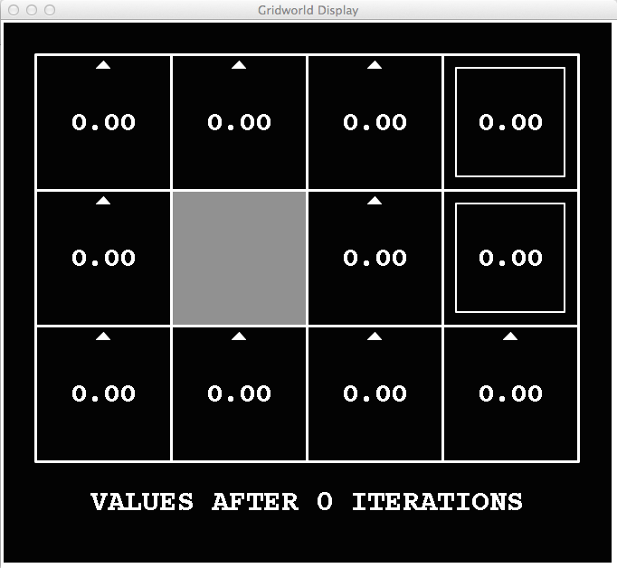
k=0
Noise = 0.2
Discount = 0.9
Living reward = 0
Notes:
Assuming zero living reward

Slide 47
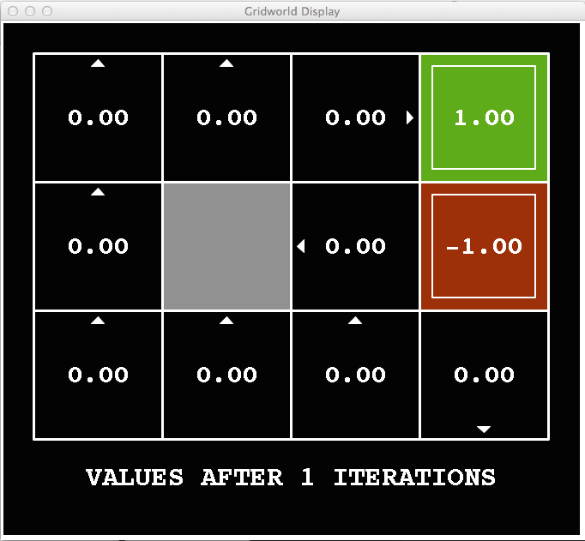
k=1
Noise = 0.2
Discount = 0.9
Living reward = 0
Notes:
Assuming zero living reward

Slide 48
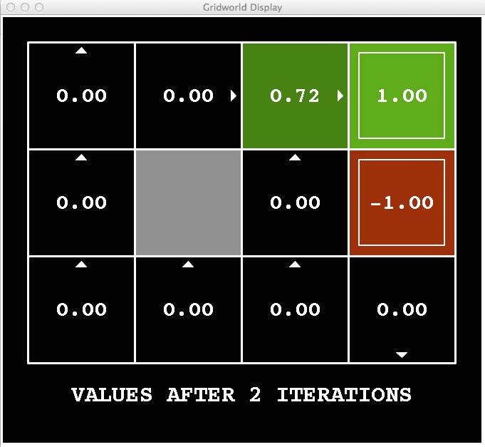
k=2
Noise = 0.2
Discount = 0.9
Living reward = 0
Notes:
Assuming zero living reward

Slide 49
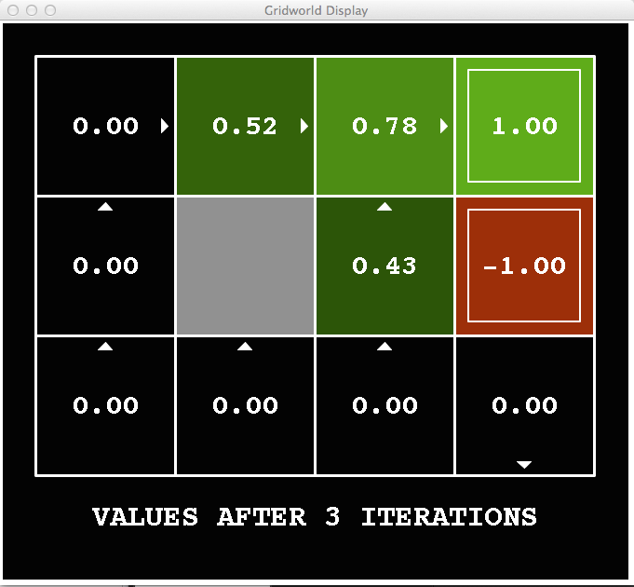
k=3
Noise = 0.2
Discount = 0.9
Living reward = 0
Notes:
Assuming zero living reward

Slide 50
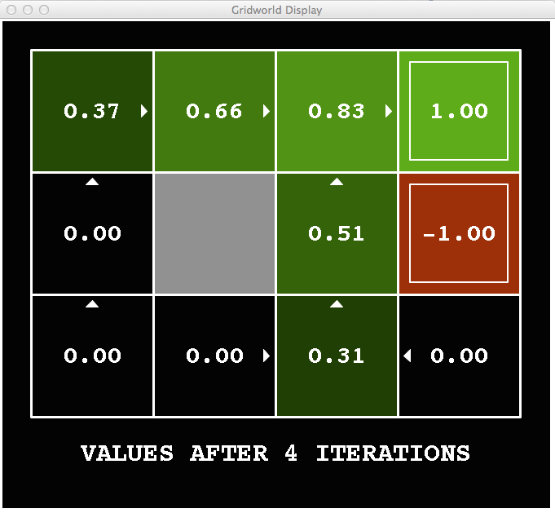
k=4
Noise = 0.2
Discount = 0.9
Living reward = 0
Notes:
Assuming zero living reward

Slide 51
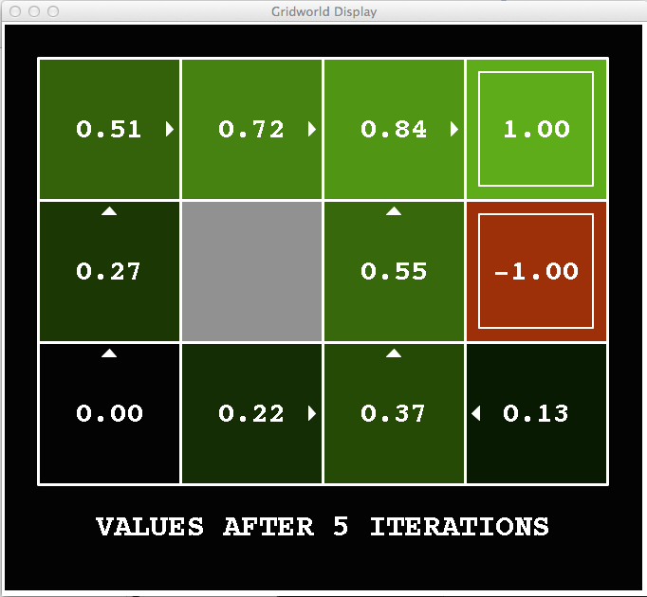
k=5
Noise = 0.2
Discount = 0.9
Living reward = 0
Notes:
Assuming zero living reward

Slide 52
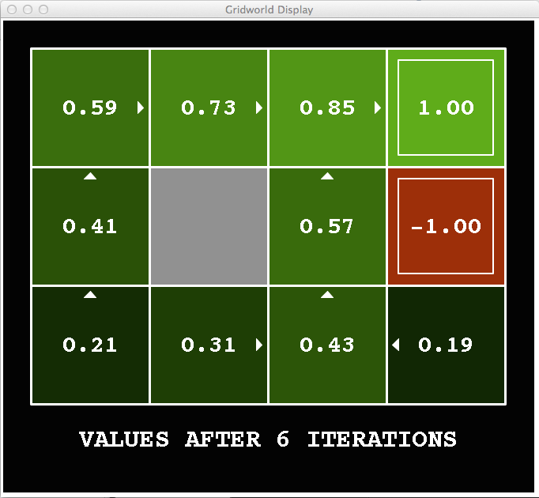
k=6
Noise = 0.2
Discount = 0.9
Living reward = 0
Notes:
Assuming zero living reward

Slide 53
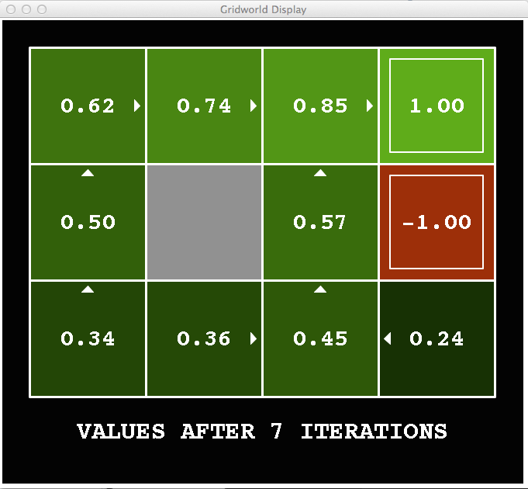
k=7
Noise = 0.2
Discount = 0.9
Living reward = 0
Notes:
Assuming zero living reward

Slide 54
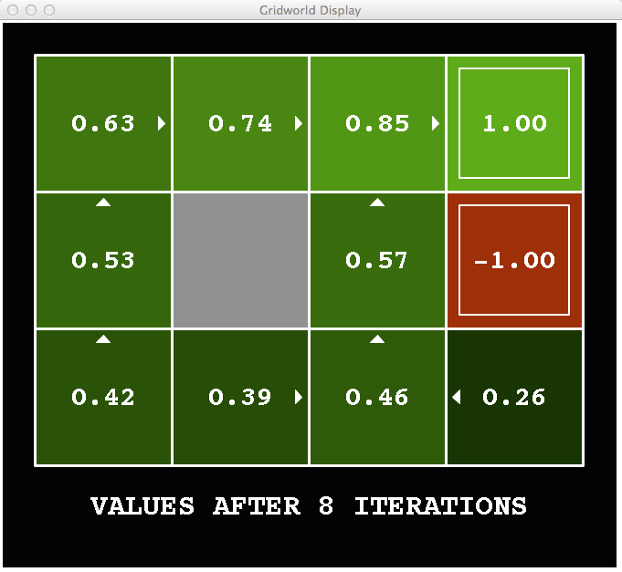
k=8
Noise = 0.2
Discount = 0.9
Living reward = 0
Notes:
Assuming zero living reward

Slide 55

k=9
Noise = 0.2
Discount = 0.9
Living reward = 0
Notes:
Assuming zero living reward

Slide 56

k=10
Noise = 0.2
Discount = 0.9
Living reward = 0
Notes:
Assuming zero living reward

Slide 57

k=11
Noise = 0.2
Discount = 0.9
Living reward = 0
Notes:
Assuming zero living reward

Slide 58

k=12
Noise = 0.2
Discount = 0.9
Living reward = 0
Notes:
Assuming zero living reward

Slide 59

k=100
Noise = 0.2
Discount = 0.9
Living reward = 0
Notes:
Assuming zero living reward

Slide 60

Gridworld Values V*

Slide 61

Gridworld: Q*

Slide 62

Convergence*
Define the max-norm:
Theorem: For any two approximations U and V
  I.e. any distinct approximations must get closer to each other, so, in particular, any approximation must get closer to the true U and value iteration converges to a unique, stable, optimal solution
Theorem:
  I.e. once the change in our approximation is small, it must also be close to correct
62

Slide 63


Convergence*
How do we know the V_{k} vectors are going to converge?
Case 1: If the tree has maximum depth M, then V_{M} holds the actual untruncated values
Case 2: If the discount is less than 1
  Sketch: For any state V_{k} and V_{k+1} can be viewed as depth k+1 expectimax results in nearly identical search trees
  The difference is that on the bottom layer, V_{k+1} has actual rewards while V_{k} has zeros
  That last layer is at best all R_{MAX}
  It is at worst R_{MIN}
  But everything is discounted by γ^{k} that far out
  So V_{k} and V_{k+1} are at most γ^{k} max|R| different
  So as k increases, the values converge

Slide 64

Policy Methods

Slide 65

Policy Evaluation

Slide 66
Fixed Policies
Do the optimal action
Do what π says to do
s
s
a
π(s)
s, a
s, π(s)
s,a,s’
s, π(s),s’
s’
s’
Expectimax trees max over all actions to compute the optimal values
If we fixed some policy π(s), then the tree would be simpler – only one action per state
  … though the tree’s value would depend on which policy we fixed

Slide 67
Utilities for a Fixed Policy
Another basic operation: compute the utility of a state s under a fixed (generally non-optimal) policy
Define the utility of a state s, under a fixed policy π:
  V^{π}(s) = expected total discounted rewards starting in s and following π
Recursive relation (one-step look-ahead / Bellman equation):
s
π(s)
s, π(s)
s, π(s),s’
s’

Slide 68


Example: Policy Evaluation
Always Go Right
Always Go Forward

Slide 69


Example: Policy Evaluation
Always Go Right
Always Go Forward

Slide 70

Policy Evaluation
s
How do we calculate the V’s for a fixed policy π?
Idea 1: Turn recursive Bellman equations into updates
(like value iteration)
Efficiency: O(S²) per iteration
Idea 2: Without the maxes, the Bellman equations are just a linear system
  Solve with Matlab (or your favorite linear system solver)
π(s)
s, π(s)
s, π(s),s’
s’

Slide 71

Policy Extraction

Slide 72



Computing Actions from Values
Let’s imagine we have the optimal values V*(s)
How should we act?
  It’s not obvious!
We need to do a mini-expectimax (one step)
This is called policy extraction, since it gets the policy implied by the values

Slide 73


Computing Actions from Q-Values
Let’s imagine we have the optimal q-values:
How should we act?
  Completely trivial to decide!
Important lesson: actions are easier to select from q-values than values!

Slide 74

Policy Iteration

Slide 75
Problems with Value Iteration
Value iteration repeats the Bellman updates:
Problem 1: It’s slow – O(S²A) per iteration
Problem 2: The “max” at each state rarely changes
Problem 3: The policy often converges long before the values
s
a
s, a
s,a,s’
s’
[Demo: value iteration (L9D2)]
Notes:
Demo steps through value iteration; snapshots of values shown on next slides.

Slide 76
k=0
Noise = 0.2
Discount = 0.9
Living reward = 0
Notes:
Assuming zero living reward

Slide 77
k=1
Noise = 0.2
Discount = 0.9
Living reward = 0
Notes:
Assuming zero living reward

Slide 78
k=2
Noise = 0.2
Discount = 0.9
Living reward = 0
Notes:
Assuming zero living reward

Slide 79
k=3
Noise = 0.2
Discount = 0.9
Living reward = 0
Notes:
Assuming zero living reward

Slide 80
k=4
Noise = 0.2
Discount = 0.9
Living reward = 0
Notes:
Assuming zero living reward

Slide 81
k=5
Noise = 0.2
Discount = 0.9
Living reward = 0
Notes:
Assuming zero living reward

Slide 82
k=6
Noise = 0.2
Discount = 0.9
Living reward = 0
Notes:
Assuming zero living reward

Slide 83
k=7
Noise = 0.2
Discount = 0.9
Living reward = 0
Notes:
Assuming zero living reward

Slide 84
k=8
Noise = 0.2
Discount = 0.9
Living reward = 0
Notes:
Assuming zero living reward

Slide 85
k=9
Noise = 0.2
Discount = 0.9
Living reward = 0
Notes:
Assuming zero living reward

Slide 86
k=10
Noise = 0.2
Discount = 0.9
Living reward = 0
Notes:
Assuming zero living reward

Slide 87
k=11
Noise = 0.2
Discount = 0.9
Living reward = 0
Notes:
Assuming zero living reward

Slide 88
k=12
Noise = 0.2
Discount = 0.9
Living reward = 0
Notes:
Assuming zero living reward

Slide 89
k=100
Noise = 0.2
Discount = 0.9
Living reward = 0
Notes:
Assuming zero living reward

Slide 90
Policy Iteration
Alternative approach for optimal values:
  Step 1: Policy evaluation: calculate utilities for some fixed policy (not optimal utilities!) until convergence
  Step 2: Policy improvement: update policy using one-step look-ahead with resulting converged (but not optimal!) utilities as future values
  Repeat steps until policy converges
This is policy iteration
  It’s still optimal!
  Can converge (much) faster under some conditions

Slide 91
Policy Iteration
Evaluation: For fixed current policy π, find values with policy evaluation:
  Iterate until values converge:
Improvement: For fixed values, get a better policy using policy extraction
  One-step look-ahead:

Slide 92
Comparison
Both value iteration and policy iteration compute the same thing (all optimal values)
In value iteration:
  Every iteration updates both the values and (implicitly) the policy
  We don’t track the policy, but taking the max over actions implicitly recomputes it
In policy iteration:
  We do several passes that update utilities with fixed policy (each pass is fast because we consider only one action, not all of them)
  After the policy is evaluated, a new policy is chosen (slow like a value iteration pass)
  The new policy will be better (or we’re done)
Both are dynamic programs for solving MDPs

Slide 93

Asynchronous Value Iteration*
In value iteration, we update every state in each iteration
  Actually, any sequences of Bellman updates will converge if every state is visited infinitely often
In fact, we can update the policy as seldom or often as we like, and we will still converge
Idea: Update states whose value we expect to change:
If is large then update predecessors of s
Notes:
93

Slide 94
Summary: MDP Algorithms
So you want to….
  Compute optimal values: use value iteration or policy iteration
  Compute values for a particular policy: use policy evaluation
  Turn your values into a policy: use policy extraction (one-step lookahead)
These all look the same!
  They basically are – they are all variations of Bellman updates
  They all use one-step lookahead expectimax fragments
  They differ only in whether we plug in a fixed policy or max over actions

Slide 95



Double Bandits

Slide 96
Double-Bandit MDP
Actions: Blue, Red
States: Win, Lose
No discount
100 time steps
Both states have the same value
0.25 $0
0.75
$2
W
L
0.25
$0
$1
1.0
$1
1.0
0.75 $2

Slide 97
Offline Planning
Solving MDPs is offline planning
  You determine all quantities through computation
  You need to know the details of the MDP
  You do not actually play the game!
No discount
100 time steps
Both states have the same value
0.25 $0
Value
0.75
$2
W
0.25
$0
Play Red
150
L
$1
1.0
$1
1.0
0.75 $2
Play Blue
100

Slide 98
Let’s Play!
$2
$2
$0
$2
$2
$2
$2
$0
$0
$0

Slide 99
Online Planning
Rules changed! Red’s win chance is different.
?? $0
??
$2
W
L
??
$0
$1
1.0
$1
1.0
?? $2

Slide 100
Let’s Play!
$0
$0
$0
$2
$0
$2
$0
$0
$0
$0

Slide 101
What Just Happened?
That wasn’t planning, it was learning!
  Specifically, reinforcement learning
  There was an MDP, but you couldn’t solve it with just computation
  You needed to actually act to figure it out
Important ideas in reinforcement learning that came up
  Exploration: you have to try unknown actions to get information
  Exploitation: eventually, you have to use what you know
  Regret: even if you learn intelligently, you make mistakes
  Sampling: because of chance, you have to try things repeatedly
  Difficulty: learning can be much harder than solving a known MDP

Slide 102
Next Time: Reinforcement Learning!

Slide 103
Asynchronous Value Iteration*
In value iteration, we update every state in each iteration
  Actually, any sequences of Bellman updates will converge if every state is visited infinitely often
In fact, we can update the policy as seldom or often as we like, and we will still converge
Idea: Update states whose value we expect to change:
If is large then update predecessors of s

Slide 104

Interlude

Slide 105

Quiz: MDP notation
Consider a gridworld MDP as shown below. The available actions in each state are to move to the neighboring grid squares. Left and Right actions are successful 80% of the time. When not successful, the agent stays in place. From state a, there is also an exit action available, which results in going to the terminal state and collecting a reward of 10. Similarly, in state e, the reward for the exit action is 1. Exit actions are successful 100% of the time.

Slide 106

Quiz: MDP notation
T(c, Right, d) =
T(c, Right, e) =
T(c, Right, c) =
T(c, Right, b) =
T(c, Right, a) =
T(c, Right, terminal state) =
T(a, Exit, terminal state) =
T(a, Right, b) =
T(a, Right, a) =
R(a, Right, a) =
R(a, Exit, terminal state) =
R(c, Right, d) =

Slide 107

Quiz: discounting
Consider the same gridworld MDP as in the previous quiz. The available actions in each state are to move to the neighboring grid squares. Left and Right actions are successful 80% of the time. When not successful, the agent stays in place. From state a, there is also an exit action available, which results in going to the terminal state and collecting a reward of 10. Similarly, in state e, the reward for the exit action is 1. Exit actions are successful 100% of the time. Note that the agent is now in state d, as shown below.

Slide 108
Quiz: discounting
Let the discount factor γ=0.1. What is the optimal action in the current state (d)?
Let the discount factor γ=0.9999. What is the optimal action in the current state (d)?

Slide 109
Quiz: solving MDPs
Consider the same gridworld MDP as in the previous quiz, except that now Left and Right actions are 100% successful. Specifically, the available actions in each state are to move to the neighboring grid squares. From state a, there is also an exit action available, which results in going to the terminal state and collecting a reward of 10. Similarly, in state e, the reward for the exit action is 1. Exit actions are successful 100% of the time.
Let the discount factor γ = 1.

Slide 110

Quiz: solving MDPs
Left and Right actions are 100% successful. γ = 1.
V₀(d) =
V₁(d) =
V₂(d) =
V₃(d) =
V₄(d) =
V₅(d) =

Slide 111

Quiz: Value iteration
Consider the same gridworld as in the previous quiz (where Left and Right actions are successful 100% of the time). Specifically, the available actions in each state are to move to the neighboring grid squares. From state a, there is also an exit action available, which results in going to the terminal state and collecting a reward of 10. Similarly, in state e, the reward for the exit action is 1. Exit actions are successful 100% of the time.
Let discount factor γ = 0.2

Slide 112

Quiz: Value iteration
Left and Right actions are successful 100% of the time
γ = 0.2.
V*(a) = V∞(a) =
V*(b) = V∞(b) =
V*(c) = V∞(c) =
V*(d) = V∞ (d) =
V*(e) = V∞ (e) =

Slide 113

Quiz: Policy evaluation
Consider the same gridworld as in the previous quiz, where Left and Right actions are successful 100% of the time.
Specifically, the available actions in each state are to move to the neighboring grid squares. From state a, there is also an exit action available, which results in going to the terminal state and collecting a reward of 10. Similarly, in state e, the reward for the exit action is 1. Exit actions are successful 100% of the time.
The discount factor (γ) is 1.

Slide 114

Quiz: Policy evaluation
Consider the policy π₁ shown here:
V^{π1}(a) =
V^{π1} (b) =
V^{π1} (c) =
V^{π1}(d) =
V^{π1} (e) =

Slide 115

Quiz: Policy evaluation
Consider the policy π₂ shown here:
V^{π2}(a) =
V^{π2} (b) =
V^{π2} (c) =
V^{π2}(d) =
V^{π2} (e) =

Slide 116

Quiz: policy iteration
Consider the same gridworld as in the previous quiz, where Left and Right actions are successful 100% of the time.
Specifically, the available actions in each state are to move to the neighboring grid squares. From state a, there is also an exit action available, which results in going to the terminal state and collecting a reward of 10. Similarly, in state e, the reward for the exit action is 1. Exit actions are successful 100% of the time.
The discount factor (γ) is 0.9.

Slide 117


Quiz: policy iteration – part 1
Left and Right actions are successful 100% of the time.
The discount factor (γ) is 0.9.
Consider the policy here
V^{πi}(a)=
V^{πi}(b)=
V^{πi}(c)=
V^{πi}(d)=
V^{πi}(e)=

Slide 118
Quiz: policy iteration – part 2
Perform a policy improvement step, using the values from part 1 as the current policy’s values.
The discount factor (γ) is 0.9.
π_{i+1}(a) = Exit or Right?
π_{i+1}(b) = Left or Right?
π_{i+1}(c) = Left or Right?
π_{i+1}(d) = Left or Right?
π_{i+1}(e) = Left or Exit?

