Slide 1
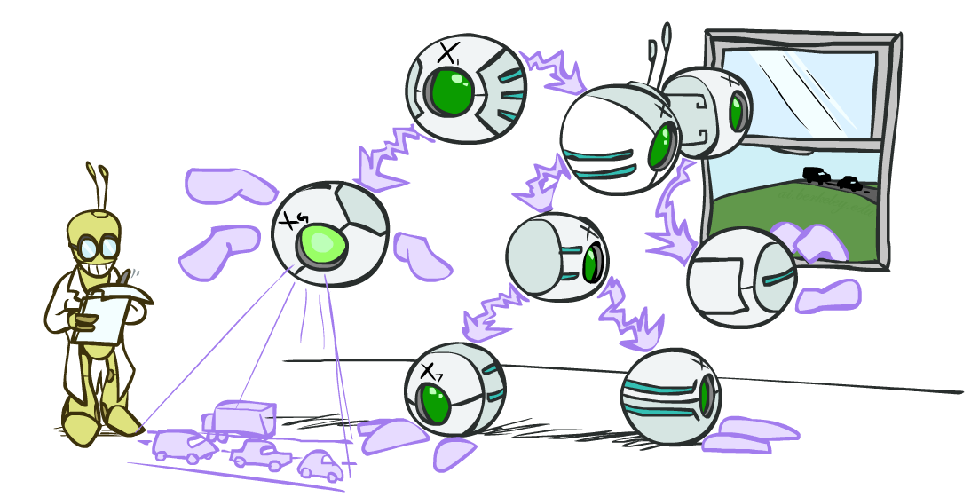
CS 188: Artificial Intelligence
Bayes’ Nets: Inference
Instructors: Dan Klein and Pieter Abbeel --- University of California, Berkeley
[These slides were created by Dan Klein and Pieter Abbeel for CS188 Intro to AI at UC Berkeley. All CS188 materials are available at http://ai.berkeley.edu.]
Notes:
Please retain proper attribution, including the reference to ai.berkeley.edu. Thanks!

Slide 2
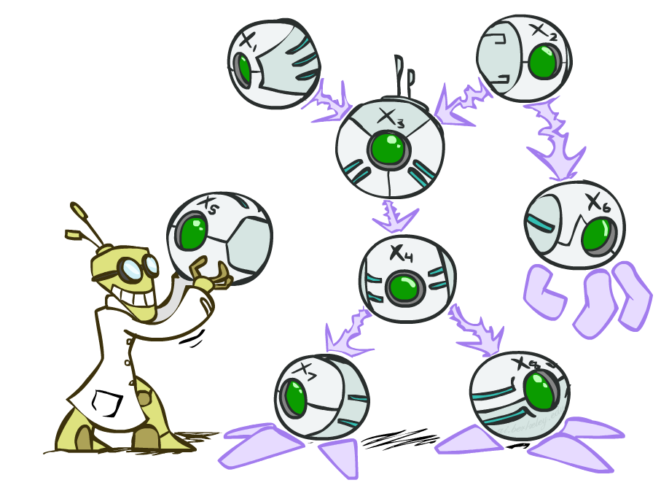

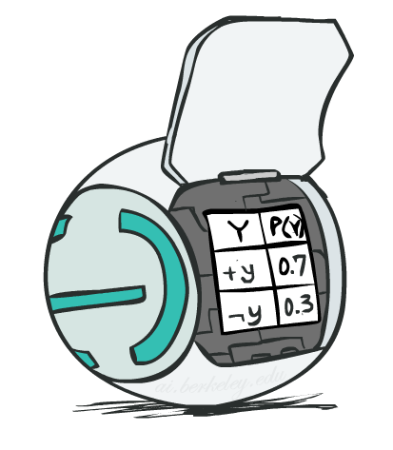
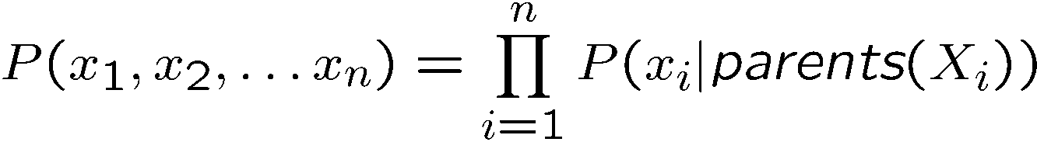
Bayes’ Net Representation
A directed, acyclic graph, one node per random variable
A conditional probability table (CPT) for each node
A collection of distributions over X, one for each combination of parents’ values
Bayes’ nets implicitly encode joint distributions
As a product of local conditional distributions
To see what probability a BN gives to a full assignment, multiply all the relevant conditionals together:

Slide 3
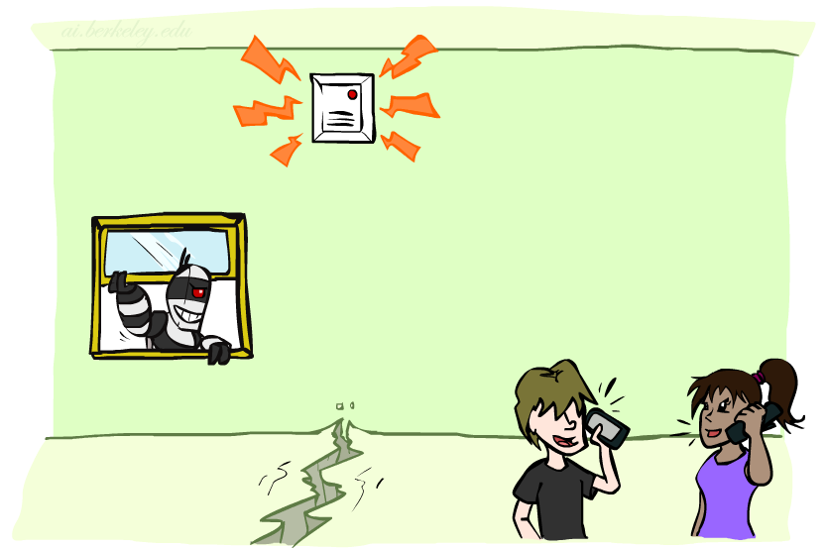
Example: Alarm Network
B | P(B)
+b | 0.001
-b | 0.999
E | P(E)
+e | 0.002
-e | 0.998
Burglary
Earthqk
Alarm
B | E | A | P(A|B,E)
+b | +e | +a | 0.95
+b | +e | -a | 0.05
+b | -e | +a | 0.94
+b | -e | -a | 0.06
-b | +e | +a | 0.29
-b | +e | -a | 0.71
-b | -e | +a | 0.001
-b | -e | -a | 0.999
John calls
Mary calls
A | J | P(J|A)
+a | +j | 0.9
+a | -j | 0.1
-a | +j | 0.05
-a | -j | 0.95
A | M | P(M|A)
+a | +m | 0.7
+a | -m | 0.3
-a | +m | 0.01
-a | -m | 0.99
[Demo: BN Applet]
Notes:
Demo:
Draw network
Specify the CPTs
Then query, e.g., Mary Calls --- not something we specified, inference computed this for us
P(B) = ?
P(B | +e) = ?
Independence
P(B) = ?
P(B | +m) = ?
Show explaining away

Slide 4

Video of Demo BN Applet

Slide 5
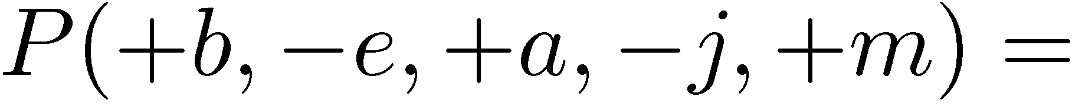
Example: Alarm Network
B | P(B)
+b | 0.001
-b | 0.999
B
E
E | P(E)
+e | 0.002
-e | 0.998
A
A | J | P(J|A)
+a | +j | 0.9
+a | -j | 0.1
-a | +j | 0.05
-a | -j | 0.95
A | M | P(M|A)
+a | +m | 0.7
+a | -m | 0.3
-a | +m | 0.01
-a | -m | 0.99
B | E | A | P(A|B,E)
+b | +e | +a | 0.95
+b | +e | -a | 0.05
+b | -e | +a | 0.94
+b | -e | -a | 0.06
-b | +e | +a | 0.29
-b | +e | -a | 0.71
-b | -e | +a | 0.001
-b | -e | -a | 0.999
J
M
Notes:
demo

Slide 6

Example: Alarm Network
B | P(B)
+b | 0.001
-b | 0.999
B
E
E | P(E)
+e | 0.002
-e | 0.998
A
A | J | P(J|A)
+a | +j | 0.9
+a | -j | 0.1
-a | +j | 0.05
-a | -j | 0.95
A | M | P(M|A)
+a | +m | 0.7
+a | -m | 0.3
-a | +m | 0.01
-a | -m | 0.99
B | E | A | P(A|B,E)
+b | +e | +a | 0.95
+b | +e | -a | 0.05
+b | -e | +a | 0.94
+b | -e | -a | 0.06
-b | +e | +a | 0.29
-b | +e | -a | 0.71
-b | -e | +a | 0.001
-b | -e | -a | 0.999
J
M
Notes:
demo

Slide 7
Modeling Example
There are 2 cups.
The first contains 1 penny and 1 quarter
The second contains 2 quarters
Say I pick a cup uniformly at random, then pick a coin randomly from that cup. It's a quarter (yes!).
What is the probability that the other coin in that cup is also a quarter?
Notes:
Model as C1 -> Q1 -> Q2. C1 is also a parent of Q2 (so 4 entries in CPT)

Slide 8

Bayes’ Nets
Representation
Conditional Independences
Probabilistic Inference
Enumeration (exact, exponential complexity)
Variable elimination (exact, worst-case exponential complexity, often better)
Inference is NP-complete
Sampling (approximate)
Learning Bayes’ Nets from Data

Slide 9

Inference
Inference: calculating some useful quantity from a joint probability distribution
Examples:
Posterior probability
Most likely explanation:

Slide 10





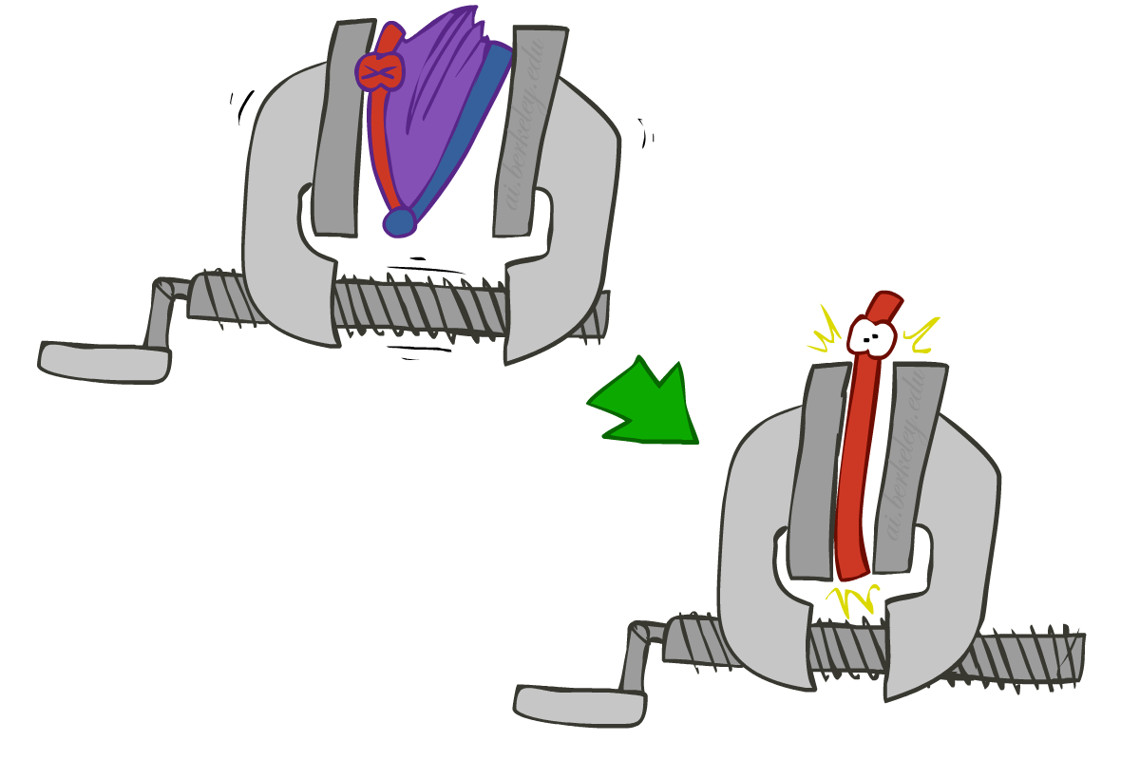
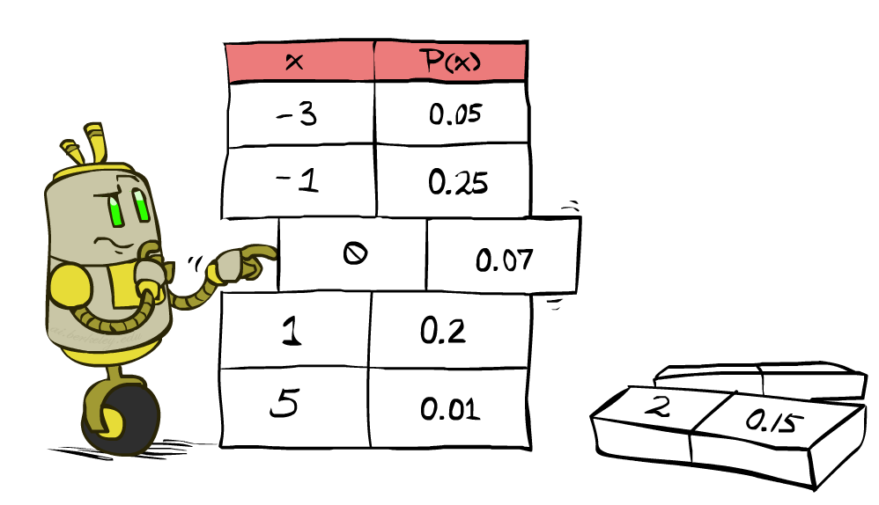


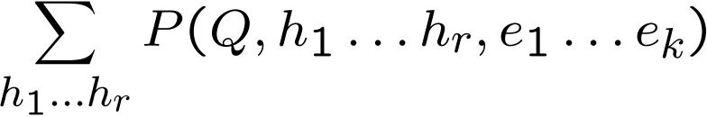
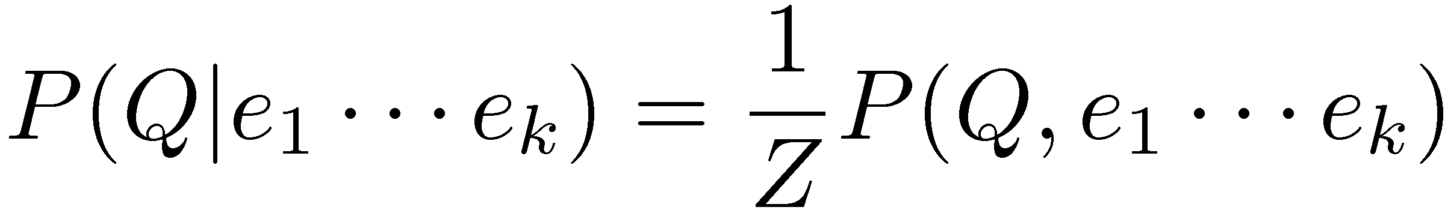
Inference by Enumeration
* Works fine with multiple query variables, too
General case:
Evidence variables:
Query* variable:
Hidden variables:
We want:
All variables
Step 1: Select the entries consistent with the evidence
Step 2: Sum out H to get joint of Query and evidence
Step 3: Normalize

Slide 11
Inference by Enumeration in Bayes’ Net
Given unlimited time, inference in BNs is easy
Reminder of inference by enumeration by example:
B
E
A
J
M

Slide 12
Inference Example
There are 2 cups.
The first contains 1 penny and 1 quarter
The second contains 2 quarters
Say I pick a cup uniformly at random, then pick a coin randomly from that cup. It's a quarter (yes!).
What is the probability that the other coin in that cup is also a quarter?
Notes:
Use net from a few slides ago. Summing over C1, get .5 for q2, .25 for ~q2 => 2/3 probability other coin a quarter

Slide 13
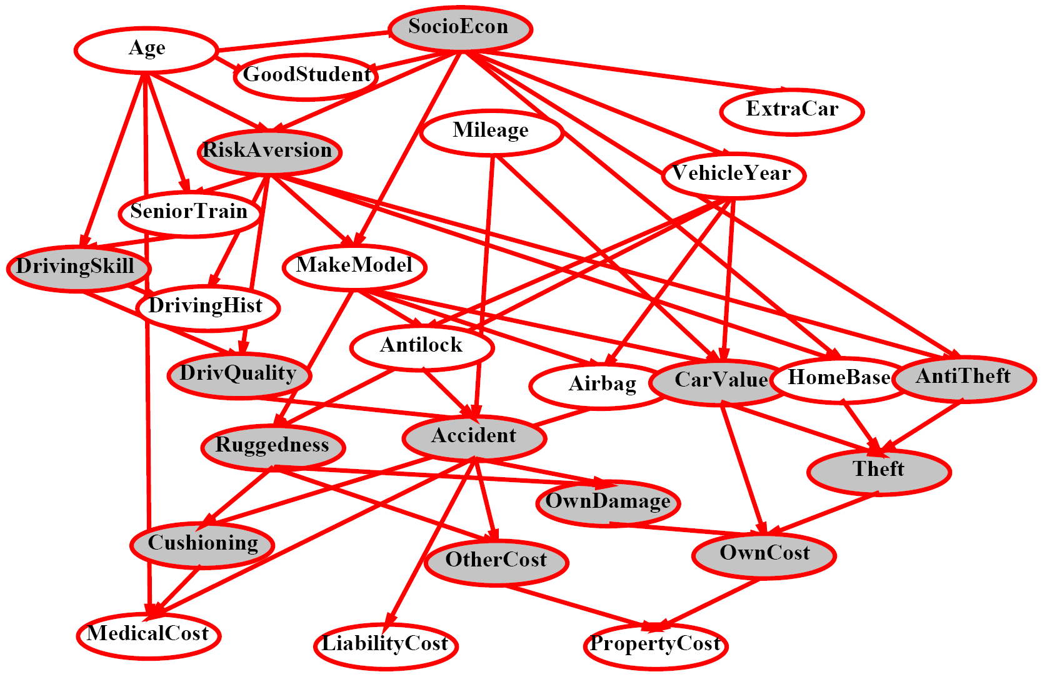
Inference by Enumeration?

Slide 14
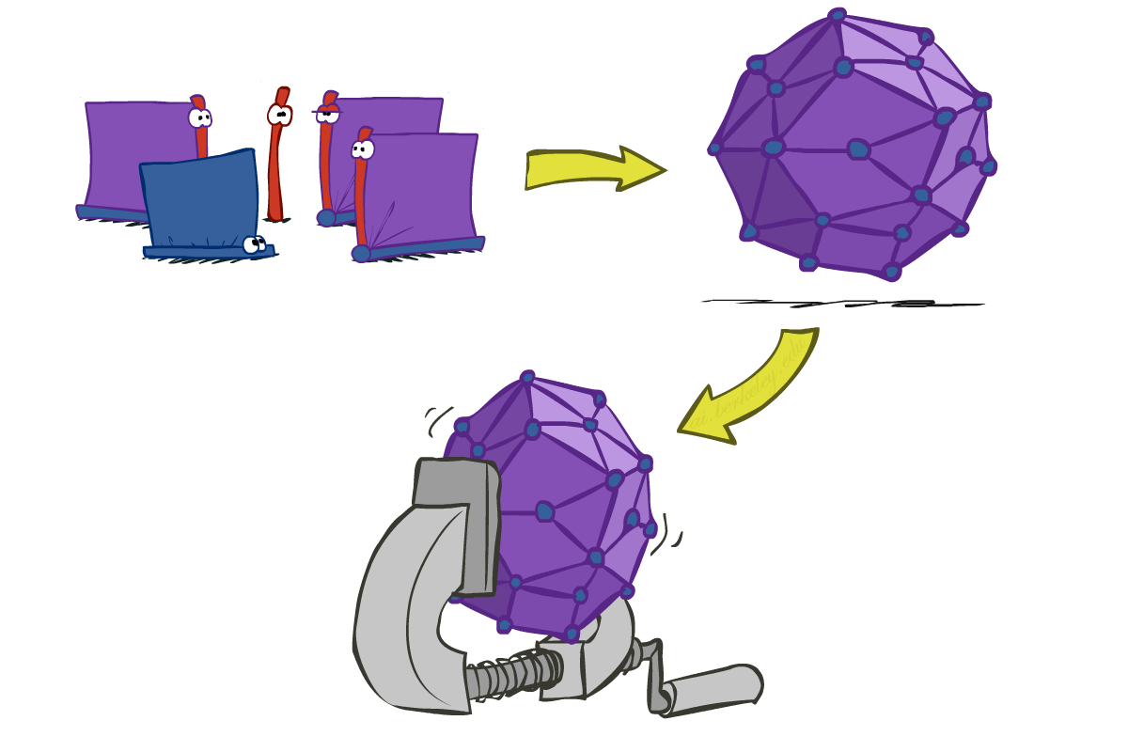
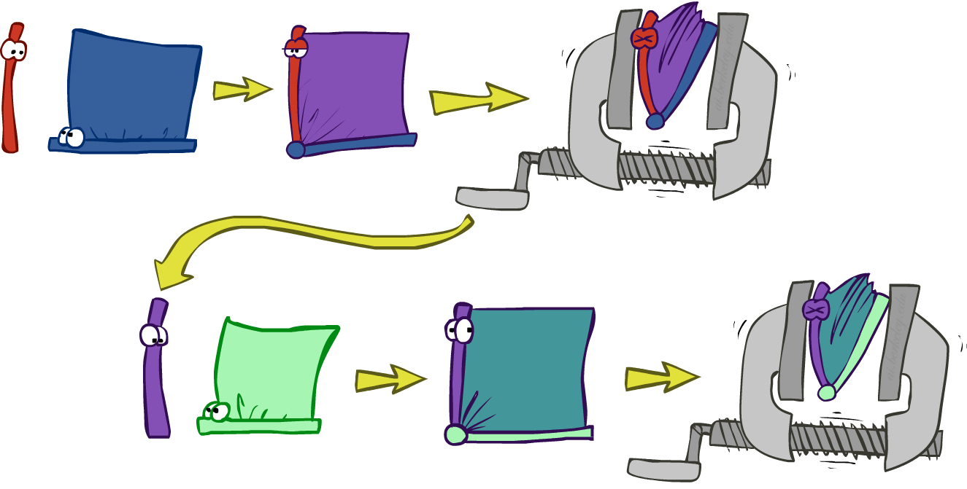
Inference by Enumeration vs. Variable Elimination
Why is inference by enumeration so slow?
You join up the whole joint distribution before you sum out the hidden variables
Idea: interleave joining and marginalizing!
Called “Variable Elimination”
Still NP-hard, but usually much faster than inference by enumeration
First we’ll need some new notation: factors

Slide 15
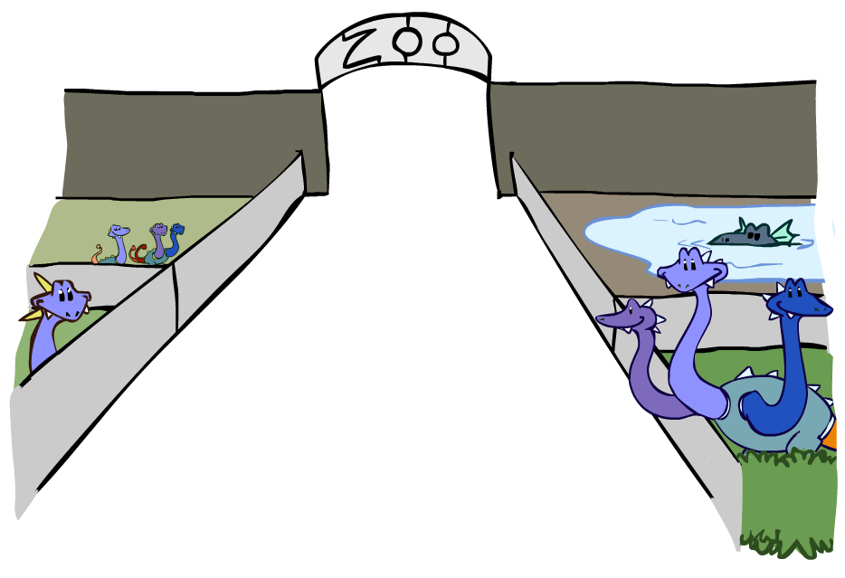
Factor Zoo

Slide 16



Factor Zoo I
Joint distribution: P(X,Y)
Entries P(x,y) for all x, y
Sums to 1
Selected joint: P(x,Y)
A slice of the joint distribution
Entries P(x,y) for fixed x, all y
Sums to P(x)
Number of capitals = dimensionality of the table
T | W | P
hot | sun | 0.4
hot | rain | 0.1
cold | sun | 0.2
cold | rain | 0.3
T | W | P
cold | sun | 0.2
cold | rain | 0.3

Slide 17
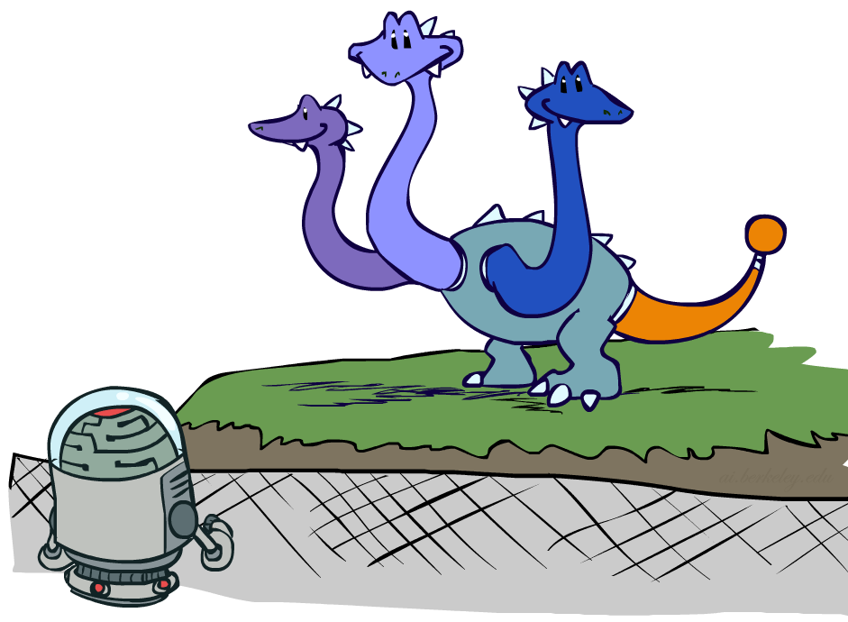

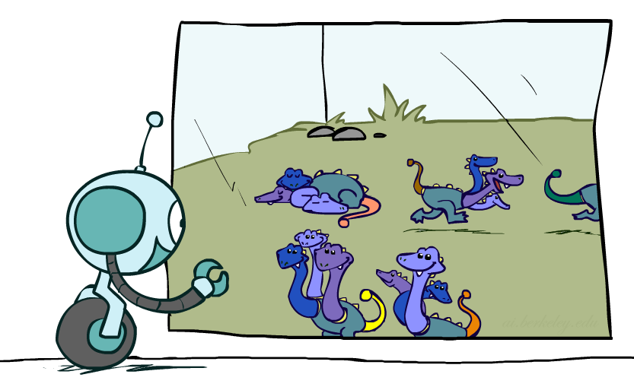



Factor Zoo II
Single conditional: P(Y | x)
Entries P(y | x) for fixed x, all y
Sums to 1
Family of conditionals:
P(X |Y)
Multiple conditionals
Entries P(x | y) for all x, y
Sums to |Y|
T | W | P
cold | sun | 0.4
cold | rain | 0.6
T | W | P
hot | sun | 0.8
hot | rain | 0.2
cold | sun | 0.4
cold | rain | 0.6

Slide 18
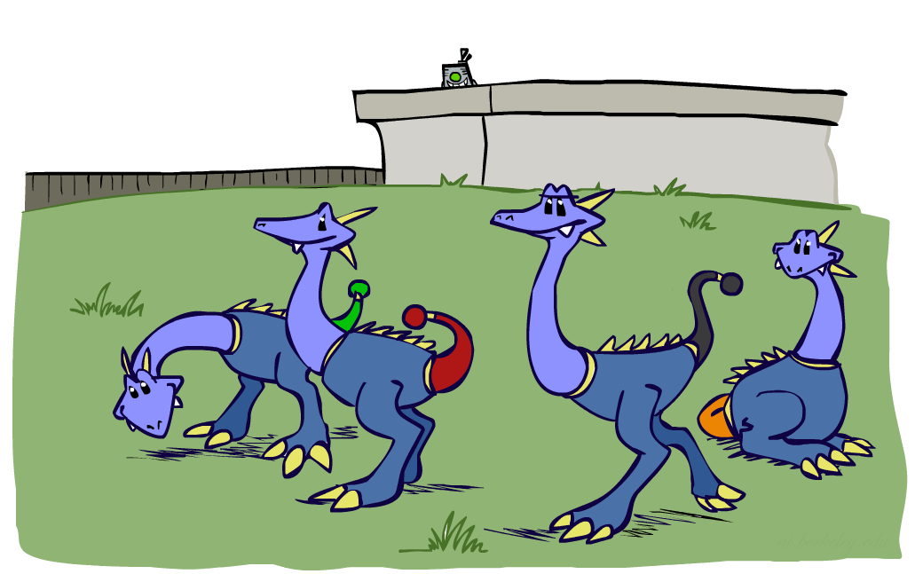



Factor Zoo III
Specified family: P( y | X )
Entries P(y | x) for fixed y,
but for all x
Sums to … who knows!
T | W | P
hot | rain | 0.2
cold | rain | 0.6

Slide 19




Factor Zoo Summary
In general, when we write P(Y₁ … Y_{N} | X₁ … X_{M})
It is a “factor,” a multi-dimensional array
Its values are P(y₁ … y_{N} | x₁ … x_{M})
Any assigned (=lower-case) X or Y is a dimension missing (selected) from the array

Slide 20



Example: Traffic Domain
Random Variables
R: Raining
T: Traffic
L: Late for class!
+r | 0.1
-r | 0.9
R
T
+r | +t | 0.8
+r | -t | 0.2
-r | +t | 0.1
-r | -t | 0.9
L
+t | +l | 0.3
+t | -l | 0.7
-t | +l | 0.1
-t | -l | 0.9

Slide 21
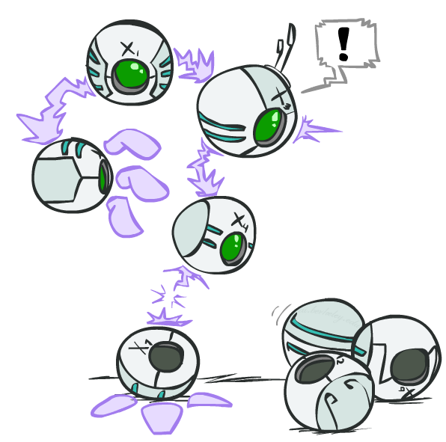
Variable Elimination (VE)

Slide 22







Inference by Enumeration: Procedural Outline
Track objects called factors
Initial factors are local CPTs (one per node)
Any known values are selected
E.g. if we know , the initial factors are
Procedure: Join all factors, then eliminate all hidden variables
+r | 0.1
-r | 0.9
+r | +t | 0.8
+r | -t | 0.2
-r | +t | 0.1
-r | -t | 0.9
+t | +l | 0.3
+t | -l | 0.7
-t | +l | 0.1
-t | -l | 0.9
+r | 0.1
-r | 0.9
+r | +t | 0.8
+r | -t | 0.2
-r | +t | 0.1
-r | -t | 0.9
+t | +l | 0.3
-t | +l | 0.1

Slide 23





Operation 1: Join Factors
First basic operation: joining factors
Combining factors:
Just like a database join
Get all factors over the joining variable
Build a new factor over the union of the variables involved
Example: Join on R
Computation for each entry: pointwise products
R
+r | 0.1
-r | 0.9
+r | +t | 0.8
+r | -t | 0.2
-r | +t | 0.1
-r | -t | 0.9
+r | +t | 0.08
+r | -t | 0.02
-r | +t | 0.09
-r | -t | 0.81
R,T
T

Slide 24
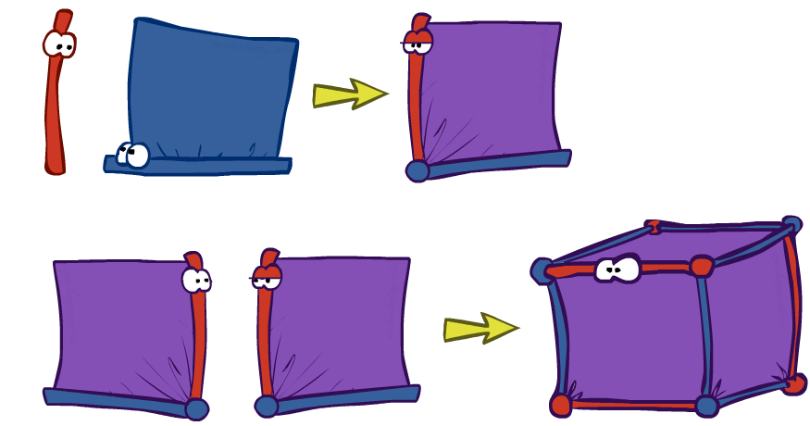
Example: Multiple Joins

Slide 25



Example: Multiple Joins
+r | 0.1
-r | 0.9
R
Join R
Join T
+r | +t | 0.08
+r | -t | 0.02
-r | +t | 0.09
-r | -t | 0.81
R, T, L
T
+r | +t | 0.8
+r | -t | 0.2
-r | +t | 0.1
-r | -t | 0.9
R, T
+r | +t | +l | 0.024
+r | +t | -l | 0.056
+r | -t | +l | 0.002
+r | -t | -l | 0.018
-r | +t | +l | 0.027
-r | +t | -l | 0.063
-r | -t | +l | 0.081
-r | -t | -l | 0.729
L
L
+t | +l | 0.3
+t | -l | 0.7
-t | +l | 0.1
-t | -l | 0.9
+t | +l | 0.3
+t | -l | 0.7
-t | +l | 0.1
-t | -l | 0.9

Slide 26
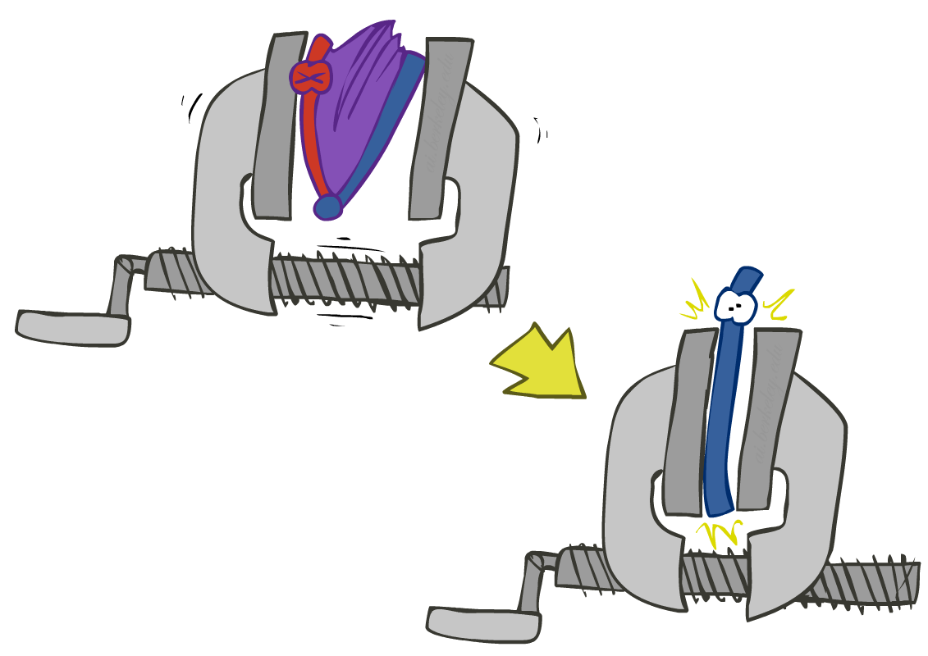


Operation 2: Eliminate
Second basic operation: marginalization
Take a factor and sum out a variable
Shrinks a factor to a smaller one
A projection operation
Example:
+r | +t | 0.08
+r | -t | 0.02
-r | +t | 0.09
-r | -t | 0.81
+t | 0.17
-t | 0.83

Slide 27



Multiple Elimination
R, T, L
T, L
L
+r | +t | +l | 0.024
+r | +t | -l | 0.056
+r | -t | +l | 0.002
+r | -t | -l | 0.018
-r | +t | +l | 0.027
-r | +t | -l | 0.063
-r | -t | +l | 0.081
-r | -t | -l | 0.729
Sum
out R
Sum
out T
+t | +l | 0.051
+t | -l | 0.119
-t | +l | 0.083
-t | -l | 0.747
+l | 0.134
-l | 0.886

Slide 28
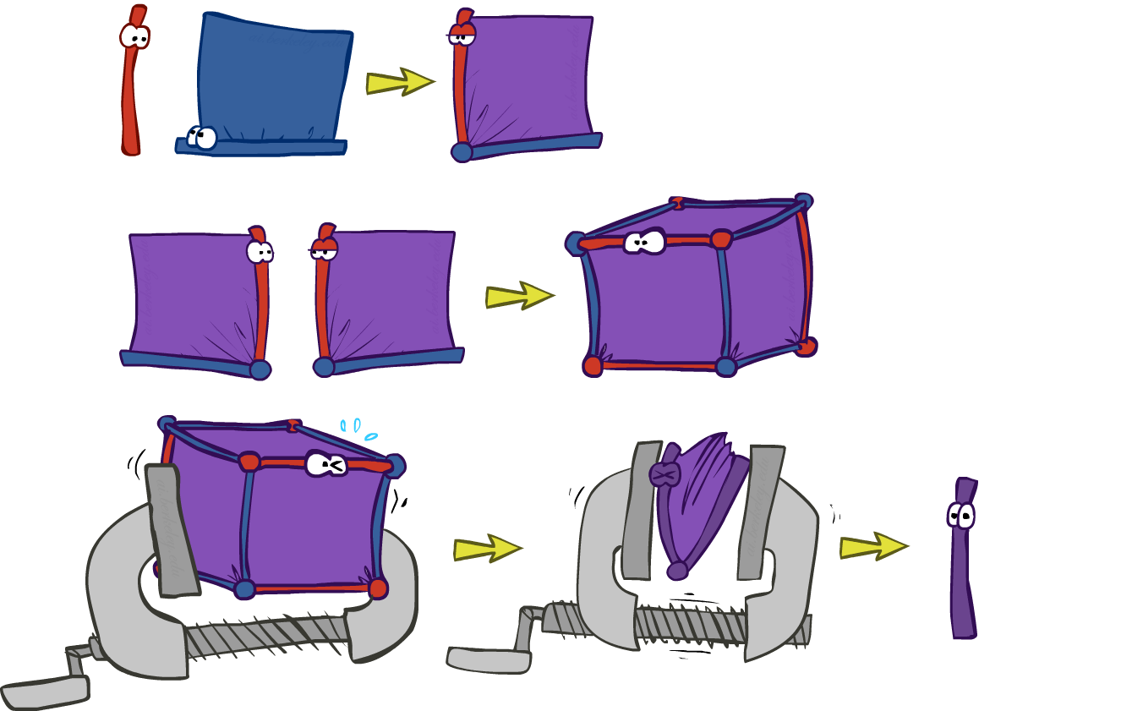
Thus Far: Multiple Join, Multiple Eliminate (= Inference by Enumeration)

Slide 29

Marginalizing Early (= Variable Elimination)

Slide 30
Traffic Domain
R
Inference by Enumeration
Variable Elimination
T
L
Join on r
Join on r
Join on t
Eliminate r
Eliminate r
Join on t
Eliminate t
Eliminate t

Slide 31


Marginalizing Early! (aka VE)
Join R
Sum out R
Join T
Sum out T
+r | +t | 0.08
+r | -t | 0.02
-r | +t | 0.09
-r | -t | 0.81
+r | 0.1
-r | 0.9
+t | 0.17
-t | 0.83
R
T
T, L
R, T
L
+r | +t | 0.8
+r | -t | 0.2
-r | +t | 0.1
-r | -t | 0.9
T
L
L
+t | +l | 0.051
+t | -l | 0.119
-t | +l | 0.083
-t | -l | 0.747
+l | 0.134
-l | 0.866
L
+t | +l | 0.3
+t | -l | 0.7
-t | +l | 0.1
-t | -l | 0.9
+t | +l | 0.3
+t | -l | 0.7
-t | +l | 0.1
-t | -l | 0.9
+t | +l | 0.3
+t | -l | 0.7
-t | +l | 0.1
-t | -l | 0.9

Slide 32
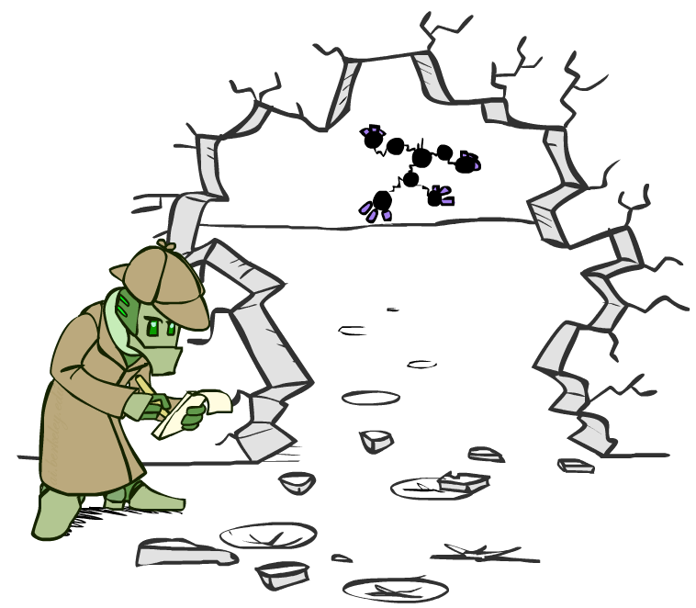



Evidence
If evidence, start with factors that select that evidence
No evidence uses these initial factors:
Computing , the initial factors become:
We eliminate all vars other than query + evidence
+r | 0.1
-r | 0.9
+r | +t | 0.8
+r | -t | 0.2
-r | +t | 0.1
-r | -t | 0.9
+t | +l | 0.3
+t | -l | 0.7
-t | +l | 0.1
-t | -l | 0.9
+r | 0.1
+r | +t | 0.8
+r | -t | 0.2
+t | +l | 0.3
+t | -l | 0.7
-t | +l | 0.1
-t | -l | 0.9

Slide 33

Evidence II
Result will be a selected joint of query and evidence
E.g. for P(L | +r), we would end up with:
To get our answer, just normalize this!
That ’s it!
Normalize
+r | +l | 0.026
+r | -l | 0.074
+l | 0.26
-l | 0.74

Slide 34

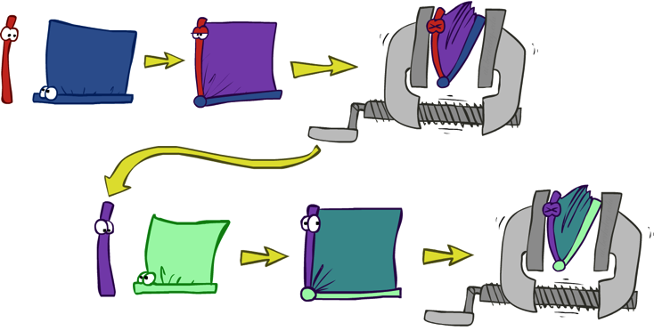


General Variable Elimination
Query:
Start with initial factors:
Local CPTs (but instantiated by evidence)
While there are still hidden variables (not Q or evidence):
Pick a hidden variable H
Join all factors mentioning H
Eliminate (sum out) H
Join all remaining factors and normalize

Slide 35
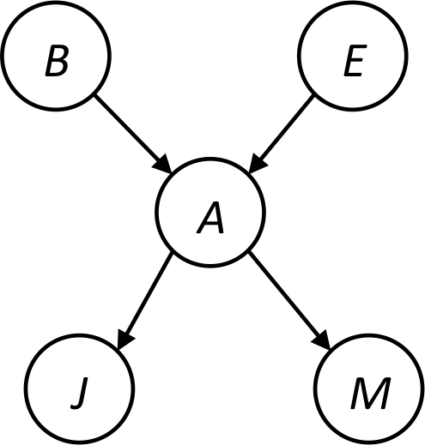









Example
Choose A

Slide 36




Example
Choose E
Finish with B
Normalize

Slide 37





Example 2: P(B|a)
Start / Select
Join on B
Normalize
B
a, B
B | P
+b | 0.1
¬b | 0.9
a
A | B | P
+a | +b | 0.08
+a | ¬b | 0.09
A | B | P
+a | +b | 8/17
+a | ¬b | 9/17
B | A | P
+b | +a | 0.8
b | ¬a | 0.2
¬b | +a | 0.1
¬b | ¬a | 0.9

Slide 38
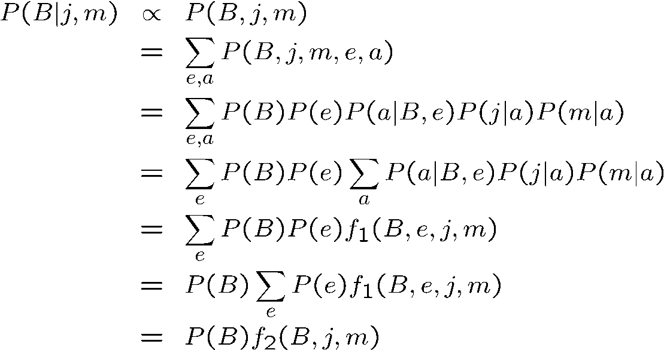
Same Example in Equations
marginal can be obtained from joint by summing out
use Bayes’ net joint distribution expression
use x*(y+z) = xy + xz
joining on a, and then summing out gives f₁
use x*(y+z) = xy + xz
joining on e, and then summing out gives f₂
All we are doing is exploiting uwy + uwz + uxy + uxz + vwy + vwz + vxy +vxz = (u+v)(w+x)(y+z) to improve computational efficiency!

Slide 39

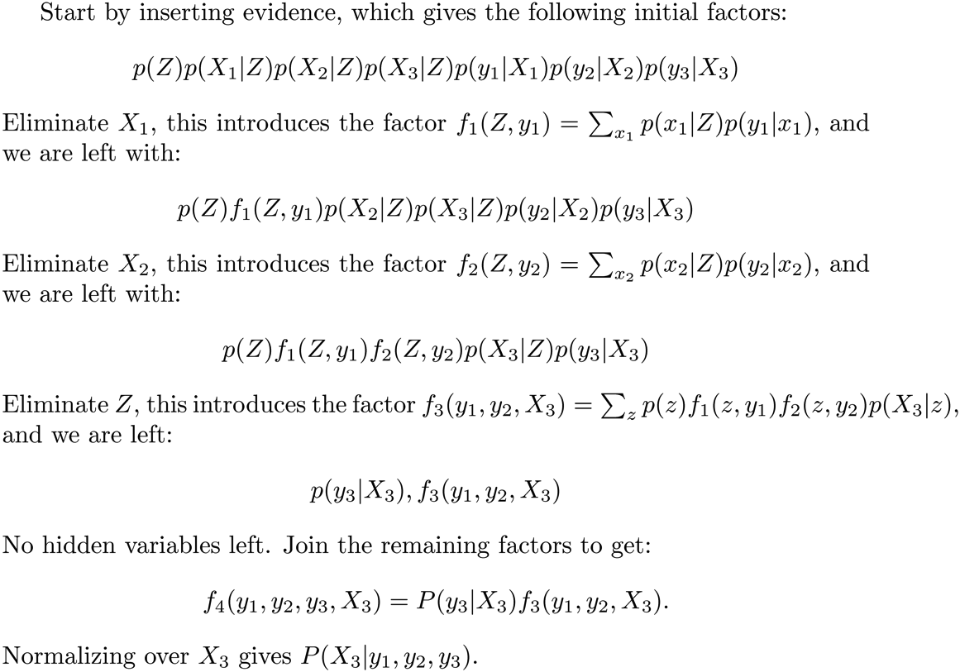






Another Variable Elimination Example
Computational complexity critically depends on the largest factor being generated in this process. Size of factor = number of entries in table. In example above (assuming binary) all factors generated are of size 2 --- as they all only have one variable (Z, Z, and X₃ respectively).

Slide 40




Variable Elimination Ordering
For the query P(X_{n}|y₁,…,y_{n}) work through the following two different orderings as done in previous slide: Z, X₁, …, X_{n-1} and X₁, …, X_{n-1}, Z. What is the size of the maximum factor generated for each of the orderings?
Answer: 2^{n+1} versus 2² (assuming binary)
In general: the ordering can greatly affect efficiency.
…
…

Slide 41
VE: Computational and Space Complexity
The computational and space complexity of variable elimination is determined by the largest factor
The elimination ordering can greatly affect the size of the largest factor.
E.g., previous slide’s example 2^{n} vs. 2
Does there always exist an ordering that only results in small factors?
No!

Slide 42















Worst Case Complexity?
CSP:
If we can answer P(z) equal to zero or not, we answered whether the 3-SAT problem has a solution.
Hence inference in Bayes’ nets is NP-hard. No known efficient probabilistic inference in general.
…
…

Slide 43
Polytrees
A polytree is a directed graph with no undirected cycles
For poly-trees you can always find an ordering that is efficient
Try it!!
Cut-set conditioning for Bayes’ net inference
Choose set of variables such that if removed only a polytree remains
Exercise: Think about how the specifics would work out!

Slide 44

Bayes’ Nets
Representation
Conditional Independences
Probabilistic Inference
Enumeration (exact, exponential complexity)
Variable elimination (exact, worst-case exponential complexity, often better)
Inference is NP-complete
Sampling (approximate)
Learning Bayes’ Nets from Data

Slide 45
Announcements
Homework 8 is out
Due Monday 4/7 at 11:59pm
Final Contest (Optional)
On-going!

Slide 46
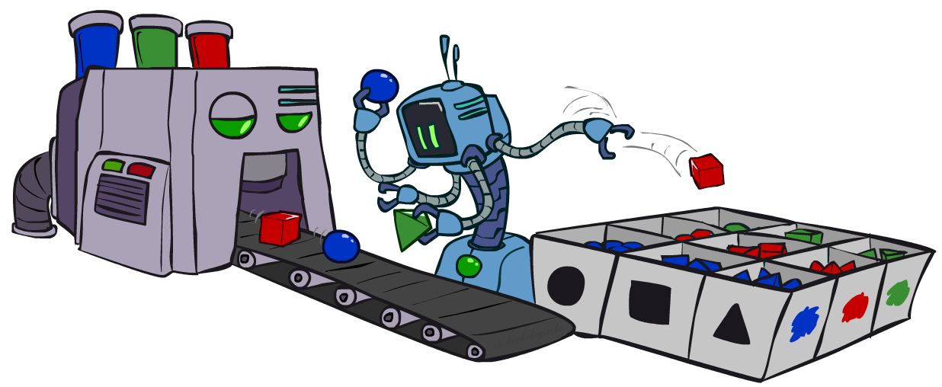
CS 188: Artificial Intelligence
Bayes’ Nets: Sampling
Instructors: Dan Klein and Pieter Abbeel --- University of California, Berkeley
[These slides were created by Dan Klein and Pieter Abbeel for CS188 Intro to AI at UC Berkeley. All CS188 materials are available at http://ai.berkeley.edu.]
Notes:
Please retain proper attribution, including the reference to ai.berkeley.edu. Thanks!

Slide 47
Bayes’ Net Representation
A directed, acyclic graph, one node per random variable
A conditional probability table (CPT) for each node
A collection of distributions over X, one for each combination of parents’ values
Bayes’ nets implicitly encode joint distributions
As a product of local conditional distributions
To see what probability a BN gives to a full assignment, multiply all the relevant conditionals together:

Slide 48

Variable Elimination
Interleave joining and marginalizing
d^{k} entries computed for a factor over k variables with domain sizes d
Ordering of elimination of hidden variables can affect size of factors generated
Worst case: running time exponential in the size of the Bayes’ net
…
…

Slide 49
Worst Case Complexity?
CSP:
If we can answer P(z) equal to zero or not, we answered whether the 3-SAT problem has a solution.
Hence inference in Bayes’ nets is NP-hard. No known efficient probabilistic inference in general.
…
…

Slide 50

Approximate Inference: Sampling

Slide 51

Sampling
Sampling is a lot like repeated simulation
Predicting the weather, basketball games, …
Basic idea
Draw N samples from a sampling distribution S
Compute an approximate posterior probability
Show this converges to the true probability P
Why sample?
Learning: get samples from a distribution you don’t know
Inference: getting a sample is faster than computing the right answer (e.g. with variable elimination)

Slide 52
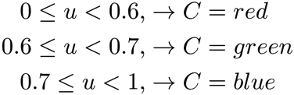

Sampling
Sampling from given distribution
Step 1: Get sample u from uniform distribution over [0, 1)
E.g. random() in python
Step 2: Convert this sample u into an outcome for the given distribution by having each outcome associated with a sub-interval of [0,1) with sub-interval size equal to probability of the outcome
Example
If random() returns u = 0.83, then our sample is C = blue
E.g, after sampling 8 times:
C | P(C)
red | 0.6
green | 0.1
blue | 0.3

Slide 53
Sampling in Bayes’ Nets
Prior Sampling
Rejection Sampling
Likelihood Weighting
Gibbs Sampling

Slide 54
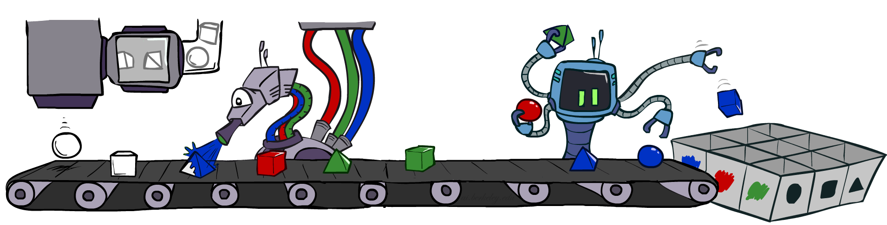
Prior Sampling

Slide 55




Prior Sampling
+c | 0.5
-c | 0.5
Cloudy
Cloudy
+c | +s | 0.1
 | -s | 0.9
-c | +s | 0.5
 | -s | 0.5
+c | +r | 0.8
 | -r | 0.2
-c | +r | 0.2
 | -r | 0.8
Sprinkler
Sprinkler
Rain
Rain
WetGrass
WetGrass
Samples:
+s | +r | +w | 0.99
 |  | -w | 0.01
 | -r | +w | 0.90
 |  | -w | 0.10
-s | +r | +w | 0.90
 |  | -w | 0.10
 | -r | +w | 0.01
 |  | -w | 0.99
+c, -s, +r, +w
-c, +s, -r, +w
…

Slide 56
Prior Sampling
For i=1, 2, …, n
Sample x_{i} from P(X_{i} | Parents(X_{i}))
Return (x₁, x₂, …, x_{n})

Slide 57
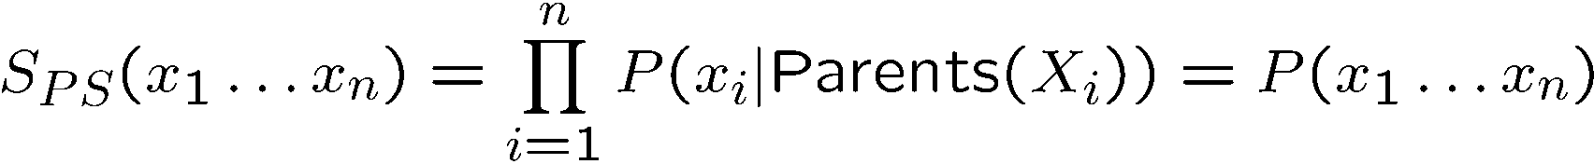

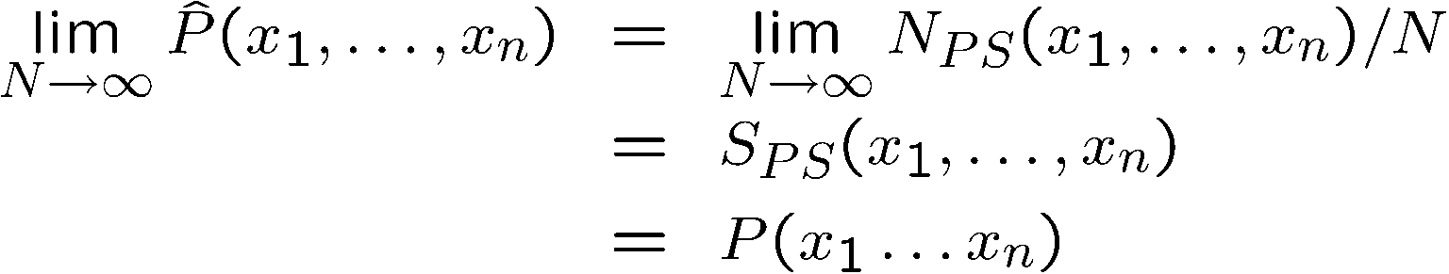
Prior Sampling
This process generates samples with probability:
…i.e. the BN’s joint probability
Let the number of samples of an event be
Then
I.e., the sampling procedure is consistent

Slide 58
Example
We’ll get a bunch of samples from the BN:
+c, -s, +r, +w
+c, +s, +r, +w
-c, +s, +r, -w
+c, -s, +r, +w
-c, -s, -r, +w
If we want to know P(W)
We have counts <+w:4, -w:1>
Normalize to get P(W) = <+w:0.8, -w:0.2>
This will get closer to the true distribution with more samples
Can estimate anything else, too
What about P(C| +w)? P(C| +r, +w)? P(C| -r, -w)?
Fast: can use fewer samples if less time (what’s the drawback?)
C
S
R
W

Slide 59
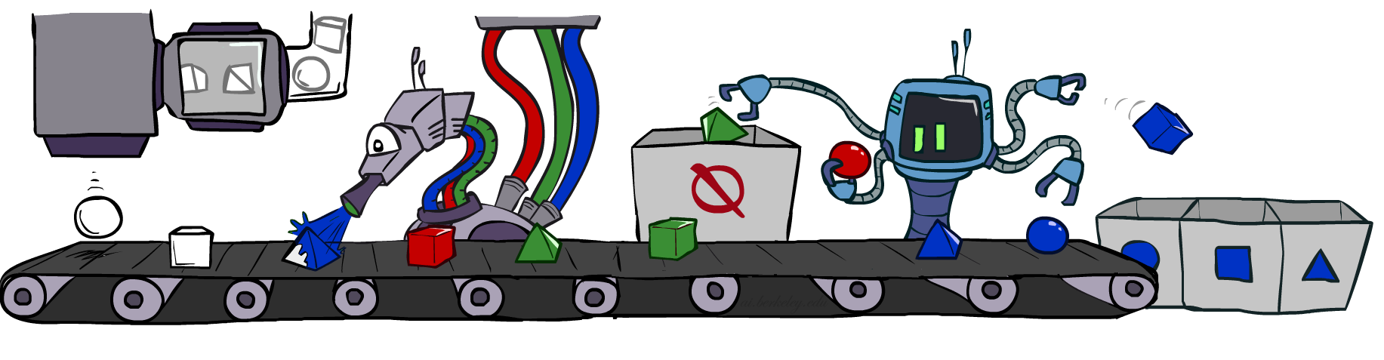
Rejection Sampling

Slide 60
Rejection Sampling
Let’s say we want P(C)
No point keeping all samples around
Just tally counts of C as we go
Let’s say we want P(C| +s)
Same thing: tally C outcomes, but ignore (reject) samples which don’t have S=+s
This is called rejection sampling
It is also consistent for conditional probabilities (i.e., correct in the limit)
C
S
R
W
+c, -s, +r, +w
+c, +s, +r, +w
-c, +s, +r, -w
+c, -s, +r, +w
-c, -s, -r, +w

Slide 61
Rejection Sampling
IN: evidence instantiation
For i=1, 2, …, n
Sample x_{i} from P(X_{i} | Parents(X_{i}))
If x_{i} not consistent with evidence
Reject: Return, and no sample is generated in this cycle
Return (x₁, x₂, …, x_{n})

Slide 62
Inference Example
There are 2 cups.
The first contains 1 penny and 1 quarter
The second contains 2 quarters
Say I pick a cup uniformly at random, then pick a coin randomly from that cup. It's a quarter (yes!).
What is the probability that the other coin in that cup is also a quarter?
Notes:
Use net from beginning. Show that rejection sampling wastes ¼ of samples – thrown out. Same answer with likelihood weighting more efficiently.

Slide 63
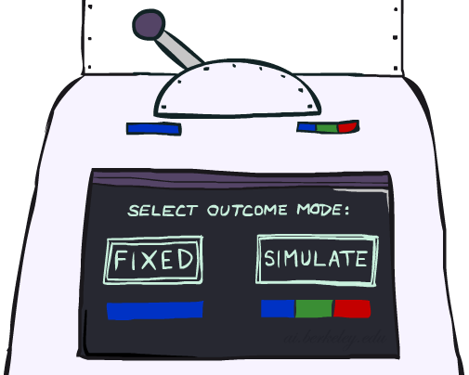
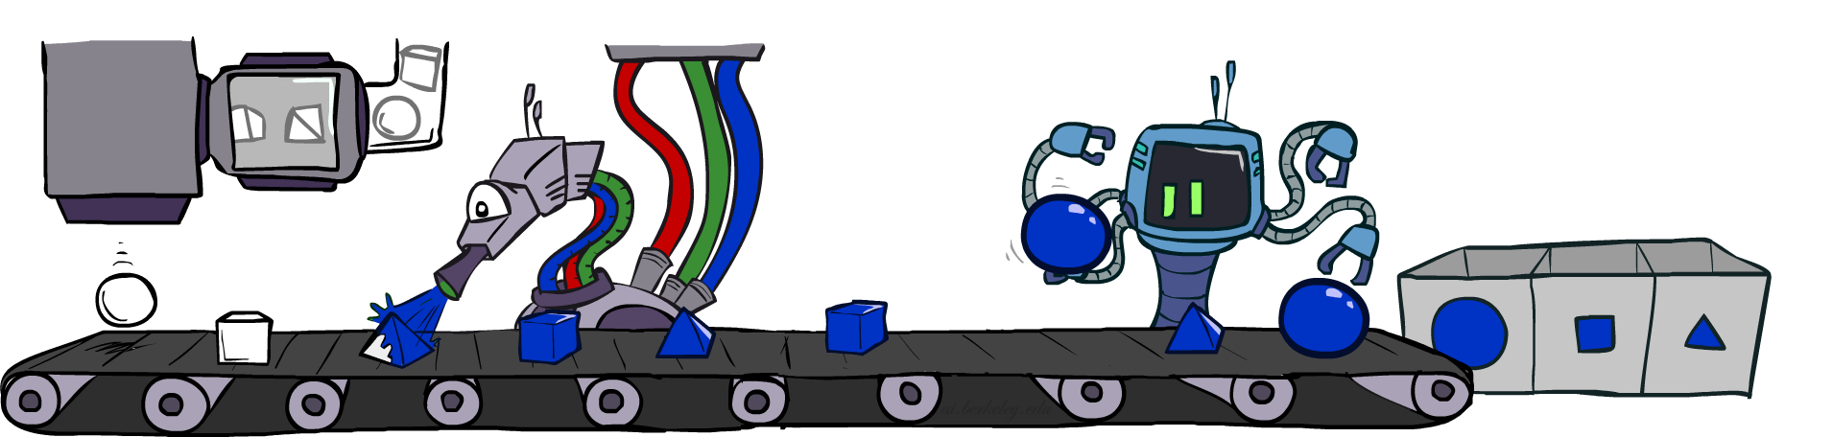
Likelihood Weighting

Slide 64
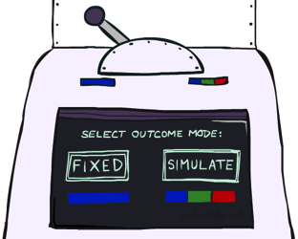


Likelihood Weighting
Problem with rejection sampling:
If evidence is unlikely, rejects lots of samples
Evidence not exploited as you sample
Consider P(Shape|blue)
Idea: fix evidence variables and sample the rest
Problem: sample distribution not consistent!
Solution: weight by probability of evidence given parents
pyramid, green
pyramid, red
sphere, blue
cube, red
sphere, green
pyramid, blue
pyramid, blue
sphere, blue
cube, blue
sphere, blue
Shape
Color
Shape
Color

Slide 65



Likelihood Weighting
+c | 0.5
-c | 0.5
Cloudy
Cloudy
+c | +s | 0.1
 | -s | 0.9
-c | +s | 0.5
 | -s | 0.5
+c | +r | 0.8
 | -r | 0.2
-c | +r | 0.2
 | -r | 0.8
Sprinkler
Sprinkler
Rain
Rain
WetGrass
Samples:
WetGrass
+s | +r | +w | 0.99
 |  | -w | 0.01
 | -r | +w | 0.90
 |  | -w | 0.10
-s | +r | +w | 0.90
 |  | -w | 0.10
 | -r | +w | 0.01
 |  | -w | 0.99
+c, +s, +r, +w
…

Slide 66
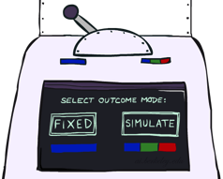
Likelihood Weighting
IN: evidence instantiation
w = 1.0
for i=1, 2, …, n
if X_{i} is an evidence variable
X_{i} = observation x_{i} for X_{i}
Set w = w * P(x_{i} | Parents(X_{i}))
else
Sample x_{i} from P(X_{i} | Parents(X_{i}))
return (x₁, x₂, …, x_{n}), w

Slide 67
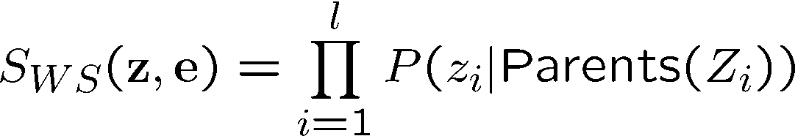
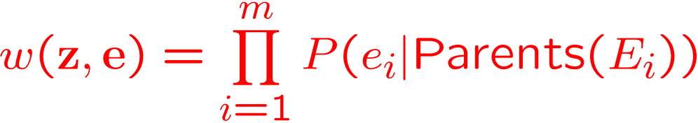
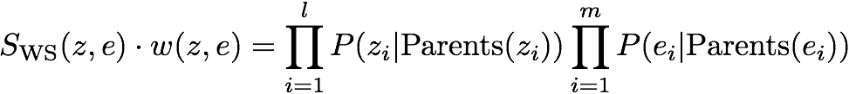

Likelihood Weighting
Sampling distribution if z sampled and e fixed evidence
Now, samples have weights
Together, weighted sampling distribution is consistent
Cloudy
C
S
R
W

Slide 68

Likelihood Weighting
Likelihood weighting is good
We have taken evidence into account as we generate the sample
E.g. here, W’s value will get picked based on the evidence values of S, R
More of our samples will reflect the state of the world suggested by the evidence
Likelihood weighting doesn’t solve all our problems
Evidence influences the choice of downstream variables, but not upstream ones (C isn’t more likely to get a value matching the evidence)
We would like to consider evidence when we sample every variable
→ Gibbs sampling

Slide 69

Gibbs Sampling

Slide 70
Gibbs Sampling
Procedure: keep track of a full instantiation x₁, x₂, …, x_{n}. Start with an arbitrary instantiation consistent with the evidence. Sample one variable at a time, conditioned on all the rest, but keep evidence fixed. Keep repeating this for a long time.
Property: in the limit of repeating this infinitely many times the resulting sample is coming from the correct distribution
Rationale: both upstream and downstream variables condition on evidence.
In contrast: likelihood weighting only conditions on upstream evidence, and hence weights obtained in likelihood weighting can sometimes be very small. Sum of weights over all samples is indicative of how many “effective” samples were obtained, so want high weight.

Slide 71
Gibbs Sampling Example: P( S | +r)
Step 1: Fix evidence
R = +r
Steps 3: Repeat
Choose a non-evidence variable X
Resample X from P( X | all other variables)
Step 2: Initialize other variables
Randomly
C
C
S
+r
S
+r
W
W
C
C
C
C
C
C
S
+r
S
+r
S
+r
S
+r
S
+r
S
+r
W
W
W
W
W
W

Slide 72
Gibbs Sampling
How is this better than sampling from the full joint?
In a Bayes’ Net, sampling a variable given all the other variables (e.g. P(R|S,C,W)) is usually much easier than sampling from the full joint distribution
Only requires a join on the variable to be sampled (in this case, a join on R)
The resulting factor only depends on the variable’s parents, its children, and its children’s parents (this is often referred to as its Markov blanket)

Slide 73
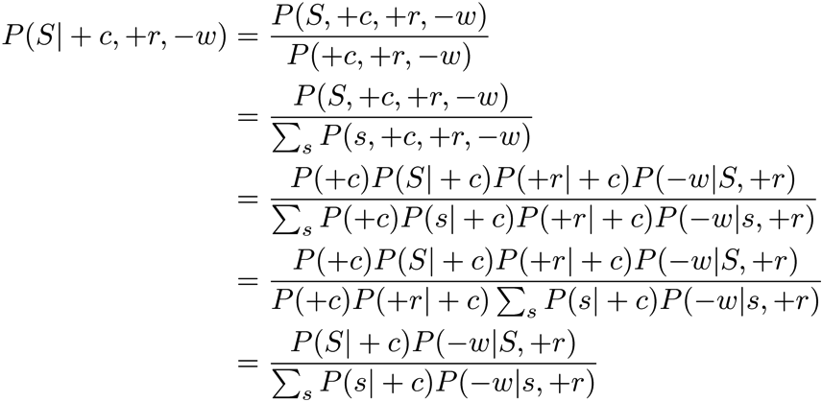
Efficient Resampling of One Variable
C
Sample from P(S | +c, +r, -w)
Many things cancel out – only CPTs with S remain!
More generally: only CPTs that have resampled variable need to be considered, and joined together
S
+r
W

Slide 74


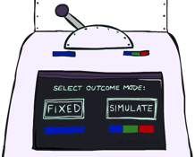
Bayes’ Net Sampling Summary
Prior Sampling P
Likelihood Weighting P( Q | e)
Rejection Sampling P( Q | e )
Gibbs Sampling P( Q | e )

Slide 75
Further Reading on Gibbs Sampling*
Gibbs sampling produces sample from the query distribution P( Q | e ) in limit of re-sampling infinitely often
Gibbs sampling is a special case of more general methods called Markov chain Monte Carlo (MCMC) methods
Metropolis-Hastings is one of the more famous MCMC methods (in fact, Gibbs sampling is a special case of Metropolis-Hastings)
You may read about Monte Carlo methods – they’re just sampling

Slide 76
How About Particle Filtering?
X₁
X₂
X₂
= likelihood weighting
E₂
Elapse
Weight
Resample
Particles:
(3,3)
(2,3)
(3,3)
(3,2)
(3,3)
(3,2)
(1,2)
(3,3)
(3,3)
(2,3)
Particles:
(3,2)
(2,3)
(3,2)
(3,1)
(3,3)
(3,2)
(1,3)
(2,3)
(3,2)
(2,2)
Particles:
(3,2) w=.9
(2,3) w=.2
(3,2) w=.9
(3,1) w=.4
(3,3) w=.4
(3,2) w=.9
(1,3) w=.1
(2,3) w=.2
(3,2) w=.9
(2,2) w=.4
(New) Particles:
(3,2)
(2,2)
(3,2)
(2,3)
(3,3)
(3,2)
(1,3)
(2,3)
(3,2)
(3,2)

Slide 77
Particle Filtering
Particle filtering operates on ensemble of samples
Performs likelihood weighting for each individual sample to elapse time and incorporate evidence
Resamples from the weighted ensemble of samples to focus computation for the next time step where most of the probability mass is estimated to be

Slide 78
Markov Chain Monte Carlo*
Idea: instead of sampling from scratch, create samples that are each like the last one.
Procedure: resample one variable at a time, conditioned on all the rest, but keep evidence fixed. E.g., for P(b|c):
Properties: Now samples are not independent (in fact they’re nearly identical), but sample averages are still consistent estimators!
What’s the point: both upstream and downstream variables condition on evidence.
+b
+a
+c
-b
+a
+c
-b
-a
+c

