Slide 1


Source Task Creation for
Curriculum Learning
Sanmit Narvekar, Jivko Sinapov, Matteo Leonetti, and Peter Stone
Department of Computer Science
University of Texas at Austin
{sanmit, jsinapov, matteo, pstone} @cs.utexas.edu

Slide 2

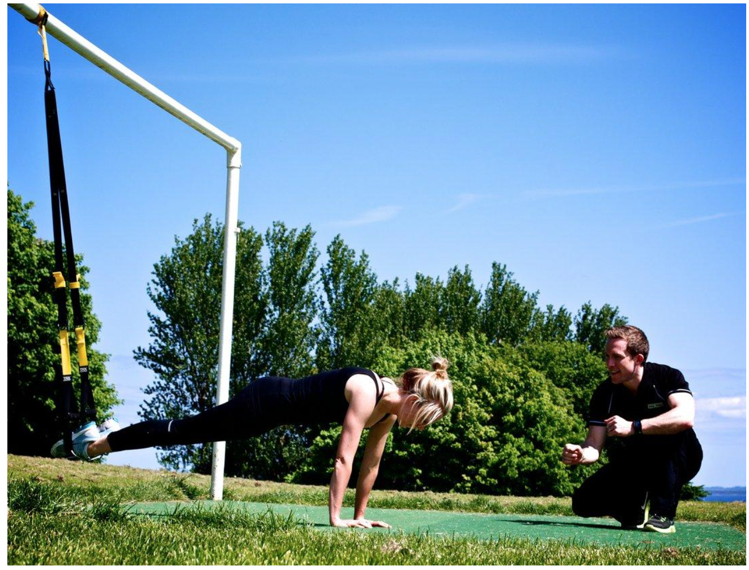
Introduction
Curricula widespread in human learning
  Education, sports, games…
Why curricula?
  Target task too hard to make progress
  Faster to learn and combine skills from
  easier tasks
A good curriculum:
Breaks down the task
Lets the agent learn on its own
Adjusts to the progress of the agent
Notes:
The idea of using a curriculum to guide human learning is used everywhere
Often times… they depend on subskills, that are easier to learn independently and combine
We use curricula because …
Seeks to address these problems by

Slide 3
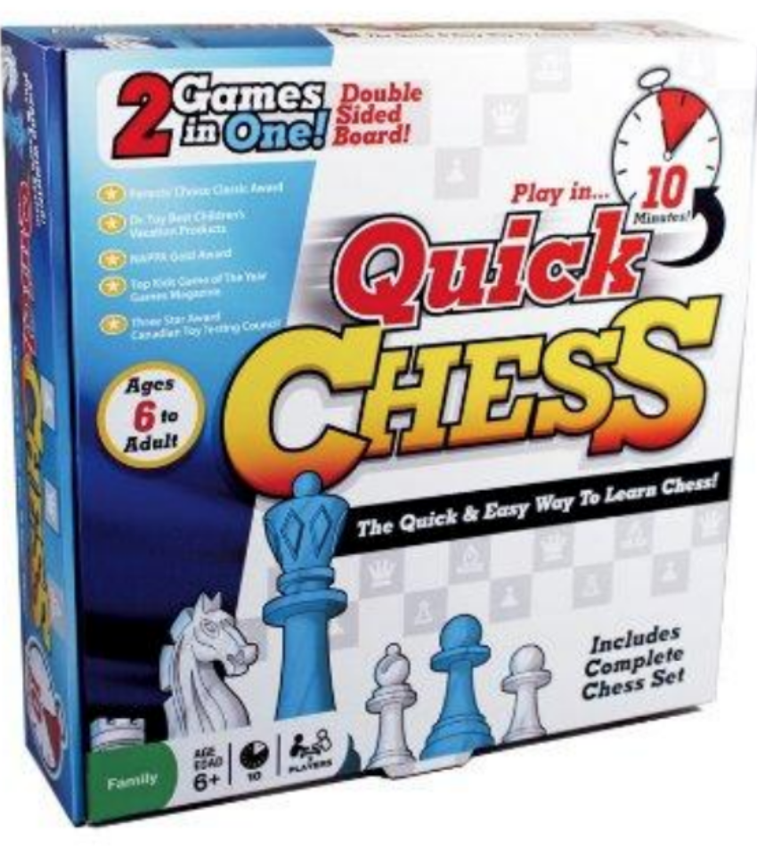
Example: Quick Chess
Quickly learn the fundamentals of chess
5 x 6 board
Fewer pieces per type
No castling
No en-passant
Notes:
Here’s one example of a curriculum, used to teach people how to play chess
It uses a simplified board and gradually introduces different elements of the game
which I’ll use to explain ideas later
Game designed to gradually introduce players to the full game of chess.

Slide 4
Example: Quick Chess
. . . . . .
Notes:
So for example, the first game would be a game with only pawns, where you learn how they move.
Next game has a king, next a rook, etc. Each successive game adds new elements until you reach the full game
Keep rules real. Fix images to exactly match the game

Slide 5
Task Space
Pawns + King
Pawns only
Target task
Empty task
One piece per type
Quick Chess is a curriculum designed for people
We want to do something similar for autonomous agents
Notes:
One way to represent this curriculum is as follows:
So if you think about this as a curriculum, basically
The orange circles represent all the possible quick chess “subgames”.
So for example, in the curriculum we just showed,
A curriculum is some path through this space.
At some point in this slide, we have to say rather than creating a fixed curriculum for everyone (and a fixed set of tasks), we want to incrementally build one based on observing the agent’s performance in the task. So the goal is to create these nodes. State research question and contributions. Maybe show recursively building a curricula by . Say we create a set of heuristic functions to create these tasks. And then we show that these are useful in creating a successful and useful curriculum for transfer. However, suppose the agent already has some of this knowledge, or due to different sensors or representation, it learns differently….

Slide 6
Curriculum Learning
Task = MDP
Environment
State
Reward
Action
Agent
Task Creation
Sequencing
Transfer Learning
Curriculum learning is a complex problem that ties task creation, sequencing, and transfer learning
Notes:
In order to do this, there are 3 parts
First we need to come up with a space of source tasks. Here (in RL) a task is represented as an MDP
Then we need to find a sequence of such tasks
During this process, we need to transfer knowledge between
The full problem of curriculum learning …

Slide 7
Transfer Learning
Task Creation
Sequencing
Transfer Learning
Well studied problem [Taylor 2009, Lazaric 2011]
Given a source and target task, how to transfer knowledge
  We transfer value functions
Notes:
There has been a lot of work on this part of the problem. We *leverage* these results…
Say value function seeds learning.
A number of methods have been proposed to do this: transferring models, policies, samples, etc.
We are going to assume that some suitable way exists (i.e. one of those listed before works)

Slide 8
Task Creation
Task Creation
Sequencing
Transfer Learning
This talk will focus on task creation
Automatic sequencing is an important direction for future work
Show we can create a useful space of tasks to compose a curriculum
Notes:
These other 2 are new problems. This talk is going to address the first of these 2 problems.
Emphasize more that sequencing will be future work.
(Instead) this (or the rest of this) talk focus on task creation (forming the orange bubbles)
Challenge is to create orange in domain –independent way.

Slide 9
Task Creation

Slide 10
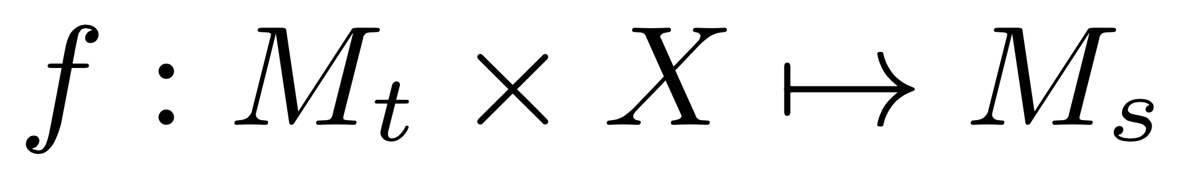
Formalism for Task Creation
Key Idea: create tasks using both domain knowledge and by observing the agent’s performance on a task
We propose a formalism for task creation
Consists of a set of heuristic functions
that create a source task M_{s} given a target task M_{t} and (s,a,s’,r) trajectory tuples X from M_{t}
Formalism is domain-independent (applicable to many domains)
Notes:
We formalize how a new source mdp can be created given a target task MDP.
Quick chess used a fixed curriculum for everyone. We would instead like to suggest source tasks also based on observing agent performance.
State dynamically created tasks? Or that each modifies an MDP?

Slide 11

Formalism for Task Creation
Each function alters different parts of the MDP M to create source tasks
Rewards
State/Action Space
Reward for promotion
Transitions
Initial/Terminal State Distributions

Slide 12
Heuristic Functions
Uses knowledge of domain
Task Simplification
Promising Initializations
Mistake Learning
Action Simplification
Option-based Subgoals
Task-based Subgoals
Composite Subtasks
Observes the agent
Notes:
In this talk, I’m going to talk about 3 of them. One uses domain knowledge, the other two observe the agent.
The rest you can find in the paper.

Slide 13
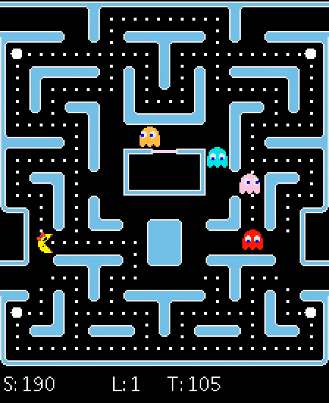
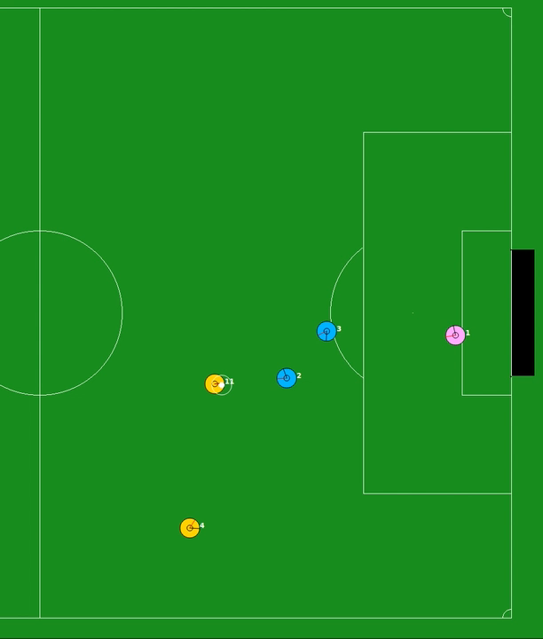
Experimental Domains
Ms. Pac-Man
Half Field Offense
Notes:
I’m going to quickly introduce 2 additional experimental domains
To show how we can use these functions to create tasks in different domains.
Pacman: you control ms. Pac-man. Goal is to accumulate points by eating things like pills while avoiding getting eaten by ghosts
HFO: subset of full simulated soccer game. Goal is to score against an opposing team.

Slide 14
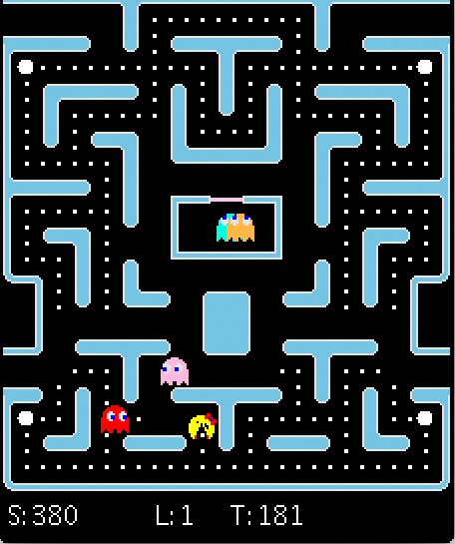
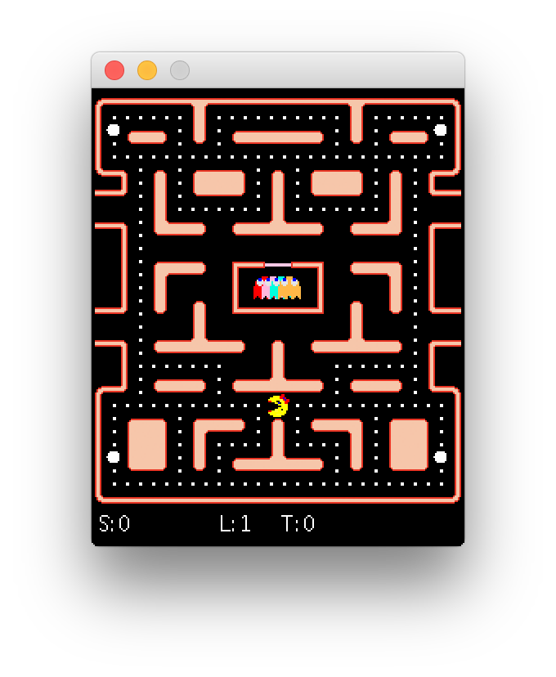
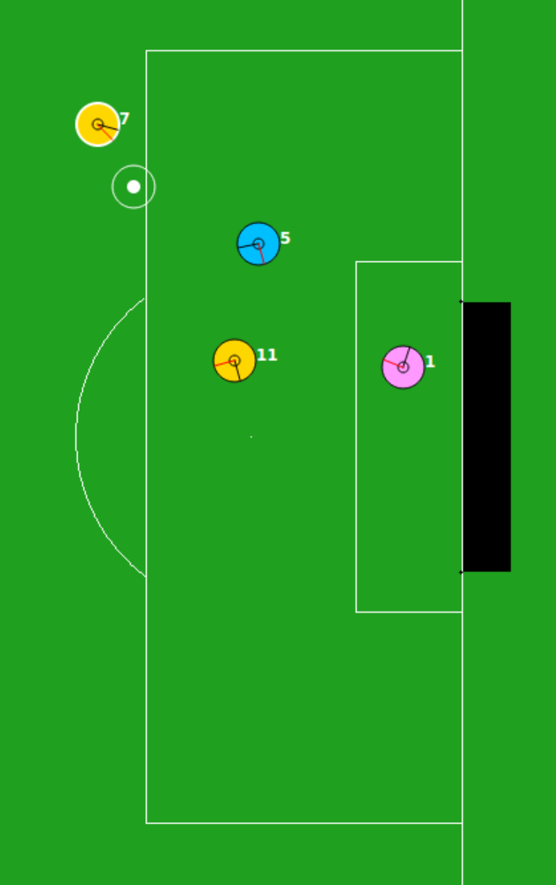
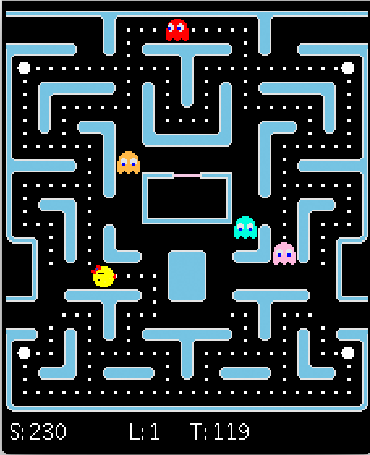
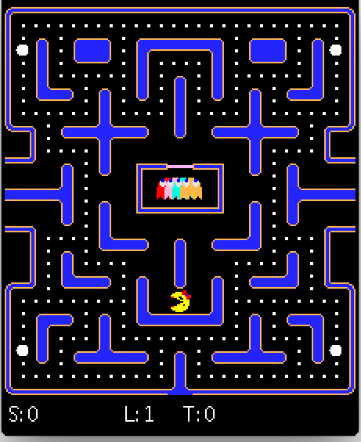
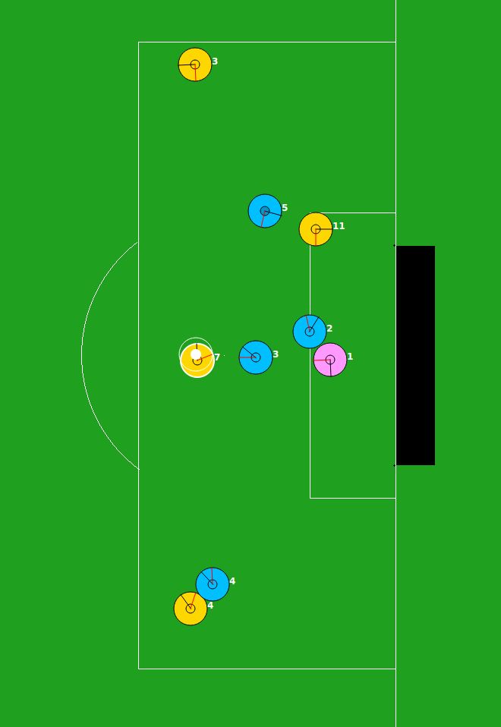
Task Simplification
Use knowledge of the domain encoded in degrees of freedom F to simplify the task
  F = [F₁, F₂, … F_{n}] vector of features that parameterize the domain
Assumes ordering over each F_{i} corresponding to task complexity
Reduces the complexity of one degree of freedom at a time
Easier
Harder
Notes:
Quickchess: board size, number of each type of piece
Pacman: remove ghosts, change maze size, change ghost behavior
HFO: add teammates, remove defenders, change behaviors, world physics
This is the most common way people create source tasks for transfer learning. Usually alters multiple aspects of an MDP at a time (S,A,P,R).
Show pictures that these apply to many different domains.

Slide 15


Promising Initializations
Positive outcomes can be rare at onset of learning
Explores regions of state space near positive outcomes/rewards
C(s₁, s₂): distance measure quantifying state proximity
: threshold on distance
: percentile threshold on which states/rewards in X are positive outcomes
Returns MDP that initializes start state distribution to these states
Notes:
Verbally emphasize next two are domain independent.
Make the most of obtained reward signal. Show the MDP and circle which elements this changes.
Why do this?
sparse reward signal because random actions won't get you there.

Slide 16
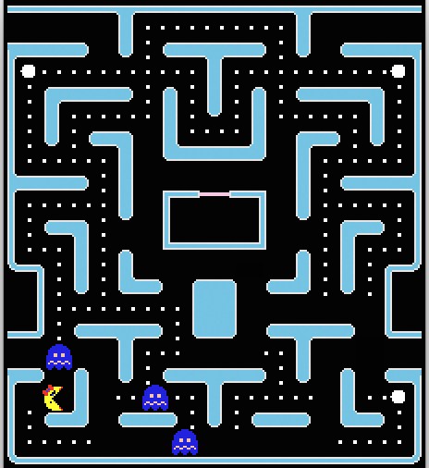
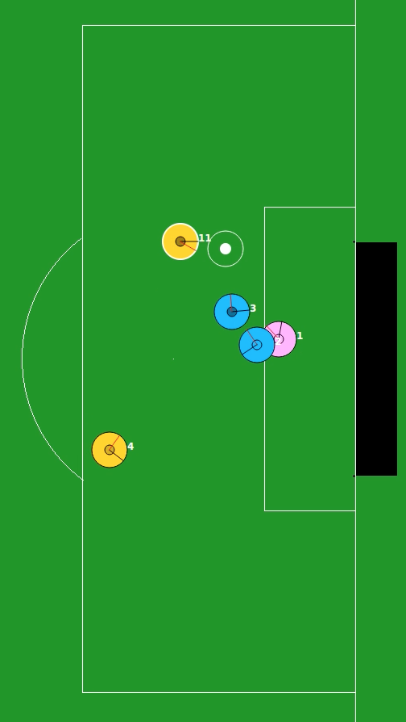
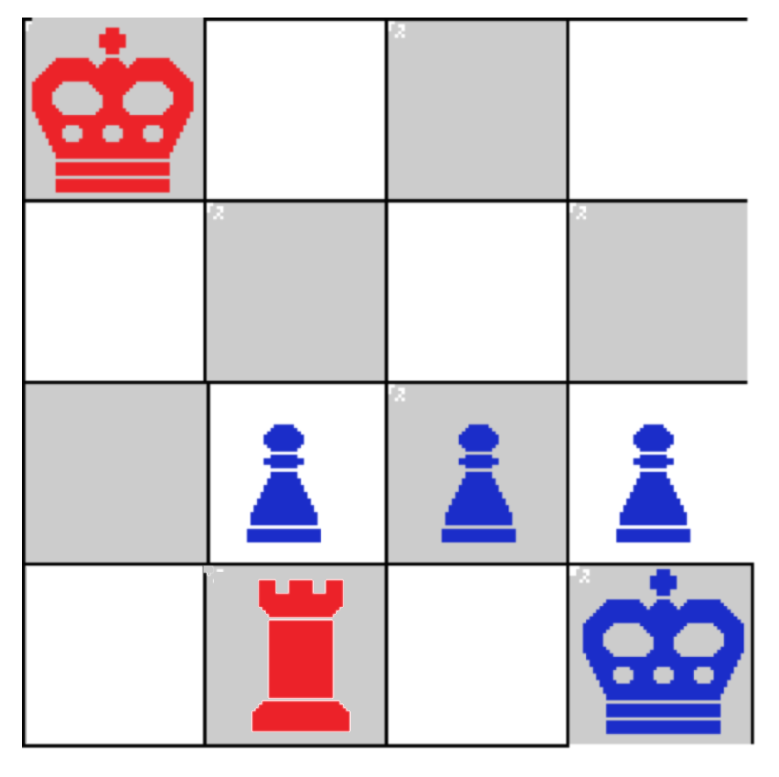
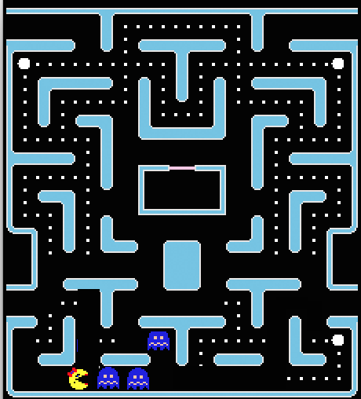
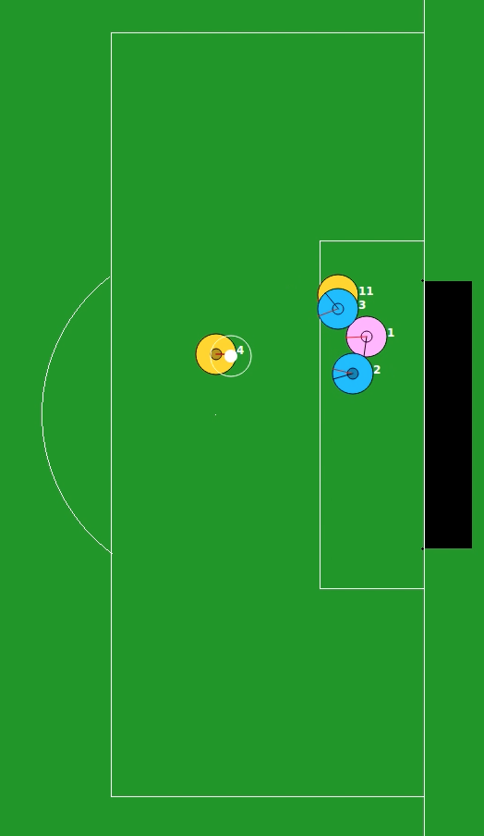
Promising Initializations
Number of “moves” away
Number of steps away
Euclidean Distance

Slide 17
Mistake Learning
Create subtasks to avoid or correct mistakes
  Specified by the domain
  Eg. Termination in non-goal state
Rewind the episode epsilon steps back, and learn a revised policy from there
Rewind
MISTAKE
Checkmate
Revise
Notes:
We assume they are specified in the domain, but a generic example would be termination in non-goal state.
Idea: Provides faster access to interesting areas, since you don’t need to waste time recreating this situation from scratch
Mistake: losing or terminating in a non-goal state
Mistake: any deviation from the optimal policy
Not known in advance, so use 3 characteristics to approximate
Actions leading to unsuccessful (non-goal state) termination
Actions incurring large negative rewards
Actions resulting in no change in state

Slide 18
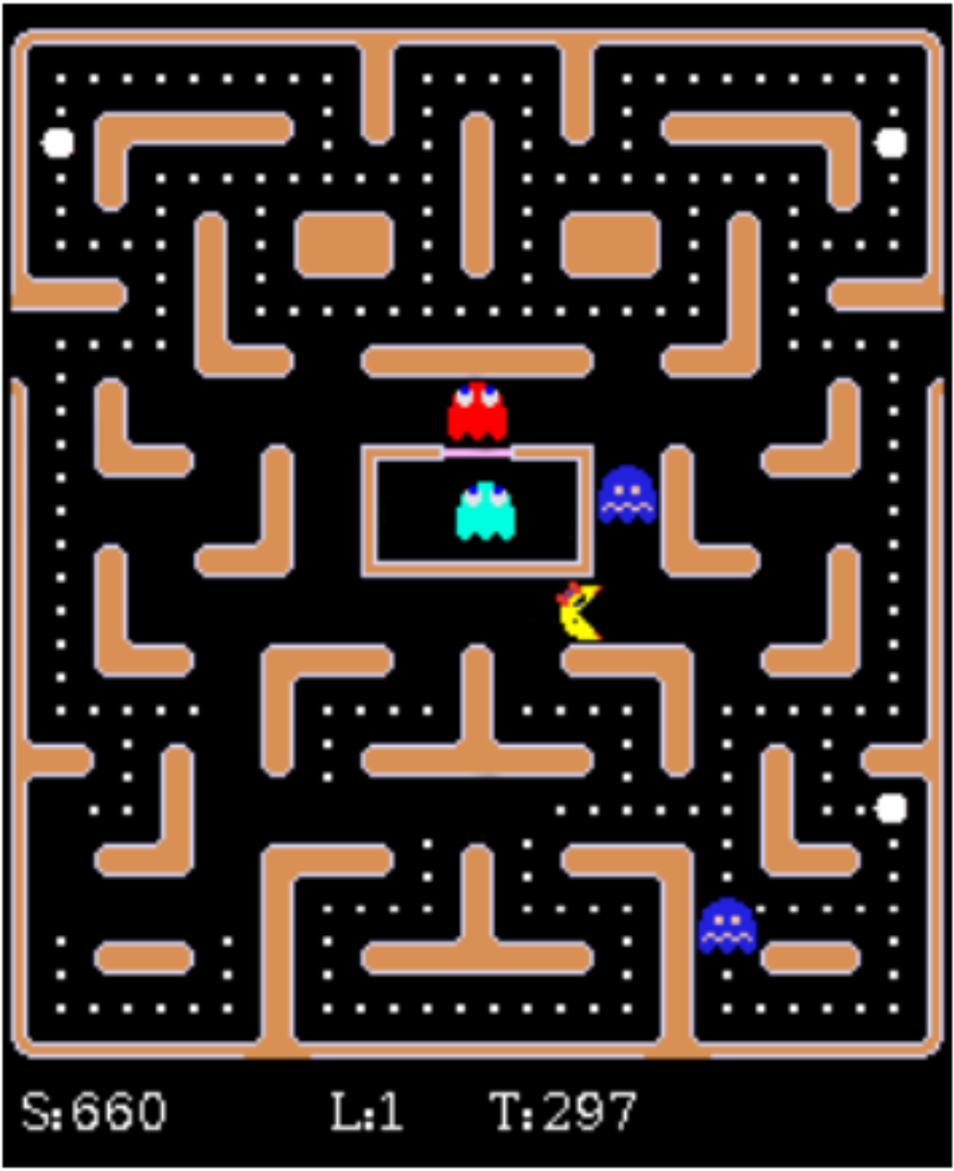
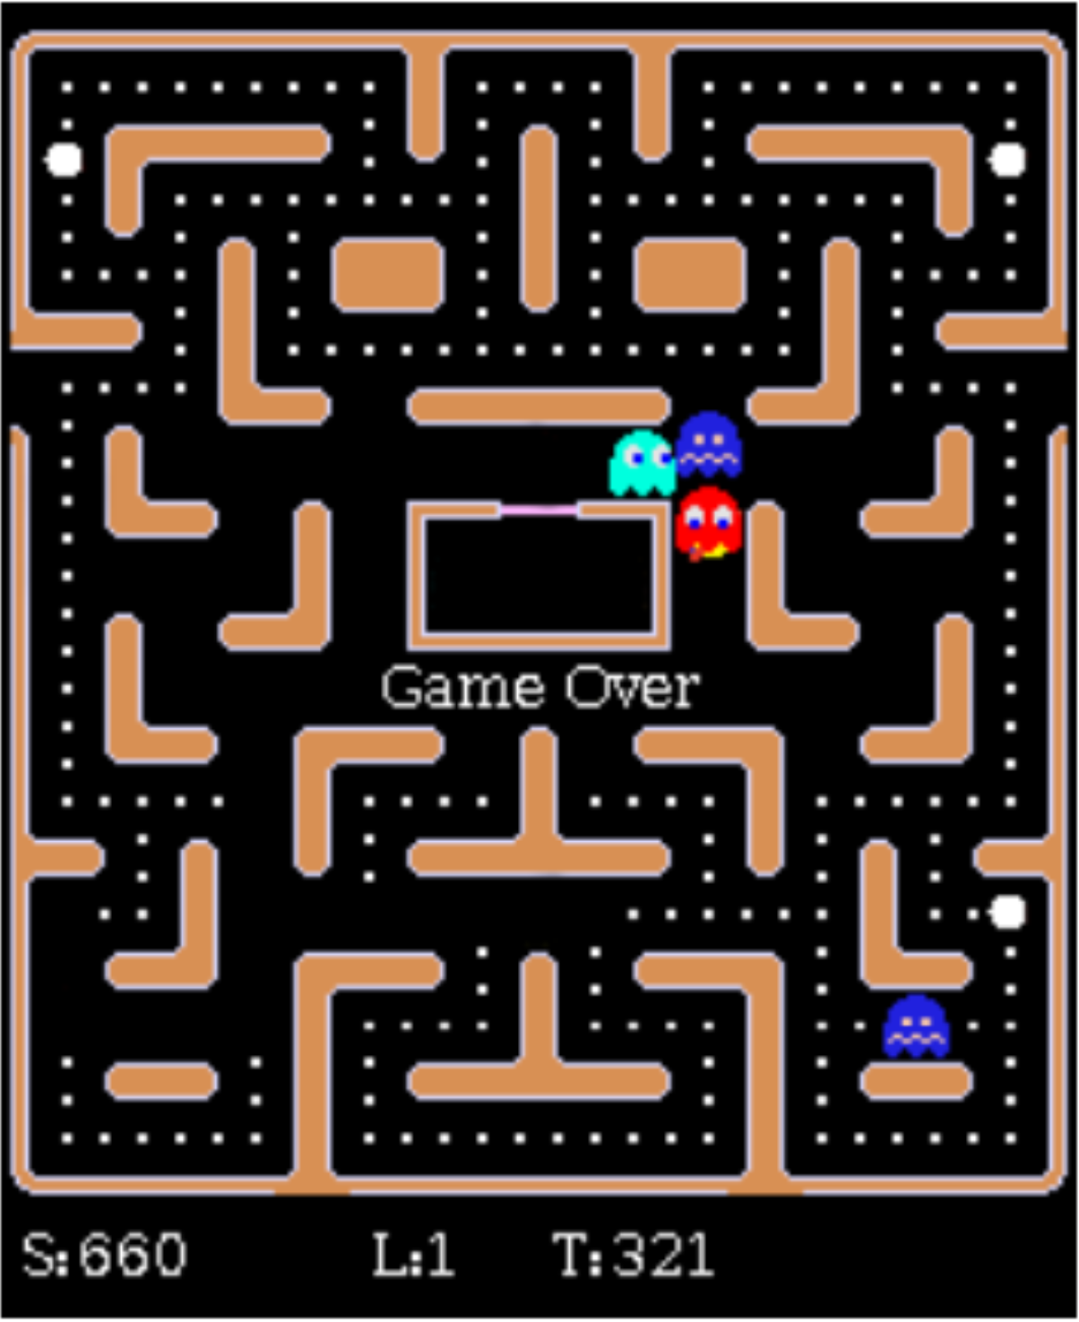
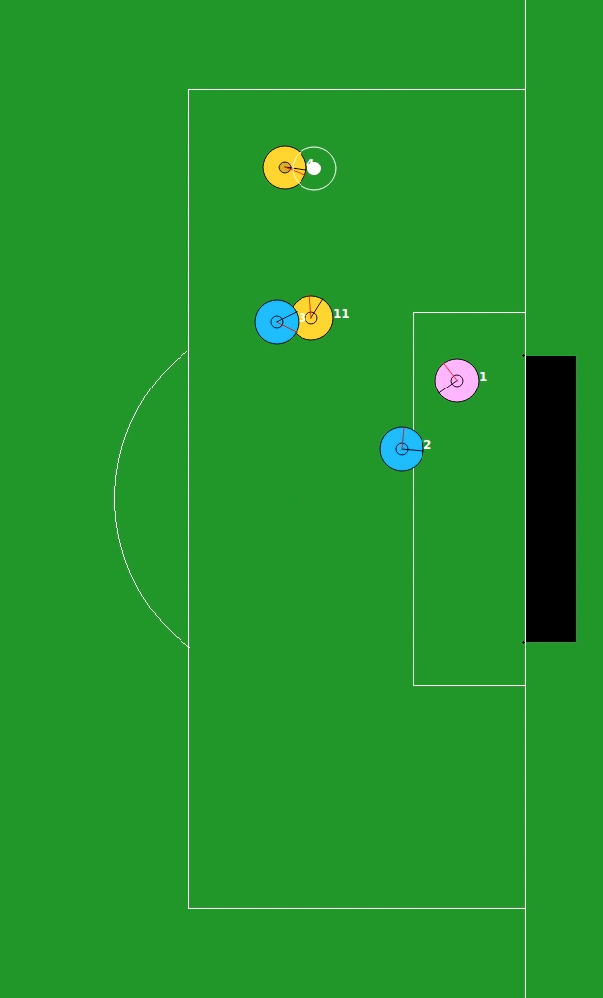
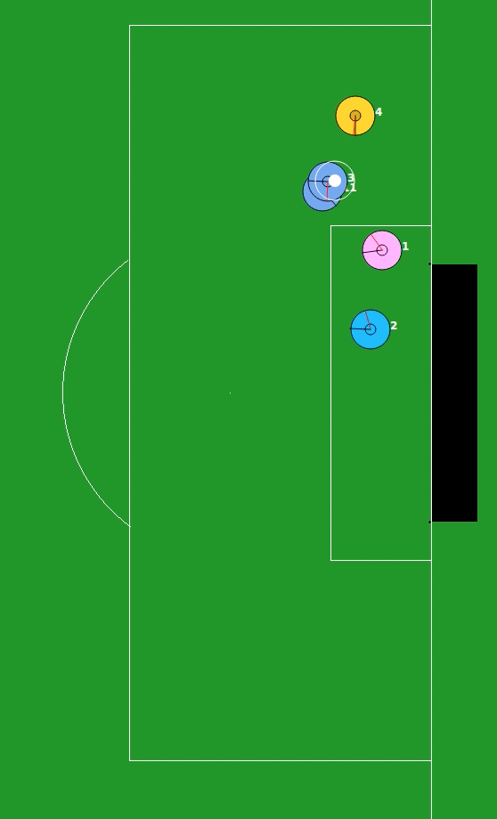
Mistake Learning
MISTAKES
Getting eaten
by ghost
Not eating
edible ghost
How far back
to rewind?
Failing to score
Losing possession
Notes:
How far back? – For now, we assume fixed, but could depend on type of mistake and where it was made.
Also after heuristics, say these affect the initial distributions. Paper talks about some that alter actions, etc. A
Pacman mistakes: getting eaten by a ghost, failing to eat a ghost after eating a power pill

Slide 19
Results
2v2 Half Field Offense
Ms. Pac-Man
(results in paper)
Notes:
Tested these functions to create source tasks in 2 domains. I’m going to present the ones in HFO. Pacman is in the paper.
Emphasize functions that we created can create a successful curriculum. For now, we will be manually sequencing.
2v2 HFO is 2 offense vs 1 defender and a goalie.

Slide 20
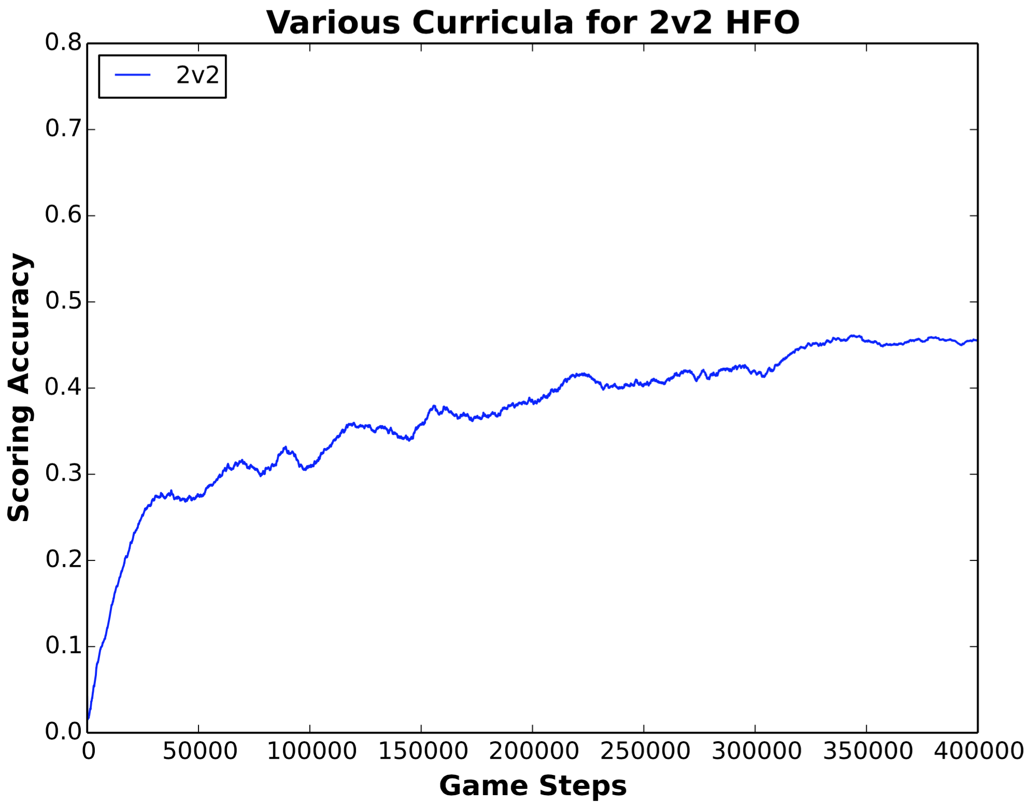
2v2 HFO Baseline
Notes:
Despite having extra field players,

Slide 21
Curriculum Generation
Task Simplification
Mistake Learning
Empty Task
Target Task
X = {(s,a,s’,r), …}
Agent
Promising Initializations
Notes:
Manual sequencing
Point is to show in this space, there is a curriculum useful for learning.
Quick chess is just a motivating example. We're going to do something different:
Show that we generate trajectories on each task, and use those to inform task creation. We generated haystack. Looking for needle
While animating this, you could have some arrows saying these tasks were created using X heuristics.

Slide 22
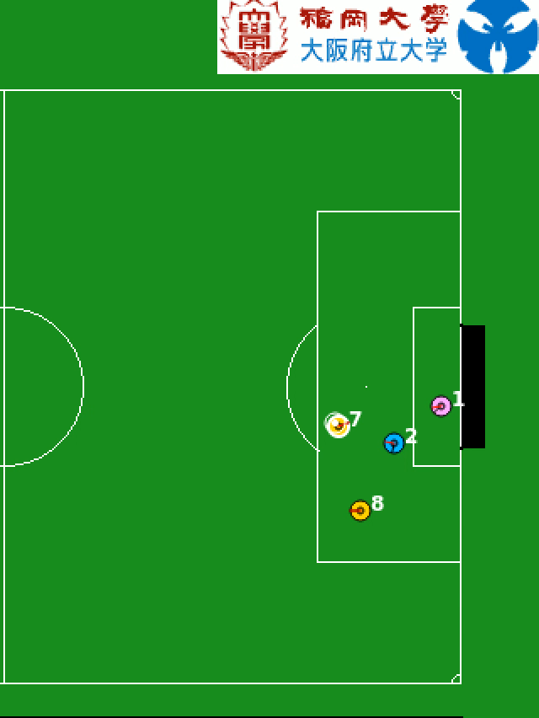
Shoot Task
Initially, goal scoring episodes are rare
We observe a few successful goals
Use PromisingInitializations to target exploration in this region
Agents learn to shoot on goal
Notes:
This led to 2 tasks. Shoot task using promising initializations – agent learns to shoot on goal.

Slide 23
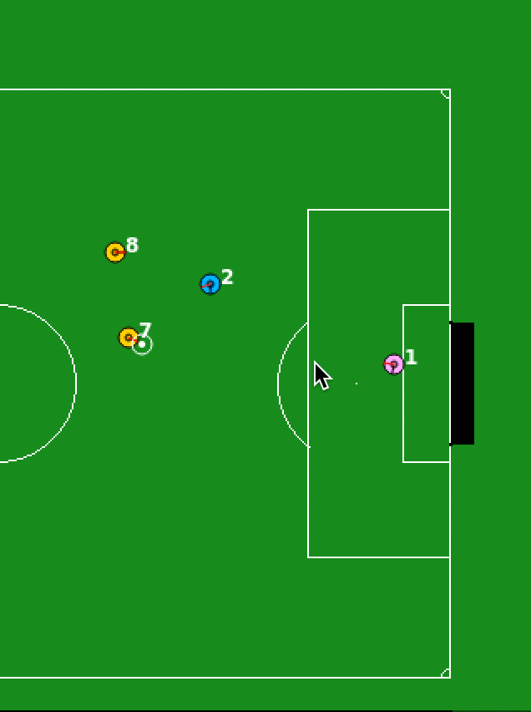
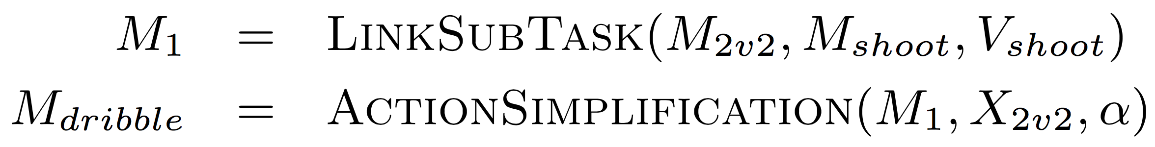
Dribble Task
Agent takes too many shots from far away
Skill needed: move the ball up the field while maintaining possession, until a shot is likely to score
Notes:
Dribble task: used two other functions (described in paper) which simplifies the action space and connects it to the shoot task,
to learn how to dribble up field while maintaining possession.
Dribble task ends before goal.
Emphasis on created a formalism. Show
Remove transitions. Let video show while playing. Same for previous task

Slide 24

2v2 HFO Results
Baseline
Notes:
Curves offset to represent time training in source tasks.
Show curves one “curriculum step” at a time
Mention additional results in pacman domain. Change legend to baseline = HFO. dribble -> HFO.
Statistical analysis in paper. Briefly mention the offset is to signify strong transfer, where even if we account time spent in source tasks, we still do better.

Slide 25
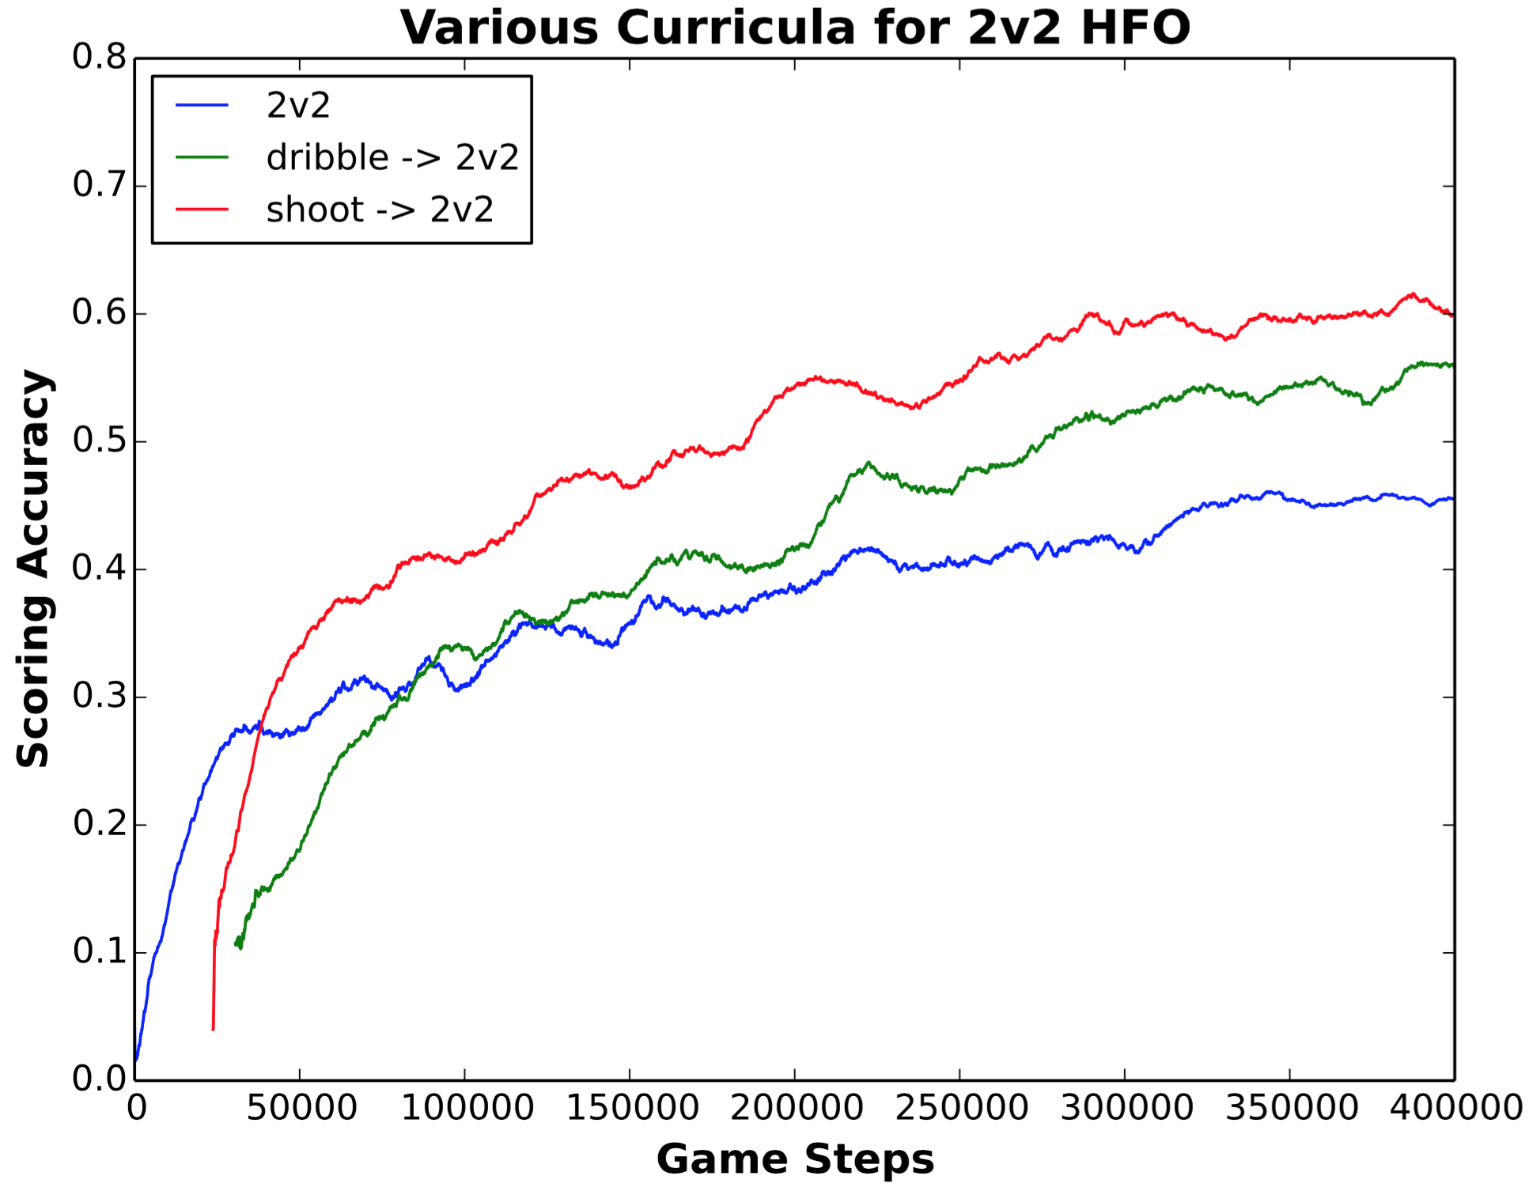
2v2 HFO Results
One step
Baseline
Notes:
Curves offset to represent time training in source tasks.
Show curves one “curriculum step” at a time
Mention additional results in pacman domain. Change legend to baseline = HFO. dribble -> HFO.
Statistical analysis in paper. Briefly mention the offset is to signify strong transfer, where even if we account time spent in source tasks, we still do better.

Slide 26
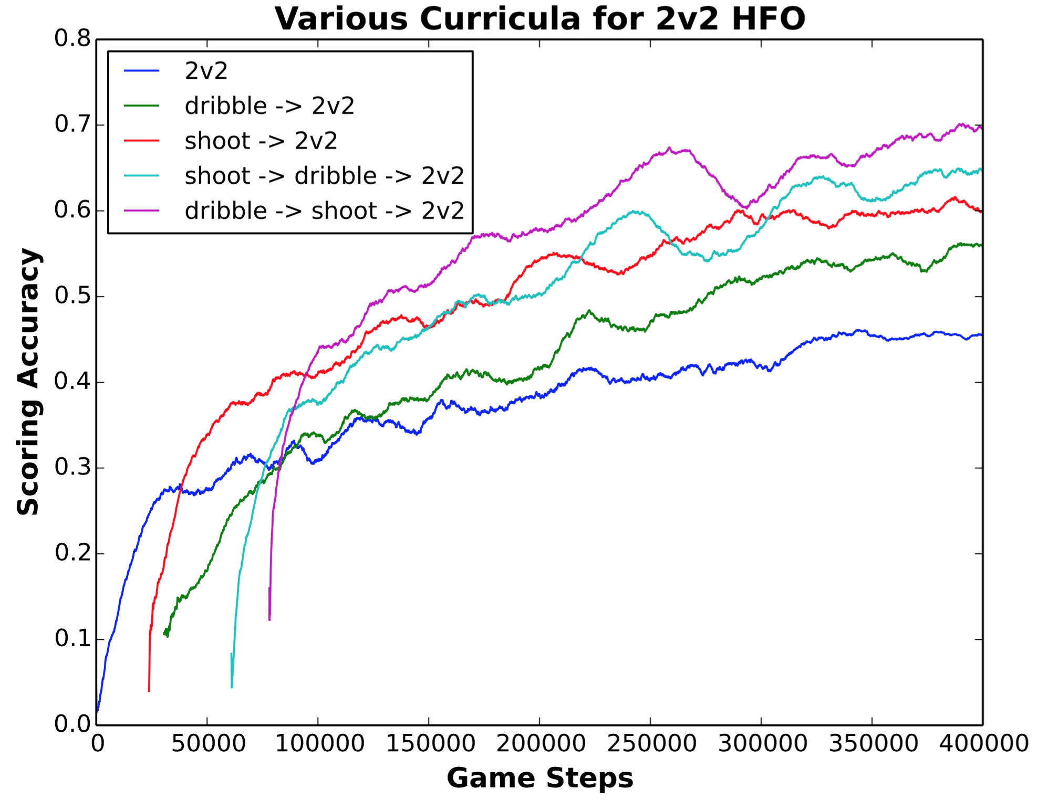
2v2 HFO Results
Two step
One step
Baseline
Notes:
Curves offset to represent time training in source tasks.
Show curves one “curriculum step” at a time
Mention additional results in pacman domain. Change legend to baseline = HFO. dribble -> HFO.
Statistical analysis in paper. Briefly mention the offset is to signify strong transfer, where even if we account time spent in source tasks, we still do better.

Slide 27
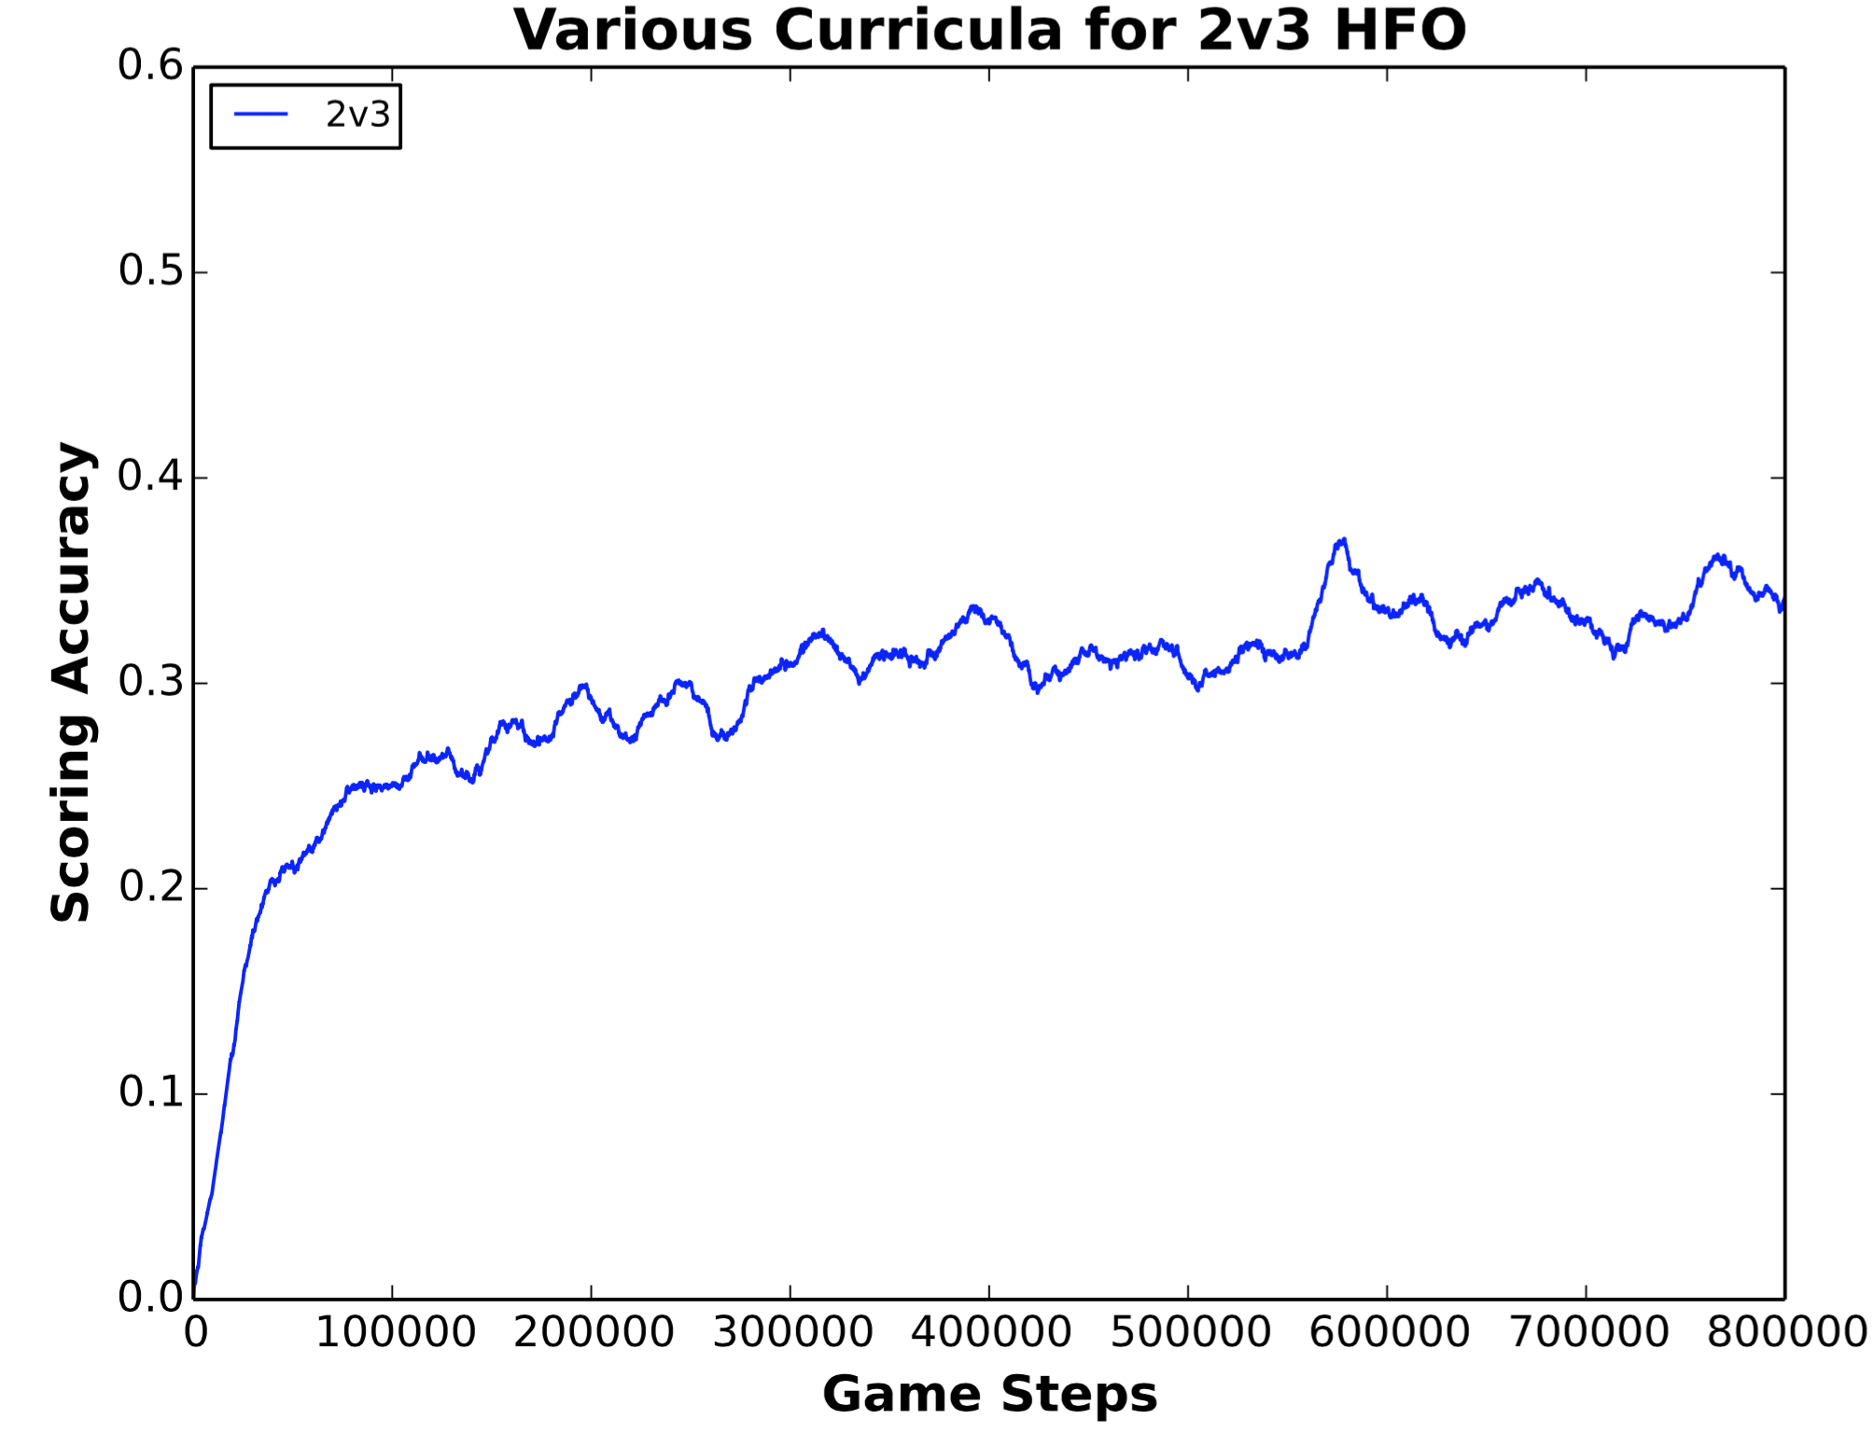
2v3 HFO Results
Baseline

Slide 28
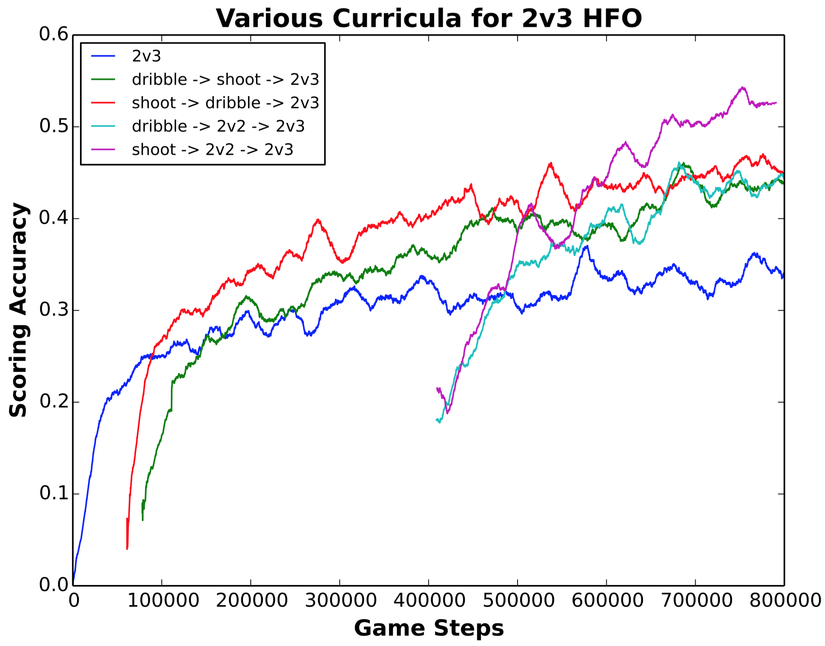
2v3 HFO Results
Two step
Baseline

Slide 29
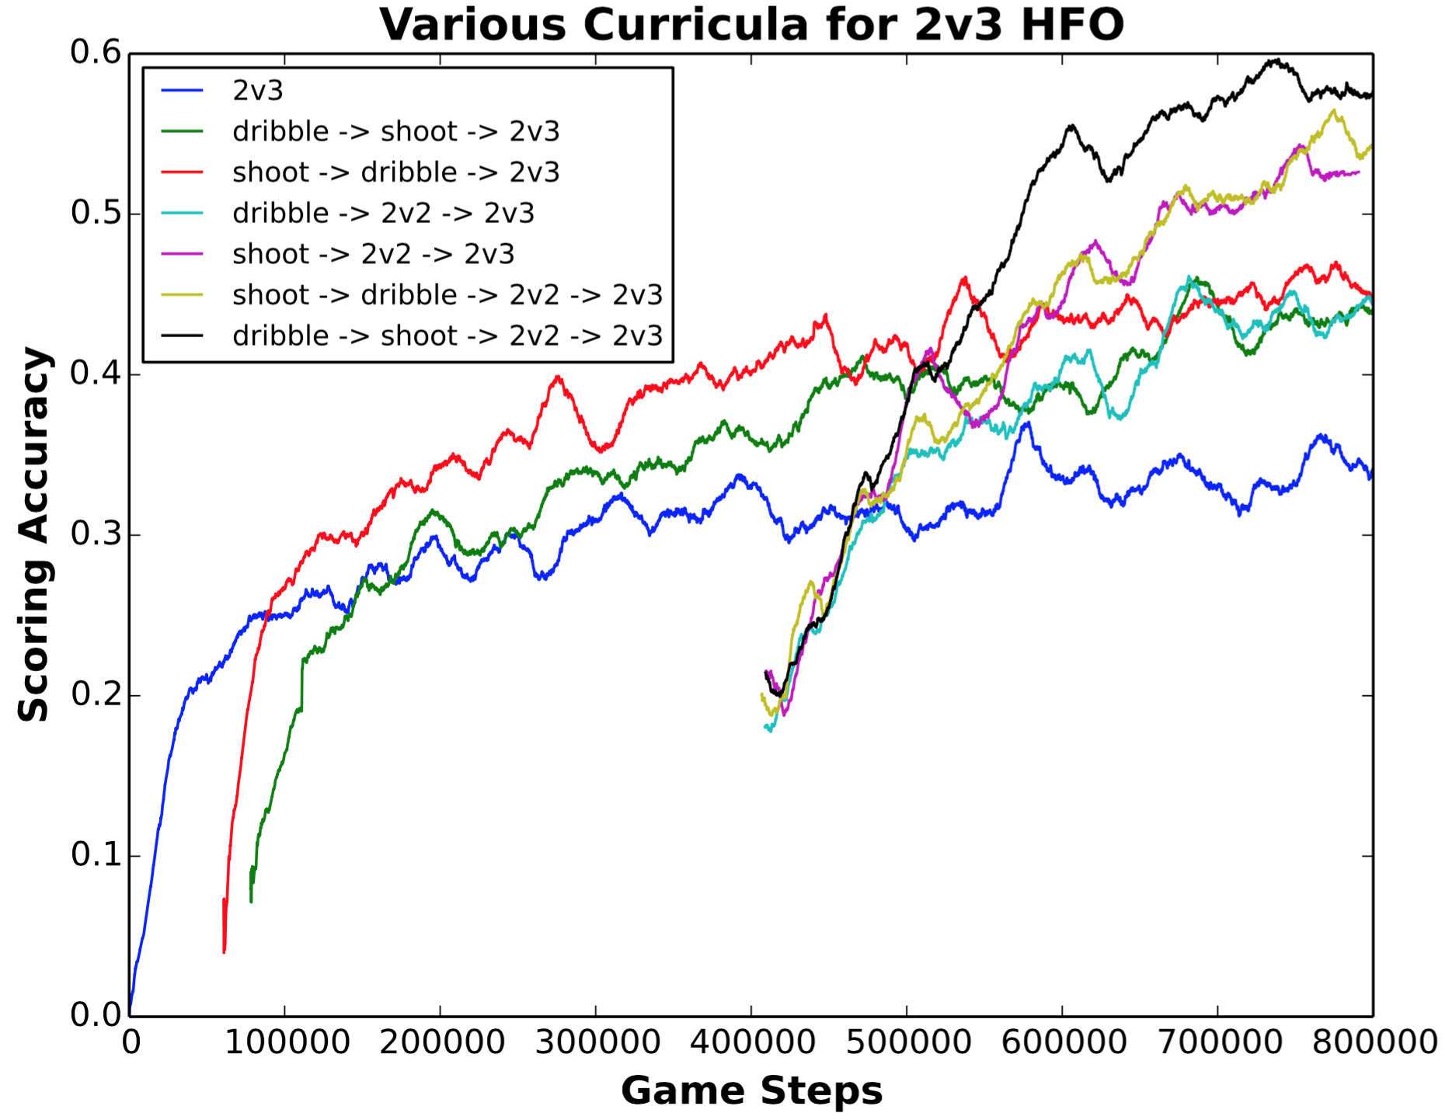
2v3 HFO Results
Three step
Two step
Baseline

Slide 30
Experimental Recap
Tasks created by our formalism can be used as source tasks in a curriculum
Learning via a curriculum can improve learning speed or performance
Notes:
Summarize point of experiments
Tasks automatically created can be used for a curricula.

Slide 31
Related Work
Curriculum learning in supervised learning [Bengio et al. 2009]
Multi-task reinforcement learning [Wilson et al. 2007]
Lifelong reinforcement learning [Ammar et al. 2014]
Learning task transferability [Sinapov et al. 2015]
Key Differences
Source tasks created solely to improve performance on target
Focus on task generation, not selection
Agent-tailored source tasks based on agent performance

Slide 32
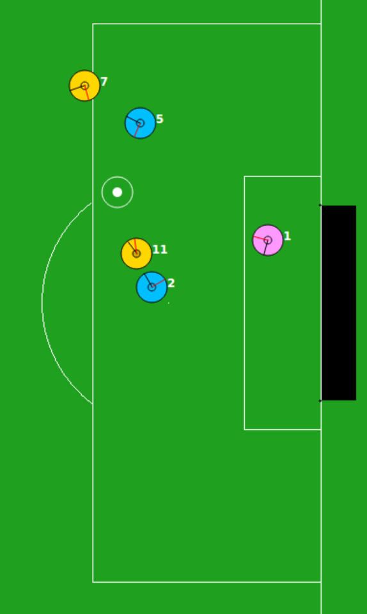
Summary
Task Creation
Presented curriculum learning in the context of reinforcement learning
Defined a domain-independent formalism to create source tasks, tailored to the performance of the agent
Empirically demonstrated using a curriculum can improve learning speed or performance
Sequencing
Transfer Learning
Notes:
Maybe explicitly restate the contributions

