Slide 1
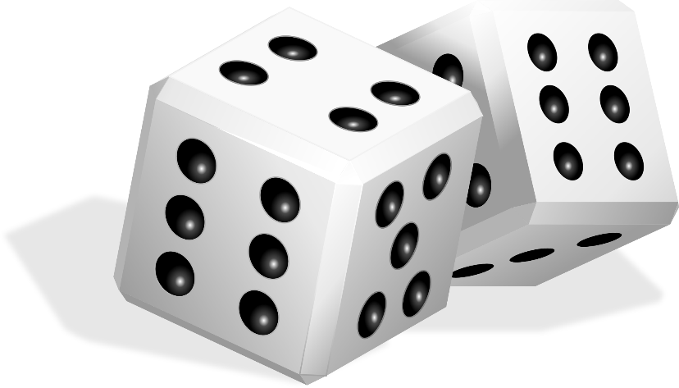

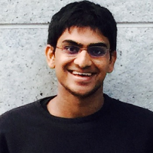

Deterministic Implementations for Reproducibility in Deep Reinforcement Learning
Prabhat Nagarajan¹, Garrett Warnell^{1,2}, and Peter Stone¹
Department of Computer Science, The University of Texas at Austin
Computational and Information Sciences Directorate, US Army Research Laboratory
Prabhat Nagarajan
Peter Stone

Slide 2
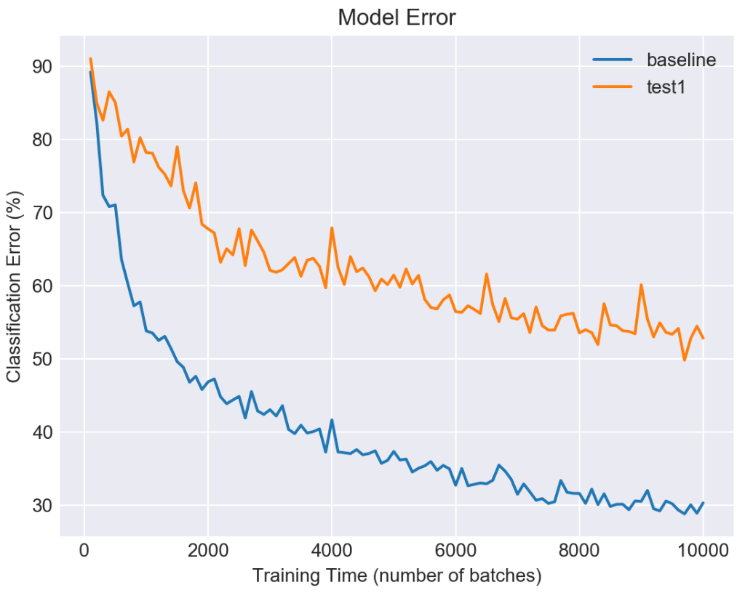
Reproducibility in Machine Learning
motivation: recent machine learning work has proven to be hard to reproduce
idea: first focus on replicability as an important sub-goal
Villa and Zimmerman. determined.ai. 2018.
Henderson et al. AAAI. 2018

Slide 3
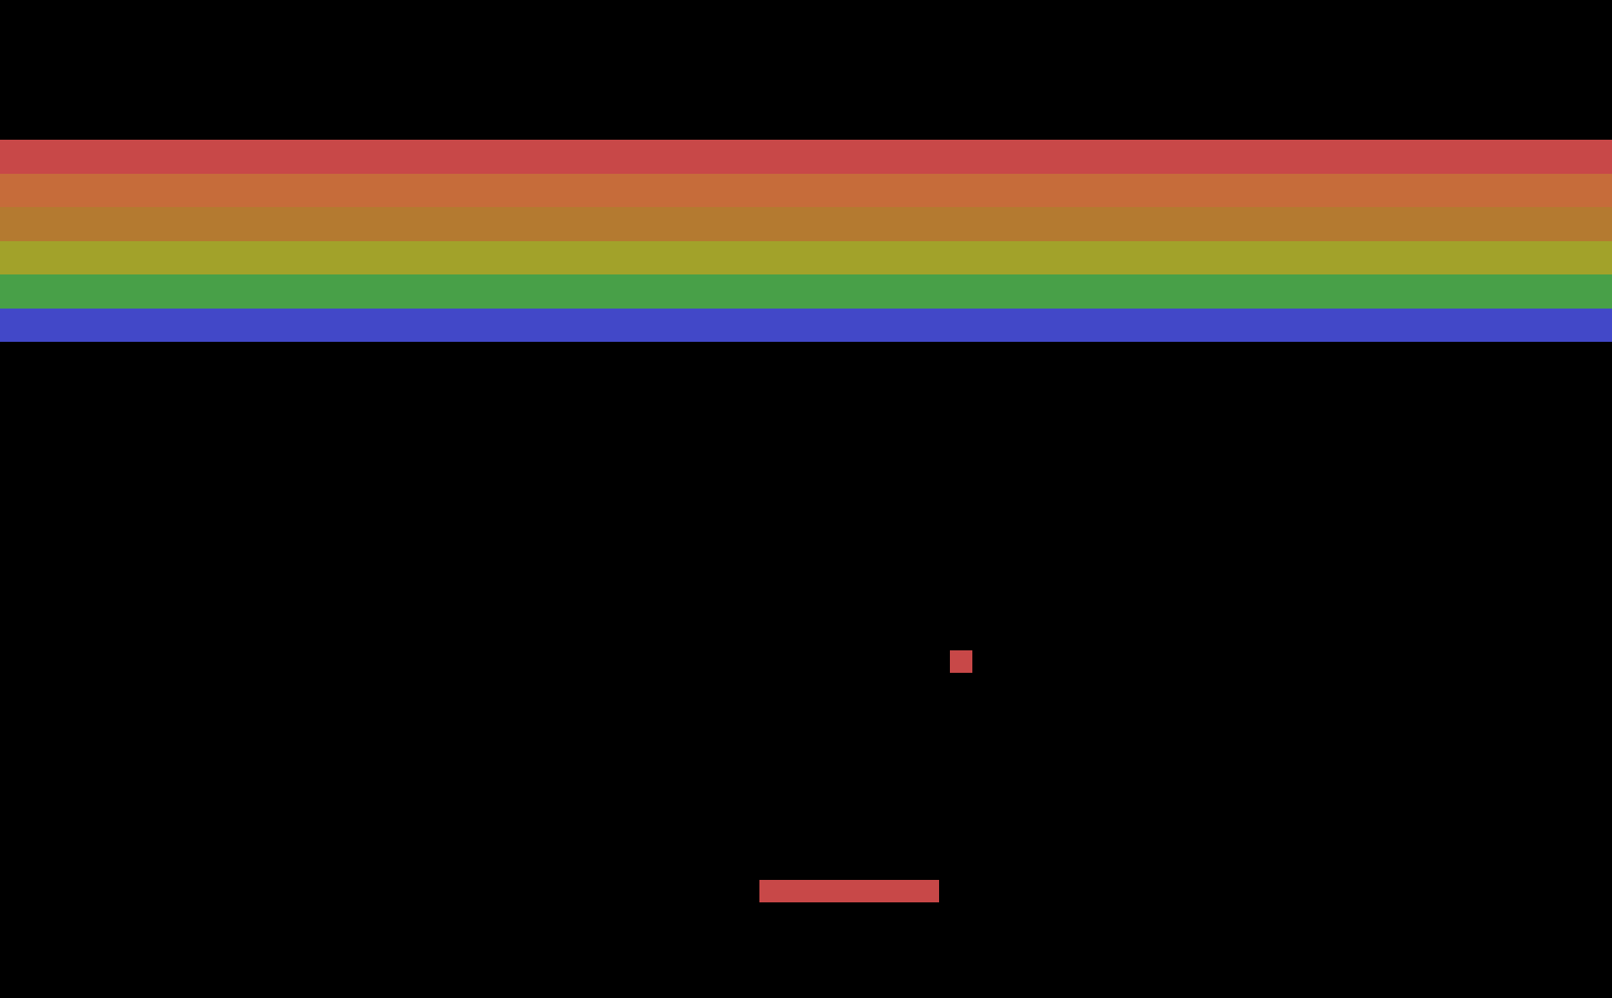
Deterministic Implementations
goal: identify and control sources of nondeterminism
case study: DQN for Atari Breakout
+
Mnih et al. Nature Letters. 2015.
Atari Breakout

Slide 4


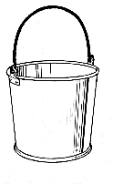
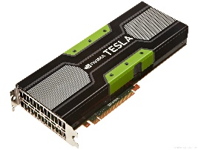
Deep Q-Learning
network initialization
exploration
stochastic transitions
action selection
deep neural network
replay buffer
computation
environment
agent
minibatch sampling
parallelized floating point arithmetic (GPU)

Slide 5
Sensitivity Analysis
what kind of experimental variance is induced by each source of nondeterminism in deep reinforcement learning?
experimental setup:
single source of nondeterminism at a time
5 training runs per source
evaluation metric:
remove environment stochasticity
100 predefined action sequences = 100 (good) start states
performance = average score at the end of 100 episodes
results:
average score (over all 5 trained networks)
best score (over all 5 trained networks)

Slide 6
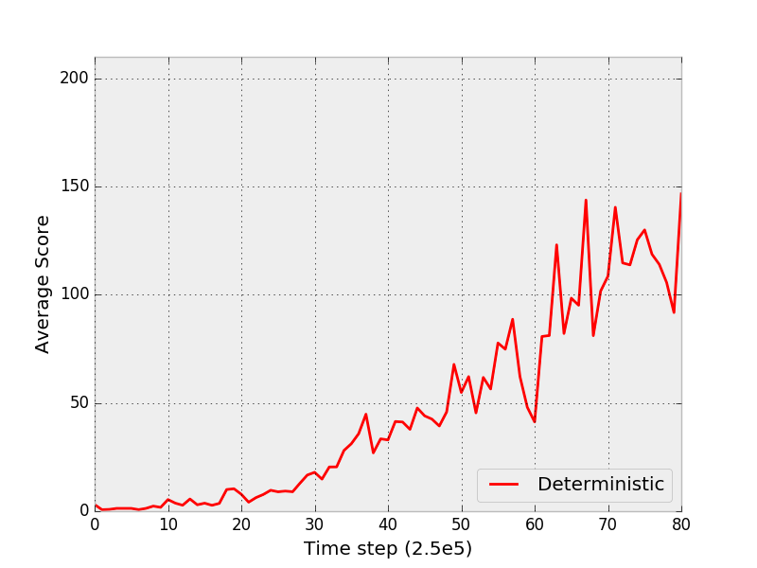
Results
practical takeaway: replicability is achievable!
run 1
+ run 2
+ run 3, 4, 5

Slide 7
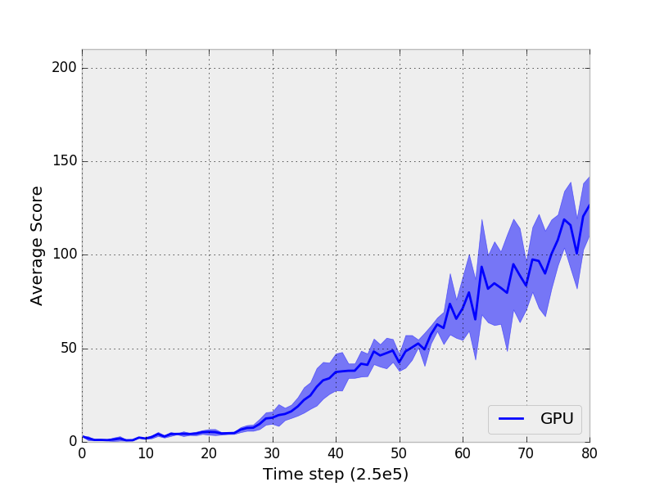
Results
uncontrolled GPU nondeterminism
computation

Slide 8
Results
sensitivity analysis
Prabhat Nagarajan
prabhatnagarajan.com

