Slide 1
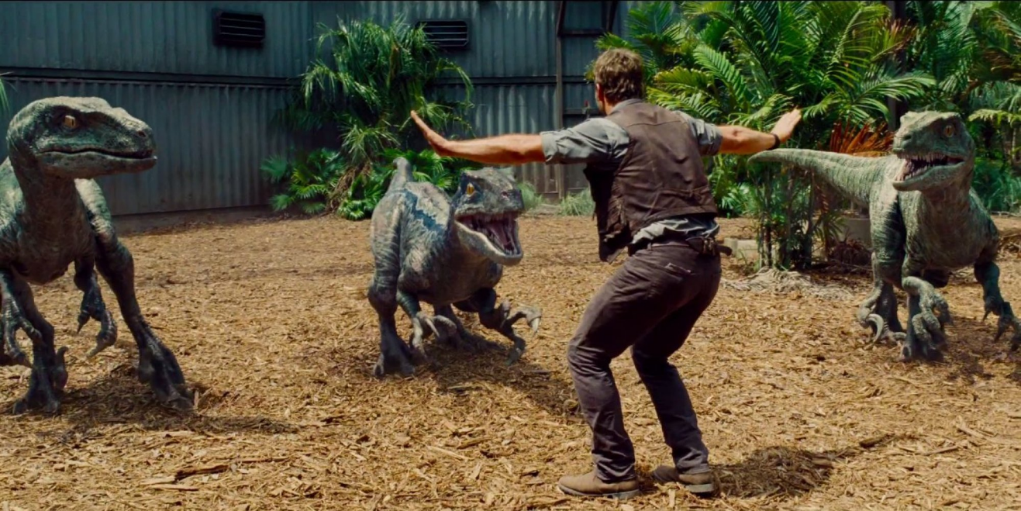
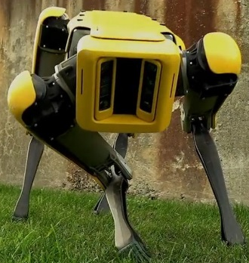






Deep TAMER:
Interactive Agent Shaping in High-Dimensional State Spaces
Garrett Warnell, Nicholas Waytowich, Vernon Lawhern, Peter Stone
US Army Research Laboratory, The University of Texas at Austin
5 February 2018

Slide 2
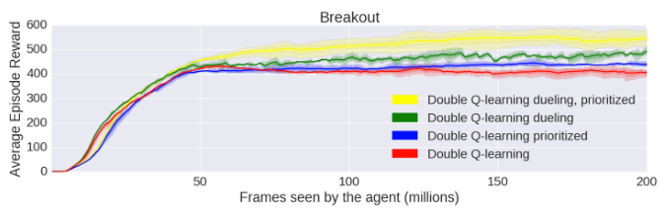
Interactive Agent Shaping
motivation: many autonomous agents currently learn very slowly
inspiration: human instruction can speed things up
50M frames, or
~4 days @ 30fps!

Slide 3
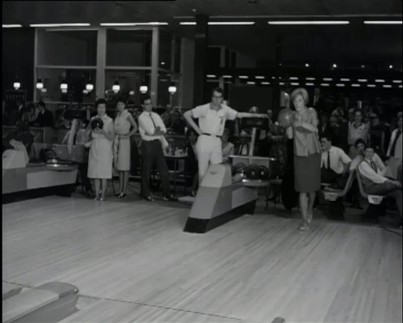
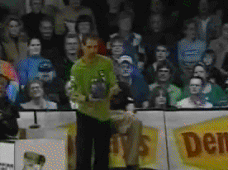
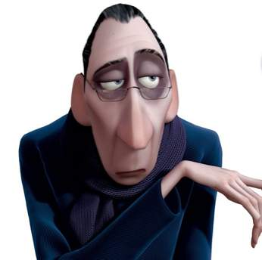
Interactive Agent Shaping
goal: agents that quickly learn effective policies using real-time, interactive, human critique

Slide 4
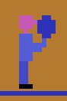
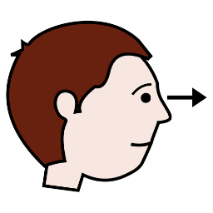


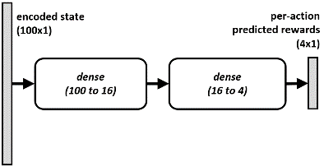
Central Question
how can autonomous agents use interactive human feedback to train quickly in complex environments?
can deep learning help?
Deep TAMER
TAMER
feedback replay
buffer
agent
agent
feature extraction
+
predictive model of human
policy
policy
human
human
environment
environment

Slide 5



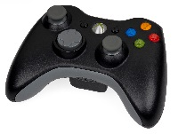
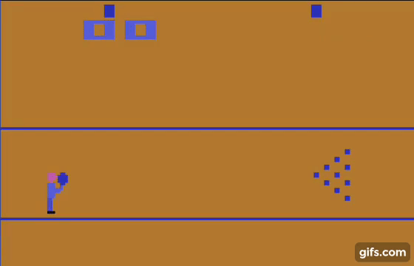






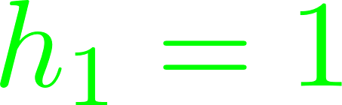







Setting
agent state space, :
agent action space, :
agent trajectories, :
human feedback, :
interaction timeline:

Slide 6


Human
provides feedback according to hidden human reward function,

Slide 7


Agent
maintains estimate of human reward function
… then acts by trying to maximize predicted human reward
NOT the game score

Slide 8



Problem Formulation
agent must estimate from interaction
…which we view as a supervised learning problem with loss
time-dependent weight
human-model agreement

Slide 9

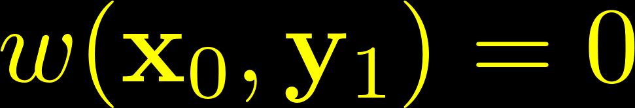
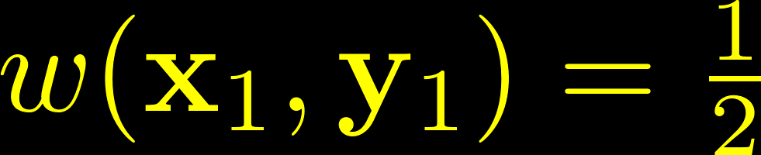
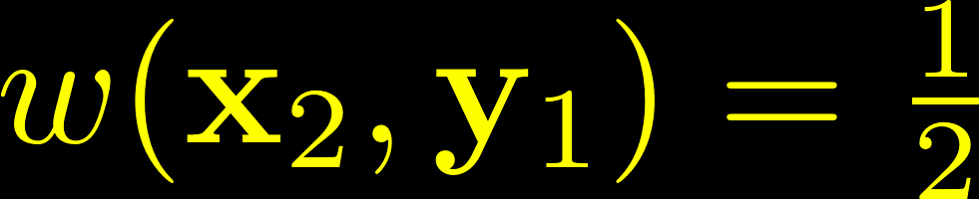
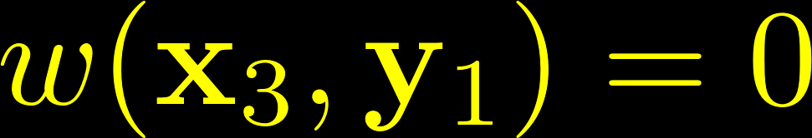
Weighting Function
…aka credit assignment
assume human meant feedback for a single state-action pair
when things happen fast, need a way to disambiguate
if distribution is assumed to be uniform:

Slide 10
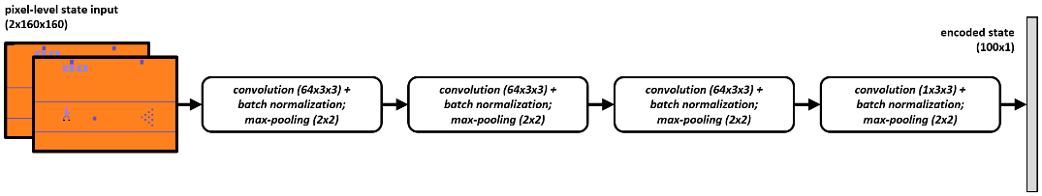
Deep TAMER
augments TAMER such that it can be applied to higher-dimensional state spaces via:
  a deep neural network reward model
  a modified training method
+
feedback replay
buffer
high-rate
SGD

Slide 11
Deep TAMER: Reward Model
  deep convolutional encoder:
  pre-trained offline via auto-encoder that uses a random policy
  reward predictor
  trained online via SGD during the interaction

Slide 12
Deep TAMER: Training
continuous learning from old feedback:
sparse feedback
feedback replay
buffer
dense sampling
SGD

Slide 13
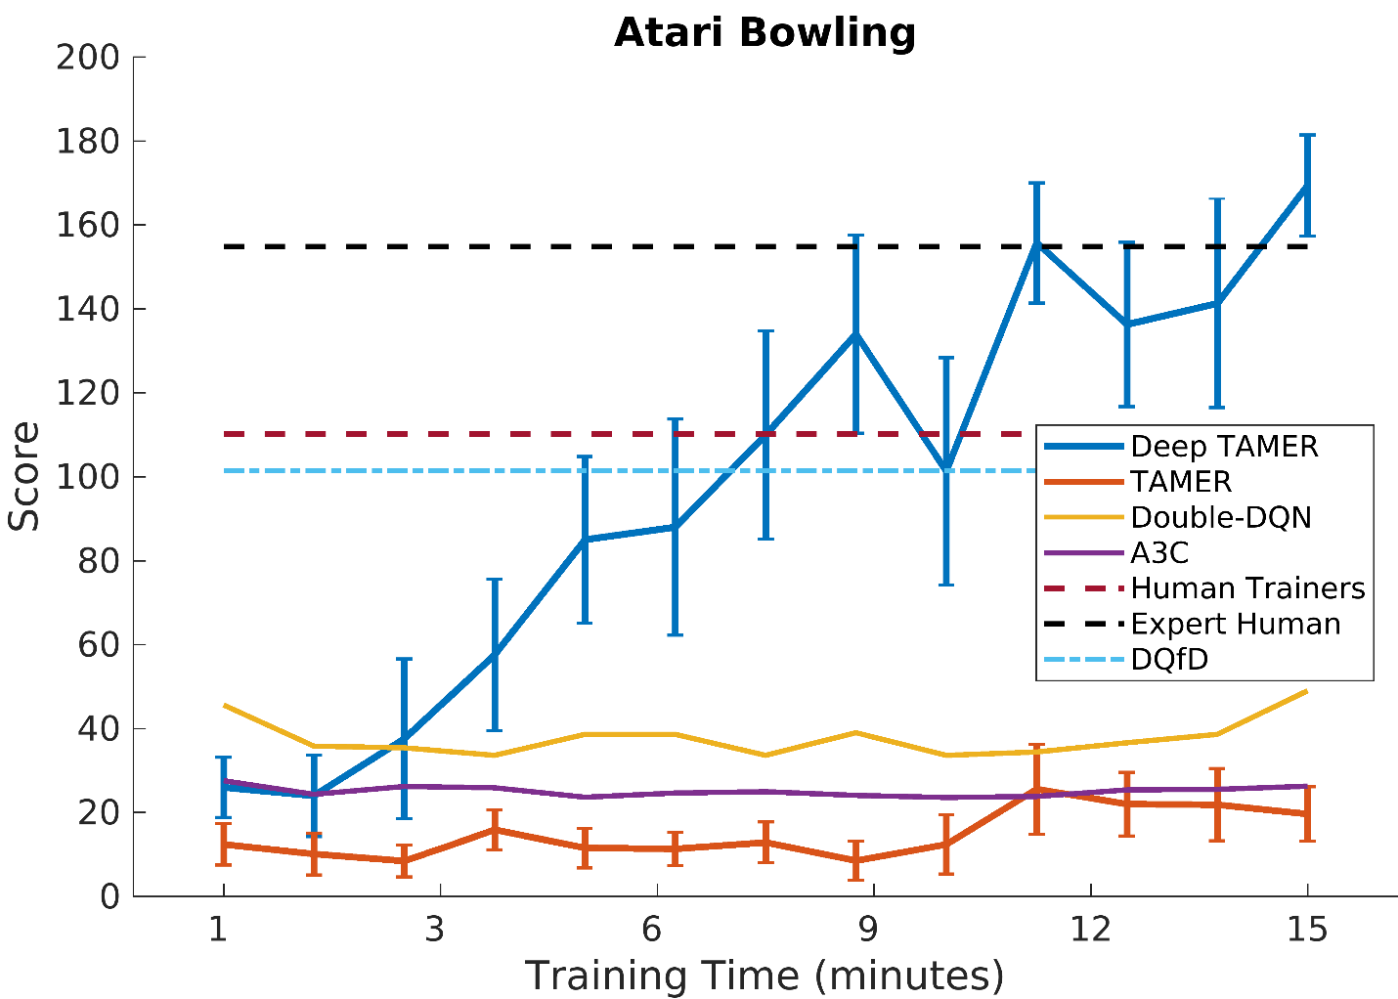
Experimental Results
Deep TAMER agents learn to bowl fast

Slide 14
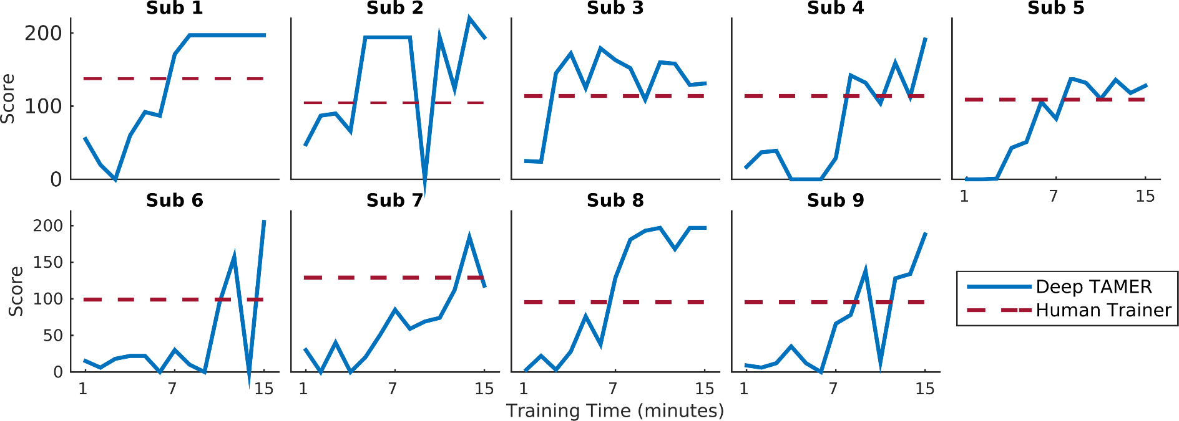
Experimental Results
Deep TAMER agents bowl at a super-human level

Slide 15
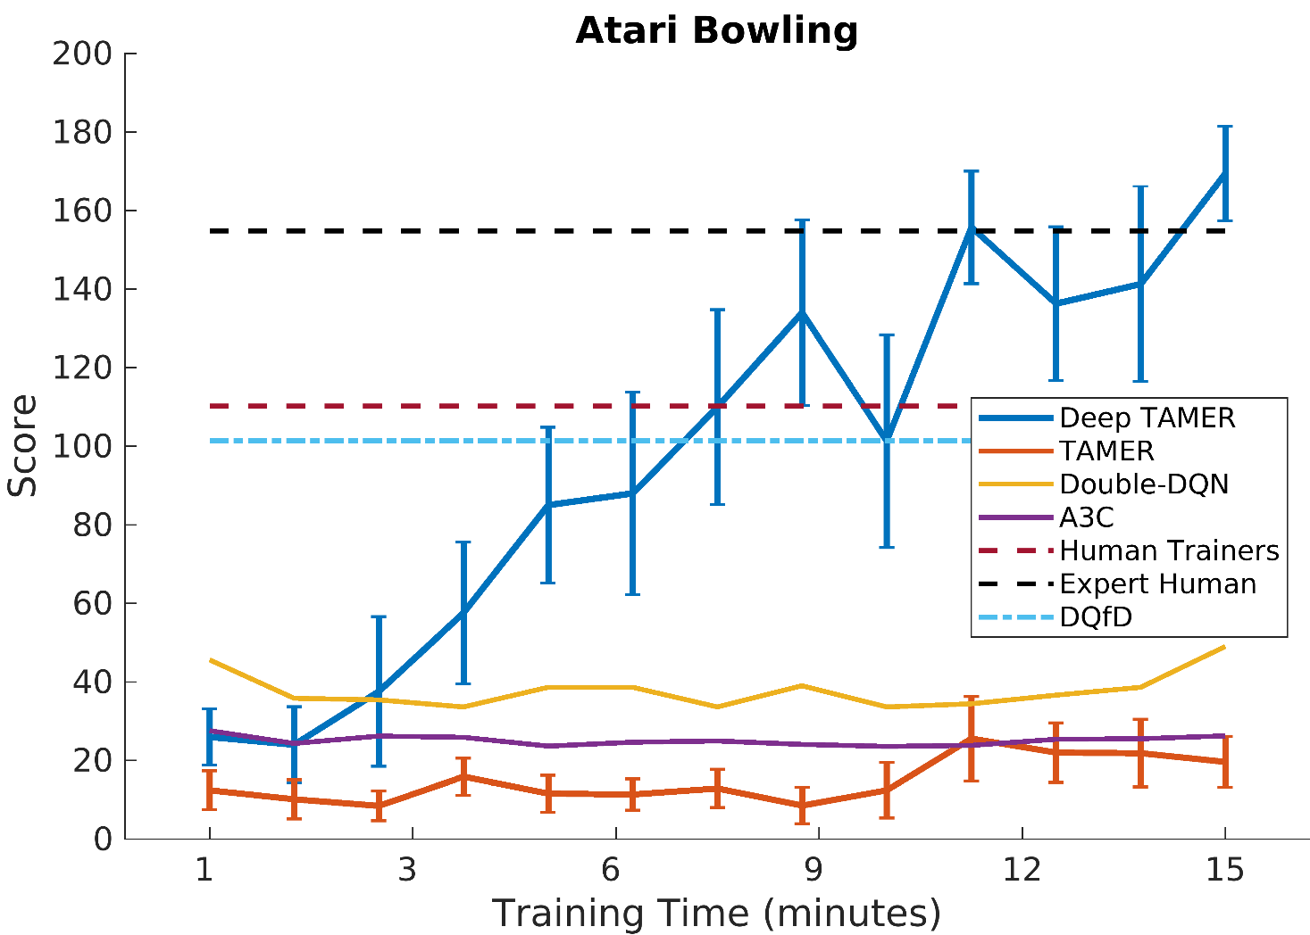
Summary
how can autonomous agents use interactive human feedback to train quickly in complex environments?
can deep learning help?
Deep TAMER
TAMER
feedback replay
buffer
agent
agent
feature extraction
+
predictive model of human
policy
policy
human
human
environment
environment

Slide 16
Garrett Warnell
US Army Research Laboratory
garrett.a.warnell.civ@mail.mil
thanks!

Slide 17
Experiments
environment: Atari Bowling
states: 2 consecutive frames (dimension 160x160x2 = ~50k)
actions: {do nothing, move up, move down, throw ball}
methods analyzed:
critique: TAMER (linear model), Deep TAMER
demonstration: DQfD (Hester et al., 2017)
reinforcement learning: Double-DQN, A3C
TAMER training:
9 humans
play + 10-minute practice training
15-minute training

Slide 18
Related Work
learning from demonstration (e.g., Argall et al., 2009)
  requires a demonstrator
manual reward shaping (e.g., Ng et al., 1999)
  influence achieved through expert knowledge only, communication to agent is cumbersome
TAMER (e.g., Knox and Stone, 2009)
  high-dimensional state spaces only with hand-crafted features

Slide 19
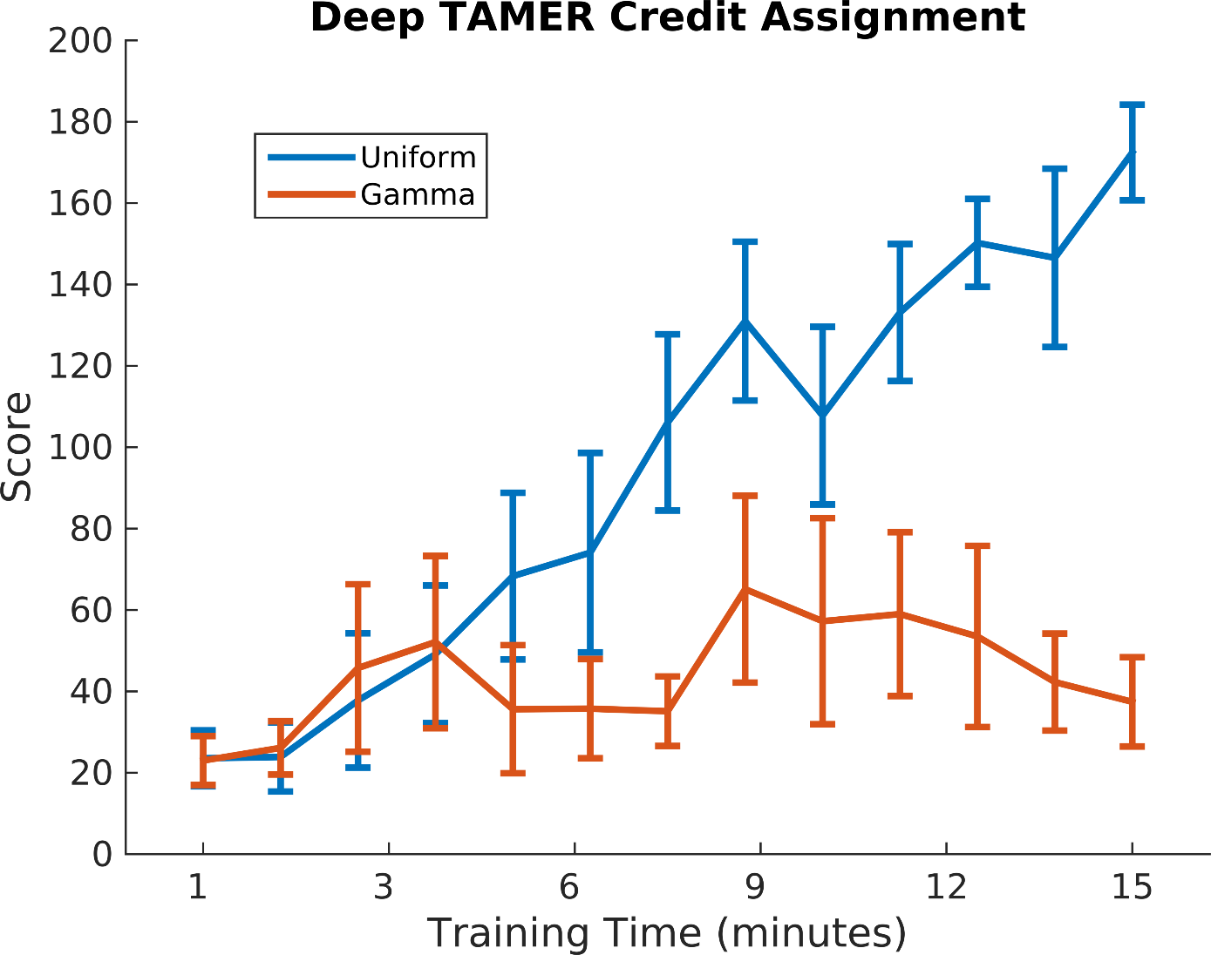
credit assignment

