Slide 1
Conservative Q-Learning for Offline Reinforcement Learning
Presenter: Siddhant Agarwal
October 6th, 2022

Slide 2
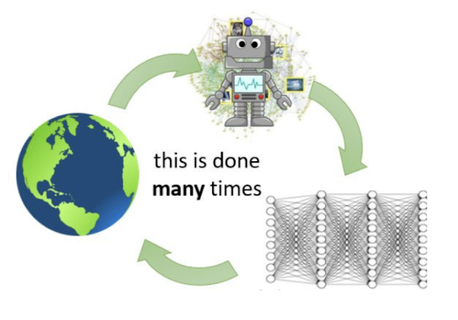
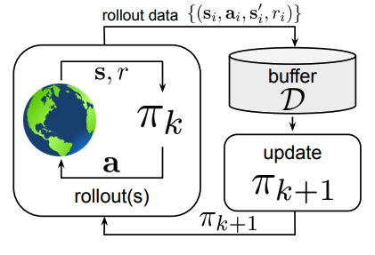
So far in RL
On-policy
Interactions with the environment
Less Data
Costly
Not safe
Sample inefficient
Off-policy
Less interactions with the environment
More data*
Less costly*
Better safety guarantees*
Better sample efficiency*
* Compared to on-policy

Slide 3
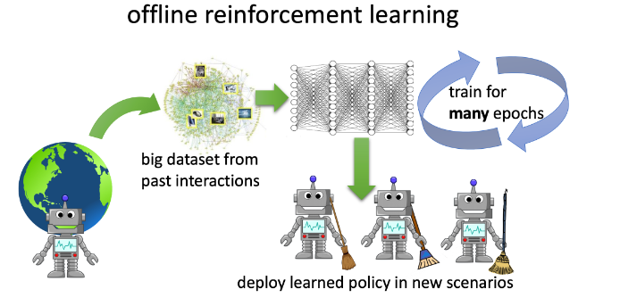

What is Offline RL?
$$π_{β}$$
Learn completely from previous dataset

Slide 4
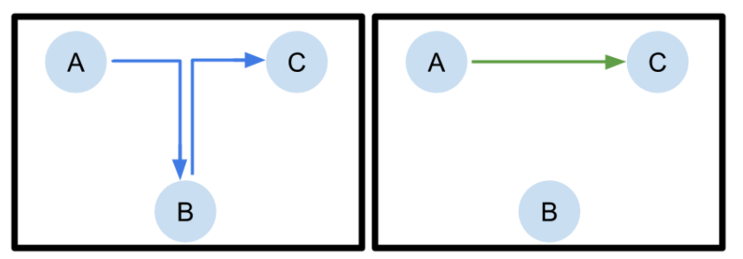
Benefits of Offline RL
Large amounts of data can be collected at once.
No active interactions (safety and cost)
“Pre-training + Finetuning” view of RL
Stitching
Fu, K., Nachum, Tucker, Levine. D4RL (2020)
Levine, K., Tucker, Fu. Offline RL Tutorial and Review (2020)

Slide 5
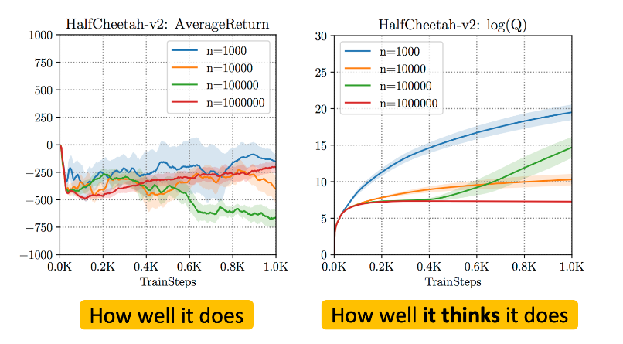
Why is Offline RL hard?
What if we have large amount of expert data?
Not statistical overfitting – performance is bad even with infinite data
    Data Distribution shift – tackling OOD samples

Slide 6
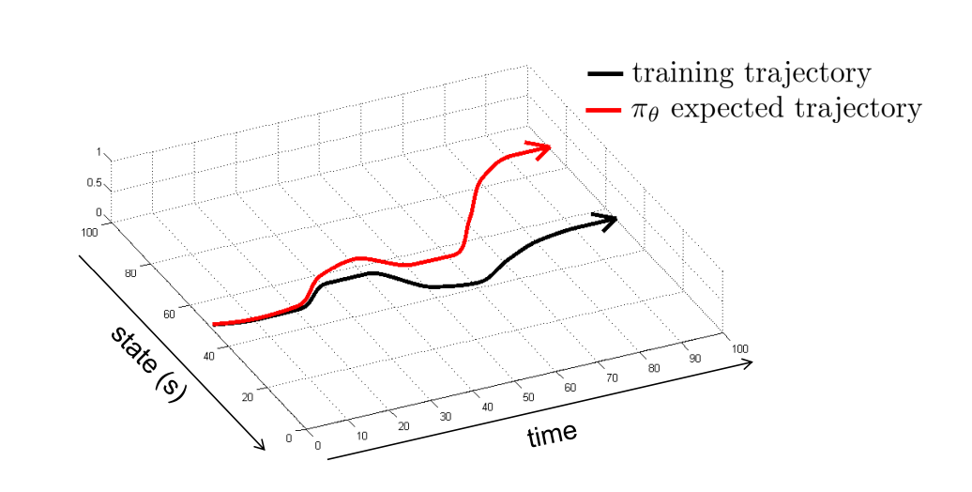
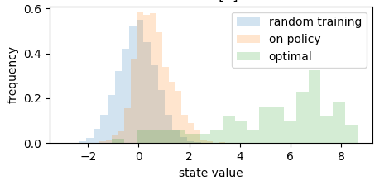
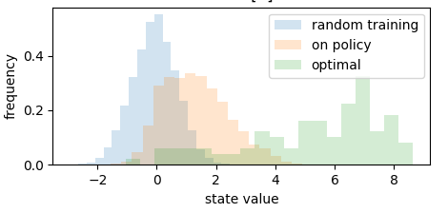
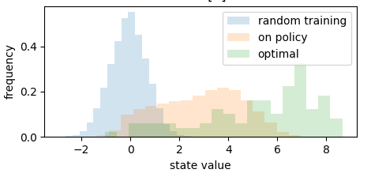
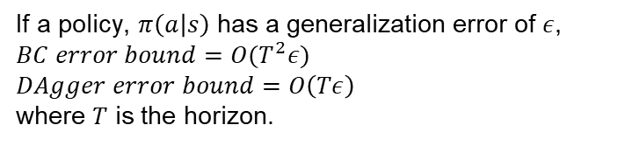
Distribution Shift
If a policy, $π\left(a | s\right)$ has a generalization error of $ε$,
$$BC error bound=O(T^{2}ε)$$
$$DAgger error bound=O\left(Tε\right)$$
where $T$ is the horizon.
Initial distribution of buffer
Policy distribution (added to the buffer)
Optimal policy

Slide 7
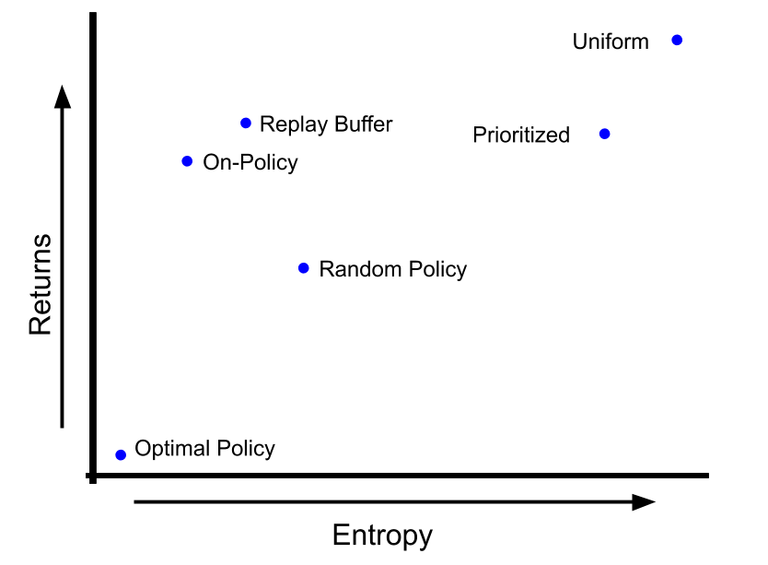
Effect of Training Distribution of the Dataset
Choice of training distribution hugely affects the performance of RL algorithms
Figure from Diagnosing Bottlenecks in Deep Q-learning Algorithms. K.*, Fu*, Levine. ICML 2019

Slide 8
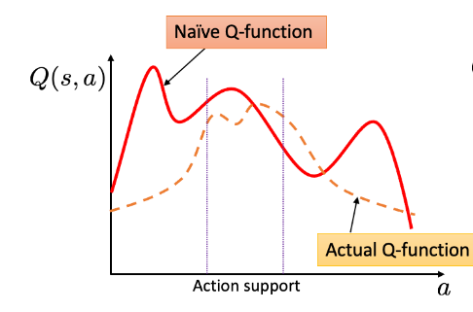
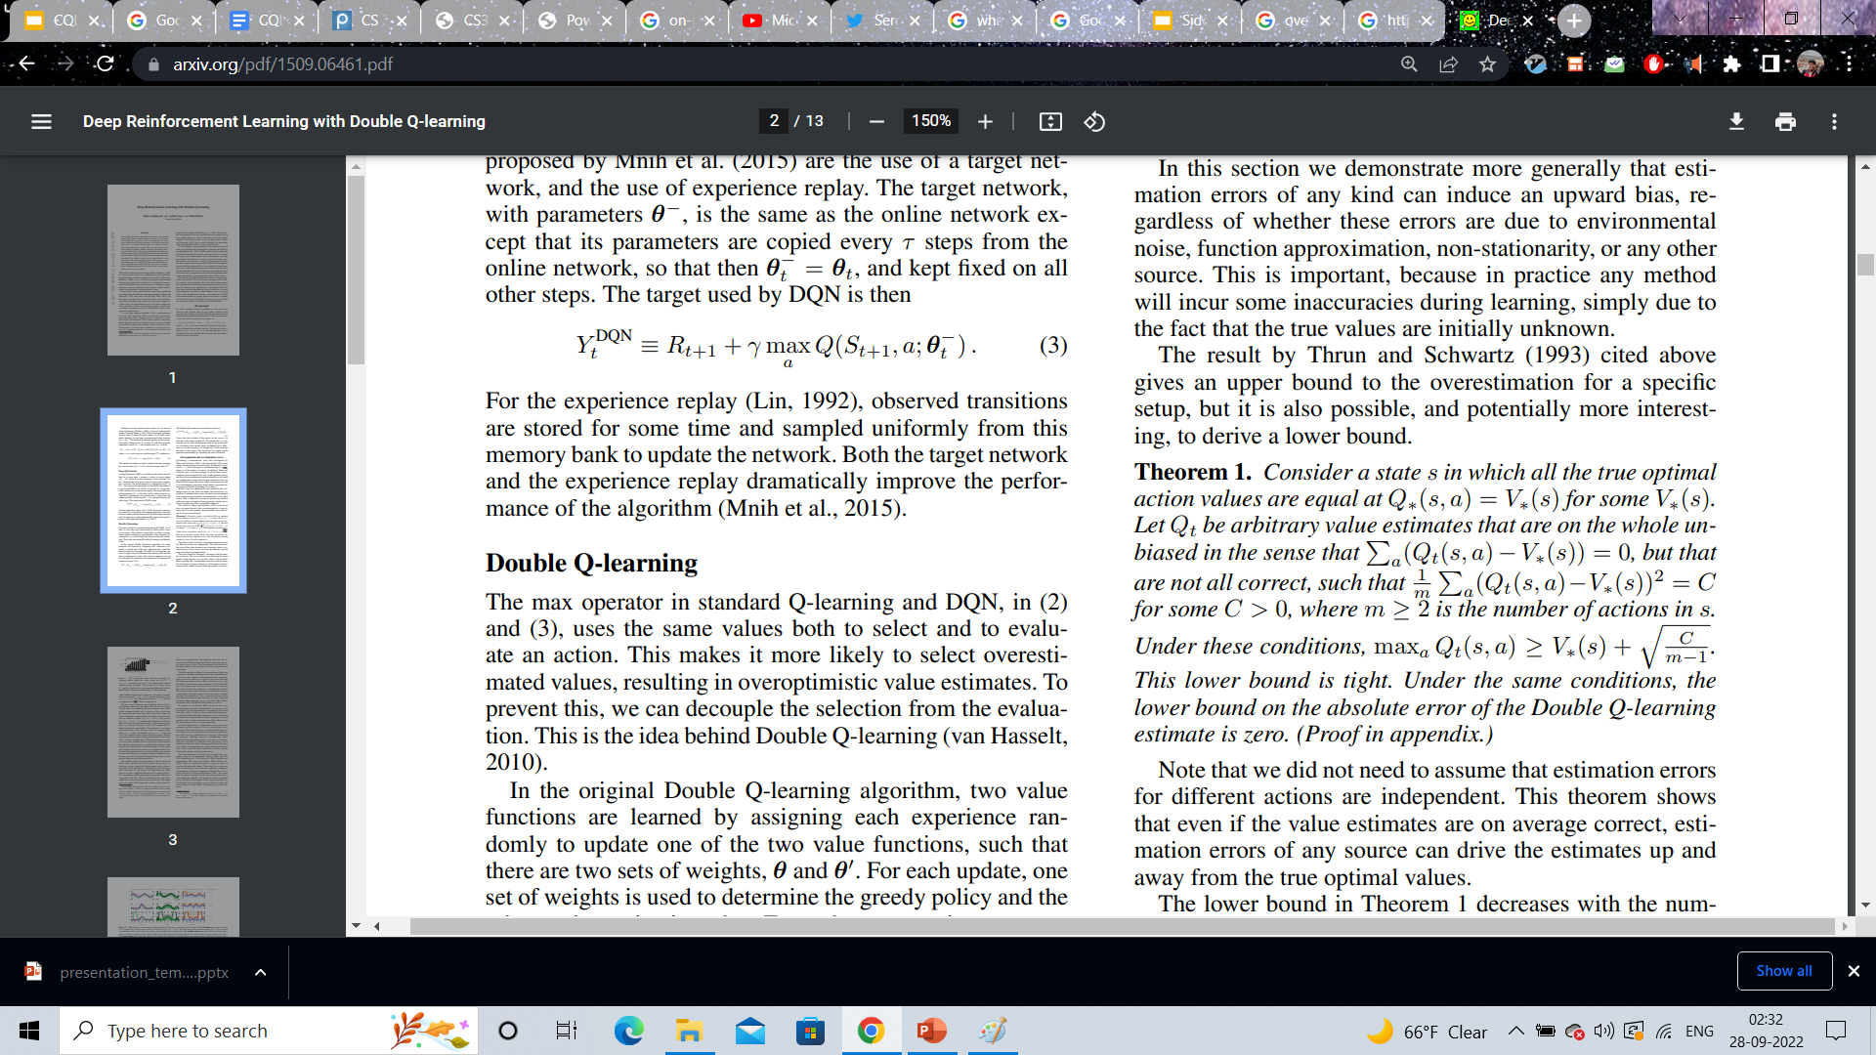
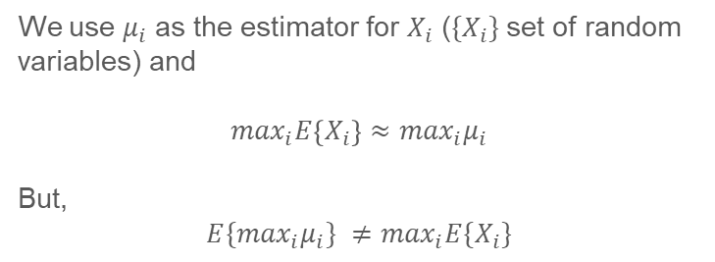
Overestimation Bias
We use $μ_{i}$ as the estimator for $X_{i}$ (${\{X}_{i}\}$ set of random variables) and
$$\max_{i}E\left\{X_{i}\right\}≈\max_{i}μ_{i}$$
But,
$${E\{max}_{i}μ_{i}\} ≠\max_{i}E\{X_{i}\}$$
Since we suffer from the curse of distribution shift, a strategy is to be pessimistic with respect to distribution shift
Hasselt, Hado. "Double Q-learning." NIPS 2010
Hasselt, Hado, Guez, and Silver. "Deep reinforcement learning with double q-learning." AAAI 2016

Slide 9

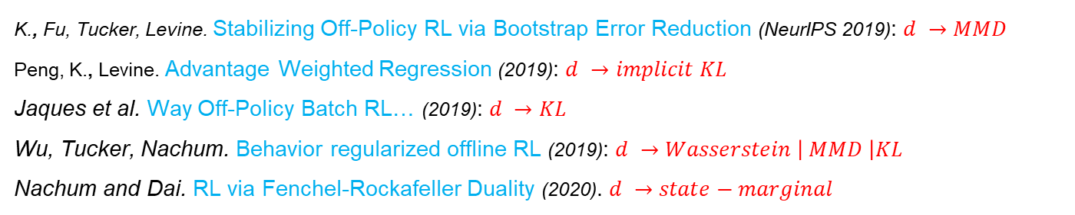
Previous works
Constraint the policy to be close to behavior policy (policy constraint)
$$d\left(π_{φ}\left(a | s\right),π_{β}\left(a | s\right)\right)≤ ε$$
Update your policy as: ${argmax}_{φ} E_{s\sim D, a\sim π_{φ}}\left[Q_{θ}\left(s, a\right)\right] − α∙d\left(π_{φ},π_{β}\right)$
K., Fu, Tucker, Levine. Stabilizing Off-Policy RL via Bootstrap Error Reduction (NeurIPS 2019): $d →MMD$
Peng, K., Levine. Advantage Weighted Regression (2019): $d →implicit KL$
Jaques et al. Way Off-Policy Batch RL… (2019): $d →KL$
Wu, Tucker, Nachum. Behavior regularized offline RL (2019): $d →Wasserstein \left| MMD \right|KL$
Nachum and Dai. RL via Fenchel-Rockafeller Duality (2020). $d →state−marginal$

Slide 10
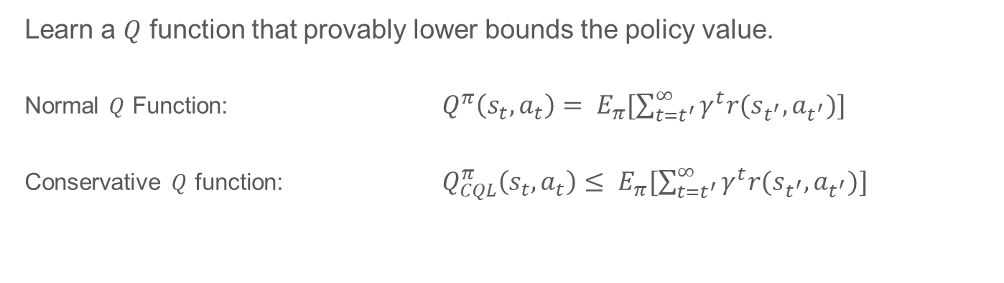

CQL: Lower Bounded Value Function
Learn a $Q$ function that provably lower bounds the policy value.
Normal $Q$ Function: $Q^{π}\left(s_{t}, a_{t}\right)= E_{π}[\sum_{t=t^{′}}^{∞}{γ^{t}r(s_{t^{′}},a_{t^{′}})]}$
Conservative $Q$ function: $Q_{CQL}^{π}\left(s_{t}, a_{t}\right)≤ E_{π}[\sum_{t=t^{′}}^{∞ }{γ^{t}r(s_{t^{′}},a_{t^{′}})]}$
guaranteed to be pessimistic, never overestimate value of unseen action
Minimize large Q-values for actions in $μ$
Bellman Error

Slide 11
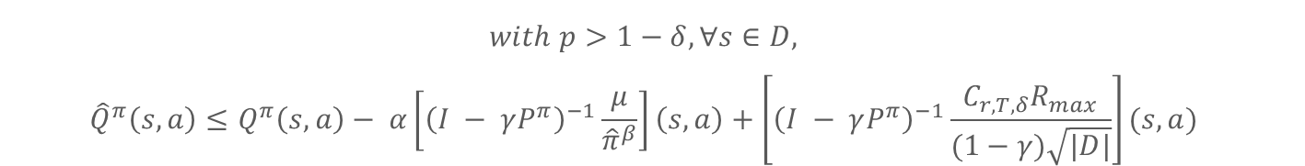
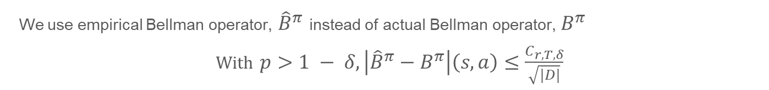
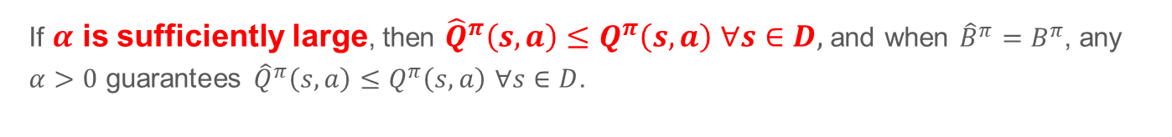
Theoretical Analysis
We use empirical Bellman operator, ${\hat{B}}^{π}$ instead of actual Bellman operator, $B^{π}$
With $p>1 − δ, \left|{\hat{B}}^{π}−B^{π}\right|\left(s, a\right)≤\frac{C_{r, T, δ}}{\sqrt{|D|}}$
$$with p>1−δ, ∀s∈D,$$
$${\hat{Q}}^{π}\left(s, a\right)≤Q^{π}\left(s, a\right)− α\left[{\left(I − γP^{π}\right)}^{−1}\frac{μ}{{\hat{π}}^{β}}\right]\left(s, a\right)+\left[{\left(I − γP^{π}\right)}^{−1}\frac{C_{r, T, δ}R_{max}}{(1−γ)\sqrt{|D|}}\right](s, a)$$
If $α$ is sufficiently large, then ${\hat{Q}}^{π}\left(s, a\right)≤Q^{π}\left(s, a\right)$ $∀s∈D,$ and when ${\hat{B}}^{π}=B^{π}$, any $α>0$ guarantees ${\hat{Q}}^{π}\left(s, a\right)≤Q^{π}\left(s, a\right)$ $∀s∈D$.

Slide 12
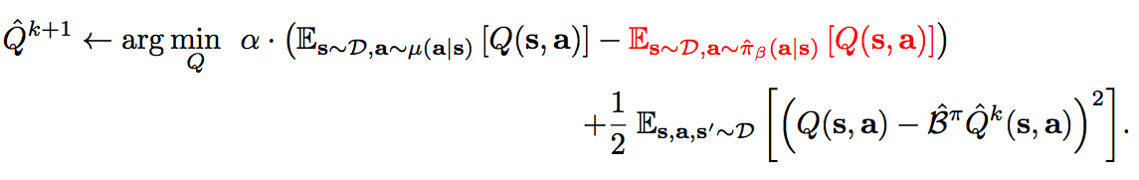
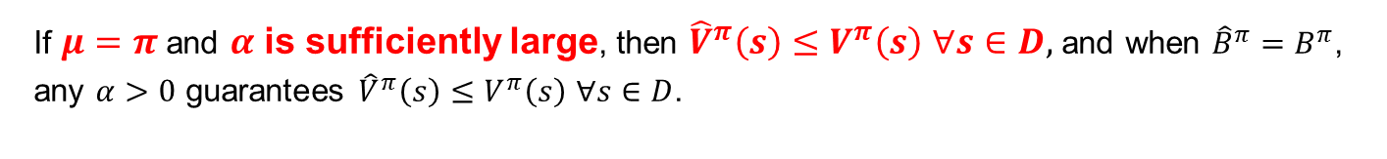
A Tighter Bound
Only need the expected value of Q under policy to lower bound V i.e. ${\hat{V}}^{π}(s)= E_{π}\left[{\hat{Q}}^{π}\left(s, a\right)\right]≤V^{π}(s)$
If $μ=π$and $α$ is sufficiently large, then ${\hat{V}}^{π}\left(s\right)≤V^{π}\left(s\right)$ $∀s∈D,$ and when ${\hat{B}}^{π}=B^{π}$, any $α>0$ guarantees ${\hat{V}}^{π}\left(s\right)≤V^{π}\left(s\right)$ $∀s∈D$.

Slide 13
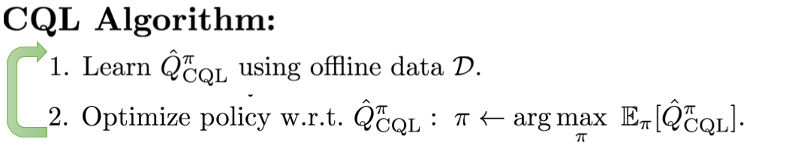
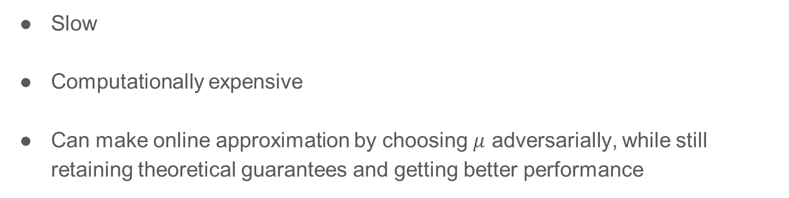
CQL Policy Optimization
Slow
Computationally expensive
Can make online approximation by choosing $μ$ adversarially, while still retaining theoretical guarantees and getting better performance

Slide 14
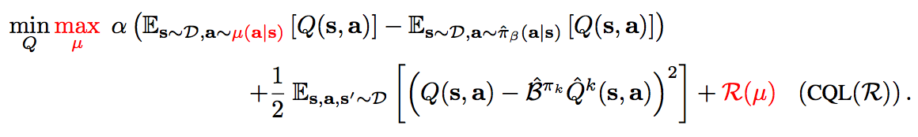
CQL Algorithm
Minimize big Q values
Maximize data Q values
Standard Bellman error
Choice of regularizer affects learned solution

Slide 15
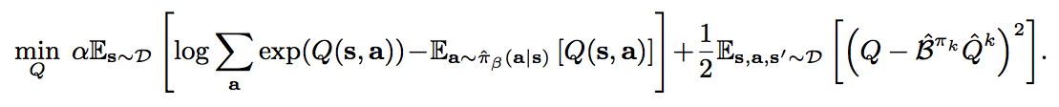

Variants of CQL
For a prior distribution $ρ$, and $R\left(μ\right)=−D_{KL}(μ, ρ)$ we get $μ\left(a | s\right)∝ρ\left(a | s\right)∙exp⁡(Q\left(s, a\right))$
If $ρ=Unif\left(a\right), R\left(μ\right)=H\left(μ\right)→[CQL\left(H\right)]$
In general,
+ Bellman Error

Slide 16
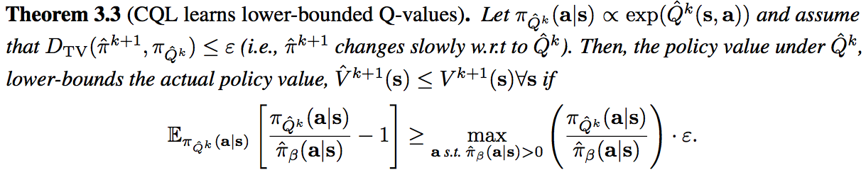
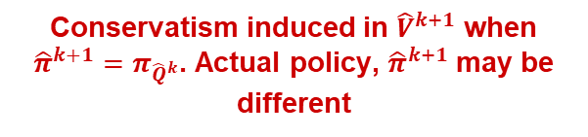
Theoretical Results: Lower Bound Guarantees
Conservatism induced in ${\hat{V}}^{k+1}$ when ${\hat{π}}^{k+1}=π_{{\hat{Q}}^{k}}$. Actual policy, ${\hat{π}}^{k+1}$ may be different
Maximum amount of potential overestimation

Slide 17
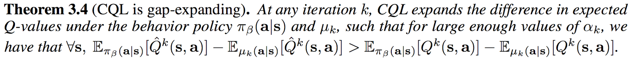
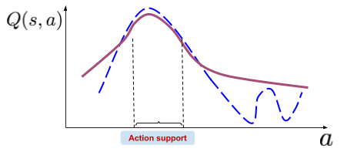
Theoretical Result: Gap Expanding
The difference in Q values at in-distribution actions and over-optimistically erroneous out-of-distribution actions is higher than the corresponding difference under the actual Q-function.
CQL Q-function
CQL implicitly constraints the policy, $π^{k}$ to be closer to $π_{β}$

Slide 18
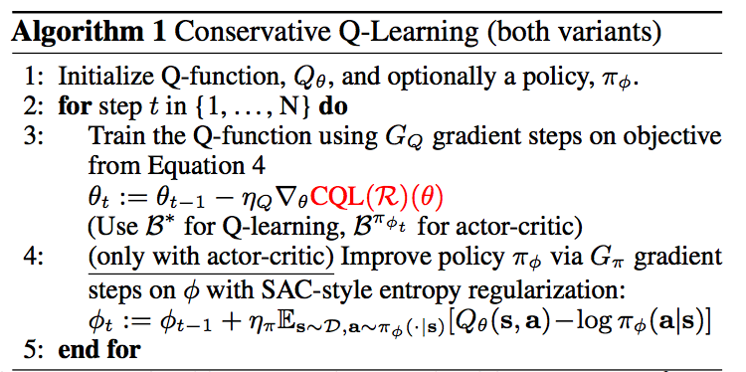
Practical Algorithm

Slide 19
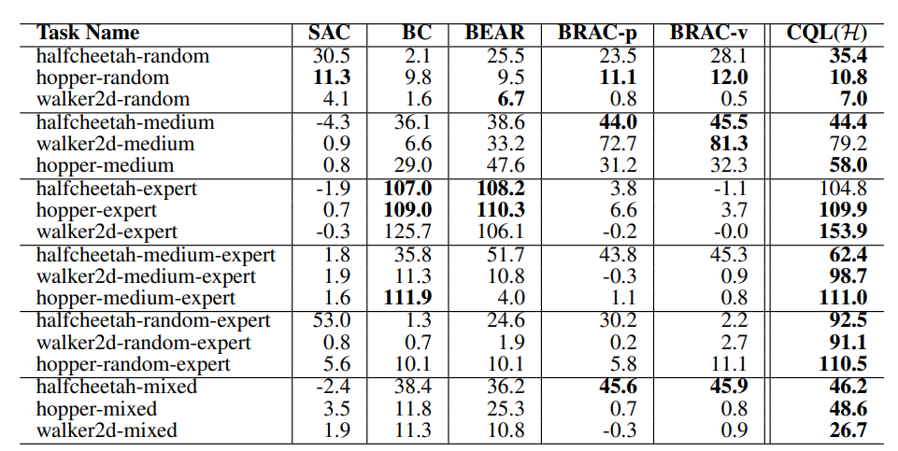
Experiments - Gym
Mujoco – continuous control tasks
Baselines: SAC (off-policy), BC, BEAR (policy constraint), BRAC (policy constraint)

Slide 20
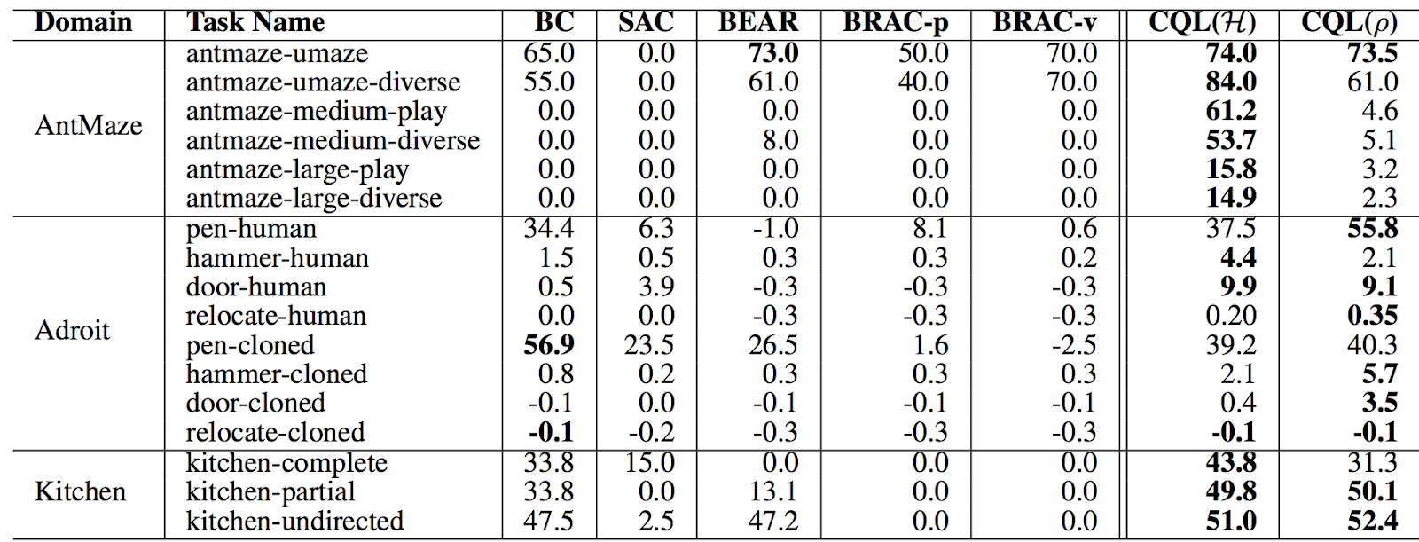
Experiments – D4RL
Tasks: Adroit (24-DoF hand), AntMaze (stitching), Kitchen tasks (manipulation)
Baselines: SAC (off-policy), BC, BEAR (policy constraint), BRAC (policy constraint)

Slide 21
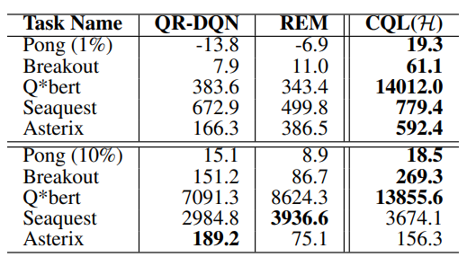
Experiments – Atari Games
5 Atari Games, 2 Datasets
Baselines: QR-DQN, REM

Slide 22
Experiments – Overestimation of Q values
Learned policy value - Actual policy value
Baselines: Ensemble(n) is ensemble of Q Learning models, BEAR

Slide 23
Summary and Reading
CQL can prevent overestimation via learning lower-bound Q-values.
It implicitly constraints the policy to be close to behavior policy.
CQL seems promising to directly apply to real-world tasks.
Offline RL tutorial: https://arxiv.org/abs/2005.01643
D4RL dataset: https://arxiv.org/abs/2004.07219
Double QL: https://papers.nips.cc/paper/2010/file/091d584fced301b442654dd8c23b3fc9-Paper.pdf
Deep Double Q Learning: https://arxiv.org/abs/1509.06461

Slide 24
Limitations and Open Questions
The policy is still close to the behavior policy.
Are the policies learnt optimal?
What about OOD states?
  Jinning, et al. “Dealing with the Unknown: Pessimistic Offline RL”, CoRL 2021
What about overfitting of RL in offline datasets
  Aviral, et al. "A Workflow for Offline Model-Free Robotic Reinforcement Learning." CoRL 2021
Use offline RL for pretraining - https://offline-rl-neurips.github.io/2022/

