Slide 1
FeUdal Networks for Hierarchical Reinforcement Learning
Presenter: Aashish Gottipati
October 20 2022

Slide 2
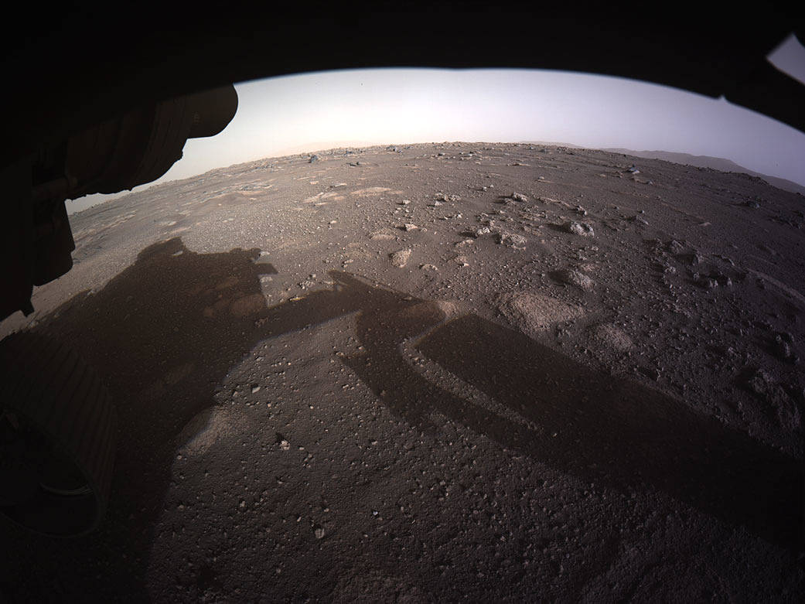
Motivation
Need robots that can perform sophisticated tasks autonomously
Reinforcement learning shows promise
Perseverance Rover from [https://mars.nasa.gov/mars2020/k]
Perseverance Mars Surface [https://www.nasa.gov/image-feature/perseverance-snaps-its-first-full-color-image-of-mars/]

Slide 3
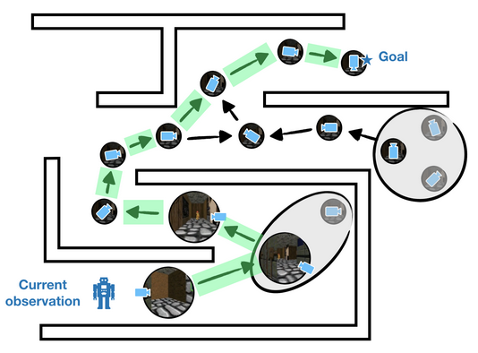
Reinforcement Learning is Hard
Sparse reward signal
Credit assignment is challenging
Long time-horizons for planning exasperate issues
Long horizon task planning from [https://bair.berkeley.edu/blog/2020/11/20/sgm/]

Slide 4
Proposed Solution
Feudal Reinforcement Learning for varying temporal granularity
Agent that learns to select abstract latent goals
Transition policy gradients for directional goals

Slide 5
Feudal Reinforcement Learning 1993
Submanagers receive reward from managers
Managers have absolute control
Granularity of world view varies
Managers are unaware of other levels’ specifics
Super Manager
Sub Manager
Sub Manager
Environment
Dayan and Hinton. Feudal Reinforcement Learning [2]

Slide 6
Related Work
Sutton et al. details options framework hierarchical reinforcement learning [6]
Tessler et al. proposes H-DRLN for learning long-term tasks in Minecraft [7]
Kulkarni et al. proposes h-DQN for learning long-horizon tasks in Montezuma’s Revenge [3]
Bellemare et al. utilizes auxiliary rewards for exploration in Montezuma’s Revenge [1]
End-to-end options-based methods tend to micro-manage or under-manage
Feudal networks promotes sub-goal emergence

Slide 7
Feudal Networks
Manager
Manager
Sets directional goals
Rewarded by environment
Lower temporal resolution
Worker
Worker
Interacts with environment
Rewarded by Manager
Higher temporal resolution
Environment
Slide adapted from T. Gaudin [https://www.pair.toronto.edu/csc2621-w20/assets/slides/lec10_feudalnets.pdf] and R. Bidart [https://cs.uwaterloo.ca/~ppoupart/teaching/cs885-spring18/slides/cs885-lecture16b.pdf]

Slide 8
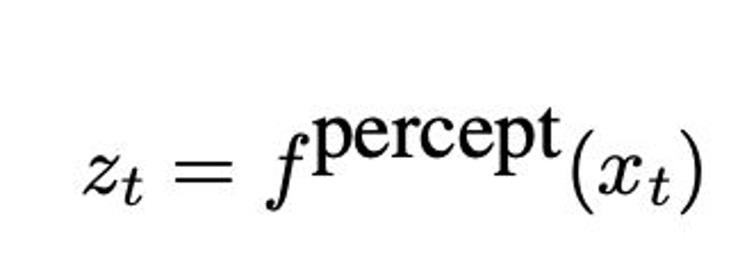
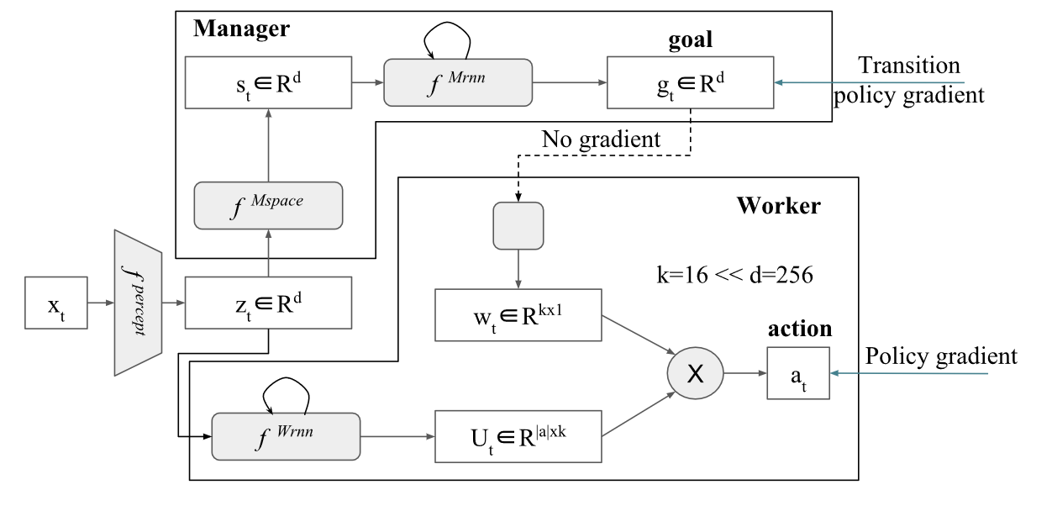
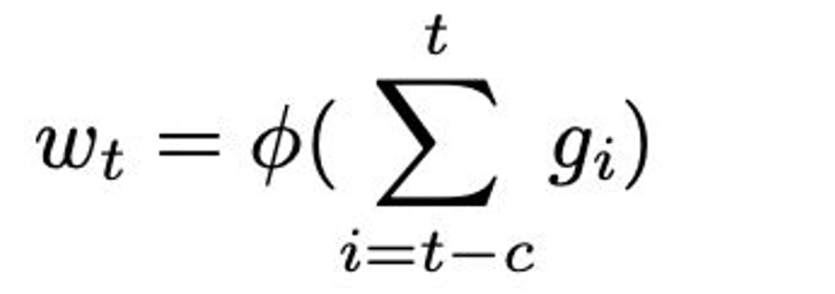
Model Architecture
Slide adapted from T. Gaudin [https://www.pair.toronto.edu/csc2621-w20/assets/slides/lec10_feudalnets.pdf]

Slide 9
Learning Policies
Manager
Worker
Slide adapted from T. Gaudin [https://www.pair.toronto.edu/csc2621-w20/assets/slides/lec10_feudalnets.pdf]

Slide 10
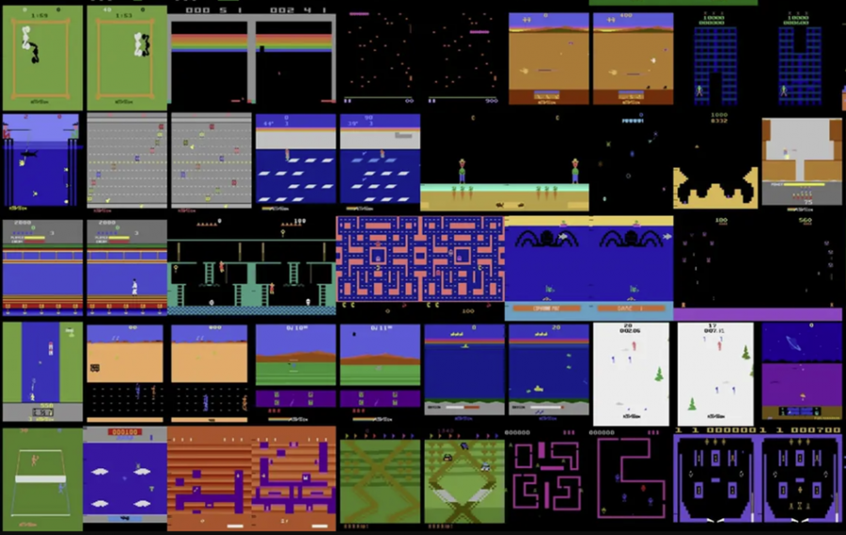
Experimental Setup
Demonstrate FuN learns helpful policies
Vanilla LSTM for baseline
Measure agents’ score on various Atari games
100 trials per model
Randomly sample hyperparameters
Training epoch ~ 1 million observations
Plot average of top 5 agents
Example Atari Games from [https://www.deepmind.com/blog/agent57-outperforming-the-human-atari-benchmark]

Slide 11
Montezuma’s Revenge

Slide 12
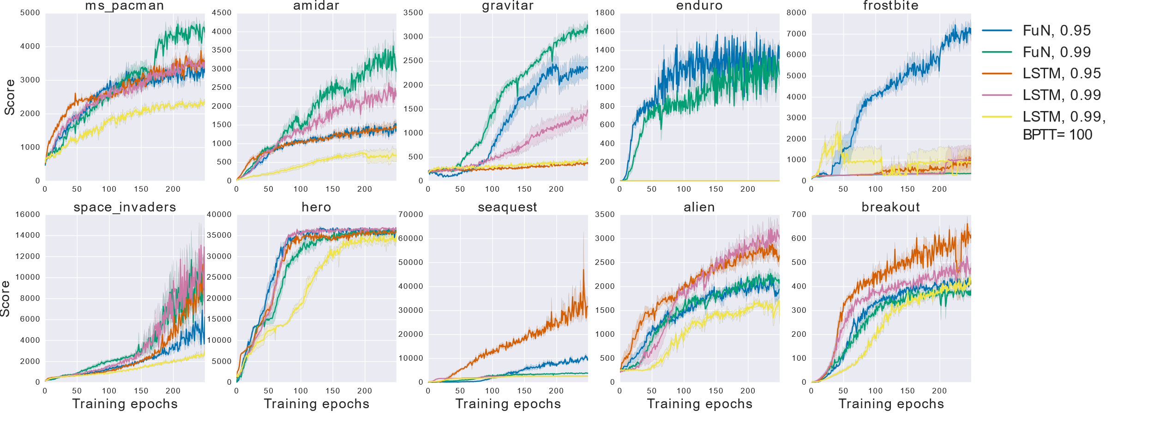
Other Atari Games

Slide 13
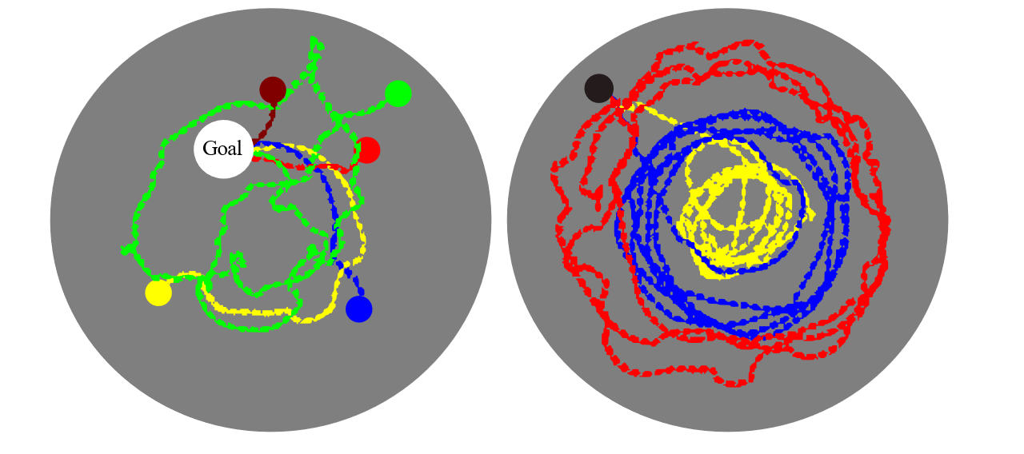
Water Maze Trajectories

Slide 14
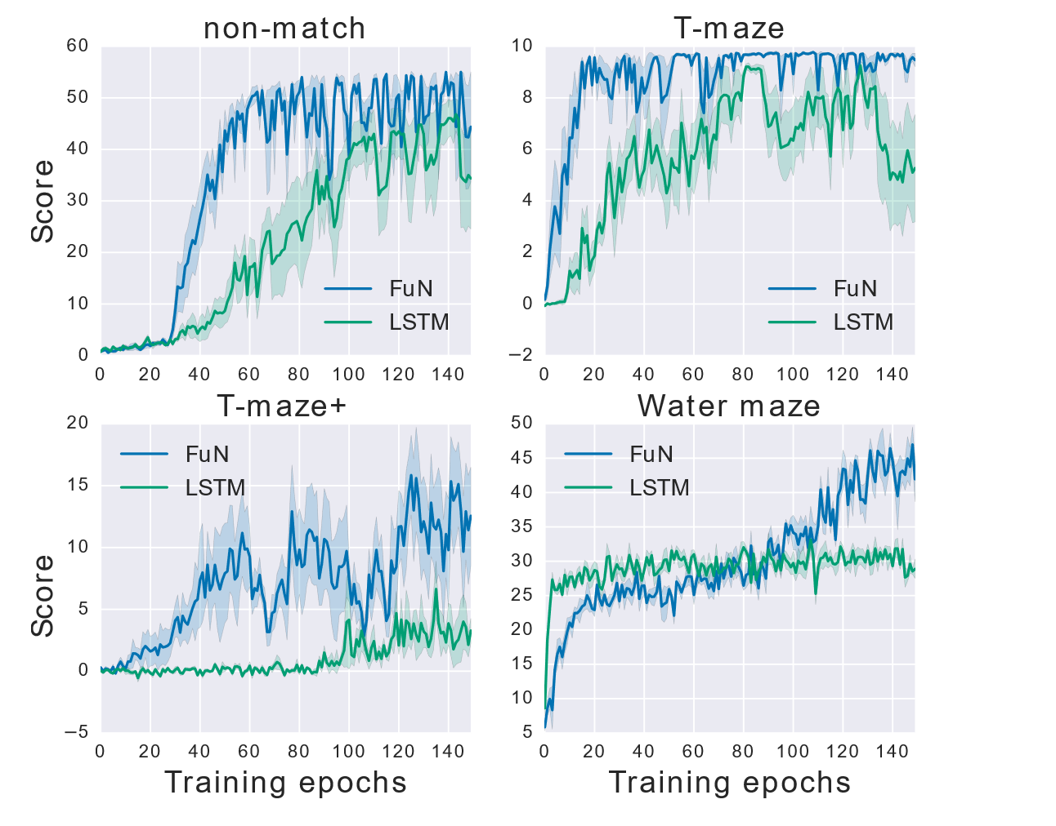
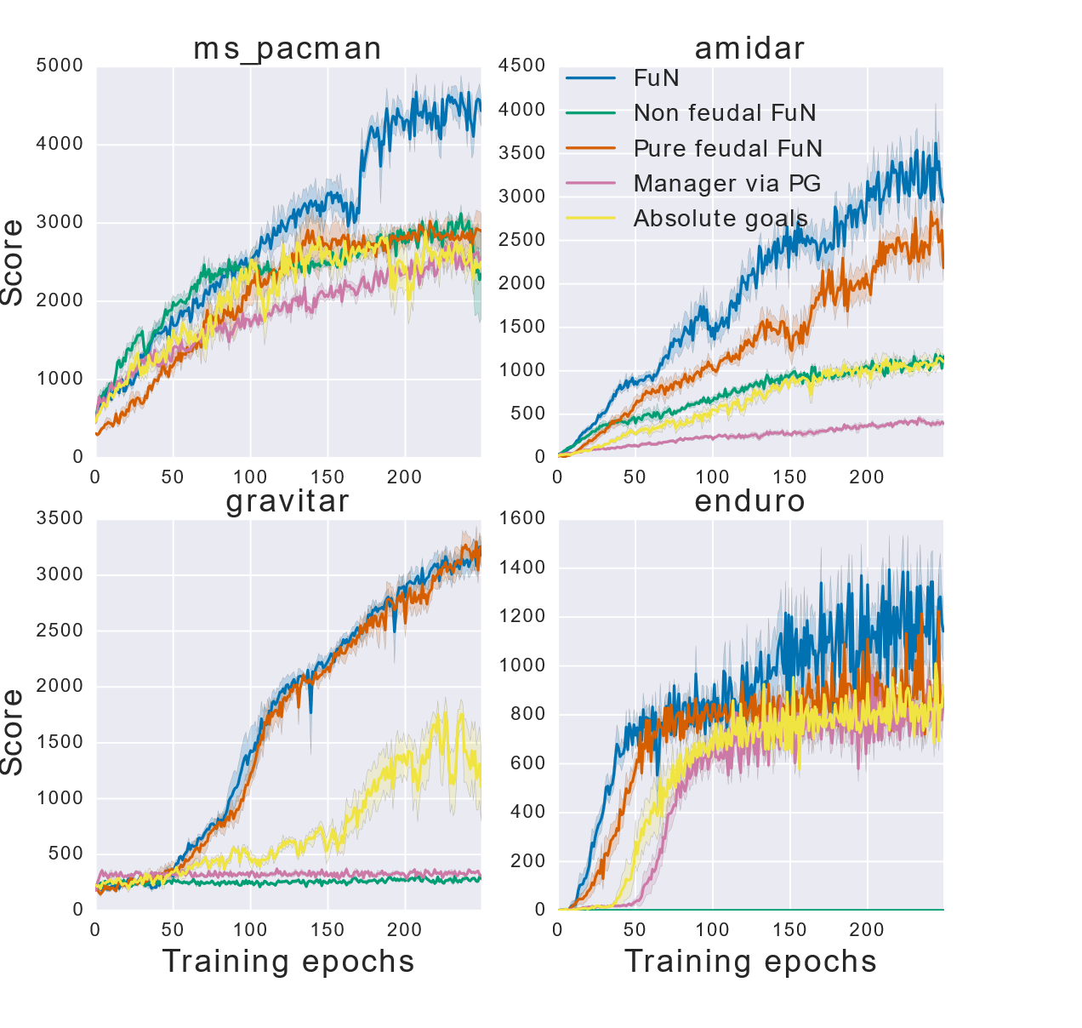
More Results

Slide 15
Action Repeat Transfer

Slide 16
Overview of Results
Learned policies are useful and non-trivial
Agent can learn sub-goals that roughly approximate hand-crafted ones
Modularity promotes transfer and multitask learning
FuN underperforms in tasks without need for long-term credit assignment

Slide 17
Critique / Limitations / Open Issues
Better baseline comparisons would have been useful
Doesn’t explore limitations
Theoretical exploration is necessary
Noisy sub-goals poses problems for safe training
Dealing with sample complexity is still a problem

Slide 18
Future Work
Real world is always more convincing
Expanding hierarchical layers
Cooperation between workers
Nachum et al. proposes using off-policy experience for all levels of training [4]
Sharma et al. proposes leveraging dynamics to discover skills [5]

Slide 19
Extended Readings
Feudal Reinforcement Learning [2]
Unifying Count-Based Exploration and Intrinsic Motivation [6]
Dynamics-Aware Unsupervised Discovery of Skills [5]
Multi-Agent Reinforcement Learning: A Selective Overview of Theories and Algorithms [8]

Slide 20
Summary
Sophisticated planning requires overcoming sparse reward and credit assignment
Previous options-based methods constrain sub-goals
Proposed FuN hierarchical reinforcement learning
Feudal Reinforcement Learning for varying temporal granularity
Introduces transition policy gradients for directional goals
Agent that learns to select abstract latent goals
Results support FuN as a viable approach for long-horizon tasks

Slide 21
References
Bellemare et al. “Unifying Count-Based Exploration and Intrinsic Motivation” 2016
Dayan and Hinton. “Feudal Reinforcement Learning” 1992
Kulkarni et al. “Hierarchical Deep Reinforcement Learning: Integrating Temporal Abstraction and Intrinsic Motivation” 2016
Nachum et al. “Data-Efficient Hierarchical Reinforcement Learning” 2018
Sharma et al. “Dynamics-Aware Unsupervised Discover of Skills” 2019
Sutton et al. “A framework for temporal abstraction in reinforcement learning” 1999
Tessler et al. “A Deep Hierarchical Approach to Lifelong Learning in Minecraft” 2016
Zhang, Yang, and Basar. “Multi-Agent Reinforcement Learning: A Selective Overview of Theories and Algorithms” 2021

