Slide 1
IRIS: Implicit Reinforcement without Interaction at Scale
Srinath Tankasala
10/06/2022

Slide 2
Outline
Motivation
Problem setting
Prior work
IRIS algorithm
Experiments
Results/Analysis
Limitations
Further work
Summary
Questions for thought
References and extended reading

Slide 3
Motivation
Short Horizon tasks - use learning through exploration
Easy and quick to explore
Reward function design is straightforward
Long Horizon - use Imitation learning/ IRL approach
Sparse rewards, ex. assembling furniture, social navigation, etc.
requires more handcrafting for desired behaviours to emerge
harder to apply at scale and explore large state-action spaces

Slide 4
Motivation
Classical/online RL: doesn’t require training data. Exploration and exploitation done by policy.
Offline RL:
Learn RL using a supervised approach
Use data of interactions to train an optimal policy
Eliminates the need for policy to interact with environment every time
Source: Levine et al [1]

Slide 5
Offline RL
Challenges with Offline RL
Resolving Counterfactual queries / out of distribution actions
Exploration policy for data generation should ensure coverage
Collected data for offline RL
Policy training queries unknown state/action values
Possible solution: Constrain training process to explore only within collected data, ex: BCQ

Slide 6
Problem setup
Aim: train policies with Imitation learning from large crowdsourced demonstrations
Challenges:
Suboptimality of collected data
Diversity in solution methods and task instances

Slide 7
Problem setup
Aim: train policies with Imitation learning from large crowdsourced demonstrations
Challenges:
Suboptimality of collected data
Diversity in solution methods and task instances

Slide 8
Problem formulation
Aim: train policies with Imitation learning from large crowdsourced demonstrations
Formulated as MDP $M=\left(S,A,T,R,γ, ρ_{0}\right)$ augmented with a set of absorbing goal states $G⊂S$
Each goal state $s_{g}∈G$ corresponds to state of world where task is solved
Reward used is a measure of task success $R\left(s,a,s^{′}\right)=1_{\left[s^{′}∈G\right]}$

Slide 9
Prior work
Batch constrained Q learning
Limitations: limited exploration and difficulty dealing with suboptimal demonstrations
**Placeholder**

Slide 10
IRIS method
Hierarchical controller structure
trajectory
Low level goal-oriented Controller
(imitation learning)
$$a_{t:t+T}=π_{im}\left(s_{t:t+T} | s_{g}\right)$$
Imitate sequence of length T with
$$s_{g} = s_{t+T}$$

Slide 11
IRIS method
Low level imitation control
Learns policy that goes from a start state to goal state in at most T time steps
Given a goal state $s_{t+T}$ and current state $s_{t}$, the controller imitates trajectories from training data to reach $s_{t+T}$
Models the diversity of solutions in the training data when generating action from $s_{t}→s_{t+T}$
High level goal selector
Learns goal states $s_{t+T}$ that are reachable from the current state
Uses a generative model to propose a set of goal states
Selecting the best goal state from the proposal set overcomes suboptimality problem

Slide 12
IRIS model: training
$[(s_{t},a_{t}),(s_{t+1},a_{t+1})$,…$(s_{t+T},a_{t+T})$]
RNN model loss: $Σ_{t}^{t+T}{\left(|\left|π_{im}\left(s_{k}|s_{g}\right)−a_{k}\right||\right)}^{2}$
Goal prediction model(cVAE) training loss
Value prediction model(cVAE) training loss
Sample goal proposals
from encoder distribution
$$z\sim N\left(μ_{g},σ_{g}\right), {\hat{s}}_{t+T}= D_{φ}(z,s_{t})$$

Slide 13
IRIS model: training
How does IRIS address challenges of this offline training task?
Constrain learning to only in-distribution states of training data
Goal proposal model proposes only goal states that have been previously observed
Low level controller directly imitates sequences from training data
Hence value function is only queried on state-action pairs that lie within the training distribution

Slide 14
IRIS model: inference

Slide 15
Datasets

Slide 16
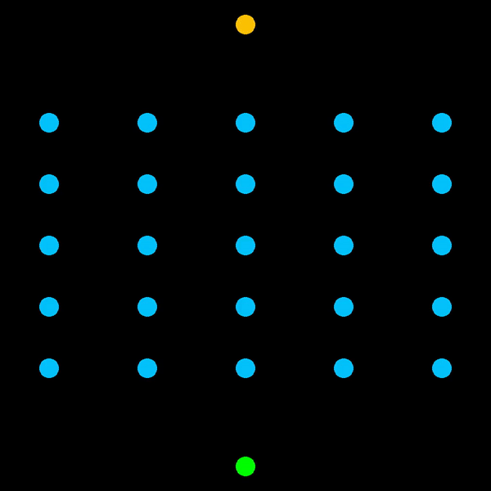
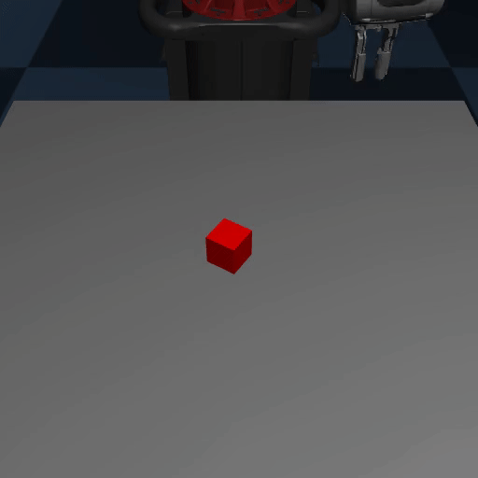
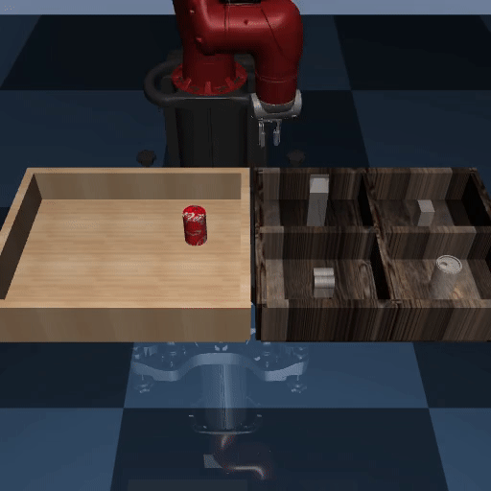
Experiments
Graph traversal
Navigating a 5x5 2D grid
Training data generated by sampling random paths from start to end
Robosuite Lift
Grasp and lift cube demonstrations
Training data is deliberately suboptimal with delayed pickup time
RoboTurk Cans
A filtered version of the RoboTurk pilot dataset consisting of the fastest 225 with diverse and suboptimal trajectories

Slide 17
Qualitative Results

Slide 18
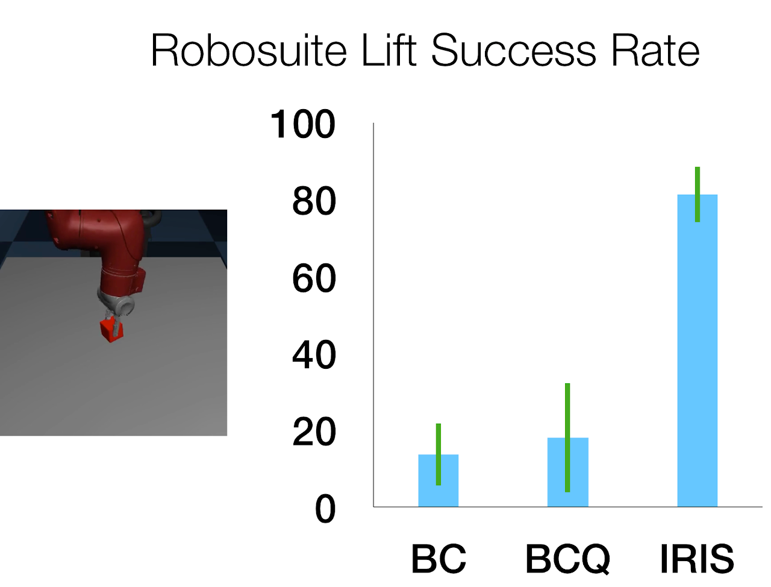
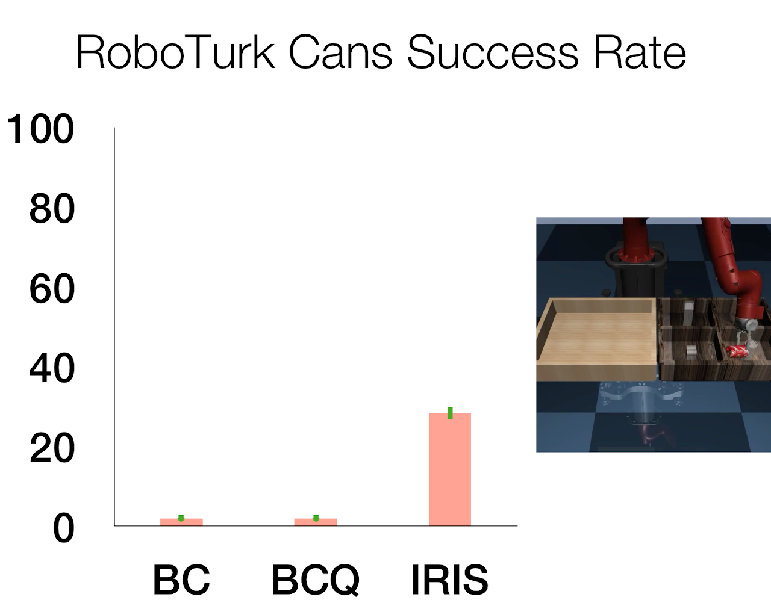
Quantitative Task success rate

Slide 19
Results
Ablations

Slide 20
Model ablation and Dataset size analysis

Slide 21
Limitations
Requires full state observations (as we augment the MDP with goal states)
Picking the parameters (Time horizon T, reward) is not clear
Adapting this trained model to different domain is difficult (due to the hierarchical controllers)

Slide 22
Further/Future work
Adapting the controller to different domain
Use goals from the observation space only
Study transferability of this to real world demonstration data

Slide 23
Summary
**Placeholder**

Slide 24
References and extended reading
**Placeholder**

