Slide 1
Concept2Robot: Learning Manipulation Concepts from Instructions and Human Demonstrations
Lin Shao, Toki Migimatsu, Qiang Zhang, Karen Yang, and Jeannette Bohg
RSS 2020
Slides: Albert Yu
October 27, 2022

Slide 2
Motivation and Main Problem
How can a policy learn different verbs?
Importance:
Deployable robots need to perform varied manipulation behaviors
Technical Challenges:
Grounding instructions in actions—how well does this transfer?
Learning suitable verb representations
Using pretrained/learned models for a joint image-language embedding space
Shortcomings of Prior Approaches:
Hard to learn a variety of verbs with a single robot policy
Key Insights of this work:
Learning from language instructions using a demonstration-based scoring function
Use video-classifier to provide rewards for single-task RL policies
Single multitask IL policy distilled from single-task RL policies performs better than directly fitting a multitask policy on the data.

Slide 3
Problem Setting
Policy
Language instruction
Trajectory
Initial State

Slide 4
Related Work: Vision-Language Grounding
Using compositionality of language for temporally extended tasks
Object arrangement, reordering
Limitations: Abstracts away motor control. Discretized actions.
Figure 1: https://arxiv.org/pdf/1906.07343.pdf

Slide 5
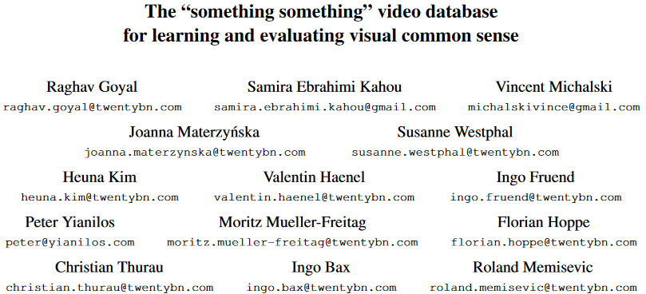
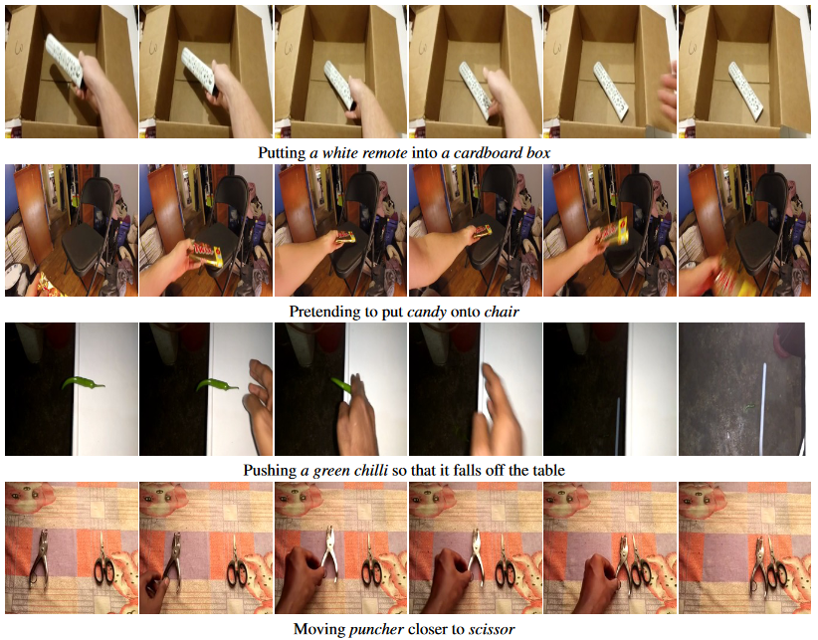
Related Work: Learning from Demos
sth
sth
100k videos, 174 classes
sth
sth
sth
sth
sth
Something Something, Figure 4: https://arxiv.org/pdf/1706.04261.pdf

Slide 6
Related Work: Trajectory Representations
1D linear spring system
$$τ\dot{v}=K\left(g−x\right)−Dv+\left(g−x_{o}\right)f$$
$$τ\dot{x}=v$$
2nd order dynamical system used by Concept2Robot
$$\ddot{y}\left(t\right)=k_{p}\left(g−y\left(t\right)\right)−k_{d}\dot{y}\left(t\right)+f\left(t\right)$$
DMP, Equations 1-2: https://ieeexplore.ieee.org/stamp/stamp.jsp?tp=&arnumber=5152385

Slide 7
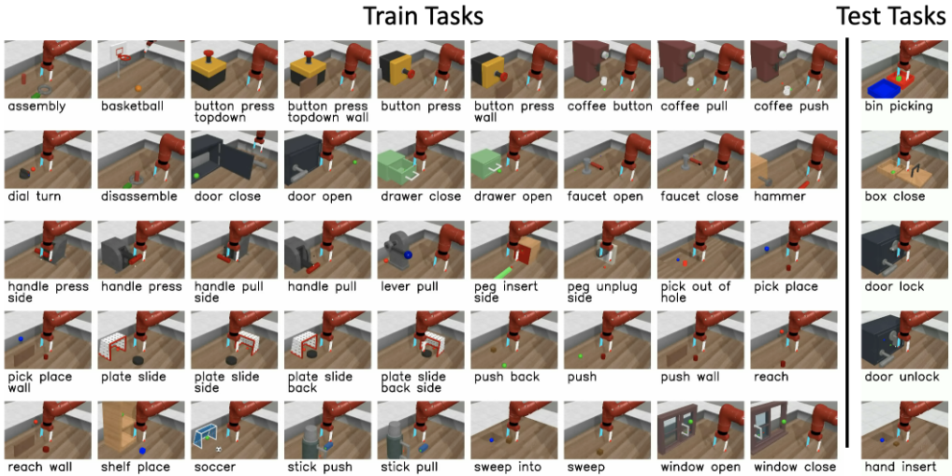
Related Work: Multi-Task Learning
50 manipulation tasks
Limitations: Does not use language
Meta-World, Figure 1: https://arxiv.org/pdf/1910.10897.pdf

Slide 8
Proposed Method
Stage I: Video Classifier (cross entropy)
Video Classifier
(3D conv)
Human Video
Task probabilities

Slide 9
Proposed Method
Stage II: Single-task RL Policy Training (done for each task)
DDPG style
Actor
Action distribution $N([\overline{g},\overline{f}], σ)$
CEM
Trajectory $\left[g,f\right]$
Initial state
Trajectory $\left[\overline{g},\overline{f}\right]$
$$ℒ_{actor}=−Q\left(s,Actor\left(s\right)\right)$$
Trajectory $\left[g,f\right]$
$$ℒ_{critic}={\left\|r−Q\left(s,a\right)\right\|}^{2}$$
Critic
Video Classifier
$$Q\left(s,a\right)$$
Trajectory Rollout Video
reward $r$
Initial state
Notes:
Emphasize main novelty here is using video classifier for rewards

Slide 10
Proposed Method
Stage III: Multi-task IL Policy Training
Rollouts for each task from all single-task policies
Multitask Policy
Resnet-18
1D Conv
$g=$ goal pose $\left(1×7\right)$
Initial State
$$\left[g,f\right]$$
DMP-styled
Trajectory
BERT
1D Conv
$f\left(⋅\right)=$ Forces $\left(T×7\right)$
Language Instruction
$$ℒ_{multitask}=\sum_{t=1}^{T}{{\left\|\hat{y}{\left(a\right)}_{t}−y_{t}^{i}\right\|}^{2}+{\left\|g−\hat{y}{\left(a\right)}_{T}\right\|}^{2}+{\left\|g−\hat{y}{\left(a^{i}\right)}_{T}\right\|}^{2}}$$
Notes:
Their notation for this equation sucks. I’ll try to improve it for clarity.
Main novelty here: multitask policy imitates the single task policies.

Slide 11
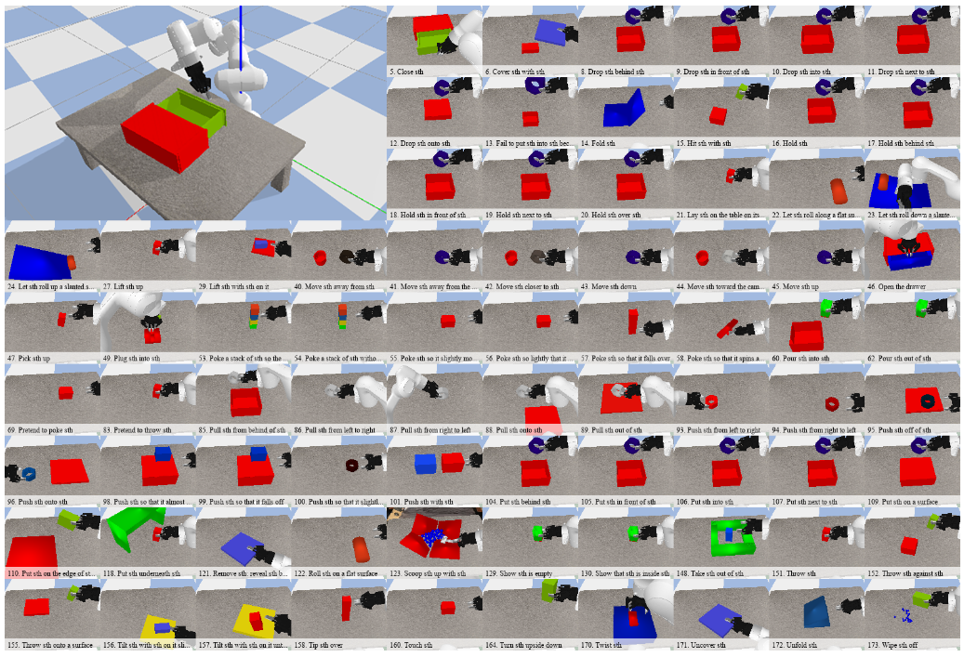
Experimental Setup: Env, Tasks, Baselines, Metrics
PyBullet Franka Panda
78 Tasks $→$
Manually defined task success metrics for evaluation
Baselines: no stage II (single task RL policies), Distral
Concept2Robot, Figure 3: http://www.roboticsproceedings.org/rss16/p082.pdf
Notes:
Read up on Distral.
Show some robot videos. Here or in exp results.

Slide 12
Experimental Setup: Hypotheses
DMP-styled trajectory representations are important.
When learning tasks, Videos $>$ Goal images
Video classifier rewards $≈$ true rewards
Method outperforms SOTA
Multi-task policy performance $≈$ single task policy performance
Generalizes to novel instructions

Slide 13
Experimental Results: Importance of DMP-styled trajectory representations
(goal only) $\left[g\right]→54\%$
(goal + forces—DMP) $\left[g,f\right]→61\%$

Slide 14
Experimental Results: Videos > Goal images
 | Image Classifier | Video Classifier
Top-1 | $$28\%$$ | $$35\%$$
Top-5 | $$43\%$$ | $$58\%$$

Slide 15
Experimental Results: Video classifier rewards $≈$ True rewards
Video classifier rewards mostly matches training on true rewards for half the tasks; true rewards does significantly better on the other half

Slide 16
Experimental Results: Beats SOTA
Concept2Robot, Table 1: http://www.roboticsproceedings.org/rss16/p082.pdf
Notes:
Label what simple and distral are.

Slide 17
Experimental Results: Multitask $≈$ Single-task Performance
Multitask: $54\%$ (trained on all tasks; performance on 8 tasks)
Single-task: $61\%$ (average over 8 single-task policies)

Slide 18
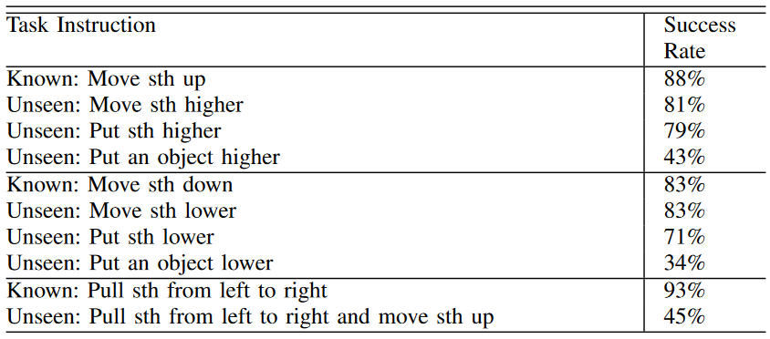
Experimental Results: Generalizes to new synonyms
Concept2Robot, Table 2: http://www.roboticsproceedings.org/rss16/p082.pdf
Notes:
Highlight knowns.

Slide 19
Discussion of Results
Key insights and conclusions:
One can use language as a “label” for diverse human demonstrations to learn a variety of manipulation skills with a single policy.
Video classifiers serve as okay-ish learned reward functions
Method strengths:
leverages readily-available large-scale datasets to distinguish between tasks
Method weaknesses:
Tasks are probably too simple / too varied for the multitask policy to perform better than the single task policies
Room for improvement on novel language compositions
All hypotheses are supported by results except the hypothesis that learning with video classifier rewards are as good as with true rewards.
Further experiments: Offline RL baselines, standard markovian policy instead of DMP trajectories.

Slide 20
Critique and Limitations
Task difficulty:
Single object
Very limited randomization
Scalability: Requires training as many policies as there are tasks. Very hard to learn new task during real-world deployment.
Lack of details in video classifier training. Does it just transfer 0-shot to videos of the robot environment?

Slide 21
Future Work
Ideas:
How can we apply learned skills to manipulate novel objects?
How effectively do the learned verb $→$ trajectory mappings generalize to new robots?
How can we use the robot’s large bank of manipulation skills to more quickly learn new manipulation skills?
Can the large-scale human dataset be leveraged in other ways besides simply training a reward classifier?
Published ideas:
Directly condition the policy on demonstration and language embeddings; regress demo embeddings toward language embeddings (BC-Z; Jang, et. al.)
Use transformer policies with multimodal task specification tokens (language and goal images (VIMA; Jiang, et. al.)
Use pretrained models for grounding new skills/object knowledge (CLIPort; Sridhar, et. al.)

Slide 22
Extended Readings
Robotics with large pretrained vision-language models
CLIPort: [PDF] [web]
Mohit Shridhar, Lucas Manuelli, Dieter Fox. “CLIPort: What and Where Pathways for Robotic Manipulation.” CoRL 2021.
R3M: [PDF] [web]
Suraj Nair, Aravind Rajeswaran, Vikash Kumar, Chelsea Finn, Abhinav Gupta. “R3M: A Universal Visual Representation for Robot Manipulation.” CoRL 2022
Multitask RoboNLP for generalization
BC-Z: [PDF] [web]
Eric Jang, Alex Irpan, Mohi Khansari, Daniel Kappler, Frederik Ebert, Corey Lynch, Sergey Levine, Chelsea Finn. “BC-Z: Zero-Shot Task Generalization with Robotic Imitation Learning.” CoRL 2021.
VIMA: [PDF] [web]
Yunfan Jiang, Agrim Gupta, Zichen Zhang, Guanzhi Wang, Yongqiang Dou, Yanjun Chen, Li Fei-Fei, Anima Anandkumar, Yuke Zhu, Linxi Fan. “VIMA: General Robot Manipulation with Multimodal Prompts.” arXiv 2022.
Other Language-Conditioned Multitask Policies
HULC: [PDF] [web]
Oier Mees, Lukas Hermann, Wolfram Burgard. “What Matters in Language Conditioned Robotic Imitation Learning over Unstructured Data.” IEEE RA-L 2022.
PerAct: [PDF] [web]
Mohit Shridhar, Lucas Manuelli, Dieter Fox. “Perceiver-Actor: A Multi-Task Transformer for Robotic Manipulation.”
Interactive Language: [PDF] [web]
Corey Lynch, Ayzaan Wahid, Jonathan Tompson, Tianli Ding, James Betker, Robert Baruch, Travis Armstrong, Pete Florence. “Interactive Language: Talking to Robots in Real Time.”

Slide 23
Summary
Problem: How can a multitask policy learn different verbs?
Necessary for all-purpose robots to be deployable, but it’s difficult to map language to actions in varied scenarios
Very little prior work experimented with language-conditioned multitask robotic manipulation; most policies learn very limited verbs
Key insight: Human video demonstrations and language instructions play an important role in multitask robotic learning.
Key result: A multitask policy that beats previous SOTA (Distral) in learning 78 different manipulation tasks from language.

Slide 24
Questions
Is there a way to more efficiently score the trajectories instead of rolling out and capturing a video?
A strength of language is its compositionality. How could we leverage this property for multi-step tasks?
How would we apply a learned verb to different objects? Instead of just being told to do a verb to “sth.”
How else can robot learning use language, besides simply as an action label for conditioning the policy?

