Slide 1
The Option-Critic Architecture Authors: Pierre-Luc Bacon, Jean Harb, Doina Precup AAAI Conference on Artificial Intelligence (2017)
Presenter: Kyle Soares
10/20/2022
Notes:
The Option-Critic Architecture Authors: Pierre-Luc Bacon, Jean Harb, Doina Precup Published in 2016, presented in the AAAI Conference on Artificial Intelligence (2017)

Slide 2
Motivation
Motivation: Efficiently learn discrete actions to solve a single task
Idea: Create temporally abstract actions as options and learn them stochastically
Abstraction example: GPS navigation directions
Importance / Limitations of Reinforcement Learning?
No universal policy for real-world, agnostic tasks
Learning options and sub-goals are expensive and impractical
Bottlenecks of learning and training policies at scale
1
2
3
4
Notes:
How can we efficiently learn a game where we are placed into a room at random?
Should we create sub goals and optimize for each room? Why not?
Think of how a GPS navigates? It doesn’t tell you what to do each time but gives you an option (straight, turn left, turn right, stop) and terminates your option when it’s time to do the next one. Much easier to remember those directions.

Slide 3
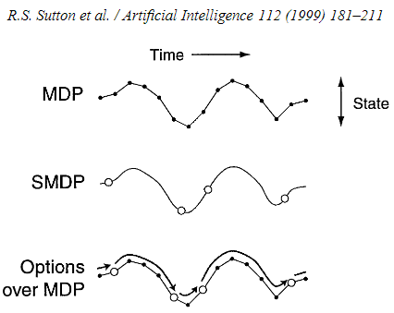
Main Problem
How to discover temporal abstractions autonomously and feasibly:
Policy Gradient Theorem applied to options framework (Sutton, Precup, and Singh, 1999)
Option-Critic Architecture to promote transfer learning
Key insights:
Goal: autonomously learn options to solve a single task
How: Learn internal policies with the policy over options
Why: No additional sub-goals or rewards needed!
Notes:
Discovering options has been outlined by (Sutton, Precup, and Sing, 1999) for some time but discovering temporal abstractions has only recently become feasible.
Now we have found ways to combine policy gradient methods and options framework to leverage transfer learning to make learning multiple policies from a single task more efficient.
Previous work limitations:
Learning sub-goals is inefficient, slow, computationally expensive, challenging to label and define rewards and difficult to scale
Key insights:
Can learn end-to-end options just by specifying the number of options
Greedy policy over options once current options terminates
Generalization with pseudo-rewards

Slide 4
Options Framework
Park
(Sutton, Precup, and Singh 1999; Precup 2000)
$ω ϵ Ω: Markovian option$
$ω$= ($Ι_{ω}, π_{ω}, β_{ω})$
$Ι_{ω} :Initiation set, {s ϵ Ι}_{ω}$
$π_{ω}:intra−option policy$
$β_{ω} →[0, 1]:termination function$
$$Ι_{ω2}, π_{ω2}, β_{ω2}$$
$$Ι_{ω1}$$
$$π_{ω1}$$
$$β_{ω1}$$
car
Notes:
Discovering options has been outlined by “A Framework for Temporal Abstraction in Reinforcement Learning” (Sutton, Precup, and Sing, 1999) for some time but discovering temporal abstractions has only recently become feasible.
Now we have found ways to combine policy gradient methods and options framework to leverage transfer learning to make learning multiple policies from a single task more efficient.
Previous work limitations:
Learning sub-goals is inefficient, slow, computationally expensive, challenging to label and define rewards and difficult to scale
Key insights:
Can learn end-to-end options just by specifying the number of options
Greedy policy over options once current options terminates
Generalization with pseudo-rewards

Slide 5
Theory
Derived from equations in intra-option learning (Sutton, Precup, and Singh, 1999)
Intra-Option Policy Gradient Theorem
Gradient of expected discounted return with respect to θ
Termination Gradient Theorem
Gradient of expected discounted return with respect to ϑ
Proofs in Appendix
Bacon, Pierre-Luc, Jean Harb, and Doina Precup. "The option-critic architecture." Proceedings of the AAAI Conference on Artificial Intelligence. Vol. 31. No. 1. 2017.
Notes:
Intra-Option Policy Gradient Theorem

Slide 6
Problem Setting
Problem: Autonomously create temporal abstractions from data
Sub-goals are expensive
How: Learn internal policies and termination conditions + policy over policies
Markov Decision Process (MDP)
Policy Gradient Theorem → Options Framework
No sub-goals or sub-rewards given
Assumptions?
Discrete state and action sets
Intra-option policies and termination functions are stochastic and differentiable
All options apply everywhere
Notes:
Assumptions:
Discrete state and action states: can be extended to continuous environments
Stochastic and differentiable
All options apply everywhere: can learn initiation sets but most be able to get from every state to every other state without exception.
This is called an ergodic Markov Chain

Slide 7
Problem Setting
Policy gradient methods:
$μ:discounted weighing of states$
Options Framework:
$ω ϵ Ω: Markovian option$
$Ι_{ω} :Initiation set$
$π_{ω}:intra−option policy$
$β_{ω}:termination function$
Markov Decision Process (MDP):
$S: set of states$
$P: transition function$
$r: reward function$
$π: Markovian stationary policy$
$V_{π}\left(s\right):expected return of π$
$Q_{π}\left(s, a\right): action−value function$
$γ:discount factor$

Slide 8
Related Work / Limitations of Prior Work
Option discovery:
(Comanici and Precup, 2010): Optimal policy switching; gradients to improve termination functions
(Levy and Shimkin, 2011): Inter and intra options learning using policy gradient methods; created augmented state space and used stopping events as actions
(Silver and Ciosek, 2012): Compositional Planning Using Optimal Option Models; chained options into temporal sequences
Relation to Option-Critic:
Option-Critic advances above strategies in conjunction
Also relies on Bellman equations and compositionality
Doesn’t create augmented state space
Intra-option Policies
Termination Functions
Policy over Options
Bacon, Pierre-Luc, Jean Harb, and Doina Precup. "The option-critic architecture." Proceedings of the AAAI Conference on Artificial Intelligence. Vol. 31. No. 1. 2017.
Notes:
Built on gradient-based approach:
Comanici and Precup, 2010: improve termination function only using gradients. Not policies
Levy and Shimkin, 2011: state action space explicitly and incorporated stopping events (waste of space)
Silver and Ciosek, 2012: chained together temporal sequences using compositionality (but doesn’t use gradient methods)
Sorg and Sing, 2010: same as previous
Our approach uses Bellman equations and compositionality in conjunction with policy gradient methods

Slide 9
Related Work / Limitations of Prior Work
Optimization:
(Vezhnevets et al. 2016): learns options with open-loop intra-option policies.
(Mankowitz, Mann, and Mannor, 2016): Adaptive Skills, Adaptive Partitions (ASAP); learned options and applicability but with restricted structure for initiation sets and termination functions
(Kulkarni et al. 2016): Hierarchical-DQN with intrinsic, extrinsic rewards, and given sub-goals
Relation to Option-Critic:
Option-critic is generalized, uses closed-loop policies, and doesn’t require sub-goals or motivation
$$$
Bacon, Pierre-Luc, Jean Harb, and Doina Precup. "The option-critic architecture." Proceedings of the AAAI Conference on Artificial Intelligence. Vol. 31. No. 1. 2017.
Notes:
Focus on option discovery:
Daniel et al. 2016: using EM to learn optimal options with termination functions as hidden variables
Vezhnevets et al. 2016: open-loop intra-option policies / macro actions. Map of states to action sequences
Mankowitz, Mann, and Mannor, 2016: restricted structure for initiation sets and termination functions
Kulkarni et al. 2016: Used DQN with intrinsic and extrinsic rewards with subgoals given as inputs
Our solution uses closed-loop policies and is better since it gets sensory feedback and more general

Slide 10
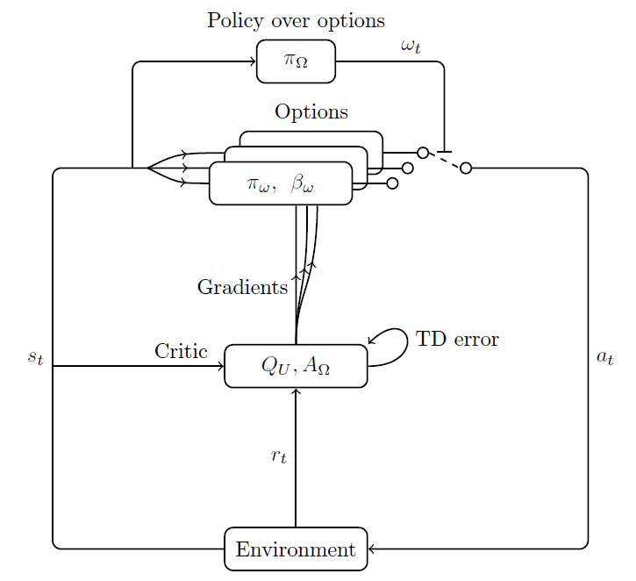
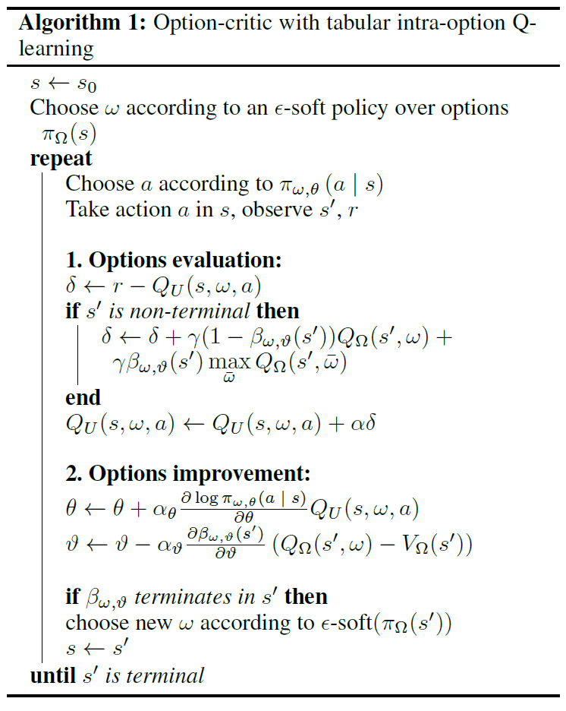
Option-Critic Architecture
*Off-policy
Bacon, Pierre-Luc, Jean Harb, and Doina Precup. "The option-critic architecture." Proceedings of the AAAI Conference on Artificial Intelligence. Vol. 31. No. 1. 2017.
Notes:
Inspired by actor-critic architectures. The Critic is Q and A, and the actor is the policies, and termination functions
The optimization objective is to maximize the expected value of executing your sequence of actions in context of each state in time
Diagram:
Highlighted the important addition to this algorithm.
The architecture starts with state St
The policy over options will select a best policy, omega, and activate the switch for that intra-policy.
The algorithm will take an action in the environment which will give reinforcement
The critic will then take the action value function and advantage function over other policies to build gradients
The gradients will train the intra-policy options and termination functions even if they are not played, making this an off-policy algorithm
Once the policy terminates, the policy over options will be greedy (probability 1-e) and select the best intra-policy option until it terminates or the task ends.
Algorithm:
Start in a state, choose an policy, pick an action, observe the difference in reward and expected reward.
If the new state is non-terminal (didn’t reach the reward), update the one-step off-policy update target and option-value expectation function
Then update gradient of the expected return parameter, thetha and gradient of expected discounted return parameter, vartheta
If the intra-option policy terminates, then the policy over options will pick a new omega according to eps-soft
Terminates when the new state is terminal

Slide 11
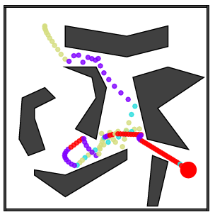
Experimental Setup
Four squares (Sutton, Precup, and Singh 1999)
Pinball domain (Konidaris and Barto 2009)
Arcade Learning Environment (ALE) (Bellemare et al. 2013)
Represent critic, intra-option policies, and termination functions
Mimic deep neural network in (Mnih et al. 2013)
Asterisk, Ms. Pacman, Seaquest, Zaxxon
1
2
3
4
Bacon, Pierre-Luc, Jean Harb, and Doina Precup. "The option-critic architecture." Proceedings of the AAAI Conference on Artificial Intelligence. Vol. 31. No. 1. 2017.
Notes:
Description of the experimental evaluation setting
What is the domain(s), e.g., datasets, tasks, robot hardware setups?
Arcade Learning Environment:
1st: 32 8x8 convolutional filters. Stride of 4
2nd: 64 4x4 filters, stride of 2
3rd: 64 3x3 filters, stride of 1
Fed into dense layer of 512 neurons
Learning rate of 0.00025, epsilon 0.05
What are the baseline(s)?
Four squares: SARSA, Primitive Actor-Critic
What scientific hypotheses are tested?
Evaluating steps / return vs number of episodes
How did the authors evaluate the success of their approach?
Want a lower steps to reach reward as iterations increases, higher undiscounted return (to compare number of options), higher score than baselines

Slide 12
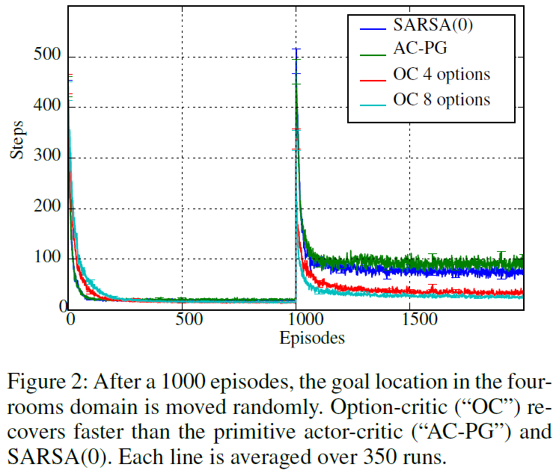
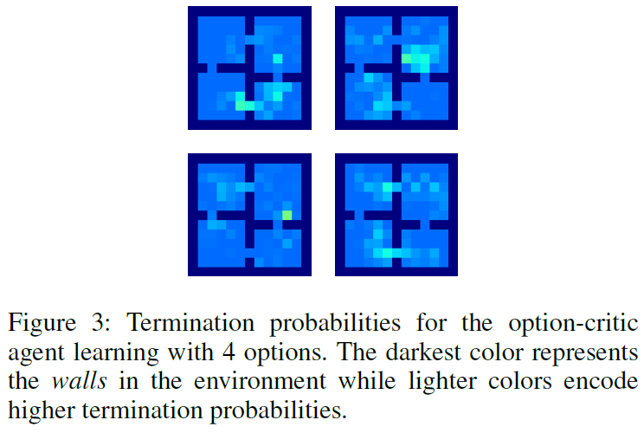
Experimental Results
Four Rooms
Bacon, Pierre-Luc, Jean Harb, and Doina Precup. "The option-critic architecture." Proceedings of the AAAI Conference on Artificial Intelligence. Vol. 31. No. 1. 2017.
Notes:
Four Rooms experiment:
Measure how fast a set of options can adapt to environment changes
Trained for 1000 episodes and then the goal moves randomly
Present the quantitative and qualitative results
Once the goal changes, OC converges / recovers faster than SARSA and primitive actor-critic baselines
The policies are learned from scratch at comparable efficiency to baselines in first 1000 episodes
Pinpoint the most interesting / significant results
OC termination probabilities right show high termination probabilities near doorways, so the policy becomes a subgoal without us having to provide that as an input

Slide 13
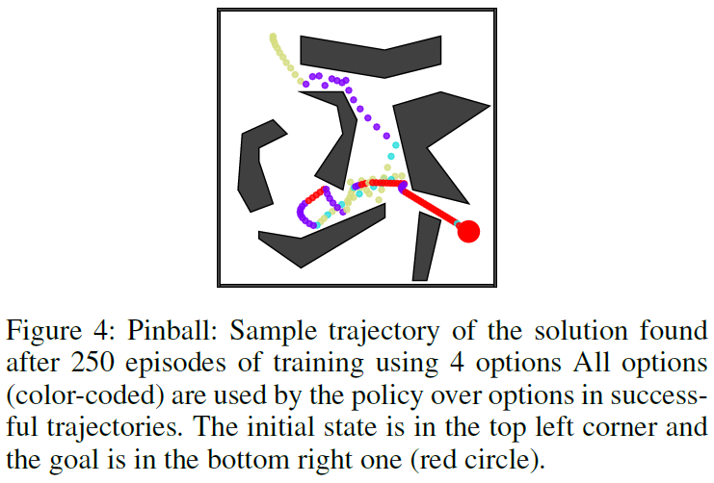
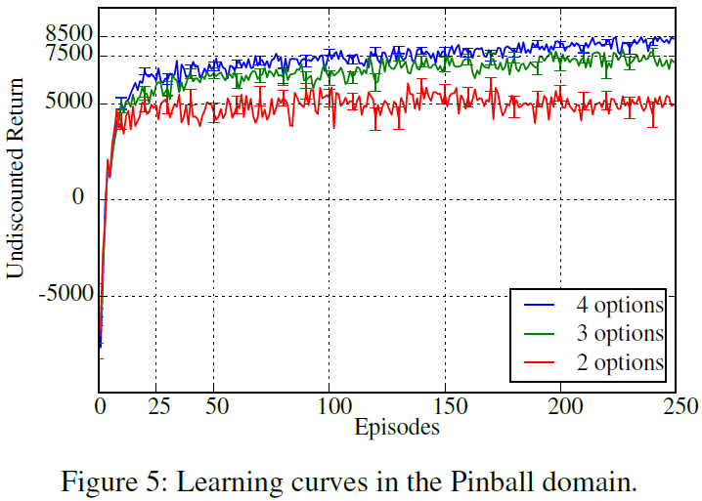
Experimental Results
Pinball
Bacon, Pierre-Luc, Jean Harb, and Doina Precup. "The option-critic architecture." Proceedings of the AAAI Conference on Artificial Intelligence. Vol. 31. No. 1. 2017.
Notes:
Pinball:
Guide the ball through a continuous space / arbitrary maze
5 actions: move faster/slower, horizontal/vertical, or do nothing
Intra-option Q-learning on the critic
Options only used after gestation period of 10 episodes so they can be trained
Compared performance of varying number of options
Present the quantitative and qualitative results
More options is better but the gap narrows as options increases
Policies learned in as few as 40 episodes
Pinpoint the most interesting / significant results
Regardless of the successful trajectory, many policies over options used the red option at the end

Slide 14
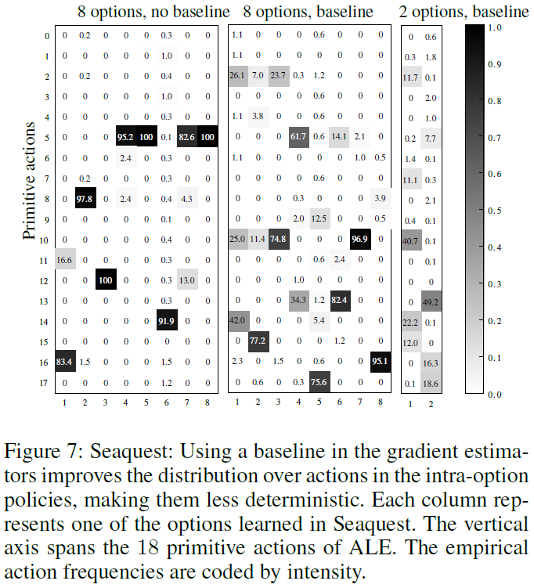
Experimental Results
Arcade Learning Environment
Bacon, Pierre-Luc, Jean Harb, and Doina Precup. "The option-critic architecture." Proceedings of the AAAI Conference on Artificial Intelligence. Vol. 31. No. 1. 2017.
Notes:
Seaquest: destroy fish and rescue humans
Present the quantitative and qualitative results
Using a baseline in gradient estimators broadens the number of intra-options policies used → less deterministic
Limitation of policy gradient methods: options can become deterministic
Option-Critic outperforms DQN which was used previously in (Mnih et al. 2013) in 3/4 games in the same episodes but with more parameters.
Pinpoint the most interesting / significant results
OC learned goals of games in 200 episodes or less
OC only needed 2 options to learn Seaquest in an intuitive way, moving just up and down
DQN is good at Ms. Pacman, why couldn’t OC get there? What was its goal?

Slide 15
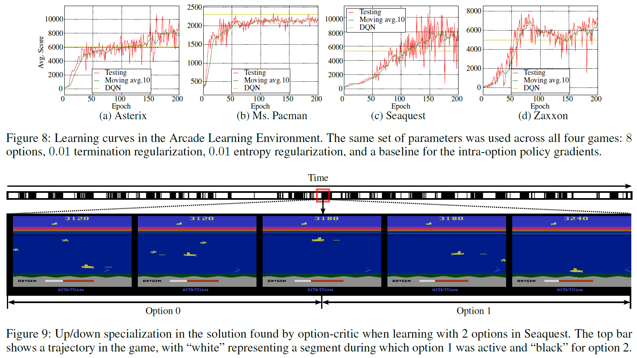
Experimental Results
Arcade Learning Environment
Bacon, Pierre-Luc, Jean Harb, and Doina Precup. "The option-critic architecture." Proceedings of the AAAI Conference on Artificial Intelligence. Vol. 31. No. 1. 2017.
Notes:
Seaquest: destroy fish and rescue humans
Present the quantitative and qualitative results
Using a baseline in gradient estimators broadens the number of intra-options policies used → less deterministic
Limitation of policy gradient methods: options can become deterministic
Option-Critic outperforms DQN which was used previously in (Mnih et al. 2013) in 3/4 games in the same episodes but with more parameters.
Pinpoint the most interesting / significant results
OC learned goals of games in 200 episodes or less
OC only needed 2 options to learn Seaquest in an intuitive way, moving just up and down
DQN is good at Ms. Pacman, why couldn’t OC get there? What was its goal?

Slide 16
Discussion of Results
Successful and efficient gradient-based performance optimization
Learn intra-option policies, termination functions, and policy over options together
Only requires number of options
Pseudo-reward and option bias flexibility
Improves upon past gradient-based learning algorithms
Same experiments within Arcade Learning Environment

Slide 17
Critique / Limitations
Limitation: all options apply everywhere
Filtering options is high cost
Must cover state-option space
Challenges:
Real-world applications may have >8 options
Critique:
Is there a trade-off with a higher number of options?
Why did DQN outperform in Ms. Pacman?
https://www.space.com/54-earth-history-composition-and-atmosphere.html

Slide 18
Future Work for Paper / Reading
Define how to learn initiation sets
Explore upper boundary of additional options
Conduct real world experiments
Learning options in multi-objective, multi-task contexts (Brunskill and Li, 2014)
Continual / Lifelong Reinforcement Learning (Khetarpal et al., 2020)
Notes:
“If initiation sets are to be learned, the main constraint that needs to be added is that the options and the policy over them lead to an ergodic chain in the augmented state-option space.”
In general, it is advised to decrease the number of assumptions we are making when aiming for continual reinforcement learning so we can have more realistic models
Khetarpal, K., Riemer, M., Rish, I., & Precup, D. (2020). Towards Continual Reinforcement Learning: A Review and Perspectives. ArXiv, abs/2012.13490.

Slide 19
Extended Readings
Brunskill, E., & Li, L. (2013). Sample Complexity of Multi-task Reinforcement Learning. ArXiv, abs/1309.6821.
Khetarpal, K., Riemer, M., Rish, I., & Precup, D. (2020). Towards Continual Reinforcement Learning: A Review and Perspectives. ArXiv, abs/2012.13490.
Mnih, V.; Kavukcuoglu, K.; Silver, D.; Graves, A.; Antonoglou, I.; Wierstra, D.; and Riedmiller, M. A. 2013. Playing atari with deep reinforcement learning. CoRR abs/1312.5602.
Puterman, M. L. 1994. Markov Decision Processes: Discrete Stochastic Dynamic Programming. John Wiley & Sons, Inc.
Sutton, R. S.; McAllester, D. A.; Singh, S. P.; and Mansour, Y. 2000. Policy gradient methods for reinforcement learning with function approximation. In NIPS 12. 1057–1063.
Sutton, R. S.; Precup, D.; and Singh, S. P. 1999. Between mdps and semi-mdps: A framework for temporal abstraction in reinforcement learning. Artificial Intelligence 112(1-2):181–211.

Slide 20
Summary
Problem: discover temporal abstractions autonomously and feasibly
Importance: precursor to scaled reinforcement learning
Limitation of prior work: defining sub-goals at scale
Key insight(s): can learn options without pre-defined sub-goals
What: learn internal policies and terminations with policy over options simultaneously
How: derived policy gradient theorems for options demonstrate flexible and efficient architecture

