Slide 1
Apprenticeship Learning via Inverse Reinforcement Learning
-Pieter Abbeel , Andrew Y. Ng
Presenter: Anshul Tomar
13th October 2022

Slide 2
Inverse reinforcement learning
Given $π^{∗}$ (or execution traces) and $T$ can we recover $R$ ?

Slide 3
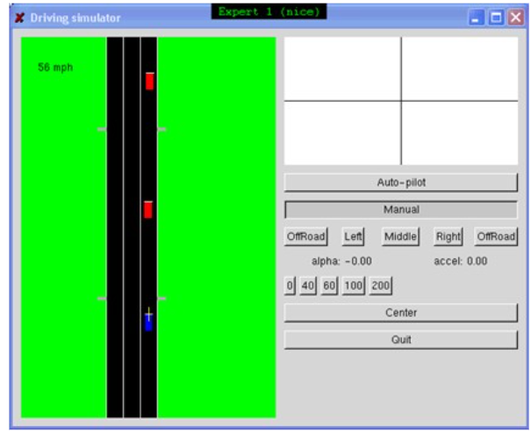
Motivation
Usually difficult to specify the reward function
Highway driving
Need to trade off distance, speed, lane, preference
Modeling human and animal behavior
Bee foraging, songbird vocalization.

Slide 4
Previous approaches
Behavioral cloning
Learn expert’s policy (state to action mappings) directly using supervised learning [Sammut et al. (1992)]
Usually $R^{∗}$ has a much simpler description than $π^{∗}$
Atkeson & Schaal (1997)
Method only applicable for mimicking expert’s trajectory (not policy)
Lack of strong performance guarantees

Slide 5
Notations
Markov decision Process (MDP) (S, A, T, $γ$, D, R)
$R\left(s\right)=ω^{T}φ\left(s\right)$ is the reward function where $φ:S→{\left[0,1\right]}^{k}$ is a k-dimensional feature vector. Let us assume ${\left|\left|ω\right|\right|}_{2}≤1$.
Policy $π:S→A$, Expert policy $π_{E}:S→A$

Slide 6
Basic Idea
Find a reward function $R^{∗}$ which explains the expert behavior ($π_{E})$.
$E_{S_{0}\sim D}[V^{π_{E}}\left(S_{0}\right)]=E[\sum_{t=0}^{∞}{γ^{t}R^{∗}\left(S_{t}\right) \left| π_{E}\right]≥}$ $E[\sum_{t=0}^{∞}{γ^{t}R^{∗}\left(S_{t}\right) \left| π\right] ∀π}$
Challenges:-
Do not know $π^{∗}$, have to estimate it using the expert trajectories
Difficult to enumerate through all policies $π$
There could be many reward functions satisfying the equation (example R(s) = 0)

Slide 7
Feature expectations
Let $R\left(s\right)=ω^{T}φ\left(s\right)$
$E[\sum_{t=0}^{∞}{γ^{t}R\left(s_{t}\right)\left| π\right]= }E[\sum_{t=0}^{∞}{γ^{t}ω^{T}φ\left(s_{t}\right)\left| π\right] }$
$=ω^{T}E[\sum_{t=0}^{∞}{γ^{t}φ\left(s_{t}\right)\left| π\right]}$
$=ω^{T}μ(π)$
Estimating expert’s feature expectation
$$μ\left(π_{E}\right)= \frac{1}{m}\sum_{i=1}^{m}{\sum_{t=0}^{∞}{γ^{t}φ\left(s_{t}^{\left(i\right)}\right)}}$$
Feature expectations

Slide 8
Problem formulation
Rephrased objective.
Given $ω^{∗}$ such that $ω^{∗^{T}}μ\left(π_{E}\right) ≥ {ω^{∗}}^{T}μ\left(π\right) ∀π$
Find $\tilde{π}$ such that $\left|{ω^{∗}}^{T}μ\left(π_{E}\right)−{ω^{∗}}^{T}μ\left(\tilde{π}\right)\right|≤ ε$
Since we had earlier put the restriction that ${\left|\left|ω\right|\right|}_{2}≤1$ we get
$$\left|{ω^{∗}}^{T}μ\left(π_{E}\right)−{ω^{∗}}^{T}μ\left(\tilde{π}\right)\right|≤{\left|\left|μ_{E} − μ\left(\tilde{π}\right)\right|\right|}_{2} ≤ ε$$

Slide 9
Algorithm
Randomly Initialize $π_{0}$
For i = 1, 2, …:
IRL step $i$: Estimate the expert’s reward function
Find a reward function $R_{ω}$ such that the expert policy maximally outperforms all previously found policies by some margin $t^{i}$
RL step $i$: Compute $π_{i}$ policy given reward $R_{ω}$ calculated from the previous step and add it to the set of calculated policies.
Terminate if $t^{i}≤ε$

Slide 10
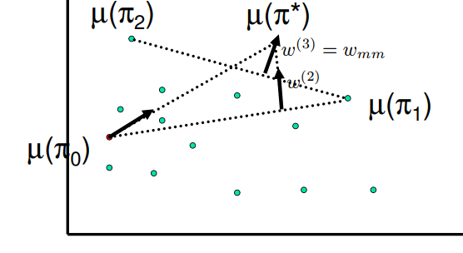
IRL step: Max margin
$$\max_{t, ω:{\left|\left|ω\right|\right|}_{2}≤1}{t}$$
s.t $ω^{T}{(μ}_{E}−μ(π))≥ t$
$$∀ π∈\{π_{0},π_{1},…, π_{i−1}\}$$
Because of the 2-norm constraint, requires a QP solver.
Can also use the SVM solver.

Slide 11
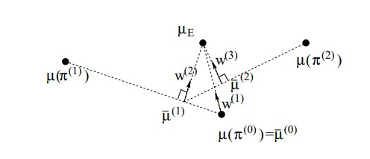
IRL step: Projection

Slide 12
Termination
On termination we will have
$$∀ω with {\left|\left|ω\right|\right|}_{2}≤1 ∃i s.t ω^{T}μ(π_{i})≥ω^{T}μ_{E} −ε$$
Picking the best policy

Slide 13
Theoretical Results: Convergence
Theorem. Let an MDP (without reward function), a k-dimensional feature vector $φ$ and the expert’s feature expectations $μ(π_{E})$ be given. Then after at most
iterations, the algorithm outputs a policy $π$ that performs nearly as well as the expert, as evaluated on the unknown reward function $R^{∗}\left(s\right)={ω^{∗}}^{T}φ\left(s\right)$, i.e,
$$E[\sum_{t=0}^{∞}{γ^{t}R^{∗}\left(S_{t}\right) \left| π\right]≥} E[\sum_{t=0}^{∞}{γ^{t}R^{∗}\left(S_{t}\right) \left| π_{E}\right] −ε}$$

Slide 14
Theoretical Results: Sampling
In practice, we have to use sampling to estimate the feature expectations of the expert.
We still have $ε$- optimal performance with high probability if the number of observed samples is at least

Slide 15
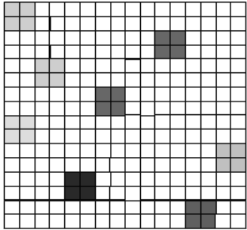
Experimental Setup: Gridworld
Reward function is piecewise constant over small regions
Features $φ$ for IRL are these small regions.
128x128 grid, small regions of size 16x16

Slide 16
Experimental Results: Gridworld

Slide 17
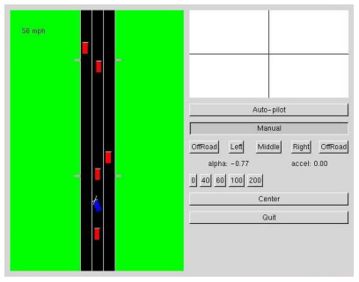
Experimental Setup: Highway driving
The only input to the learning algorithm was the driving demonstration. No reward function was provided.

Slide 18
Experimental Results: Highway driving
Nice driving expert
Nasty driving expert
Demonstrated driving styles:- Nice, Nasty, Right lane nice, Right lane nasty, Middle lane

Slide 19
Discussions of results
Gridworld
Using the IRL algorithm, they were able to achieve expert level performance using only a few expert trajectories
Observe that it is able to learn faster, with better feature vector design
Highway driving simulation
The algorithm was qualitatively able to mimic the demonstrated driving style

Slide 20
Critique / Limitations / Open Issues
Authors assume that the reward function can be expressed as a linear function of known features.
Assumes that the expert is optimal.
It is computationally expensive to solve the QP problem and may take too long to converge.

Slide 21
Future work
Try to apply apprenticeship learning on real world tasks with large feature vectors instead of just toy examples
Solve the IRL problem for non-linear reward functions.
Active inverse reinforcement learning.

Slide 22
Extended readings
Maximum margin planning
Bayesian Inverse Reinforcement Learning
Hierarchical Apprenticeship Learning, with Application to Quadruped Locomotion
An inverse optimal control approach to human motion modeling

Slide 23
Summary
We try to imitate the expert policy by trying to guess the reward function.
Prior work used behavior cloning, which aimed to directly learn the more complex policy instead of Reward function.
Iteratively find the reward function which maximizes the separation between expert policy and other policies and find the policy corresponding to this reward function.
Proved theoretical guarantees for convergence and number of samples required to estimate expert policy.
Demonstrated on Gridworld and highway driving that the IRL policy was able to mimic the expert policy.

