Slide 1
Differentiable Particle Filters: End-to-End Learning with Algorithmic Priors
Jonschkowski et al., 2018
Presenter: Frank Regal
September 15th, 2022

Slide 2
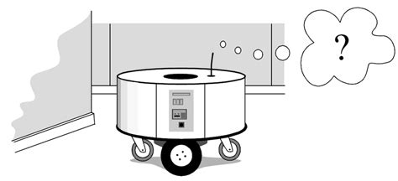
Motivation
Robots need to know where they are
Autonomous Driving Cars
Robot assistants

Slide 3
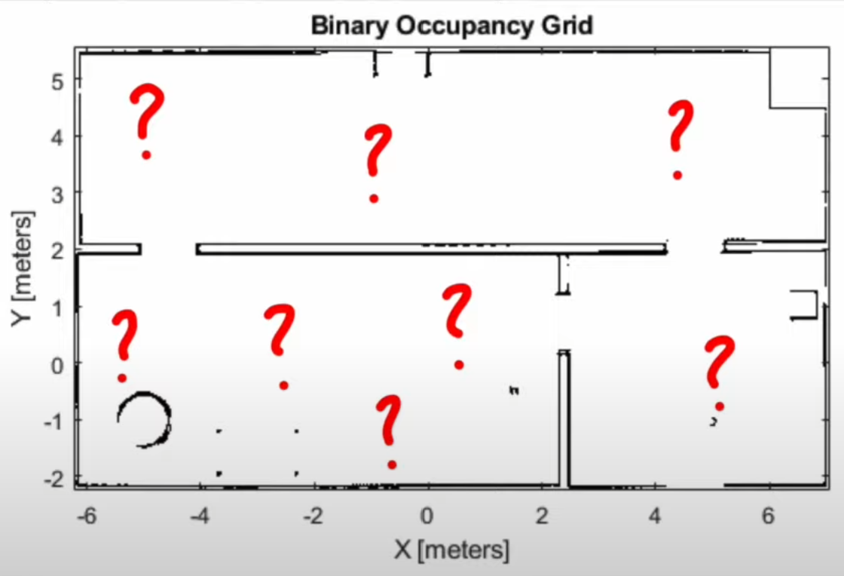
Motivation
Hard Problem
Similar looking doors
Large open regions
No “closed-form” solution
Biswas, Joydeep. “CS393R: Autonomous Robots Particle Filters for Mobile Robot Localization Lecture Slides”. The University of Texas at Austin, 2021.

Slide 4
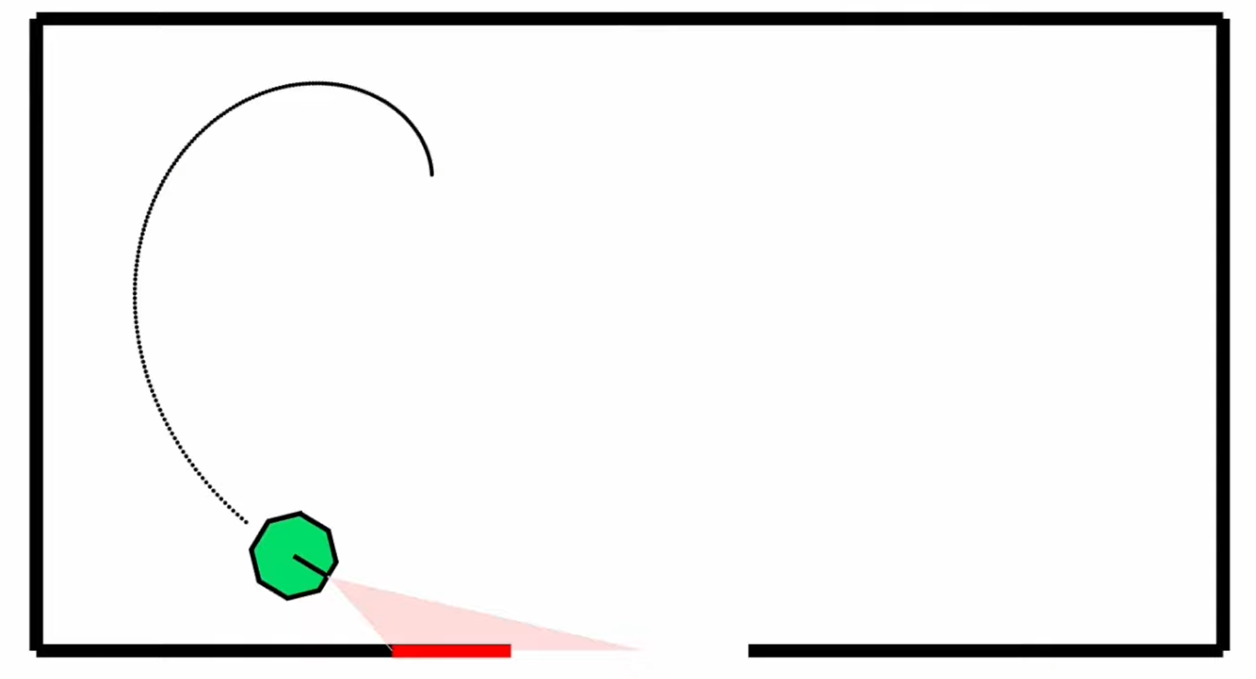
Localization Problem
Noisy Motions
Odometry measurements (IMU’s, encoders, physical models, etc.)
Noisy Observations
Sensor measurements (RGB, LiDAR, etc.)
Motion
Observation

Slide 5
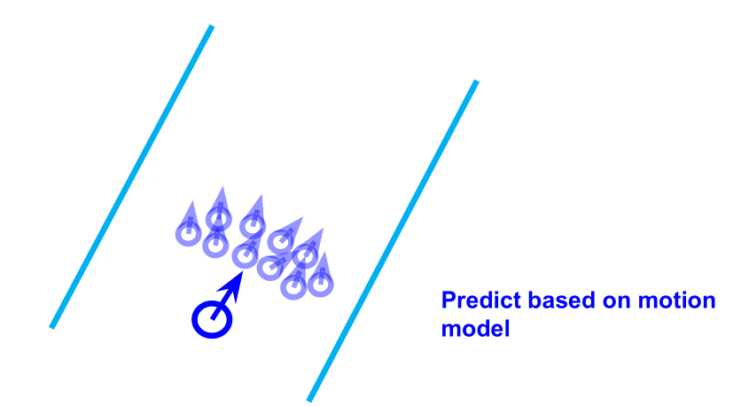
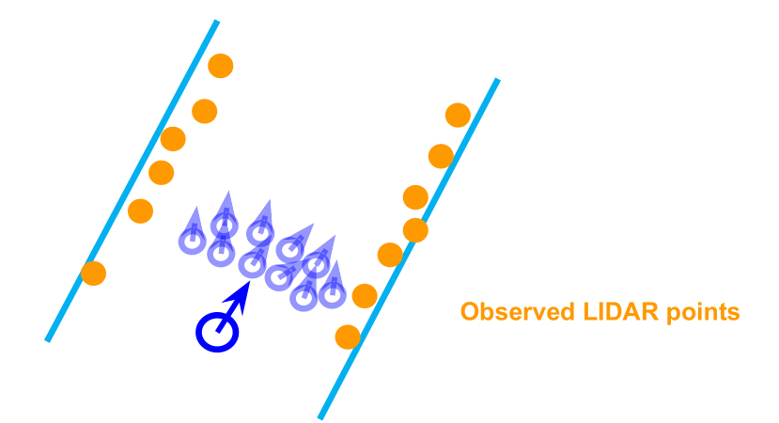
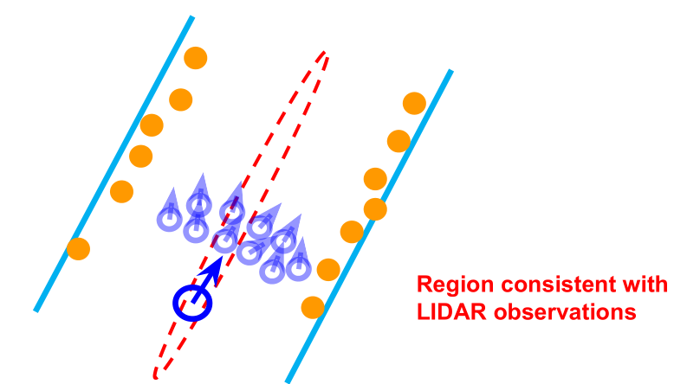
Standard Particle Filters
Known Map w/ LiDAR
Approximate the belief with particles
Prediction
Motion Model
Measurement Update
Observation Model
Particle Proposal and Resampling
Weighting and selection
Biswas, Joydeep. “CS393R: Autonomous Robots Particle Filters for Mobile Robot Localization Lecture Slides”. The University of Texas at Austin, 2021.

Slide 6
Problem
Motion and Odometry models are always wrong
Prediction Step
$$\overline{bel}\left(s_{t}\right)=\int{p\left(s_{t} | s_{t−1},a_{t}\right)bel\left(s_{t−1}\right)ds_{t−1}}$$
Measurement step
$$bel\left(s_{t}\right)=ηp\left(o_{t} | s_{t}\right)\overline{bel}\left(s_{t}\right)$$
Gaussian Mixture Models are typically used (never correct)
Notes:
Motion Model: A model (limited approximation) of the probabilistic outcomes of the robot’s motion as a function of its expected outcomes
Observation Likelihood Model: A model (limited approximation) of the probabilistic likelihood of the robot making an observation as a function of its predicted observations, given the state of the robot

Slide 7
Research Question
How can we use network architectures to learn these models and improve state estimation?
Turn the algorithms into network architectures
Make algorithms differentiable
Make models learnable
Enables end-to-end learning

Slide 8
Related Work
Algorithmic priors and end-to-end learning for planning and state estimation with histogram-based and Gaussian belief representations
Tamar et al. – Value Iteration Networks (differentiable planning algorithm)
State estimation (and planning) with histograms
Jonschowski and Brock - Introduce end-to-end learnable histogram filter
State estimation with Gaussians
Harnooja et al. - Present a differentiable Kalman filter with Gaussian belief and an end-to-end learnable measurement model from visual input.

Slide 9
Proposed Approach
Make robotic algorithms
Differentiable
Learnable
Approach enables end-to-end learning while also encoding prior knowledge from algorithms
Apply end-to-end learning with algorithmic priors for state estimation

Slide 10
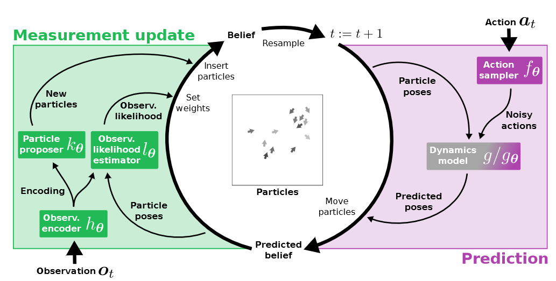
Method
Differentiable particle filter (DPF)
Learn the observation and motion models & Maximize the belief

Slide 11
Method
Belief
$$bel\left(s_{t}\right)= \left(S_{t},w_{t}\right)$$
Prediction
$S$: state of n particles in d-dimensional state space
$w$: weights of each state
$f_{θ}$: action sampler, creates noisy action ${{\hat{a}}_{t}}^{[i]}$
$g$: dynamics model which moves each particle $i$ according to ${{\hat{a}}_{t}}^{[i]}$

Slide 12
Method
Measurement Update
${{h_{θ}, k}_{θ}, l}_{θ}$ - feedforward networks
$h_{θ}$: observation encoder, encodes $o_{t}$ into a vector $e_{t}$
$k_{θ}$: particle proposer, generates new particles
$l_{θ}$: observation likelihood estimator, weights each particle based on the observation

Slide 13
Method
Particle Proposal and Resampling
1000 particles for testing and 100 particles for training
Supervised learning
Individual Learning of the motion model
Individual learning of the measurement model
End-to-end learning

Slide 14
Experiments
Differentiable Particle Filters tested with
Global localization
3D maze simulations (vision and odometry)
Focus because of the simultaneous need for considering multiple hypotheses
Main advantage of particle filter over Kalman filter
Visual odometry
DPFs applied to KITTI visual odometry tasks
Track the pose of a driving car based on a FPV video

Slide 15
Global Localization
Results
Algorithmic priors enable explainability
End-to-end learning improves performance, but sequencing individual and end-to-end learning is even more powerful
Algorithmic priors in DPFs improve performance compared to LSTMs reducing the error by ~80%
Algorithmic priors lead to policy invariance

Slide 16
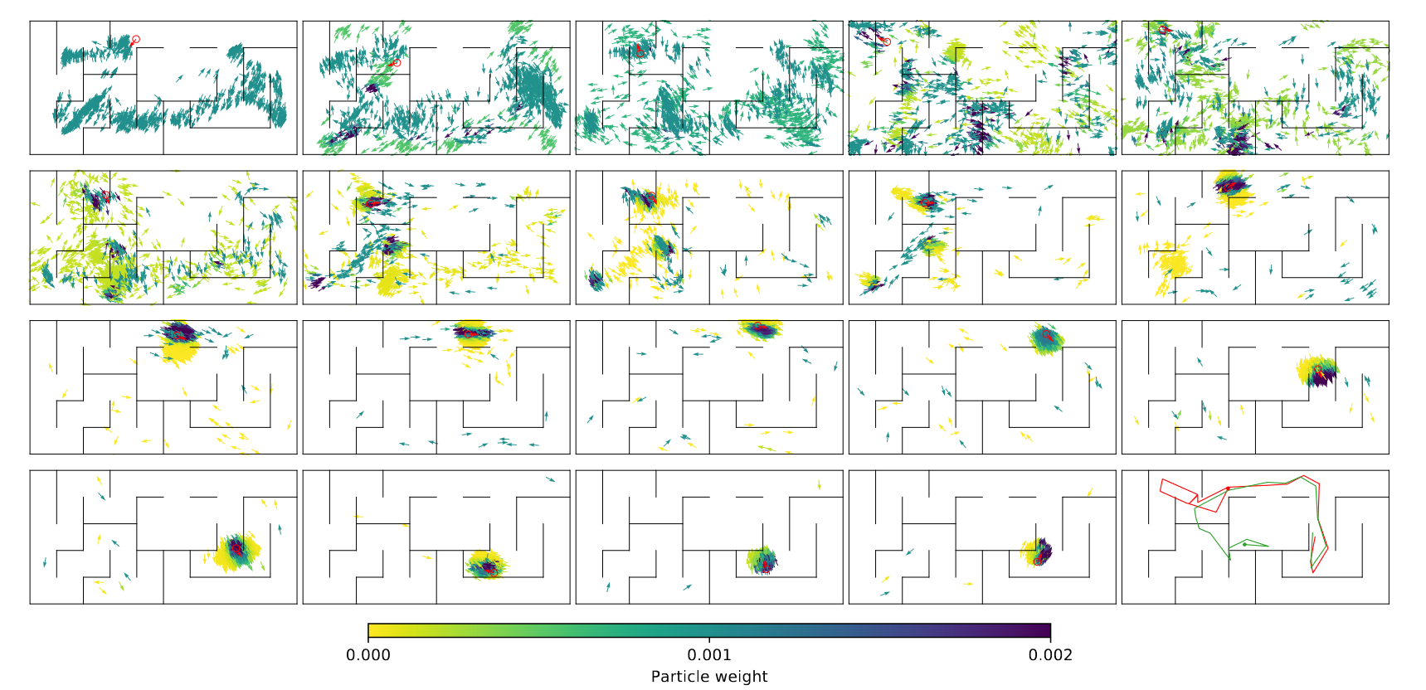
Global Localization

Slide 17
Visual Odometry
Results
DPF outperform backdrop Kalman Filters
DPFs work on real data and can learn measurement models that work for visually diverse observations based on less than 40-minute videos

Slide 18
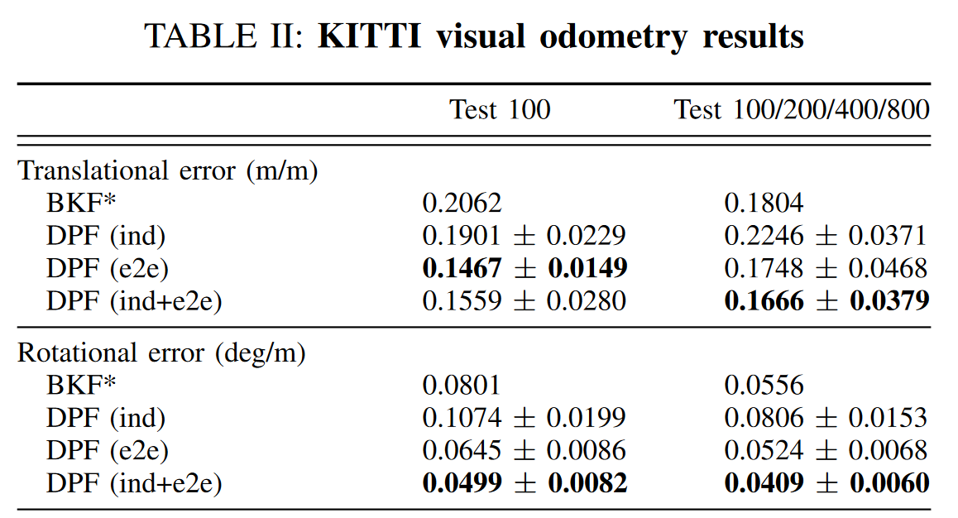
Visual Odometry

Slide 19
Extended Readings
Probabilistic Robotics Textbook - Sebastian Thrun, Wolfram Burgard, and Dieter Fox. Probabilistic Robotics. MIT Press, 2005.
Intro. to Differentiable End-to-end Learning - Aviv Tamar, Yi Wu, Garrett Thomas, Sergey Levine, and Pieter Abbeel. Value Iteration Networks. In Advances in Neural Information Processing Systems (NIPS), pages 2154–2162, 2016.
Kalman Filter Variation - Tuomas Haarnoja, Anurag Ajay, Sergey Levine, and Pieter Abbeel. Backprop KF: Learning Discriminative Deterministic State Estimators. In Advances in Neural Information Processing Systems (NIPS), pages 43764384, 2016.

Slide 20
Motivation and Main Problem
1-5 slides
High-level description of problem being solved
Why is the problem important?
its significance towards general-purpose robot autonomy
its potential application and societal impact of the problem
Technical challenges arising from the problem
the role of the AI and machine learning in tackling this problem
High-level idea of why prior approaches didn’t already solve
Key insight(s) (try to do in 1-3) of the proposed work

Slide 21
Problem Setting
1 or more slides
Problem formulation, key definitions and notations
Be precise -- should be as formal as in the paper

Slide 22
Context / Related Work / Limitations of Prior Work
1 or more slides
Which other papers have tried to tackle this problem or a related problem?
The paper’s related work is a good start, but there may be others
What is the key limitations of prior work(s)?

Slide 23
Proposed Approach / Algorithm / Method
1-5 slides
Describe algorithm or framework (pseudocode and flowcharts can help)
What is the optimization objective?
What are the core technical innovations of the algorithm/framework?
Implementation details should be left out here, but may be discussed later if its relevant for limitations / experiments

Slide 24
Theory (if relevant)
What are the assumptions made for the theory? Are these reasonable? Realistic?
If the theory build strongly on other prior theory / results, reference those and state them here.

Slide 25
Theory (if relevant, continued)
State main results formally
Give proof sketches
Refer students to the full proofs in paper

Slide 26
Experimental Setup
1-3 slides
Description of the experimental evaluation setting
What is the domain(s), e.g., datasets, tasks, robot hardware setups?
What are the baseline(s)?
What scientific hypotheses are tested?
How did the authors evaluate the success of their approach?
Clear description of the metrics that will be used

Slide 27
Experimental Results
>1 slide
Present the quantitative and qualitative results
Show figures / tables / plots / robot demos
Pinpoint the most interesting / significant results

Slide 28
Discussion of Results
1-2 slides
What conclusions are drawn from the results by the authors?
What insights are gained from the experiments?
What strengths and weaknesses of the proposed method are illustrated by the results?
Are the stated conclusions fully backed by the results and references?
If so, why? (Recap the relevant supporting evidences from the given results + refs)
If not, what are the additional experiments / comparisons that can further support/repudiate the conclusions of the paper?

Slide 29
Critique / Limitations / Open Issues
1-2 slides
What are the key limitations of the proposed approach / ideas? (e.g. does it require strong assumptions that are unlikely to be practical? Computationally expensive? Require a lot of data?)
Are there any practical challenges in deploying the approach on physical robots in the real world? Are there any safety or ethical concerns of using such approach?
If follow-up work has addressed some of these limitations, include pointers to that. But don’t limit your discussion only to the problems / limitations that have already been addressed.

Slide 30
Future Work for Paper / Reading
1-2 slides
What interesting questions does it raise for future work?
Your own ideas for future work
Others’ ideas (if others have already built on this idea)

Slide 31
Summary
1 slide
Approximately one bullet for each of the following
Problem the reading is discussing
Why is it important and hard
What is the key limitation of prior work
What is the key insight(s) (try to do in 1-3) of the proposed work
What did they demonstrate by this insight? (tighter theoretical bounds, state of the art performance on X, etc)

