Slide 1
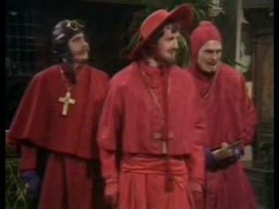
CS303e Course Introduction
Chapman: I didn't expect a kind of Spanish Inquisition.
Cardinal Ximinez[Palin]: NOBODY expects the Spanish Inquisition! Our chief weapon is surprise...surprise and fear...fear and surprise.... Our two weapons are fear and surprise...and ruthless efficiency.... Our three weapons are fear, surprise, and ruthless efficiency...and an almost fanatical devotion to the Pope.... Our four...no... Amongst our weapons.... Amongst our weaponry...are such diverse elements as fear, surprise....
Mike Scott
scottm@cs.utexas.edu www.cs.utexas.edu/~scottm/cs303e
1

Slide 2
Agenda
Overview of:
this course
the elements of computing program
Course logistics including:
how to get help
the schedule
tips for success

Slide 3
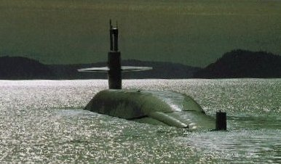
Who Am I
Lecturer in CS department since 2000
Undergrad Stanford, MSCS RPI
US Navy for 8 years, submarines
2 years Round Rock High School

Slide 4
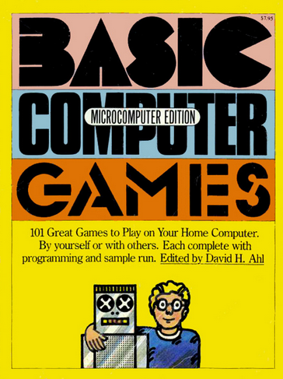
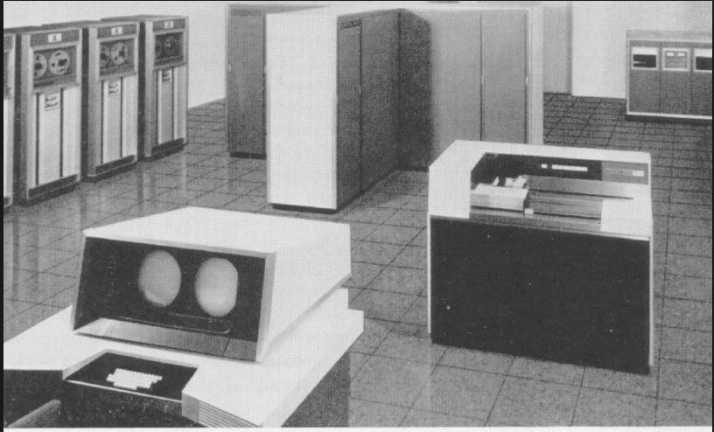
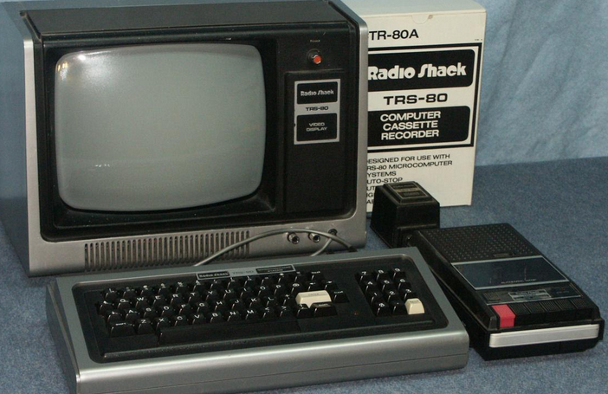
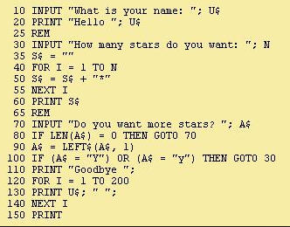
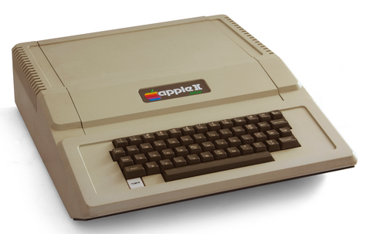
My Path to CS

Slide 5
Intro to Programming
Learn to design and implement computer programs to solve problems.
I assume you have NEVER written a single line of code
output, fstrings
identifiers
errors (syntax, runtime, logic)
reserved words
variables, operators, computations
constants
built in math functions
conditional execution
boolean logic
iteration, repetition
programmer defined functions
Strings
lists
lists of lists (matrices)
files
exceptions
dictionaries
objects and classes (programmer defined data types)
recursion
sorting and searching

Slide 6
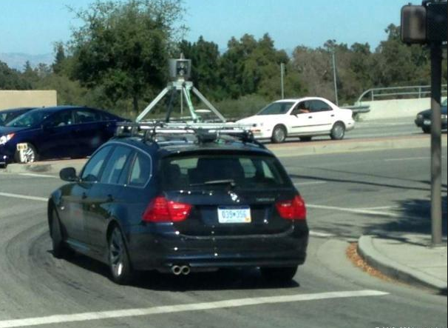
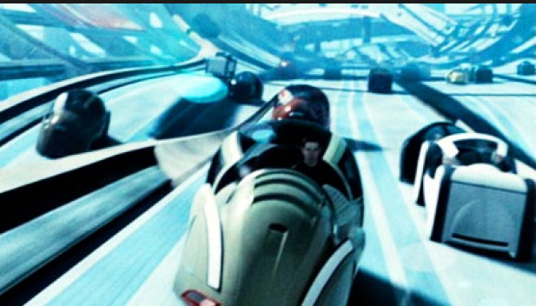
Programing and CS
A tool for doing the cool stuff in CS
You can't create a self driving vehicle without the software to control the vehicle

Slide 7
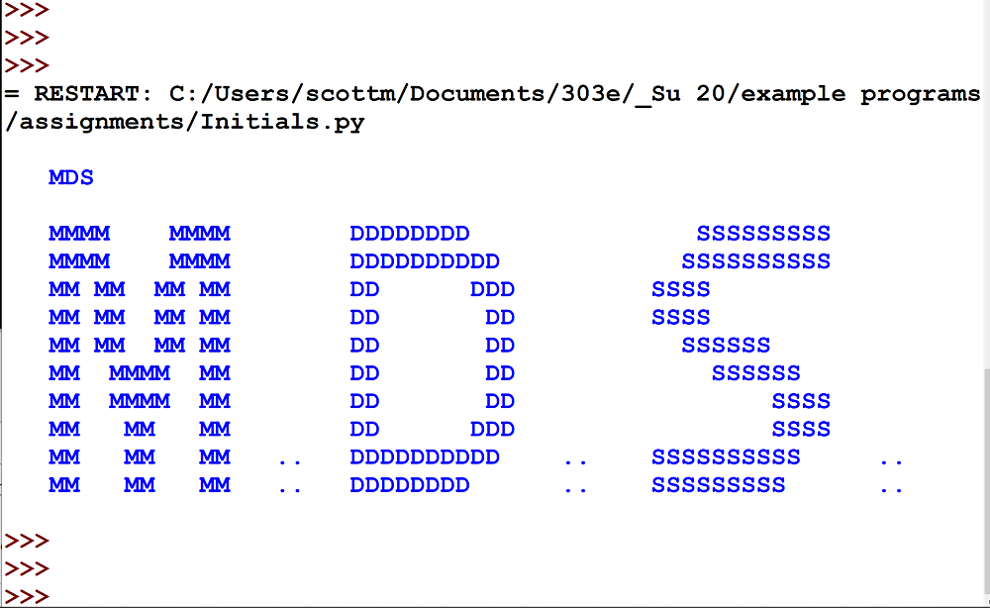
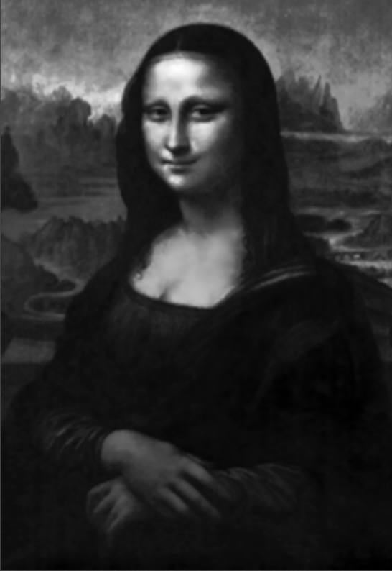
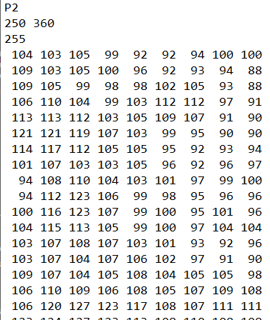
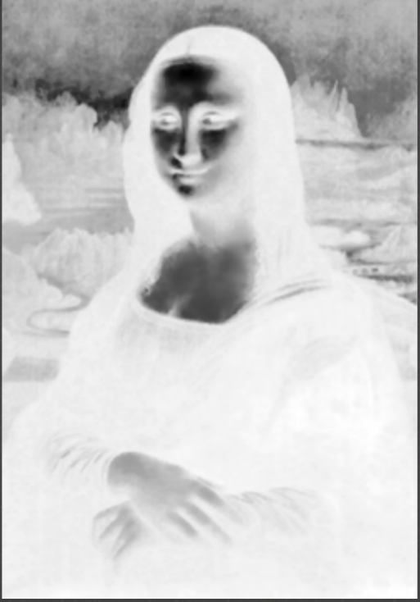
Programming
Start simple ….
… but get complex by end of the class

Slide 8
Startup
If you have not already done so …
… complete the items on the class start-up page
http://www.cs.utexas.edu/~scottm/ cs303e/handouts/startup.htm

Slide 9
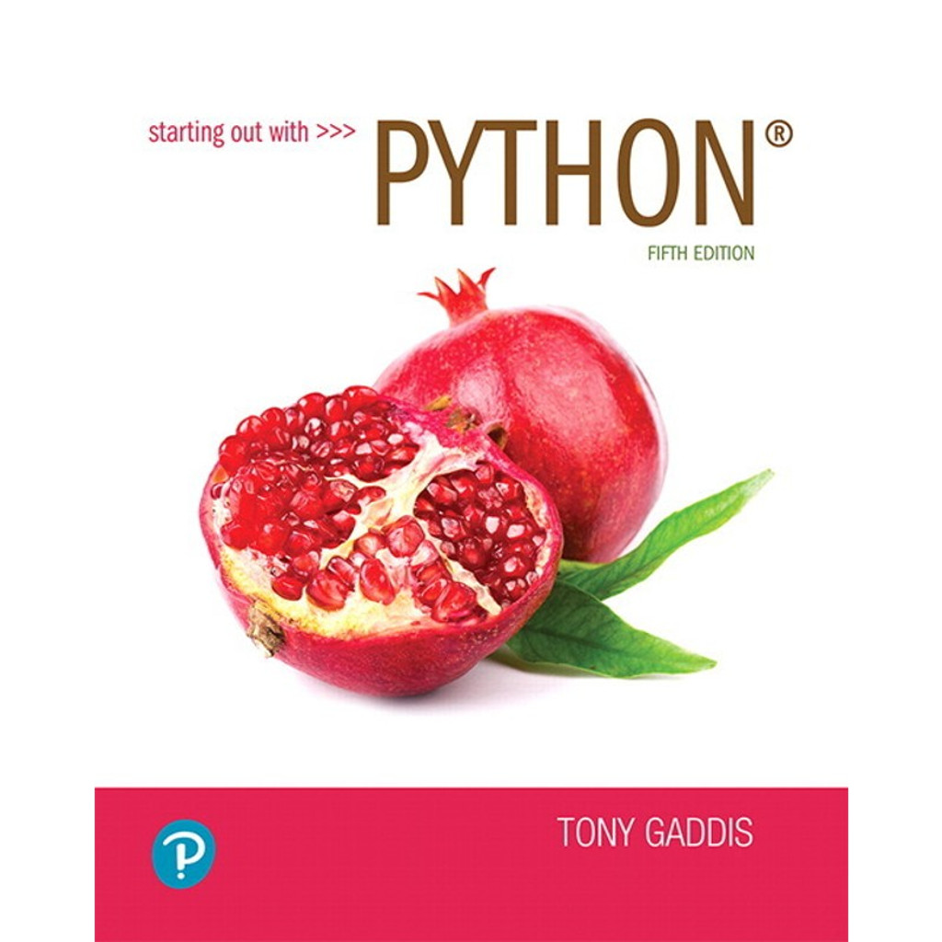
Book
book is required - we follow it quite closely
programming assignments, limited to features from the book up to a given chapter
suggested exercises
Course Overview
9

Slide 10
Graded Course Components
Programming projects
13 projects, 10 or 20 points : 210 points
Exams
Midterm, In class Wednesday, July 3, 11:30 am – 1:30 pm 400 points
Final, Thursday, August 1, 7 - 10 pm 400 points
Extra credit
CS background survey on Canvas. 10 points
course survey completion, 10 points
210 + 400 + 400 + 10 + 10 = 1030
Programming Assignments capped at 200 pts
30 points of “slack”, including extra credit
No points added! Grades based on 1000 points, not 1030
Final point total = min(200, sum of points on programs + background survey completion + instructor end of course survey) + midterm exam score + final exam score

Slide 11
Letter Grades
Final grade determined by final point total >= 925 -> A 900 - 924 -> A- 875 - 899 -> B+ 825 - 874 -> B 800 - 824 -> B- 775 - 799 -> C+ 725 - 774 -> C 700 - 724 -> C- 675 - 699 -> D+ 625 - 674 -> D 600 - 624 -> D- <= 599 -> F

Slide 12
In Class Exercises - Grade Bump
Recall: Final point total = min(200, sum of points on programs + background survey completion + instructor end of course survey) + midterm exam score + final exam score
Each lecture shall have an in-class programming exercise. 21 total. Completing these may help you get bumped to the next higher grade if you are close to a cutoff.
1 point added for every 2 exercises completed with reasonable effort
rounded up
For example, you end up with 893 points per the formula above. You complete 14 or more of the 21 in class exercises with a reasonable attempt. You grade shall be bumped from B+ to A-.

Slide 13
Assignments
Start out simple but get more challenging
Individual – do your own work
Programs checked automatically with plagiarism detection software, MOSS
Turn in the right thing - correct name, correct format or you will lose points / slip days
Slip days
8 for term, max 1 per assignment
don’t use frivolously
Graded on correctness and program hygiene (style, best practices), typical 60% / 40% split

Slide 14
Getting Help
Post to Ed (link on Canvas).
can make anonymous to other students
can post to instructors only
do not post more than 2 lines of code on a public post
Help Hours
check schedule
Most help hours in person in GDC 3.202
A few help hours via Zoom, check the Canvas course page and the Zoom tab for links

Slide 15
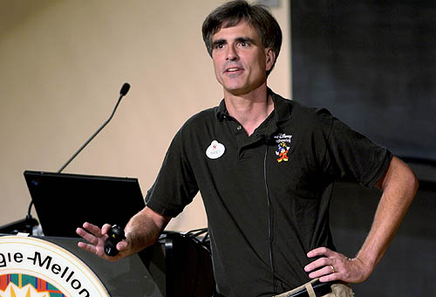
Succeeding in the Course
Randy Pausch, CS Professor at CMU said:
"When I got tenure a year early at Virginia, other Assistant Professors would come up to me and say, 'You got tenure early!?!?! What's your secret?!?!?' and I would tell them, 'Call me in my office at 10pm on Friday night and I'll tell you.' "
“A lot of people want a shortcut. I find the best shortcut is the long way, which is basically two words: work hard.”

Slide 16
Succeeding in the Course - Meta
“Be the first penguin” Randy Pausch
Ask questions!!!
lecture, Piazza, help hours
“It is impossible to be perfect” Captain Symons
Mistakes are okay.
That is how we learn.
Trying to be perfect means not taking risks.
no risks, no learning
Notes:
Be the first penguin, Professor Randy Pausch
It is impossible to be perfect, Captaim Tim Symons
Find a Pack, Quellcrist Falconer

Slide 17
Succeeding in the Course - Concrete
Whole course is cumulative!
Material builds on itself
failure to understand a concept leads to bigger problems down the road, so …
do the readings
come to class
start on assignments early
get help from the teaching staff when you get stuck on an assignment
participate on the class discussion group
ask questions and get help when needed
DO MORE PRACTICE PROBLEMS -> Book, CodingBat, Professor Bulko's Site

Slide 18
Succeeding in the Course
Cannot succeed via memorization.
The things I expect you to do are not rote.
programming is a skill
you cannot memorize your way through the material and the course
Learn by doing.
If you are brand new to programming or have limited experience I strongly recommend you do lots and lots of practice problems.

