Slide 1


Slide 2
Procedural Programming
Procedures: synonym for functions and sub-routines
Procedural programming: writing programs made of functions that perform specific tasks
  Functions typically operate on data items that are separate from the functions
  Data items commonly passed from one function to another
  Focus: On the algorithm and steps. Create functions that operate on the program’s data

Slide 3
Object-Oriented Programming
Object-oriented programming: focuses on creating classes and objects
Model the problem on the data involved first, not the big steps.
Class: A programmer defined data type
Object: entity that contains data and functions
  Data is known as data attributes and functions are known as methods
    Methods perform operations on the data attributes
Encapsulation: combining data and code into a single object

Slide 4
Object Oriented Programming
Recall a CPU only knows how to perform on the order of 100 operations
High level languages such as Python allow us to, seemingly, create new operations by defining new functions
Object oriented languages allow programmers to create new data types in addition to the ones built into the language
  int, float, string, list, tuple, file, dictionary, set

Slide 5
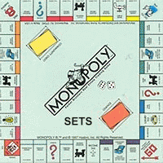




Object Oriented Design
Example - Monopoly
If we had to start
from scratch what
new data types would
we need to create?
Data Types Needed:

Slide 6
Object Orientation
The basic idea of object oriented programming (OOP) is to view your problem as a collection of objects, each of which has certain state and can perform certain actions.
Each object has:
some data that it maintains characterizing its current state;
a set of actions (methods) that it can perform.
A programmer interacts with an object by calling its methods; this is called method invocation. That should be the only way that another programmer interacts with an object.
Significant object-oriented languages include Python, Java, C++, C#, Perl, JavaScript, Objective C, and others.

Slide 7
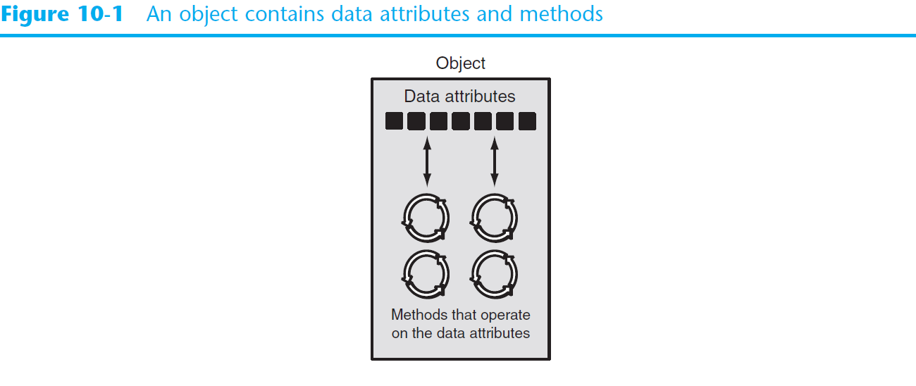
Object-Oriented Programming (cont’d.)

Slide 8
Object-Oriented Programming (cont’d.)
Data hiding: object’s data attributes are hidden from code outside the object
  Access restricted to the object’s methods
    Protects from accidental corruption
    Outside code does not need to know internal structure of the object
Object reusability: the same object can be used in different programs
  Example: 3D image object can be used for architecture and game programming

Slide 9
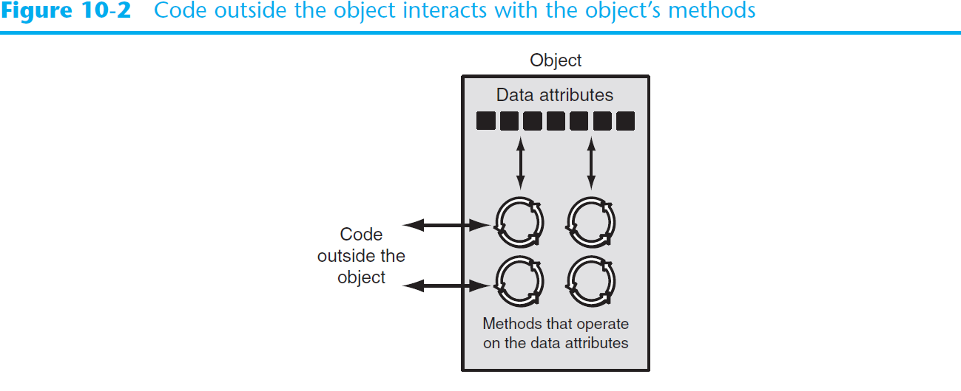
Object-Oriented Programming (cont’d.)

Slide 10
An Everyday Example of an Object
Data attributes: define the state of an object
  Example: clock object would have second, minute, and hour data attributes
Public methods: allow external code to manipulate the object
  Example: set_time, set_alarm_time
Private methods: used for object’s inner workings

Slide 11
Classes
Class: code that specifies the data attributes and methods of a particular type of object
  Similar to a blueprint of a house or a cookie cutter
Instance: an object created from a class
  Similar to a specific house built according to the blueprint or a specific cookie
  There can be many instances of one class

Slide 12
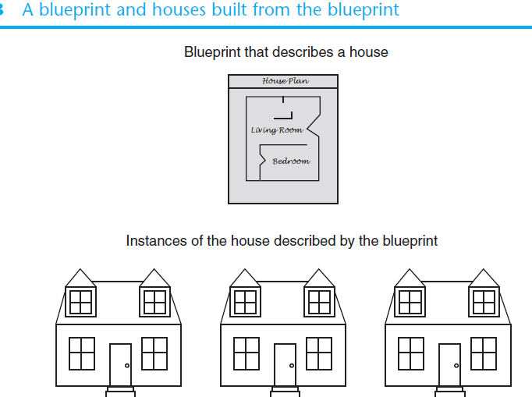
Classes

Slide 13
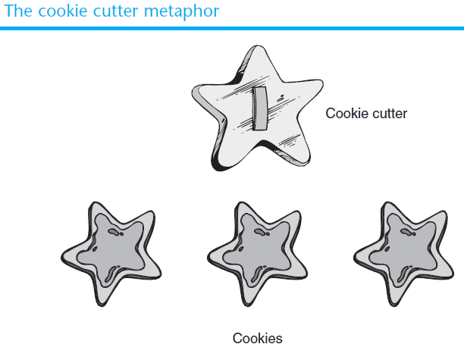
Classes

Slide 14
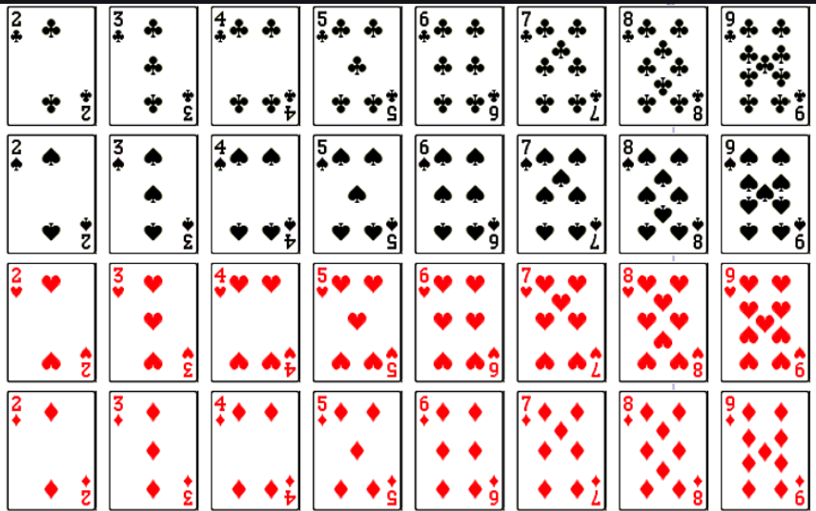
Simple Example
Class Definition for Playing cards
Playing cards have:
A Rank
A Suit
Define a
PlayingCard
class and then
create objects of
type PlayingCard
to form a deck
or a hand
of cards.

Slide 15
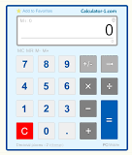
A Concrete Example
Imagine that you’re trying to do some simple arithmetic. You need a Calculator application, programmed in an OO manner. It will have:
Some data: the current value of its
accumulator (the value stored and displayed on the screen).
History of ops?
Memory?
Some methods: things that you can ask of the calculator to do:
  add a number to the accumulator, subtract a number, multiply by a number, divide by a number, zero out the accumulator value, etc.

Slide 16
Calculator Specification
In Python, you implement a particular type of object (soda machine, calculator, etc.) with a class.
Let’s define a class for our simple interactive calculator.
Data: the current value of the accumulator.
Maybe a history of operations? Memory spots, aka variables?
Methods: any of the following.
  clear: zero the accumulator
  print: display the accumulator value
  add k: add k to the accumulator
  sub k: subtract k from the accumulator
  mult k: multiply accumulator by k
  div k: divide accumulator by k

Slide 17

Yet Another Example
Example: A soda machine has:
Data: products inside, change available, amount previously deposited, etc.
Methods: accept a coin, select a product, dispense a soda, provide change after purchase, return money deposited, etc.
Assignment 13

Slide 18
Class Definitions
Class definition: set of statements that define a class’s methods and data attributes
  Format: begin with class ClassName:
    Class names typically start with uppercase letter and internal words are capitalized, aka CamelCase
  Method definition like other Python
  function definitions
    self parameter: required in every method in the class – references the specific object that the method is working on - The object the method is working on. The object that called the method
    name = 'Olivia'
    name.upper() # name is the argument to self

Slide 19
Class Definitions (cont’d.)
Initializer method: automatically executed when an instance of the class is created
  Initializes object’s data attributes and assigns self parameter to the object that was just created.
  Format: def __init__ (self):
  That's two underscores before and after init.
  Typically the first method in a class definition.

Slide 20
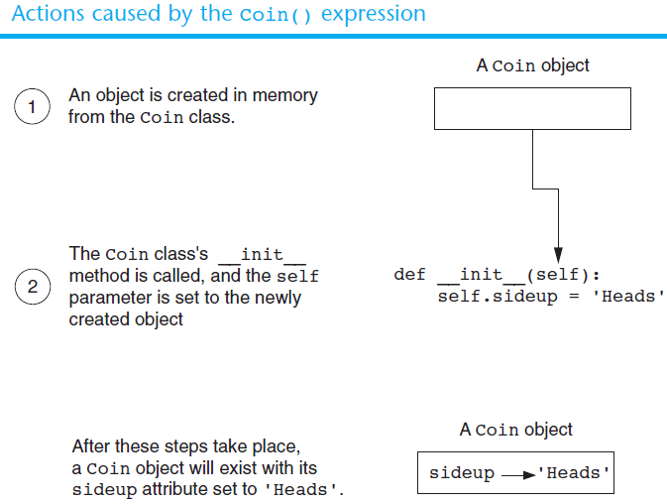
Class Definitions (cont’d.)

Slide 21
Class Definitions (cont’d.)
To create a new instance of a class call the initializer method
  Format: my_instance = ClassName()
To call any of the class methods using the created instance, use dot notation
  Format: my_instance.method()
  Because the self parameter references the specific instance of the object, the method will affect this instance
    Reference to self is passed automatically

Slide 22
Hiding Attributes and Storing Classes in Modules
An object’s data attributes (aka the internal variables) should be difficult to access
  To make sure of this, place two underscores (__) in front of attribute name
    Example: __current_minute
Classes can be stored in modules
  Filename for module must end in .py
  Module can be imported to programs that use the class

Slide 23
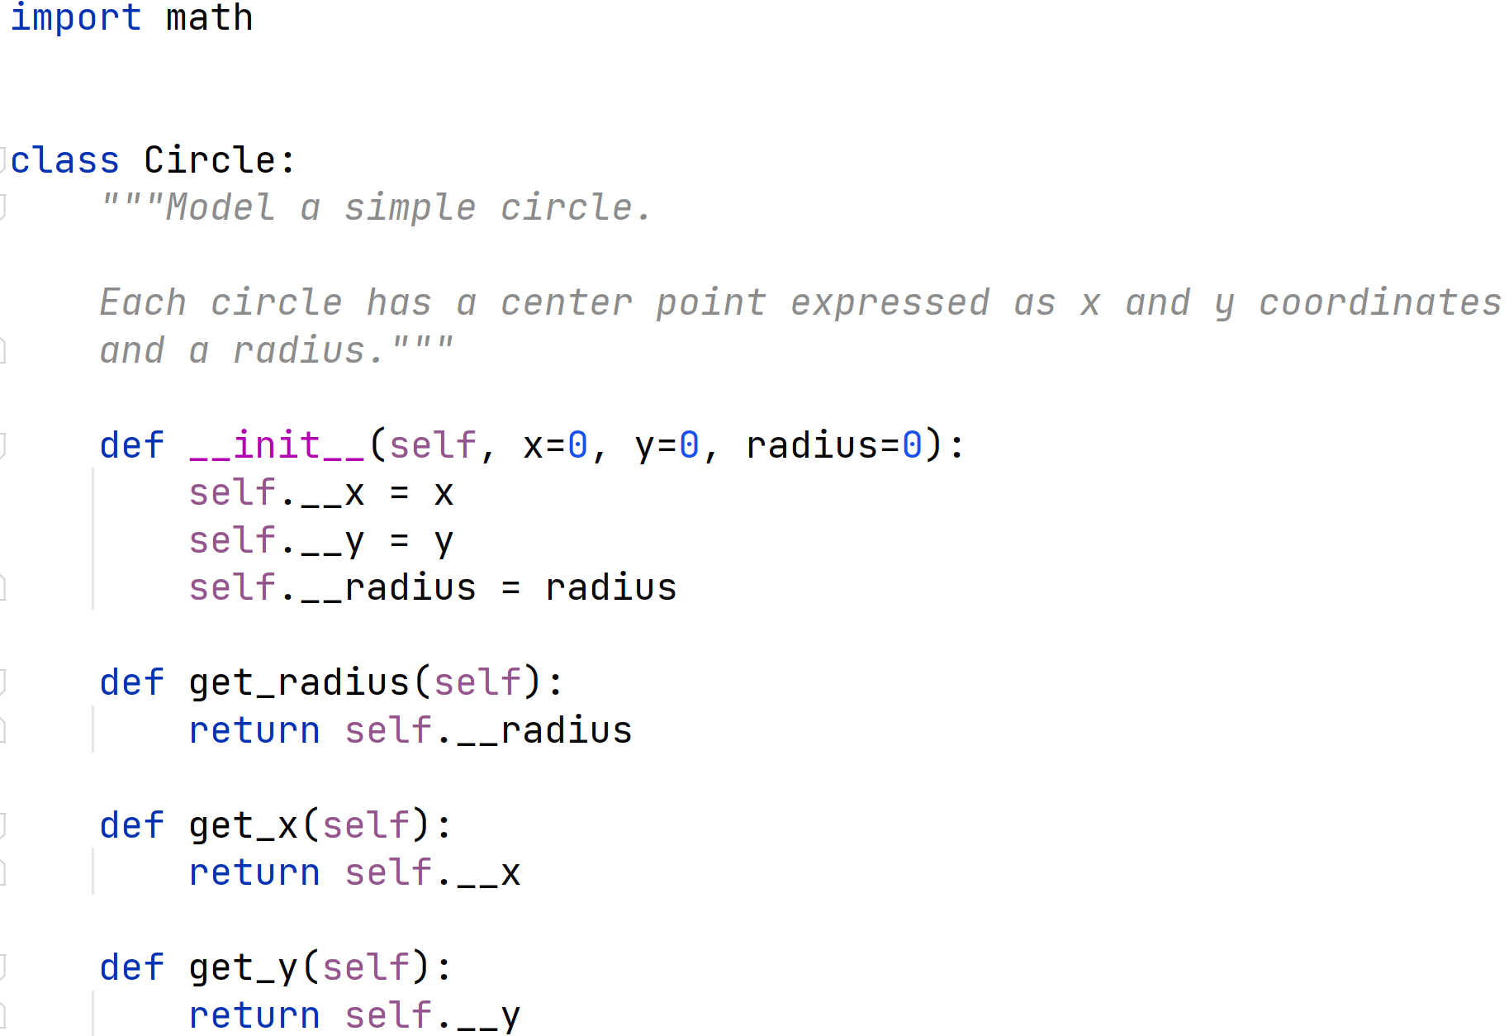
The Circle Class - in Circle.py

Slide 24
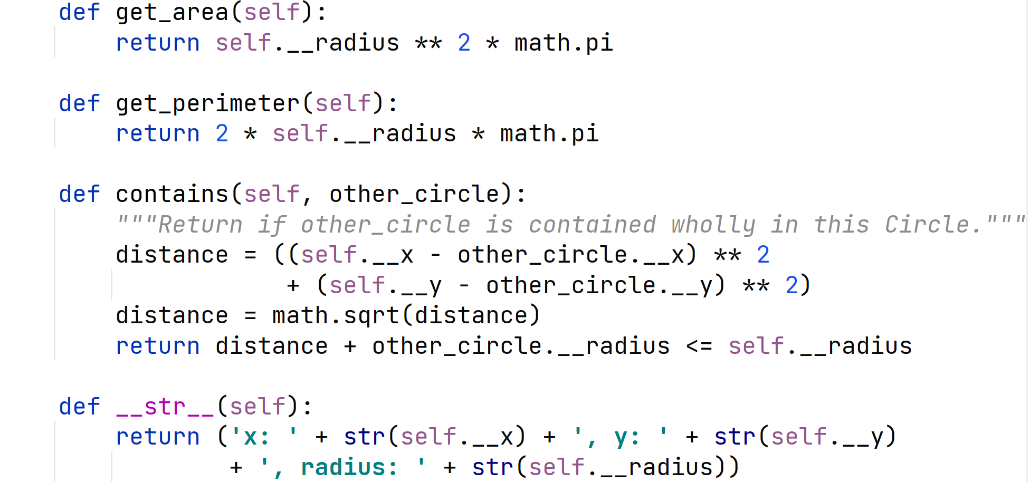
The Circle Class - in Circle.py

Slide 25
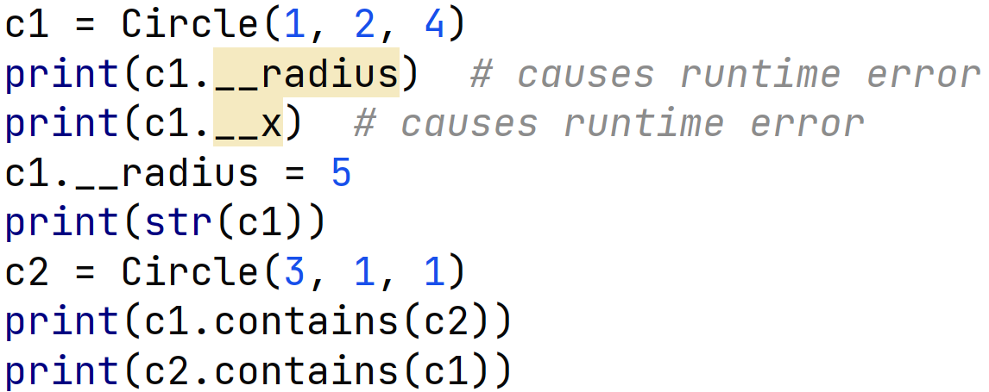
Client Code of Circle Class
Recall, variables prefixed with the double underscore (_ _) are hidden from clients.
Careful, easy to create logic errors

Slide 26
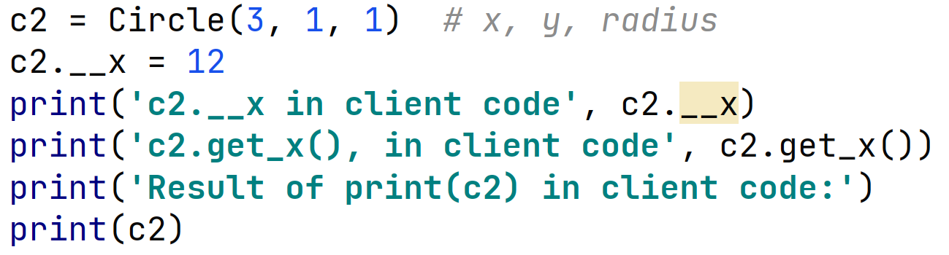
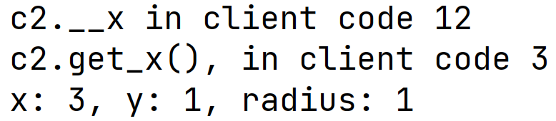
Logic Error in Client Code
Clients can add attributes (internal data, internal variables) to objects
Flexible? Yes. Dangerous? You bet!

Slide 27
The BankAccount Class – More About Classes
Class methods can have multiple parameters in addition to self
  For __init__, parameters needed to create an instance of the class
    Example: a BankAccount object is created with a balance
      When called, the initializer method receives a value to be assigned to a __balance attribute
  For other methods, parameters may be needed to perform required task
    Example: deposit method amount to be deposited

Slide 28
The __str__ method
Object’s state: the values of the object’s attribute at a given moment
__str__ method: return a string version of the object, typically the state of its internal data
Automatically called when the object is passed as an argument to the
print function
Automatically called when the object is passed as an argument to the str function

Slide 29
Working With Instances
Instance attribute: belongs to a specific instance of a class
  Created when a method uses the self parameter to create an attribute
  Can be local to a method, but continues to exist after that method completes
If many instances of a class are created, each would has its own set of attributes

Slide 30
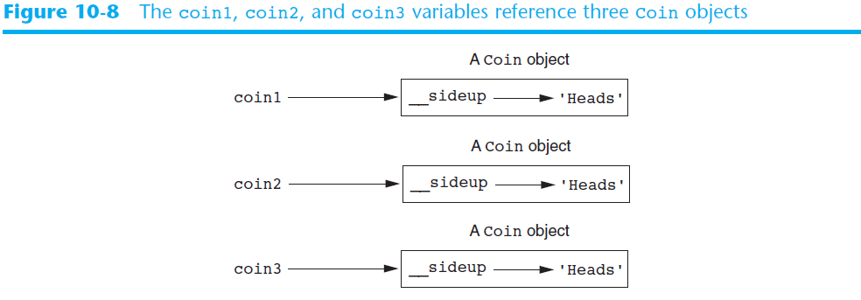
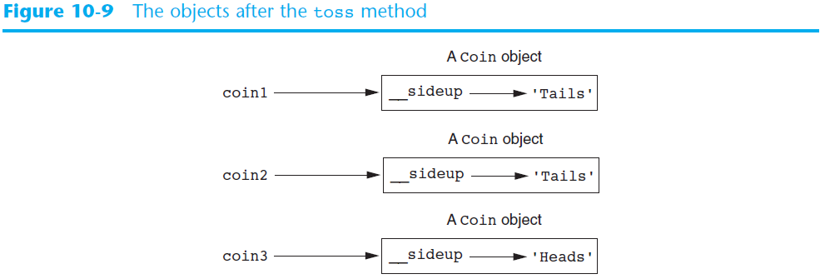

Slide 31
Accessor and Mutator Methods
Typically, all of a class’s data attributes are private and provide methods to access and change them
Accessor methods: return a value from a class’s attribute without changing it
  Safe way for code outside the class to retrieve the value of attributes
Mutator methods: store or change the value of a data attribute
  You DO NOT have to have mutator methods for all (or any) internal attributes

Slide 32
Passing Objects as Arguments
Methods and functions often need to accept objects as arguments
When you pass an object as an argument, you are actually passing a reference to the object
  The receiving method or function has access to the actual object
    Methods of the object can be called within the receiving function or method, and data attributes may be changed using mutator methods

Slide 33
Other methods
generally methods with the _ _name_ _ format are not meant to be called directly
Instead we define them and then the are called with other operators
_ _init_ _ ClassName()
_ _len_ _ len()
_ _str_ _ str
_ _add_ _ + _ _eq_ _ ==
_ _lt_ _ < _ _le_ _ <=
_ _gt_ _ > _ _ge_ _ >=

Slide 34
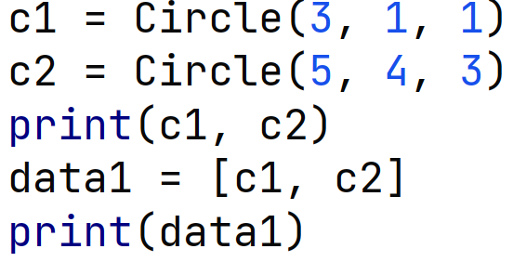
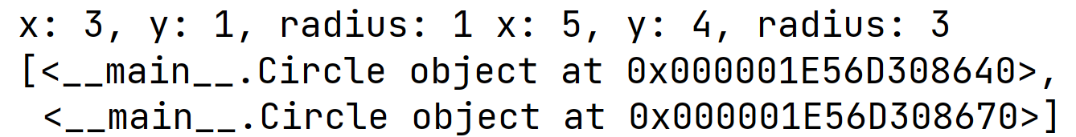
Displaying New Classes in Data Structures
Output of
print. Great!
Output of
print of list. Yuck!

Slide 35
_ _str_ _ and _ _ repr_ _
print calls the _ _str_ _ method on objects sent to it
a data structure calls the _ _repr_ _ method on the objects inside it to
repr for representation
Like _ _str_ _ but should display the object in a way that we could use to rebuild the object

Slide 36
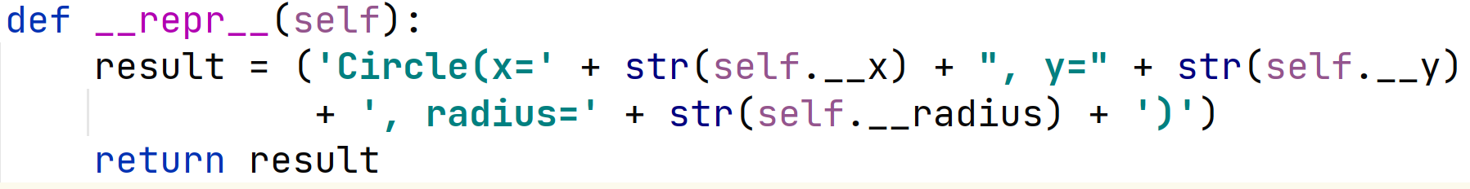
_ _repr_ _ method for Circle

Slide 37
Techniques for Designing Classes
UML diagram: standard diagrams for graphically depicting object-oriented systems
  Stands for Unified Modeling Language
General layout: box divided into three sections:
  Top section: name of the class
  Middle section: list of data attributes
  Bottom section: list of class methods

Slide 38
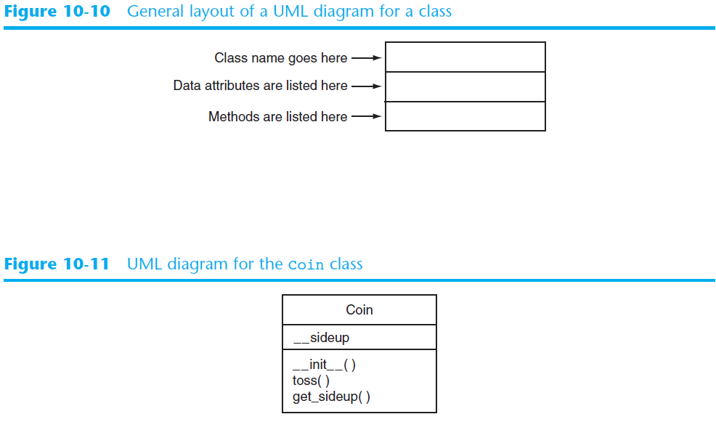

Slide 39
Finding the Classes in a Problem
When developing object oriented program, first goal is to identify classes
  Typically involves identifying the real-world objects that are in the problem
  Technique for identifying classes:
    Get written description of the problem domain
    Identify all nouns in the description, each of which is a potential class
    Refine the list to include only classes that are relevant to the problem

Slide 40
Finding the Classes in a Problem (cont’d.)
Get written description of the problem domain
  May be written by you or by an expert
  Should include any or all of the following:
    Physical objects simulated by the program
    The role played by a person
    The result of a business event
    Recordkeeping items

Slide 41
Finding the Classes in a Problem (cont’d.)
Identify all nouns in the description, each of which is a potential class
  Should include noun phrases and pronouns
  Some nouns may appear twice

Slide 42
Finding the Classes in a Problem (cont’d.)
Refine the list to include only classes that are relevant to the problem
  Remove nouns that mean the same thing
  Remove nouns that represent items that the program does not need to be concerned with
  Remove nouns that represent objects, not classes
  Remove nouns that represent simple values that can be assigned to a variable

Slide 43
Identifying a Class’s Responsibilities
A classes responsibilities are:
  The things the class is responsible for knowing
    Identifying these helps identify the class’s data attributes
  The actions the class is responsible for doing
    Identifying these helps identify the class’s methods
To find out a class’s responsibilities look at the problem domain
  Deduce required information and actions

Slide 44
Summary
This chapter covered:
  Procedural vs. object-oriented programming
  Classes and instances
  Class definitions, including:
    The self parameter
    Data attributes and methods
    __init__ and __str__ functions
    Hiding attributes from code outside a class
  Storing classes in modules
  Designing classes

