Slide 2
An Interesting Problem
Write a method that determines how much space is take up by the files in a directory
A directory can contain files and directories
How many directories does our code have to examine?
How would you add up the space taken up by the files in a single directory
Hint: don't worry about any sub directories at first

Slide 3
Sample Directory Structure
scottm
cs303e
AP
m1.txt
m2.txt
A.pdf
AB.pdf
hw
a1.htm
a2.htm
a3.htm
a4.htm

Slide 4
os.path
We used os.path to check if a path (location of a file or directory) refers to a file that exists
Lots of other useful methods:
os.path.isfile(path)
os.path.isdir(path)
os.path.getsize(path)
Return the size, in bytes, of path. Raise OSError if the file does not exist or is inaccessible.
os.listdir(path='.')
Return a list containing the names of the entries in the directory given by path.

Slide 5
Implementation
Write a function that given the name of a directory returns the size of the files in that directory
… and if the directory has directories in it (subdirectories) return the size of the files in those subdirectories
… and if those subdirectories have subdirectories…

Slide 6
Introduction to Recursion
Recursive function: a function that calls itself (with different arguments)
Recursive function must have a way to control the number of times it repeats
Usually involves an if-else statement which defines when the function should return a value and when it should call itself
Depth of recursion: the number of times a function calls itself

Slide 7
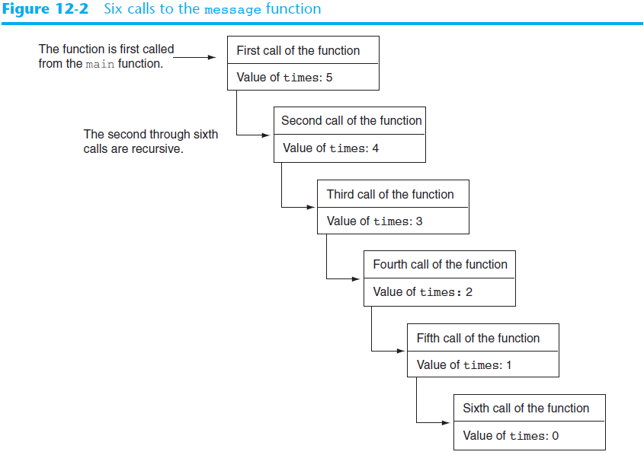
def main():
message(5)
def message(x):
if x == 0:
print(x, 'last!')
else:
print(x)
message(x - 1)

Slide 8
Introduction to Recursion (cont’d.)

Slide 9
Problem Solving with Recursion
Recursion is a powerful tool for solving repetitive problems
Recursion is never required to solve a problem
Any problem that can be solved recursively can be solved with a loop
Recursive algorithms may be less efficient than iterative ones in the number of computations
Due to overhead of each function call

Slide 10
Problem Solving with Recursion (cont’d.)
Some repetitive problems are more easily solved with recursion
General outline of recursive function:
If the problem can be solved now without recursion, solve and return
Known as the base case
Otherwise, reduce problem to smaller problem of the same structure and call the function again to solve the smaller problem
Known as the recursive case

Slide 11
Using Recursion to Calculate the Factorial of a Number
In mathematics, the n! notation represents the factorial of a number n
For n = 0, n! = 1
For n > 0, n! = 1 x 2 x 3 x … x n
The above definition lends itself to recursive programming
n = 0 is the base case
n > 0 is the recursive case
factorial(n) = n x factorial(n-1)

Slide 12
Using Recursion (cont’d.)

Slide 13
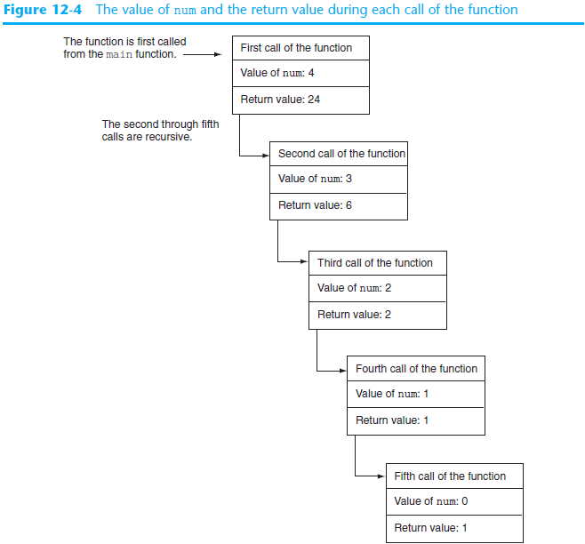

Slide 14
Using Recursion (cont’d.)
Since each call to the recursive function reduces the problem:
Eventually, it will get to the base case which does not require recursion, and the recursion will stop
Usually the problem is reduced by making one or more parameters smaller at each function call

Slide 15
Direct and Indirect Recursion
Direct recursion: when a function directly calls itself
All the examples shown so far were of direct recursion
Indirect recursion: when function A calls function B, which in turn calls function A
also known as mutual recursion

Slide 16
Examples of Recursive Algorithms
Summing a range of list elements with recursion
Function receives a list containing range of elements to be summed, index of starting item in the range, and index of ending item in the range
Base case:
if start index > end index return 0
Recursive case:
return current_number + sum(list, start+1, end)

Slide 17
Examples of Recursive Algorithms (cont’d.)

Slide 18
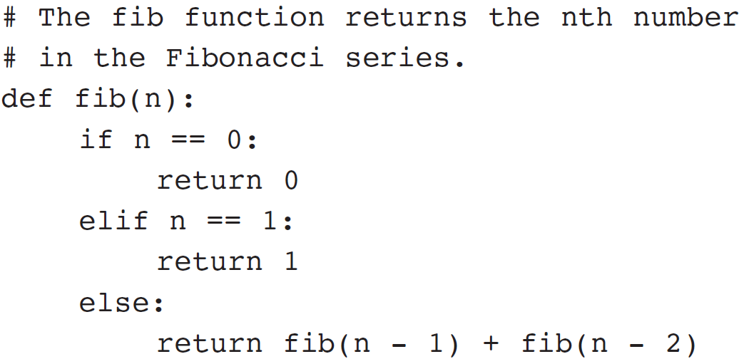
The Fibonacci Series
Fibonacci series: has two base cases
if n = 0 then Fib(n) = 0
if n = 1 then Fib(n) = 1
if n > 1 then Fib(n) = Fib(n-1) + Fib(n-2)
Corresponding function code:

Slide 19
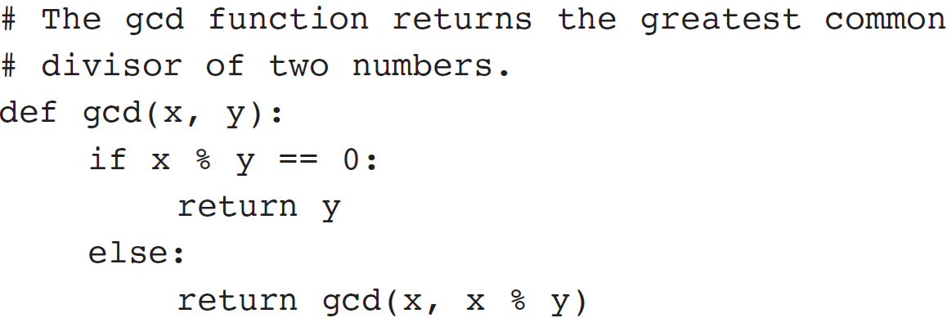
Finding the Greatest Common Divisor
Calculation of the greatest common divisor (GCD) of two positive integers
If x can be evenly divided by y, then
gcd(x,y) = y
Otherwise, gcd(x,y) = gcd(y, remainder of x/y)
Corresponding function code:

Slide 20
The Towers of Hanoi
Mathematical game commonly used to illustrate the power of recursion
Uses three pegs and a set of discs in decreasing sizes
Goal of the game: move the discs from leftmost peg to rightmost peg
Only one disc can be moved at a time
A disc cannot be placed on top of a smaller disc
All discs must be on a peg except while being moved

Slide 21
The Towers of Hanoi (cont’d.)

Slide 22
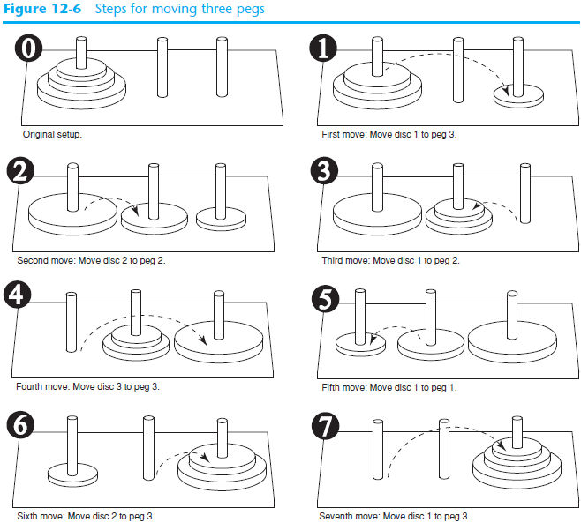

Slide 23
The Towers of Hanoi (cont’d)
Problem statement: move n discs from peg 1 to peg 3 using peg 2 as a temporary peg
Recursive solution:
If n == 1: Move disc from peg 1 to peg 3
Otherwise:
Move n-1 discs from peg 1 to peg 2, using peg 3
Move remaining disc from peg 1 to peg 3
Move n-1 discs from peg 2 to peg 3, using peg 1

Slide 24
The Towers of Hanoi (cont’d.)

Slide 25
Recursion versus Looping
Reasons not to use recursion:
Less efficient: entails function calling overhead that is not necessary with a loop
Usually a solution using a loop is more evident than a recursive solution
Some problems are more easily solved with recursion than with a loop
Example: Factorial, where the mathematical definition lends itself to recursion

