Slide 1
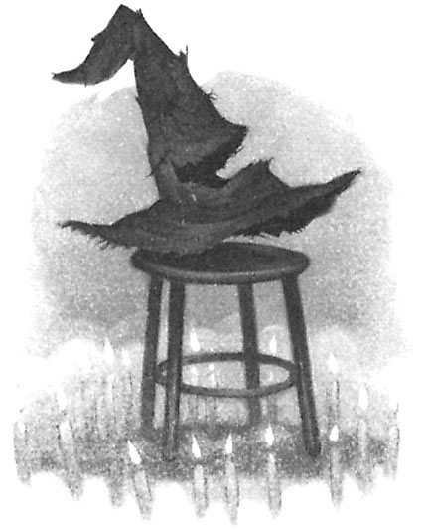
Sorting and Searching Lists
"There's nothing in your head the sorting hat can't see. So try me on and I will tell you where you ought to be."
-The Sorting Hat, Harry Potter and the Sorcerer's Stone

Slide 2
Searching
Given a list of ints find the index of the first occurrence of a target int
Given the above list and a target of 27 the method returns 2
What if not present?
What if more than one occurrence?
index | 0 | 1 | 2 | 3 | 4 | 5
value | 89 | 0 | 27 | -5 | 42 | 11

Slide 3
Using List Methods

Slide 4
linear or sequential search
Implement code for linear search in Python, give a list.

Slide 5
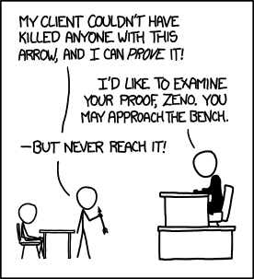
Binary Search

Slide 6
Searching in a Sorted List
If items are sorted then we can divide and conquer
dividing your work in half with each step
generally a good thing
The Binary Search on List in Ascending order
Start at middle of list
is that the item?
If not is it less than or greater than the item?
less than, move to second half of list
greater than, move to first half of list
repeat until found or sub list size = 0

Slide 7
Binary Search
list
low item middle item high item
Is middle item what we are looking for? If not is it
more or less than the target item? (Assume lower)
list
low middle high item item item
and so forth…

Slide 8
Implement Binary Search
0 1 2 3 4 5 6 7 8 9 10 11 12 13 14 15
2
3
5
7
11
13
17
19
23
29
31
37
41
43
47
53

Slide 9
Trace When Key == 3 Trace When Key == 30 Variables of Interest?

Slide 10
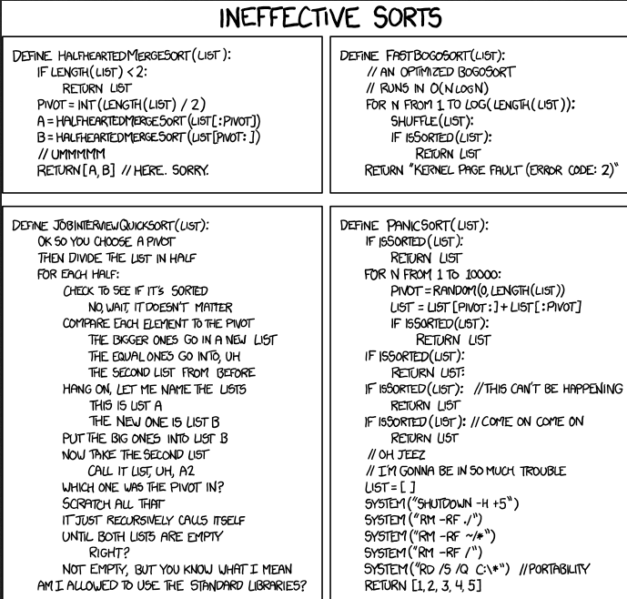
Sorting XKCD http://xkcd.com/1185/

Slide 11
Sorting
A fundamental application for computers
Done to make finding data (searching) faster
Many different algorithms for sorting
One of the difficulties with sorting is working with a fixed size storage container (array)
if resize, that is expensive (slow)
Trying to apply a human technique of sorting can be difficult
try sorting a pile of papers and clearly write out the algorithm you follow

Slide 12
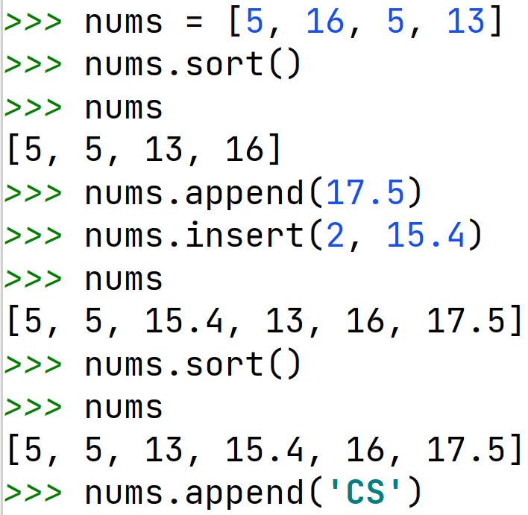
List sort Method
List has a sort method
Works with mixed ints and floats
Works with Strings
Does not work with strings and numbers mixed
Can work with other data types

Slide 13
Insertion Sort
Another of the Simple sort
The first item is sorted
Compare the second item to the first
if smaller swap
Third item, compare to item next to it
need to swap
after swap compare again
And so forth…

Slide 14
Insertion Sort in Practice
44 68 191 119 119 37 83 82 191 45 158 130 76 153 39 25
http://tinyurl.com/d8spm2l
animation of insertion sort algorithm

Slide 15
Timing Question
Determine how long it takes to sort an array with 100,000 elements in random order using insertion sort. When the number of elements is increased to 200,000 how long will it take to sort the array?
About the same
1.5 times as long
2 times as long
4 times as long
8 times as long

