Slide 1
CS303E: Elements of Computers and Programming
Conditionals and Boolean Logic
Mike Scott Department of Computer Science
University of Texas at Austin
Adapted from Professor Bill Young's Slides
Last updated: May 31, 2023

Slide 2
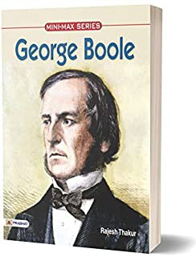
Booleans
So far we’ve been considering straight line code, meaning executing one statement after another.
a.k.a. sequential flow of control
But often in programming, you need to ask a question, and do different things based on the answer.
Boolean values are a useful way to refer to the answer to a yes/no question.
The Boolean literal values are the values: True, False. A Boolean expression evaluates to a Boolean value.

Slide 3
Using Booleans
>>> import math
>>> b = ( 30.0 < math . sqrt( 1024 ))
>>> print( b ) True
>>> x = 1
>>> x < 0
False
>>> x >= -2
# statement
# boolean expression
# boolean expression
True
>>> b = ( x == 0 ) # statement containing
# boolean expression
>>> print ( b) False
Booleans are implemented in the bool class.

Slide 4
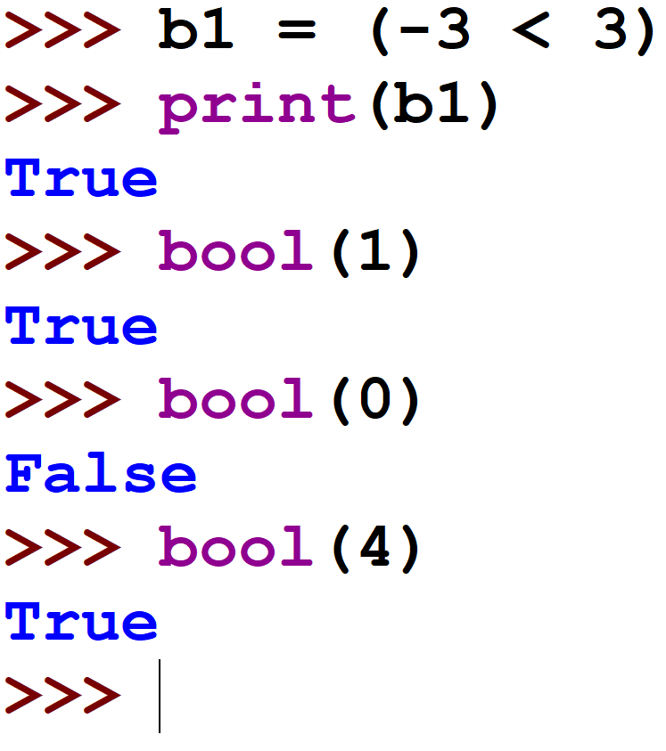
Booleans
Internally, Python uses 0 to represent False and anything not 0 to represent True. You can convert from Boolean to int using the int function and from int to Boolean using the bool function.

Slide 5
Boolean Context
In a Boolean context—one that expects a Boolean value—False, 0, "" (the empty string), and None all is considered False and any other value is considered True.
>>> bool(" xyz ") True
>>> bool (0.0) False
>>> bool("") False
>>> if 4: print(" xyz ") # boolean context xyz
>>>if 4.2: print(" xyz ") xyz
>>> if " ab": print(" xyz ") xyz
This may be confusion but can be very useful in some programming situations.

Slide 6
Comparison Operators
The following comparison (or relational) operators are useful for comparing numeric values:
Operator | Meaning | Example
< | Less than | x < 0
<= | Less than or equal | x <= 0
> | Greater than | x > 0
>= | Greater than or equal | x >= 0
== | Equal to | x == 0
!= | Not equal to | x != 0
Each of these returns a Boolean value, True or False.
What happened on that last line?

Slide 7
Caution
Be very careful using “==” when comparing floats, because float arithmetic is approximate.
>>> (1.1 * 3 == 3.3)
False
>>> 1.1 * 3
3 .3000000000000003
# What happened ?
The problem: converting decimal 1.1 to binary yields a repeating binary expansion: 1.000110011 . . . = 1.00011. That means it can’t be represented exactly in a fixed size binary representation.
Thought for the day. Some rational numbers are repeating decimals in one base, but not in others. 1/3 = 0.33333…₁₀ = 0.1₃

Slide 8
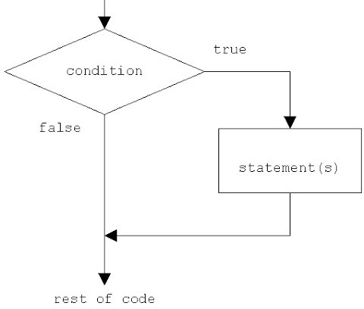
One Way If Statements
It’s often useful to be able to perform an action only if some conditions is true.
General form:
if boolean-expression: statement(s)
Note the colon after the boolean-expression. All of the statements controlled by the if must be indented the same amount.
if y != 0 :
z = ( x / y )

Slide 9
If Statement Example
In file if_example.py:
Would “if x:” have worked instead of “if ( x != 0 ):”?

Slide 10
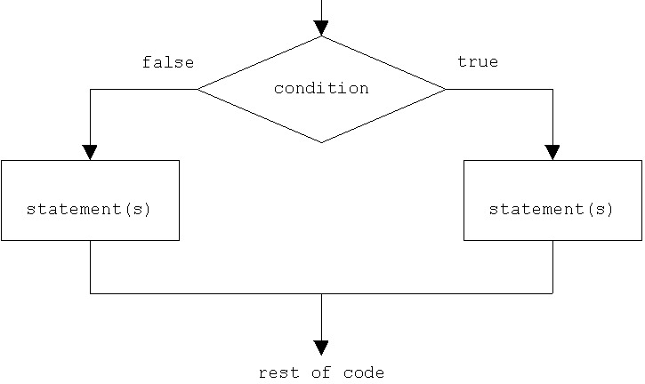
Two-way If-else Statements
A two-way If-else statement executes one of two actions, depending on the value of a Boolean expression.
General form:
if boolean-expression: true-case-statement(s)
else:
false-case-statement(s)
Note the colons after the boolean-expression and after the else. All of the statements in both if and else branches should be indented the same amount.

Slide 11
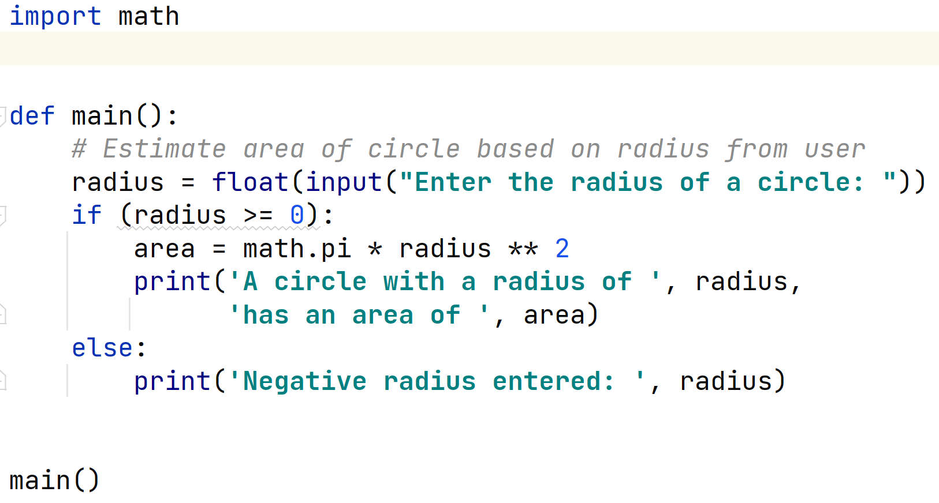
If-else Statement: Example
In file compute_circle_area.py:

Slide 12
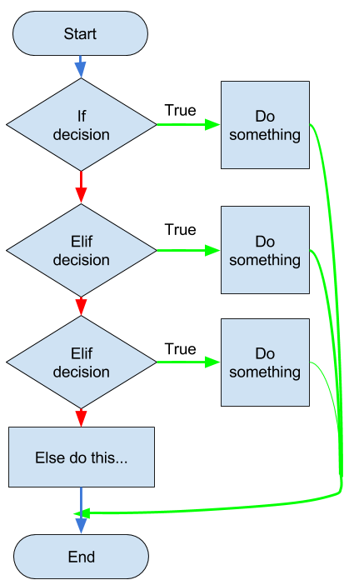
Multiway if-elif-else Statements
If you have multiple options, you can use if-elif-else statements.
General Form:
if boolean-expression1: statement(s)
elif boolean-expression2: statement(s)
elif boolean-expression3:
...
else: # optional statement(s)
You can have any number of elif branches with their conditions. The else branch is optional.

Slide 13
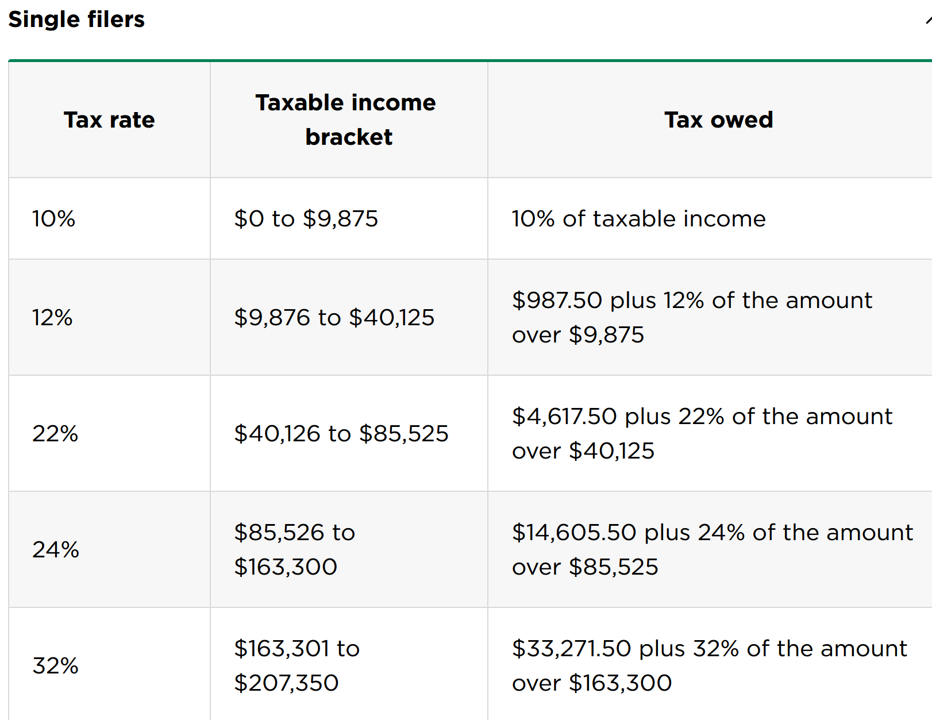
Sample Program: Calculate US Federal Income Tax
Simplified US Federal Income Tax Table
Source: https://www.nerdwallet.com/article/taxes/federal-income-tax-brackets

Slide 14
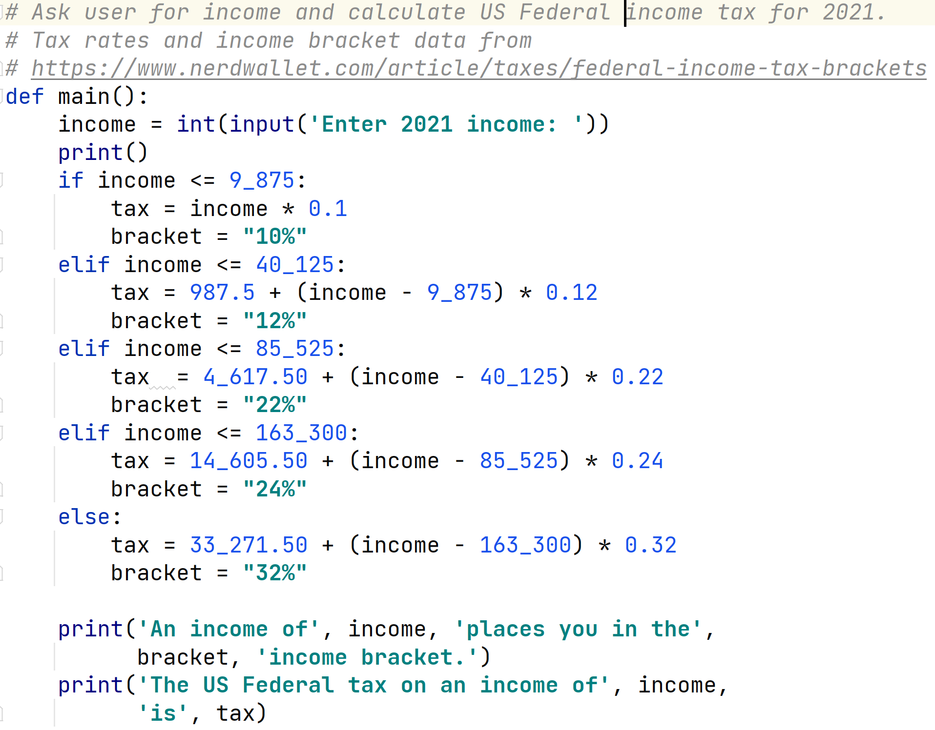
income_tax.py

Slide 15
Break
Maybe take a break?

Slide 16
Logical Operators
Python has logical operators (and, or, not) that can be used to make compound Boolean expressions.
not : logical negation and : logical conjunction
or : logical disjunction
Operators and and or are always evaluated using short circuit evaluation.
( x % 100 == 0 ) and not ( x % 400 == 0 )

Slide 17
Truth Tables
And: (A and B) is True whenever both A is True and B is True.
Not: not A is True whenever A is False.
A not A
False True
A | B | A and B
False | False | False
False | True | False
True | False | False
True | True | True
True
False
Or: (A or B) is True whenever either A is True or B is True.
Remember that “is True” really means “is not False, the empty string, 0, or None.”
A | B | A or B
False | False | False
False | True | True
True | False | True
True | True | True

Slide 18
Short Circuit Evaluation
Notice that (A and B) is False, if A is False; it doesn’t matter what B is. So there’s no need to evaluate B, if A is False!
Also, (A or B) is True, if A is True; it doesn’t matter what B is. So there’s no need to evaluate B, if A is True!
>>> x = 13
>>> y = 0
>>> legal = (y == 0 or x / y > 0 )
>>> print(legal) True
Python doesn’t evaluate B if evaluating A is sufficient to determine the value of the expression. That’s important sometimes. This is called short circuiting the evaluation. Stopping early when answer it know.

Slide 19
Boolean Operators
In a Boolean context, Python doesn’t always return True or False, just something equivalent. What’s going on in the following?
>>> "" and 14 ’’
>>> bool("" and 14)
False
>>> 0 and " abc" 0
>>> bool (0 and " abc")
False
>>> not (0.0)
True
>>> not (1000)
False
>>> 14 and "" ’’
>>> 0 or " abc"
’ abc ’
>>> bool (0 or ’ abc ’) True
# equivalent to False
# coerced to False
# equivalent to False # coerced to False
# same as not( False )
# same as not( True )
# equivalent to False
# same as False or True # equivalent to True
# coerced to True

Slide 20
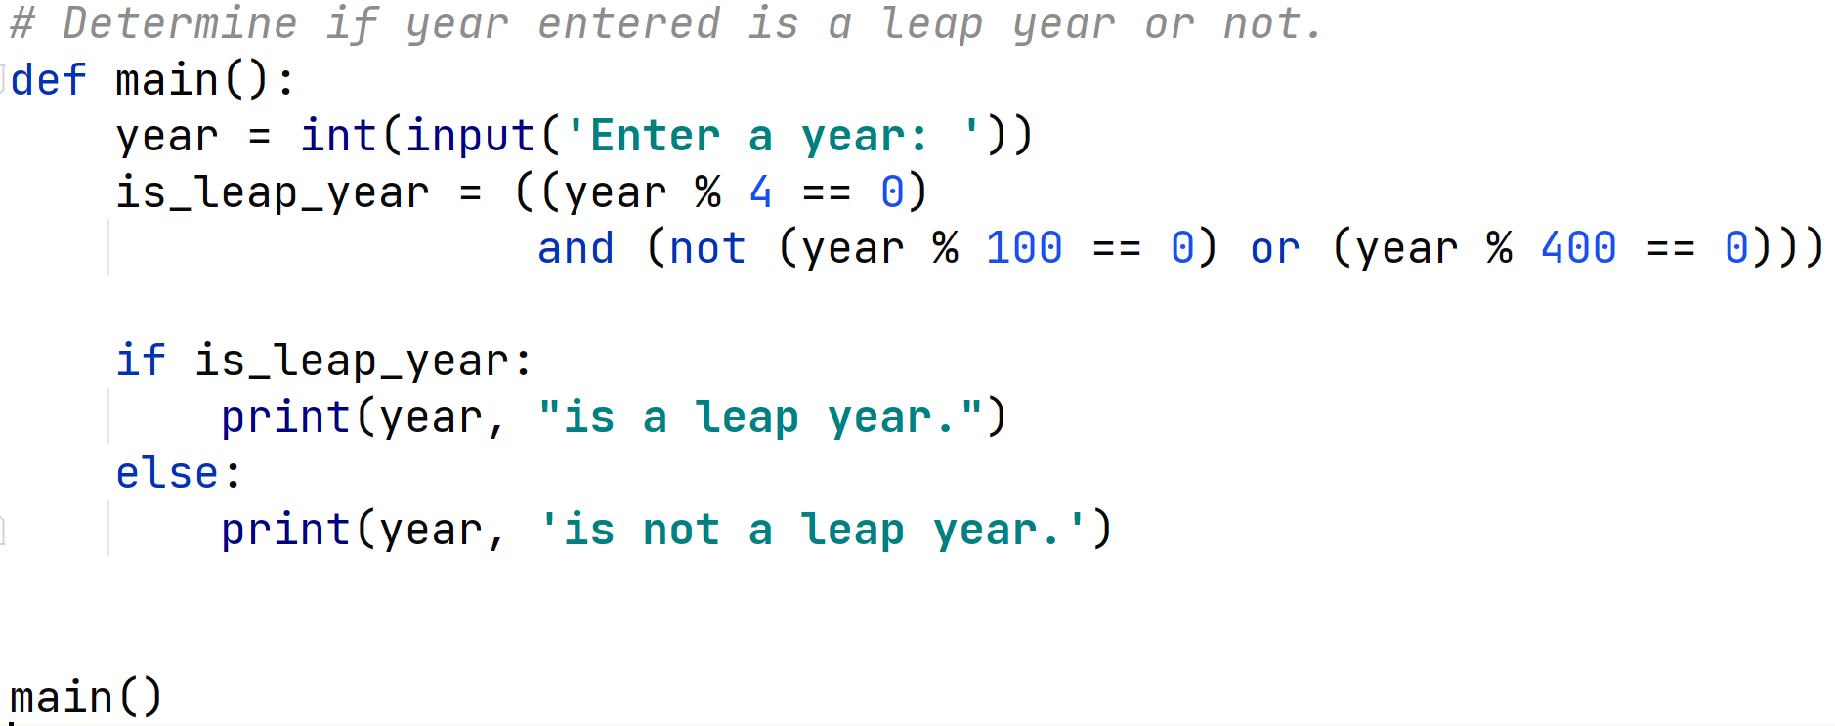
Leap Years
Here’s a concise way to do a Leap Year computation:
Note the use of outer parenthesis on the assignment to is_leap_year
to avoid the use of the continuation character, "\".

Slide 21
Leap Years Revisited
python Leap Year2 . py Enter a year: 2000
Year 2000 is a leap year.
python Leap Year2 . py Enter a year: 1900
Year 1900 is not a leap year.
python Leap Year2 . py Enter a year: 2004
Year 2004 is a leap year.
python Leap Year2 . py Enter a year: 2005
Year 2005 is not a leap year.

Slide 22
Conditional Expressions
A Python conditional expression returns one of two values based on a condition.
Consider the following code:
# Set parity according to num if (num % 2 == 0):
parity = " even " else :
parity = " odd "
This sets variable parity to one of two values, “even” or “odd”. An alternative is:
parity = " even " if ( num % 2 == 0 ) else " odd "

Slide 23
Conditional Expression
General form:
expr-1 if boolean-expr else expr-2
It means to return expr-1 if boolean-expr evaluates to True, and to return expr-2 otherwise.
# find maximum of x and y max = x if ( x >= y ) else y

Slide 24
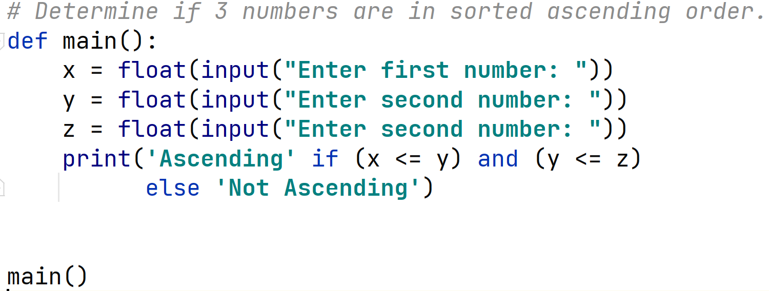
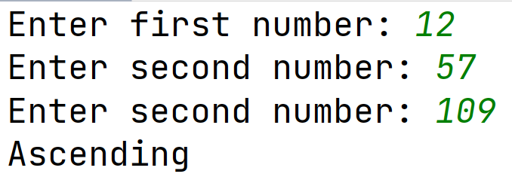
Conditional Expression
Use of conditional expressions can simplify your code. In file test_sort.py:

Slide 25
Operator Precedence
Arithmetic expressions in Python attempt to match widely used mathematical rules of precedence. Thus,
3 + 4 * (5 + 2)
is interpreted as representing:
(3 + ( 4 * ( 5 + 2 ))).
That is, we perform the operation within parenthesis first, then the multiplication, and finally the addition.
To make this happen we precedence rules are enforced.

Slide 26
Precedence
The following are the precedence rules for Python, with items higher in the chart having higher precedence.
Operator
+, -
Meaning
Unary plus, minus, like - 3, +12
** not
*, /, //, %
Exponentiation logical negation
Multiplication, division, integer division, modulus Binary plus, minus Comparison
Equal, not equal Conjunction Disjunction
+, -
<, <=, >, >=
==, !=
and or

Slide 27
Precedence Examples
>>> -3 * 4
-12
>>> - 3 + - 4
-7
>>> 3 + 2 ** 4
19
>>> 4 + 6 < 11
True
>>> 4 < 5 <= 17
and 3 - 10 < 0
# notice special syntax
True
>>> 4 + 5 < 2 + 7
False
>>> 4 + (5 < 2) + 7
11
# this surprised me!
Most of the time, the precedence follows what you would expect.

Slide 28
Precedence
Operators on the same line have equal precedence.
Operator
+, -
Meaning
Binary plus, minus
*, /, //, %
Multiplication, division, integer division, remainder
Evaluate them left to right.
All binary operators are left associative. Example: x + y - z + w
means ((x + y) - z) + w.
Note that assignment is right associative.
x = y = z = 1 # assign z first

Slide 29
Use Parentheses to Override Precedence
Use parenthesis to override precedence or to make the evaluation clearer.
>>> 10 - 8 + 5
7
>>> (10 - 8) + 5
7
>>> 10 - (8 + 5)
-3
>>> 5 - 3 * 4 / 2
-1.0
>>> 5 - ((3 * 4) / 2)
-1.0
# an expression
# what precedence will do # override precedence
# not particularly clear # better
Work to make your code easy to read!

