Slide 1
CS303E: Elements of Computers and Programming
Repitition with Loops
Mike Scott Department of Computer Science
University of Texas at Austin
Adapted from Professor Bill Young's Slides
Last updated: May 30, 2024

Slide 2
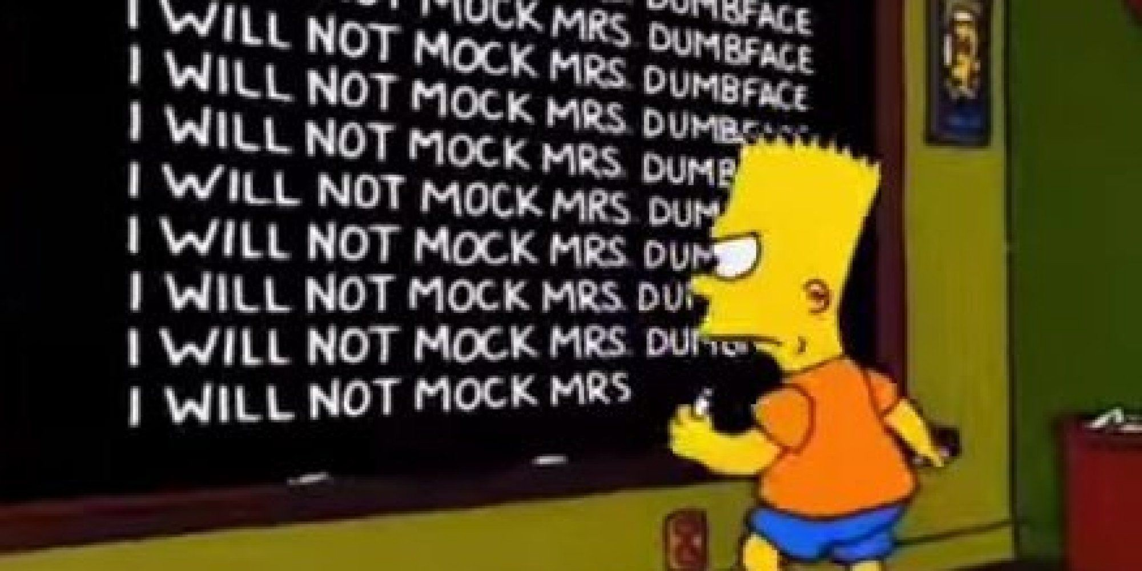
Repetitive Activity
Often we need to do some (program) activity numerous times:

Slide 3
Using Loops
So we might as well use cleverness to do it. That’s what loops are for.
It doesn’t have to be the exact same thing over and over.
And this is how we really harness the power of a computer that can perform tens of billions (or more) computations per second!

Slide 4
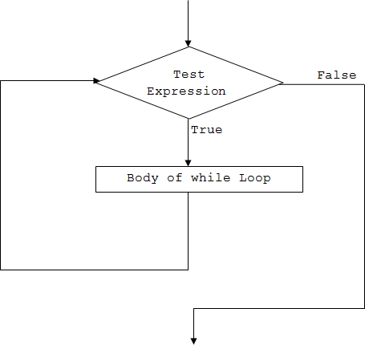
While Loop
The majority of programming languages include syntax to repeat operations.
while loop is one option. General form:
while condition: statement(s)
Meaning: as long as the condition is true when checked, execute the statements.
As with conditionals (if/elif/else), all of the statements in the body of the loop must be indented the same amount.

Slide 5
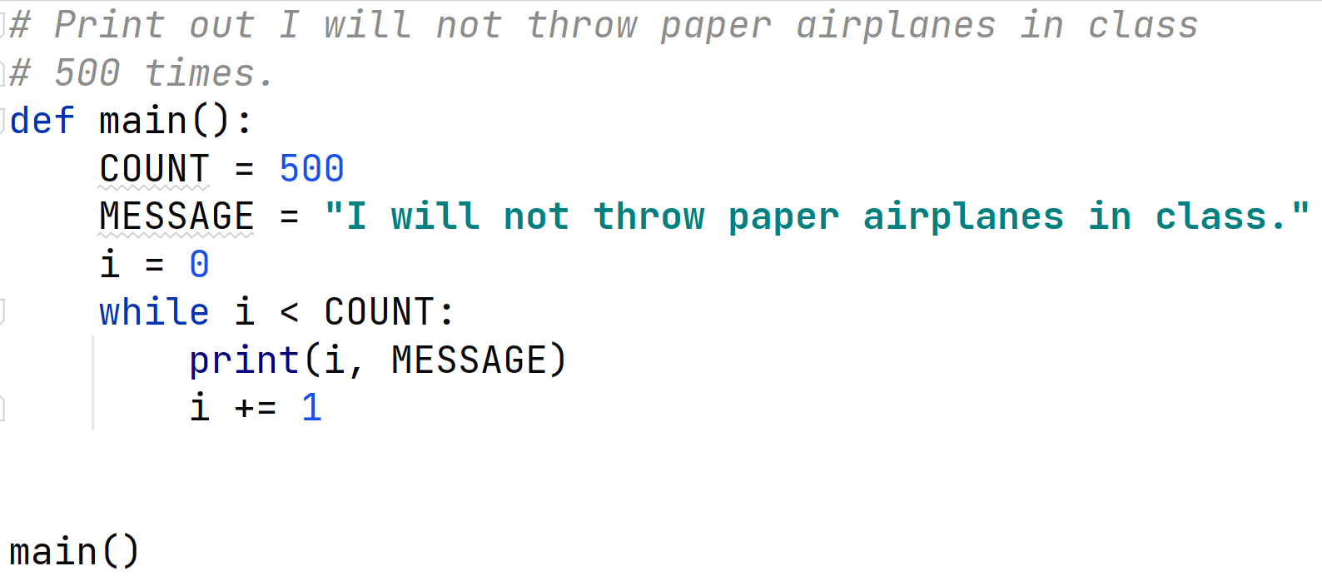
While Loop
In file not_throw_airplanes.py:
What would happen if we forgot the i += 1?

Slide 6
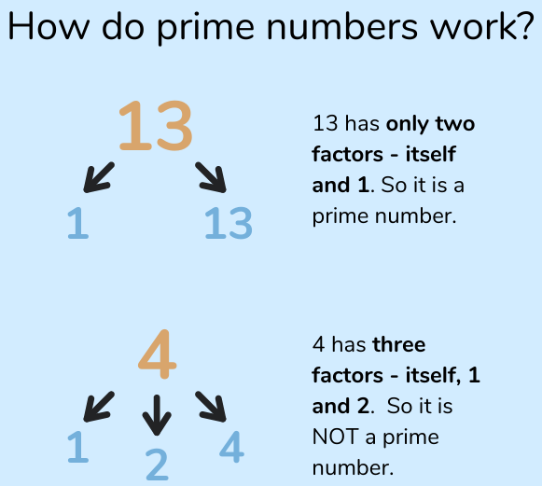
While Loop Example: Test Primality
An integer is prime if it is greater than 1 and has no positive integer divisors except 1 and itself.
To test whether an arbitrary integer n
is prime, see if any number in
[2 ... n-1], divides it with no remainder
You couldn’t do that in straight line code without knowing n in advance. Why not?
Even then it would be really tedious if n is very large.

Slide 7
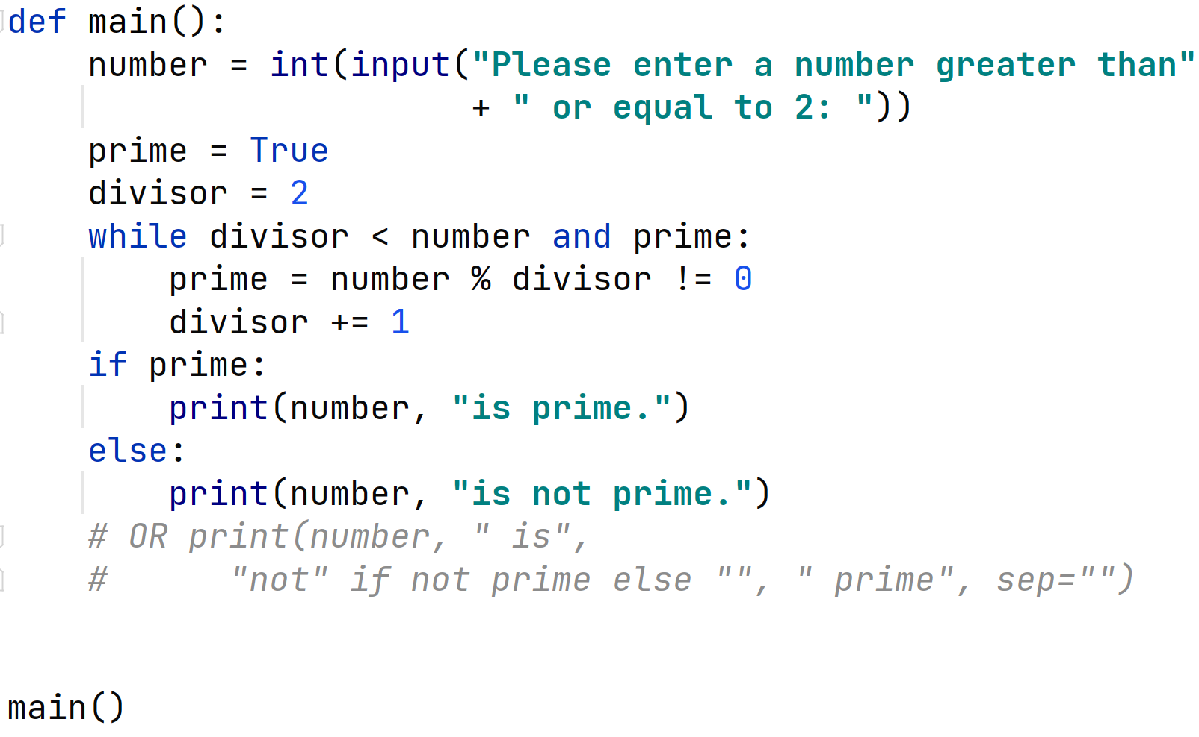
is_prime_1 Loop Example
is_prime_1.py

Slide 8
is_prime_1 Loop Example
The second example took ~24 seconds to complete on my laptop.
It works, though it’s pretty inefficient. If a number is prime, we test every possible divisor in [2 ... n-1].
We don’t actually need the special test for 2. Think about why that is.
If n is not prime, it will have a divisor less than or equal to √n. There’s no need to test any even divisor except 2.

Slide 9
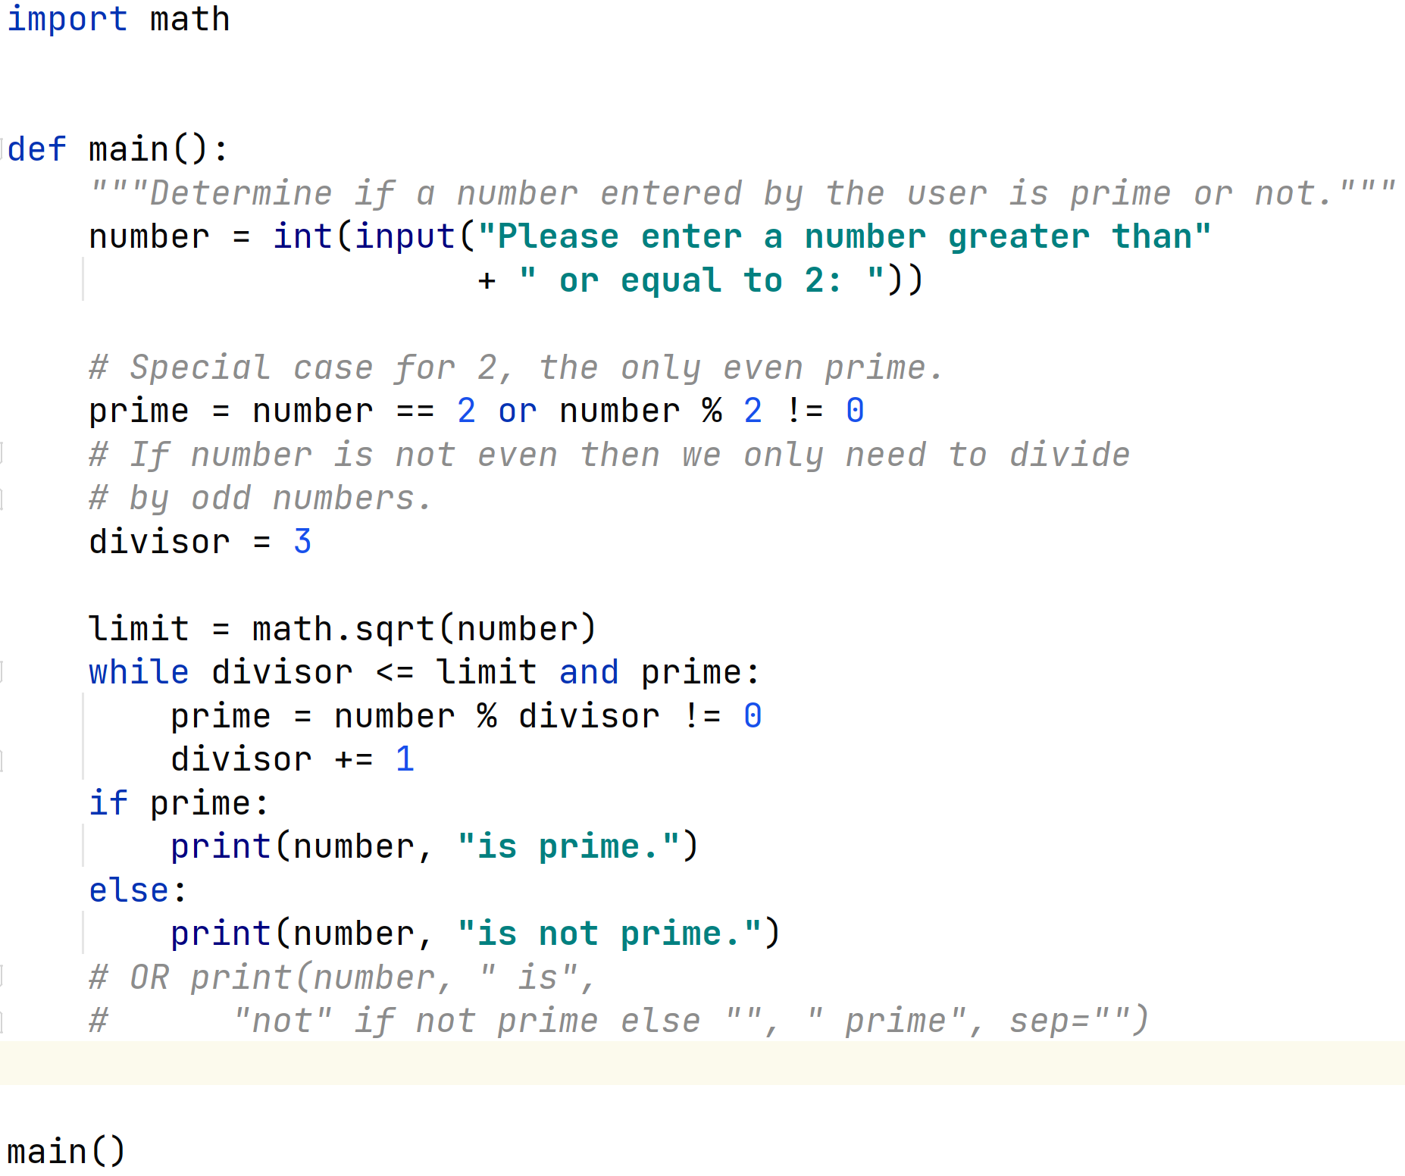
A Better Version: is_prime_2.py

Slide 10
The Better is_prime_2 Version
is_prime_1 does 176,970,202 divisions to discover that 176_970_203 is prime.
is_prime_2 does "only” 13,302.
Took much less than a second to complete.
Computer scientists and software developers spend a lot of time trying to improve the efficiency of their programs and algorithms.
Measurably reduce the number of computations.

Slide 11
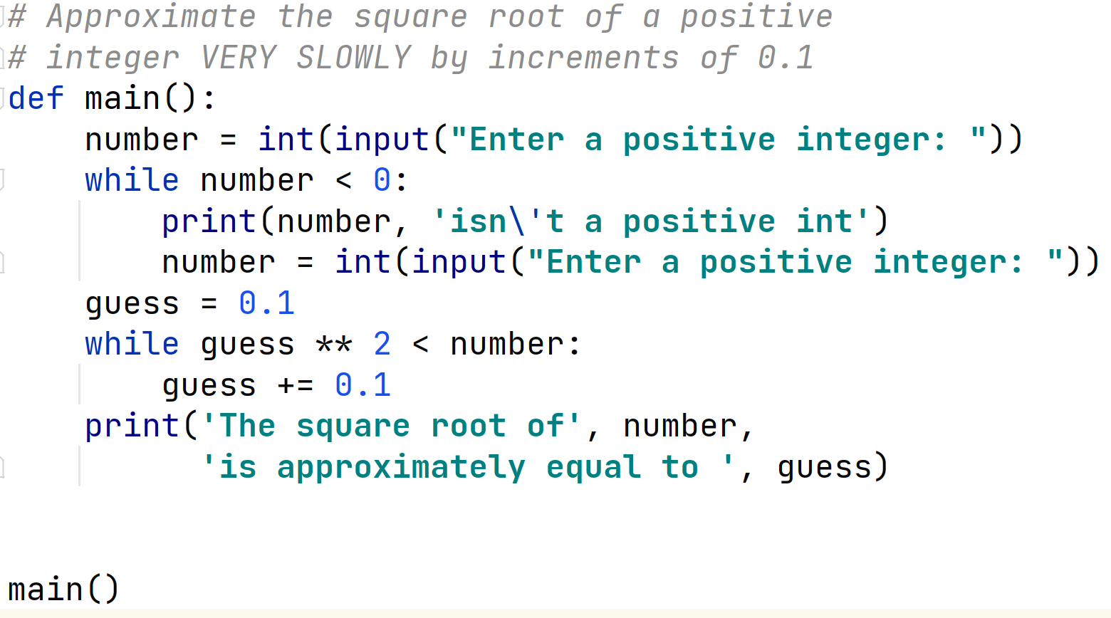
Example While Loop: Approximate Square Root
You could approximate the square root of a positive integer as follows: square_root.py

Slide 12
Running the Example
Notice that the last one isn’t quite right. The square root of 100 is exactly 10.0. Foiled again by the approximate nature of floating point numbers and floating point arithmetic.

Slide 13
More efficient way of calculating square root?
Newton's method for approximating square roots adapted from the Dr. Math website The goal is to find the square root of a number. Let's call it num 1. Choose a rough approximation of the square root of num, call it approx. How to choose? 2. Divide num by approx and then average the quotient with approx, in other words we want to evaluate the expression ((num/approx) + approx) / 2 3. How close are we? In programming we would store the result of the expression back into the variable approx. 4. How do you know if you have the right answer?

Slide 14
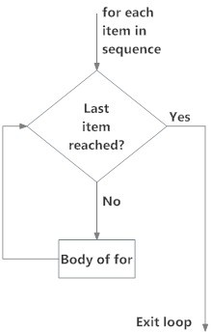
For Loop
In a for loop, you typically know how many times you’ll execute.
General form:
for <var> in <sequence>: <statement(s)>
Meaning: assign each element of sequence in turn to var and execute the statements.
As usual, all of the statements in the body must be indented the same amount.

Slide 15
What’s a Sequence?
A Python sequence holds multiple items stored one after another.
>>> seq = [2 , 3 , 5 , 7 , 11 , 13] # a list
The range function is a good way to generate a sequence.
range(a, b) : denotes the sequence a, a+1, ..., b-1. range(b) : is the same as range(0, b).
range(a, b, c) : generates a, a+c, a+2c, ...., b’, where b’ is the last value < b.

Slide 16
Range Examples
>>> for i in range (3 , 6): print(i, end =" ")
...
3 4 5
>>> for i in range (3): print(i, end =" ")
...
0 1 2
>>> for i in range (0 , 11 , 3): print(i, end =" ")
...
0 3 6 9
>>> for i in range (11 , 0 , -3): print(i, end =" ")
...
11 8 5 2
>>>

Slide 17
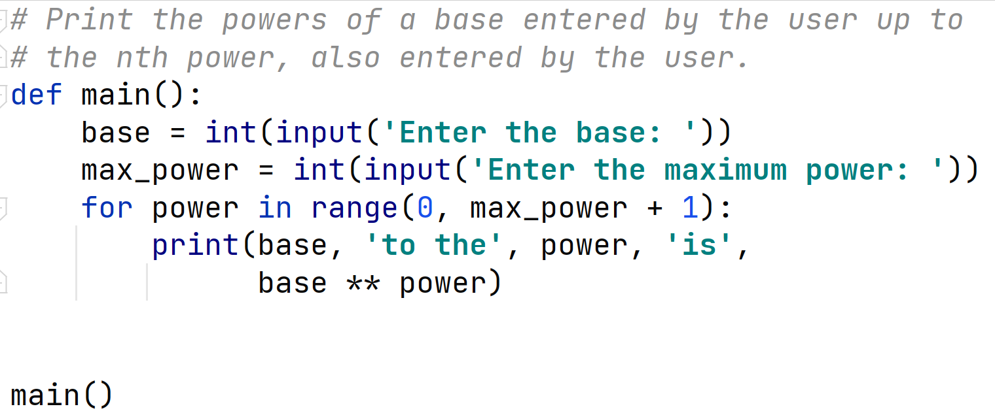
For Loop Example
Suppose you want to print a table of the powers of a given base up to base^{n}. In file powers_of.py:

Slide 18
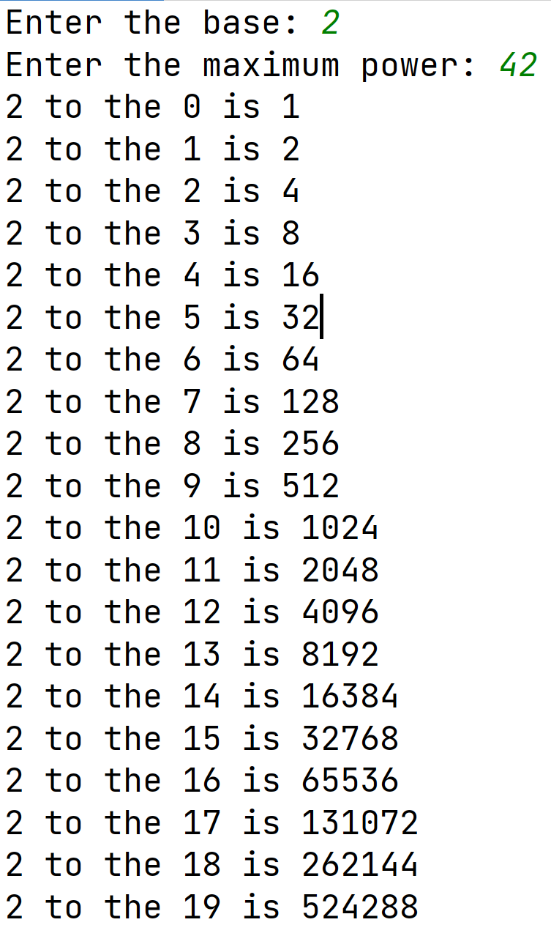
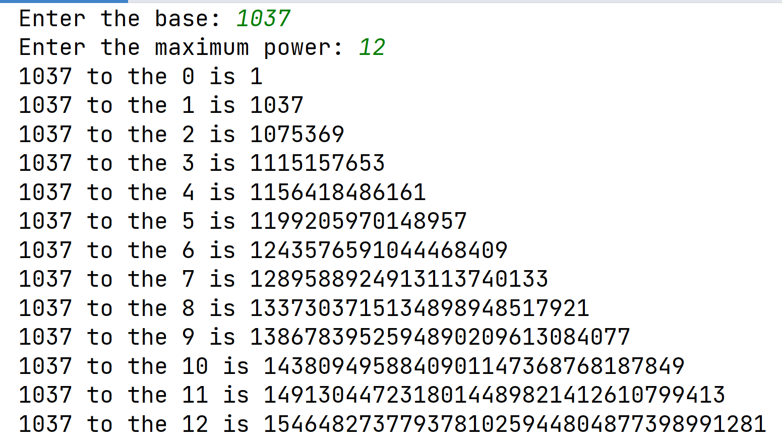
For Loop Example

Slide 19
Nested Loops
The body of while loops and for loops contain any kind of statements, including other loops.
Suppose we want to compute and print out the BMI value for heights from 4' 6" (4 feet, 6 inches = 54 inches) to 6' 10" (82 inches) going up by 2 inches each time AND weights from 85 to 350 pounds, going up by 5 pounds?
We could then take that data and create a visual graph for quick look up.
It is arbitrary whether the outer loop is height or weight

Slide 20
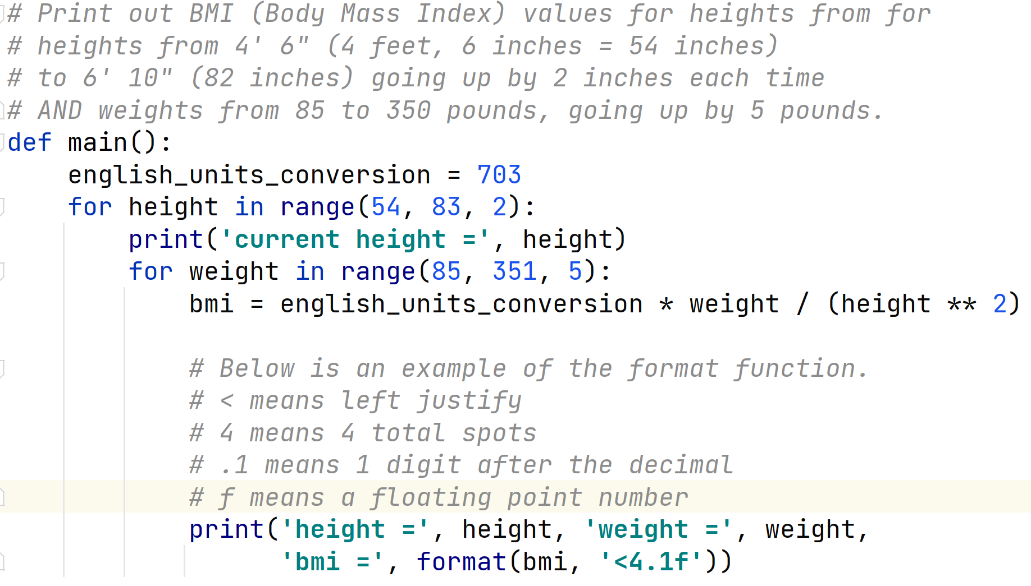
Print BMI for various heights and weights

