Slide 1
CS303E: Elements of Computers and Programming
Files
Mike Scott Department of Computer Science
University of Texas at Austin
Adapted from Professor Bill Young's Slides
Last updated: June 23, 2022

Slide 2

Value of Files
Files are a persistent way to store programs, input data, and output data.
Files are stored in the memory of your computer in an area allocated to the file system, which is typically arranged into a hierarchy of directories (aka folders).
The path to a particular file details where the file is stored within this hierarchy.

Slide 3
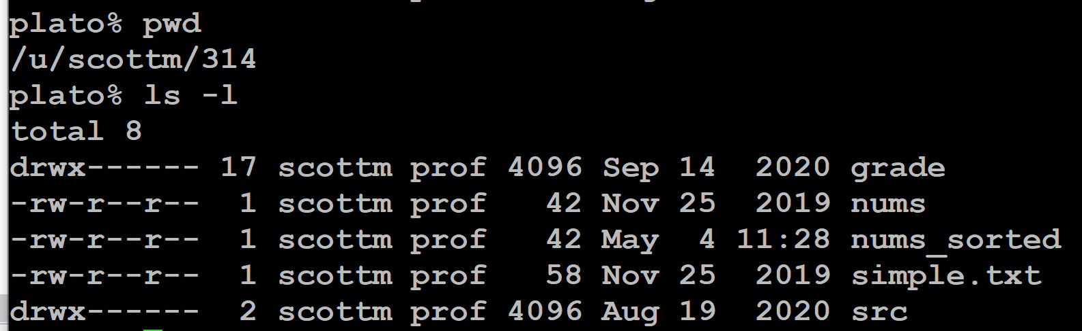
Relative Pathnames
A path to a file may be absolute or relative.
If you just use the name of the file, you’re assuming that it is in the current working directory.
pwd -> print working directory
ls -l -> list the contents of the current directory in long form (with details)

Slide 4
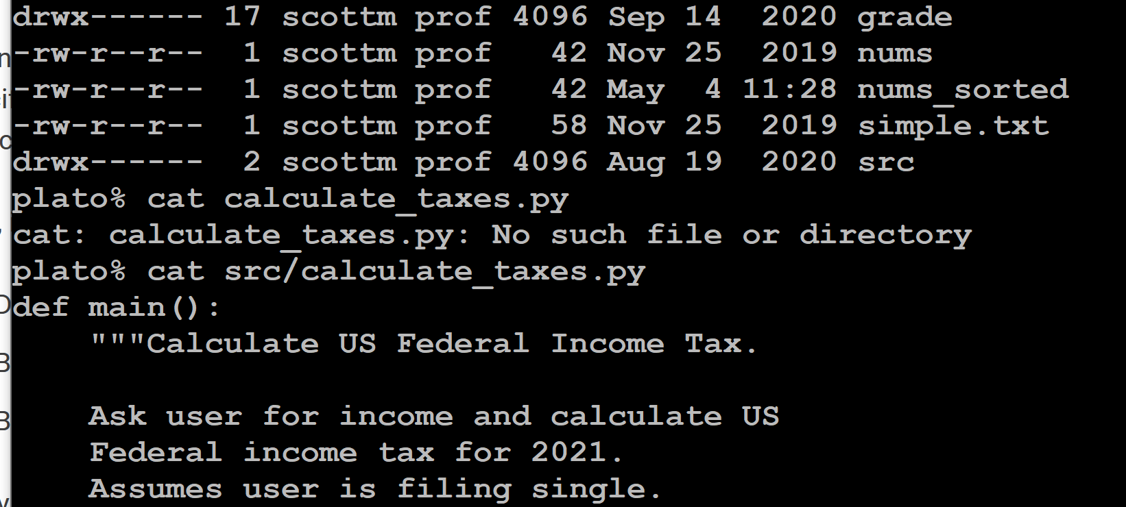
Relative Pathnames
cat -> from concatenate, synonym for append
(in this case to standard output)
src/ means look for the file in the directory
named src

Slide 5
File Paths
On Windows, a file path might be:
C:\Users\scottm\314\src\calculate_texas.py
On Linux or MacOS, it might be:
/home/scottm/314/src/calculate_texas.py
Python passes filenames around as strings, which causes some problems for Windows systems, partly because Windows uses the '\' in filepaths. Recall that backslash is an escape character, and including it in a string may require escaping it.

Slide 6
Raw Strings
There is a way in Python to treat a string as a raw string, meaning that escaped characters are treated just as any other characters.
>>> print(' abc\ ndef') abc
def
>>> print( r' abc\ ndef') abc\ ndef
Prefix the string with an 'r'. You may or may not need to do the for Windows pathnames including '\'

Slide 7
Python - Show the Current Working Directory
In CS303e when we open a file we will generally assume it is in the same directory as the running Python program.
When doing homework, how do you know what that is so you can put your data files in the same directory?
import os
print(os.getcwd())
Of course your output will be different.

Slide 8
Working with Files in Python
Python provides a simple, elegant interface to storing and retrieving data in files.
Functions for dealing with files:
open : establish a connection to the file and associate a local file handle with a physical file.
close : terminate the connection to the file.

Slide 9
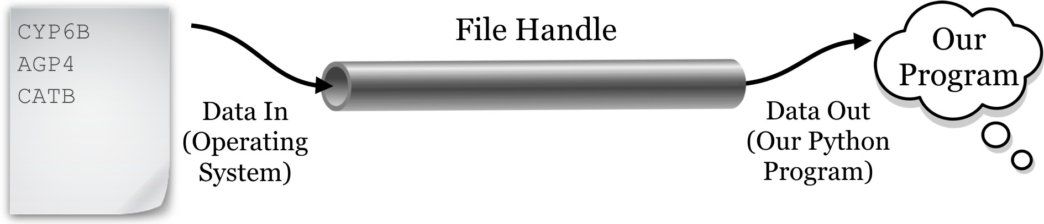
Opening a File
Before your program can access the data in a file, it is necessary to open it. This returns a file object, also called a 'handle,' that you can use within your program to access the file.
It also informs the system how you intend for your program to
interact with the file, the 'mode.'

Slide 10
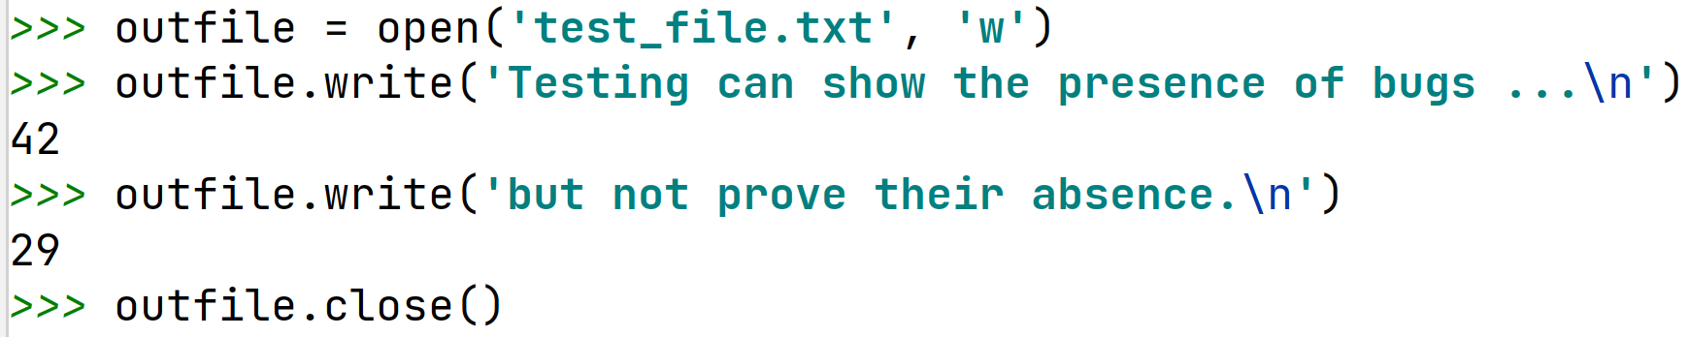
Example of Opening a File
General Form:
fileVariable = open(filename, mode)
What do you think the 42 and 29 (an int returned by the write function) represent above?
Notice we are calling a function (method) on a variable.
outfile.write

Slide 11
Opening a File: Modes
Permissible modes for files:
Mode Description
'r' Open for reading.
'w' Open for writing. If the file already exists the old contents are overwritten.
'a' Open for appending data to the end of the file.
'rb' Open for reading binary data.
'wb' Open for writing binary data.
You also have to have necessary permissions from the operating system to access the files.
This semester we won’t be using the binary modes.
In other words we are going to read from files assuming it is encoded as text. In binary we would read the raw 0s and 1s.

Slide 12
Closing the File
General form:
file_variable.close()
All files are closed by the OS when your program terminates. Still, it is very important to close any file you open in Python.
the file will be locked from access by any other program while you have it open;
items you write to the file may be held in internal buffers rather than written to the physical file;
if you have a file open for writing, you can’t read it until you close it, and re-open for reading;
it’s just good programming practice.

Slide 13
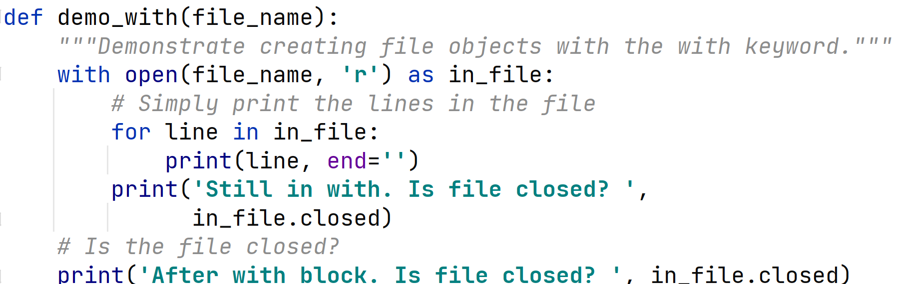
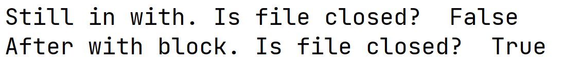
Using the with statement
Although not in the textbook, the preferred way of opening a file is with the with statement. (Another Python keyword)

Slide 14
Reading/Writing a File
There are various Python functions for reading data from or writing data to a file, given the file object in variable fn.
Function
fn.read()
Description
Return entire remaining contents of file as a string.
fn.read(k) Return next k characters from the file as a string.
fn.readline() Returns the next line as a string.
fn.readlines() Returns all remaining lines in the file as a list of strings.
fn.write(str) Writes the string to the file.
These functions advance an internal file pointer (like a cursor in a word processing document or a program editor) that indicates where in the file you’re reading/writing. open sets the file pointer or cursor at the beginning of the file.

Slide 15
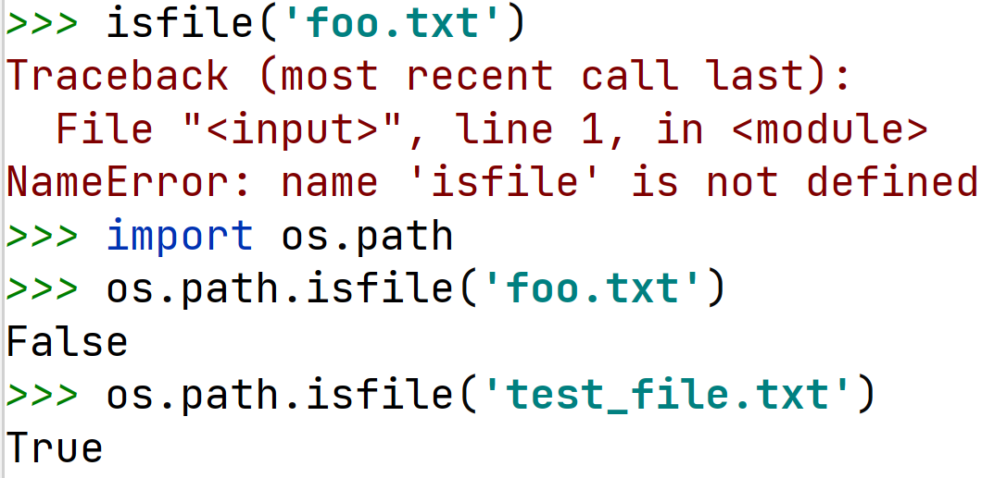
Testing File Existence
Sometimes you need to know whether a file exists, otherwise you may overwrite an existing file.
Use the isfile function from the os.path module.
Here the filepath given is relative to the current directory.

Slide 16
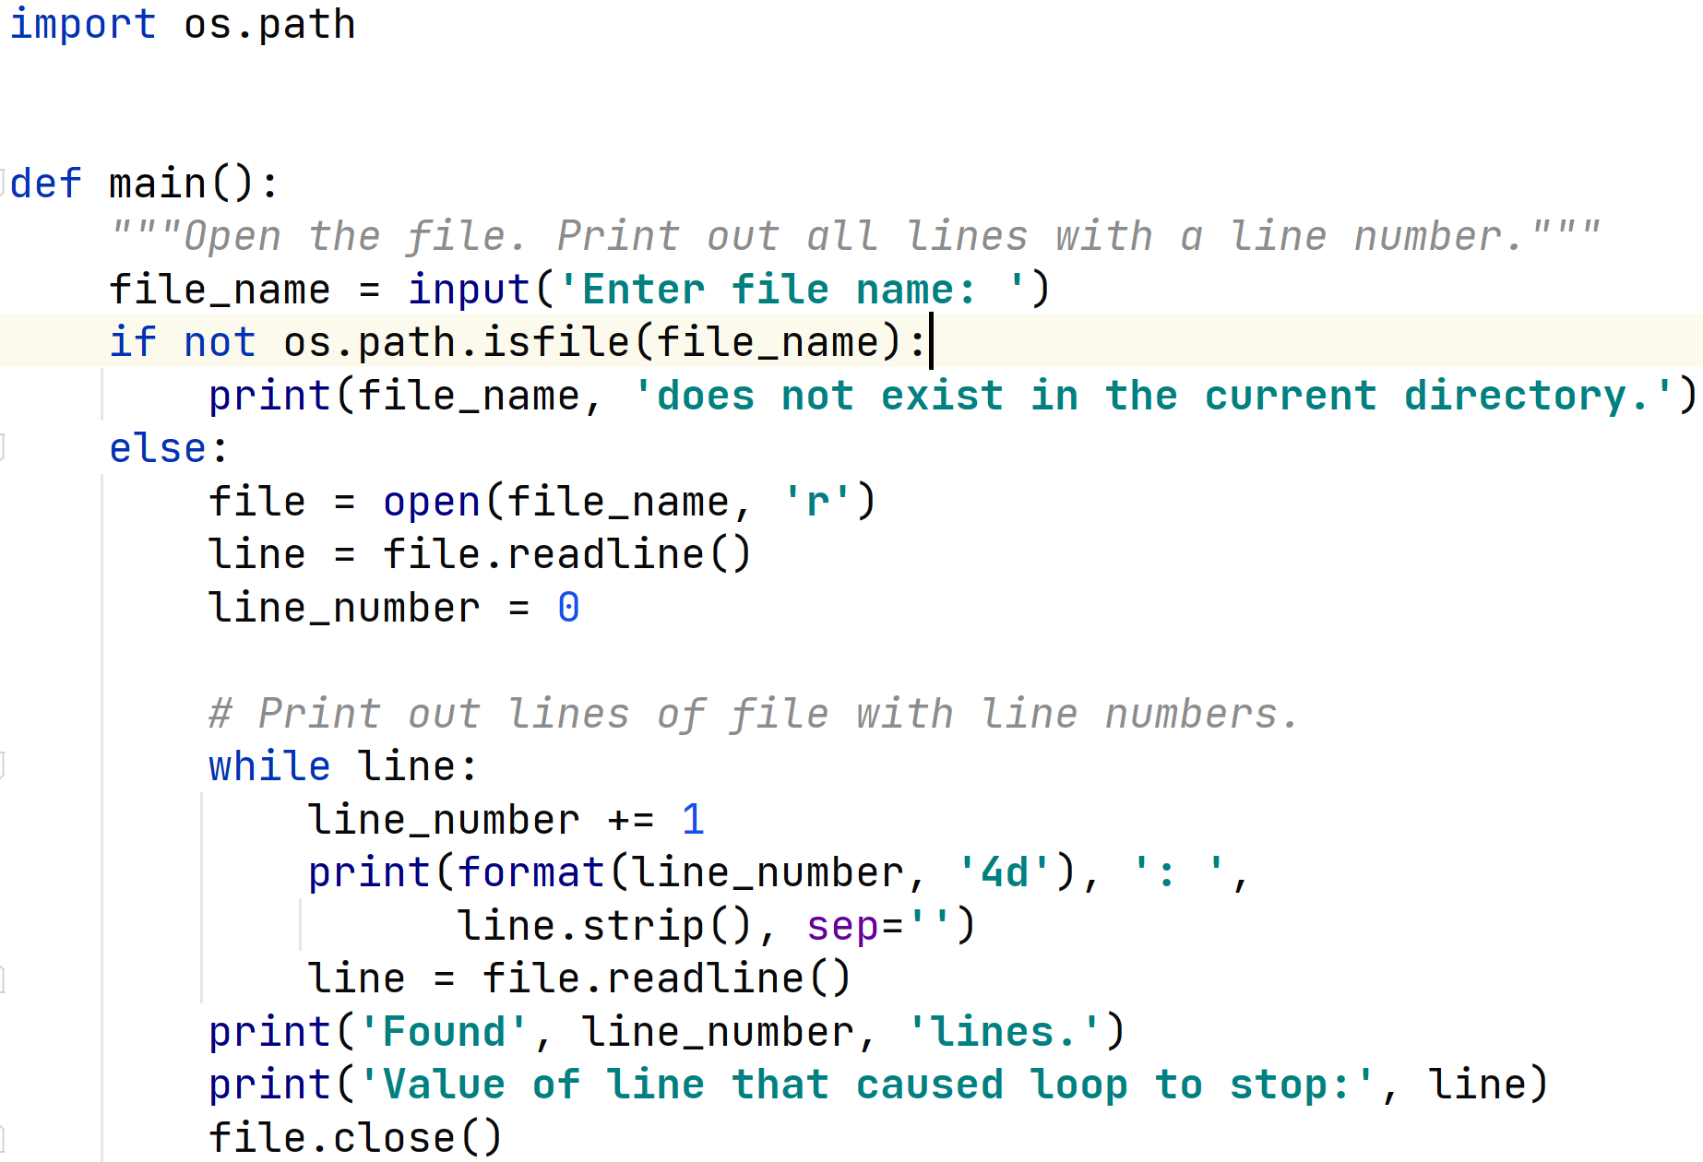
Example: Read Lines from File

Slide 17
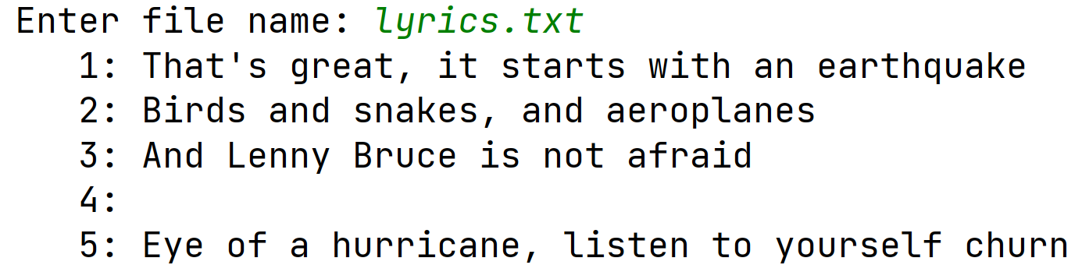
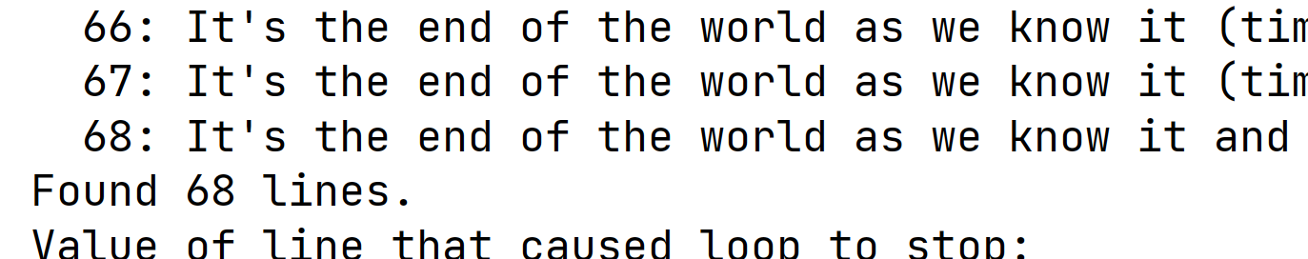
Example: Read Lines from File
…

Slide 18
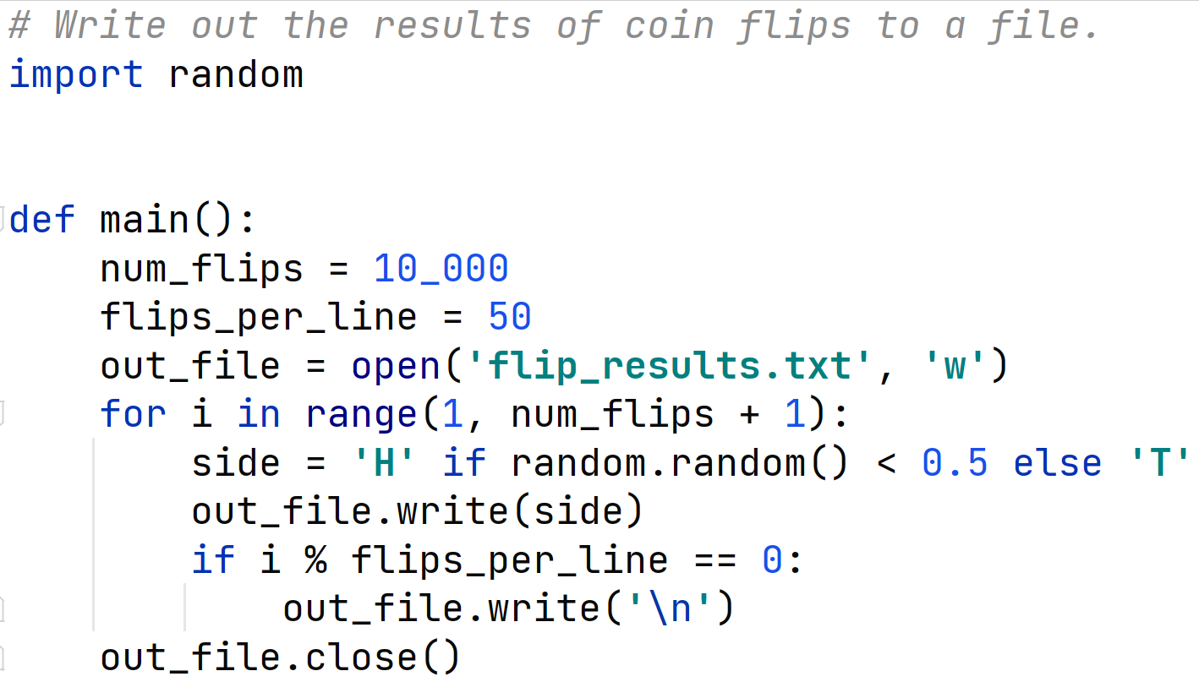
Example: Write File
Let's write out the flip of 10,000 coins to a file, H for heads, T for tails. 50 results per line separated by a space.
One major difference is that print inserts a newline at the end of each line, unless you ask it not to. write does not do that.

Slide 19
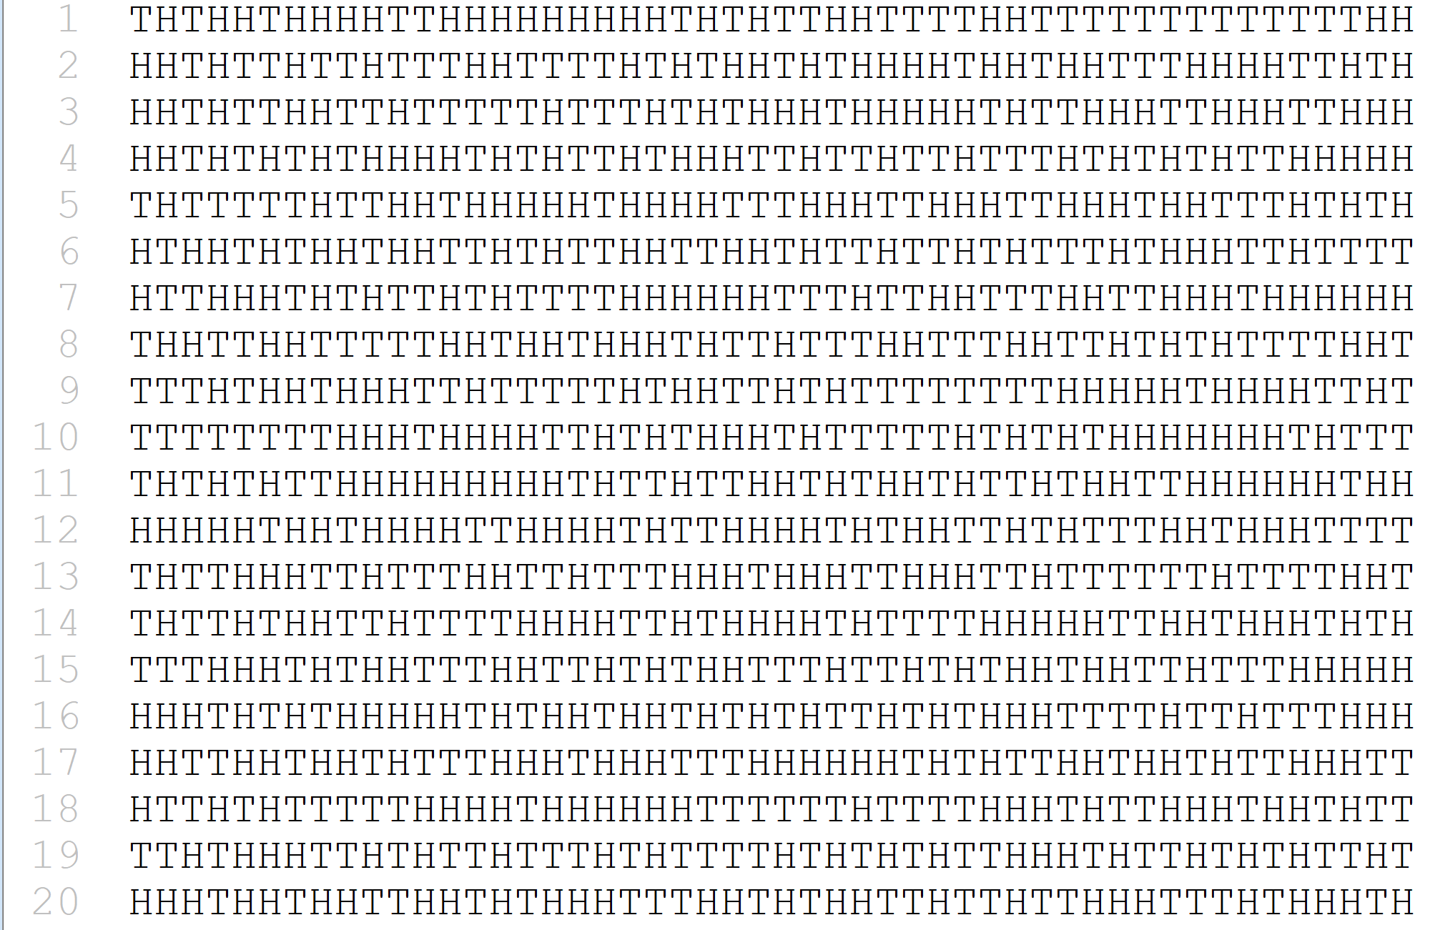
Part of Resulting File - Coin Flip Results
Note, the line numbers are NOT part of the file. They are shown by the text editor I used.

Slide 20
Aside: Redirecting Output
There’s another way to get the output of a program into a file.
When your file does a print, it sends the output to standard out, which is typically the terminal.
You can redirect the output to a file, using > filename on Linux systems. Anything that would have been printed on the screen goes into a file instead.
Notice that this happens at the OS level, not at the Python level.
Programmers know how to do things multiple ways!
Can even redirect standard output inside of a Python program.
This is part of how the auto grader works. Redirecting your program's standard output so we can compare it to what we expect the output to be.

Slide 21
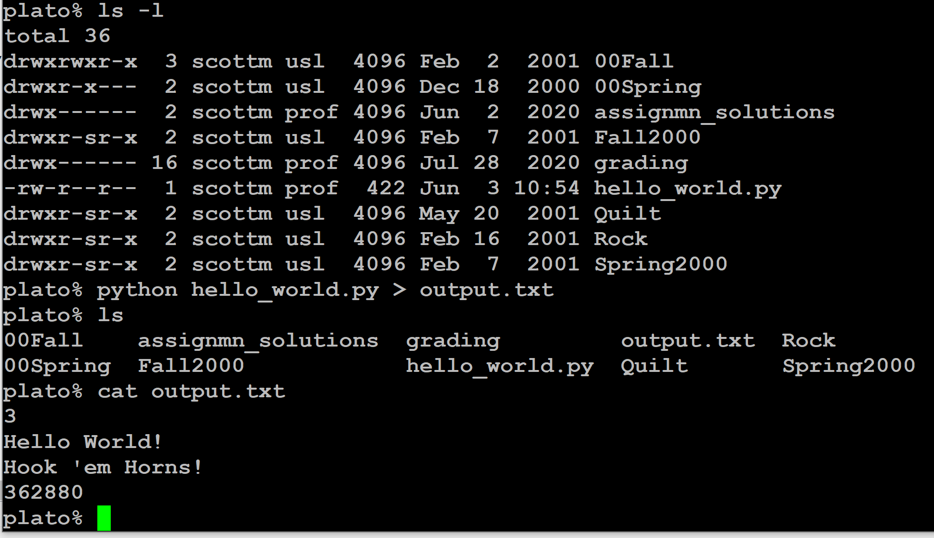
Aside: Redirecting Output

Slide 22
Example: Reading and Writing File
import os. path
def copy_file ():
''' Copy contents from file1 to file2 . ''' # Ask user for filenames
f1 = input(' Source filename : '). strip ()
f2 = input(' Target filename : '). strip () # Check if target file exists.
if os. path . isfile ( f2 ):
print( f2 + ' already exists' ) return
# Open files for input and output
infile = open ( f1 , ' r' ) outfile = open ( f2 , ' w' )
# Copy from input to output a line at a time
for line in infile : outfile . write ( line )
# Close both files
infile . close () outfile . close ()
copy_file()
Notice the use of a
for loop to read all
the lines in the file.

Slide 23
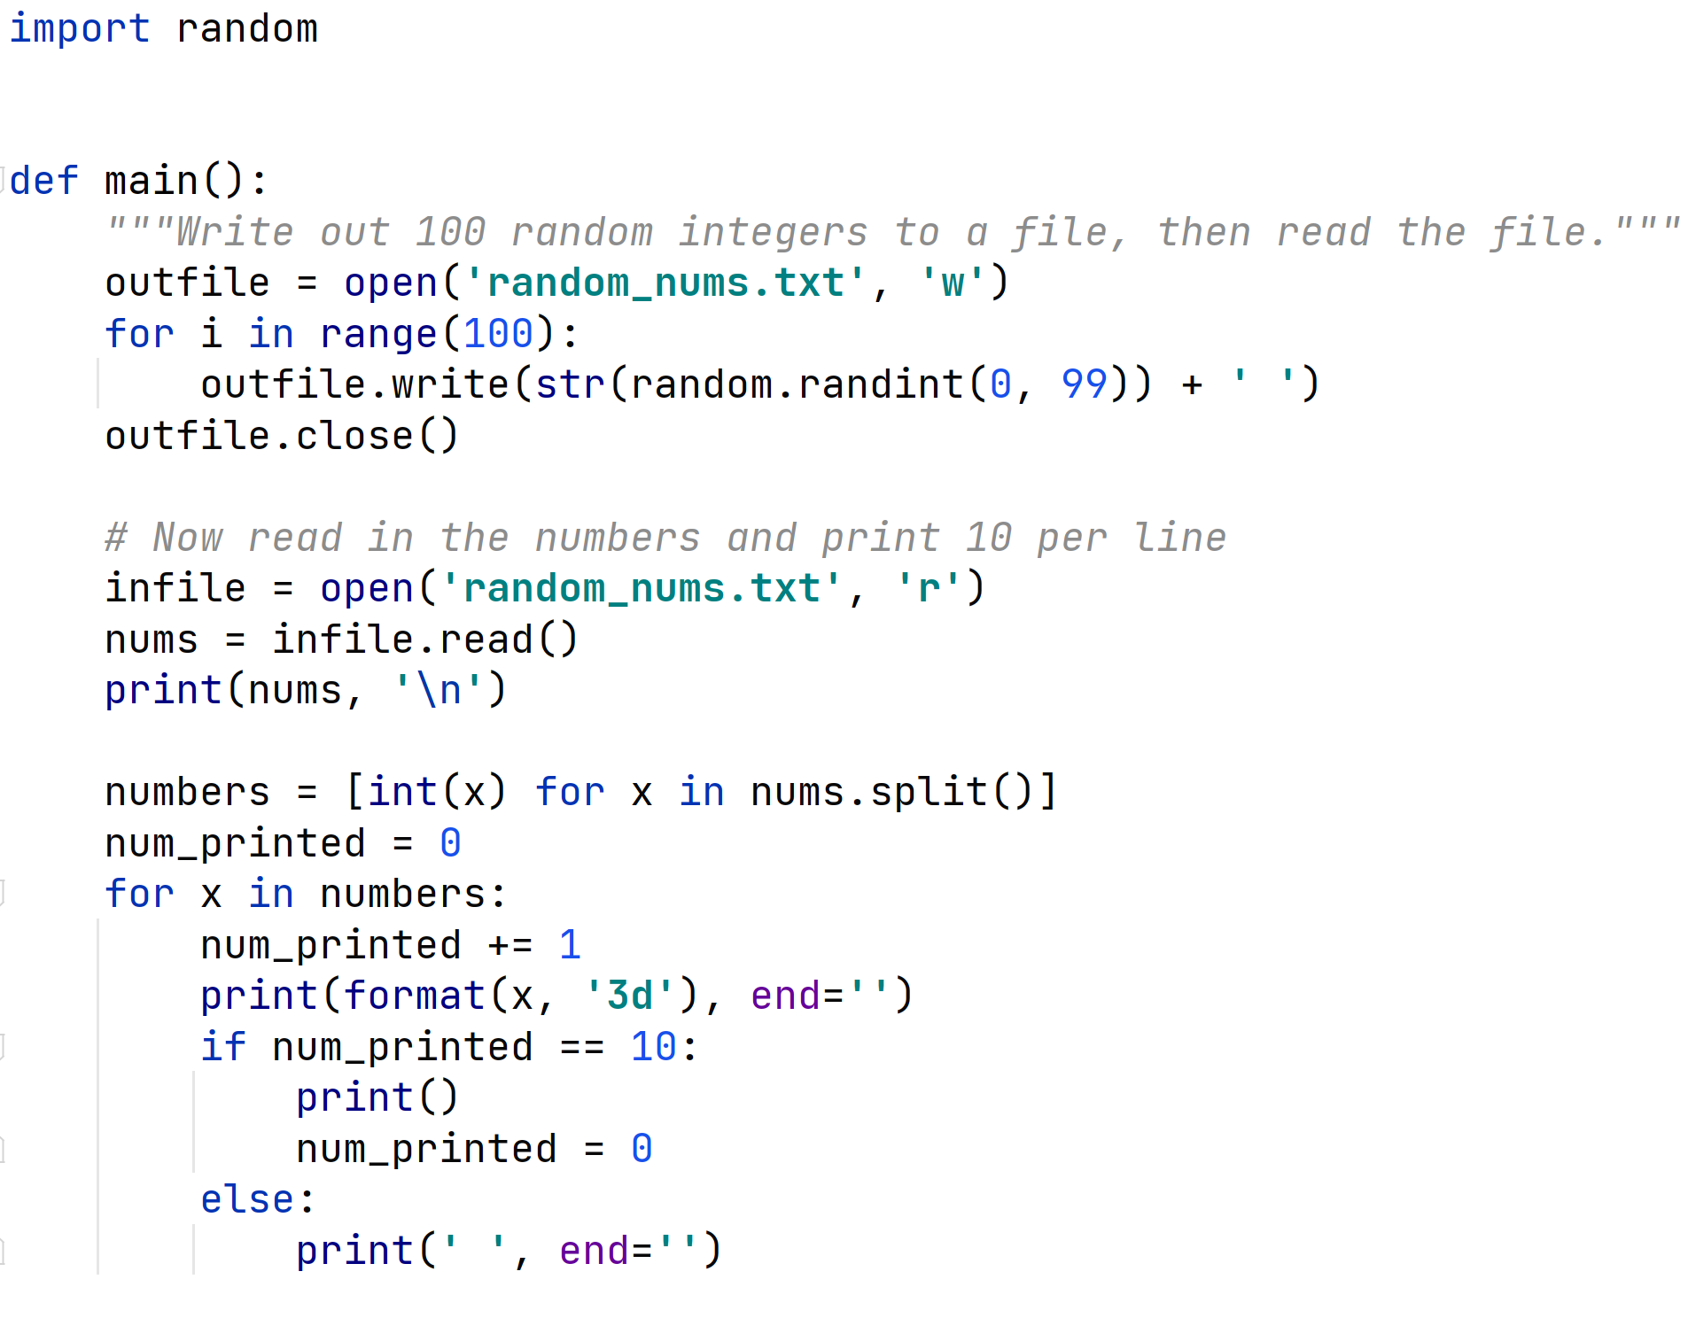
Example: Reading and Writing File
One cannot simultaneously read and write a file in Python. However, you can write a file, close it, and re-open it for reading.

Slide 24
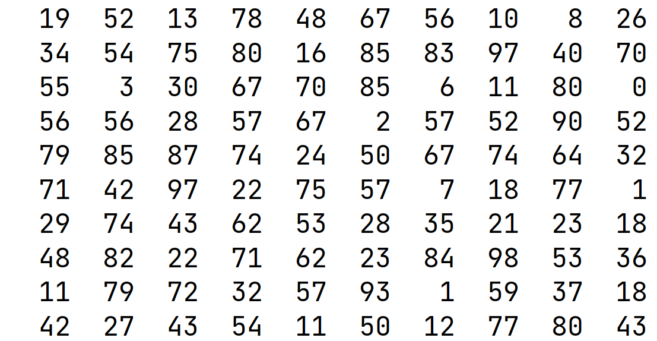
Reading and Writing File

Slide 25

Append Mode
Opening a file in append mode 'a', means that writing a value to the file appends it at the end of the file.
It does not overwrite the previous content of the file.
You might use this to maintain a log file of transactions on an account.
New transactions are added at the end, but all transactions are recorded.

