Slide 1
CS303E: Elements of Computers and Programming
Lists
Mike Scott Department of Computer Science
University of Texas at Austin
Adapted from Professor Bill Young's Slides
Last updated: June 28, 2023

Slide 2
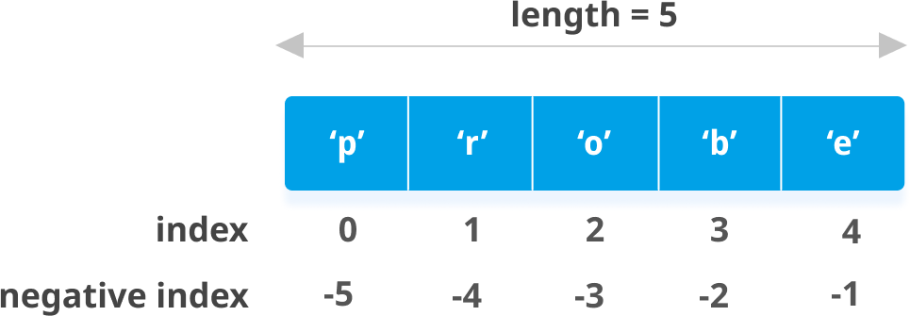
Lists
The list class is a very useful tool in Python.
Both lists and strings are sequence types in Python, so share many similar methods. Unlike strings, lists are mutable.
If you change a list, it doesn’t create a new copy; it changes the actual contents of the list.

Slide 3
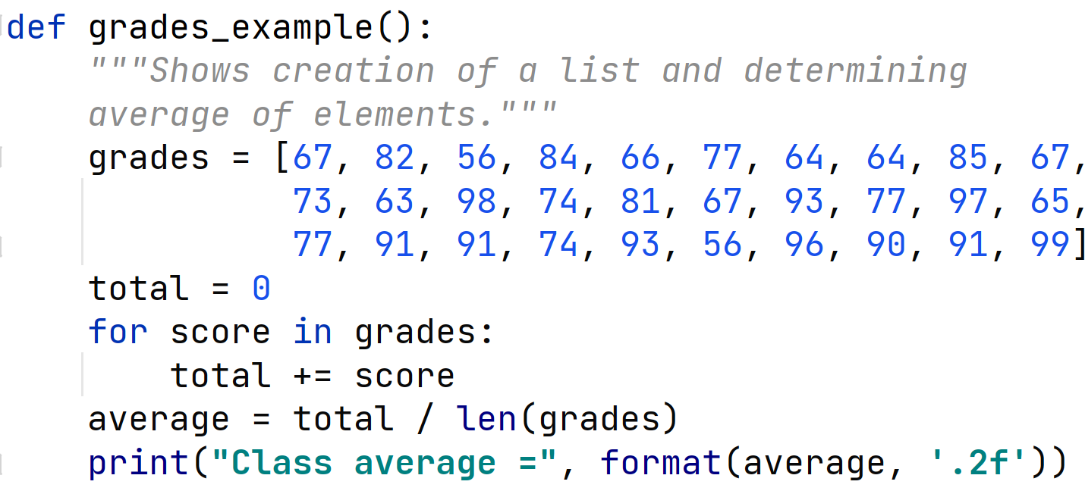
Value of Lists
Suppose you have 30 different test grades to average. You could use 30 variables: grade1, grade2, ..., grade30. Or you could use one list with 30 elements: grades[0], grades[1], ..., grades[29].

Slide 4
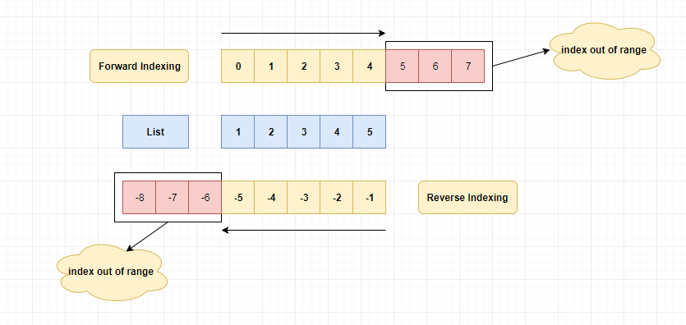
Indexing and Slicing
With Lists you can get sublists using slicing

Slide 5
List Slicing
List slicing format: list[start : end]
Span is a list containing copies of elements from start up to, but not including, end
If start not specified, 0 is used for start index
If end not specified, len(list) is used for end index
Slicing expressions can include a step value and negative indexes relative to end of list

Slide 6
Creating Lists
Lists can be created with the list class constructor or using special syntax.
>>> list () []
>>> list ([1 , 2 , 3])
# create empty list , with constructor
# create list [1 , 2 , 3]
[1 , 2 , 3]
>>> list ([" red ", 3 , 2.5]) # create heterogeneous list
[’ red ’, 3 , 2.5]
>>> [" red ", 3 , 2.5]
[’ red ’, 3 , 2.5]
>>> range (4) range (0 , 4)
>>> list( range (4))
[0 , 1 , 2 , 3]
>>> list(" abcd ") [’a’, ’b’, ’c’, ’d’]
# create list , no explicit constructor
# not an actual list
# create list using range
# create character list from string

Slide 7
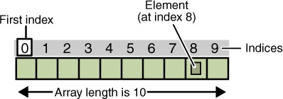
Lists vs. Arrays
Many programming languages have an array type.
Arrays are:
homogeneous (all elements are of the same type)
fixed size
permit very fast access time
Python lists are:
heterogeneous (can contain elements of different types)
variable size
permit fast access time
Lists and arrays are examples of data structures. A very simple definition of
a data structure is a variable that stores other variables.
CS313e explores many standard data structures.

Slide 8
Sequence Operations
Lists are sequences and inherit various functions from sequences.
Function
x in s
Description
x is in sequence s
x not in s s1 + s2
s * n s[i] s[i:j] len(s)
min(s)
max(s)
sum(s) for loop
<, <=, >, >=
==, !=
x is not in sequence s concatenates two sequences repeat sequence s n times
ith element of sequence (0-based) slice of sequence s from i to j-1 number of elements in s minimum element of s
maximum element of s
sum of elements in s
traverse elements of sequence compares two sequences compares two sequences

Slide 9
Calling Functions on Lists
>>> l1 = [1 , 2 , 3 , 4 , 5]
>>> len ( l1 ) 5
>>> min ( l1 ) 1
>>> max ( l1 )
5
>>> sum ( l1 )
# assumes elements are comparable
# assumes elements are comparable # assumes summing makes sense
15
>>> l2 = [1 , 2 , " red "]
>>> sum ( l2 )
Traceback ( most recent call last): File " <stdin >", line 1 , in <module >
Type Error: unsupported operand type ( s) for +: ’ int ’ and ’ str
’
>>> min ( l2 )
Traceback ( most recent call last): File " <stdin >", line 1 , in <module >
Type Error: ’ <’ not supported between instances of ’ str ’ and
’ int ’
>>>

Slide 10
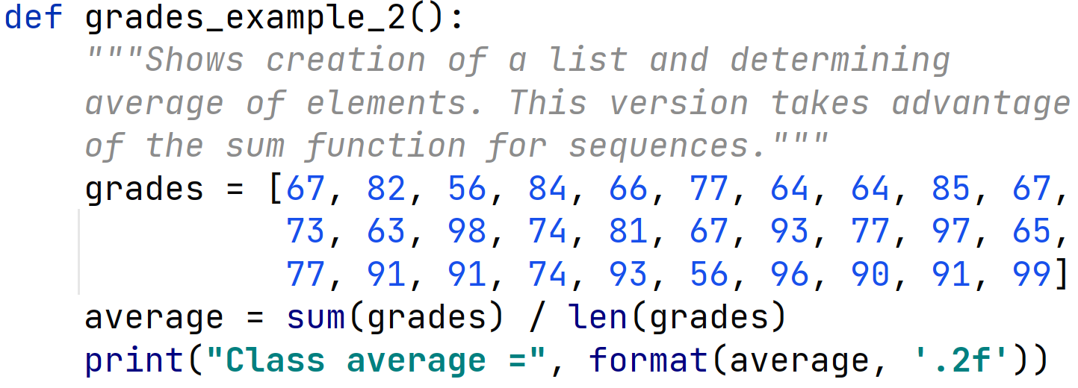
Using Functions
We could rewrite the grades_examples function as follows:

Slide 11
Traversing Elements with a For Loop
General Form:
for u in list:
body
In file test.py:
for u in range (3): print(u, end =" ")
print ()
for u in [2 , 3 , 5 , 7]:
print(u, end =" ") print ()
for u in range (15 , 1 , -3): print(u, end =" ")
print ()
# not really a list
# not really a list
> python test. py 0 1 2
2 3 5 7
15 12 9 6 3

Slide 12
Comparing Lists
Compare lists using the operators: >, >=, <, <=, ==, !=. Uses lexicographic ordering: Compare the first elements of the two lists; if they match, compare the second elements, and so on. The elements must be of comparable classes.
>>> list1 = [" red ", 3 , " green "]
>>> list2 = [" red ", 3 , " grey "]
>>> list1 < list2 True
>>> list3 = [" red ", 5 , " green "]
>>> list3 > list1 True
>>> list4 = [5 , " red ", " green "]
>>> list3 < list4
Traceback ( most recent call last): File " <stdin >", line 1 , in <module >
Type Error: ’ <’ not supported between instances of ’ str ’ and
’ int ’
>>> [" red ", 5 , " green "] == [5 , " red ", " green "] False

Slide 13
List Comprehension
List comprehension gives a compact syntax for building lists.
>>> range (4) range (0 , 4)
>>> [ x for x in range (4) ]
# not actually a list
# create list from range
[0 , 1 , 2 , 3]
>>> [ x ** 2 for x in range (4) ] [0 , 1 , 4 , 9]
>>> lst = [ 2 , 3 , 5 , 7 , 11 , 13 ]
>>> [ x ** 3 for x in lst ] [8 , 27 , 125 , 343 , 1331 , 2197]
>>> [ x for x in lst if x > 2 ]
[3 , 5 , 7 , 11 , 13]
>>> [ s[0] for s in [" red ", " green ", " blue "] if s <= " green "] [’g’, ’b’]
>>> from IsPrime3 import *
>>> [ x for x in range (100) if isPrime ( x) ]
[2 , 3 , 5 , 7 , 11 , 13 , 17 , 19 , 23 , 29 , 31 , 37 , 41 , 43 , 47 , 53 ,
59 , 61 , 67 , 71 , 73 , 79 , 83 , 89 , 97]

Slide 14
List Comprehension with Files
List comprehension gives a compact syntax for building lists, even from files.

Slide 15
List Comprehension with Files
List comprehension gives a compact syntax for building lists, even from files.

Slide 16
List Comprehension with Files
List comprehension gives a compact syntax for building lists, even from files.

Slide 17
Let’s Take a Break

Slide 18
More List Methods
These are methods from class list.
Since lists are mutable, these actually change t.
Method
t.append(x)
Description
add x to the end of t
t.count(x) t.extend(l1) t.index(x) t.insert(i, x)
t.pop()
t.pop(i) t.remove(x) t.reverse() t.sort()
number of times x appears in t append elements of l1 to t index of first occurence of x in t insert x into t at position i
remove and return the last element of t remove and return the ith element of t remove the first occurence of x from t reverse the elements of t
order the elements of t

Slide 19
List Examples
>>> | l1 = [1 , 2 , 3]
>>> | l1 . append (4) # add 4 to the end of l1
>>> | l1 # note : changes l1
[1 , | 2 , 3 , 4]
>>> | l1 . count (4) # count occurrences of 4 in | l1
1
>>> | l2 = [5 , 6 , 7]
>>> | l1 . extend ( l2 ) # add elements of l2 to l1
>>> | l1
[1 , | 2 , 3 , 4 , 5 , 6 , 7]
>>> | l1 . index (5) # where does 5 occur in l1 ?
4
>>> | l1 . insert (0 , 0) # add 0 at the start of l1
>>> | l1 # note new value of l1
[0 , | 1 , 2 , 3 , 4 , 5 , 6 , 7]
>>> | l1 . insert (3 , ’a’) # lists are heterogenous
>>> | l1
[0 , | 1 , 2 , ’a’, 3 , 4 , 5 , 6 , 7]
>>> | l1 . remove (’a’) # what goes in can come out
>>> | l1
[0 , | 1 , 2 , 3 , 4 , 5 , 6 , 7]

Slide 20
List Examples
>>> | l1 . pop () | # | remove and return last element
7
>>> | l1
[0 , | 1 , 2 , 3 , 4 , 5 , 6]
>>> | l1 . reverse () | # | reverse order of elements
>>> | l1
[6 , | 5 , 4 , 3 , 2 , 1 , 0]
>>> | l1 . sort () | # | elements must be comparable
>>> | l1
[0 , | 1 , 2 , 3 , 4 , 5 , 6]
>>> | l2 = [4 , 1.3 , " dog "]
>>> l2 . sort () # elements must be comparable Traceback ( most recent call last):
File " <stdin >", line 1 , in <module >
Type Error: ’ <’ not supported between instances of ’ str ’ and ’ float ’
>>> l2 . pop () ’ dog ’
>>> l2
[4 , 1.3]
>>> l2 . sort ()
>>> l2 [1.3 , 4]
# remove 'dog'
# int and float are comparable

Slide 21
Random Shuffle
A useful method on lists is random.shuffle() from the random module.
>>> list1 = [ x for x in range (9) ]
>>> list1
[0 , 1 , 2 , 3 , 4 , 5 , 6 , 7 , 8]
>>> random . shuffle (list1)
>>> list1
[7 , 4 , 0 , 8 , 1 , 6 , 5 , 2 , 3]
>>> random . shuffle (list1)
>>> list1
[4 , 1 , 5 , 0 , 7 , 8 , 3 , 2 , 6]
>>> random . shuffle ( list1 )
>>> list1
[7 , 5 , 2 , 6 , 0 , 4 , 3 , 1 , 8]

Slide 22
Processing CSV Lines
Suppose grades for a class were stored in a list of csv strings, such as:
student_data = ['Alice ,90 ,75 ',
' Robert ,8 ,77 ',
'Charlie,60 ,80 ']
Here the fields are: Name, Midterm grade, Final Exam grade.
Compute the average for each student and print a table of results.

Slide 23
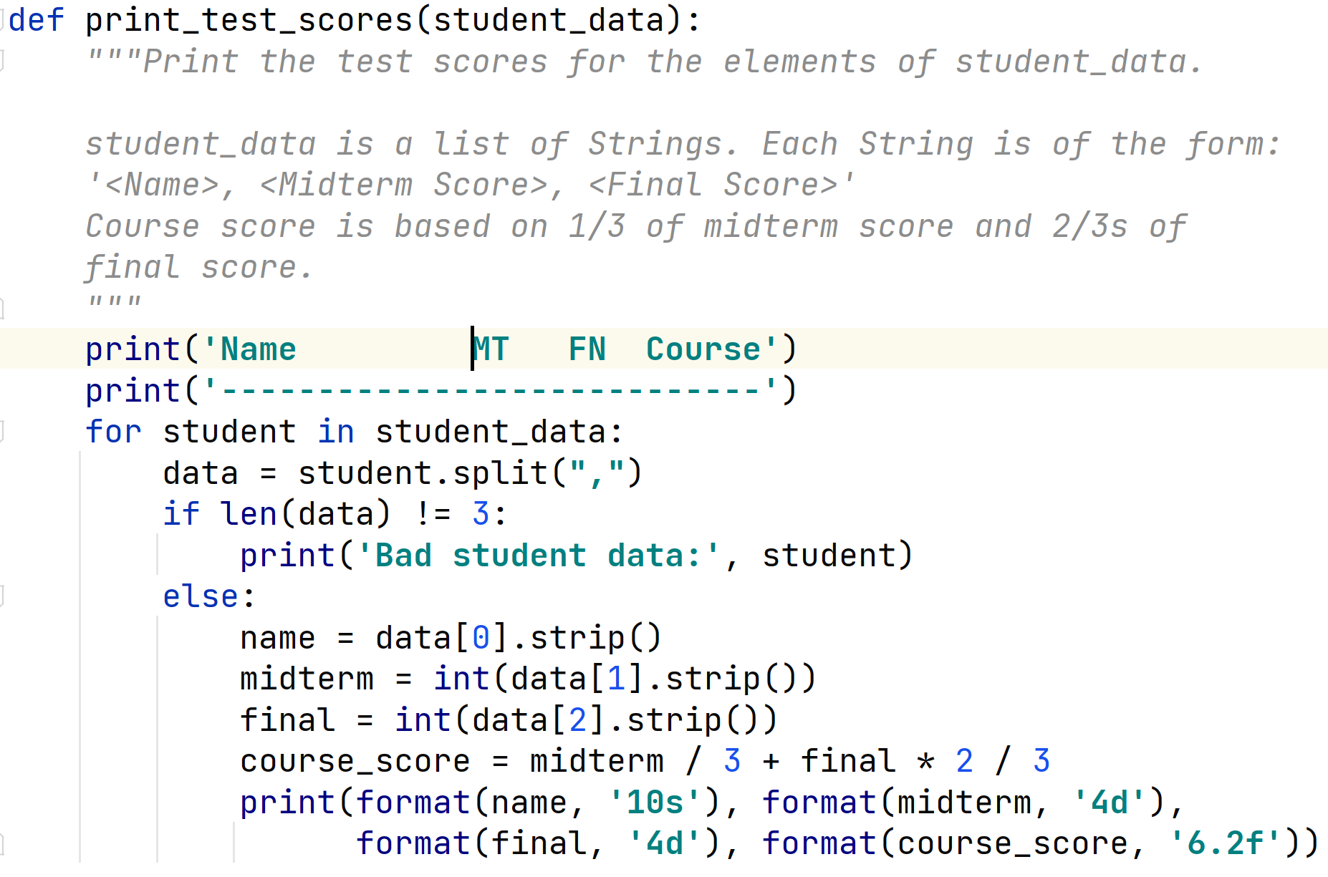
Processing CSV Lines from List

Slide 24
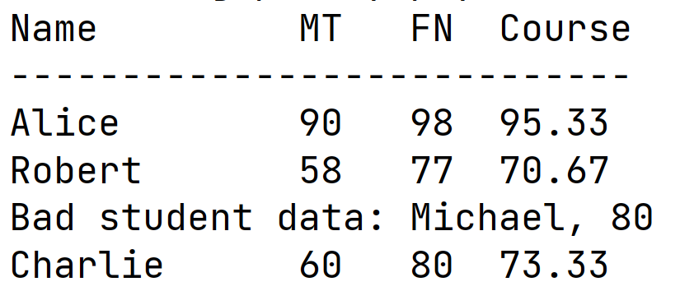
Processing CSV Lines

Slide 25
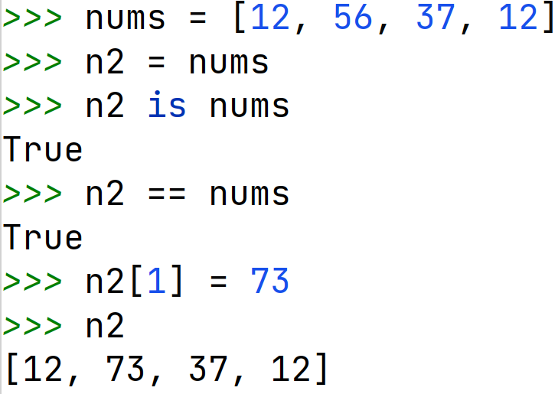
Copying Lists
Suppose you want to make a copy of a list. The following won’t work!

Slide 26
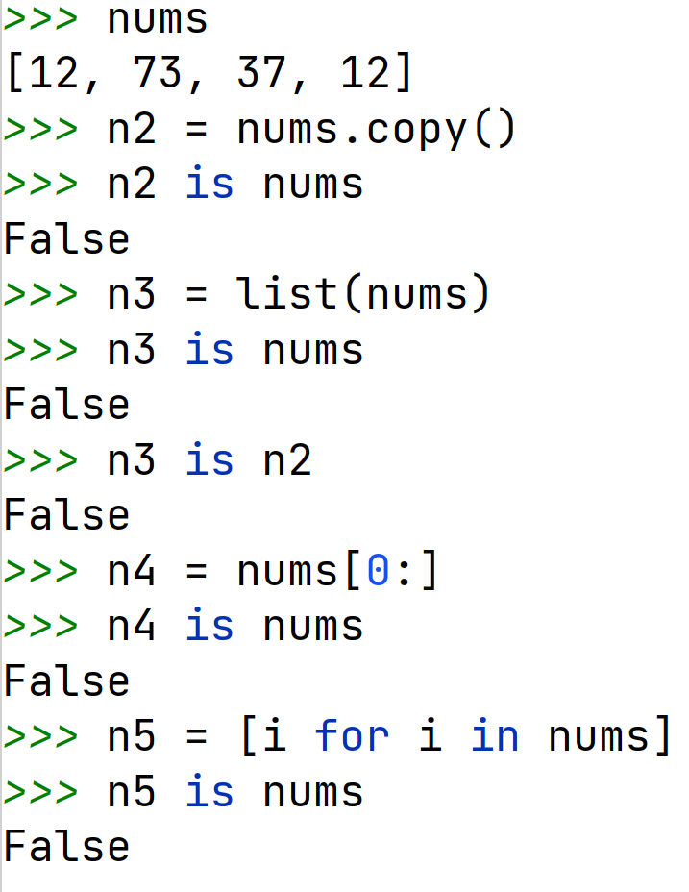
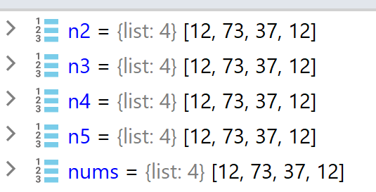
Copying Lists
But, many ways of making a copy of a list.

Slide 27
Passing Lists to Functions
Like any other mutable object, when you pass a list to a function, you’re really passing a reference (pointer) to the object in memory.
def alter( lst ): lst. pop ()
def main ():
lst = [1 , 2 , 3 , 4]
print( " Before call: ", lst ) alter( lst )
print( " After call: ", lst )
main ()
> python ListArg . py
Before call: [1 , 2 , 3 , 4]
After call: [1 , 2 , 3]

Slide 28
Let’s Take a Break

Slide 29
Example Problems
To get good at working with lists, we must practice!
CodingBat: https://codingbat.com/python
List1: first_last6, same_first_last, max_end3
List2: count_even, big_diff, has_22
given list of ints or floats, is it sorted in descending order?
get last index of a given value in list
given two lists of ints, return a list that contains the difference between corresponding elements
change to be the max
are all the elements of a given list unique? In other words, no duplicate values in the list
given a list of ints place all even values before all odd values

