Slide 1
CS303E: Elements of Computers and Programming
Lists of Lists
Mike Scott
Department of Computer Science
University of Texas at Austin
Last updated: May 30, 2024

Slide 2
Creating list of lists
Can create list of lists in Python
  table = [[1, 2], [3, 6], [7,-3], [5, 6]]
  Access an element with 2 subscripts.
  By convention first subscript is row and the second is the column
0 1
index of column
0
1
2
3
1 2
3 6
7 -3
5 6
access element with
2 subscripts:
table[2][0] -> 7
index of row

Slide 3
Creating list of lists
Can also use list comprehension
  table2 = [[0] * 12] * 10
  A list of lists with 10 rows and 12 columns
  per row.
  flips = [['H' if random.random() <= 0.5 else 'T'
  for x in range(12)] for x in range(10)]
  A table with 10 rows and 12 columns per row.
  Each elements is a random coin flip.

Slide 4
List of Lists Problems
Write a function that returns the index of the row of a list of lists of ints has the largest sum. In the case of a tie return the index closest to 0.
Write a function that returns the index of the column of a list of lists of ints has the largest sum. In the case of a tie return the index closest to 0.

Slide 5
Example of using a list of lists
Conway's Game of Life
  a cellular automaton designed by John Conway, a mathematician
  not really a game
  a simulation
  takes place on a 2d grid
  each element of the grid is occupied
  or empty by a simple organism, but not any known organism

Slide 6
Simulation
http://www.cuug.ab.ca/dewara/life/life.html
Select pattern from menu
Select region in large area with mouse by pressing the control key and left click at the same time
Select the paste button

Slide 7
Generation 0
0 1 2 3 4 5
0
1
2
3
. * . * . *
* . * * * *
. . * * . *
. * * * . *
* indicates occupied, . indicates empty

Slide 8
Or
0 1 2 3 4 5
0
1
2
3

Slide 9
Generation 1
0 1 2 3 4 5
0
1
2
3
. * . * . *
. . . . . *
. . . . . *
. * . * . .
* indicates occupied, . indicates empty

Slide 10
Or , Generation 1
0 1 2 3 4 5
0
1
2
3

Slide 11
Rules of the "Game"
If a cell is occupied in this generation.
  it survives if it has 2 or 3 neighbors in this generation
  it dies if it has 0 or 1 neighbors in this generation
  it dies if it has 4 or more neighbors in this generation
If a cell is unoccupied in this generation.
  there is a birth if it has exactly 3 neighboring cells that are occupied in this generation
Neighboring cells are up, down, left, right, and diagonal. In general a cell has 8 neighboring cells

Slide 12
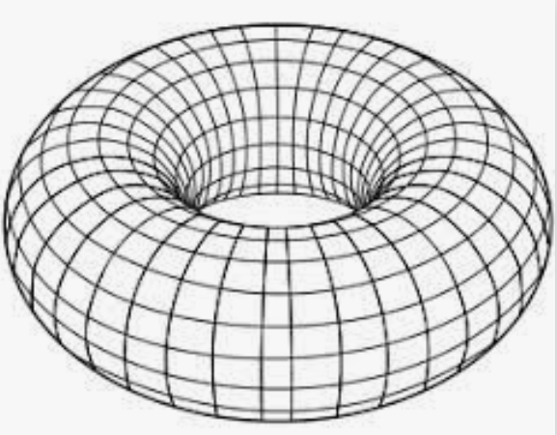
Case study
Design and implement a complete Python program to automate Conway's Game of Life
  text based
  user input for size of world
  wrapped or bounded?
  border or not?
  high level design first,
  then implement solution
  test, test, test, test

